Slide 1
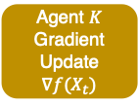

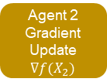



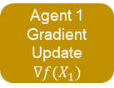
Sec. 4
Sec. 5.1
updates the central server w/ the local data
Sec. 5.2
Common operator 1
NN 1
Central Server
Network $f$
Outlier Detection Task $O$
Common operator 2
Neural Network Converter
NN 2
Weight sync
Gradient update w.r.t local data loss
…
…
Agent 1
Gradient Update $∇f(X_{1})$
Agent 2
Gradient Update $∇f(X_{2})$
Agent $K$
Gradient Update $∇f(X_{t})$
MD decomposes an OD task into common operators
NNC converts an operator into neural networks
Common operator $h$
…
NN $h$

