Slide 1
Multimodal Anomaly Detection
Yue Zhao*, Xiyang Hu*, Wen Wang*
Final Report
*Equal contribution
Notes:
Main title: 40 pt. Arial
Presenter Name: 16 pt. Arial
Presenters Title: 16 pt. Arial Italic

Slide 2
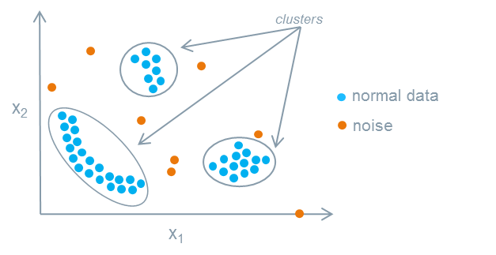
Anomaly Detection & Challenges
Anomaly detection, also known as outlier detection, aims to identify the data samples that are deviant from the general distribution. This task is deemed unsupervised.
For long, it only concerns unimodal setting, although it is natural to consider for multimodal setting.
Multiple sensors on an autonomous driving car
By analyzing medical image and clinical note, we may identify rare disease (as anomaly) more effectively.
In this work, we explore the possibility of leveraging multimodal machine learning in anomaly detection. To our best knowledge, there is the first comprehensive research on this topic.
Major challenges: the lack of benchmark datasets and baselines.

Slide 3
Research Questions
How to generate and extract multimodal data representation for anomaly detection? Simply put, autoencoder is a natural choice for this purpose. We can directly extract the latent space and conduct anomaly detection on the latent space.
Will multiple modalities help the identification of anomalies? We compare multimodal setting to unimodal setting, and ensemble learning with multiple unimodalities, to understand which approach leads to better detection quality.
Different from unimodal setting, multimodal ML uses alignment information. Does stronger alignment facilitate the detection of anomalies?
Can we make anomaly detection part of the multimodal learning process and have an end-to-end learning method?
To foster reproducibility and further research on this new problem, we open-source our entire multimodal system, benchmark environment, and testbed datasets.

Slide 4
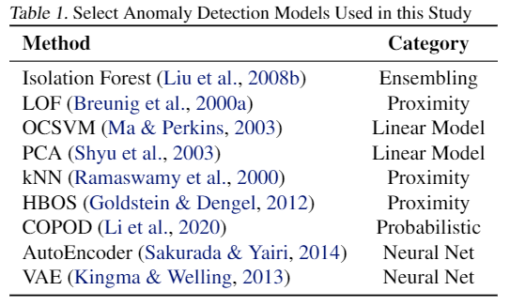
Experiment Setup
Implement various models falling in the unimodal and multimodal categories (with increasing alignment)
Three unimodal representations: no alignment
One ensemble approach: weak alignment
Four multimodal representations:
Some alignment
Strong alignment: incorporate alignment information into the model
Conduct anomaly detection with multiple popular algorithms on these representations (if possible)

Slide 5
Models
Model | Description | Alignment
Unimodal_Image | Image2vec representation (resnet 18) | No alignment
Unimodal_word2vec | Word2vec representation | No alignment
Unimodal_Bert | Bert representation | No alignment
Multimodal_Score_Comb | Average the outlier scores from image and text | Weak alignment
Multimodal_Input_Concat | Concatenate the raw image and text inputs | Weak alignment
Multimodal_Embedding_Concat | Concatenate the two-way relation (extracted by two autoencoders) between image and text. | Weak alignment
Multimodal_Joint_Embedding | Use a VAE to learn the joint representation with text and image | Some alignment
Multimodal_Self_Supervised | Create unmatched pairs of samples to improve the robustness of the model. Use the alignment information explicitly. | Strong alignment

Slide 6
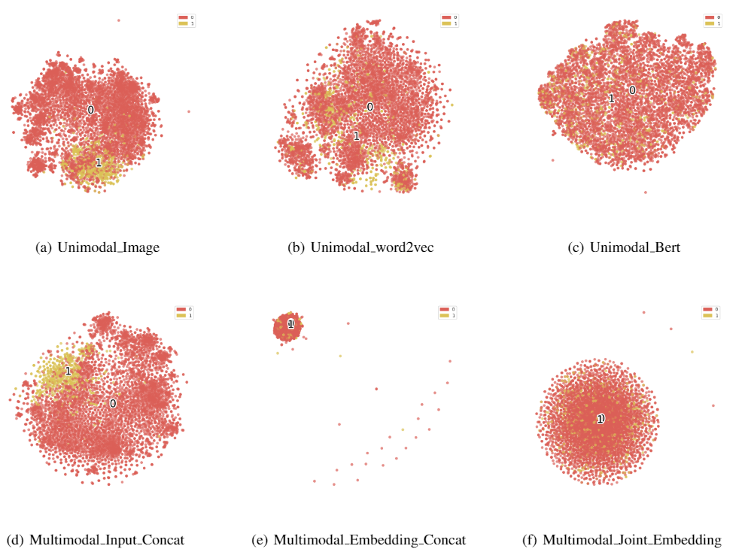
Representation Visualization
Other than directly evaluating the performance of anomaly detectors with different representations, we also take the qualitative approaches to understand the anomaly/normal points separability through direct visualization.
The visualization does not yield a consistent conclusion on whether it is helpful to use multimodal machine learning.
Possible reasons: t-SNE as a visualization tool may yield varying results based on the hyperparameters
t-SNE visualization of unimodal and multimodal representation, where 0 (red) denotes for normal points and 1 (red) denotes anomalies. By visualization, we could not find a clear conclusion on the representation quality.

Slide 7
Proposed Algorithm – Multimodal_Self_Supervised
Datasets are in the form of pairs: {image 1, text 1}, {image 2, text 2}, …, {image n, text n}
Intuition: we could better use the alignment information. For any true pairs, it should have more close embeddings to half-matched pairs (same text or image) than to fully different pairs.
Data augmentation (with self-supervised learning): we could better use the alignment information by creating unaligned image and text pairs like {image 1, text 3}, and use a contrastive loss to detect this.
Data Augmentation with unaligned pairs
View 1
Input pairs
View 2
Contrastive loss: Enforce triplet loss
encoder
Latent space
decoder
Reconstruction Loss
View 3

Slide 8
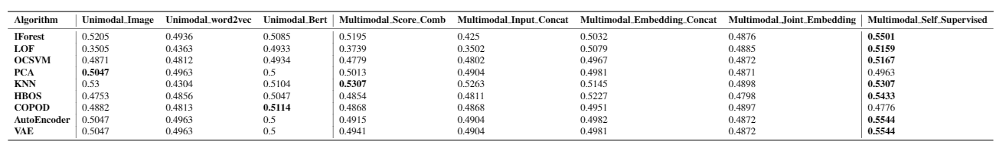
Performance & Discussion (more in the report)
ROC score of popular anomaly detection algorithms on unimodal and multimodal representation. The highest value is highlighted in each row (for each AD algorithm). The proposed Multimodal_Self_Supervised outperforms on most algorithms.
Simply combining the anomaly scores generated from unimodal representations does NOT work
Multimodal representations outperform regarding all metrics (ROC, P@N, and AP, showing the effectiveness of taking all modalities into account
With more and more enforced alignment information, the model performance improves. The proposed Multimodal_Self_Supervised outperforms on most algorithms.

Slide 9
Conclusion & Next Steps
In this study, we investigate into the use of multiple modalities in anomaly detection. Key takeaway messages:
Using unimodality only is inferior to the effective use of multiple modalities. Specifically, simple unimodal representations are worse than multimodal representations.
Ensemble learning that simply combine the representations/scores from unimodalities are not as effective as multimodal approaches that learn a joint representation.
With more emphasis on alignment, we could observe improvement on anomaly detection quality.
We plan to further complete the project with the following instruments:
Adapt more datasets for this purpose and conduct more experiments to verify the conclusion.
Polish the study to have it ready as a publication.

Slide 10


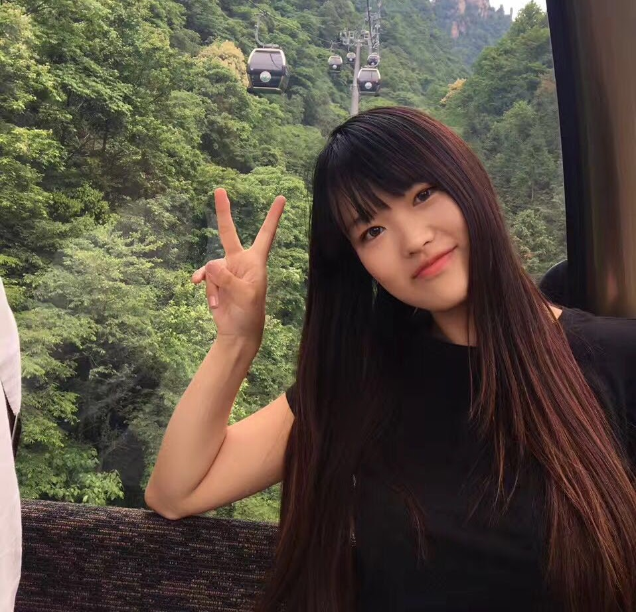
Feel Excited?
Other than course required feedback, we welcome general feedback/advice/questions/collaborations.
Yue Zhao*
zhaoy@cmu.edu
https://www.andrew.cmu.edu/user/yuezhao2/
Xiyang Hu*
xiyanghu@cmu.edu
https://www.andrew.cmu.edu/user/xiyanghu/
Wen Wang*
wenw3@andrew.cmu.edu
https://sites.google.com/andrew.cmu.edu/wenwang/
*Equal contribution

