Slide 1
Multimodal Anomaly Detection
Yue Zhao*, Xiyang Hu*, Wen Wang*
Proposal presentation
*Equal contribution
Notes:
Main title: 40 pt. Arial
Presenter Name: 16 pt. Arial
Presenters Title: 16 pt. Arial Italic

Slide 2
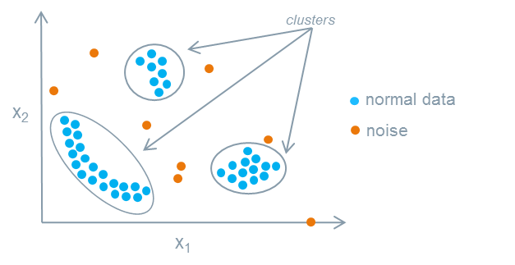
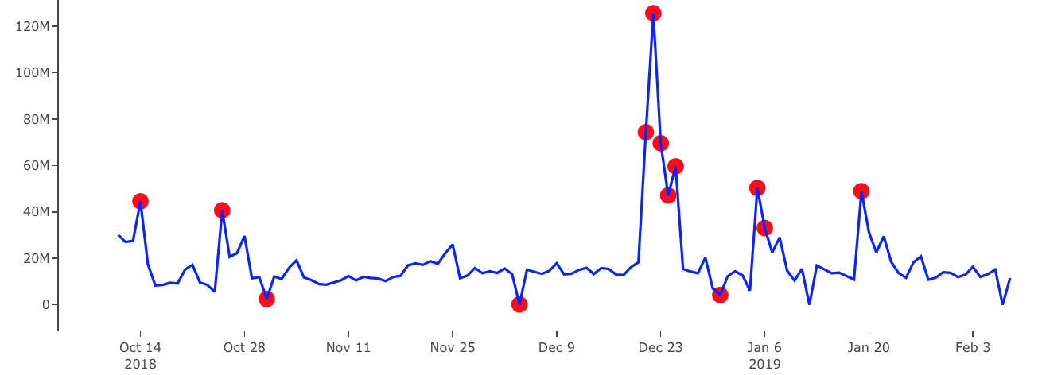
Anomaly Detection
Outlier detection, also known as anomaly detection, aims to identify the data samples that are deviant from the general distribution. This task is generally deemed unsupervised.
Anomalies are not necessarily “bad” events, but “interesting” ones.
Anomalies in Tabular Data
Source: https://developer.mindsphere.io/apis/analytics-anomalydetection/api-anomalydetection-overview.html
Anomalies in Time-series
Source: https://towardsdatascience.com/anomaly-detection-with-isolation-forest-visualization-23cd75c281e2

Slide 3
Problem Statement & Related Works
For long, anomaly detection only concerns unimodal setting, although it is natural to consider for multimodal setting. For instance,
There might be multiple sensors on an autonomous driving car, and a security issue or emergency may be identified through anomaly detection (modeled as rare events) via all kinds of sensors
By analyzing medical image and clinical note, we may identify rare disease (as anomaly) more effectively.
In this work, we plan to explore the possibility of leveraging multimodal machine learning in anomaly detection.
Challenges: the lack of baselines and datasets
To our best knowledge, there is no immediate multimodal works for anomaly detection. There a re a few relevant works but not directly concern this problem.

Slide 4
Research Questions & Potential Contributions
How to generate and extract multimodal data representation for anomaly detection? For example, autoencoder is a natural choice for this purpose, and we may directly extract the latent space and conduct anomaly detection on the latent space.
Will multiple modalities help the identification of anomalies? We may compare multimodal setting to unimodal setting, and ensemble learning with multiple unimodalities, to understand which approach leads to better detection quality.
Can we make anomaly detection part of the multimodal learning process and have an end-to-end learning method?
Based on these observations, can we propose a new multimodal learning method for anomaly detection?
To foster reproducibility and further research on this new problem, we open-source our entire multimodal system, benchmark environment, and testbed datasets.

Slide 5
Datasets
Given this is first known effort in detecting anomalies with multimodal approaches, we do not have immediate benchmark datasets for comparison. As one of the contributions of this work, we plan to adapt the following datasets for anomaly detection purposes.
CrisisMMD: Natural Disaster Assessment
Tumblr Dataset: Sentiment and Emotion Analysis
MediaEval challenge datasets
To adapt these classification multimodal datasets to anomaly detection tasks, these datasets meet:
it is a multi-classification problem
there is semantic meaning if we regard one or two classes as anomaly
We regard one or two classes (with semantic meaning) as anomaly and the remaining classes as normal class. This is typical process in anomaly detection research.

Slide 6
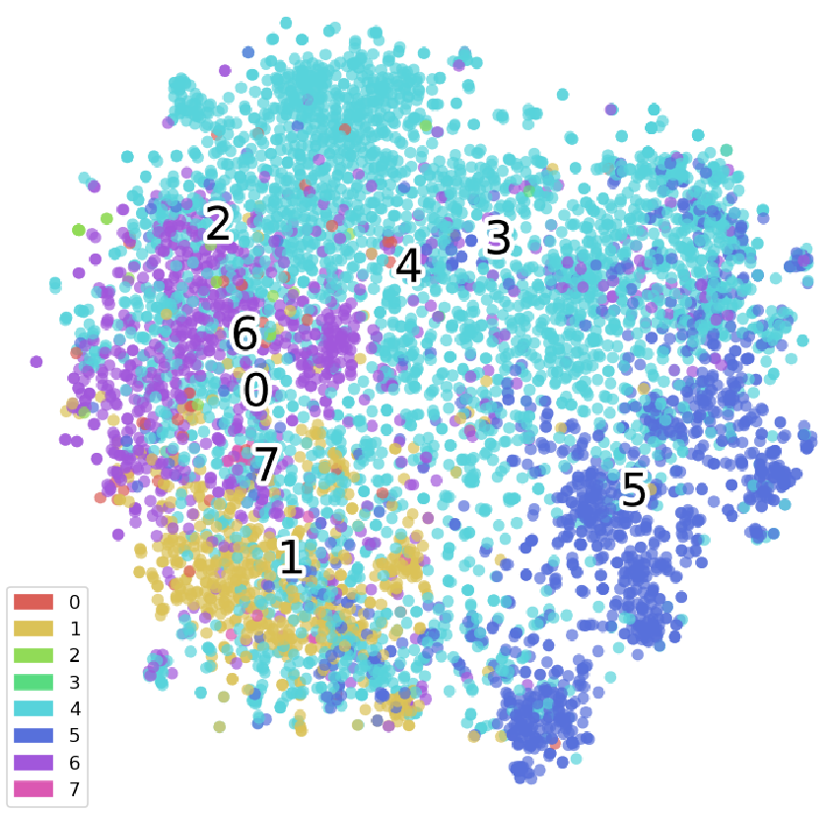
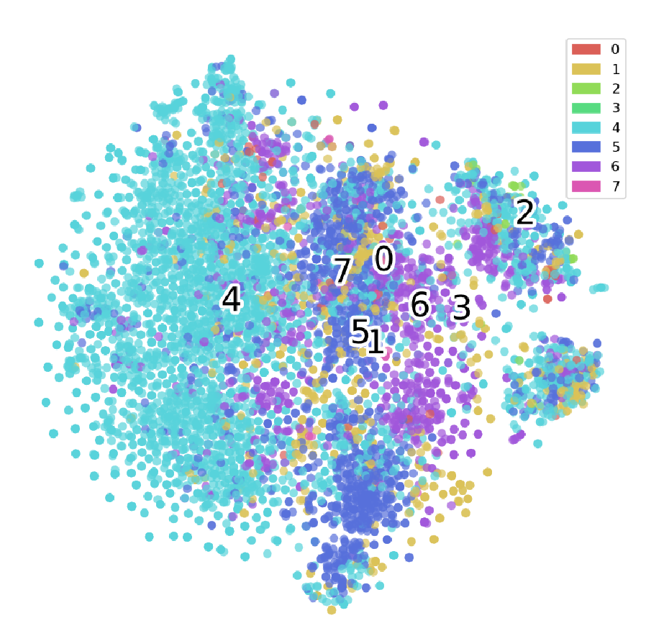
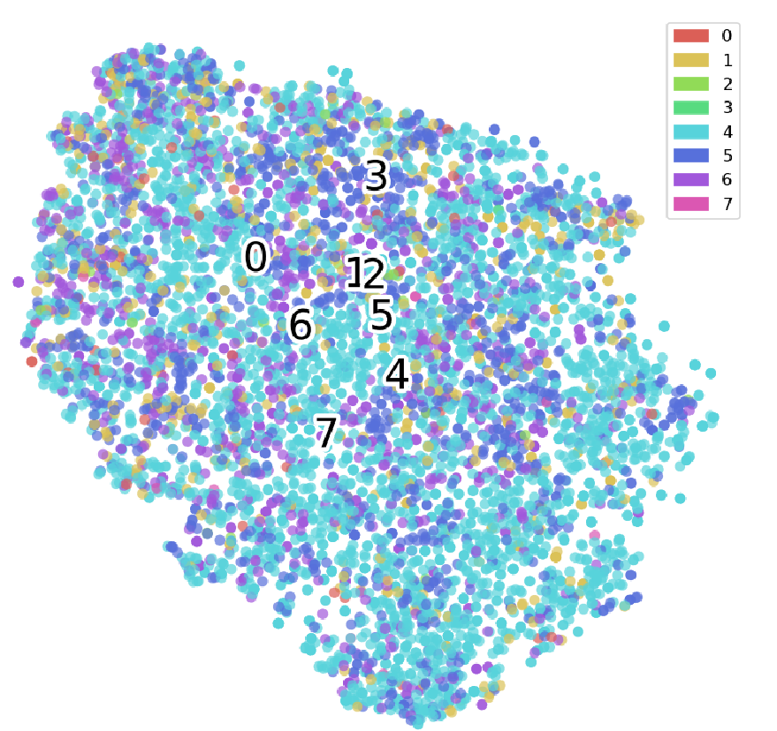
Exploratory Data Analysis
As the first step, we adapt CrisisMMD dataset (8 classes) for further investigation. This dataset comes with both image and text (twitter-like). We first analyze the unimodal representation with pretrained models. From left to right, we show the t-SNE visualization of image (ResNet-18, 512 dimensions), word level (word2vec, google-news, 300 dimensions), and sentence level (Bert, 768 dimensions).
Image
Word level
Sentence level

Slide 7
Exploratory Data Analysis
Image
Word level
Sentence level
None of the unimodality leads to perfect separation.
By considering the semantic meaning and the visualization, we may use class 1 or 6 as anomaly class.

Slide 8
Next Steps
The following tasks will be executed in order:
Generate multimodal representation for CrisisMMD dataset by considering image and text.
Construct performance comparison of key anomaly detection algorithms on the previous image, word/sentence unimodal representation, and the multimodal representation:
Ensemble-based methods: Isolation Forest, HBOS, COPOD etc.
Proximity-based methods: LOF, kNN etc.
More if time allows. All these can be found in our open-source library PyOD [3].
Do quantitative analysis on whether multimodal representation is better than
unimodal representation
Ensemble learning with unimodal representation (e.g., averaging)
Extend on more datasets.

Slide 9



Feel Excited?
Other than course required feedback, we welcome general feedback/advice/questions/collaborations.
Yue Zhao*
zhaoy@cmu.edu
https://www.andrew.cmu.edu/user/yuezhao2/
Xiyang Hu*
xiyanghu@cmu.edu
https://www.andrew.cmu.edu/user/xiyanghu/
Wen Wang*
wenw3@andrew.cmu.edu
https://sites.google.com/andrew.cmu.edu/wenwang/
*Equal contribution

Slide 10
References
[1] Park, D., Kim, H. and Kemp, C.C., 2019. Multimodal anomaly detection for assistive robots. Autonomous Robots, 43(3), pp.611-629.
[2] Sasaka, Y., Ogawa, T. and Haseyama, M., 2018. A novel framework for estimating viewer interest by unsupervised multimodal anomaly detection. IEEE Access, 6, pp.8340-8350.
[3] Zhao, Y., Nasrullah, Z. and Li, Z., 2019. PyOD: A Python Toolbox for Scalable Outlier Detection. Journal of Machine Learning Research, 20, pp.1-7.

