Slide 1

Week 3 Wealth Over Time
Yixuan Zhao, Kaitlyn Biehler, Haoming Tang, Brian Maitner
SUNY-BUFFALO-GEO-511
Week 3

Slide 2
Use library(ggplot2); library(gapminder); library(dplyr) to load the necessary packages.
library(dplyr)
library(ggplot2)
library(gapminder)

Slide 3
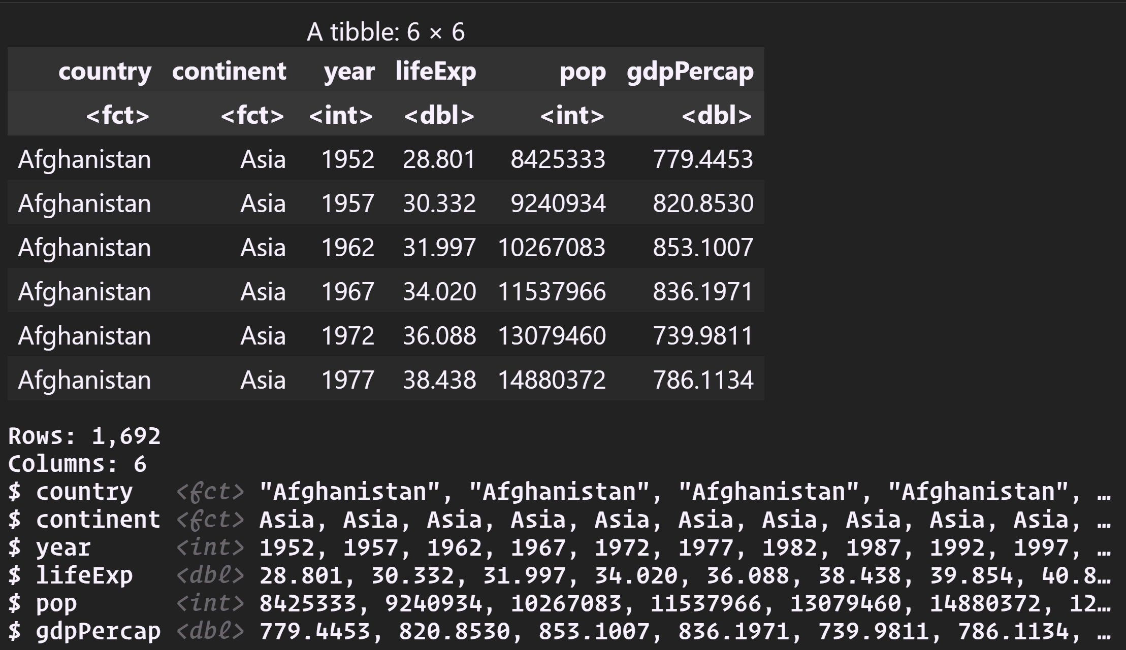
Use filter() to remove “Kuwait” from the gapminder dataset for reasons noted in the background
data(gapminder)
gapminder2 =
filter(gapminder,country != "Kuwait")
head(gapminder2)
glimpse(gapminder2)

Slide 4
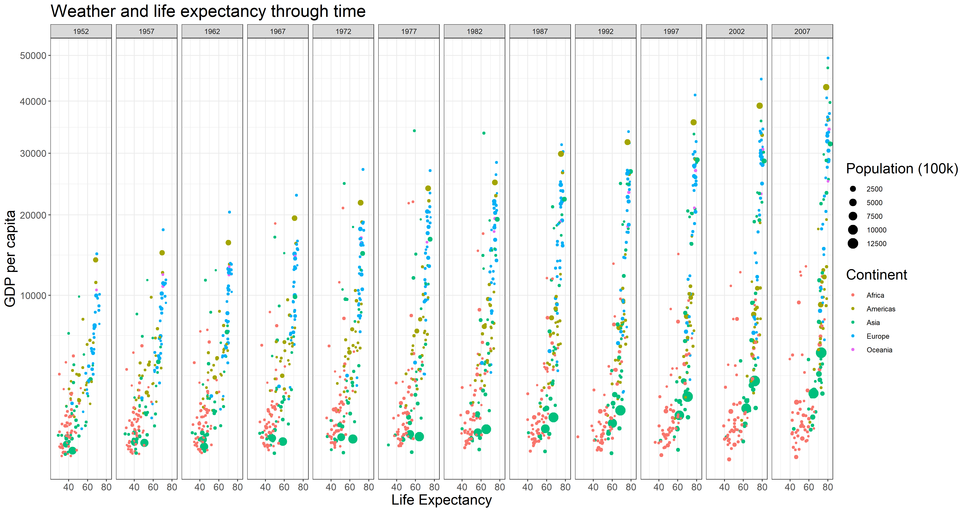
Plot #1 (the first row of plots)
ggplot(gapminder2)
+ geom_point(aes(x = lifeExp, y = gdpPercap, size=pop/100000, color = continent))
+ facet_wrap(~year, nrow = 1)
+ scale_y_sqrt()
+ theme_bw()
+ labs(x = "Life Expectancy", y = "GDP per capita", size = "Population (100k)", color = "Continent", title = "Weather and life expectancy through time")
+ theme(axis.text.x = element_text(size = 12),axis.text.y = element_text(size = 12),title = element_text(size = 18))

Slide 5
Prepare the data for the second plot
Use group_by() to group by continent and year
Use summarize() with the below commands to calculate the data for the black continent average line on the second plot:
gdpPercapweighted = weighted.mean(x = gdpPercap, w = pop)
pop = sum(as.numeric(pop))
gapminder3 = gapminder2 %>%
group_by(continent, year) %>%
summarise(gdpPercapweighted = weighted.mean(x = gdpPercap, w = pop),
pop = sum(as.numeric(pop)))

Slide 6
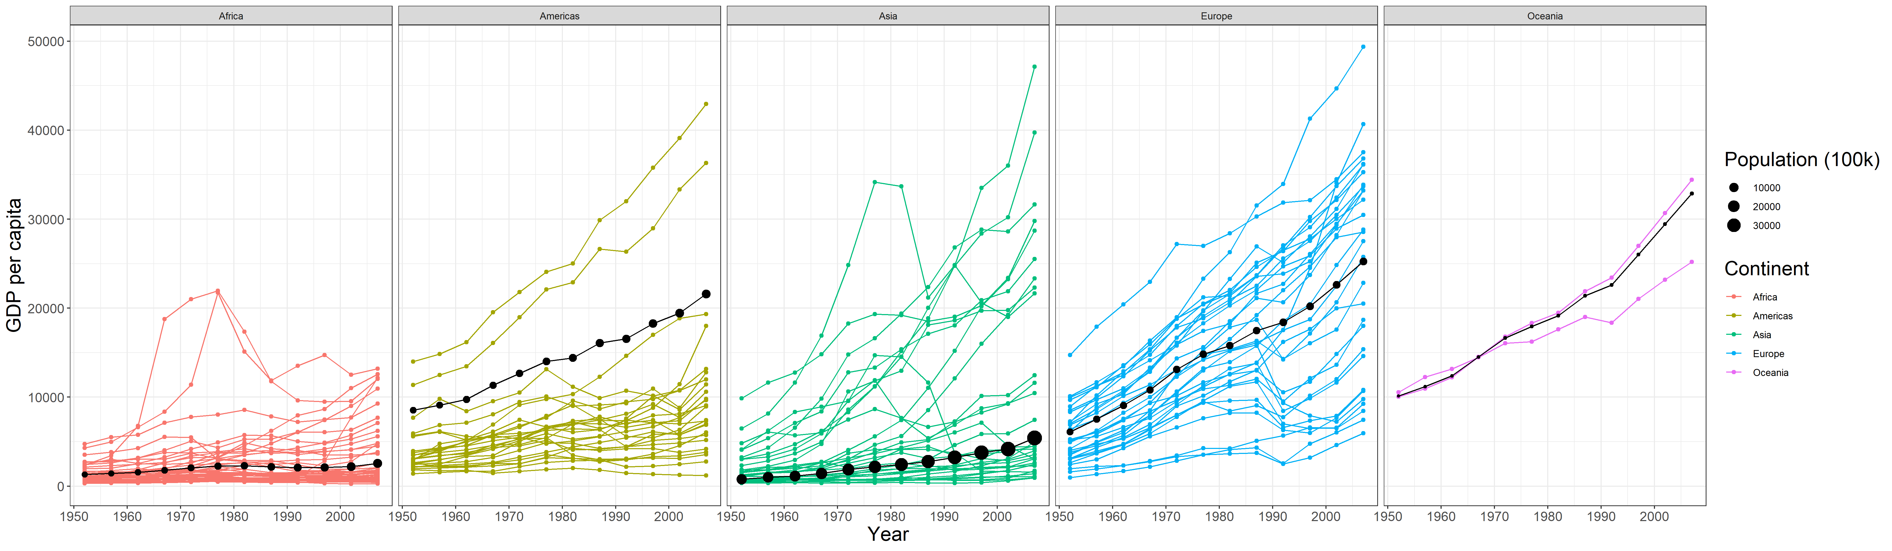
Plot #2 (the second row of plots)
ggplot(gapminder2)
+ geom_line(aes(x = year, y = gdpPercap, color = continent, group = country))
+ geom_point(aes(x = year, y = gdpPercap, color = continent, group = country))
+ geom_point(data = gapminder3, aes(x = year, y = gdpPercapweighted, size = pop/100000))
+ geom_line(data = gapminder3, aes(x = year, y = gdpPercapweighted))
+ facet_wrap(~continent, nrow = 1)
+ theme_bw()
+ labs(x = "Year", y = "GDP per capita", size = "Population (100k)", color = "Continent")
+ theme(axis.text.x = element_text(size = 12),axis.text.y = element_text(size = 12),title = element_text(size = 18))
ggsave(
filename = "Plot2 .png",
width = 24,
height = 7,
units = "in",
dpi = 300
)

