Slide 1

Week 4 Farthest airport from New York City
Yixuan Zhao, Ehsan Ul Hoque Tanim, Haoming Tang, Brian Maitner
SUNY-BUFFALO-GEO-511
Week 4

Slide 2
Load the necessary packages
library(tidyverse)
library(nycflights13)

Slide 3
Join !!!!!!!!
df_sub = flights %>%
dplyr::select(tailnum, flight, origin, dest, distance) %>%
unique() %>%
arrange(desc(distance)) %>%
slice(1) %>%
left_join(., airports, c("dest" = "faa"))
tailnum | flight | origin | dest | distance | name | lat | lon | alt | tz | dst | tzone
<chr> | <int> | <chr> | <chr> | <dbl> | <chr> | <dbl> | <dbl> | <dbl> | <dbl> | <chr> | <chr>
N380HA | 51 | JFK | HNL | 4983 | Honolulu Intl | 21.31868 | -157.9224 | 13 | -10 | N | Pacific/Honolulu

Slide 4

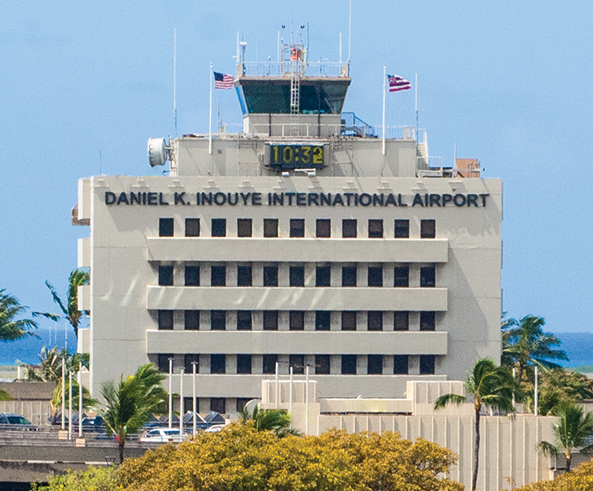
Farthest airport
farthest_airport = df_sub %>% pull(name)
farthest_airport

