Slide 1
Chapter 1: Introduction

Slide 2
教学目的、 要求
数据库基础知识，着重于基本概念和原理
  SQL语言
  数据库设计 理论+实践
  事务管理 并发 恢复
考试成绩：
平时成绩 30？% 作业，签到，小测验
期末考试 40？%
课程设计 30？%
学习方法 ：
PowerPoint 每1-2分钟一页。信息量较大，
希望作笔记。试验表明，复制PPT,效果不好
不动笔墨不读书，铅笔在书上作笔记
实践非常重要！

Slide 3
Book
  by Silberschatz
  数据库系统概念 Database System Concepts
Reference book
  Thomas M. Connolly, et al.
  Database Systems:
    A practical approach to Design, Implementation, and Management
交流
  zhangtq@scu.edu.cn
  139 8196 4715

Slide 4

教科书作者介绍
Abraham Silberschatz ,
阿伯拉罕. 西尔伯沙茨 ，耶鲁大学计算机系教授，
Henry F. Korth 里海大学，原贝尔实验室 数据库研究室主任。
S. Sudarshan 印度 I I T计算机工程与科学系，原在 贝尔实验室
第5、6版好 第7版很好
一本质量在不断上升的教材。

Slide 5
Outline
Database-System Applications
Purpose of Database Systems
View of Data
Database Languages
Database Design
Database Engine
Database Architecture
Database Users and Administrators
History of Database Systems

Slide 6
Database Systems
DBMS contains information about a particular enterprise
  Collection of interrelated data 相关数据集（database）
  Set of programs to access the data 用于访问数据的程序
  An environment that is both convenient and efficient to use
Database systems are used to manage collections of data that are:
  Highly valuable 高价值
  Relatively large 相对庞大
  Accessed by multiple users and applications, often at the same time. 多用户、应用同时（并发）访问
A modern database system is a complex software system whose task is to manage a large, complex collection of data.
Databases touch all aspects of our lives
Notes:
6

Slide 7
Database Applications Examples
Enterprise Information
  Sales: customers, products, purchases 销售
  Accounting: payments, receipts, assets 会计
  Human Resources: Information about employees, salaries, payroll taxes. 人力资源
Manufacturing: management of production, inventory, orders, supply chain. 制造
Banking and finance 银行 金融
  customer information, accounts, loans, and banking transactions.
  Credit card transactions
  Finance: sales and purchases of financial instruments (e.g., stocks and bonds; storing real-time market data
Universities: registration, grades 大学
Notes:
7

Slide 8
Database Applications Examples (Cont.)
Airlines: reservations, schedules 航空 订票 计划调度
Telecommunication: records of calls, texts, and data usage, generating monthly bills, maintaining balances on prepaid calling cards 电信
Web-based services
  Online retailers: order tracking, customized recommendations
  Online advertisements
Document databases 文档数据库
Navigation systems: For maintaining the locations of varies places of interest along with the exact routes of roads, train systems, buses, etc. 导航系统
Notes:
8

Slide 9
Purpose of Database Systems
In the early days, database applications were built directly on top of file systems, which leads to:
Data redundancy(数据冗余) and inconsistency(不一致): data is stored in multiple file formats resulting induplication of information in different files
Difficulty in accessing data 数据访问困难
  Need to write a new program to carry out each new task
Data isolation 数据孤立
  Multiple files and formats
Integrity problems 完整性问题
  Integrity constraints (e.g., account balance > 0) become “buried” in program code rather than being stated explicitly
  Hard to add new constraints or change existing ones
Notes:
9

Slide 10
Purpose of Database Systems (Cont.)
Atomicity of updates (更新原子性)
  Failures may leave database in an inconsistent state with partial updates carried out
  Example: Transfer of funds from one account to another should either complete or not happen at all
Concurrent access by multiple users (多用户并发访问)
  Concurrent access needed for performance
  Uncontrolled concurrent accesses can lead to inconsistencies
    Ex: Two people reading a balance (say 100) and updating it by withdrawing money (say 50 each) at the same time
Security problems (安全性问题)
  Hard to provide user access to some, but not all, data
Database systems offer solutions to all the above problems
Notes:
10

Slide 11
University Database Example
In this text we will be using a university database to illustrate all the concepts 全书通例
Data consists of information about:
  Students
  Instructors
  Classes
Application program examples:
  Add new students, instructors, and courses
  Register students for courses, and generate class rosters (名册)
  Assign grades to students, compute grade point averages (GPA) and generate transcripts
Notes:
11

Slide 12
View of Data 数据视图
A database system is a collection of interrelated data and a set of programs that allow users to access and modify these data.
A major purpose of a database system is to provide users with an abstract view of the data.
  Data models 数据模型
    A collection of conceptual tools for describing data, data relationships, data semantics, and consistency constraints.
  Data abstraction 数据抽象
    Hide the complexity of data structures to represent data in the database from users through several levels of data abstraction.
Notes:
12

Slide 13
Data Models
A collection of tools for describing 软工具集
  Data 数据
  Data relationships 数据联系
  Data semantics 数据语义
  Data constraints 数据约束
Relational model 关系模型
Entity-Relationship data model (mainly for database design) 实体联系模型
Object-based data models (Object-oriented and Object-relational)
Semi-structured data model (XML)
Other older models:
  Network model
  Hierarchical model
Notes:
13

Slide 14
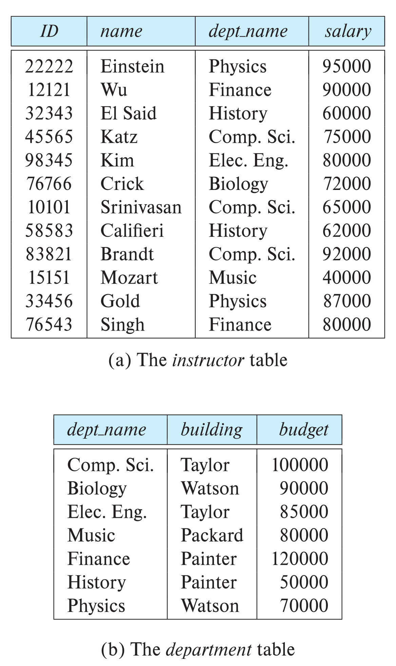

Relational Model 关系模型
All the data is stored in various tables.
Example of tabular data in the relational model
Columns
Rows
Ted Codd
Turing Award 1981
Notes:
14

Slide 15
A Sample Relational Database
Notes:
15

Slide 16
Levels of Abstraction
Physical level: describes how a record (e.g., instructor) is stored. 物理层
Logical level: describes data stored in database, and the relationships among the data. 逻辑层
  type instructor = record
  ID : string;
  name : string;
  dept_name : string;
  salary : integer;
        end;
View level: application programs hide details of data types. Views can also hide information (such as an employee’s salary) for security purposes. 视图层
Notes:
16

Slide 17
View of Data
An architecture for a database system
Notes:
17

Slide 18
Instances and Schemas 实例与模式
Similar to types and variables in programming languages
Logical Schema – the overall logical structure of the database 逻辑模式
  Example: The database consists of information about a set of customers and accounts in a bank and the relationship between them
    Analogous to type information of a variable in a program
Physical schema – the overall physical structure of the database 物理模式
Instance – the actual content of the database at a particular point in time
  Analogous to the value of a variable 实例
Notes:
18

Slide 19
Physical Data Independence
Physical Data Independence – the ability to modify the physical schema without changing the logical schema 物理数据独立性
  Applications depend on the logical schema
  In general, the interfaces between the various levels and components should be well defined so that changes in some parts do not seriously influence others.
Notes:
19

Slide 20
Data Definition Language (DDL)
Specification notation for defining the database schema
  Example: create table instructor (
  ID char(5),
  name varchar(20),
  dept_name varchar(20),
  salary numeric(8,2))
DDL compiler generates a set of table templates stored in a data dictionary 数据字典
Data dictionary contains metadata 元数据 (i.e., data about data)
  Database schema 数据库模式
  Integrity constraints 完整性约束
    Primary key (ID uniquely identifies instructors)
  Authorization 授权
    Who can access what
Notes:
20

Slide 21
Data Manipulation Language (DML)
Language for accessing and updating the data organized by the appropriate data model 数据操纵语言
  DML also known as query language
There are basically two types of data-manipulation language
  Procedural DML -- require a user to specify what data are needed and how to get those data. 过程化DML
  Declarative DML -- require a user to specify what data are needed without specifying how to get those data. 申明式DML 非过程化DML
Declarative DMLs are usually easier to learn and use than are procedural DMLs.
Declarative DMLs are also referred to as non-procedural DMLs
The portion of a DML that involves information retrieval is called a query language. 查询语言
Notes:
21

Slide 22
SQL Query Language
SQL query language is nonprocedural. A query takes as input several tables (possibly only one) and always returns a single table.
Example to find all instructors in Comp. Sci. dept
select name
from instructor
where dept_name = 'Comp. Sci.'
SQL is NOT a Turing machine equivalent language (图灵机等效语言：在可计算性理论中，编程语言或任意其他的逻辑系统如具有等同于通用图灵机的计算能力)
To be able to compute complex functions SQL is usually embedded in some higher-level language
Application programs generally access databases through one of
  Language extensions to allow embedded SQL （嵌入式SQL）
  Application program interface (e.g., ODBC/JDBC) which allow SQL queries to be sent to a database （API）
Notes:
22

Slide 23
Database Access from Application Program
Non-procedural query languages such as SQL are not as powerful as a universal Turing machine.
SQL does not support actions such as input from users, output to displays, or communication over the network.
Such computations and actions must be written in a host language, such as C/C++, Java or Python, with embedded SQL queries that access the data in the database.
Application programs -- are programs that are used to interact with the database in this fashion.
Notes:
23

Slide 24
Database Design
The process of designing the general structure of the database:
Logical Design – Deciding on the database schema. Database design requires that we find a “good” collection of relation schemas. 逻辑设计
  Business decision – What attributes should we record in the database?
  Computer Science decision – What relation schemas should we have and how should the attributes be distributed among the various relation schemas?
Physical Design – Deciding on the physical layout of the database 物理设计
Notes:
24

Slide 25
Database Engine
A database system is partitioned into modules that deal with each of the responsibilities of the overall system.
The functional components of a database system can be divided into
  The storage manager, 存储管理
  The query processor component, 查询处理
  The transaction management component. 事务管理
Notes:
25

Slide 26
Storage Manager
A program module that provides the interface between the low-level data stored in the database and the application programs and queries submitted to the system.
The storage manager is responsible to the following tasks:
  Interaction with the OS file manager
  Efficient storing, retrieving and updating of data
The storage manager components include:
  Authorization and integrity manager
  Transaction manager
  File manager
  Buffer manager
Notes:
26

Slide 27
Storage Manager (Cont.)
The storage manager implements several data structures as part of the physical system implementation:
  Data files -- store the database itself
  Data dictionary -- stores metadata about the structure of the database, in particular the schema of the database.
  Indices -- can provide fast access to data items. A database index provides pointers to those data items that hold a particular value.
Notes:
27

Slide 28
Query Processor
The query processor components include:
  DDL interpreter -- interprets DDL statements and records the definitions in the data dictionary.
  DML compiler -- translates DML statements in a query language into an evaluation plan consisting of low-level instructions that the query evaluation engine understands.
    The DML compiler performs query optimization; that is, it picks the lowest cost evaluation plan from among the various alternatives.
  Query evaluation engine -- executes low-level instructions generated by the DML compiler.
Notes:
28

Slide 29
Query Processing
1. Parsing and translation
2. Optimization
3. Evaluation
Notes:
29

Slide 30
Transaction Management
A transaction is a collection of operations that performs a single logical function in a database application （事务，用于并发与恢复）
Transaction-management component ensures that the database remains in a consistent (correct) state despite system failures (e.g., power failures and operating system crashes) and transaction failures.
Concurrency-control manager controls the interaction among the concurrent transactions, to ensure the consistency of the database.
Notes:
30

Slide 31
Database Architecture
Centralized databases
  One to a few cores, shared memory
Client-server,
  One server machine executes work on behalf of multiple client machines.
Parallel databases
  Many core shared memory
  Shared disk
  Shared nothing
Distributed databases
  Geographical distribution
  Schema/data heterogeneity
Notes:
31

Slide 32
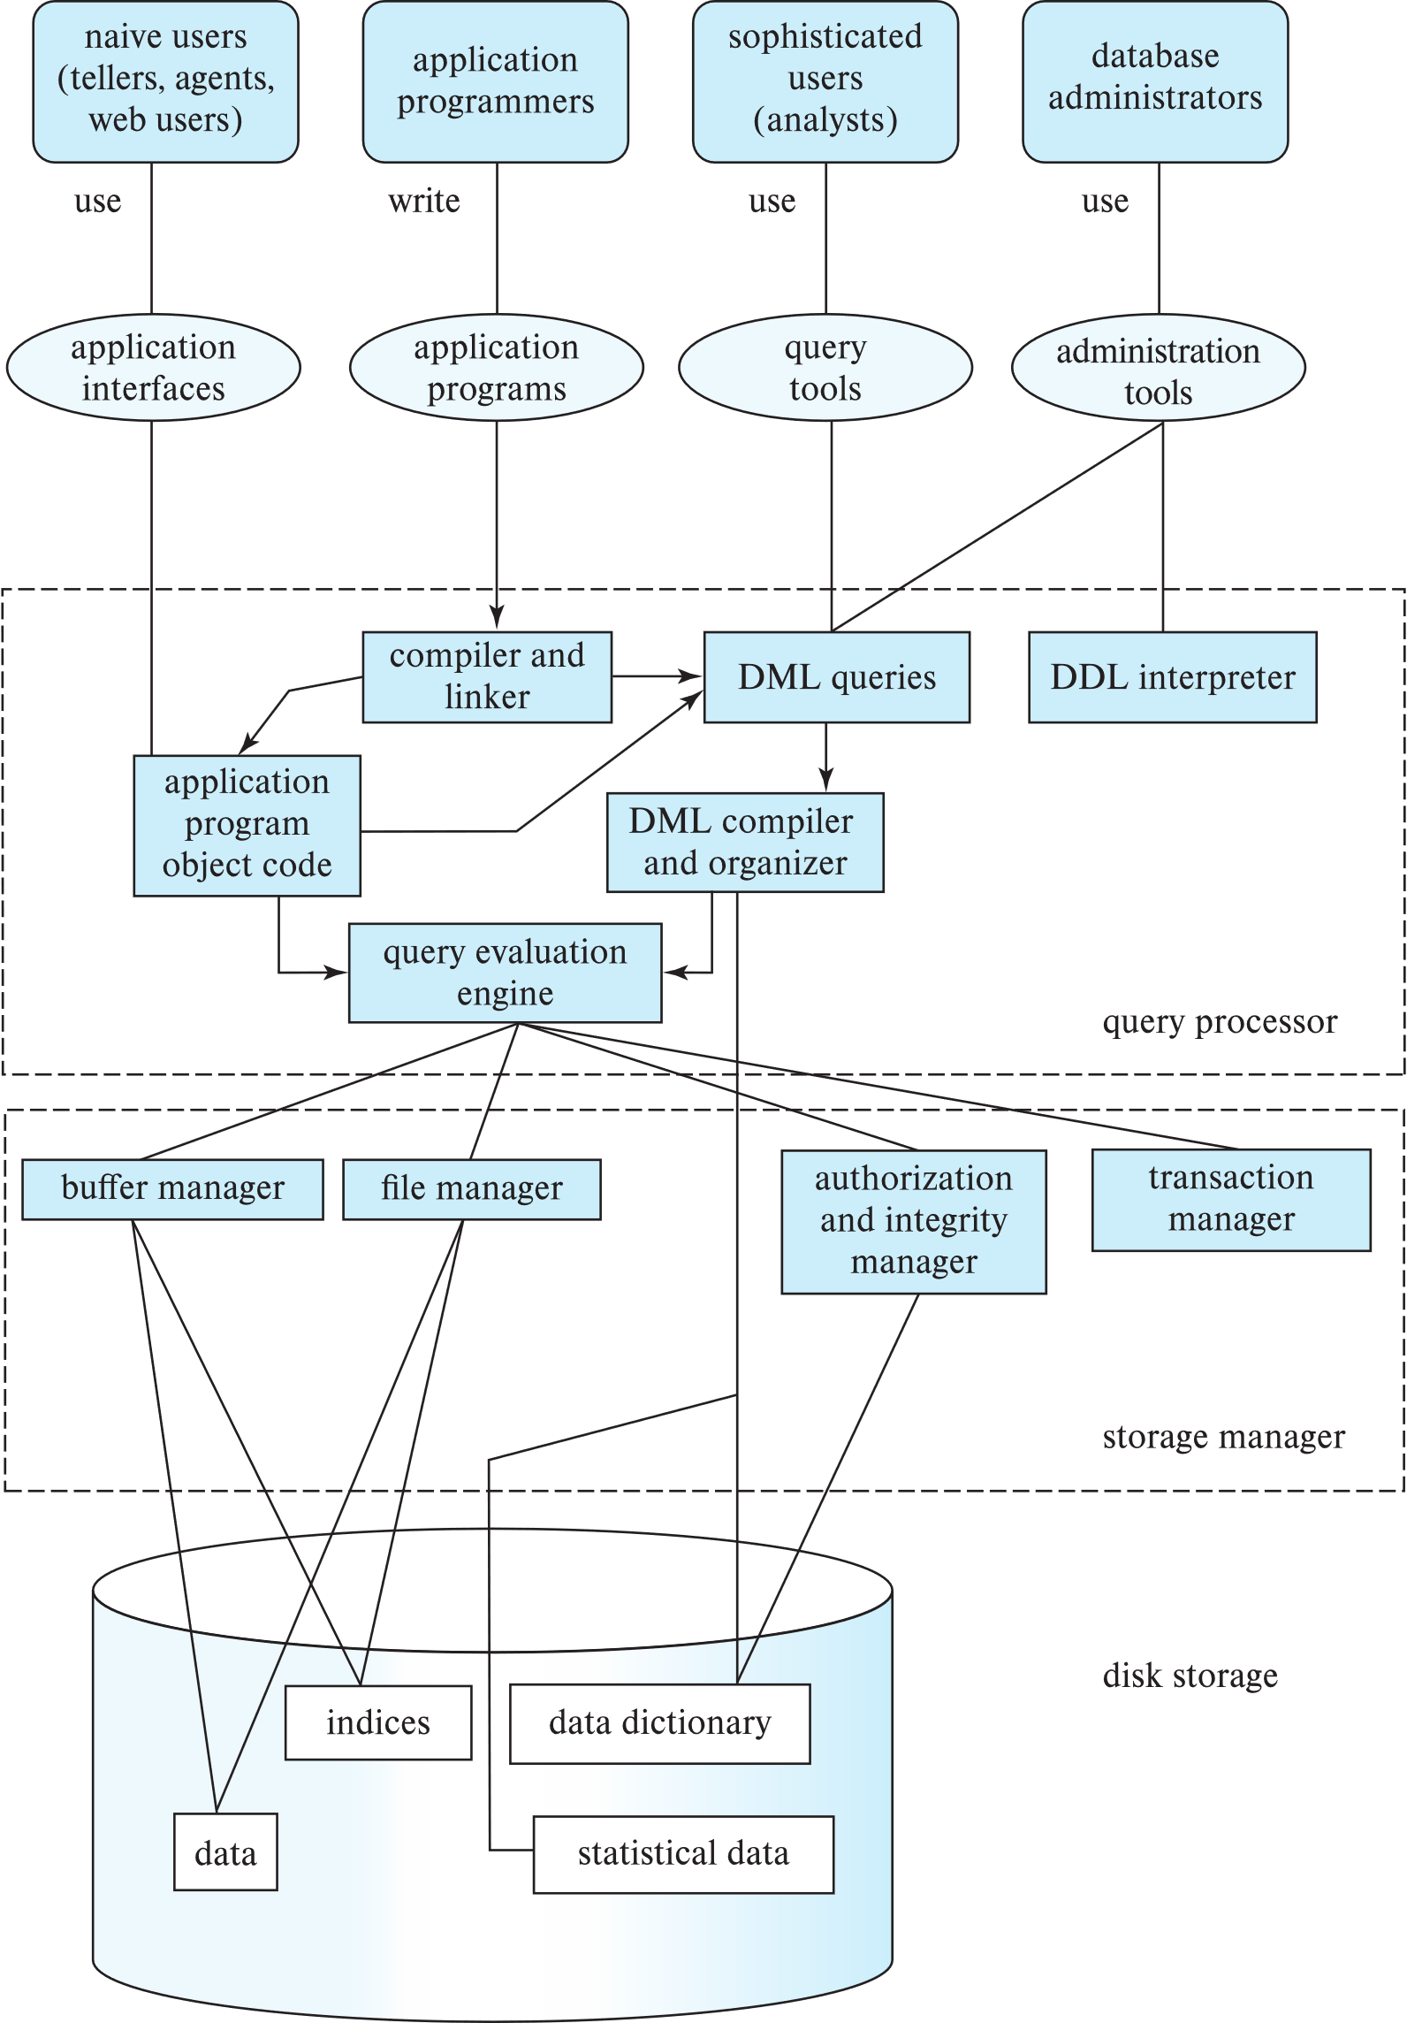
Database Architecture
(Centralized/Shared-Memory)

Slide 33
Database Applications
Database applications are usually partitioned into two or three parts
Two-tier architecture -- the application resides at the client machine, where it invokes database system functionality at the server machine
Three-tier architecture -- the client machine acts as a front end and does not contain any direct database calls.
  The client end communicates with an application server, usually through a forms interface.
  The application server in turn communicates with a database system to access data.
Notes:
33

Slide 34
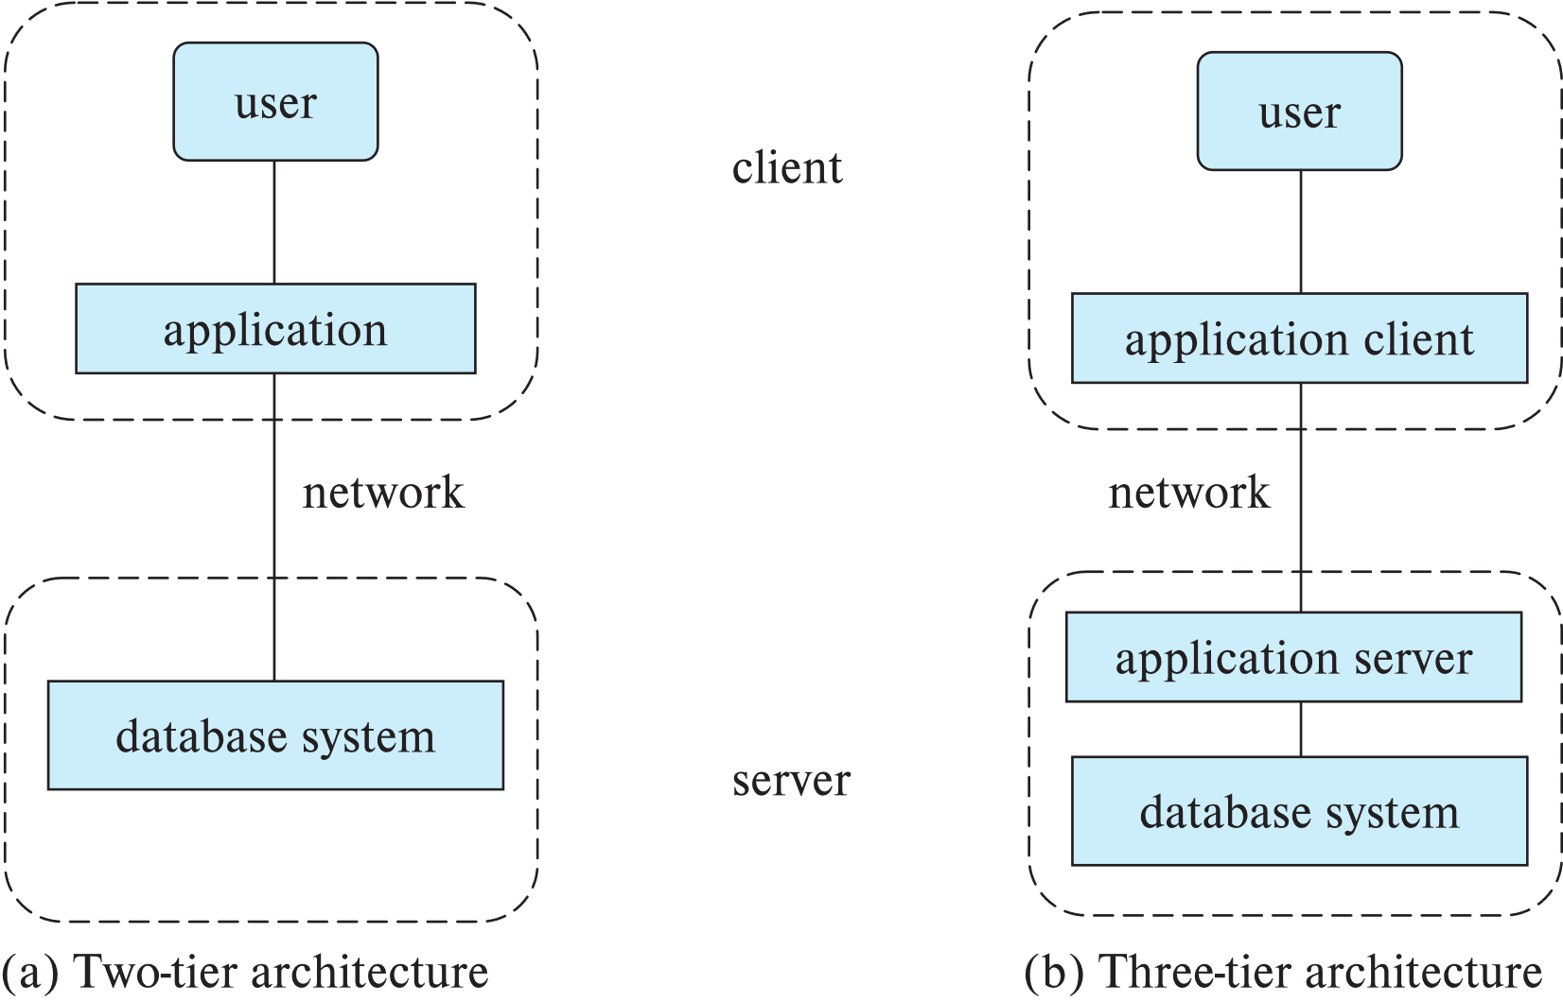
Two-tier and three-tier architectures
Notes:
34

Slide 35
Database Users
Notes:
35

Slide 36
Database Administrator
A person who has central control over the system is called a database administrator (DBA). Functions of a DBA include:
Schema definition
Storage structure and access-method definition
Schema and physical-organization modification
Granting of authorization for data access
Routine maintenance
Periodically backing up the database
Ensuring that enough free disk space is available for normal operations, and upgrading disk space as required
Monitoring jobs running on the database
Notes:
36

Slide 37
History of Database Systems
1950s and early 1960s:
  Data processing using magnetic tapes for storage
    Tapes provided only sequential access
  Punched cards for input
Late 1960s and 1970s:
  Hard disks allowed direct access to data
  Network and hierarchical data models in widespread use
  Ted Codd defines the relational data model
    Would win the ACM Turing Award for this work
    IBM Research begins System R prototype
    UC Berkeley (Michael Stonebraker) begins Ingres prototype
    Oracle releases first commercial relational database
  High-performance (for the era) transaction processing
Notes:
37

Slide 38
History of Database Systems (Cont.)
1980s:
  Research relational prototypes evolve into commercial systems
    SQL becomes industrial standard
  Parallel and distributed database systems
    Wisconsin, IBM, Teradata
  Object-oriented database systems
1990s:
  Large decision support and data-mining applications
  Large multi-terabyte data warehouses
  Emergence of Web commerce
Notes:
38

Slide 39
History of Database Systems (Cont.)
2000s
  Big data storage systems
    Google BigTable, Yahoo PNuts, Amazon,
    “NoSQL” systems.
  Big data analysis: beyond SQL
    Map reduce and friends
    MapReduce是一种编程模型，用于大规模数据集（大于1TB）的并行运算。概念“Map（映射）”和“Reduce（归约）”，是它们的主要思想，都是从函数式编程语言里借来的，还有从矢量编程语言里借来的特性。它极大地方便了编程人员在不会分布式并行编程的情况下，将自己的程序运行在分布式系统上。 当前的软件实现是指定一个Map（映射）函数，用来把一组键值对映射成一组新的键值对，指定并发的Reduce（归约）函数，用来保证所有映射的键值对中的每一个共享相同的键组
Notes:
39

Slide 40
History of Database Systems (Cont.)
2010s
  SQL reloaded
    SQL front end to Map Reduce systems
    Massively parallel database systems
    Multi-core main-memory databases
Notes:
40

Slide 41
End of Chapter 1
Notes:
41

