Slide 1
Chapter 3: Introduction to SQL

Slide 2
Outline
Overview of The SQL Query Language
SQL Data Definition
Basic Query Structure of SQL Queries
Additional Basic Operations
Set Operations
Null Values
Aggregate Functions
Nested Subqueries
Modification of the Database
Notes:
1

Slide 3
History
IBM Sequel language developed as part of System R project at the IBM San Jose Research Laboratory
Renamed Structured Query Language (SQL)
ANSI and ISO standard SQL:
  SQL-86
  SQL-89
  SQL-92
  SQL:1999 (language name became Y2K compliant!)
  SQL:2003
Commercial systems offer most, if not all, SQL-92 features, plus varying feature sets from later standards and special proprietary features.
  Not all examples here may work on your particular system.

Slide 4
SQL Parts
DML – provides the ability to query information from the database and to insert tuples into, delete tuples from, and modify tuples in the database. 查、插、删、改
integrity – the DDL includes commands for specifying integrity constraints. 完整性
View definition -- The DDL includes commands for defining views. 视图定义
Transaction control –includes commands for specifying the beginning and ending of transactions. 事务控制
Embedded SQL and dynamic SQL -- define how SQL statements can be embedded within general-purpose programming languages. 嵌入式SQL和动态SQL
Authorization – includes commands for specifying access rights to relations and views. 授权

Slide 5
Data Definition Language
The SQL data-definition language (DDL) allows the specification of information about relations, including:
The schema for each relation. 每一关系的模式
The type of values associated with each attribute. 每个属性的取值类型
The Integrity constraints 完整性约束
The set of indices to be maintained for each relation. 每个关系的索引集
Security and authorization information for each relation. 每个关系的安全性与授权
The physical storage structure of each relation on disk. 每个关系的物理存储结构

Slide 6
Domain Types in SQL
char(n). Fixed length character string, with user-specified length n.
varchar(n). Variable length character strings, with user-specified maximum length n.
int. Integer (a finite subset of the integers that is machine-dependent).
smallint. Small integer (a machine-dependent subset of the integer domain type).
numeric(p,d). Fixed point number, with user-specified precision of p digits, with d digits to the right of decimal point. (ex., numeric(3,1), allows 44.5 to be stores exactly, but not 444.5 or 0.32)
real, double precision. Floating point and double-precision floating point numbers, with machine-dependent precision.
float(n). Floating point number, with user-specified precision of at least n digits.
More are covered in Chapter 4.

Slide 7
Create Table Construct
An SQL relation is defined using the create table command:
create table r
(A₁ D₁, A₂ D₂, ..., A_{n} D_{n},
(integrity-constraint₁),
...,
(integrity-constraint_{k}))
  r is the name of the relation
  each A_{i} is an attribute name in the schema of relation r
  D_{i} is the data type of values in the domain of attribute A_{i}
Example: create table instructor (
ID char(5),
name varchar(20),
dept_name varchar(20),
salary numeric(8,2))

Slide 8
Integrity Constraints in Create Table
Types of integrity constraints
  primary key (A₁, ..., A_{n} ) 主码
  foreign key (A_{m}, ..., A_{n} ) references r 外码
  not null 非空
SQL prevents any update to the database that violates an integrity constraint.
Example:
create table instructor (
ID char(5),
name varchar(20) not null,
dept_name varchar(20),
salary numeric(8,2),
primary key (ID),
foreign key (dept_name) references department);

Slide 9
And a Few More Relation Definitions
create table student (
ID varchar(5),
name varchar(20) not null,
dept_name varchar(20),
tot_cred numeric(3,0),
primary key (ID),
foreign key (dept_name) references department);
create table takes (
ID varchar(5),
course_id varchar(8),
sec_id varchar(8),
semester varchar(6),
year numeric(4,0),
grade varchar(2),
primary key (ID, course_id, sec_id, semester, year) ,
foreign key (ID) references student,
foreign key (course_id, sec_id, semester, year) references section);

Slide 10
And more still
create table course (
course_id varchar(8),
title varchar(50),
dept_name varchar(20),
credits numeric(2,0),
primary key (course_id),
foreign key (dept_name) references department);

Slide 11
Updates to tables
Insert
  insert into instructor values ('10211', 'Smith', 'Biology', 66000);
Delete
  Remove all tuples from the student relation
    delete from student
Drop Table
  drop table r
Alter
  alter table r add A D
    where A is the name of the attribute to be added to relation r and D is the domain of A.
    All exiting tuples in the relation are assigned null as the value for the new attribute.
  alter table r drop A
    where A is the name of an attribute of relation r
    Dropping of attributes not supported by many databases.

Slide 12
Basic Query Structure
A typical SQL query has the form:
select A₁, A₂, ..., A_{n}
from r₁, r₂, ..., r_{m}
where P
  A_{i} represents
  an attribute
  R_{i} represents a relation
  P is a predicate.
The result of an SQL query is a relation.
Notes:
2

Slide 13
The select Clause
The select clause lists the attributes desired in the result of a query
  corresponds to the projection operation of the relational algebra
Example: find the names of all instructors:
select name
from instructor
NOTE: SQL names are case insensitive (i.e., you may use upper- or lower-case letters.)
  E.g., Name ≡ NAME ≡ name
  Some people use upper case wherever we use bold font.
Notes:
3

Slide 14
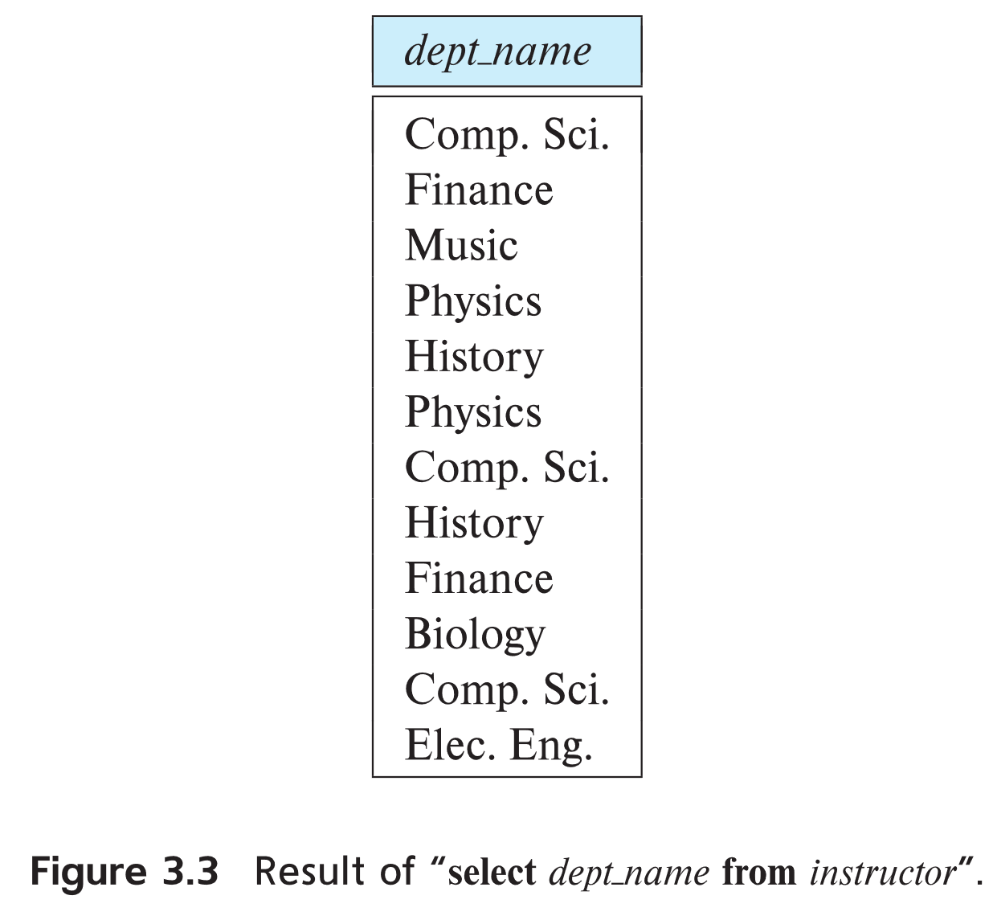
The select Clause (Cont.)
SQL allows duplicates in relations as well as in query results.
To force the elimination of duplicates, insert the keyword distinct after select. 消重
Find the department names of all instructors, and remove duplicates
select distinct dept_name
from instructor
The keyword all specifies that duplicates should not be removed.
select all dept_name
from instructor
Notes:
4

Slide 15
The select Clause (Cont.)
An asterisk in the select clause denotes “all attributes”
select *
from instructor
An attribute can be a literal with no from clause
select '437'
  Results is a table with one column and a single row with value “437”
  Can give the column a name using:
  select '437' as FOO
An attribute can be a literal with from clause
select 'A'
from instructor
  Result is a table with one column and N rows (number of tuples in the instructors table), each row with value “A”
Notes:
5

Slide 16
The select Clause (Cont.)
The select clause can contain arithmetic expressions involving the operation, +, –, ∗, and /, and operating on constants or attributes of tuples.
  The query:
  select ID, name, salary/12
  from instructor
  would return a relation that is the same as the instructor relation, except that the value of the attribute salary is divided by 12.
  Can rename “salary/12” using the as clause:
  select ID, name, salary/12 as monthly_salary
Notes:
5

Slide 17
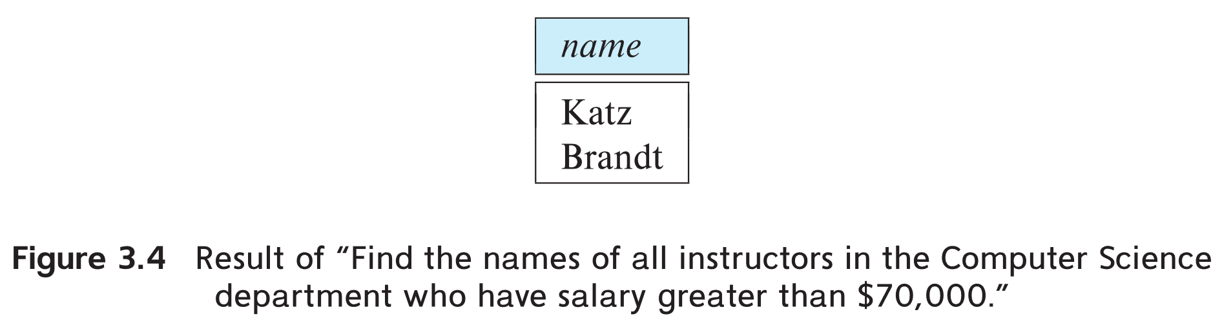
The where Clause
The where clause specifies conditions that the result must satisfy
  Corresponds to the selection predicate of the relational algebra.
To find all instructors in Comp. Sci. dept
select name
from instructor
where dept_name = 'Comp. Sci.'
SQL allows the use of the logical connectives and, or, and not 逻辑运算
The operands of the logical connectives can be expressions involving the comparison operators <, <=, >, >=, =, and <>. 比较运算
Comparisons can be applied to results of arithmetic expressions
To find all instructors in Comp. Sci. dept with salary > 70000
  select name
  from instructor
  where dept_name = 'Comp. Sci.' and salary > 70000
Notes:
6

Slide 18
The from Clause
The from clause lists the relations involved in the query
  Corresponds to the Cartesian product operation of the relational algebra. From后的关系按笛卡尔积方式产生候选元组
Find the Cartesian product instructor X teaches
select ∗
from instructor, teaches
  generates every possible instructor – teaches pair, with all attributes from both relations.
  For common attributes (e.g., ID), the attributes in the resulting table are renamed using the relation name (e.g., instructor.ID)
Cartesian product not very useful directly, but useful combined with where-clause condition (selection operation in relational algebra).通常需要与where子句配合使用
Notes:
8

Slide 19
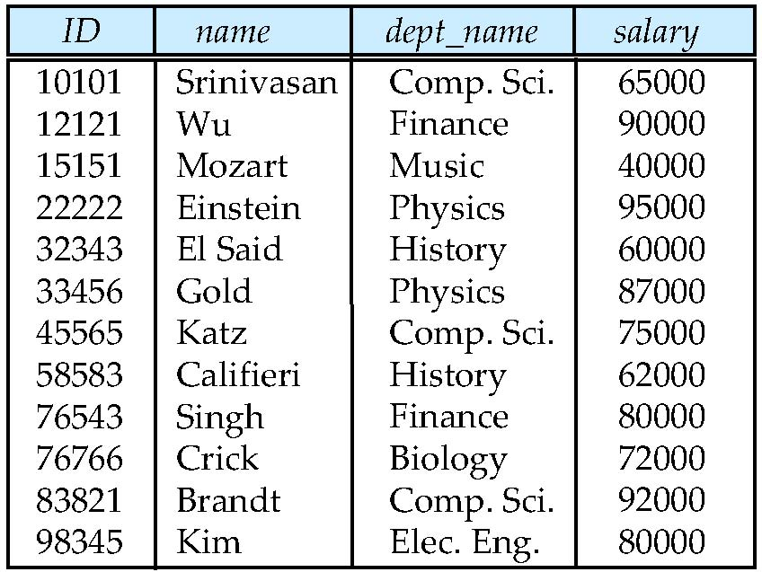
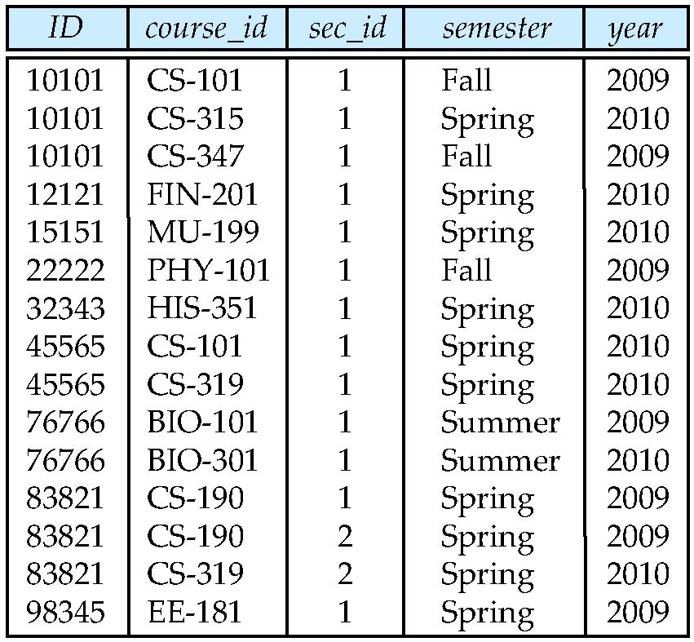
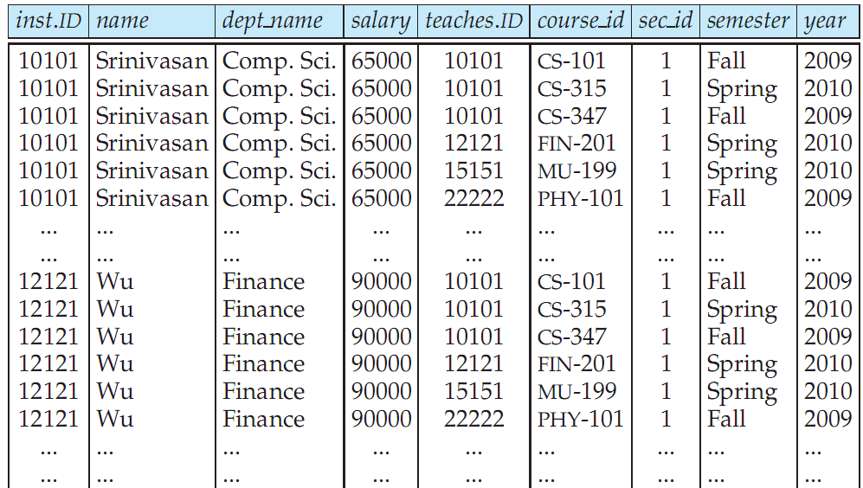
Cartesian Product: instructor X teaches
instructor
teaches

Slide 20
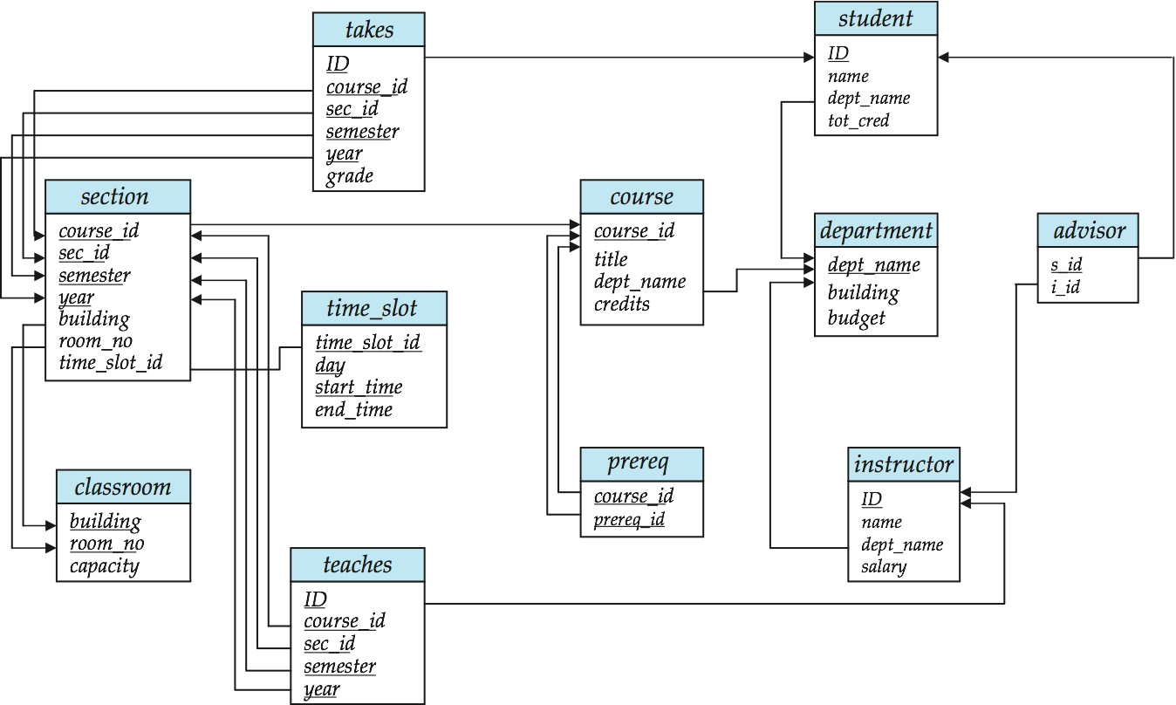
Joins 连接
For all instructors who have taught some course, find their names and the course ID of the courses they taught.
select name, course_id
from instructor, teaches
where instructor.ID = teaches.ID
Find the course ID, semester, year and title of each course offered by the Comp. Sci. department
select section.course_id, semester, year, title
from section, course
where section.course_id = course.course_id and
dept_name = ‘Comp. Sci.'

Slide 21
Examples
Find the names of all instructors who have taught some course and the course_id
  select name, course_id
  from instructor , teaches
  where instructor.ID = teaches.ID
Find the names of all instructors in the Art department who have taught some course and the course_id
  select name, course_id
  from instructor , teaches
  where instructor.ID = teaches.ID
  and instructor. dept_name = 'Art'
Notes:
9

Slide 22
The meaning of an SQL query
1. Generate a Cartesian product of the relations listed in the from clause.
2. Apply the predicates specified in the where clause on the result of Step 1.
3. For each tuple in the result of Step 2, output the attributes (or results of expressions) specified in the select clause.

Slide 23
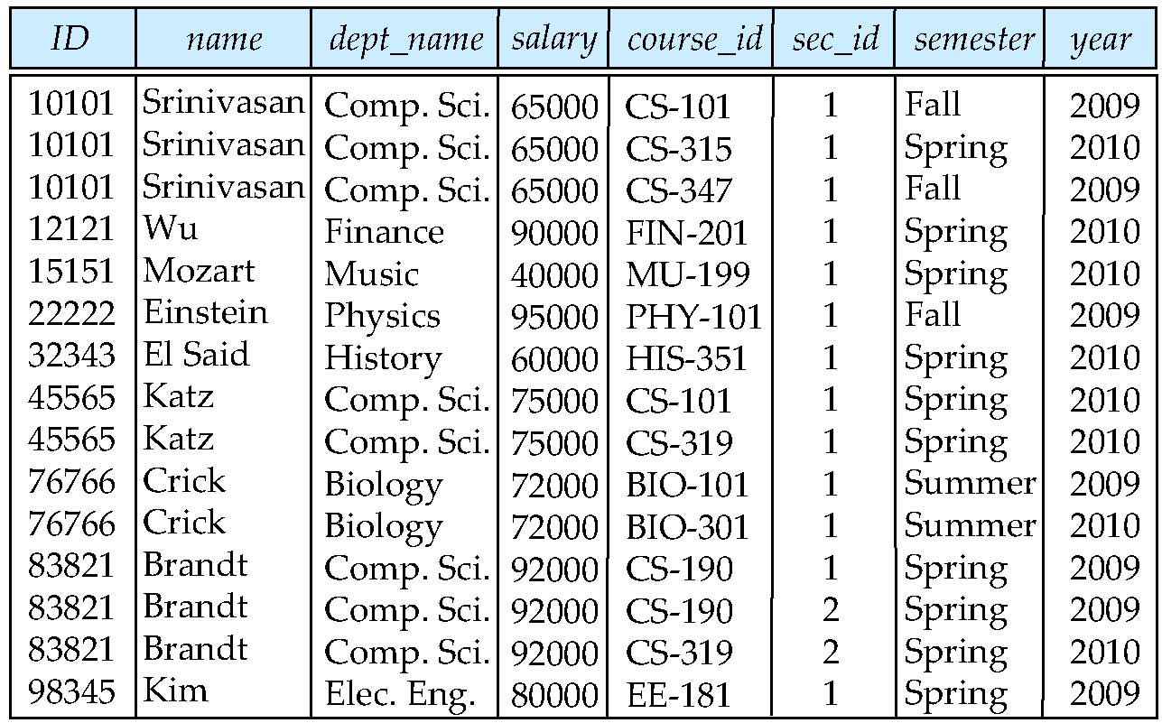
Natural Join
Natural join matches tuples with the same values for all common attributes, and retains only one copy of each common column
select *
from instructor natural join teaches;

Slide 24
Natural Join Example
List the names of instructors along with the course ID of the courses that they taught.
  select name, course_id
  from instructor, teaches
  where instructor.ID = teaches.ID;
  select name, course_id
  from instructor natural join teaches;

Slide 25
Natural Join (Cont.)
Danger in natural join: beware of unrelated attributes with same name which get equated incorrectly 危险：同名异义
List the names of instructors along with the the titles of courses that they teach
  Incorrect version (makes course.dept_name = instructor.dept_name)
    select name, title
    from instructor natural join teaches natural join course;
  Correct version
    select name, title
    from instructor natural join teaches, course
    where teaches.course_id = course.course_id;
  Another correct version
    select name, title
    from (instructor natural join teaches)
    join course using(course_id);

Slide 26
The Rename Operation 更名
The SQL allows renaming relations and attributes using the as clause:
old-name as new-name
Find the names of all instructors who have a higher salary than
some instructor in 'Comp. Sci'.
  select distinct T.name
  from instructor as T, instructor as S
  where T.salary > S.salary and S.dept_name = 'Comp. Sci.’
Keyword as is optional and may be omitted from子句的as通常省略
instructor as T ≡ instructor T
Notes:
9

Slide 27
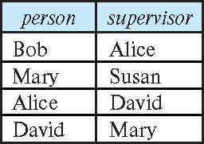
Self Join Example
Relation emp-super
Find the supervisor of “Bob”
Find the supervisor of the supervisor of “Bob”
Can you find ALL the supervisors (direct and indirect) of “Bob”?
Notes:
9

Slide 28
String Operations
SQL includes a string-matching operator for comparisons on character strings. The operator like uses patterns that are described using two special characters:
  percent ( % ). The % character matches any substring.
  underscore ( _ ). The _ character matches any character.
Find the names of all instructors whose name includes the substring “dar”.
select name
from instructor
where name like '%dar%'
Match the string “100%”
like '100 \%' escape '\'
in that above we use backslash (\) as the escape character.

Slide 29
String Operations (Cont.)
Patterns are case sensitive.
Pattern matching examples:
  'Intro%' matches any string beginning with “Intro”.
  '%Comp%' matches any string containing “Comp” as a substring.
  '_ _ _' matches any string of exactly three characters.
  '_ _ _ %' matches any string of at least three characters.
SQL supports a variety of string operations such as
  concatenation (using “||”)
  converting from upper to lower case (and vice versa)
  finding string length, extracting substrings, etc.

Slide 30
Ordering the Display of Tuples
List in alphabetic order the names of all instructors
select distinct name
from instructor
order by name
We may specify desc for descending order or asc for ascending order, for each attribute; ascending order is the default.
  Example: order by name desc
Can sort on multiple attributes
  Example: order by dept_name, name

Slide 31
Where Clause Predicates
SQL includes a between comparison operator
Example: Find the names of all instructors with salary between $90,000 and $100,000 (that is, ≥ $90,000 and ≤ $100,000)
  select name
  from instructor
  where salary between 90000 and 100000
Tuple comparison
  select name, course_id
  from instructor, teaches
  where (instructor.ID, dept_name) = (teaches.ID, 'Biology');
Notes:
7

Slide 32
Set Operations
Find courses that ran in Fall 2017 or in Spring 2018
(select course_id from section where sem = 'Fall' and year = 2017)
union
(select course_id from section where sem = 'Spring' and year = 2018)
Find courses that ran in Fall 2017 and in Spring 2018
(select course_id from section where sem = 'Fall' and year = 2017)
intersect
(select course_id from section where sem = 'Spring' and year = 2018)
Find courses that ran in Fall 2017 but not in Spring 2018
(select course_id from section where sem = 'Fall' and year = 2017)
except
(select course_id from section where sem = 'Spring' and year = 2018)

Slide 33
Set Operations (Cont.)
Set operations union, intersect, and except
  Each of the above operations automatically eliminates duplicates
To retain all duplicates use the 多重集 并、交、差
  union all,
  intersect all
  except all.

Slide 34
Null Values
It is possible for tuples to have a null value, denoted by null, for some of their attributes
null signifies an unknown value or that a value does not exist. 空值：不知道、不确定
The result of any arithmetic expression involving null is null
  Example: 5 + null returns null
The predicate is null can be used to check for null values.
  Example: Find all instructors whose salary is null.
select name
from instructor
where salary is null
The predicate is not null succeeds if the value on which it is applied is not null.

Slide 35
Null Values (Cont.)
SQL treats as unknown the result of any comparison involving a null value (other than predicates is null and is not null).
  Example: 5 < null or null <> null or null = null
The predicate in a where clause can involve Boolean operations (and, or, not); thus the definitions of the Boolean operations need to be extended to deal with the value unknown.
  and : (true and unknown) = unknown,
  (false and unknown) = false,
  (unknown and unknown) = unknown
  or: (unknown or true) = true,
  (unknown or false) = unknown
  (unknown or unknown) = unknown
Result of where clause predicate is treated as false if it evaluates to unknown

Slide 36
Aggregate Functions
These functions operate on the multiset of values of a column of a relation, and return a value
avg: average value
min: minimum value
max: maximum value
sum: sum of values
count: number of values

Slide 37
Aggregate Functions Examples
Find the average salary of instructors in the Computer Science department
  select avg (salary)
  from instructor
  where dept_name= 'Comp. Sci.';
Find the total number of instructors who teach a course in the Spring 2018 semester
  select count (distinct ID)
  from teaches
  where semester = 'Spring' and year = 2018;
Find the number of tuples in the course relation
  select count (*)
  from course;

Slide 38
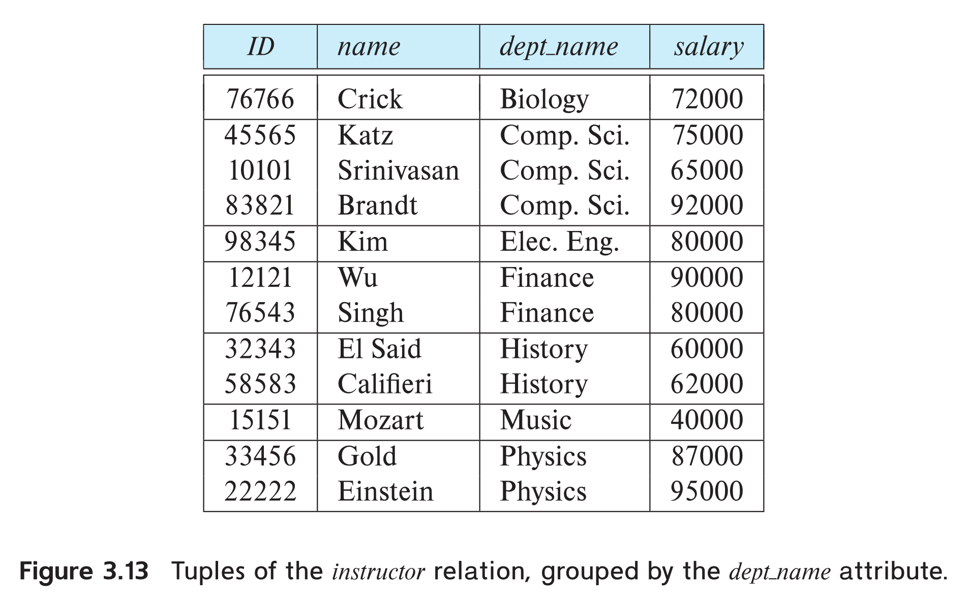
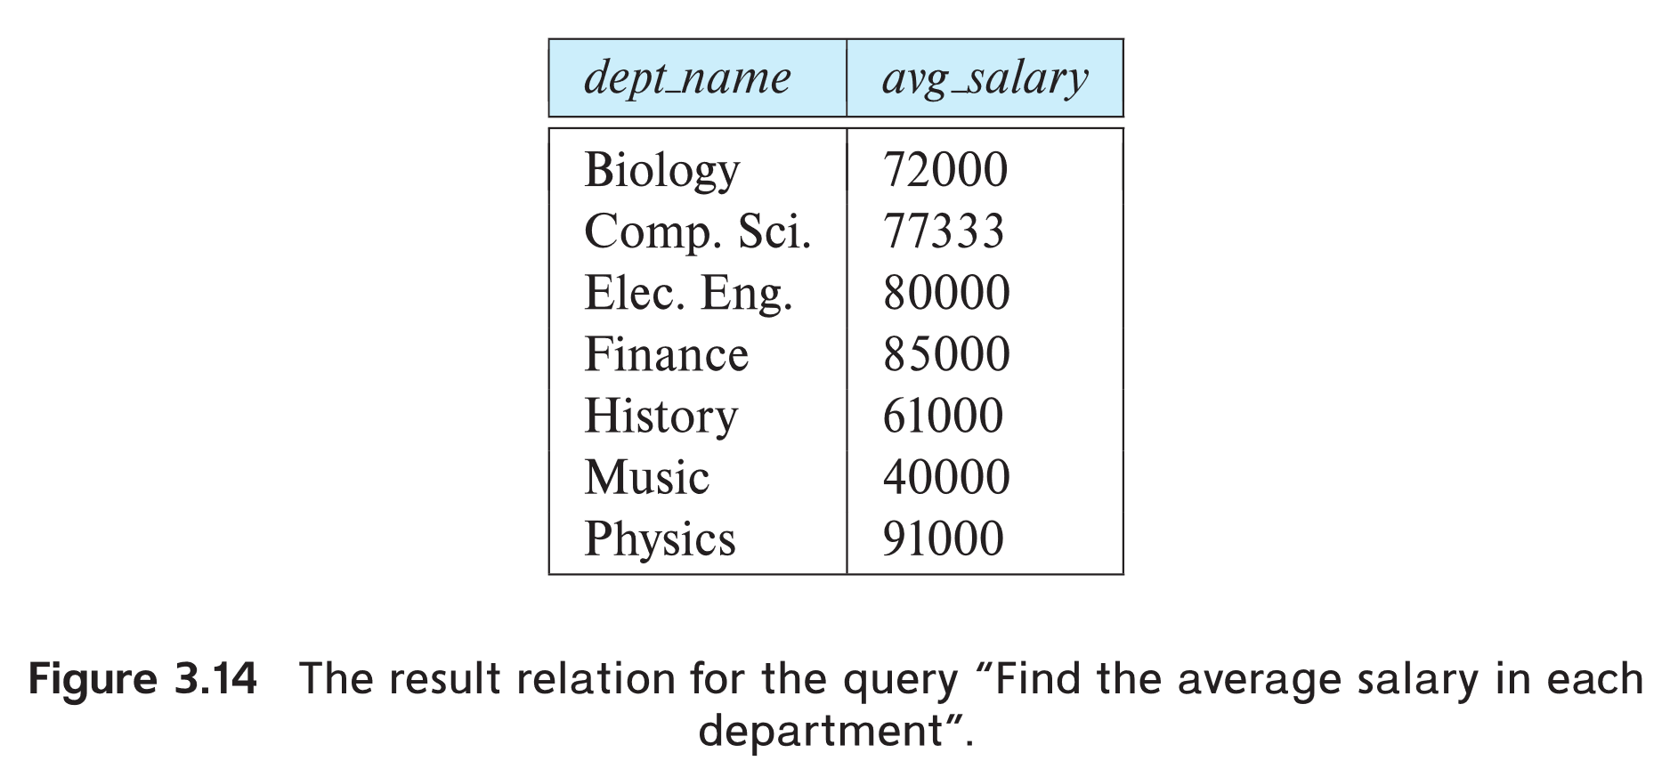
Aggregate Functions – Group By
Find the average salary of instructors in each department
  select dept_name, avg (salary) as avg_salary
  from instructor
  group by dept_name;

Slide 39
Aggregation (Cont.)
Attributes in select clause outside of aggregate functions must appear in group by list 除了聚集函数，能够出现在select子句后的属性必须出现在group by后
  /* erroneous query */
  select dept_name, ID, avg (salary)
  from instructor
  group by dept_name;

Slide 40
Aggregate Functions – Having Clause
Find the names and average salaries of all departments whose average salary is greater than 42000
Note: predicates in the having clause are applied after the formation of groups whereas predicates in the where clause are applied before forming groups having对分组进行限制
select dept_name, avg (salary) as avg_salary
from instructor
group by dept_name
having avg (salary) > 42000;

Slide 41
Nested Subqueries
SQL provides a mechanism for the nesting of subqueries. A subquery is a select-from-where expression that is nested within another query.
The nesting can be done in the following SQL query
select A₁, A₂, ..., A_{n}
from r₁, r₂, ..., r_{m}
where P
as follows:
  From clause: r_{i} can be replaced by any valid subquery
  Where clause: P can be replaced with an expression of the form:
  B <operation> (subquery)
  B is an attribute and <operation> to be defined later.
  Select clause:
    A_{i} can be replaced be a subquery that generates a single value.

Slide 42
Set Membership

Slide 43
Set Membership
Find courses offered in Fall 2017 and in Spring 2018
Find courses offered in Fall 2017 but not in Spring 2018
select distinct course_id
from section
where semester = 'Fall' and year= 2017 and
course_id in (select course_id
from section
where semester = 'Spring' and year= 2018);
select distinct course_id
from section
where semester = 'Fall' and year= 2017 and
course_id not in (select course_id
from section
where semester = 'Spring' and year= 2018);

Slide 44
Set Membership (Cont.)
Name all instructors whose name is neither “Mozart” nor Einstein”
select distinct name
from instructor
where name not in ('Mozart', 'Einstein')
Find the total number of (distinct) students who have taken course sections taught by the instructor with ID 10101
Note: Above query can be written in a much simpler manner.
The formulation above is simply to illustrate SQL features
select count (distinct ID)
from takes
where (course_id, sec_id, semester, year) in
(select course_id, sec_id, semester, year
from teaches
where teaches.ID= 10101);

Slide 45
Set Comparison

Slide 46
Set Comparison – “some” Clause
Find names of instructors with salary greater than that of some (at least one) instructor in the Biology department.
Same query using > some clause
select distinct T.name
from instructor as T, instructor as S
where T.salary > S.salary and S.dept name = 'Biology';
select name
from instructor
where salary > some (select salary
from instructor
where dept name = 'Biology');

Slide 47
Definition of “some” Clause
F <comp> some r ⇔ ∃ t ∈ r such that (F <comp> t )
Where <comp> can be: <, ≤, >, =, ≠
0
(5 < some
5
) = true
(read: 5 < some tuple in the relation)
6
0
(5 < some
5
) = false
0
(5 = some
) = true
5
0
(5 ≠ some
5
) = true (since 0 ≠ 5)
(= some) ≡ in
However, (≠ some) ≡ not in

Slide 48
Set Comparison – “all” Clause
Find the names of all instructors whose salary is greater than the salary of all instructors in the Biology department.
select name
from instructor
where salary > all (select salary
from instructor
where dept name = 'Biology');

Slide 49
Definition of “all” Clause
F <comp> all r ⇔ ∀ t ∈ r (F <comp> t)
0
(5 < all
5
) = false
6
6
(5 < all
) = true
10
4
(5 = all
) = false
5
4
(5 ≠ all
) = true (since 5 ≠ 4 and 5 ≠ 6)
6
(≠ all) ≡ not in
However, (= all) ≡ in

Slide 50
Test for Empty Relations
The exists construct returns the value true if the argument subquery is nonempty.
exists r ⇔ r ≠ Ø
not exists r ⇔ r = Ø
用于解决集合包含问题，方法重要

Slide 51
Use of “exists” Clause
Yet another way of specifying the query “Find all courses taught in both the Fall 2017 semester and in the Spring 2018 semester”
select course_id
from section as S
where semester = 'Fall' and year = 2017 and
exists (select *
from section as T
where semester = 'Spring' and year= 2018
and S.course_id = T.course_id);
Correlation name – variable S in the outer query
Correlated subquery – the inner query 相关子查询

Slide 52
Use of “not exists” Clause
Find all students who have taken all courses offered in the Biology department.
Note that X – Y = Ø ⇔ X ⊆ Y
Note: Cannot write this query using = all and its variants
select distinct S.ID, S.name
from student as S
where not exists ( (select course_id
from course
where dept_name = 'Biology')
except
(select T.course_id
from takes as T
where S.ID = T.ID));
First nested query lists all courses offered in Biology
Second nested query lists all courses a particular student took

Slide 53
Test for Absence of Duplicate Tuples
The unique construct tests whether a subquery has any duplicate tuples in its result.
The unique construct evaluates to “true” if a given subquery contains no duplicates .
Find all courses that were offered at most once in 2017
  select T.course_id
  from course as T
  where unique ( select R.course_id
  from section as R
  where T.course_id= R.course_id
  and R.year = 2017);

Slide 54
Test for Absence of Duplicate Tuples
The unique construct tests whether a subquery has any duplicate tuples in its result.
The unique construct evaluates to “true” if a given subquery contains no duplicates .
Find all courses that were offered at most once in 2017
  select T.course_id
  from course as T
  where 1>=( select count(*)
  from section as R
  where T.course_id= R.course_id
  and R.year = 2017);

Slide 55
Subqueries in the From Clause

Slide 56
Subqueries in the Form Clause
SQL allows a subquery expression to be used in the from clause
Find the average instructors’ salaries of those departments where the average salary is greater than $42,000.”
  select dept_name, avg_salary
  from ( select dept_name, avg (salary) as avg_salary
  from instructor
  group by dept_name)
  where avg_salary > 42000;
Note that we do not need to use the having clause

Slide 57
Subqueries in the Form Clause
SQL allows a subquery expression to be used in the from clause
Find the average instructors’ salaries of those departments where the average salary is greater than $42,000.”
Another way to write above query
  select dept_name, avg_salary
  from ( select dept_name, avg (salary)
  from instructor
  group by dept_name)
  as dept_avg (dept_name, avg_salary)
  where avg_salary > 42000;
注意，这个as一般不能省略

Slide 58
With Clause
The with clause provides a way of defining a temporary relation whose definition is available only to the query in which the with clause occurs.
Find all departments with the maximum budget
with max_budget (value) as
(select max(budget)
from department)
select department.name
from department, max_budget
where department.budget = max_budget.value;

Slide 59
Complex Queries using With Clause
Find all departments where the total salary is greater than the average of the total salary at all departments
with dept _total (dept_name, value) as
(select dept_name, sum(salary)
from instructor
group by dept_name),
dept_total_avg(value) as
(select avg(value)
from dept_total)
select dept_name
from dept_total, dept_total_avg
where dept_total.value > dept_total_avg.value;

Slide 60
Scalar Subquery
Scalar subquery is one which is used where a single value is expected
List all departments along with the number of instructors in each department
select dept_name,
( select count(*)
from instructor
where department.dept_name = instructor.dept_name)
as num_instructors
from department;
Runtime error if subquery returns more than one result tuple

Slide 61
Modification of the Database
Deletion of tuples from a given relation.
Insertion of new tuples into a given relation
Updating of values in some tuples in a given relation

Slide 62
Deletion
Delete all instructors
delete from instructor
Delete all instructors from the Finance department
delete from instructor
where dept_name= 'Finance’;
Delete all tuples in the instructor relation for those instructors associated with a department located in the Watson building.
delete from instructor
where dept name in (select dept name
from department
where building = 'Watson');

Slide 63
Deletion (Cont.)
Delete all instructors whose salary is less than the average salary of instructors
  Problem: as we delete tuples from instructor, the average salary changes
  Solution used in SQL:
    First, compute avg (salary) and find all tuples to delete
    Next, delete all tuples found above (without recomputing avg or retesting the tuples)
delete from instructor
where salary < (select avg (salary)
from instructor);

Slide 64
Insertion
Add a new tuple to course
insert into course
values ('CS-437', 'Database Systems', 'Comp. Sci.', 4);
or equivalently
insert into course (course_id, title, dept_name, credits)
values ('CS-437', 'Database Systems', 'Comp. Sci.', 4);
Add a new tuple to student with tot_creds set to null
insert into student
values ('3003', 'Green', 'Finance', null);

Slide 65
Insertion (Cont.)
Make each student in the Music department who has earned more than 144 credit hours an instructor in the Music department with a salary of $18,000.
insert into instructor
select ID, name, dept_name, 18000
from student
where dept_name = 'Music' and total_cred > 144;
The select from where statement is evaluated fully before any of its results are inserted into the relation.
Otherwise queries like
insert into table1 select * from table1
would cause problem

Slide 66
Updates
Give a 5% salary raise to all instructors
  update instructor
  set salary = salary * 1.05
Give a 5% salary raise to those instructors who earn less than 70000
update instructor
set salary = salary * 1.05
where salary < 70000;
Give a 5% salary raise to instructors whose salary is less than average
update instructor
set salary = salary * 1.05
where salary < (select avg (salary)
from instructor);

Slide 67
Updates (Cont.)
Increase salaries of instructors whose salary is over $100,000 by 3%, and all others by a 5%
  Write two update statements:
  update instructor
  set salary = salary * 1.03
  where salary > 100000;
  update instructor
  set salary = salary * 1.05
  where salary <= 100000;
  The order is important
  Can be done better using the case statement (next slide)

Slide 68
Case Statement for Conditional Updates
Same query as before but with case statement
update instructor
set salary = case
when salary <= 100000 then salary * 1.05
else salary * 1.03
end

Slide 69
Updates with Scalar Subqueries
Recompute and update tot_creds value for all students
update student S
set tot_cred = (select sum(credits)
from takes, course
where takes.course_id = course.course_id and
S.ID= takes.ID.and takes.grade <> 'F' and
takes.grade is not null);
Sets tot_creds to null for students who have not taken any course
Instead of sum(credits), use:
case
when sum(credits) is not null then sum(credits)
else 0
end

Slide 70
End of Chapter 3

