Slide 1
AI for Multiscale
Dynamical Systems Forecasting
Yuhan Zheng
Department of Electrical Engineering and Computer Sciences
University of California, Berkeley

Slide 2
Contents
1 Lorenz–96 benchmark
Sampling, dataset construction, and validation
2 Panda fine-tuning on Lorenz–96
Architecture, checkpoint reproducibility, and forecasting experiments

Slide 3
Lorenz–96 benchmark
Dataset construction, sampling, and validation

Slide 4
Panda sampling and the role of dysts
dysts supplies equations and trajectory tools
The library provides published dynamical systems, numerical integration,
and metadata that includes the characteristic period (period field).
Panda builds its pretraining data on this foundation
Panda starts from 129 curated chaotic systems, perturbs their parameters,
and combines systems through skew-product coupling.
Characteristic period and initial integration step size
The characteristic period determines the sampling interval. The dt field stores
the initial integration step size. Error control adjusts later integration step sizes.
01
Lai, Bao & Gilpin (ICLR 2026), §3 and App. A.3 Gilpin (NeurIPS 2021), §2 dysts library

Slide 5
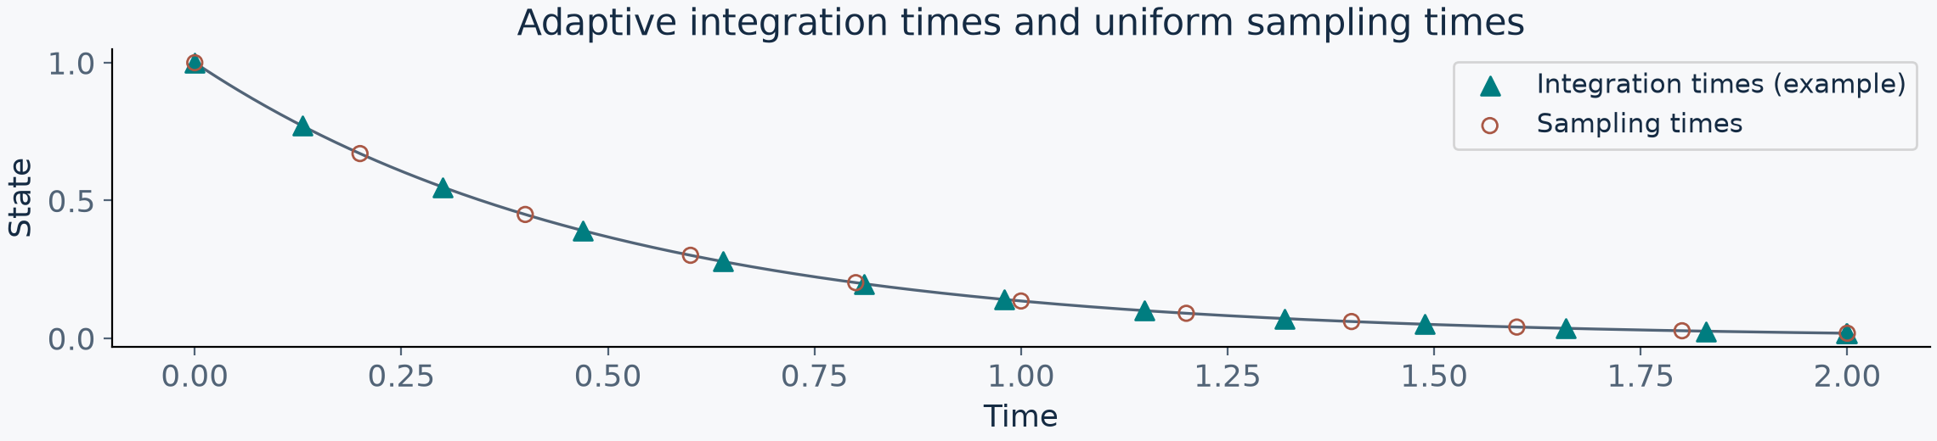
Integration step size and sampling interval
Adaptive integration step sizes advance the solver. Sampling times follow a separate grid.
At sampling times within an accepted integration step, the solver evaluates its interpolant.
Saved samples are the resulting state values. Sampling times need not be integration times.
The grid illustration is a simple ODE example, independent of the benchmark.
02
SciPy solve_ivp: t_eval and dense output dysts integration path

Slide 6
Calibration of the characteristic period
Start from existing system metadata
Initial conditions, an initial integration step size estimate (dt), and a
characteristic period estimate (period) initialize the calibration trajectory.
Generate and trim a calibration record
Current defaults generate 40,000 points and discard the first 20%.
Standardize channels before estimating their spectral timescales.
Refine the stored estimates
The default calibration loop repeats 20 times, updating the dt and period fields.
Within each run, the solver separately adapts its integration step size.
03
dysts: compute_timestep Gilpin (2021), Supp. V

Slide 7
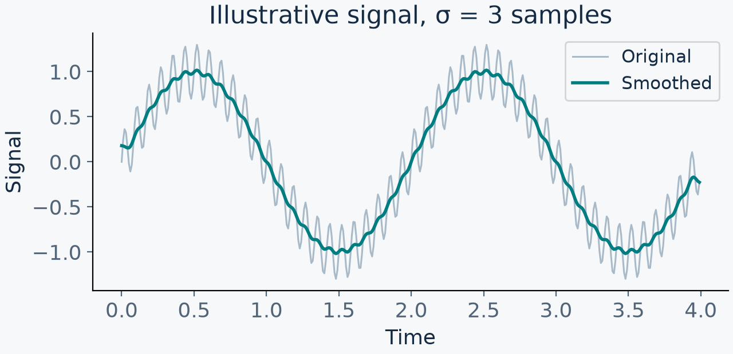
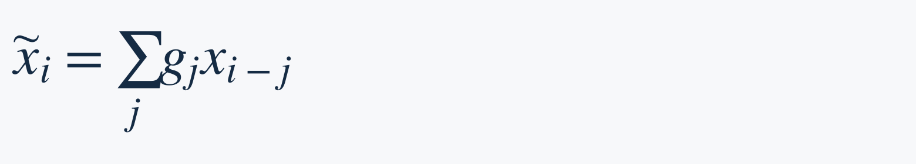
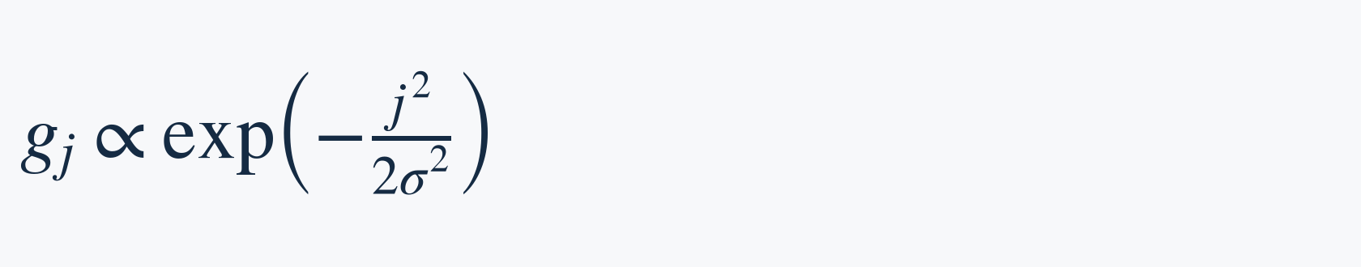
Characteristic period: Gaussian smoothing
A weighted local average
Replace each sample using nearby values.
Closer neighbors receive more weight.
The weights sum to one.
dysts uses σ = 3 samples. The physical
width therefore depends on the input grid.
$${\tilde{x}}_{i}=∑_{j}g_{j}x_{i−j}$$
$$g_{j}∝exp(\frac{−j^{2}}{2σ^{2}})$$
Local averaging suppresses high-frequency oscillations, including genuine fast dynamics.
It does not identify which fluctuations are noise.
04
dysts: find_characteristic_timescale SciPy gaussian_filter1d

Slide 8
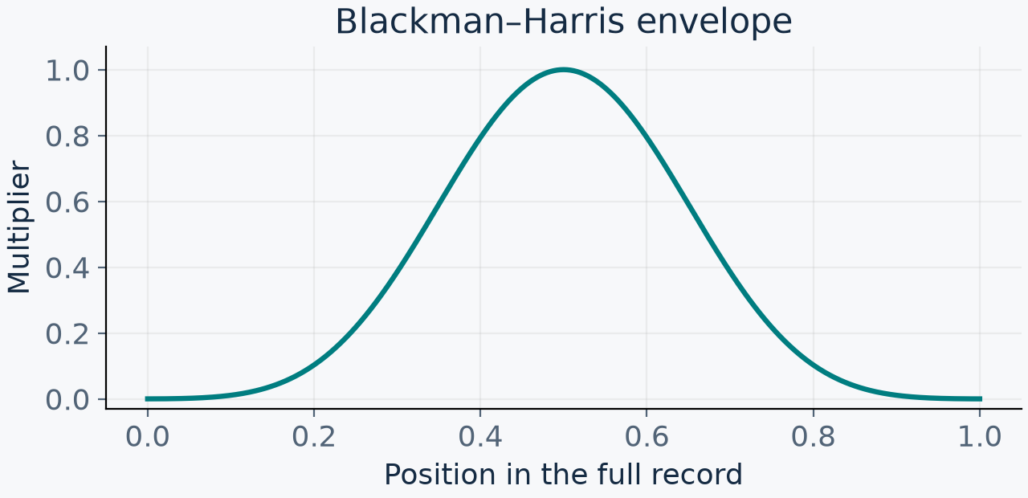
Characteristic period: Blackman–Harris window
A finite record has boundaries
A Fourier representation repeats the record.
A mismatch between its ends can spread
power into other frequency bins.
Multiply each sample by an envelope
that approaches zero at both ends.
The center receives the largest weights.
$$u_{i}=w_{i}{\tilde{x}}_{i}$$
The window reduces boundary leakage and changes the spectrum.
Blackman–Harris suppresses sidelobes at the cost of a wider main peak.
05
dysts: find_psd SciPy Blackman–Harris window

Slide 9
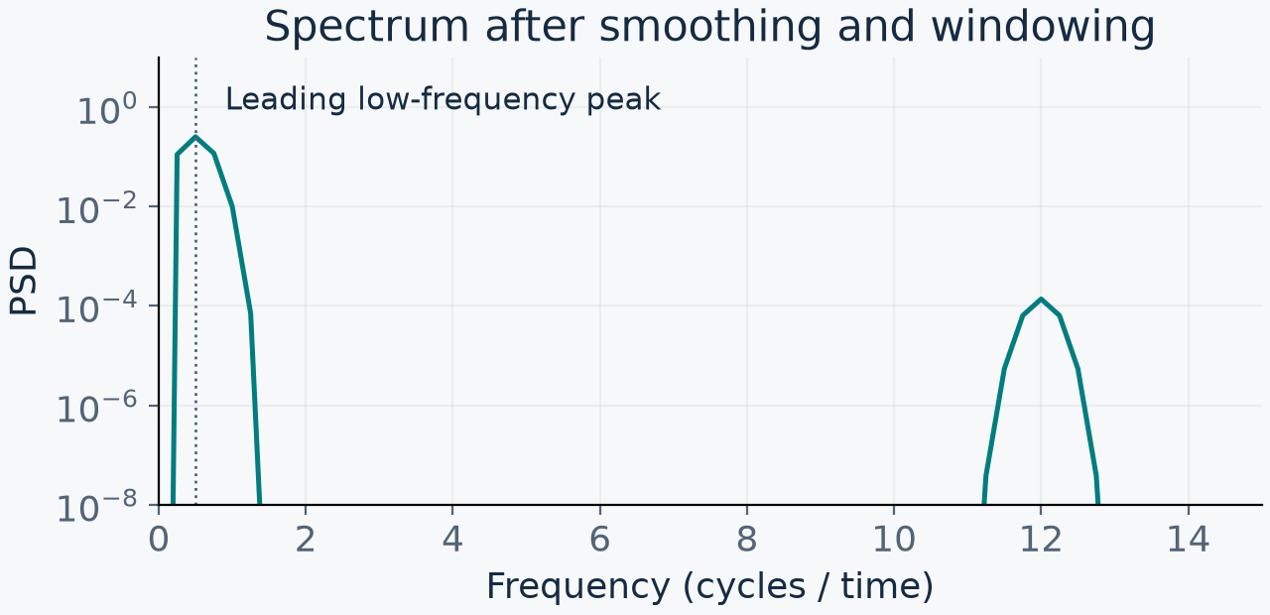
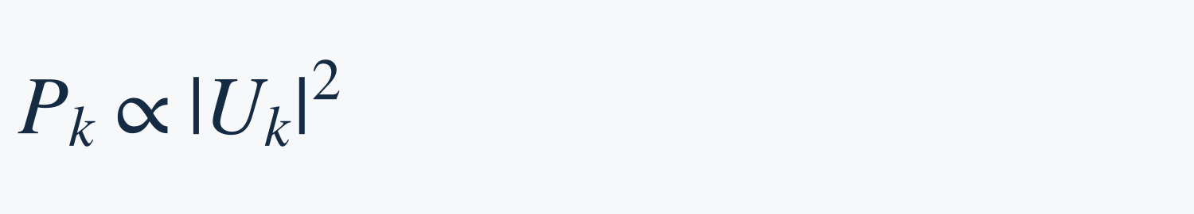
Characteristic period: spectrum and peak choice
A periodogram estimates power
Compute the Fourier transform of u,
the smoothed and windowed signal.
Power is proportional to squared magnitude.
$$P_{k}∝{|U_{k}|}^{2}$$
The helper sorts bins by power, groups consecutive increasing bin indices in that order,
and uses the mean index of the leading retained group as its frequency candidate.
This grouping is an implementation-specific heuristic, rather than a general peak detector.
06
dysts: spectral utilities dysts: group_consecutives SciPy periodogram

Slide 10
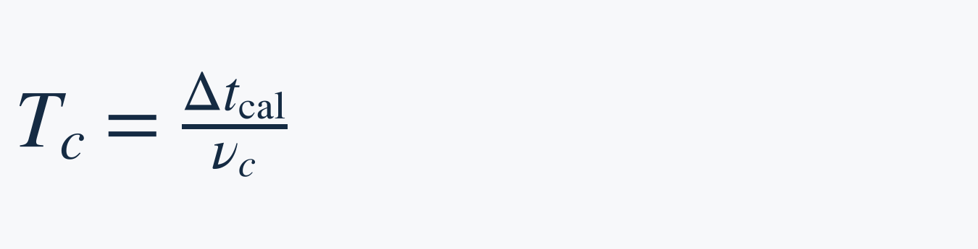
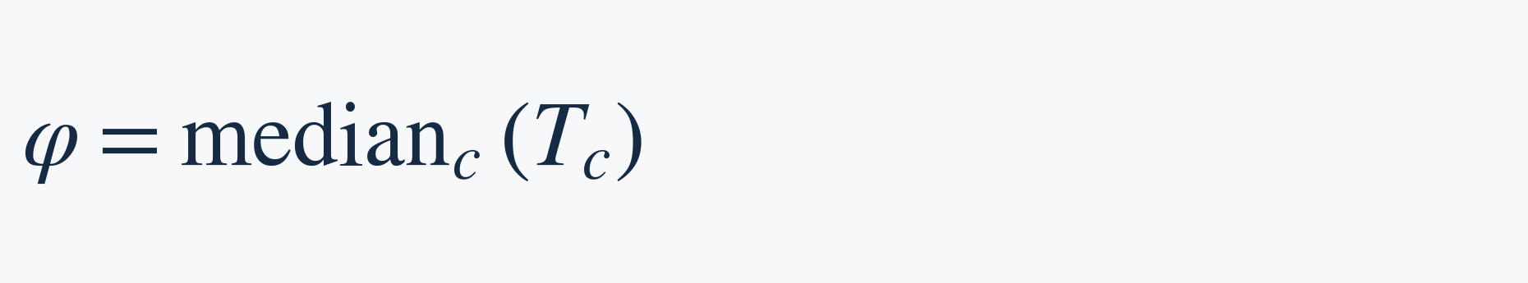
Characteristic period: channel aggregation
Convert the selected frequency from cycles per sample into a physical timescale.
$$T_{c}=\frac{{Δt}_{cal}}{ν_{c}}$$
$$φ={median}_{c}(T_{c})$$
The numerator is the calibration sampling interval. Each ν is in cycles per sample.
Estimate a characteristic period per channel, then take the median across channels.
Example: channel characteristic periods 4, 5, and 100 give a system characteristic period of 5.
The characteristic period is a representative spectral timescale estimated by dysts.
A chaotic trajectory generally has no exact repetition period or unique characteristic time.
07
dysts: compute_timestep Gilpin (2021), timescale alignment

Slide 11

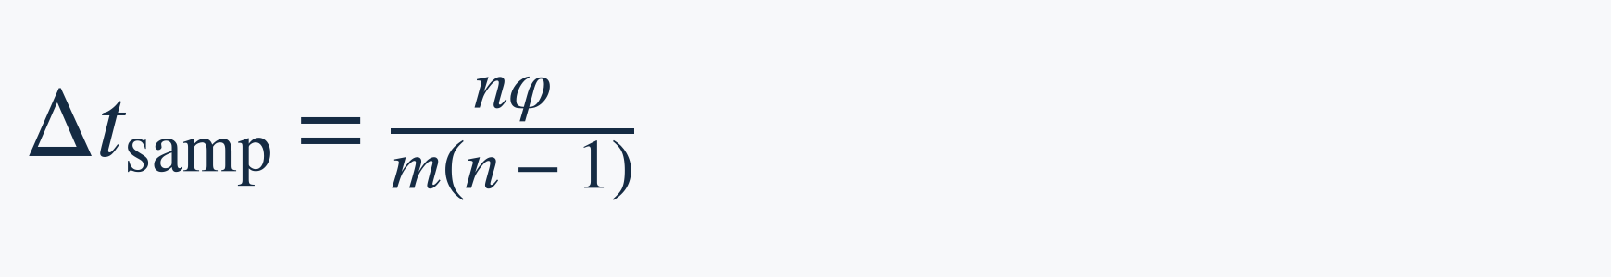
Sampling interval in Panda
Choose m saved samples per characteristic period and n saved samples in total.
$${Δt}_{samp}≈\frac{φ}{m}$$
$${Δt}_{samp}=\frac{nφ}{m(n−1)}$$
Paper protocol
Main-text trajectories contain 4,096 saved samples over 40 characteristic periods.
Skew products use the larger parent characteristic period: about 100 samples per period.
Code detail: m = 4096 // 40 = 102. Rounding and endpoint conventions give a
sampling interval that differs slightly from a duration of exactly 40 characteristic periods.
Panda inherits the characteristic period from dysts metadata to set its sampling times.
08
Panda, App. A.3 dysts: output grid Panda: trajectory sampler

Slide 12
Initial integration step size: frequency screening
Compare each frequency against surrogate records
The code constructs 100 random-phase controls and compares windowed spectral power
at the same frequency. Its default exceedance threshold is 0.95.
$$r(f_{k})=\frac{\#\{j:P(f_{k})>P_{j}(f_{k})\}}{100}$$
Keep a frequency when the original power exceeds at least 95 of the 100 controls.
The code also removes very low frequencies, below roughly 20 cycles per record.
This is the code’s surrogate-comparison criterion. It is not a cumulative-energy cutoff
or a statement that a frequency has a 95% probability of being “real”.
09
dysts: find_significant_frequencies dysts: compute_timestep

Slide 13
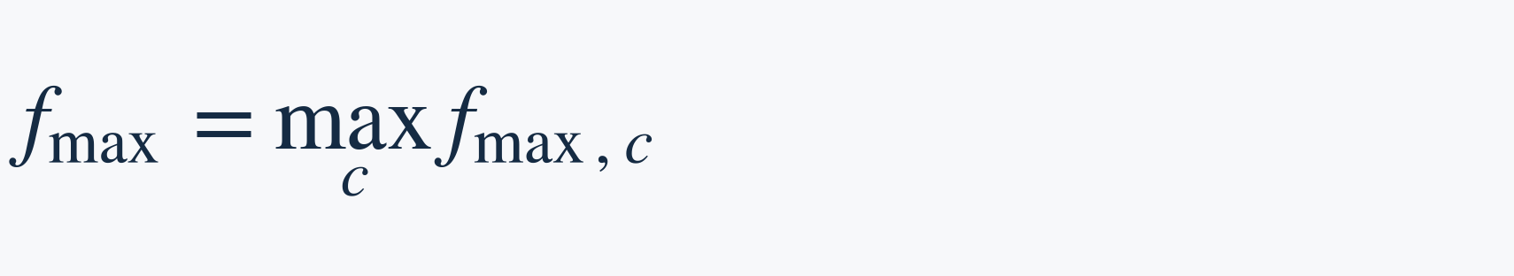
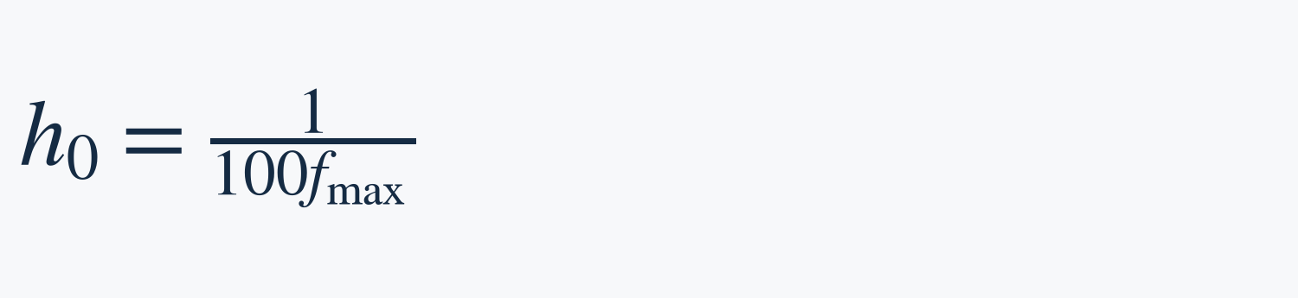
Initial integration step size: fastest frequency
Select the fastest retained frequency
Take the highest retained frequency in each channel, then the maximum across channels.
Convert it to cycles per model time to compute the initial integration step size.
$$f_{max}=\max_{c}f_{max,c}$$
$$h_{0}=\frac{1}{100f_{max}}$$
The dt field sets the initial integration step size (first_step). Panda skew products
inherit the smaller parent dt. The solver may reject and reduce its first trial step.
This estimate initializes integration. It sets neither the maximum integration step size
nor the sampling interval. Later integration step sizes follow adaptive error control.
10
dysts: compute_timestep dysts: first_step Panda: inherited parent dt

Slide 14
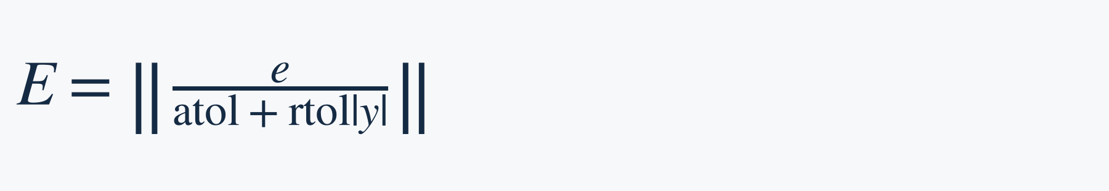
Adaptive integration after initialization
Panda uses Radau, a fifth-order implicit Runge–Kutta solver.
Trial integration step and error estimate
Compute a candidate state and estimate its local error. Scale the error using
absolute and relative tolerances, then test whether the step is acceptable.
$$E=‖\frac{e}{atol+rtol|y|}‖$$
Schematic error scaling. The implementation
uses component-wise scales and a norm.
A scaled error above 1 rejects the trial and reduces the integration step size. Accepted
steps advance the state. Error control chooses the next size without new spectral analysis.
Paper tolerances: rtol = 10⁻⁹, atol = 10⁻¹⁰. A cubic interpolant evaluates states at sampling times.
11
Panda, App. A.3 SciPy Radau and solve_ivp

Slide 15
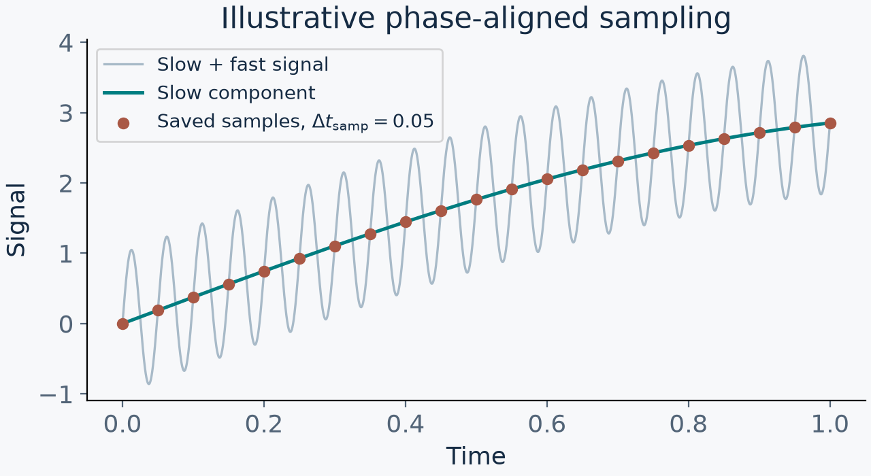
Sampling interval and multiscale resolution
A characteristic period can reflect slow motion while faster fluctuations remain.
$$x(t)=3sin(2π·0.2t)+sin(2π·20t)$$
Illustrative example
Slow component period: 5
Fast component period: 0.05
With m = 100:
Characteristic period ≈ 5
Sampling interval ≈ 0.05.
Saved samples may miss fast fluctuations at this sampling interval.
This example motivates a bandwidth criterion. It does not establish failure on Panda’s data.
12
Interpretation of period alignment Panda sampling protocol

Slide 16

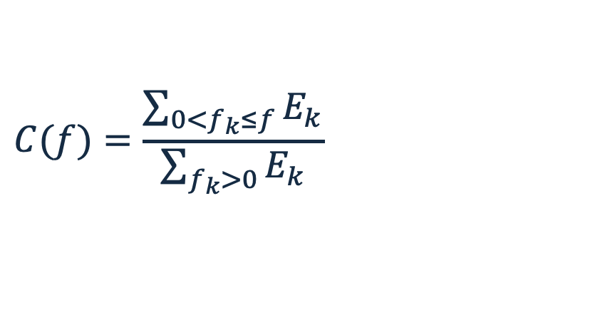
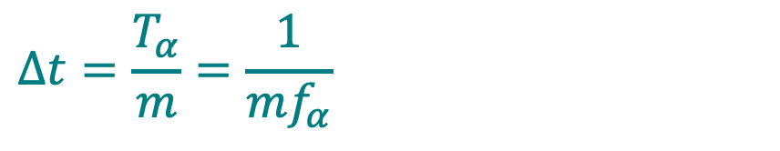
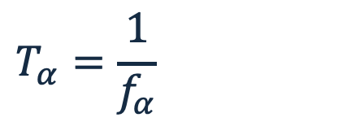
Fluctuation-energy sampling algorithm
1 Estimate the spectrum
$$C(f)=\frac{\sum_{0<f_{k}≤f}^{​}{E_{k}}}{\sum_{f_{k}>0}^{​}{E_{k}}}$$
For each channel, FFT a densely sampled trajectory. Use one-sided energy Eₖ proportional to |FFTₖ|², excluding DC.
$$f_{α}=min\{f:C(f)≥α\}$$
2 Select the retained-energy cutoff
$$T_{α}=\frac{1}{f_{α}}$$
Choose the smallest frequency fα whose cumulative non-DC energy reaches α of the total.
$$Δt=\frac{T_{α}}{m}=\frac{1}{mf_{α}}$$
Hyperparameters: α = 0.99 (empirical choice) and m = saved samples per bandwidth period
13

Slide 17
Our spectral bandwidth and sampling choices
Reference spectrum from dense calibration
Compute NumPy rFFT directly on the calibration states, with no Gaussian smoothing
or explicit window. Use one-sided weights and exclude DC from AC-energy fractions.
Bandwidth threshold and sampling interval
Choose the lowest frequency containing 99% of each channel’s AC energy.
Use 32 saved samples per calibrated bandwidth period for slow/state channels.
Aggregate within each channel group
A bandwidth period is the reciprocal of the bandwidth frequency. Take group medians.
Freeze these periods per family and configuration. This differs from dysts’ characteristic period.
14
Project code: src/data/sampling_interval/ Dataset specification: data/lorenz96_benchmark/README.md

Slide 18
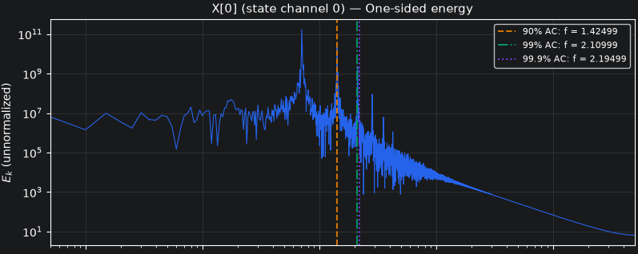
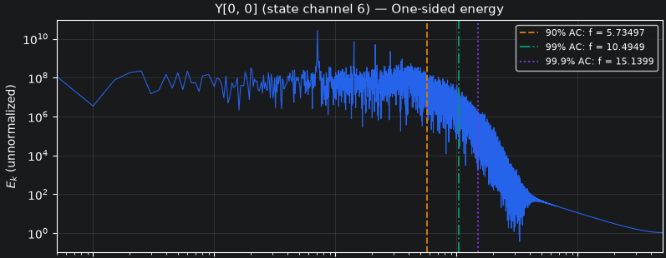
Spectral evidence: slow and fast channels
Slow variable X[0]
Fast variable Y[0,0]
99% cutoff ≈ 2.11 cycles / model time
99% cutoff ≈ 10.49 cycles / model time
The fast-channel cutoff is about 5× higher in this example.
Cumulative energy and −3 dB amplitude/power thresholds define different cutoffs.
15

Slide 19
Our numerical integration interface
DOP853 selects the initial integration step size
Eighth-order explicit Runge–Kutta. Default tolerances: rtol = 10⁻⁸, atol = 10⁻¹⁰.
With first_step omitted, SciPy estimates the initial integration step size automatically.
Adaptive error control and interpolation
Embedded error estimates control rejection and integration step size updates.
A seventh-order interpolant evaluates states at the sampling times (t_eval).
Configurable maximum integration step size
By default, max_step equals sample_dt: the maximum integration step size equals the
sampling interval. An override changes this cap. Steps remain adaptive and need not align.
16
Project code: src/data/lorenz96/simulate.py SciPy DOP853 and solve_ivp

Slide 20
Lorenz–96 benchmark: baseline split
K = 9 J = 8 hₓ = −0.8 hᵧ = 1 F = 10 ε = 2⁻⁷
Split | Trajectory pairs | Purpose
Training | 32 | Fit model parameters
Validation | 8 | Select model / hyperparameters
Test A | 16 | New trajectories at training configuration
Each pair contains a multiscale and a single-scale trajectory.
Single-scale dynamics retain fast-variable influence through a frozen instantaneous GP closure.
Independent trajectory pairs; 50 model time units of spin-up.
17

Slide 21
Test B: one-parameter generalization
Change one parameter at a time. Keep all other baseline parameters fixed.
Varied parameter | Baseline | Test B value | Pairs
K | 9 | 18 | 4
J | 8 | 16 | 4
hₓ | −0.8 | −1.2 | 4
hᵧ | 1 | 1.4 | 4
F | 10 | 14 | 4
20 Test B pairs
76 pairs across the full benchmark
18

Slide 22
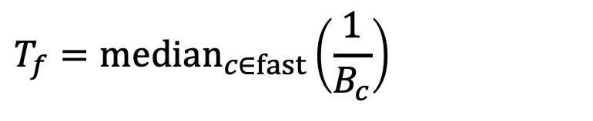
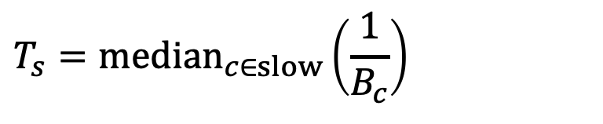
Calibration before retained sampling
Spin-up
Separate calibration
Frozen sampling times
Run for 50 model time units. Discard this segment before retaining data.
Use one independent dense calibration per family and configuration (12 total), separate from forecasting data.
Freeze the sampling interval per family and configuration. Reuse it across forecasting trajectories.
Median bandwidth periods define slow and fast resolution scales
$$T_{s}={median}_{c∈slow}\left(\frac{1}{B_{c}}\right)$$
$$T_{f}={median}_{c∈fast}\left(\frac{1}{B_{c}}\right)$$
Training, validation, and Test A share baseline sampling times within each family.
19

Slide 23
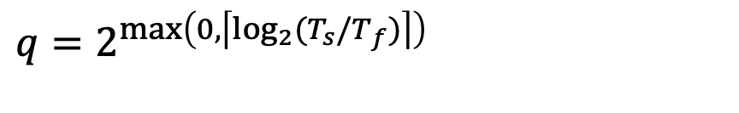
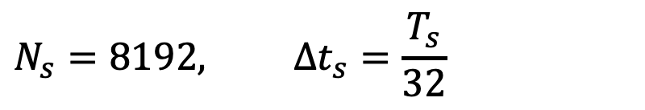
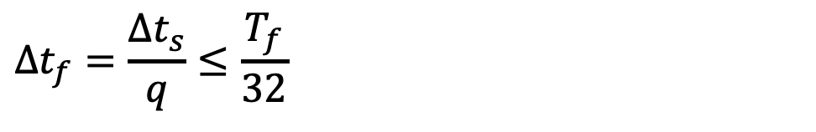
A shared fine grid resolves the fast dynamics
Slow observation target
Power-of-two subdivision
$$N_{s}=8192, Δt_{s}=\frac{T_{s}}{32}$$
$$q=2^{max\left(0,\left\lceil \log_{2}(T_{s}/T_{f})\right\rceil \right)}$$
$$Δt_{f}=\frac{Δt_{s}}{q}≤\frac{T_{f}}{32}$$
Save every slow and fast channel at the fine sampling interval.
Keep the first K channels at every q-th sampling time.
This preserves both endpoints and gives exactly 8,192 slow samples.
20

Slide 24
Exact counts and baseline calibration
$$N_{f}=(8192−1)q+1, D=8191 Δt_{s}$$
Quantity | Baseline split calibration
Slow bandwidth period Tₛ | 0.4184100418410042
Fast bandwidth period T_{f} | 0.004628988143111395
Period ratio and subdivision | Tₛ / T_{f} ≈ 90.4, so q = 128
Stored samples per channel | 1,048,449 on the shared fine grid
Slow observations after stride 128 | 8,192, including both endpoints
All six configurations use q = 128 and 1,048,449 points per channel.
Single-scale trajectories use their own calibrated sampling interval and save 8,192 samples.
21

Slide 25
Benchmark completion and validation
v0.5: generation and validation complete
Collection | Count | Validation
Forecasting trajectories | 152 (76 pairs) | 152 passed
Dense calibrations | 12 | 12 passed
Frozen GP closures | 6 | 6 passed
0 failures and 0 review flags
Structural, numerical, and statistical checks cover the full benchmark.
22

Slide 26
Panda fine-tuning
on Lorenz–96
Panda architecture, pretraining, and Lorenz–96 adaptation
Single-scale and multiscale slow observations

Slide 27
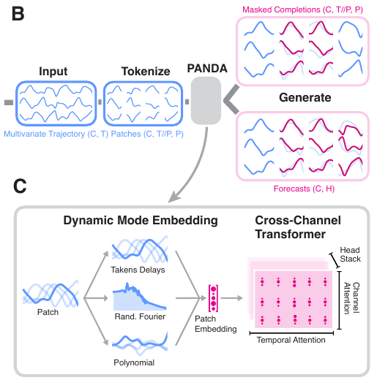
Panda forecasting architecture
Base forecast checkpoint: GilpinLab/panda
Input and patching
512 past values per observed channel.
Length-16 patches with stride 16 give
32 tokens per channel.
Encoder and forecast head
8 encoder blocks, hidden width 512,
8 attention heads. Mean pooling over
patches and a linear head output
128 future values per channel.
23
Lai, Bao & Gilpin (ICLR 2026), Fig. 1 and App. B GitHub: architecture HF: forecast checkpoint

Slide 28
Temporal and channel attention
Hidden state in each block: C channels × 32 patches × 512 features
Temporal attention
Each channel attends across its 32 patches.
Partial rotary position encoding (p-RoPE) encodes temporal order.
Channel attention
At each patch position, attention mixes the observed channels.
Shared weights allow different channel counts at inference.
Feed-forward layer
A nonlinear feed-forward network transforms each token.
RMSNorm and residual connections surround the sublayers.
24
Lai, Bao & Gilpin (ICLR 2026), §4 and App. B GitHub: attention implementation

Slide 29
Panda patch embeddings
Each channel’s 512 context samples form 32 patches (length 16, stride 16).
Each patch x = (x₁, …, x₁₆) supplies the feature blocks below.
Feature block | Construction | Dimensions
Raw patch | The 16 observed values x₁, …, x₁₆ | 16
Quadratic | Products xᵢxⱼ using randomly sampled index pairs | 120
Cubic | Products xᵢxⱼxₖ using randomly sampled index triples | 120
Fourier | sin(xW + b) and cos(xW + b), with fixed random W and b | 256
Concatenation: 16 + 120 + 120 + 256 = 512 features per patch
A learned 512 × 512 linear projection produces the transformer token.
Polynomial indices and Fourier parameters are sampled at initialization.
25
Lai, Bao & Gilpin (ICLR 2026), §4 GitHub: feature embedding HF: exact configuration

Slide 30
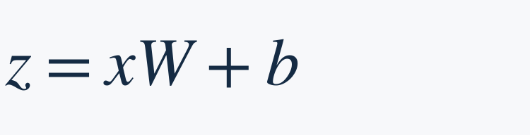


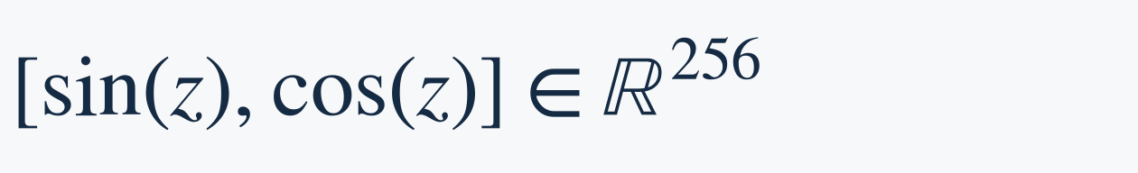
Feature initialization and reuse
Seeded model initialization
A random seed controls initialization of polynomial indices, Fourier W and b, and other weights.
Each model draws 120 index pairs and 120 triples over 16 positions, allowing repeats.
W and b use standard-normal draws. All patches and channels reuse these features.
$$z=xW+b$$
$$W∈ℝ^{16×128}$$
$$b∈ℝ^{128}$$
$$[sin(z),cos(z)]∈ℝ^{256}$$
Loading a pretrained checkpoint
The model first constructs its features and weights using seeded random initialization.
Checkpoint values then overwrite saved parameters, including W and b and linear weights.
Restored Fourier parameters therefore do not depend on the loading seed.
Missing polynomial mapping
Upstream checkpoints omit the polynomial indices, so the new random mapping remains.
The next slide explains the resulting reproducibility issue and our JSON workaround.
26
Lai, Bao & Gilpin (ICLR 2026), §4 GitHub: feature initialization HF: rff_trainable = false

Slide 31
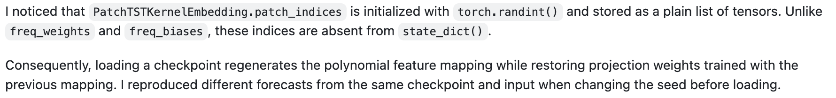
Checkpoint reproducibility issue
Upstream checkpoints omit the polynomial feature mapping
Cause: polynomial indices are not saved. Fourier W and b are saved.
Effect: new polynomial features can be paired with old projection weights.
Our workaround: save and restore polynomial_indices.json with checkpoints.
Reported in Panda GitHub issue #12
Our runs use seed 99 to match Panda’s recorded training seed.
Matching the seed alone cannot guarantee the original mapping without the same RNG history.
This may affect zero-shot evaluation, but does not establish why it failed.
27
GitHub: polynomial-index implementation Panda GitHub issue #12 HF: training metadata (seed 99)

Slide 32
Forecasting from slow observations
Model input
Hidden dynamics
Past slow observations
Hidden fast states influence
slow-state evolution
Prediction target
Fast states remain unavailable
at inference
Future slow observations
Can observation history capture enough
of the hidden fast dynamics?
28

Slide 33
Why fine-tune Panda?
Panda reports zero-shot forecasts on unseen chaotic systems.
Our zero-shot pilot | Qualitative outcome
Single-scale observations | Poor forecasting
Multiscale slow observations | Poor forecasting
Poor forecasts in both families do not isolate hidden-fast effects.
Fine-tuning tests whether a gap remains after adaptation.
Hypothesis: the reduced single-scale system is easier to forecast.
29
Zero-shot claim: Lai, Bao & Gilpin (ICLR 2026), §5.1

Slide 34
Panda pretraining for direct forecasting
512 history samples, 128 future target samples
The forecast head predicts all 128 samples directly in one forward pass.
Training minimizes MSE between the forecast and the future trajectory.
Synthetic pretraining data
About 20,000 synthetic chaotic ODE systems from evolutionary search.
Training samples 3 channels per trajectory and applies augmentations to 20%.
Inference can use all observed channels.
Base forecast model: 100,000 iterations, AdamW, peak LR 10⁻³,
cosine schedule, 10% warmup, gradient clipping 1.0.
Longer forecasts concatenate blocks of 128 predicted samples autoregressively.
30
Lai, Bao & Gilpin (ICLR 2026), §3, §5.1 and App. B GitHub: autoregressive rollout

Slide 35
Paired fine-tuning experiments
Baseline configuration: training / validation splits, 9 observed channels.
Setting | Single-scale | Multiscale slow
Benchmark split | Training / validation | Training / validation
Observation source | singlescale/ | multiscale/ slow_downsampled/
Trajectories: train / val | 32 / 8 | 32 / 8
Samples per trajectory | 8,192 time points | 8,192 time points
Windows: train / val | 1,920 / 480 | 1,920 / 480
Context / forecast / stride | 512 / 128 / 128 | 512 / 128 / 128
Windows per trajectory = floor((8,192 − 512 − 128) / 128) + 1 = 60
Train: 32 × 60 = 1,920 Validation: 8 × 60 = 480
Each family uses its own calibrated sampling interval. Windows inherit trajectory splits.
31

Slide 36
Shared fine-tuning protocol
Two matched runs, one node with 4 A100 GPUs per run
Setting | Both runs
Initialization | Panda forecast checkpoint, seed 99
Optimization | AdamW on trainable weights, observed-channel MSE
Learning rate / decay | 3e-5 / 0.01
Schedule | Cosine, 5% warmup, gradient clipping 1.0
Training budget | Up to 50 epochs, early-stopping patience 10
Batch / precision | Global batch 32 (8 per GPU), BF16
Checkpoint selection | Lowest validation loss, evaluated every epoch
Fine-tuning results pending
32
Initialization: GilpinLab/panda on Hugging Face Panda code: github.com/abao1999/panda

