Slide 1
FRAUD PRIORITIZATION
Fraud Prioritization
1%
From broad rules to precise investigation queues
of transactions can be reviewed
The decision is not simply
“is this fraud?”
It is “what should we review first?”
Executive decision deck
Notes:
[Sources] Analysis: Phase2_Fraud_Prioritization.ipynb (user-provided); no external sources.
Opening: frame this as a resource-allocation problem, not a generic classification exercise.

Slide 2
EXECUTIVE DECISION
Approve ML prioritization — deployed as Strategy A
Probability-ranked Logistic Regression materially improves case capture at the same investigator capacity.
98.8%
97.9%
7.9
Fraud cases captured
Fraud value captured
Reviews per fraud detected
vs. 32.5% with rule baseline
vs. 76.3% with rule baseline
vs. 24.0 with rule baseline
Recommendation
Adopt Strategy A: rank the top 1% of transactions by P(Fraud), retain the Phase 1 rule as a guardrail, and monitor performance as new feedback arrives.
Fraud prioritization | Executive findings | 02
Notes:
[Sources] Analysis: Phase2_Fraud_Prioritization.ipynb (user-provided); no external sources.
Decision metrics are held-out test results; workload is unchanged at a fixed top-1% investigation queue.

Slide 3
1. DESCRIBE, ALIGN & INVESTIGATE
A 1% review queue turns fraud detection into ranking
We must place the highest-risk transactions at the top of a fixed 1% queue.
509k
654
The operating constraint
labeled training transactions
fraud cases in training
Investigators can review only ~1% of all transactions.
A useful solution therefore ranks risk—not merely labels transactions as fraud or legitimate.
0.13%
1%
underlying fraud rate
available review queue
Fraud prioritization | Executive findings | 03
Notes:
[Sources] Analysis: Phase2_Fraud_Prioritization.ipynb (user-provided); no external sources.
Training set: 509,009 rows, 654 fraud cases, 0.1285% fraud rate. Accuracy is misleading: predicting every transaction legitimate would be 99.8715% accurate while detecting no fraud.

Slide 4
1. DESCRIBE, ALIGN & INVESTIGATE
Rules help—but cannot prioritize tightly enough
Fraud has a clear behavioral signature, but the signature is too broad for a 1% queue.
Fraud rate by transaction type (basis points)
The rule signal is real but over-inclusive
98.8%
of fraud empties the sender balance
90.1%
of legitimate transfer/cash-out also does
The strongest Phase 1 rule matches 18.7% of all transactions—nearly 19× the review capacity.
Fraud prioritization | Executive findings | 04
Notes:
[Sources] Analysis: Phase2_Fraud_Prioritization.ipynb (user-provided); no external sources.
EDA: fraud exists only in TRANSFER (0.77%) and CASH_OUT (0.18%) in this data. Sender balance is fully emptied in 98.78% of fraud vs. 90.13% of legitimate transfer/cash-out. The Phase 1 rule matches 95,264/509,009 = 18.7%.

Slide 5
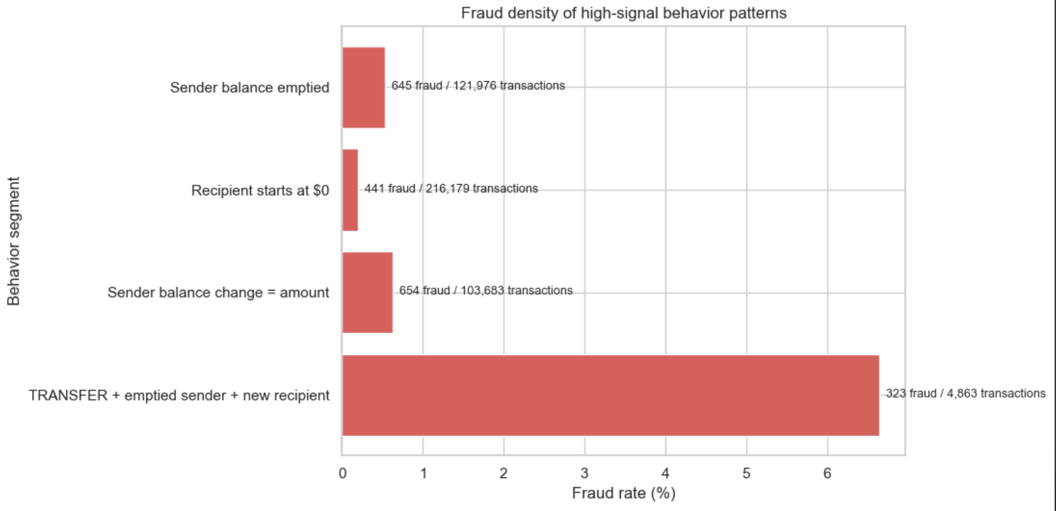

Slide 6
1. DESCRIBE, ALIGN & INVESTIGATE
ML turns rule signals into a precise review order
The critical gap is not identifying risk patterns—it is separating the most suspicious cases within them.
Phase 1: rule-based screening
Phase 2: AI/ML prioritization
•
Transparent and easy to audit
•
Scores the combined behavior of each transaction
→
•
Flags broad patterns: type + balance empty + prior balance
•
Ranks by calibrated P(Fraud) for the fixed top-1% queue
•
Needs an arbitrary amount-based tie-breaker inside an 18.7% alert pool
•
Improves detection without increasing investigator workload
Fraud prioritization | Executive findings | 05
Notes:
[Sources] Analysis: Phase2_Fraud_Prioritization.ipynb (user-provided); no external sources.
Explain that ML is not replacing domain rules: it is using observed behavior to rank constrained review capacity more efficiently.

Slide 7
2. SOLVE
Model lifecycle: behavioral evidence
We excluded raw account IDs, engineered auditable behavior features, and kept data roles clean.
1
2
3
4
Prepare
Engineer
Preprocess
Evaluate
→
→
→
Target: is_fraud
Exclude raw sender/recipient IDs
Stratified 5-fold CV
Balance changes and errors
Sender-balance-emptied
Amount-to-balance ratio
Log transforms + scaling for LR
Raw monetary values for trees
Transaction type encoding
Out-of-fold predictions
Technical + business metrics
Top-1% capacity lens
The data signal is behavioral—how funds move—not account identity.
Fraud prioritization | Executive findings | 06
Notes:
[Sources] Analysis: Phase2_Fraud_Prioritization.ipynb (user-provided); no external sources.
Feature engineering: sender/recipient balance changes, balance-reconciliation errors, sender_balance_emptied, amount_to_sender_balance, recipient_is_merchant, hour_of_day. Tree feature matrix has 14 columns; LR feature matrix has 18 after encoding.

Slide 8
2. SOLVE
A simple, interpretable model won the ranking test
Behavioral engineering made the problem close to linearly separable—so Logistic Regression edged the tree-based challengers.
OOF precision-recall AUC (higher is better)
Why this model
•
Highest PR-AUC
•
100% Recall@1% in OOF
•
Fully interpretable
Tree models remain strong challengers if behavior becomes more nonlinear over time.
Fraud prioritization | Executive findings | 07
Notes:
[Sources] Analysis: Phase2_Fraud_Prioritization.ipynb (user-provided); no external sources.
OOF PR-AUC: Logistic Regression 0.9997, XGBoost 0.9975, LightGBM 0.9970. At top 1%, LR and XGBoost both captured 100% of training fraud; LR selected as simpler and fully interpretable.

Slide 9
2. SOLVE
Strategy A: rank by fraud probability
At this fraud rate and review capacity, adding transaction value did not create measurable upside.
Strategy A | P(Fraud)
Strategy B | P(Fraud) × Amount
Case-focused and simple
Exposure-weighted
Rank transaction probability directly.
OOF: 654 of 654 fraud cases captured at the top 1%.
Recommended strategy.
No added value capture in this data regime.
OOF: 652 of 654 fraud cases at the top 1%; value recall still at ceiling.
Revisit if capacity tightens.
Same 1% investigation queue • Strategy A wins on simplicity and case recall
Fraud prioritization | Executive findings | 08
Notes:
[Sources] Analysis: Phase2_Fraud_Prioritization.ipynb (user-provided); no external sources.
Strategy A OOF: recall@1%=100%, precision@1%=12.85%, value recall=100%, reviews/fraud=7.784. Strategy B OOF: recall@1%=99.69%, value recall=100%, reviews/fraud=7.808. The notebook selected Strategy A.

Slide 10
3. SUSTAIN
Stage the rollout from guardrails to a learning hybrid system
Use the rule as a controlled fallback while ML gains operational trust and new feedback compounds value.
PHASE 1
PHASE 2
PHASE 3
Instrument & validate
Deploy in real time
Learn with feedback
Lock the top-1% queue definition. Establish Phase 1 rule as a sanity check/fallback. Confirm investigator workflow and success metrics.
Operationalize Logistic Regression + Strategy A. Feed the ranked queue to investigators; monitor recall, reviews per fraud, queue latency, and exceptions.
Adopt the hybrid control system: Rules + ML + investigator feedback. Retrain on new labels, test challengers, and tune thresholds as capacity changes.
Fraud prioritization | Executive findings | 10
Notes:
[Sources] Analysis: Phase2_Fraud_Prioritization.ipynb (user-provided); no external sources.
Rollout plan requested by user. Phase 2 uses ML1 / Strategy A for real-time deployment; Phase 3 adopts Rules + ML + Feedback with more labeled data.

Slide 11
ONE RECOMMENDATION
Approve a real-time rollout of
Logistic Regression + Strategy A.
98.8%
of fraud cases caught
in held-out testing
The case is compelling: materially more fraud captured, materially fewer investigations wasted, and an interpretable model that is straightforward to deploy and monitor.
1%
review capacity
Decision gate
Launch the probability-ranked top-1% queue, preserve rule-based guardrails, and use investigator outcomes to improve the hybrid system over time.
Notes:
[Sources] Analysis: Phase2_Fraud_Prioritization.ipynb (user-provided); no external sources.
Close with the implementation ask: approve the real-time rollout and the feedback loop. The Phase 1 rule remains available as guardrail/fallback.

