Slide 1
Custom Log2 and Square Root ISA Extension for RISC-V Pipelined RV32IM with FPGA Acceleration
Yuchen Zhou
Email: yzhou276@jh.edu

Slide 2
Introduction
Introduction
RISCV Architecture Update
FPGA Implementation of LOG2 and SQRT
Performance Comparison between application specific module and standard RV32IM computation
LOG2
SQRT
Plan and Future Efforts

Slide 3
Overview
Goal
Accelerate integer sqrt and log2 computation on RV32IM using custom ISA instructions + FPGA hardware
Motivation
Software implementations require ~80–200+ cycles
Hardware can compute results in ~1–20 cycles
Approach
Add custom R-type instructions:
sqrt rd, rs1 → floor(√x)
log2 rd, rs1 → ceil(log₂(x))
Implement dedicated hardware modules
Integrate into RV32IM pipeline
Key Ideas
Replace iterative software:
log2 → shift loop (O(N))
sqrt → Newton / restoring (multi-cycle)
With hardware:
log2 → leading-one detector (O(1))
sqrt → dedicated datapath
Evaluation
Compare software vs hardware latency
Measure cycle count reduction & speedup
Platform
Pipelined RV32IM RISC-V Architecture on Nexys A7
MATLAB
Project Repository: https://github.com/yzhou276/Computer-Architecture-Project

Slide 4
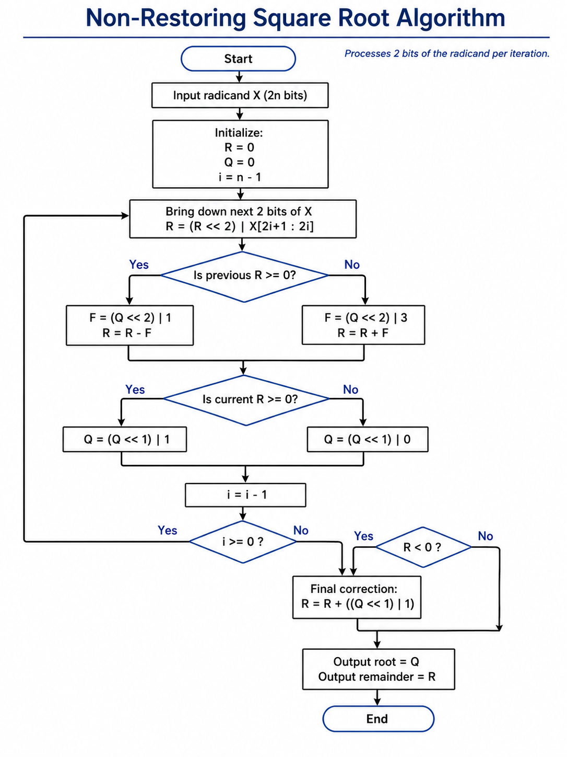
Square Root Algorithm
Non-Restoring Method
Uses only shift, add, subtract (no division/multiplication)
Simple and deterministic hardware
Latency scales linearly (~N/2 cycles for N-bit input)
Easy to integrate into pipeline with predictable timing
Lower design complexity and verification effort
Newton Raphson Method
Fewer iterations (fast convergence)
But each iteration requires division/multiplication
Higher per-iteration cost and control complexity
Overall latency may not be lower in hardware

Slide 5
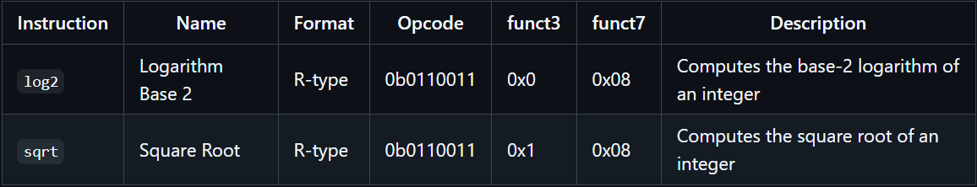
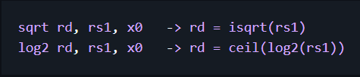
Custom R-type Instruction

Slide 6
RISCV Architecture Update
Introduction
RISCV Architecture Update
FPGA Implementation of LOG2 and SQRT
Performance Comparison between application specific module and standard RV32IM computation
LOG2
SQRT
Plan and Future Efforts

Slide 7
Decode Stage
Decode two custom R-type instructions for i_log2 and i_sqrt
Forwarding source list — added i_log2 | i_sqrt to i_rs1 so the forwarding mux supplies the freshest rs1 value to the ALU/sqrt unit
Writeback enable — included i_sqrt | i_log2 in the wreg signal so destination register rd is decoded.
ALU control bits — aluc[3:1] set to encode the new 4'b1110 (LOG2) opcode; the ALU then routes log2_result through its casex.
rv32m signal — i_sqrt was added to the rv32m set (gates the EXE-stage c_rv32m mux), but left out of rv32m_fuse so sqrt is not fused with mul/div.
Sqrt control outputs:
sqrt — sustained "i_sqrt in ID" flag.
start_sqrt — one-cycle pulse generated by a PulseGenerator on the rising edge of i_sqrt (mirrors start_sdivide).
Legality — both decodes added to the unimplemented_inst exclusion list so they don't trap.

Slide 8
Execution Stage
log2 — purely combinational inside alu.v: a ceil_log2_32 block consumes a (rs1) and emits log2_result, selected by aluc==4'b1110. No new ports, no stall.
sqrt — added the iterative accelerator on a separate path:
Instantiation of isqrt32_nonrestoring driven by clk, clrn (as rst_n), estart_sqrt (start pulse), radicand=ea (forwarded rs1).
Outputs sqrt_busy, sqrt_done, sqrt_root[15:0], sqrt_remainder[16:0].
Result mux chain (last writer wins):
alu → mux2(erv32m → c_rv32m) → mux2(esqrt → {16'd0, sqrt_root}) → eal
When esqrt=1 the sqrt result overrides whatever the rv32m mux selected.
Stall generation — mdwait = muldiv_ready & (~esqrt | sqrt_done);
While a sqrt instruction sits in EXE (esqrt=1) and hasn't finished (sqrt_done=0), mdwait drops, which causes pl_id_cu to clear wpcir/wremw and freeze IF/ID/EX/MEM for the ~16 iteration cycles.
On the cycle sqrt_done pulses, mdwait reasserts and pl_reg_em latches {16'd0, sqrt_root} into mal.

Slide 9
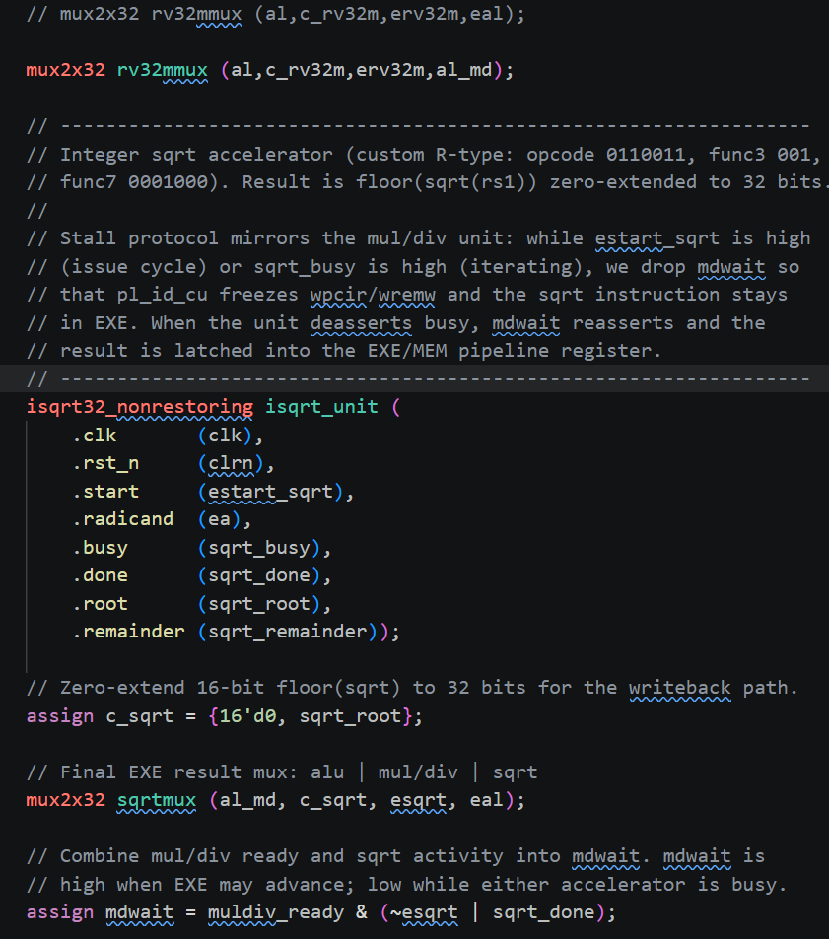
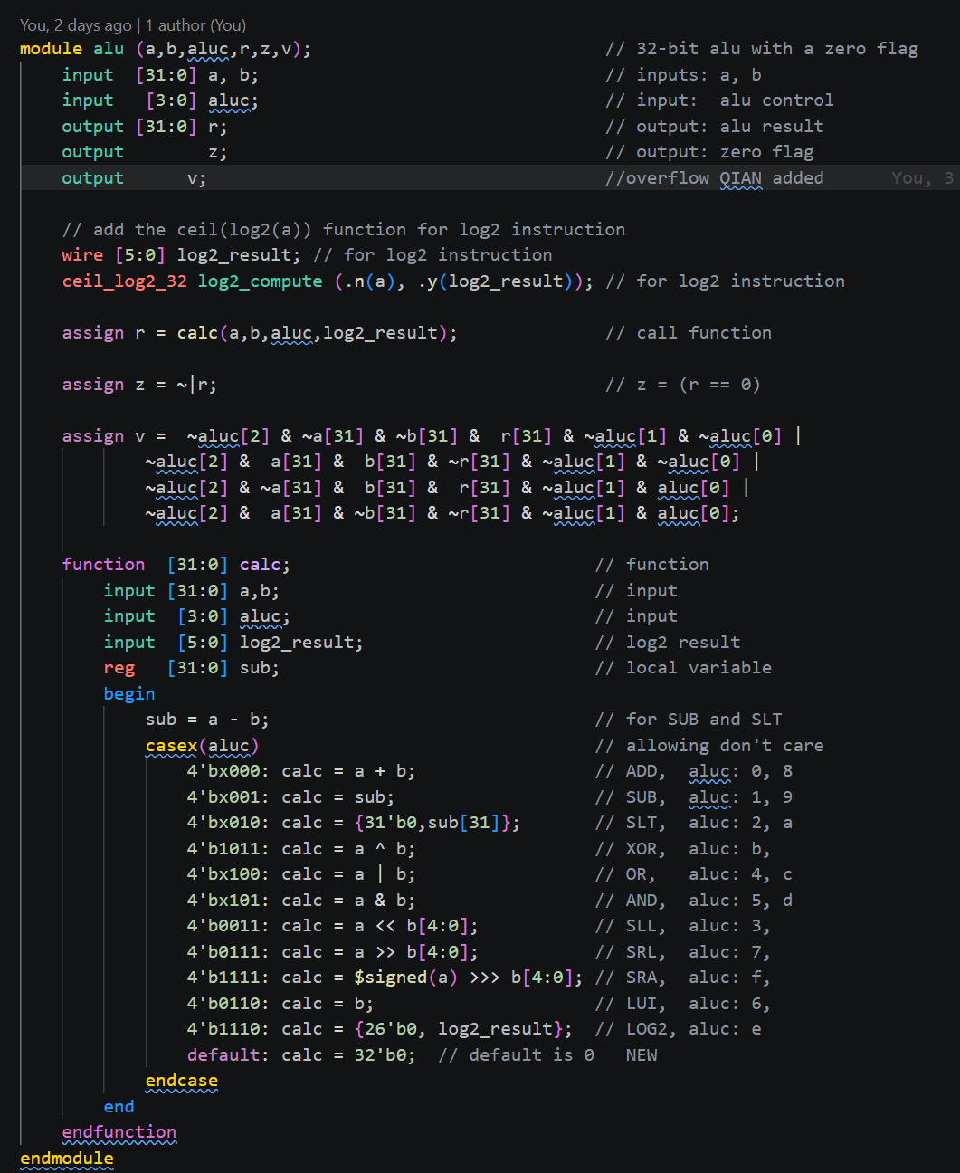
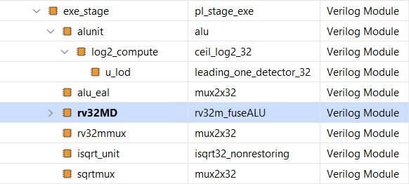
Execution Stage Code Example

Slide 10
BLE/BGE Implementation
For most of the iterative algorithms, comparisons are needed.
Current RV32IM pipelined CPU only supports BEQ and BNE
Non-Restoring square root algorithm compares the remainder to 0 to determine how to update the root. Therefore BLE/BGE is required to make branch happening.
BLE/BGE is implemented by following the design pattern of BEQ and BNE. The less than / greater than result is routed back to the control unit for the branch decision.
Check the repo for the detailed implementation.

Slide 11
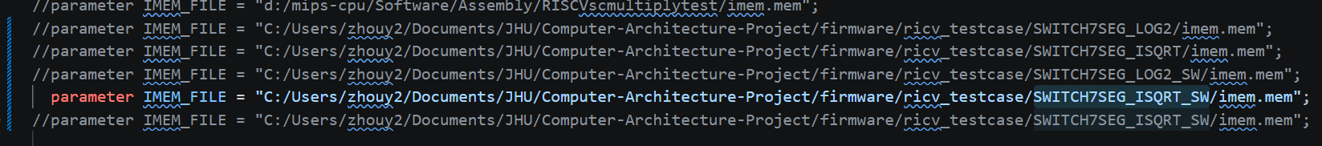
Create applications to validate the modules
module pl_reg_if
Configure the default instruction memory for simulation

Slide 12
FPGA Implementation of LOG2 and SQRT
Introduction
RISCV Architecture Update
FPGA Implementation of LOG2 and SQRT
Performance Comparison between application specific module and standard RV32IM computation
LOG2
SQRT
Plan and Future Efforts

Slide 13




FPGA Module Design and Implementation Approach
Design Requirement Documents
Design model
VHDL & Simulation
Extract Design Specifications
List of user specification parameters to be used in the model
List of user run time configurable options
Design MATLAB Script for the Model
Design a MATLAB code to allow:
User entry for design specification
Bit accurate fixed point model
Display performance results
Generate FPGA VHDL packages
Generate FPGA simulation files
Design VHDL Custom Code and Simulation Testbench
Design Custom VHDL generic synthesizable code
Design custom generic simulation test benches
Design is FPGA vendor independent

Slide 14
LOG2 MATLAB Module
function y = ceil_log2(N)
% ceil_log2
% Returns ceil(log2(N)) for uint32 input.
%
% Input:
% N - uint32 input
%
% Output:
% y - uint32 result
%
% Examples:
% ceil_log2(uint32(1)) = 0
% ceil_log2(uint32(2)) = 1
% ceil_log2(uint32(3)) = 2
% ceil_log2(uint32(4)) = 2
% ceil_log2(uint32(9)) = 4
N = uint32(N);
if N <= 1
y = uint32(0);
return;
end
[pos, valid] = leading_one_detector(N - 1);
if valid
y = pos + uint32(1);
else
y = uint32(0);
end
end
function [pos, valid] = leading_one_detector(x)
% leading_one_detector
% Returns the position of the most significant 1 bit in a uint32 input.
%
% Input:
% x - uint32 input
%
% Output:
% pos - 0-based position of MSB '1' from LSB side
% valid - true if x /= 0, false if x == 0
%
% Examples:
% x = uint32(8) -> pos = 3, valid = true
% x = uint32(18) -> pos = 4, valid = true
% x = uint32(0) -> pos = 0, valid = false
x = uint32(x);
if x == 0
pos = uint32(0);
valid = false;
return;
end
valid = true;
pos = uint32(0);
for i = 31:-1:0
if bitget(x, i+1) == 1
pos = uint32(i);
return;
end
end
end

Slide 15
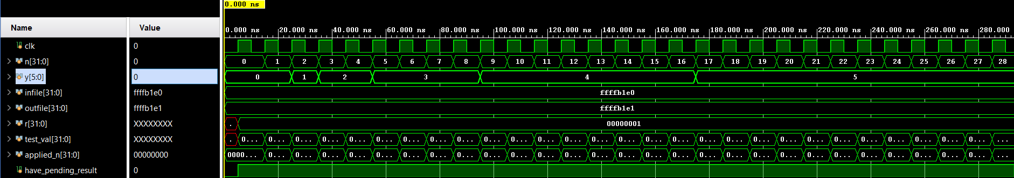
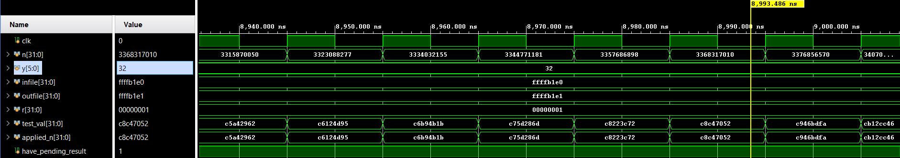
LOG2 RTL Module Simulation

Slide 16
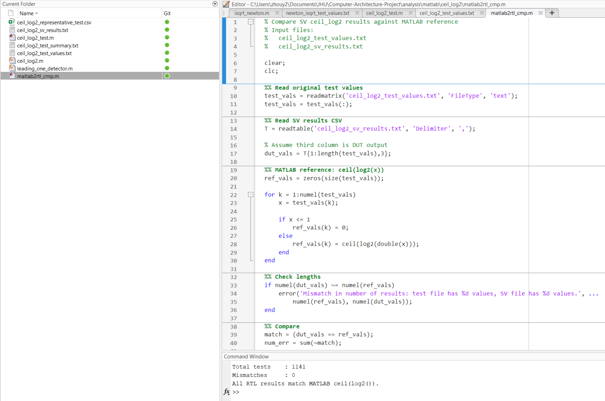
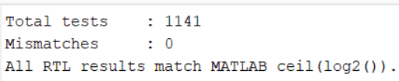
LOG2 MATLAB – RTL Comparison
ceil(log2(double(x))) should be replaced by ceil_log2 function, which is implemented using the digital algorithm

Slide 17

Resource Utilization on the Nexys A7 FPGA board – LOG2
Count

Slide 18
SQRT MATLAB Module – Non-restoring Algorithm
function [root, rem, iter] = isqrt_nonrestoring_nbit(x, N)
if x < 0 || floor(x) ~= x
error('x must be a nonnegative integer.');
end
if N <= 0 || floor(N) ~= N
error('N must be a positive integer.');
end
if x >= 2^N
error('x must be less than 2^N.');
end
x = uint64(x);
num_groups = ceil(N / 2);
P = int64(0);
root = uint64(0);
iter = 0;
fprintf('\nNon-restoring integer sqrt trace\n');
fprintf('Input x = %d, N = %d\n\n', x, N);
fprintf('%5s %8s %8s %12s %12s %12s\n', ...
'Iter', 'Group', 'Op', 'F', 'P/rem', 'Q/root');
fprintf('%5s %8s %8s %12s %12s %12s\n', ...
'----', '-----', '--', '-', '-----', '------');
for k = num_groups-1 : -1 : 0
iter = iter + 1;
shift_amt = 2 * k;
next2 = bitand(bitshift(x, -shift_amt), uint64(3));
P = bitshift(P, 2) + int64(next2);
if P >= 0
F = int64(bitshift(root, 2) + uint64(1));
P = P - F;
op = "SUB";
else
F = int64(bitshift(root, 2) + uint64(3));
P = P + F;
op = "ADD";
end
if P >= 0
root = bitshift(root, 1) + uint64(1);
else
root = bitshift(root, 1);
end
fprintf('%5d %8s %8s %12d %12d %12d\n', ...
iter, dec2bin(double(next2), 2), op, F, P, root);
end
if P < 0
correction = int64(bitshift(root, 1) + uint64(1));
fprintf('\nFinal correction: P = P + (2Q + 1) = %d + %d\n', ...
P, correction);
P = P + correction;
end
rem = uint64(P);
while root * root > x
root = root - 1;
end
while (root + 1) * (root + 1) <= x
root = root + 1;
end
rem = x - root * root;
fprintf('\nFinal result:\n');
fprintf('root = %d\n', root);
fprintf('rem = %d\n', rem);
fprintf('iter = %d\n\n', iter);
end

Slide 19
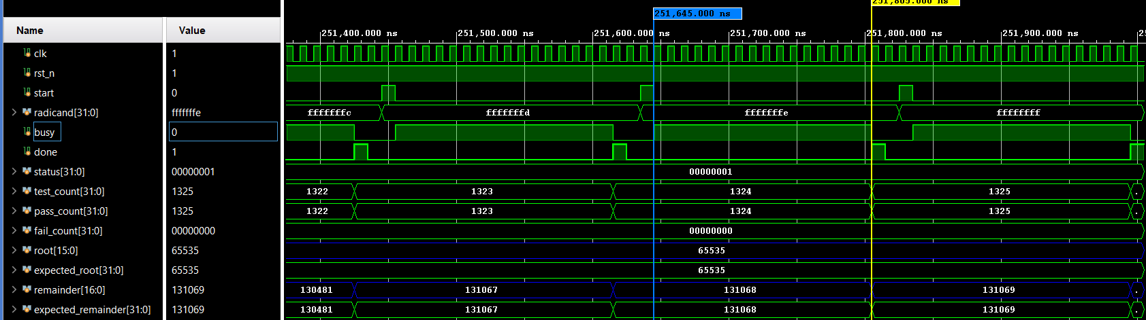
SQRT RTL Module Simulation

Slide 20
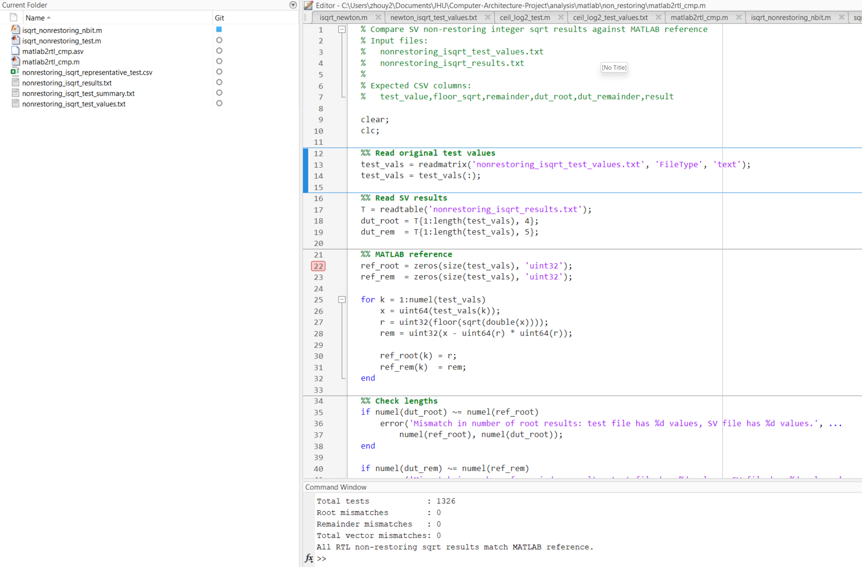
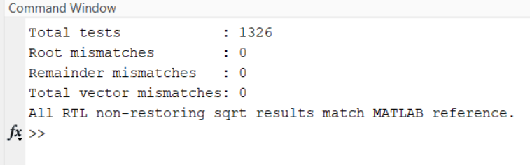
SQRT MATLAB – RTL Comparison

Slide 21
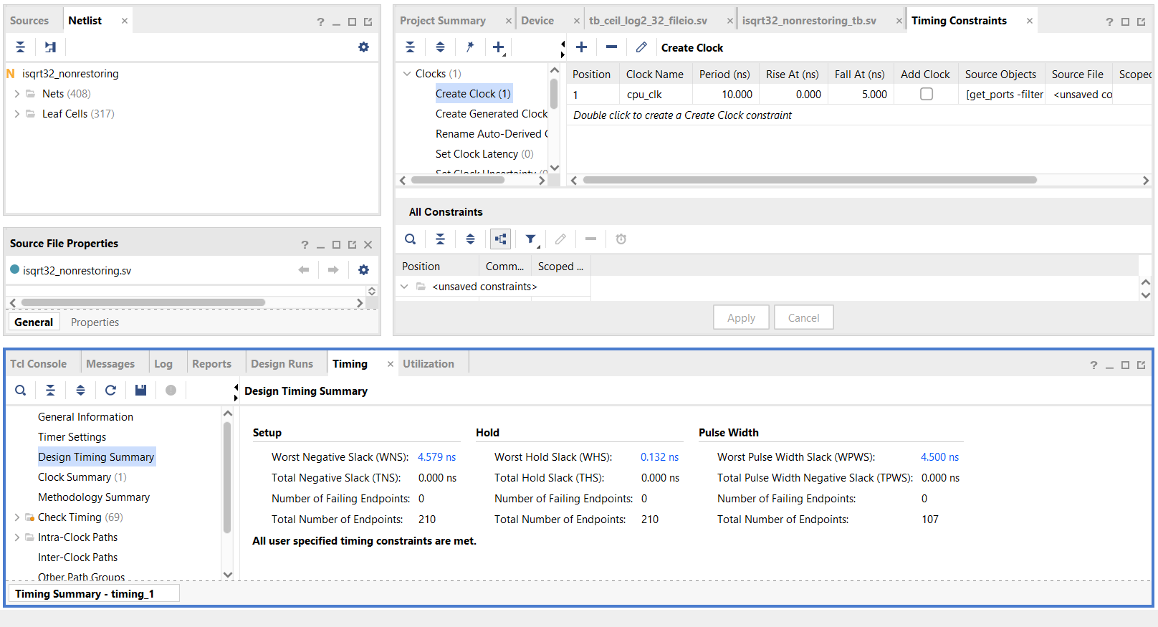
SQRT Module – Static Timing Analysis (STA)
$$Maximum achievable clock Frequency=\frac{1}{clock constraint −WNS}=\frac{1}{10 −4.579}=184.5 MHz$$

Slide 22


Resource Utilization on the Nexys A7 FPGA board – SQRT
Count
Percentage (%)

Slide 23
Performance Comparison – LOG2
Introduction
RISCV Architecture Update
FPGA Implementation of LOG2 and SQRT
Performance Comparison between application specific module and standard RV32IM computation
LOG2
SQRT
Plan and Future Efforts

Slide 24
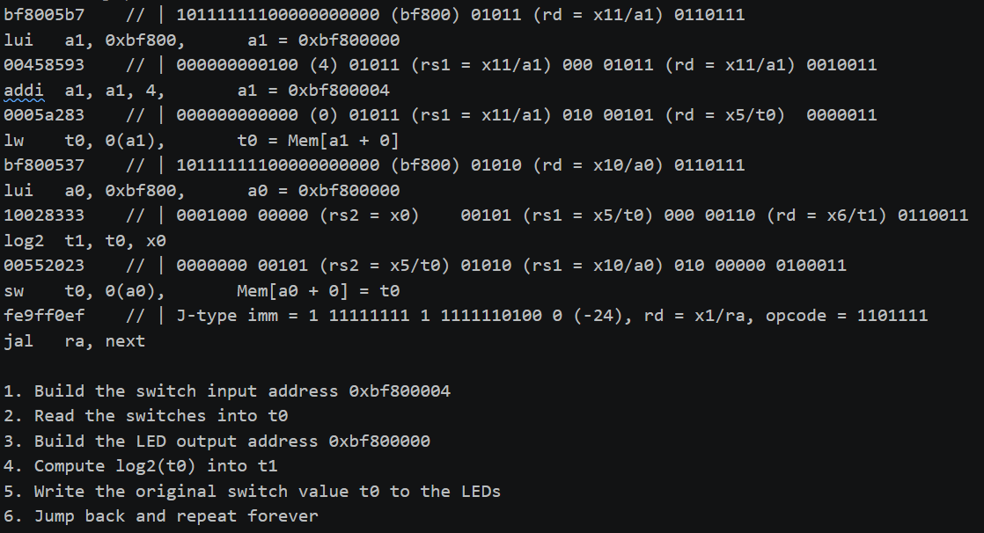
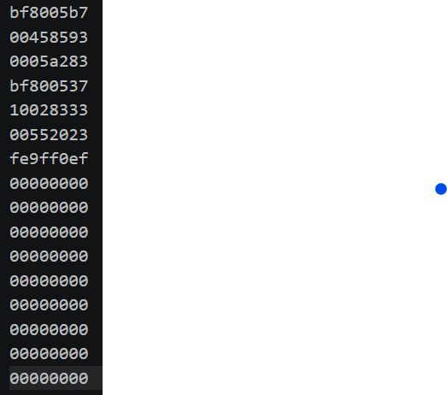
Simulation Testcase – SW2SEVENSEG

Slide 25
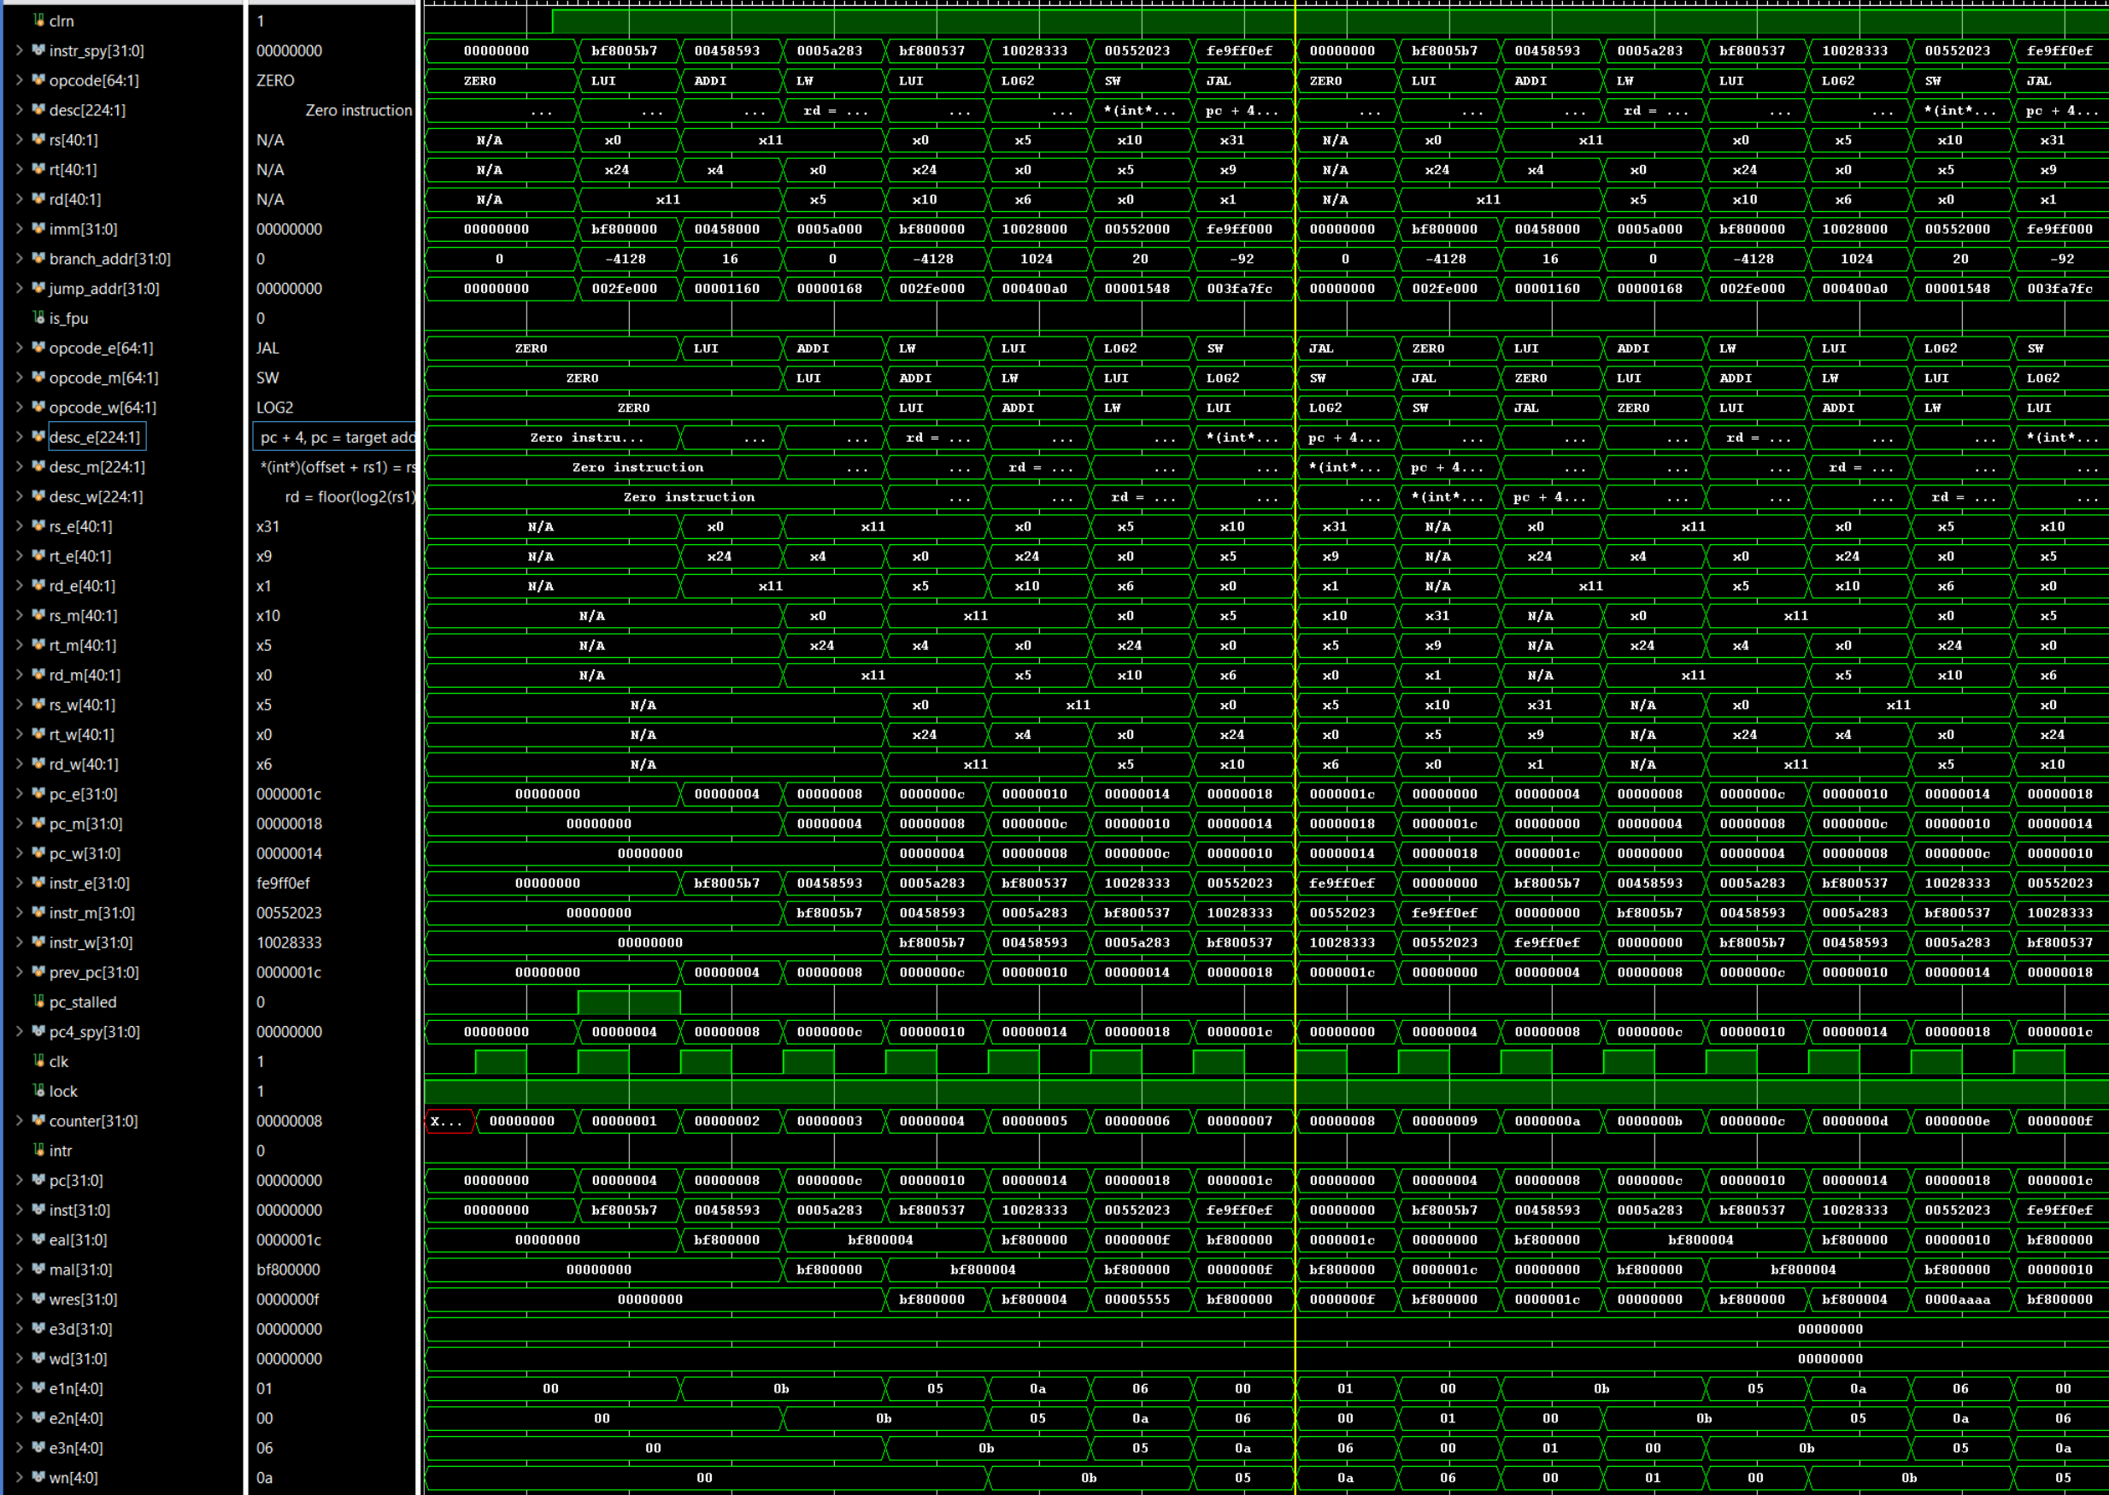
Simulation – LOG2 target module ( Top Level )

Slide 26
Simulation – LOG2 target module (LOG2 entity )

Slide 27
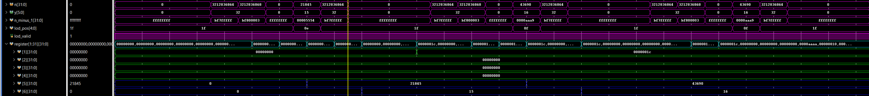
Simulation – LOG2 target module ( Register File)

Slide 28
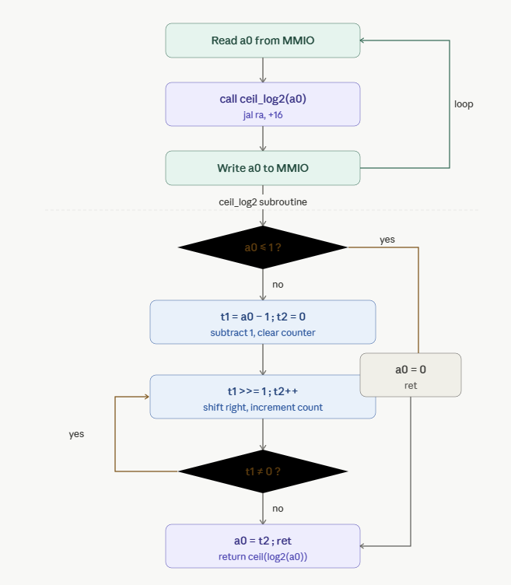
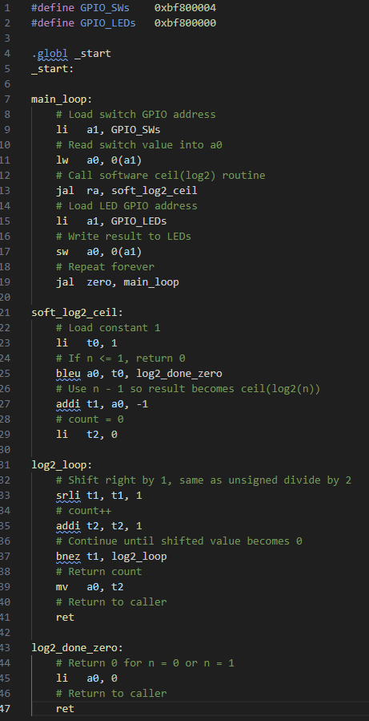
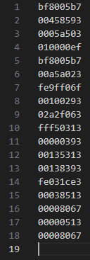
RISC-V Assembly Implementation of LOG2

Slide 29
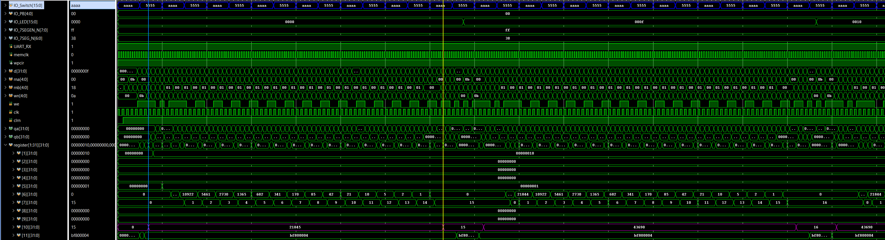




Simulation – RV32IM LOG2 Computation
$$ceil\left(log2(21845)\right)=15$$
$$Computation Time≈60 cycles$$
$$ceil\left(log2(43690)\right)=16$$
$$Computation Time≈64 cycles$$

Slide 30
Comparison
Implementation Type | Estimated Latency (# clocks)
FPGA Module | 1-2
RV32IM Software | ~ 4 x N (N = bit-width)
$$Speedup =\frac{\left(Software latency\right)}{(Hardware latency)}≈\frac{4∗N}{1}≈4N, N=minimum \# bits to represent the input$$
The software implementation of the log₂ operation has latency that scales with the magnitude (or bit-width)
of the input value. Specifically, the algorithm repeatedly shifts the input right until it becomes zero,
requiring up to N iterations for an N-bit operand in the worst case.
Therefore, the execution time increases linearly with input size.
In contrast, the custom FPGA implementation computes log₂ using a leading-one detector,
resulting in a fixed and constant latency independent of the input value.

Slide 31
Performance Comparison – SQRT
Introduction
RISCV Architecture Update
FPGA Implementation of LOG2 and SQRT
Performance Comparison between application specific module and standard RV32IM computation
LOG2
SQRT
Plan and Future Efforts

Slide 32
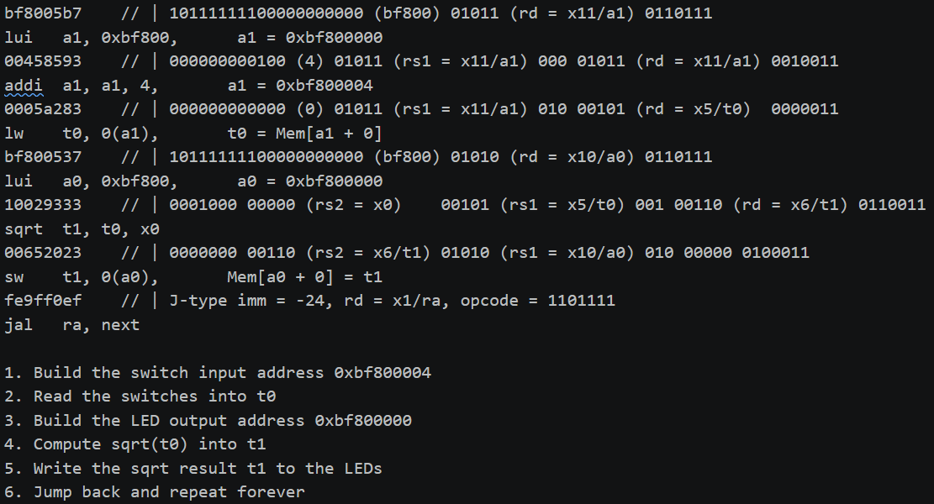
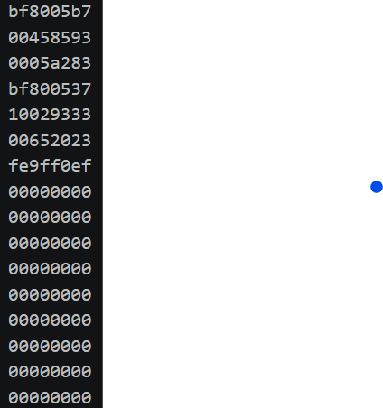
Simulation Testcase – SW2SEVENSEG

Slide 33
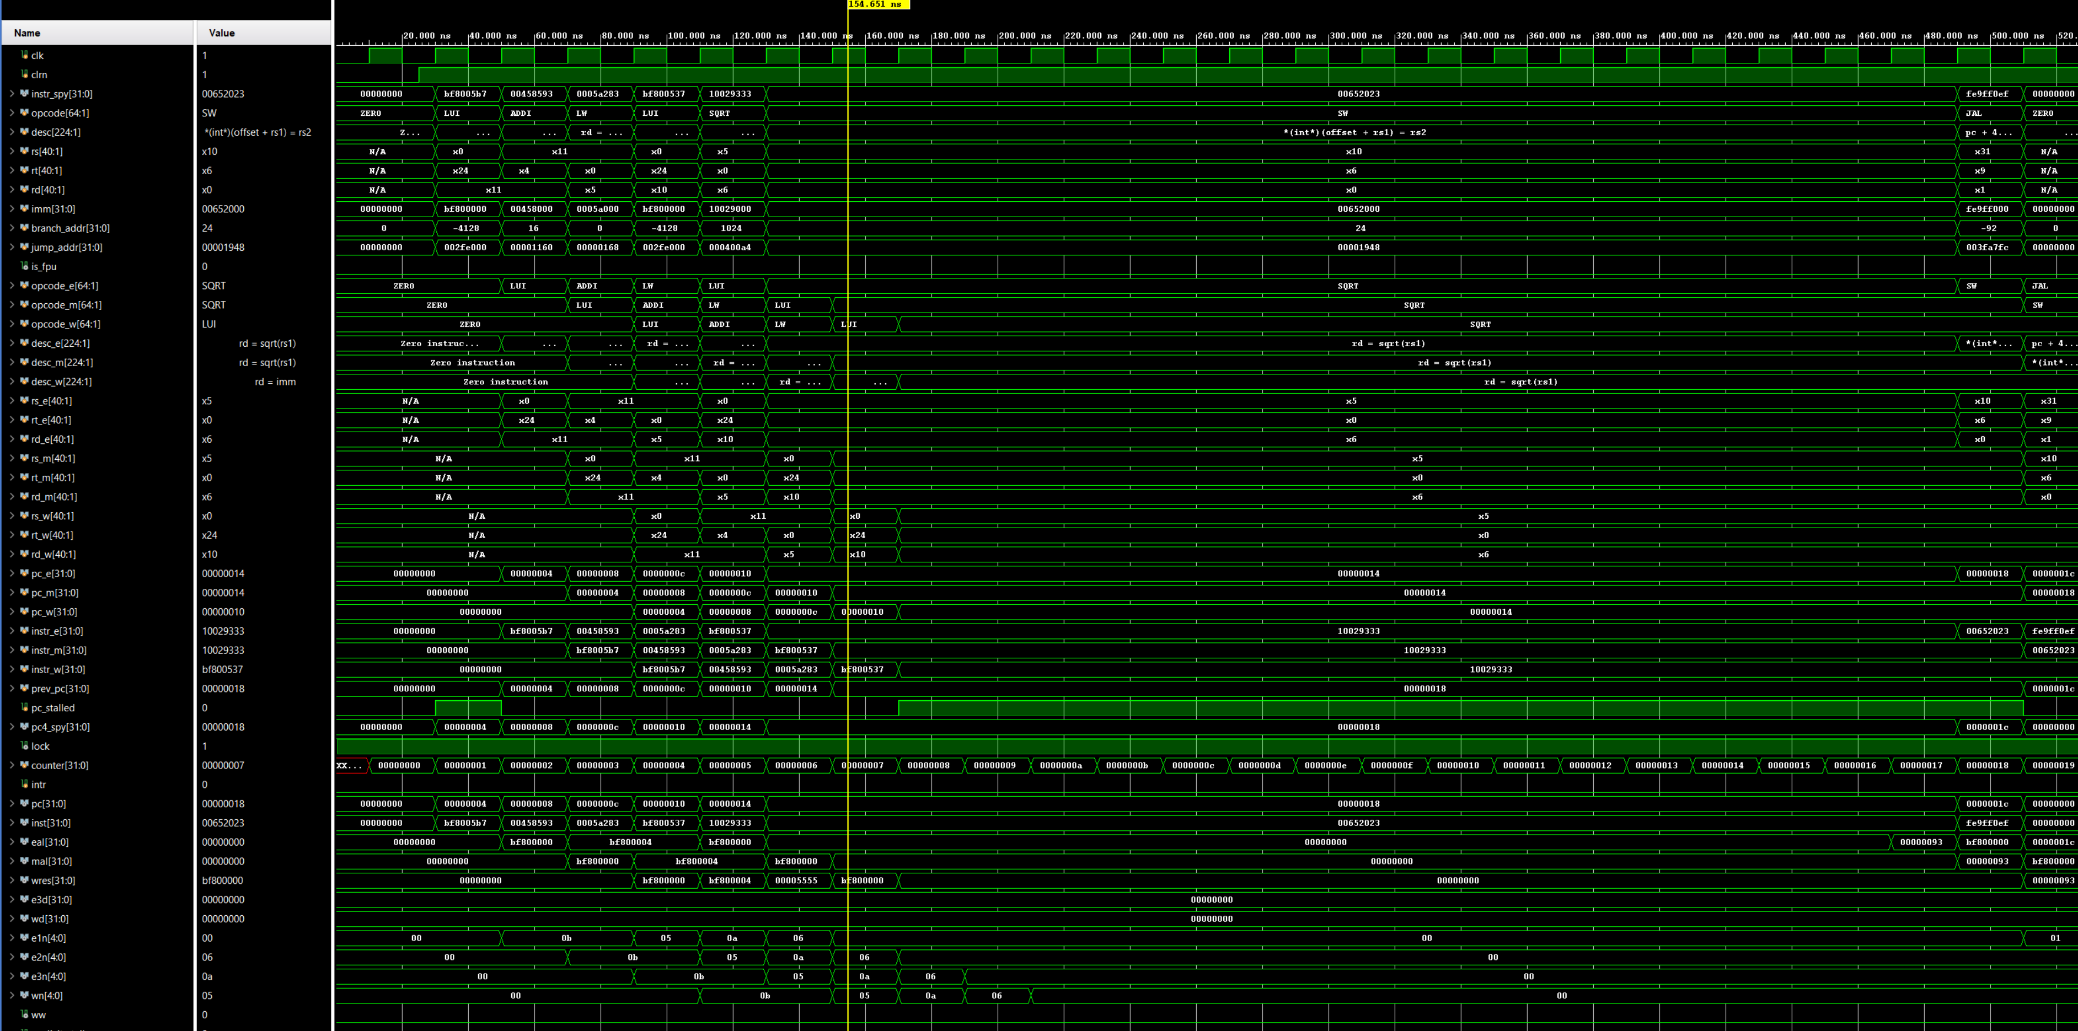
Simulation – SQRT target module ( Top Level )

Slide 34
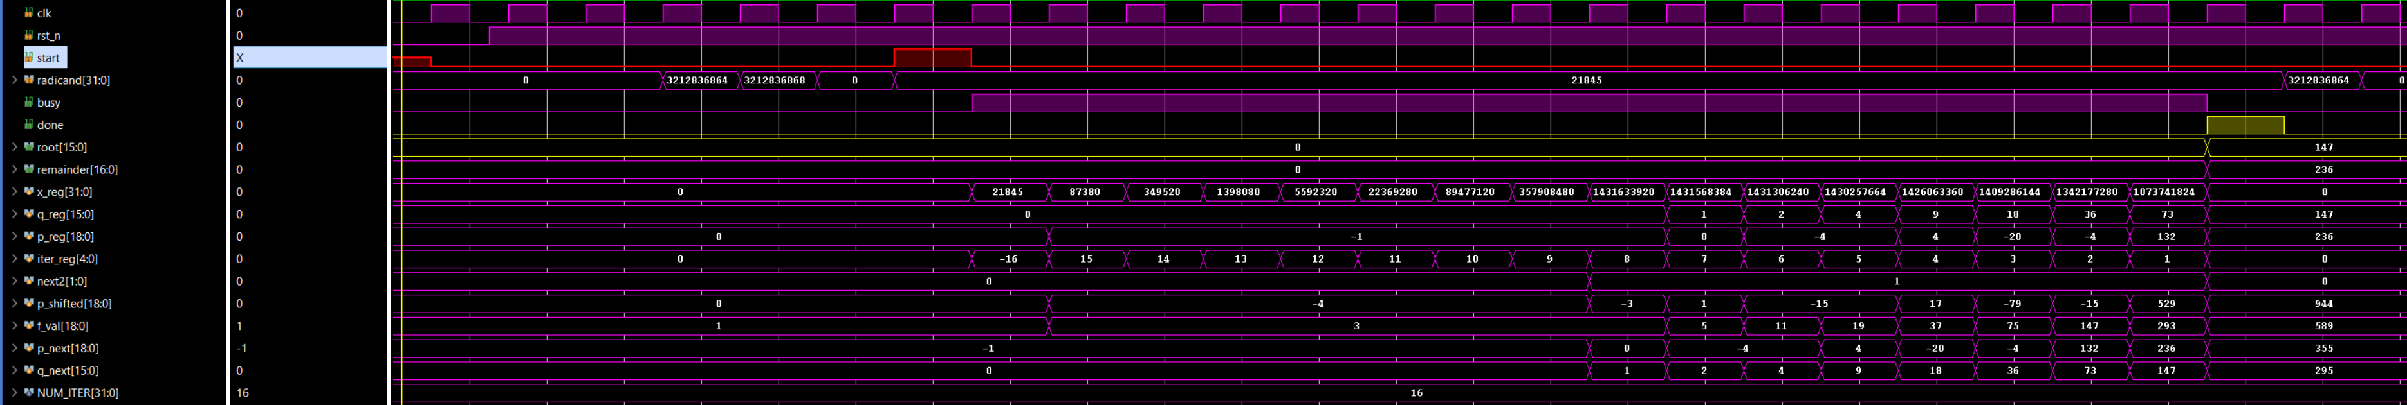
Simulation – SQRT target module ( SQRT entity )

Slide 35
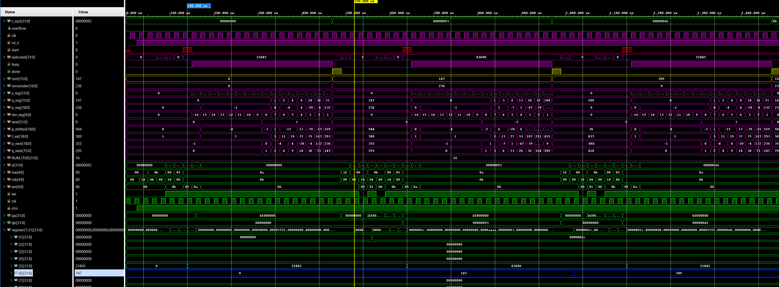
Simulation – SQRT target module ( Register File)
$$Computation Time=380 ns→\frac{380}{20}=19 clock cycles$$

Slide 36
SQRT Non-Restoring Square Root Algorithm

Slide 37

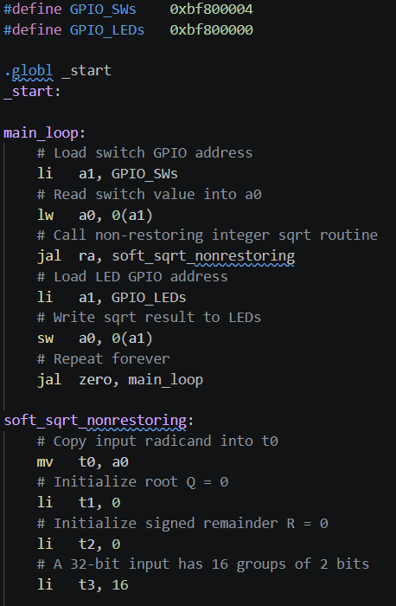
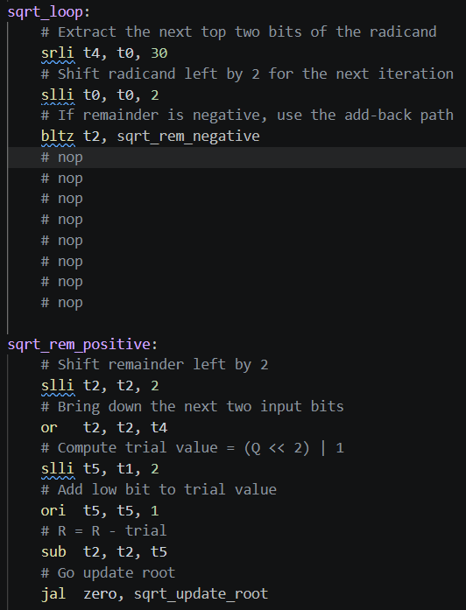
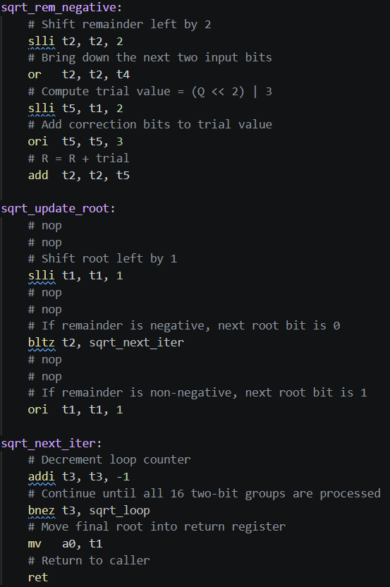
RISC-V Assembly Implementation of Non-restoring SQRT
Note: This implementation is a simplified version. It does not include the final remainder correction.

Slide 38


Simulation – RV32IM SQRT Computation
$$Floor\left(\sqrt{21845}\right)=147$$
$$Computation Time=5000 ns→\frac{5000}{20}=250 clock cycles$$
$$Floor\left(\sqrt{43690}\right)=209$$
$$Computation Time=5000 ns→\frac{5000}{20}=250 clock cycles$$

Slide 39

Comparison
Implementation Type | Estimated Latency (# clocks)
FPGA Module | 19
RV32IM Software | 250
$$Speedup =\frac{\left(Software latency\right)}{(Hardware latency)}≈13.2$$
The square root latency scales linearly with operand bit-width (≈ N/2 iterations for an N-bit input),
whereas the FPGA module has fixed latency, leading to increasing speedup for larger inputs.

Slide 40
Plan & Future Efforts
Introduction
RISCV Architecture Update
FPGA Implementation of LOG2 and SQRT
Performance Comparison between application specific module and standard RV32IM computation
LOG2
SQRT
Plan and Future Efforts

Slide 41
Plan and Future Efforts
Compiler Integration
Add sqrt and log2 support to compiler (intrinsics / auto-generation from C/C++)
Fixed-Point Support
Extend from integer to fixed-point arithmetic for DSP/real-world use
Pipeline & Hardware Optimization
Improve multi-cycle handling (stall/forwarding)
Optimize datapath and timing
Scalability & Extensions
Support wider bit-widths
Explore additional custom math instructions

Slide 42
Project Repository:
https://github.com/yzhou276/Computer-Architecture-Project

Slide 43
Reference
[An Efficient Implementation of the Non-Restoring Square Root Algorithm in Gate Level](https://www.ijcte.org/papers/281-G850.pdf)
[Parallel-array implementations of a non-restoring square root algorithm](https://ieeexplore.ieee.org/document/628940/metrics#metrics)
[Non-Restoring Algorithm for Square Root](https://digitalsystemdesign.in/non-restoring-algorithm-for-square-root/?srsltid=AfmBOooe-J1mTJxCGnhCMuo_kYEsorPiwPaaQxmiC2l5sYe-qcwxKrWD

