Slide 1




ROAM
A Retrieval-augmented Optimization Agentic Model for Spontaneous Trip Blueprint Generation
From "Wandering" to "Executable" — An Agentic Approach to Multi-Day Travel Planning
Authors
Ye Zihao (Team Leader) 59179849
| Lin Xiaoheng 59374250
Affiliation
City University of Hong Kong
Emails
ye.zihao@my.cityu.edu.hk,
xiaohelin2-c@my.cityu.edu.hk
Notes:
Good morning/afternoon, everyone. Today, we are excited to present our project, ROAM. Our core mission is to tackle a common modern-day problem: transforming a single, vague travel idea, like 'I want to explore Shanghai's art scene for a weekend,' into a fully-fledged, physically executable multi-day itinerary. We aim to bridge the gap between spontaneous desire and real-world feasibility.

Slide 2

Table of Contents
01
Background & Motivation
Exploring the dynamic travel planning landscape and identifying critical user pain points that current tools fail to address.
05
Core Methodology
Delving into the three pillars: Semantic Retrieval, Multi-Objective Optimization, and Natural Language Generation.
02
Problem Formalization (OUIP)
Precisely defining the Open-domain Urban Itinerary Planning problem with formal constraints and user-centric objectives.
06
Deliverables & UI Demo
Showcasing the functional prototype, including a user-friendly interface and real-world itinerary outputs.
03
Prior Works & Positioning
Contextualizing our solution against state-of-the-art academic research and mainstream commercial travel platforms.
07
Evaluation & Experimental Design
Presenting formula-driven metrics, baseline comparison, and five-component ablation study to validate the ROAM pipeline's effectiveness.
04
System Architecture Overview
A bird’s-eye view of the ROAM pipeline, highlighting its modular design and end-to-end workflow.
08
Summary & Future Work
Recapping key innovations and proposing exciting extensions, from multi-city planning to real-time adaptability.
Notes:
Here's a quick roadmap of our presentation. We'll start by setting the stage with the background and motivation. Then, we'll formalize the problem and position our work against prior research. The core of our talk will cover the system architecture and methodology. Finally, we'll discuss our evaluation plan, demonstrate our deliverables, and conclude with a summary and future outlook.

Slide 3




The Evolution and Dilemma of Travel Planning
01 The Evolution Timeline
1841 · Birth of Tourism
Thomas Cook's first group train trip began the era of organized travel.
1950s · Guidebook Era
Paper guides like Michelin became essential for navigation.
1990s · Digital Booking
Platforms like Ctrip moved travel reservations online.
2010s · UGC Overload
Social media flooded users, creating decision fatigue.
02 The Modern Dilemma: Desire vs. Reality
3–5 Hours to Plan
A simple weekend trip can take hours of tedious research.
The "Involution" Trap
Burnout from work leaves little energy for planning.
Spontaneity vs. Effort
People crave spontaneity but lack tools for instant trips.
Notes:
Let's take a step back. Travel planning has come a long way from Thomas Cook's first tour. Today, we're drowning in information. Planning a simple trip can feel like a part-time job, taking hours of research. This is especially true in our post-pandemic world, where 'involution' leaves us tired, but we still crave escape. This creates a huge tension: a strong desire for spontaneous travel, but a complete lack of efficient tools to make it a reality. This is the pain point we aim to solve.

Slide 4
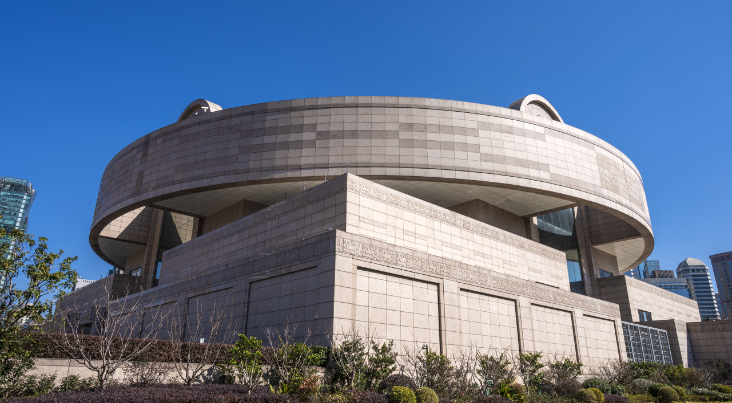



Why Existing Tools Fail
01. Search-Aggregation Platforms
02. LLM-Based Chatbots
Examples: Ctrip, Mafengwo
Limit: They showwhat’s popularbut fail to logically schedulewhen & howto visit, leaving gaps in the journey.
Examples: ChatGPT, Kimi
Limit: Generate grammatically plausible butfactually flaweditineraries that collapse in the real world.
The Three Systematic Failures of Pure LLMs
Spatial Cognitive Bias
Miscalculates real-world travel time (e.g., 8 km apart as "walking distance").
Disregard for Time Constraints
Schedules visits after closing hours (e.g., arriving at a museum at 5:30 PM).
Critical Knowledge Lag
Lacks real-time access to weather, closures, traffic, or holiday updates.
Notes:
So why can't we just use existing tools? Let's look at the two main options. Platforms like Ctrip are great for booking individual items, but they don't connect the dots into a logical schedule. On the other hand, AI chatbots like ChatGPT can write a nice-sounding itinerary, but they are prone to critical errors. Imagine this horror story: you follow a plan to a popular museum, only to find it's closed on Mondays, or you arrive just as it's shutting its doors. These aren't just minor inconveniences; they make the entire plan unexecutable. The core issue is that pure LLMs lack a grounding in the physical world's constraints.

Slide 5




Problem Formalization – Open-domain Urban Itinerary Planning (OUIP)
We formalize the task as generating afeasible, user-centric daily sequenceof urban activities from an open-domain natural language request, balancing practicality and personalization.
Input: Natural Language & Context
Output: Structured Daily Itinerary
Free-form query (e.g., "2 days in Shenzhen for culture"), number of days (D), and optional must-do constraints (e.g., "visit the museum").
A sequence I = {Day₁, Day₂, ..., Day_D}, each containing an ordered list of POIs with precise arrival/departure times and realistic travel routes.
Hard Constraints (Feasibility)
Soft Constraints (Quality)
1.Spatial:Adheres to real-world road network travel times (OSRM).
2.Temporal:Arrivals within POI opening hours.
3.Consistency:No time overlaps; full schedule fits daily limits.
1.Relevance:POIs match user's interest keywords.
2.Balance:Even distribution of activities across days.
3.Diversity:Mix of categories (food, culture, nature).
Notes:
To address this problem academically, we formalize it as the Open-domain Urban Itinerary Planning, or OUIP, problem. The input is a simple sentence and a number of days. The output is a day-by-day plan. The key is what makes a plan valid. We have hard constraints that are non-negotiable for real-world use: the plan must be spatially feasible, meaning travel times are accurate; it must comply with business hours; and the timeline must be consistent. Additionally, we aim to optimize soft constraints like matching user preferences and ensuring each day is not too busy or too light. This is essentially an NP-hard combinatorial optimization problem, which requires a sophisticated approach.

Slide 6



Prior Works and Our Positioning
ITINERA (Tang et al., 2024 – KDD UrbComp 2024 Best Paper)
A foundational work that first formalized the OUIP problem and proposed a complete pipeline (retrieval → clustering → TSP → generation). While groundbreaking, it has critical limitations that ROAM addresses for real-world applicability.
Multi-Day Adaptation
Hard Time- Window Feasibility
Category-Aware Dwell Times
ITINERA: Restricted to single-day itineraries
ROAM:Enables multi-day planning with smart cross-day load balancing to ensure balanced daily activities.
ITINERA: Uses soft, loose time estimates
ROAM:Implements hard time-window correction to guarantee minute-level schedule feasibility and eliminate conflicts.
ITINERA: Assumes fixed/arbitrary dwell times
ROAM:Adapts durations to POI categories (e.g., 2h for museums vs. 30min for viewpoints).
OUR GOAL:To extend the OUIP framework to solve real-world, multi-day travel planning challenges by rigorously addressing physical constraints and practical feasibility, making it truly useful for travelers.
Notes:
We stand on the shoulders of giants. The most relevant prior work is ITINERA, a fantastic system that laid the groundwork. However, ITINERA is designed for single-day trips and uses soft, estimated time constraints. This is where ROAM makes its breakthrough. We've extended the framework to handle multi-day trips with intelligent load balancing. Most importantly, we've replaced soft time estimates with a hard time-window correction algorithm that ensures every single POI visit is feasible down to the minute. We're not reinventing the wheel; we're fixing its critical flaws to make it suitable for real-world, multi-day travel.

Slide 7
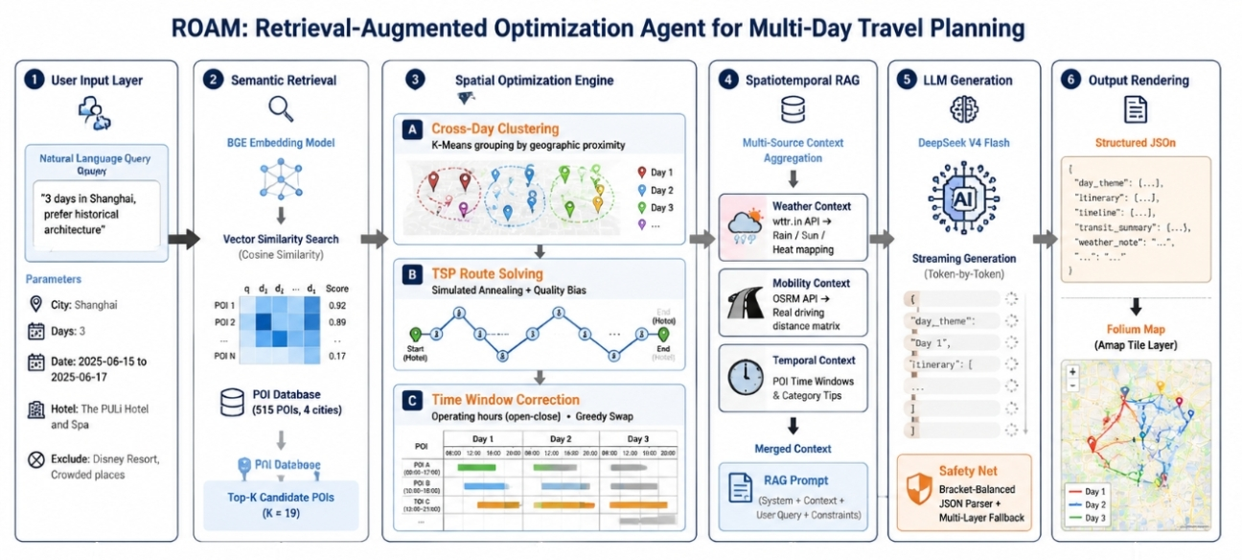
ROAM System Architecture – Six-Stage End-to-End Pipeline
Notes:
This is the high-level architecture of ROAM, a three-stage pipeline. It all starts with semantic retrieval, where we understand the user's intent and find matching places to visit. The magic happens in Stage 2, our Spatial Optimization Engine. Here, we use a combination of clustering, a TSP solver, and our novel time-window correction to create a physically feasible route for each day. Finally, in Stage 3, we use a spatiotemporal RAG approach to enhance an LLM, which then generates a polished, human-readable itinerary and interactive maps. This pipeline ensures a closed loop from understanding a user's vague idea to producing a plan they can actually follow.

Slide 8
External Tool Integration & Fallback Strategy
01.wttr.in
Purpose: Global weather forecast & alerts
Invocation: Simple HTTP GET requests
Fallback: Generate plan without weather context
02. OSRM Routing
Purpose: Real-time driving time & distance
Invocation: Open-source routing engine API
Fallback: Haversine formula (straight-line)
03. Amap API
Purpose: Geo-coding, ratings & map tiles
Invocation: RESTful JSON API endpoints
Fallback: Pre-cached data & static maps
04. BGE-small-zh
Purpose: Semantic embedding for POI search
Invocation: Sentence-Transformers library
Fallback: Local lightweight embedding model
05. DeepSeek LLM
Purpose: Intent parsing & plan generation
Invocation: OpenAI-compatible API
Fallback: Ollama-hosted local LLM (Llama3)
🛡️ No Single Point of Failure
The system architecture ensures graceful degradation. Core planning functionality persists even if multiple external services experience downtime simultaneously.
Engineering for Reliability:By designing granular fallbacks for every dependency, ROAM evolves from a research prototype into a robust, production-ready application that you can trust to work when you need it.
Notes:
A key aspect of building a real-world system is handling failures. ROAM integrates several external tools, from weather APIs to routing engines. As this table shows, we've designed a fallback strategy for each one. If the weather API is down, the plan is still generated, just without weather tips. If the routing engine fails, we use a simpler distance calculation. This level of engineering ensures that ROAM is a robust, reliable application, not just a fragile research prototype.

Slide 9
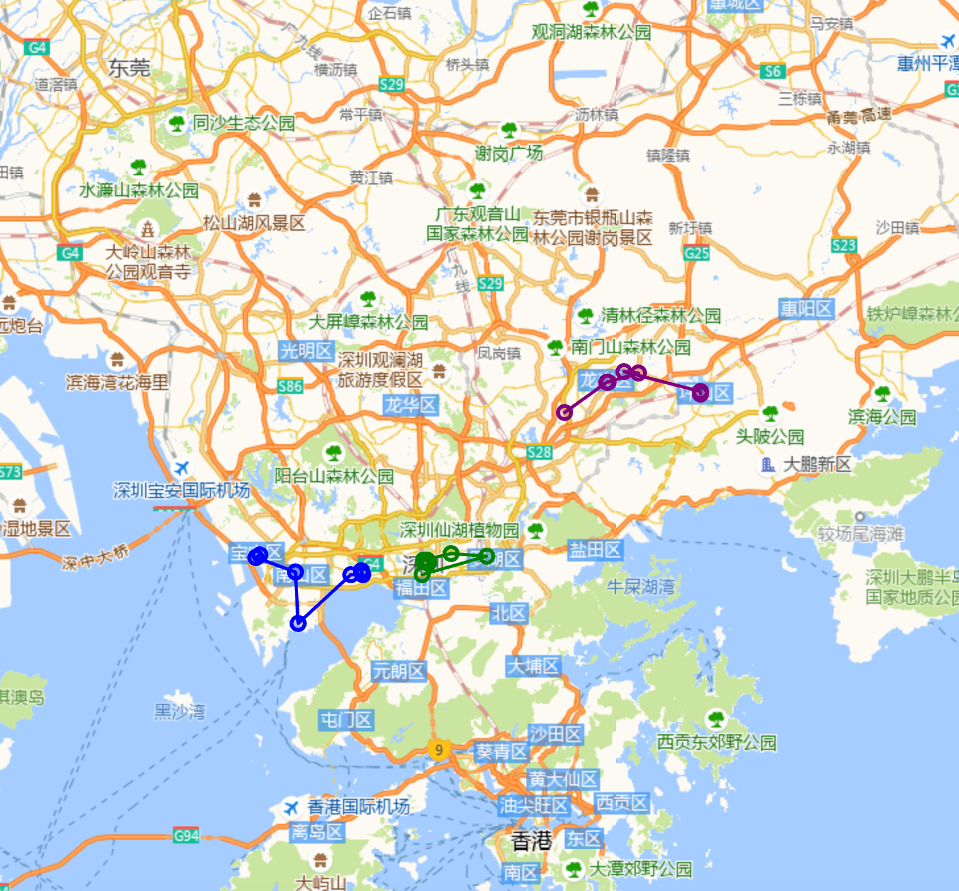


Output & Visualization
01. Structured JSON Itinerary
A machine-readable blueprint encapsulating all trip specifics: daily thematic focuses, comprehensive POI data (coordinates, timing, and transport modes), a chronological timeline, and weather-aware recommendations for seamless third-party app integration.
02. Interactive HTML Maps (Folium + Amap)
Dynamic, browser-native maps featuring color-coded full-trip overviews and detailed day-by-day navigation. Each location marker is interactive, revealing rich POI details and turn-by-turn paths—fully exportable for offline use.
Live Preview: Interactive Map with Geocoded POIs & Route Visualization
Notes:
So, what does the user actually get? Two key outputs. First, a structured JSON file that contains every single detail of the plan in a machine-readable format. This is perfect for integration with other apps or services. Second, and more importantly for the end-user, a set of interactive HTML maps. There's an overview map to see the big picture, and a detailed map for each day. These maps are not just static images; they are interactive, showing the exact route and allowing users to click on points for more information. This is a truly usable, downloadable product.

Slide 10
EVALUATION & EXPERIMENTAL DESIGN
◆ Metrics (Formula-Driven)
Dimension
Formula
Target
Spatial Reasonableness
(LLM Route − TSP Opt) / TSP Opt
Lower is better
Time Compliance Rate ⭐
On-time POIs / Total POIs
100% (hard constraint)
Semantic Matching
cos(user_emb, poi_emb)
Maximize alignment
◆ Baseline: Full ROAM vs. Bare LLM (no retrieval / no optimization / no RAG)
◆ Ablation Study (Five Variants — One Component Removed Each)
w/o Retrieval
w/o Time-Window
w/o RAG Context
w/o Quality Bias
Random POI selection
w/o Spatial Optimization
Raw LLM order
(no routing)
Skip hours
constraint
No real-time
weather/road
No rating
weighting
→ tests relevance
→ tests efficiency
→ tests feasibility
→ tests adaptability
→ tests preference
Key Hypothesis: Time-Window Correction and Spatial Optimization yield the largest gains.
📦 Code: https://github.com/yzhzy12321/travel-agent/
Notes:
How do we know ROAM works? We've defined three clear metrics. First, 'Spatial Reasonableness' measures how much extra travel our system saves compared to a naive approach. Second, 'Semantic Matching' ensures the plan is relevant to what the user asked for. But the most important metric is 'Time Compliance Rate'—the percentage of POIs that are visited on time. This is the true measure of whether a plan is executable. Our goal is to achieve a compliance rate as close to 100% as possible.

Slide 11








Summary & Future Work
CORE CONTRIBUTIONS
FUTURE DIRECTIONS
FirstEnd-to-End Agentfor multi-day short-trip planning, ensuring comprehensive coverage of user needs.
Global Scale:Expand coverage to thousands of cities and integrate diverse, hyper-local POI databases.
NovelHard Time-Window Correctionguaranteeing minute-level feasibility for real-world execution.
Dynamic Re-planning:Real-time itinerary adjustments reacting to live events, weather, or traffic.
InnovativeThree-Stage Pipelinethat bridges abstract semantic intent with physical travel constraints.
Personalization Loop:A closed-loop system that learns from user feedback to refine future suggestions.
Drastic efficiency gain: Compresses3–5 hoursof manual effort into justminutes.
“ROAM transforms spontaneous travel dreams into actionable, stress-free reality — turning ‘I want to go on a whim’ into an instant, intelligent plan.”
THANK YOU & Q&A
Notes:
To summarize, ROAM is a complete end-to-end solution for automated travel planning. Our key innovation is the hard time-window correction that guarantees a usable plan. By compressing hours of work into minutes, we're making spontaneous travel a reality. Looking ahead, we aim to scale to more cities and add dynamic re-planning capabilities. In short, ROAM turns the dream of a last-minute getaway into a practical possibility. Thank you, and we're happy to answer any questions.

