Slide 1
VLA-R3L : achieving performant robotic generalist policy in real world via reflective residual reinforcement learning
Yan Ziming
2026/02/27

Slide 2
DSRL Reproduce I:
Overview:
Evaluate the performance of dsrl with different tasks in simulation. (ref: https://github.com/ajwagen/dsrl)
Workflow:
Environment Setup: Intergrating robomimic with dppo
Load Pretrained Model: Loading the official checkpoints (Lift, Can, Square) to initialize action trunck.
Training: Executing DSRL-based Reinforcement Learning to optimize the pre-trained policy

Slide 3
Obstacles:
MuJoCo & Dependency Conflicts
Legacy mujoco-py requirements in the DSRL source code conflicted with modern environments. Automated installation triggered recursive build errors.
Solution: Decoupled MuJoCo installation.
2. The "Square Task" Performance Paradox
Since the pretrained checkpoint loading, the training time for model converging should be much shorter than training diffusion model. However, during the first 800,000 steps, the Success Rate for square task remained near 0 (<0.1)

Slide 4
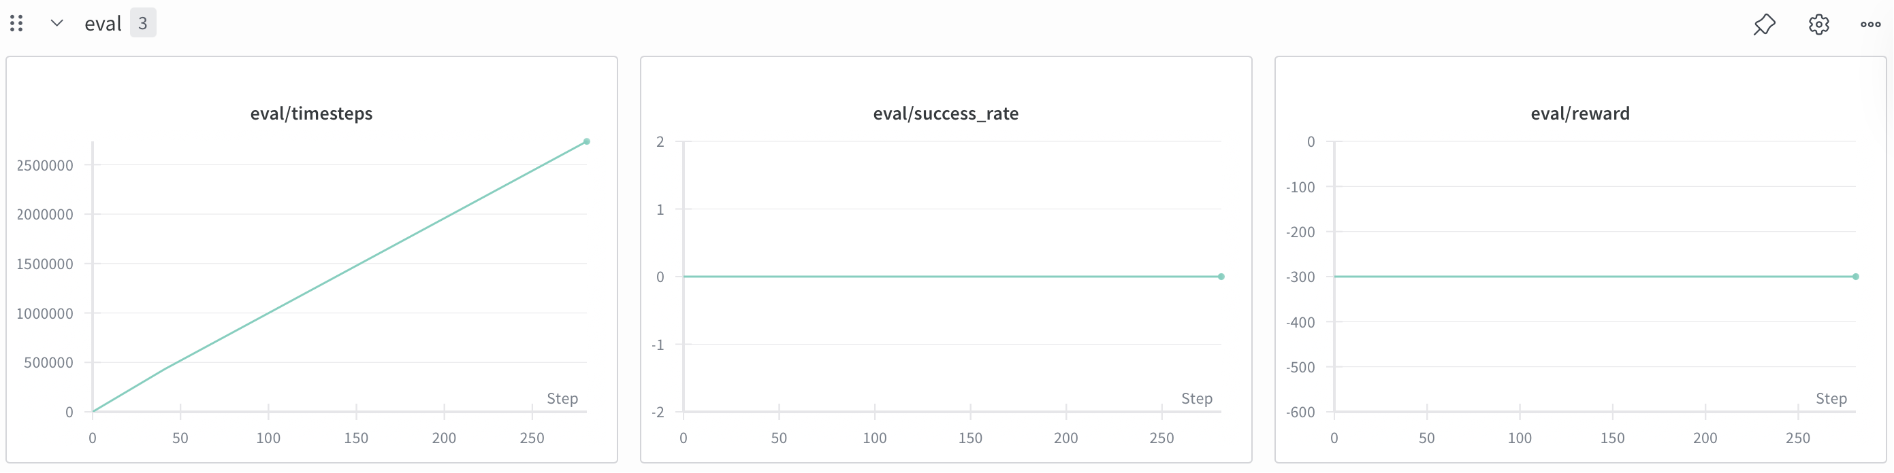
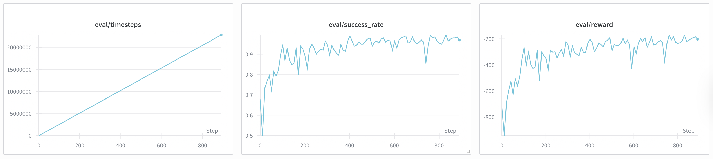
Cont’d
Solution: Increase max_steps from 300 to 1600. The success rate surged to about 0.9, proving the model's underlying policy was correct but prematurely truncated.

Slide 5
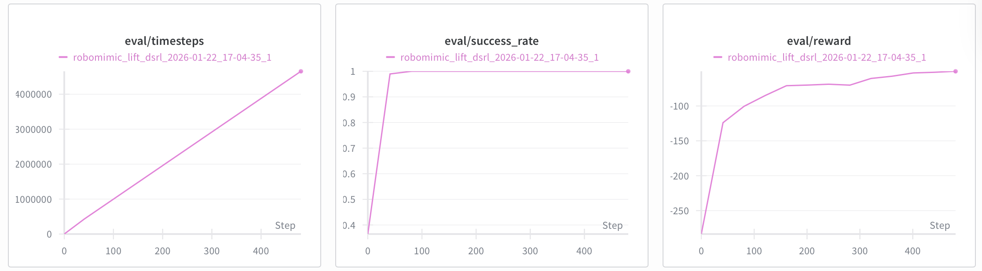
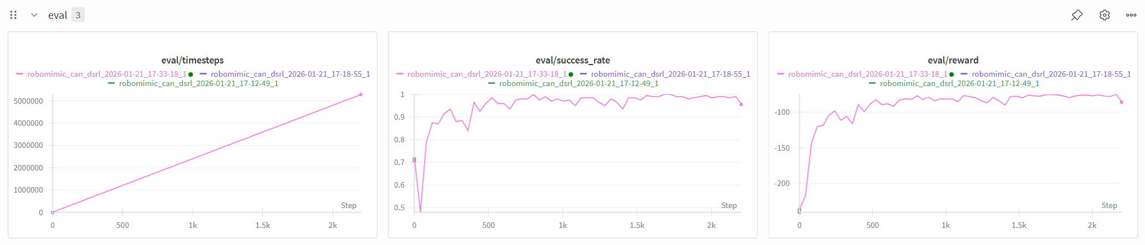
Lift Task Performance:
Can Task Performance:

Slide 6
DSRL Reproduce II:
Overview:
In paper, researchers adapt the idea based on diffusion to the flow matching, successfully combined the dsrl with vla mode, pi0. (ref: https://github.com/nakamotoo/dsrl_pi0). I tried to evaluate the model performance.
The pi0 is embedded on libero environment and the model is trained by libero benchmark.

Slide 7
Limitation of Origin Code:
The default script treated libero_90 as whole block and required manual configuration for individual tasks, making the running task plan complex and cannot differentiate model performance across various complexity (eg. spatial, semantic)
Solution: Optimize the run.sh script to evaluate suite by suite (spatial, object, goal, long) and aggregate the performance of tasks in same suite into one group shown in wandb, convinient to analyze the model ability with comparing output of different suite.

Slide 8
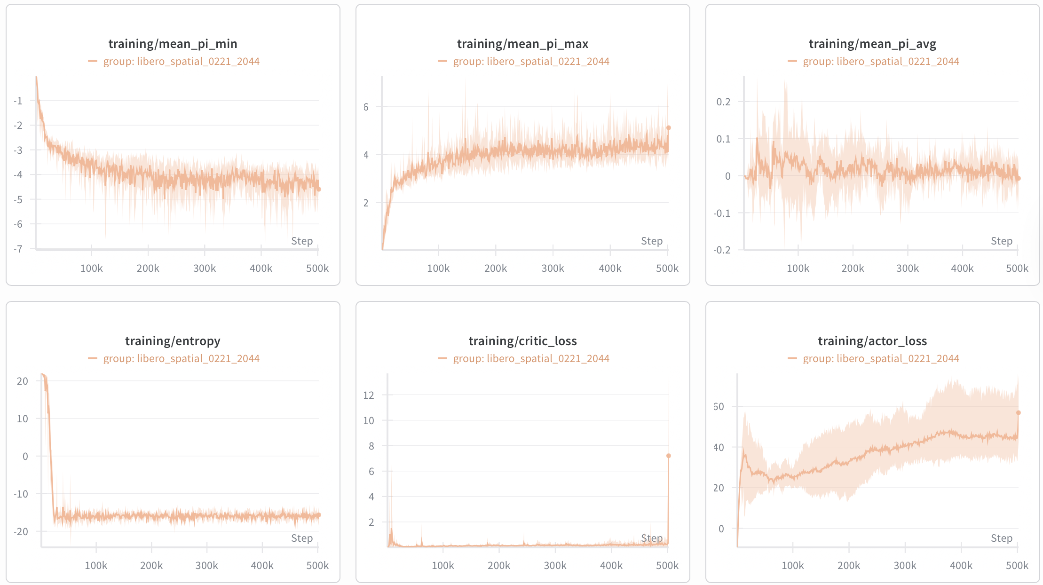
Training Losses 1

Slide 9
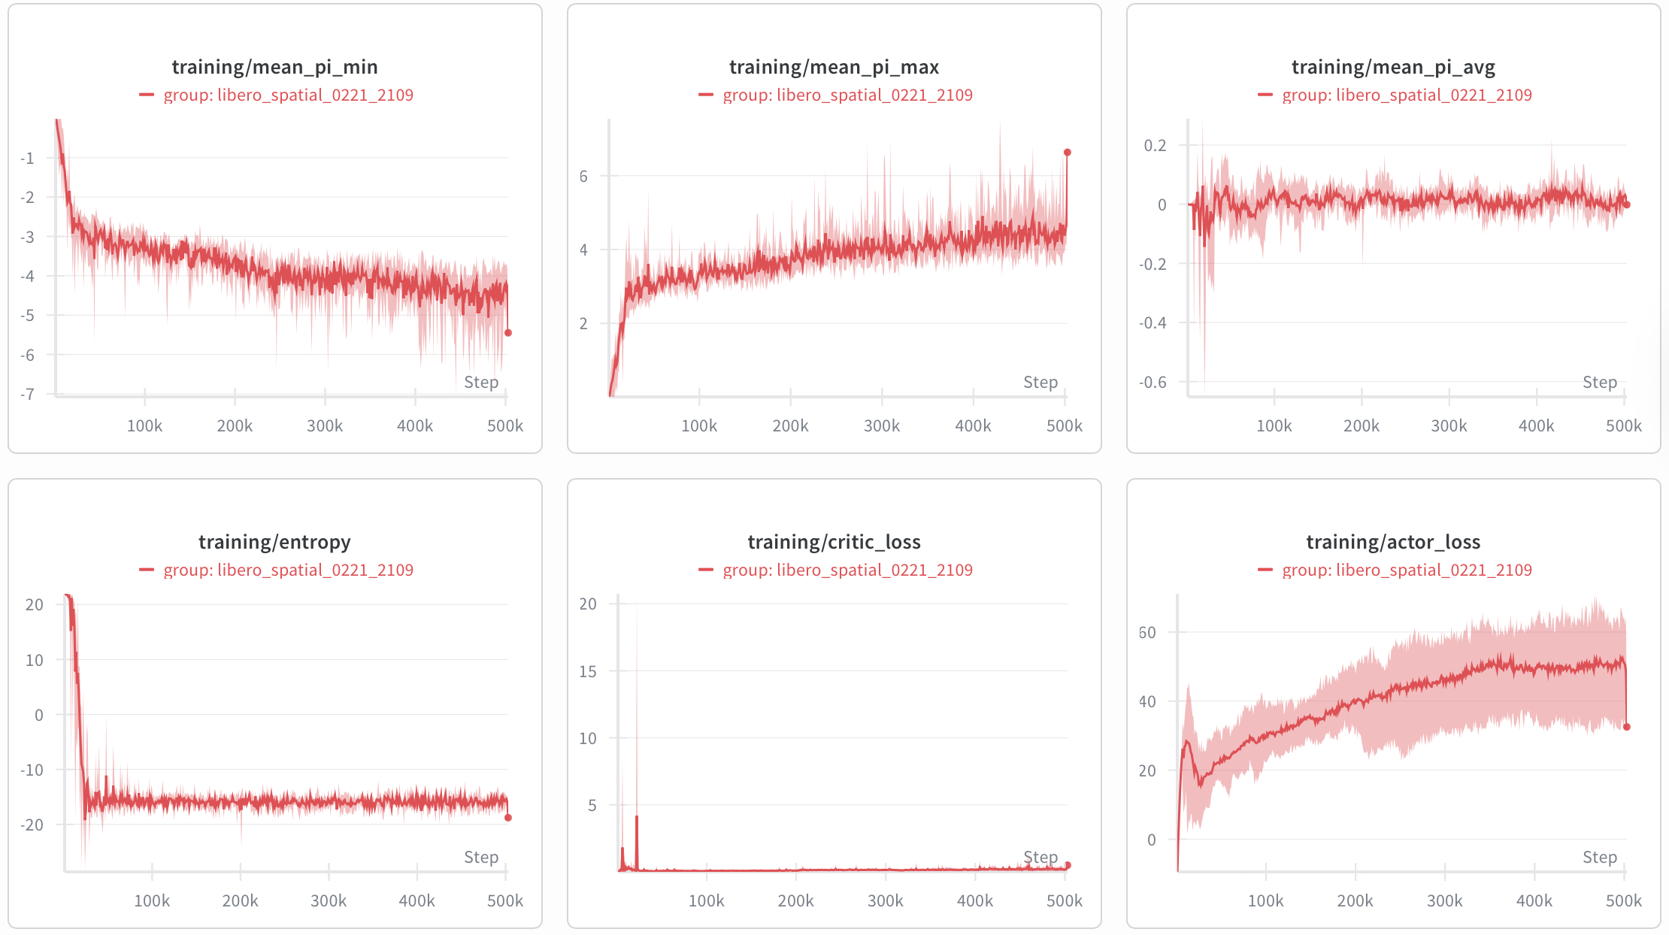
Training Losses 2

Slide 10
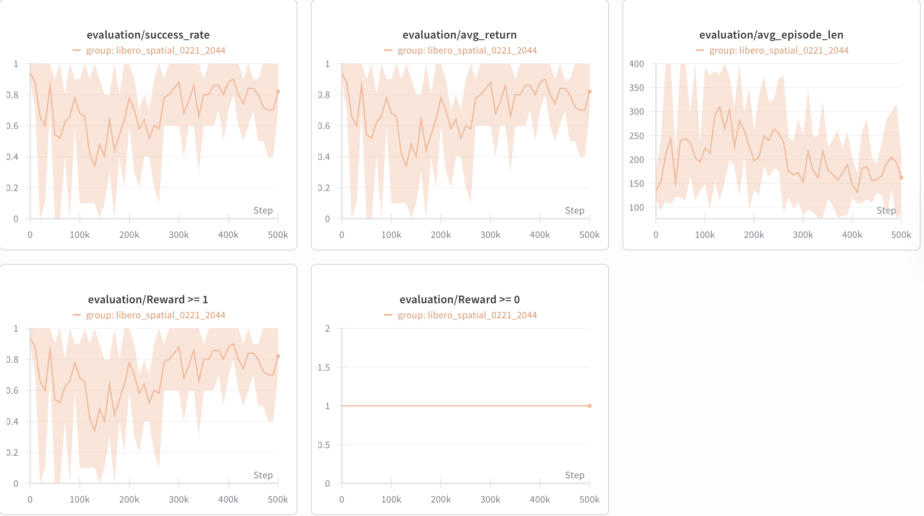
Evaluation 1

Slide 11
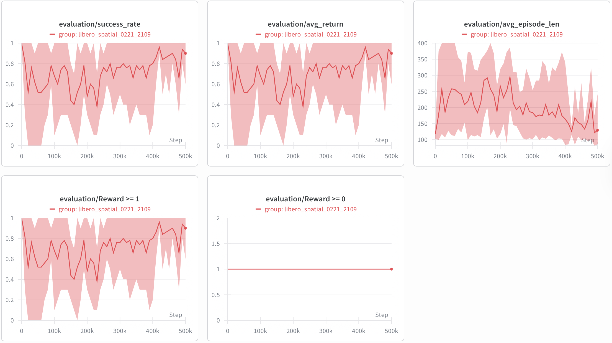
Evaluation 2

Slide 12
Analysis & Process:
Have finished the training of spatial suite and object suite is in processing.
The eval_success didn’t converge well, even though the training loss seems converged. This may related to two parameter:
eval_episode: default 10
multi_grad_step: default 20
Small episode cannot avoid chance effect.
Gradstep may be too big for simple tasks (need to check by comparing with goal/long tasks)

Slide 13
