Slide 1
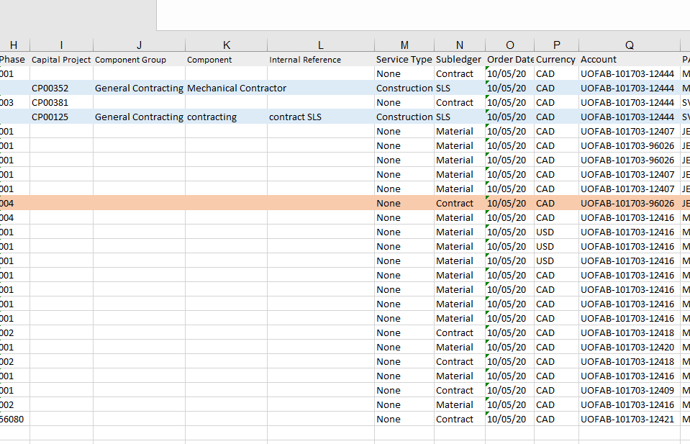
For CPPM line, use column M as either “construction” or “consultant”; use column N as CPPM type
For non-CPPM line, must be ‘material’ or ‘contract’

Slide 2
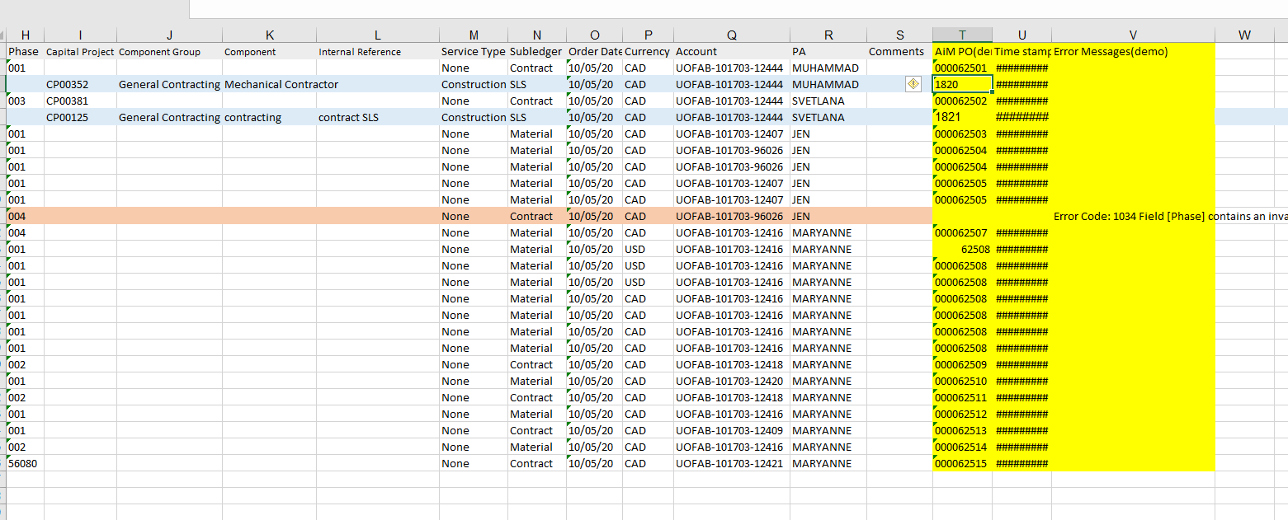
This will be the contract id

