Slide 1
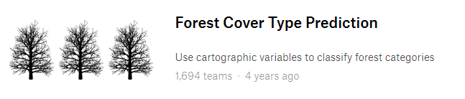

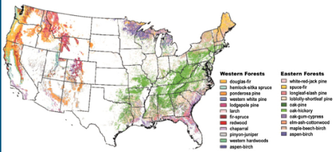
Forest Cover Type Prediction
Chloe Wu, Erik Hou, Adam Sohn, Curtis Lin
Notes:
Hello W207. I’m Adam Sohn on behalf of my teammates Chloe Wu, Erik Hou, and Curtis Lin. Our project is to use Machine Learning with cartographic variables to predict Forest Cover Types.

Slide 2
Motivation - Aid conservation efforts
Forests are 740 million acres of United States ~ one third of total land.
Forests are homes for a myriad of species.
Forests can be strengthened by sustainable usage and weakened by wildfire and development.
Developing an machine learning-based forest classification tool provides conservationists a tool to leverage minimal data to better characterize the environment.
Notes:
The motivation for the analysis is to aid conservation efforts.
Forests are an important part of the landscape of the United States and house much bioversity.
Conservationists focus on ensuring nature is conserved.
We can help. We can develop a machine learning-based forest classification tool that will help conservationists understand cover types based on minimal feature data about the landscape.

Slide 3
Data analysis plan
Raw data
EDA / Data Clean
Baseline analysis (7 models)
Model selection (Best 3 models)
Feature engineering (categorization)
Feature engineering (feature reduction)
Bagging
Bagging
Hyper-parameter tuning
Hyper-parameter tuning
Performance improvement (comparison to baseline)
Performance improvement (comparison to baseline)
Final Model selection (Best 2 models)
Error analysis
Feature engineering (focus on soil features)
Performance improvement (comparison to baseline)
Test_data prediction for Kaggle submission
Notes:
The analysis plan begins by getting to know the data by EDA and cleaning the data to be functional in a Machine Learning model.
Then a baseline analysis is performed to note the relative performance of some common classifier varieties.
CLICK
Choosing the top 3 performing models, there are 2 different avenues of feature engineering that are attempted to improve performance.
The avenue on the left is to pursue Feature Engineering based on Feature Categorization. Then, attempts at improvement are made by Bagging and hyperparameter turning. Dissapointed in the results, attempts were made to add soil features.
The avenue on the right is to pursue Feature Engineering based on Feature Reduction. Then, attempts at improvement are made by Bagging and hyperparameter turning. This path gave better results.
CLICK
Then performance is graded w/ the Kaggle submission.

Slide 4
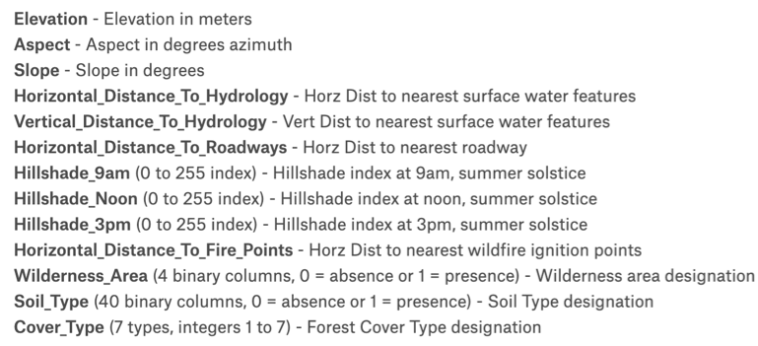
EDA
Continuous
Discrete
Notes:
For EDA, each feature was pored over for comprehension, identification of data distribution, correlations, and ability to differentiate over cover types.

Slide 5

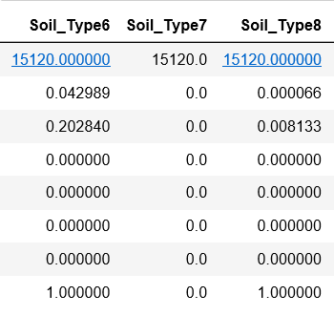
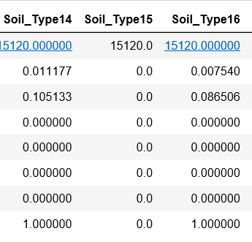


Data Clean
Sequential
No data
No data
Notes:
In Data Cleaning, Soil_Type7 & 15 are removed for lack of training data. This keeps models concise.
We wanted to include ID, as it could be a key to random order, however felt it could only serve as a source of error as the rules of assignment are unknown and not necessarily consistent between datasets.

Slide 6
Baseline Analysis
Classifier | Accuracy
Support Vector Machine (SVM) Un-normalized | 0.8488
Random Forest | 0.8208
Decision Tree | 0.7923
K-Nearest Neighbors | 0.7919
Logistic Regression | 0.6759
Support Vector Model (SVM) Normalized | 0.6232
Gaussian Naive Bayes | 0.5983
Minimal hyperparameter tuning & no Feature Engineering
Notes:
With minimal adjustments and no feature engineering, the top 3 performing classifiers are shown in the green box.

Slide 7
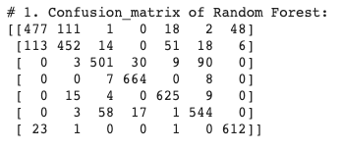
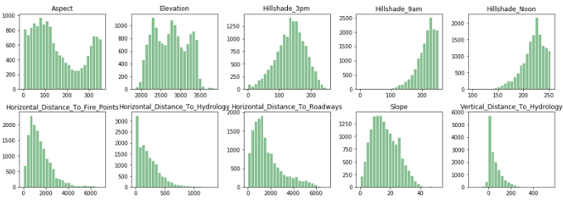
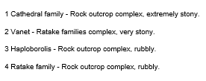
Feature Engineering - Categorization
Error Analysis
Adding Features
Soil Features
Improvement (Max delta)
Random Forest: 0.8208 (baseline) -> 0.8302 (no bagging) -> N/A (w/ bagging) -> 0.8543 (w/ hyperparameter tuning)= + 3.35%
SVM: 0.8488 (baseline) -> 0.8492(no bagging) -> 0.8415(w/ bagging) -> 0.8611 (w/ hyperparameter tuning) = + 1.23%
Decision Tree: 0.7923 (baseline) -> 0.7897(no bagging) -> 0.8646 (w/ Adaboost) -> 0.8560 (w/ hyperparameter tuning) = + 7.23%
Notes:
Following the categorization path, Aspect and Elevation showed potential to be broken into 3 bucketed categories as shown by red boxes. This did offer some improvement.
CLICK
Error analysis then shows there is a confounding issue between Cover Types 1 and 2.
CLICK
Attempting to correct this, the soil types were further featurized based on their descriptions. This did not offer any improvement.
As you can see below, at the end of the process, Decision Tree, w/ AdaBoost was the highest performer, increasing 7 percentage points to 85.6%

Slide 8
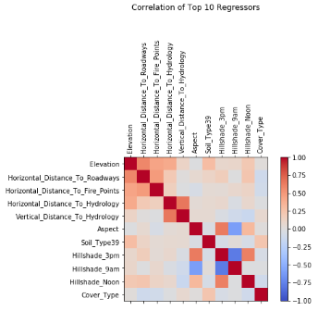
Feature Engineering - Feature Reduction
'Horizontal_Distance_To_Hydrology'
'Vertical_Distance_To_Hydrology'
'Aspect'
‘Slope'
'Hillshade_9am'
'Hillshade_Noon'
'Hillshade_3pm'
'Distance_To_Hydrology'
1-component PCA
'Shade’'
1-component PCA
Improvement (Max delta)
Random Forest: 0.8208 (baseline) -> 0.8781 (no bagging) -> N/A (w/ bagging) -> 0. 8796(w/ hyperparameter tuning)= + 5.88%
SVM: 0.8488 (baseline) -> 0.8479 (no bagging) -> N/A(w/ bagging) -> 0.8479 (w/ hyperparameter tuning) = - 0.09%
Decision Tree: 0.7923 (baseline) -> N/A (no bagging) -> 0.8805(w/ Adaboost) -> 0.8814(Adaboost w/ hyperparameter tuning) = + 8.91%
Notes:
Instead of the categorization path, the feature reduction path leverages the correlations between hydrology vectors in green and shade vectors in blue.
CLICK
1-component PCA gave the best results, with Decision Tree still showing best performance, increasing almost 9 percentage points to 88.14%

Slide 9
Hyperparameter Tuning
Classifier | Baseline | After Tuning
Random Forest | 0.8208 | 0.8796
Decision Tree w/ AdaBoost | 0.7923 (no AdaBoost) | 0.8814
Hyperparameter Modified:
Modified # of estimators, Max depth, Learning Rate
Notes:
For hyperparameter tuning, shown is the improvement of the leading classifiers compared to original baselines. For the hyperparameters, estimator count was modified, as well as max depth and learning rate.

Slide 10
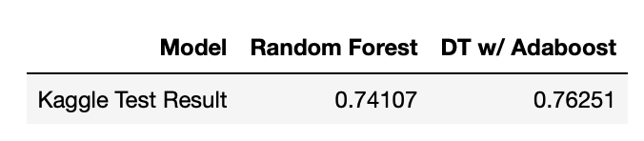
Kaggle Submission
Notes:
The Kaggle submission was a marked drop in accuracy, which is suspected to be due to overfit issues as the train data was uniformly representing each cover type.

Slide 11
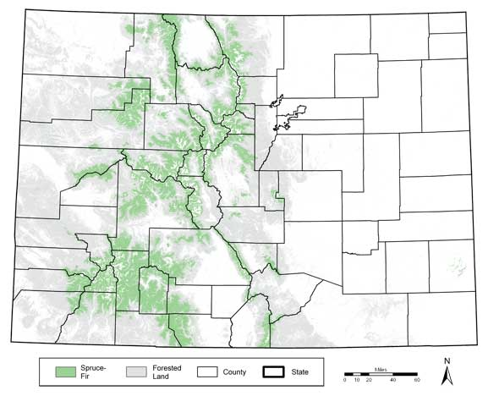
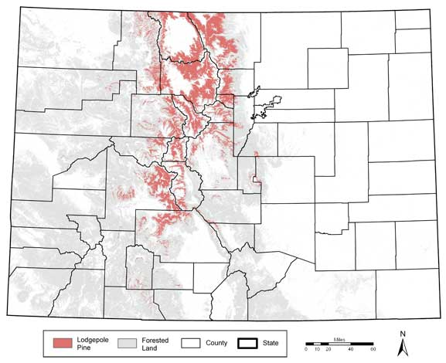
Conclusion
Random Forest and Decision Tree were optimal due to their abilities to navigate complex decision boundaries.
Still, classifiers had difficulty disambiguating Cover Type 1 & 2.
Next recommended steps are:
Address possible over-fit
Modify training data set
change train/dev %, perhaps eliminate dev set for final step.
ensemble learn w/ split training set
Seek location data such as latitude and longitude
Cover Type 1
Cover Type 2
Notes:
To conclude, Random Forest and Decision Tree were the top performers due to their abilities to navigate complex decision boundaries.
Still, cover types 1 and 2 were difficult to disambiguate.
Next steps recommended for this analysis would be to address the possibility of an overfit, change treatment of training data, and seek additional features to increase correlations.
Thank you

