Slide 1
W200 - Python for Data Science
Topic 4:
More About Control and Algorithms
updated Sept 21, 2018

Slide 2
Course Content | First 8 Weeks - Programming
Unit 1 | Introduction, the Command Line, Source Control
Unit 2 | Starting Out with Python
Unit 3 | Sequence Types and Dictionaries
Unit 4 | More About Control and Algorithms
Unit 5 | Functions
Unit 6 | Modules and Packages
Unit 7 | Classes
Unit 8 | Object-Oriented Programming

Slide 3
Week 4 | Agenda
Week 2 Assignment Review Week 3 Assignment Discussion Pseudocoding & Algorithms - Activity 1 For Loops vs. While Loops - Activity 2 Exiting Loops Early Comprehensions - Activity 3
Some of the main points include
(1) iterators vs. loop;
(2) the importance of pseudocoding, and
(3) planning ahead for algorithm efficiency.

Slide 4
Review | Logistics
Asynchronous, class meetings, and breakout sessions
Using github to get and submit your assignments
https://github.com/MIDS-INFO-W18/assignments-upstream-spring18
The Google group list
https://groups.google.com/forum/#!forum/w200-python-2018-spring
Course Schedule:
https://docs.google.com/spreadsheets/d/11DxadnNwyFaJIPYLUJSPUlNGCtTenBCR4yaR1CbFBKg/edit?usp=sharing

Slide 5
Helpful Git Term | “git stash”
If you’ve modified files in a repository but want to keep them without “committing” them, try “git stash” to stash the changes before using “git pull” or “git add”.
Stash states away untracked changes.
See https://gist.github.com/carnivore/997001
https://git-scm.com/downloads
Notes:
https://abdulapopoola.com/2014/06/05/i-git-stashing-explained/

Slide 6
Week 4 | Agenda
Week 2 Assignment Review Week 3 Assignment Discussion Pseudocoding & Algorithms - Activity 1 For Loops vs. While Loops - Activity 2 Exiting Loops Early Comprehensions - Activity 3

Slide 7
Assignment Review | Week 2
Refresher:
Tip calculator
Gasoline Conversion
Average Types
Income Tax Calculator
Palindrome! Names

Slide 8
Assignment Review | Week 2
Grading questions: Please email all instructors so we can discuss!
Test your code to avoid crashes!
Check for incorrect math and formulas! Might need to do them by hand first and see if the code matches.
Use string formatting to print without gaps and with a logical number of digits. You don’t need to separate the formatting by a comma:
print("The total including tip would be ${:,.2f}".format(total)) vs: print("The total including tip would be","${:,.2f}".format(total))

Slide 9
Assignment Review | Week 2 (cont)
Your user experience matters - in coding and in data analysis!
Consider number based inputs vs. text based. Sometimes it makes sense to number the options and ask the user for an integer.
.lower() can be useful on input to ensure a standard string format. Always control user input where you can!
You can use a while loop for data validation!
You can “update” a variable each pass through a loop to build strings, lists, etc. over time. Even though strings aren’t mutable! You simply are creating a new string with the same variable name each pass through the loop

Slide 10
Week 4 | Agenda
Week 2 Assignment Review Week 3 Assignment Discussion Pseudocoding & Algorithms - Activity 1 For Loops vs. While Loops - Activity 2 Exiting Loops Early Comprehensions - Activity 3

Slide 11
Week 3 | Polls
Discuss: What was the hardest part of HW3?
Poll: How long did you spend on this week’s assignment?

Slide 12
Look Forward - Arrays | NumPy
We will come back to the topic of arrays when we discuss NumPy.
Other programming languages use “arrays” and “matrices” frequently. In Python, a lot can be done with lists instead.
When working with large vectors or matrices of numeric calculations, NumPy arrays are much, much faster.
NumPy also has some useful data generation functions, such as those in the “random” library, that can be leveraged in code. There is also the regular “random” library. https://docs.python.org/3.6/library/random.html

Slide 13
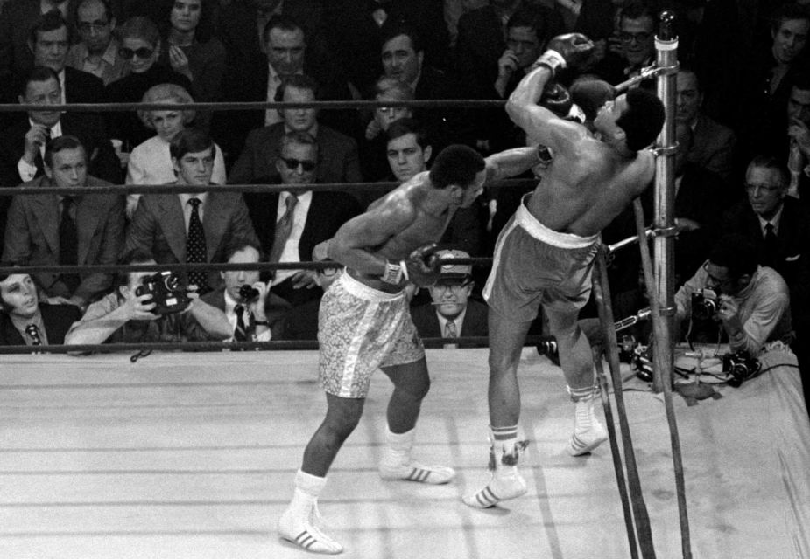
Soft skills; stamina = energy and focus
Coding can be strenuous and tiring and confusing
Breaks
Polmodoros (25on:5off)
Time tracking
Psuedocoding
Notes:
For task time and polmodoro tracking
https://kanbanflow.com/

Slide 14

While coding - take a break! Polmodors (try 25 min on, 5 min off). Keep track of your time while working.
Pseudocoding (aka “Structured English”) to clarify your goals; the logic of the program … modularize the code’s activities … very important.
Very easy to get lost in complicated tasks - use the resources you can understand.
Control the scope of your vars.
Less, simpler, clarity … but balance…
https://en.wikipedia.org/wiki/Pseudocode
https://en.wikipedia.org/wiki/Pomodoro_Technique

Slide 15

Soft skills - More answers than questions
Don’t get lost in the forest
Use resources that you can understand.
Identify your specific question.
Control scope of your vars.
Eliminate more than you keep

Slide 16
Week 4 | Agenda
Week 2 Assignment Review Week 3 Assignment Discussion Pseudocoding & Algorithms - Activity 1 For Loops vs. While Loops - Activity 2 Exiting Loops Early Comprehensions - Activity 3

Slide 17
Pseudocoding & Algorithms | Pseudocoding
What is Pseudocoding?
Who used it in Homework 3?

Slide 18
Pseudocoding & Algorithms | Pseudocoding
What is Pseudocoding?
Pseudocode is an informal high-level description of the operating principle of a computer program or other algorithm. It uses the structural conventions of a normal programming language, but is intended for human reading rather than machine reading (Wikipedia).
Planning leads to smart coding!
Modularization.
Saves time, and in the real world, saves money.
https://en.wikipedia.org/wiki/Software_design

Slide 19
Pseudocoding & Algorithms | Pseudocoding
Pause for Demo - Pseudocoding Pascal

Slide 20

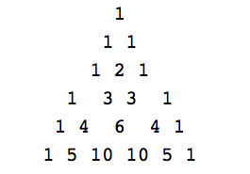
Pseudocoding & Algorithms | Pseudocoding
Pause - Draw it out
These statements should be distilled to simplicity
There are 1s flanking each row
Adding each possible pair of previous row makes next row without the flanking 1s

Slide 21
Pseudocoding & Algorithms | Pseudocoding
## We will use two arrays, one for the "last row" one for "current row" ## Insight: Each pass through the loop, we can set "current row" to "last row". Then we can build a new "current row".

Slide 22
Initialize a list with the number 1.
Then, make a new list in each iteration.
In that list, put in the first element of the old list.
Then, go through every 2 elements in the list (firstelement + secondele, secondele + thirdele) till you are at the last element, and append every addition to the newList.
Finally, append the last element of the oldList to the new list.
Print out the list sometime
# pascal.py
list = [1]
for i in range(10):
print(list)
newList = []
newList.append(list[0])
for i in range(len(list)-1):
newList.append(list[i]+list[i+1])
newList.append(list[-1])
list = newList
## We will use two arrays, one for the "last row" one for "current row" ## Insight: Each pass through the loop, we can set "current row" to "last row". Then we can build a new "current row".

Slide 23
>>> for i in range(10):
... print(list)
... newList = []
... newList.append(list[0])
... for i in range(len(list)-1):
... newList.append(list[i]+list[i+1])
... newList.append(list[-1])
... list = newList
...
[1]
[1, 1]
[1, 2, 1]
[1, 3, 3, 1]
[1, 4, 6, 4, 1]
[1, 5, 10, 10, 5, 1]
[1, 6, 15, 20, 15, 6, 1]
[1, 7, 21, 35, 35, 21, 7, 1]
[1, 8, 28, 56, 70, 56, 28, 8, 1]
[1, 9, 36, 84, 126, 126, 84, 36, 9, 1]
>>>

Slide 24
Pseudocoding & Algorithms | Pseudocoding
## We will use two arrays, one for the "last row" one for "current row" ## Insight: Each pass through the loop, we can set "current row" to "last row". Then we can build a new "current row".
## We first initialize the two arrays to [1] and [1,1] for rows 1 and 2 ## We then loop through an algorithm as follows:

Slide 25
Pseudocoding & Algorithms | Pseudocoding
## We will use two arrays, one for the "last row" one for "current row" ## Insight: Each pass through the loop, we can set "current row" to "last row". Then we can build a new "current row".
## We first initialize the two arrays to [1] and [1,1] for rows 1 and 2 ## We then loop through an algorithm as follows: ## 1. Replace "last_row" with the contents of "current_row" so we can create a new "current_row".

Slide 26
Pseudocoding & Algorithms | Pseudocoding
## We will use two arrays, one for the "last row" one for "current row" ## Insight: Each pass through the loop, we can set "current row" to "last row". Then we can build a new "current row".
## We first initialize the two arrays to [1] and [1,1] for rows 1 and 2 ## We then loop through an algorithm as follows: ## 1. Replace "last_row" with the contents of "current_row" so we can create a new "current_row". ## 2. Clear out "current_row" to have nothing in it.

Slide 27
Pseudocoding & Algorithms | Pseudocoding
## We will use two arrays, one for the "last row" one for "current row" ## Insight: Each pass through the loop, we can set "current row" to "last row". Then we can build a new "current row".
## We first initialize the two arrays to [1] and [1,1] for rows 1 and 2 ## We then loop through an algorithm as follows: ## 1. Replace "last_row" with the contents of "current_row" so we can create a new "current_row". ## 2. Clear out "current_row" to have nothing in it. ## 3. The 0 digit in current_row is 1

Slide 28
Pseudocoding & Algorithms | Pseudocoding
## We will use two arrays, one for the "last row" one for "current row" ## Insight: Each pass through the loop, we can set "current row" to "last row". Then we can build a new "current row".
## We first initialize the two arrays to [1] and [1,1] for rows 1 and 2 ## We then loop through an algorithm as follows: ## 1. Replace "last_row" with the contents of "current_row" so we can create a new "current_row". ## 2. Clear out "current_row" to have nothing in it. ## 3. The 0 digit in current_row is 1 ## 4. Start a "While" loop that iterates until len(current_row) == len(last_row)

Slide 29
Pseudocoding & Algorithms | Pseudocoding
## We will use two arrays, one for the "last row" one for "current row" ## Insight: Each pass through the loop, we can set "current row" to "last row". Then we can build a new "current row".
## We first initialize the two arrays to [1] and [1,1] for rows 1 and 2 ## We then loop through an algorithm as follows: ## 1. Replace "last_row" with the contents of "current_row" so we can create a new "current_row". ## 2. Clear out "current_row" to have nothing in it. ## 3. The 0 digit in current_row is 1 ## 4. Start a "While" loop that iterates until len(current_row) == len(last_row) ## 5. Use a counter (n) that starts at 1 and increments by 1 each time through the loop

Slide 30
Pseudocoding & Algorithms | Pseudocoding
## We will use two arrays, one for the "last row" one for "current row" ## Insight: Each pass through the loop, we can set "current row" to "last row". Then we can build a new "current row".
## We first initialize the two arrays to [1] and [1,1] for rows 1 and 2 ## We then loop through an algorithm as follows: ## 1. Replace "last_row" with the contents of "current_row" so we can create a new "current_row". ## 2. Clear out "current_row" to have nothing in it. ## 3. The 0 digit in current_row is 1 ## 4. Start a "While" loop that iterates until len(current_row) == len(last_row) ## 5. Use a counter (n) that starts at 1 and increments by 1 each time through the loop ## 6. Use "append" to set current_row[n] = last_row[n] + last_row[n-1]

Slide 31
Pseudocoding & Algorithms | Pseudocoding
## We will use two arrays, one for the "last row" one for "current row" ## Insight: Each pass through the loop, we can set "current row" to "last row". Then we can build a new "current row".
## We first initialize the two arrays to [1] and [1,1] for rows 1 and 2 ## We then loop through an algorithm as follows: ## 1. Replace "last_row" with the contents of "current_row" so we can create a new "current_row". ## 2. Clear out "current_row" to have nothing in it. ## 3. The 0 digit in current_row is 1 ## 4. Start a "While" loop that iterates until len(current_row) == len(last_row) ## 5. Use a counter (n) that starts at 1 and increments by 1 each time through the loop ## 6. Use "append" to set current_row[n] = last_row[n] + last_row[n-1] ## 7. After exiting the loop, add the final "1"
Does this fully solve the problem?

Slide 32
Pseudocoding & Algorithms | Pseudocoding
## We will use two arrays, one for the "last row" one for "current row" ## Insight: Each pass through the loop, we can set "current row" to "last row". Then we can build a new "current row".
## We first initialize the two arrays to [1] and [1,1] for rows 1 and 2 ## We then loop through an algorithm as follows: ## 1. Replace "last_row" with the contents of "current_row" so we can create a new "current_row". ## 2. Clear out "current_row" to have nothing in it. ## 3. The 0 digit in current_row is 1 ## 4. Start a "While" loop that iterates until len(current_row) == len(last_row) ## 5. Use a counter (n) that starts at 1 and increments by 1 each time through the loop ## 6. Use "append" to set current_row[n] = last_row[n] + last_row[n-1] ## 7. After exiting the loop, add the final "1" ## Now wait, what is the problem? This only builds one row. Go into breakouts and, starting with ## this pseudocode, update the pseudocode to find the "N"th line, as required in the problem.

Slide 33
Pseudocoding & Algorithms | Activity 1
Activity 1 - Finish the Pseudocode then implement it!

Slide 34
Pseudocoding & Algorithms | Algorithms
Discuss: What is the underlying purpose of teaching you Search algorithms?
Notes:
How do these relate to solution space?

Slide 35
Pseudocoding & Algorithms | Algorithms
Discuss: What is the underlying purpose of teaching you Search algorithms?
Answer: To show that creative code solutions can drastically improve runtimes.
As you take courses on data at scale, it’s not enough for your code to work. It has to work, efficiently. Planning and pseudocoding help!
Unit 6 will explore this further.

Slide 36


Pseudocoding & Algorithms | Algorithms
Discuss: What is the difference between the three methods?
Brute force
Bisection search
Heron’s method
Bisection search
Heron’s method
Notes:
How do these relate to solution space?

Slide 37
Week 4 | Agenda
Week 2 Assignment Review Week 3 Assignment Discussion Pseudocoding & Algorithms - Activity 1 For Loops vs. While Loops - Activity 2 Exiting Loops Early Comprehensions - Activity 3

Slide 38
Looping | For vs. While
Question: What is the difference between a “for” loop and a “while” loop?

Slide 39
Looping | For vs. While
Question: What is the difference between a “for” loop and a “while” loop?
Answer: A “while” loop iterates until a condition is met. The programmer may not know in advance how many iterations are needed.
A “for” loop iterates over a predefined group of objects, acting once on each one.

Slide 40


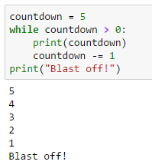
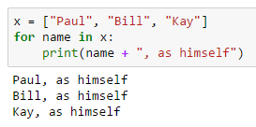
Looping | Examples

Slide 41
Looping | Code Design
Discuss: How should you select what type of loop to use?
Is one more “general” than the other?

Slide 42
Looping | Code Design
Discuss: How should you select what type of loop to use?
Is one more “general” than the other?
Answer: Generally, use a “for” loop when you have a known set of items to iterate over. Use a “while” loop when you are not sure how many iterations are needed in advance.
All “for” loops can be re-written as “while” loops. In fact, in the first weeks of this course we had you practice implementing several items as “while” loops that are easier to implement as “for” loops.

Slide 43
Looping | Breakout Activity 2

Slide 44
Week 4 | Agenda
Week 2 Assignment Review Week 3 Assignment Discussion Pseudocoding & Algorithms - Activity 1 For Loops vs. While Loops - Activity 2 Exiting Loops Early Comprehensions - Activity 3

Slide 45
Exiting Loops | Purpose
Question: Why might we want to exit a loop early?

Slide 46
Exiting Loops | Three Tools
Question: Why might we want to exit a loop early?
Why “break” a loop?
Why use “continue”?
Why use “else” after a loop?

Slide 47
Exiting Loops | Explanations
Question: Why might we want to exit a loop early?
Break exits the entire loop early, preventing our code for running needlessly.
Continue skips the rest of the iteration, and starts the next part of the loop. There is no need to continue processing a row.
Else can be used after a loop completes, and triggers if the loop never “breaks”.

Slide 48

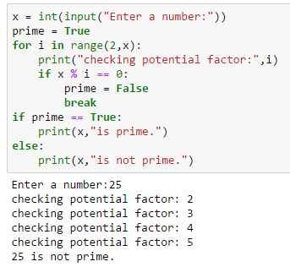
Exiting Loops | Break
Question: When would we use “break”?
In the prime checker code, we do not need to check any values after we find the first non-prime value.
* What is a boolean flag

Slide 49
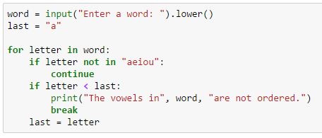
Exiting Loops | Continue
Question: When would we use “continue”?
Use of “continue” early in a loop can save you processing time on many iterations, or when only some values need to be processed (e.g., vowels).
See whether the vowels in the input are ordered

Slide 50

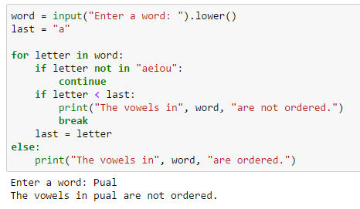
Exiting Loops | Break/Else
Question: When would we use “else”?
“Else” can be used to save coding effort by processing the data in a certain way if your entire loop runs.

Slide 51
Week 4 | Agenda
Week 2 Assignment Review Week 3 Assignment Discussion Pseudocoding & Algorithms - Activity 1 For Loops vs. While Loops - Activity 2 Exiting Loops Early Comprehensions - Activity 3

Slide 52
Comprehensions | Purpose
Question: What is a “list comprehension”?
Question: Why would we want to use one?

Slide 53
Comprehensions | Purpose
Question: What is a “list comprehension”?
Answer: A comprehension is a single-line “for loop” that enables you to quickly build a list. You can also build sets or dictionaries.
Question: Why would we want to use one?
Answer: They are fast, efficient, and fun ways to build sequences out of other sequences!

Slide 54
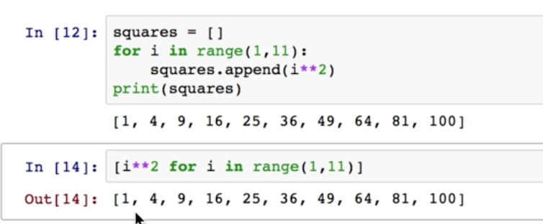
List Comprehensions | a compact for loop
List comprehension implicitly appends items resulting from the “Expression”
Structure :[Expression(item) for Item in Iterable]
For loop:
List comp:

Slide 55

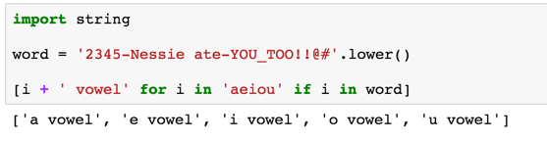
List Comprehensions | loops with conditionals
List comprehension is run on items also in the second iterable
Structure :[Expression(item) for Item in Iterable if Item in container]

Slide 56

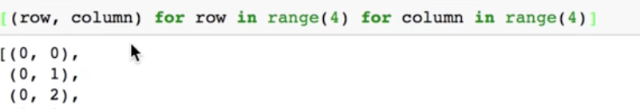
List Comprehensions | loops + loops
List comprehension produces tuples resulting from NESTED loops
Structure :[(Expr1(item1), Expr2(item2)) for Item1 in Iter1 for Item2 in Iter2]
[(0,0),(0,1),(0,2),(0,3),(0,0),(1,0),(1,1),(1,2),(1,3)...(3,3)]
Try this on pythontutor.org http://pythontutor.com/visualize.html#togetherjs=6mOAavcRgK

Slide 57

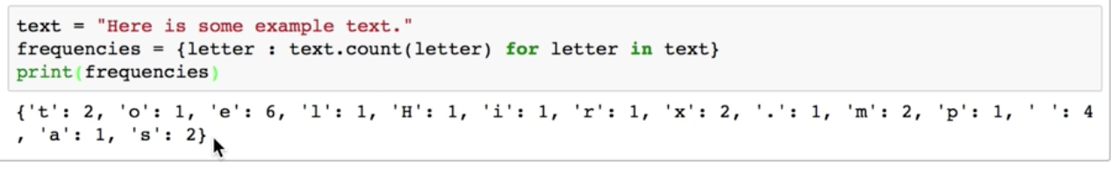
Other Comprehensions | Key:value pairs
Curly {} braces and key value pairs define this one
Structure :{Item : Expression(item) for Item in Iterable}

Slide 58
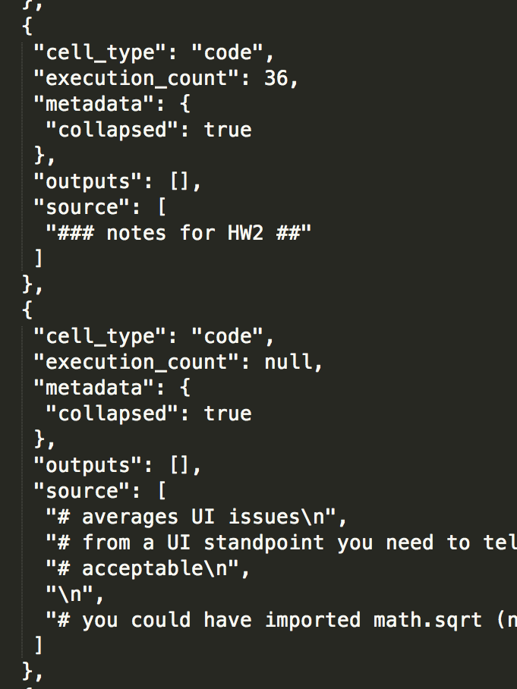
Comprehensions | Activity 3
What is JSON data?
Similar to a dictionary.
Fun Fact: Your entire Jupyter Notebook is actually saved as JSON. You will see this if you ever need to resolve a Jupyter “merge conflict”.

