Slide 1

Topic 12:
Plotting & Data Visualization
https://jovianlin.io/data-visualization-seaborn-part-1/

Slide 2
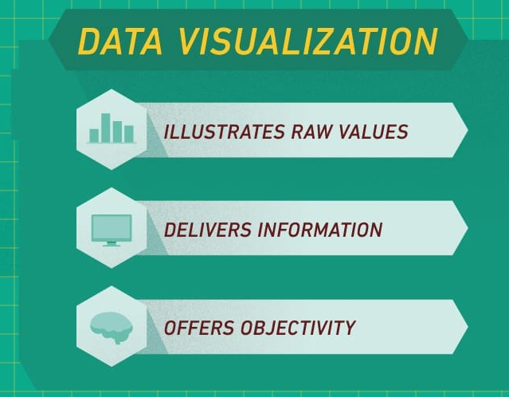
Plotting & Data Visualization
DataVis refers primarily to specific techniques to represent data in a visual language - graphs, plots, charts … and more.
Successful visualizations (data + design) convey an overview of the data, help you to explain the raw data, explore the data to discover new events or association, and do so in aesthetic ways that do not distract the viewers and so confuse the message.
If you get lost in creating a visual representation of your data, ask yourself what are the implications (or the “so what?” factor) and focus on that message.

Slide 3
Discussion
What’s your experience with data visualization/plotting? [Open Discussion]
Any specific examples that you found useful? How/why?
Why and when would we want to visualization data?
Beyond data vis/plotting what is there?
Recognize any relationships between DataSci/BigData/DataMining/Stats and vis? [See SAS, SPSS, IBM, Oracle/Java’s white papers on visualization.]

Slide 4
Libraries to help you display data
matplotlib
seaborn [on top of matplotlib; for statistics and cool visualizations]
ggplot [library for R and python]
bokeh [interactive vis]
pygal
plotly [interactive vis]
geoplotlib [maps; chloropleth]
gleam Other projects
missingno
leather
basemap (for geographic data) [requires installing base map library; pillow (but not PIL) https://pillow.readthedocs.io/en/stable/installation.html
Another great tool of particular value is the JavaScript-oriented d3.js library. Check out Mike Bostock’s Data-Driven Documents homepage and on GitHub. By saving your analysed and processed data, it’s easy to stream them into a file to be read later by a website calling the d3.js library.
Commercial products - Tableau is very popular.
Poll: Who has used what?

Slide 5
Matplotlib + Seaborn
Read about a comparison between Seaborn and Matplotlib https://jakevdp.github.io/PythonDataScienceHandbook/04.14-visualization-with-seaborn.html.
And this great seaborn tutorial https://jovianlin.io/data-visualization-seaborn-part-1/
Notes:
https://abdulapopoola.com/2014/06/05/i-git-stashing-explained/

Slide 6
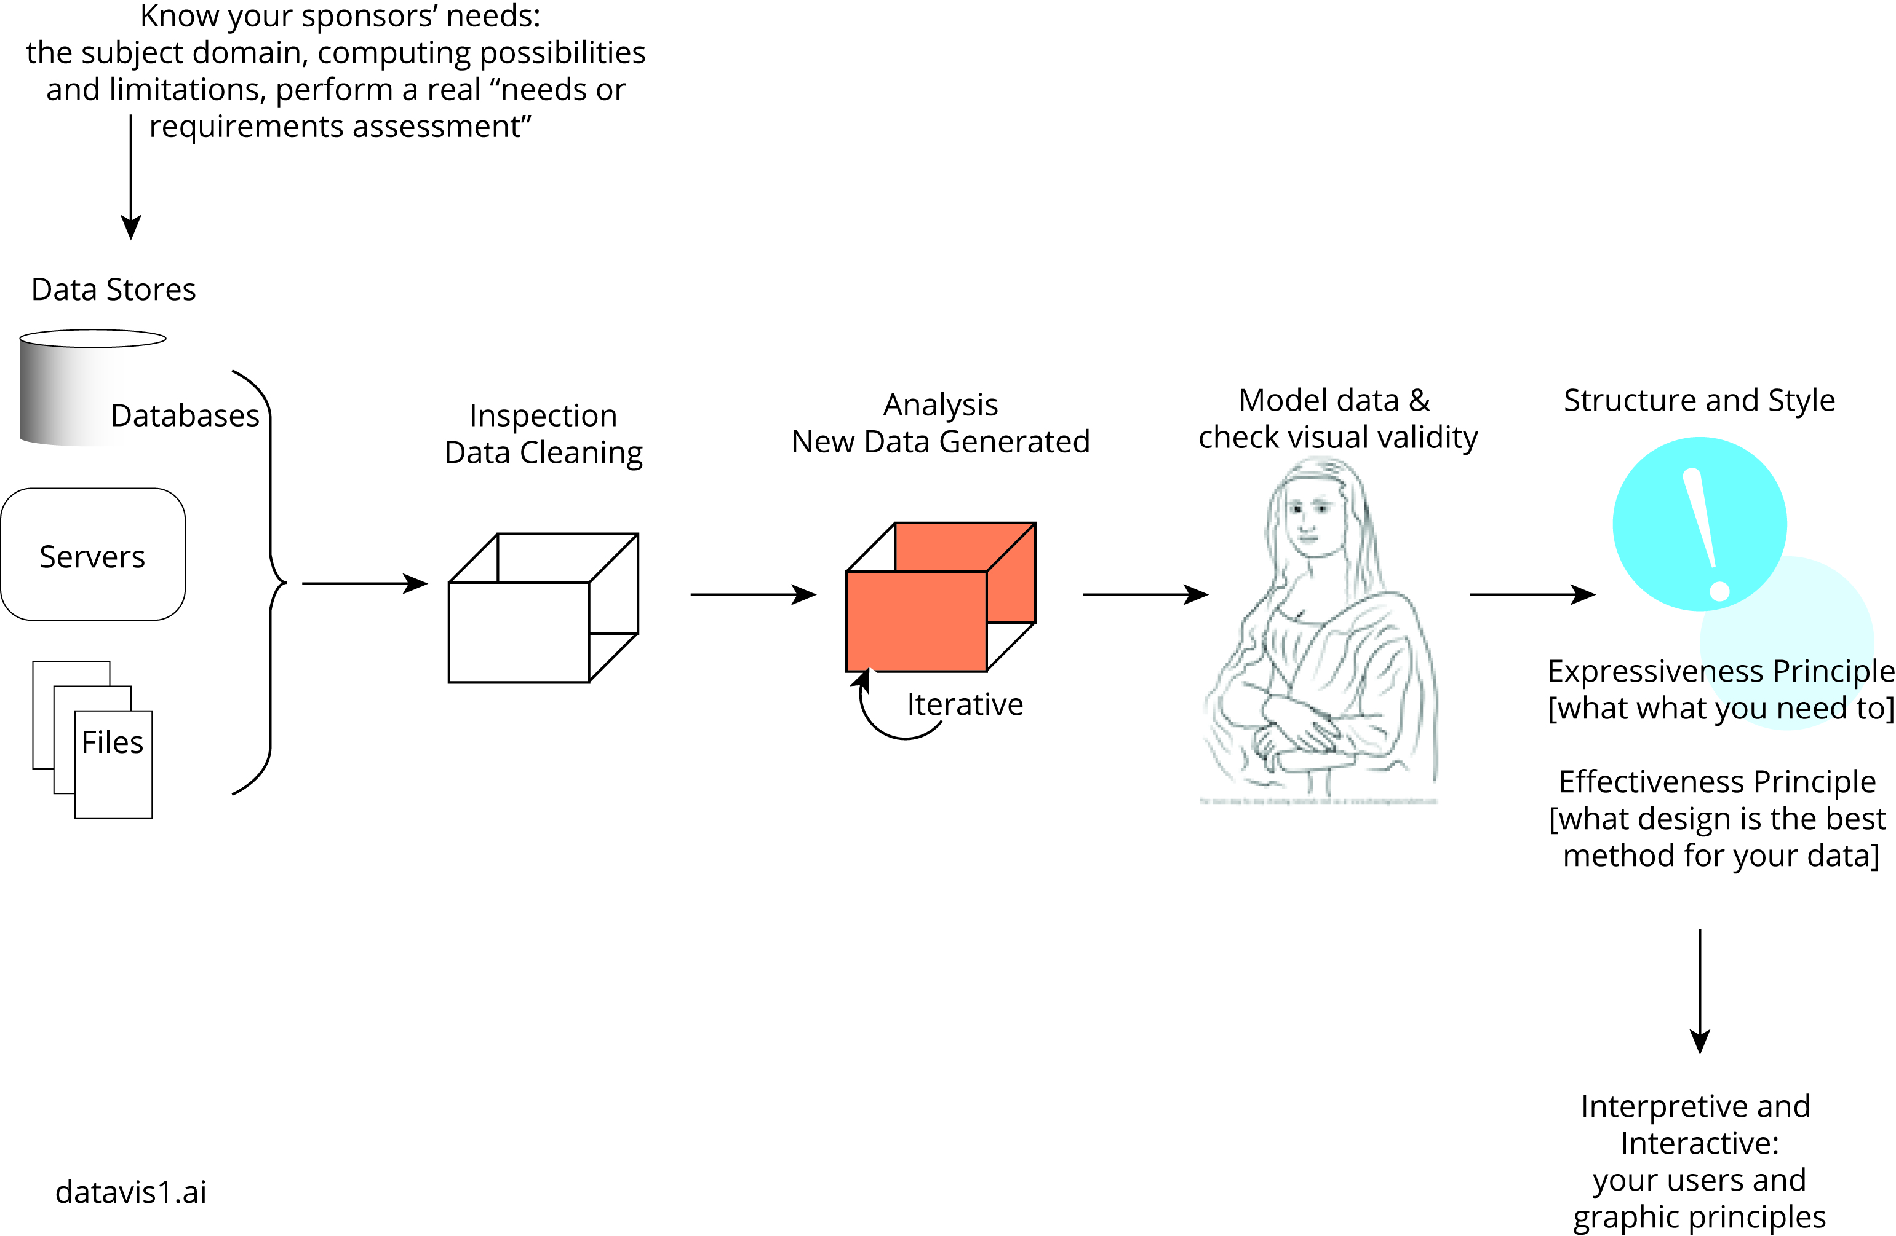
DataVis | Process

Slide 7
Hints about DataVis
Using matplotlib as a the first example, let’s say your data are stored in a .csv file ... and that you’ve already checked for missing values, NaN, and values that are within range and domain, and that you know the data types of each of the columns & rows (whew!).
What data structure will hold your data? List? dictionary, NymPy array, other?
Linear? Box plot? Heatmap? There are lots of visualization ideas. Combine this with graphic design issues.
Color scheme (complementary, tritonic, analogous, etc.); visual elements (line, circle, spacing, size, placement, etc. Perhaps create a dictionary or list to hold these data.

Slide 8
Steps ... present, explain, explore
Import libraries
Use % to display inline [also other options such as “retina”]
Read or access your data file
Create the container to hold the visualizations (“figure”); compare this to HTML5’s Container and an SVG container (scalable vector graphics; d3)
Framework: axes [placement, ticks], title and labels, subplots
Design model and aesthetics [symbols, “visual primitives” [line, dot and other symbols, placement, distance, size, color scheme, alpha]
Shortcuts in the code? [in the commands to create figures, subplots; color schemes stored in a dictionary]
User needs & interpretation; output the data plot.

Slide 9
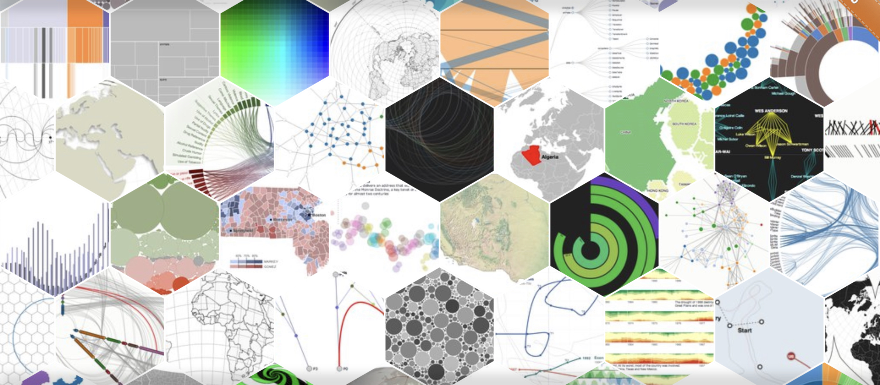
Check out d3js.org for a sample of the many types available.

Slide 10
Dot Graph
Stacked Bar Graph
Proportional Symbol Map
Choropleth
Force-Directed Layout
Radar Graph
Stream Graph
Parallel Coordinate
Stacked Line Graph
Box-and-Whiskers
Radial Tree
Dasymetric
Circular Graph
Tag Cloud
Line Graph
Tree View
Cartogram
Force-Directed Layout
Hive Graph
Pie Chart
Stepped Relief Map
Balloon Tree
Stripe Graph
Arc
Scatter
Bimodal
Crossmap
Steam and Leaf
Bubble Chart
Doughnut
Dot Density
Isoline
Chord
Sankey
Proportional Symbol
Treemap
Arc Graph
History Flow
Elevation
Histogram
Science
Isarithmic
Strip Map
Isochrome Map
Population Pyramid
Enclosure Tree
Dendrogram
Börner, K. Atlas of knowledge. MIT Press

Slide 11
Samples (of the many) demo’d
Line plot - 1 + lines
Line plots with insert line plot (plot in plot)
Bar charts [usually with box+whiskers for MCT]; histograms; 2D; 3D
Regression
Donuts, radar, polar [these are all circular; popular in dashboards]
Choropleth [maps - often use svg for visual units (countries, cities, etc) with data superimposed; monochromatic or analogous; map size misrepresents true data values, tho.]
Heatmaps, Kohonen feature maps
3D plots

Slide 12
Identify the code sections for plotting
import matplotlib
import matplotlib.pyplot as plt
%config InlineBackend.figure_formats = ["retina"]
import numpy as np
x = np.linspace(0, 5, 10)
y = x ** 2
figure()
plot(x, y, 'r')
xlabel('x')
ylabel('y')
title('title')
show()
fig = plt.figure()
axes = fig.add_axes([0.1, 0.1, 0.8, 0.8]) # left, bottom, width, height (range 0 to 1)
axes.plot(x, y, 'r')
axes.set_xlabel('x')
axes.set_ylabel('y')
axes.set_title('title');
Time for an Activity Breakout

Slide 13
Resources
Prof Benoît’s Folder
DataVis_1_Matplotlib.ipynb
DataVis-extra-fyi.ipynb
Python for Data Analysis
Prof Huntsinger’s Folder
“Cheet-Sheets”

Slide 14
Resources
Benoît (2019) Introduction to information visualization
Ware Information visualization and Design for visual thinking
Tufte Visual display of quantified data, Visual explanation, Beautiful evidence, etc.
Steele & Illinsky Beautiful information [series of articles]
Börner, K. Atlas of knowledge and Atlas of science [various demos of one-off examples
Munzner Visual analysis and design
IEEE Visualization [professional organization]
ACM SIGVIS [professional organization]
Information visualization (journal)

Slide 15
White Papers
Gartner “Not all BI platforms are created equal”
Bobriakov (2018) Comparative analysis of …
Tableau (homepage; download and try for free)

