Slide 1
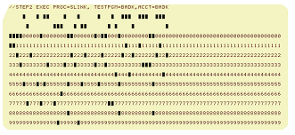
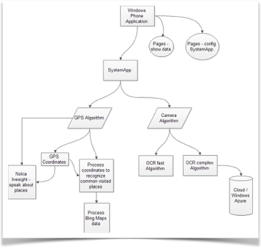
Week 8:
Object-Oriented Design

Slide 2
Tonight’s agenda
Points from your homeworks/scrabble
Docstrings
PEP8, Dunder, Private vs. Public
Project 1 & Schedule
Why classes?
Inheritance
Polymorphism
super() and pass()
Quack Typing
Magic Methods
Project 1 and rest of course
x = 4
repr(x) outputs ‘4’
str(x) outputs ‘4’
y = ‘hello’
repr(y) outputs “‘hello’”
str(y) outputs ‘hello’

Slide 3
Homeworks & Scrabble Implementations
Good Algorithm Design:
Iterated through scrabble words list only once
For wildcards: did not make a list of all possible rack letters
Compared words to rack while keeping track of wildcards:
If word length > rack length - immediately discard (& move to next word)
If letter is not in the rack & no wildcards - discard
if wildcards, word could be ‘off” by that many letters (1 or 2)
if word was off by more than # of wildcards - discard
If word passes the above tests - add to valid word list & go to next word.

Slide 4
Homeworks
Tabs v Spaces - An eternal debate
One reason 4 spaces are better: 4 spaces = 4 spaces whenever copying & pasting the code. 1 tab isn’t necessarily 4 spaces [tab sizes are different; space size isn’t]
79 character limit:
a little arbitrary today (with wide-screen monitors, etc)
Based in the old unix default window of 80 chars [itself based on the old keypunch cards]
Designed to increase the readability of code
Jupiter notebook doesn’t wrap code so the code may continue off the right side of the screen

Slide 5
Docstrings:
Usually do this after defining a function to indicate the input arguments, type, and what the function does and returns. Example:
def function_with_docstring(param1, param2): """This function takes a string, param2, and checks if a number, param1,
is in that string. Args: param1 (int): The number to check for
param2 (str): The string to check Returns: bool: True for success, False otherwise. """

Slide 6
Other points …
Autoformat PEP8?:
Yes, in PyCharm (and maybe in others)
“Dunder” is the __ (as in __init__):
Invoked behind the scenes – that is, you don’t specifically call that method.
Using __init__ as an example - it’s a method that is called automatically when the object is substantiated
Public vs. private variables:
Private variables are annotated by a dander __ or one __ (like __count). The means that variable is accessed only by that class, not from outside the class. Python doesn’t truly have private vars - because they can still be modified. [Not the case in other OOP languages; private vars cannot be modified outside class.]

Slide 7
Project 1 reminder
The proposal was due, but treat is as a hypothesis as how you’ll solve the problem. In the two weeks left, implement, refine and adjust.
An iterative process while you learn.
Next week there will be more time to discuss your progress and discuss outstanding issues in breakout groups.

Slide 8

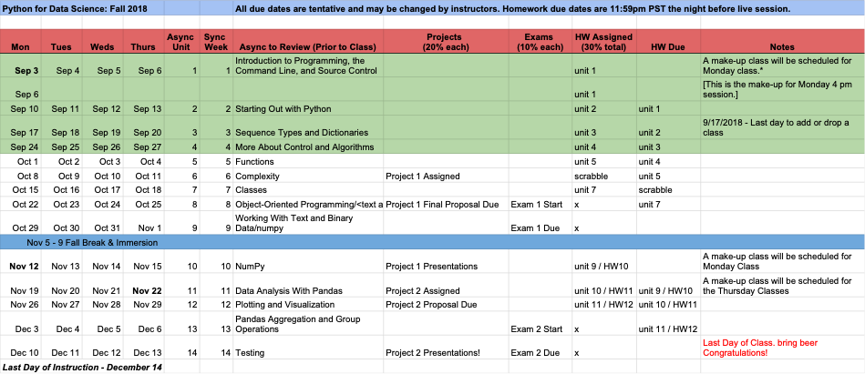
Schedule
https://docs.google.com/spreadsheets/d/1sVV7-4OHZ-EDNqkMJ55OPUfz_QLJ4LZNuZl-cRaxgV0/edit#gid=0

Slide 9

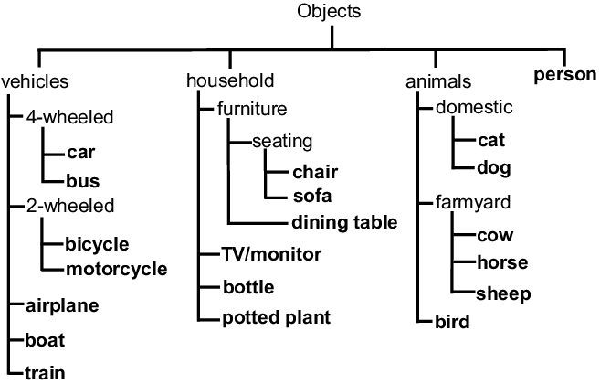
Why classes?
Can be challenging…
Encapsulation
Modularity
Inheritance
Polymorphism
Why did we create a “card” class, even tho we didn’t need its functions?
How can you decide when to use an “object” versus an “attribute” for a given part of your code?

Slide 10
Discussion points (from asynch notebooks)
Inheritance (§8.4)
Polymorphism (§8.7)
Magic Methods (§8.9)

Slide 11
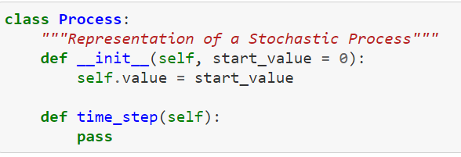
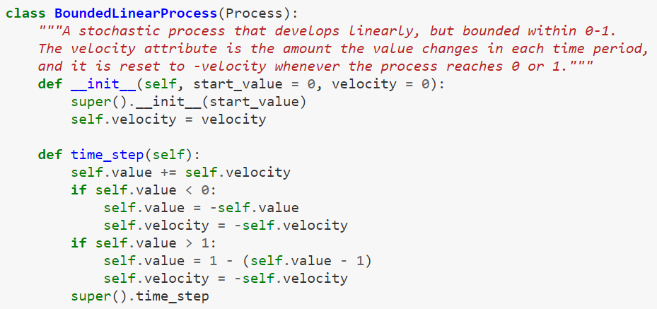
Why inheritance?
Why would we want to use inheritance?
What’s super?
What’s pass?

Slide 12
Why inheritance?
Why would we want to use inheritance?
A template for other classes
What’s super?
Run the function as defined in the superclass (parent)
What’s pass?
Define a function to be implemented in subclasses

Slide 13

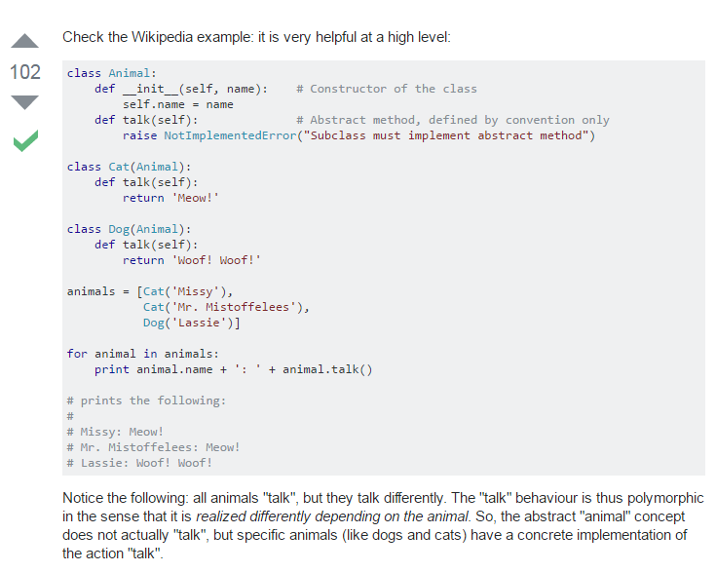
What’s polymorphism?
The provision of a single interface to entities of different types.
Discuss: How might this relate to inheritance?

Slide 14
Optional: super() and inheritance[s]
# a case of single inheritance; allows us to refer to the
# base class by invoking super()
class Mammal(object):
def __init__(self, mammalName):
print(mammalName, ‘ is a warm-blooded animal.’)
class Dog(Mammal):
def __init__(self):
print(‘Dog has 4 legs’)
super().__init__(‘Dog’)
d1 = Dog()
2 examples of class inheritance,
using super() to invoke the parent class
class NonMarineMammal(Mammal):
def __init__(self, NonMarineMammalName):
print(NonMarineMammalName, “can’t swim.”)
super().__init__(NonMarineMammalName)

Slide 15
Optional: super() and multiple inheritance
class A:
def __init__(self, name)
class B(A):
def __init__(self, name)
super().__init__(name)
class C:
def __init__(self, xxx)
a class can inherit from multiple parents
class D(B, C):
def __init__(self, xxx)

Slide 16

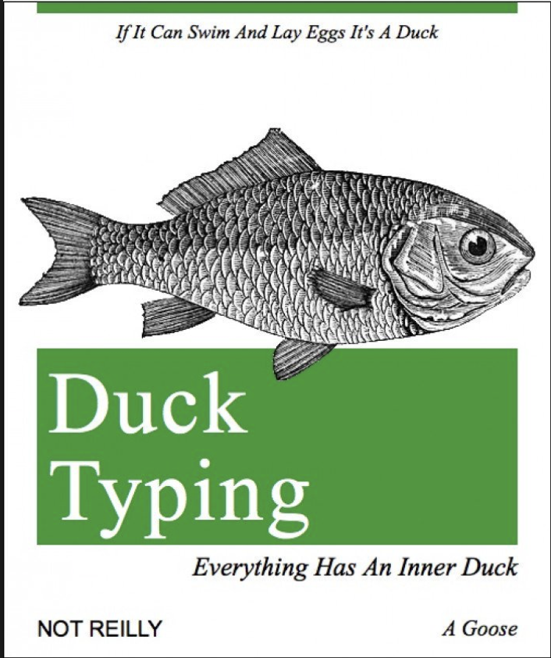

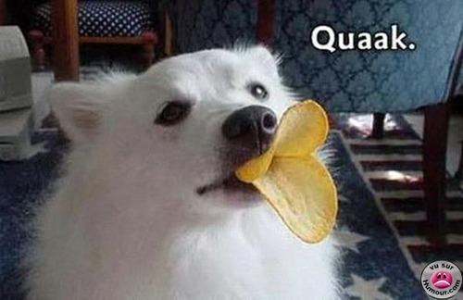
Quack. Repeat, quack. What is duck typing?

Slide 17
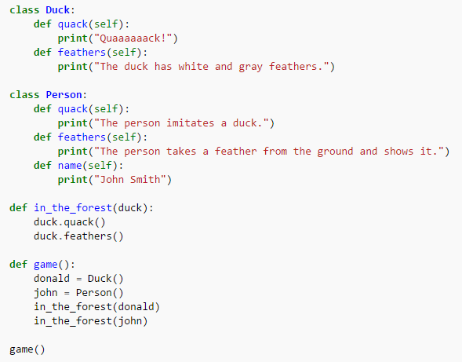
What is duck typing?
Python won’t check variable types before running a function.
if it looks like a duck
and quacks like a duck,
it’s a duck.

Slide 18
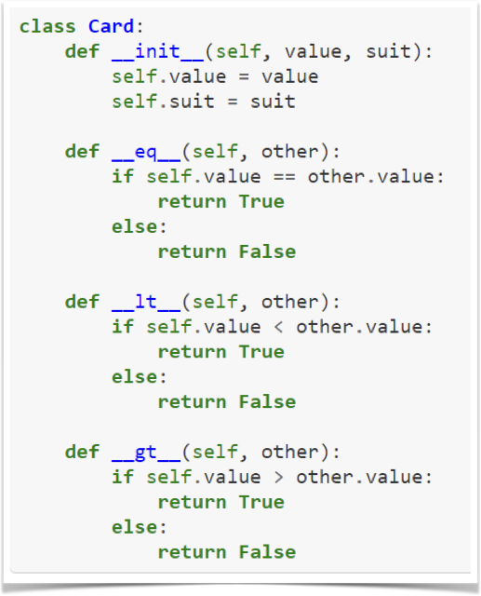
Magic Methods
Read and think about these methods. What is the purpose of ‘em?
How might you apply them in your own classes?

Slide 19
Magic Methods (from p. 138ff)
__eq__(self, other)
__ne__(self, other)
__lt__(self, other)
__gt__(self, other)
__le__(self, other)
__ge__(self, other)
__str__(self)
__repr__(self)
__len__(self)
__name__(self)
__main__
__add__(self, other)
__sub__(self, other)
__mul__(self, other)
__floordiv__(self, other)
__truediv__(self, other)
__mod__(self, other)
__pow__(self, other)

Slide 20
Recap of the schedule:
Project 1 | build your own object oriented project
Code at home and collaborate in class
Unit 9 | Working With Text and Binary Data
Unit 10 | NumPy
Unit 11 | Data Analysis With Pandas
Unit 12 | More Analysis With Pandas; Data Vis
Unit 13 | Testing

