Slide 1
Week 9:
Encoding Text
and a quick glance at NymPy
你好？
سالام
हिंदिसटन
a à å b c d e é g h i î j k l m n ñ ø p q r s ß t ü v w x y z

Slide 2

Tonight’s agenda
The Second Half!
Congratulations on completing part 1.
Working with text, binary data. NumPy.
More NuyPy.
Data Analysis with Pandas
More Data Analysis with Pandas
Group Work
… and your final quiz
Code Testing and … your final project showcase!

Slide 3
Schedule …
Class 9 - Working with text and binary
Encoding
Unicode Strings
Formatting
RegEx
Binary
File I/O
Structured Files
10: NumPy
11: Data Analysis with Pandas
12: Plotting & Visualization
13: Pandas aggregation & group operations
14: Testing & Wrapup.

Slide 4

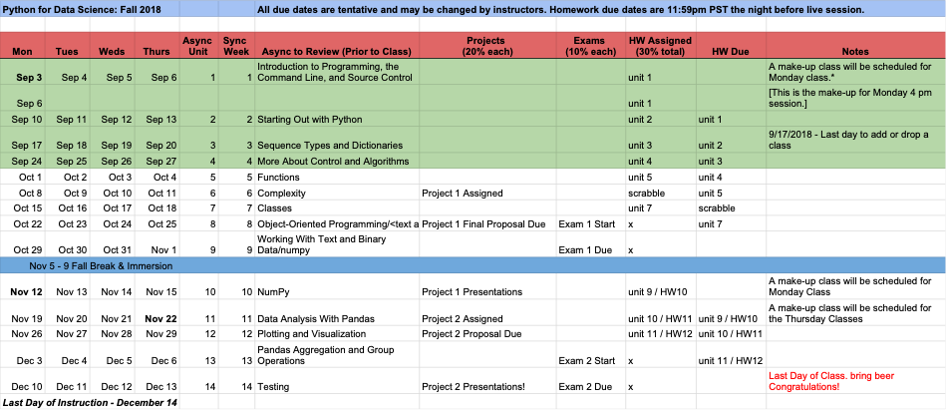
NumPy will likely take back seat to your presentations.
https://docs.google.com/spreadsheets/d/1sVV7-4OHZ-EDNqkMJ55OPUfz_QLJ4LZNuZl-cRaxgV0/edit#gid=0

Slide 5
Any questions about the showcase?
Some questions that you may address …
Explain your project at a high level
Share your screen, run your code, a couple of slides if you want, … show off what you’ve done!
Open the code and share to discuss …
what classes did you use to solve your problem?
what were the major challenges of your implementation?
Please practice a brief (about 5 min, tops) presentation that communicates your project to others. Very important skill.

Slide 6

Moving on … Up and down levels of abstraction
We’ve traversed the levels of abstraction … up and down …
Fundamental types: ints, floats … [aka primitives]
Container objects: lists, strings
Classes
Now … drill down to characters and bytes [oh, boy!]

Slide 7
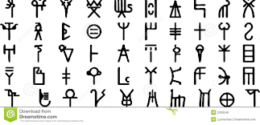

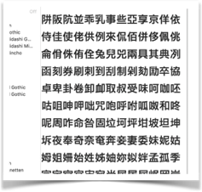
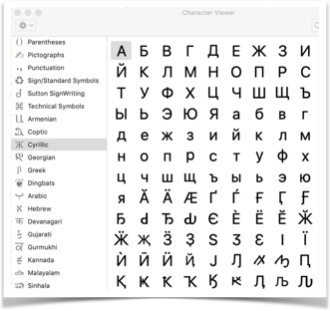
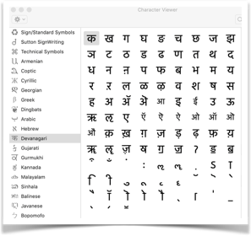
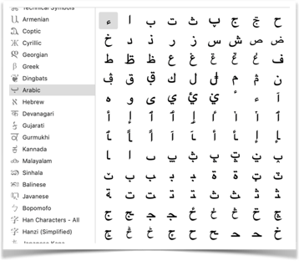
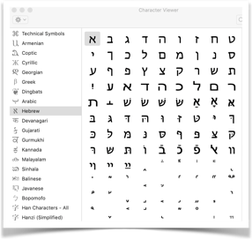
The challenge? Translate icons/type to code & back
http://unicode.org and
check out the codesheets.

Slide 8
Translating encoding schemes …
Everything is stored in binary (o, 1)
At some point, data are translated into this common format.
BTW, note that how the data are stored on the hard drive is the “internal reflection” of the data (usually as UTF-8); and then there’s the “external reflection” of the data (what’s shown on the screen, often UTF-8, but could be win-1285, MacRoman, koi-8, etc.!).
https://en.wikipedia.org/wiki/Character_encoding
Keep in mind: it’s all just data! We can call “X” the same thing in a variety of “dialects” … as you’ll see! (grin)… But first things first …

Slide 9
Encoding Schemes … before we press on
Binary (base 2; 0 or 1)
Octal (base 8); e.g., 1 + 2 + 4 (2⁰ + 2¹ + 2^{2.} 1 + 2 = 3; 1 + 4 = 5; 1 + 2 + 4 = 7). example?
e.g., setting file permissions read, write, execute = 1, 2, 4 = 7; so what is 755?
Decimal (base 10; back to 0,1,2,3,4,5,6,7,8,9)
Hexadecimal (base 16; 0, 1, 2, 3, 4, 5, 6, 7, 8, 9, A, B, C, D, E, F)
This leads to various expressions: e.g., “byte” [8-bits], “nibble” [4-bits]; “multibyte” [unicode, ISO-639-x, utf-x [8, 16, 32, 64, even 128.]].
Check out: http://unicode.org/charts/charindex.html for the names!
BTW, when data don’t appear on screen correctly it is often an encoding mis-match error between the data stream and the output device’s encoding settings. In word processing programs and in CJK and other language groups, byte-shifting is critical to storage and retrieval.

Slide 10
Encoding Schemes
Most end-users think about what they type … but most professional/industrial standards require UTF-8. (https://www.w3schools.com/charsets/ref_html_utf8.asp). There are hundreds of encoding schemes - from Big5, TwinBridge to IIS, JIS, MacRoman, win-1285, utf-8, utf-16, etc.!
Base 10 example:
0000 = 0 [zero in all places, 0, 0, 0, 0]
0001 = 1 [ 1 x 2⁰] 1 in the one’s place *nb: take the bite * 2…
0010 = 2 [ 1 x 2¹] 1 in the two’s place
0100 = 4 [ 1 x 2²] 1 in the four’s place
1000 = 8 [ 1 x 2³] 1 in the eight’s place
1100 = 12 [ 1 x 2⁴] 8 + 4 … on in the eight’s place and one in the four’s … and so on…
In binary every number takes one of 2 values
0 or 1)
------------------------------------
The places are multiples of 16 -> 1, 2, 4, 6, 8, 10

Slide 11
Encoding Schemes, con’t.
The choice of base 16 comes directly from the use of phrases binary strings; first 3 (Octal) and then 4 digit (Nybble, aka: hexadecimal)
3 digit binary phrase (Octal)
000=0, 001=1, 010=2, 011=3, 100=4, 101=5, 011=6, 111=7
These 8 numbers represent one Octal digit that can take values 0-7
Similarly the 4 digit binary phrase (“nibble”) has 16 values and represents one hexadecimal digit (0-F)

Slide 12

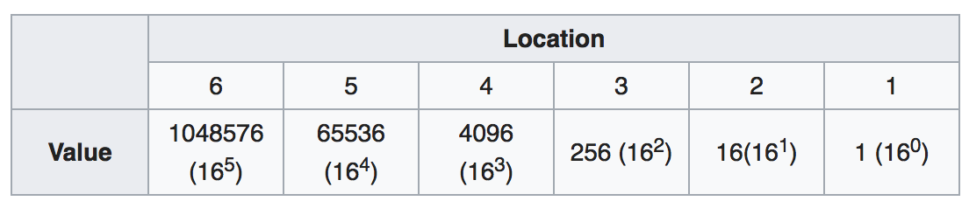
Encoding Schemes, con’t.
Computers also use hexadecimal which is base 16,
– 000 is 0 zero in all places
– 005 is 5 (5 x 2**0) one in the 1s place
– 050 is 16 (5 x 16**1) one in the 16s place
– 500 is 1280 (5 x 16**2) one in the 256s place
In hexadecimal every number takes one of 16 values coded as 0-F
0 1 2 3 4 5 6 7 8 9 A B C D E F

Slide 13

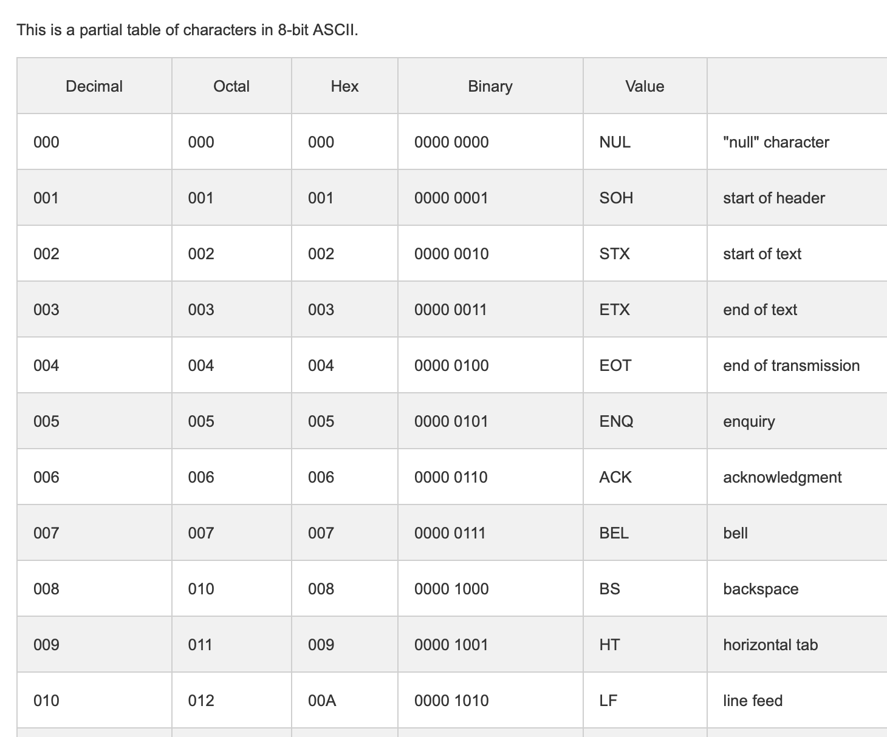
ASCII?!
ASCII uses 7 binary bits
2⁷ = 128 characters
Please note that there’s also 8-bit ascii.
[https://www.sciencebuddies.org/science-fair-projects/references/table-of-8-bit-ascii-character-codes]
There are other encoding systems
What are some?
* Often incompatible *

Slide 14
Unicode, 1
Unicode encodes 120k characters
Modern and ancient languages, math
UTF-8
Compatible with Unicode
Python 3 has native support for unicode
Note: Windows 10 may create files using UTF-10. For example, if you try to create a file using the command line: echo “test” >> test.txt
If you run into encoding issues, this may be the cause.

Slide 15
Unicode, 2
Python 3 has native support for unicode - All strings are Unicode strings!
>>> "\u0047\u0072\u0072\u0021" == 'Grr!' True
>>> "\u0047\u0072\u0072\u0021" == 'GRR!' False
[Optional note: Some characters, particularly historical ones and ligatures, may be software or O/S dependent. Accessing these characters requires knowing and being able to read the “GID”: graph identification number.]

Slide 16
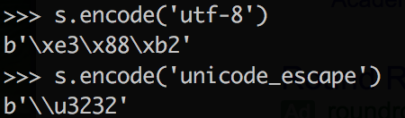
Unicode, 3
Every unicode value has a standard name
Unicodedata.name() to get name from a value
Value can be literal “B” or unicode value “/u0042”
Returns “LATIN CAPITAL LETTER B”
Benefit? Every character can be identified uniquely!
You can often paste exotic characters
We can encode a text string in unicode using encode(‘utf-8’). Other options are available.
To decode unicode, use decode(‘utf-8’)
b denotes bitwise encoding \x means “hexadecimal”

Slide 17
Encoding & Decoding: (codec)
Not all characters can be represented in each encoding scheme! You can specify how to handle this
Replace with blank (‘?’)
XML friendly
https://msdn.microsoft.com/en-us/library/aa468560.aspx
Unicode Escape (backslash)

Slide 18
Encoding & Decoding | Methods & Packages
Try the following commands:
Unicodedata package
encode (), decode()
type (), len()

Slide 19
Regular Expressions (RegEx) | Finding Patterns
re.compile() # compile a search string
re.search() # gets the first match
re.match() # extract match - if at beginning
re.split() # split on matches
re.sub() # substitute on matches
re.findall() # get all matches as list
.group() # used after matching to pull out groups

Slide 20
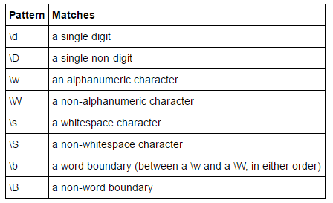
RegEx | Special characters & specifiers
. # any character 1 place
* # any number of char
? # any character optional
[0-9] , /d # any digit
[a-z] # any letter lowercase letter
/w # any alpha-numeric char
r’ ’ # the raw string literal

Slide 21

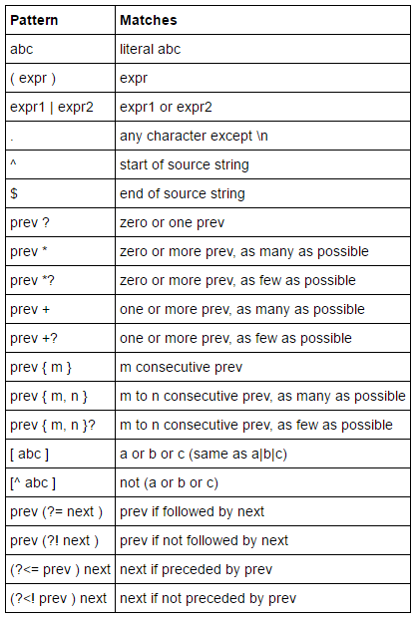
RegEx | Specifiers
matchObject = re.search(pattern, input_str, flags=0)
https://regexone.com/references/python

Slide 22

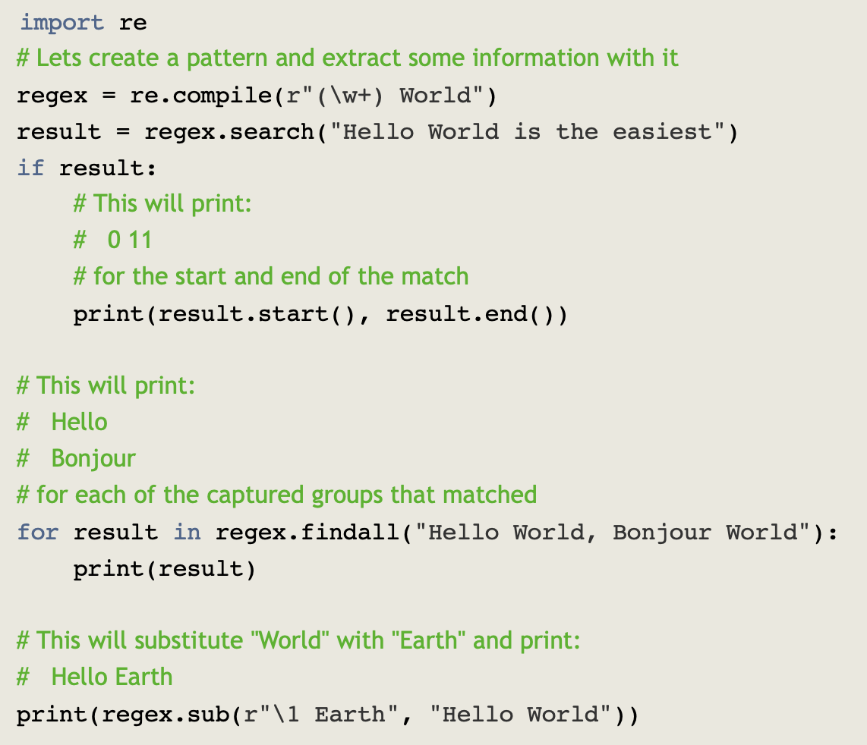
https://www.machinelearningplus.com/python/python-regex-tutorial-examples/
https://regexone.com/references/python

Slide 23

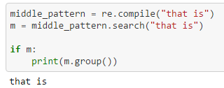

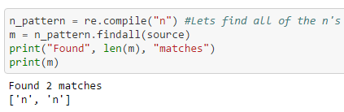
RegEx | Basic Examples

Slide 24
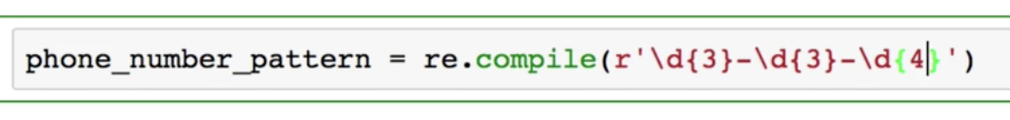
RegEx | Phone Number Example
Compact version
expanded version

Slide 25

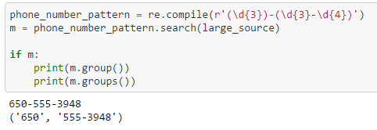

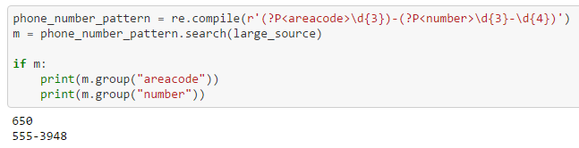
RegEx | Matching Groups

Slide 26


Text Output | Basics
Consider:
>>> s='㈲word'
Simple concatenation
print (‘this is my text: ’ + s)

Slide 27


Text Output | The Basics | Oldstyle
The old s(%) style
>>> print (‘this is my text: %10s ’ % (s))

Slide 28


Text Output | The Basics | New Style
The new {} style
print ("This is my text: {sentence:<20s}".format(sentence=s))
print ("This is my text: {sentence}".format(sentence=s))
print ("This is my text: {}".format(s))

Slide 29
Basic Patterns | Python Functions
.open(file, mode),
open modes (‘wt’, ‘rt’, ‘at’, ’rb’, ‘wb’ )
Action on file:
write(), read(), readlines(), readline()
.close()

Slide 30
Loading Files | Python Functions
.open(file, mode), .close()
open modes (‘wt’, ‘rd’, ‘at’, ‘rb’, ’wb’)
with() # you don’t need to close this one
read()
readlines() # reads all lines as a list
readline() #reads one line in at a time

Slide 31

NumPy
Check out this quickstart tutorial on NumPy
https://docs.scipy.org/doc/numpy/user/quickstart.html

Slide 32
Quick NumPy
http://www.numpy.org
NumPy gives you the ability to work with n-dimensional arrays of numeric data of many types.
Pandas is built on top of NumPy and provides a more user friendly experience. There, we work with a “dataset” and include non-numeric variables.
Understanding NumPy is critical to understanding more advanced packages.
A basic understanding of NumPy will deepen your understanding of Pandas.
NumPy offers vectorized operations
** But see this: https://timothyhelton.github.io/pandas_best_practices.html

Slide 33
NumPy | Python Functions
http://www.numpy.org
np.array()
np.arange(), np.linspace()
np.min(), np.max(), np.std(), np.var()
np.argmax(), np.argmin()
np.shape(), np.reshape()
np.zeros()
np.random.seed(), np.random.random_integers()
np.vstack(), np.hstack()
Dealing with n-dimensions: “axis = “ (o or 1)

