Slide 1
APPLS: Evaluating Evaluation Metrics for Plain Language Summarization
EMNLP 2024
Yue Guo1* Tal August1 Gondy Leroy2
Trevor Cohen3 Lucy Lu Wang3,4
1 University of Illinois Urbana-Champaign 2 University of Arizona
3 University of Washington 4 Allen Institute for AI
Notes:
appls,评估简明摘要的评估指标

Slide 2
Motivation
Problem
Plain language summarization(PLS) lacks dedicated metric
Suitability of text generation metrics is unclear(removing details, adding background, jargon interpretation, text simplification are all included)
Contribution
Propose APPLS, a meta-evaluation testbed for PLS
Evaluate 14 PLS metrics and give insights
Notes:
首先是目前存在的问题，简明摘要，以下我们简称为PLS，缺乏专用的评估指标，与此同时文本生成的评价指标在PLS任务上的适应性不明确，因为PLS任务存在许多与文本生成任务不一致的特点，比如PLS可能会包含去除细节，增加背景知识，专有名词的转译，文本的化简这些特征，导致文本生成的评价指标难以直接运用在PLS任务上，在这个工作中，作者提出了Apples，一个元评价基准，也就是对评价指标进行评价。他测试了14种可以用在PLS上的评价指标，并且给予了一些洞见

Slide 3
Background-Existing metrics
Automated evaluation metrics
Overlap-based: ROUGE, BLEU, METEOR, SARI
Model-based: GPT-PPL, BERT-Score, LENS
QA-based: QAEval
Lexical features: length, familiarity, conjuctions, function words...
LLM prompt-based evaluations: prompt GPT-4 to evaluate
Notes:
首先我们介绍一下现存的可以应用在PLS任务上的评价指标，首先是一些自动评价指标，他主要分为基于重复的，基于模型的和基于问答的。基于重复的模型，包括ROUGE也就是生成文本和参考文本的ngram召回率，blue计算生成文本相对于参考文本的ngram精确度，包含简短惩罚机制。Meteor在考虑engram精确度和召回率的基础上进一步进行了词极对齐，Sari更加关注文本简化，比较生成文本与参考文本之间的保留，添加，删除关系，并求平均。第二种是基于模型的评价指标，GPTPPL计算GPT2的模型困惑度来衡量生成文本的流畅性和连贯性，bertscore通过计算参考文本和生成文本的上下文embedding的相似度来捕捉语义的相似性。LENS经过大规模的监督训练，通过Transformer将输入文本、简化文本以及参考文本转换为向量，并结合这些向量来计算文本简化的质量得分。QAEval（Deutsch等，2021）从目标文本生成问答对，随后通过训练好的问答模型基于生成文本回答这些问题，其评分以正确回答问题的比例计算。

Slide 4
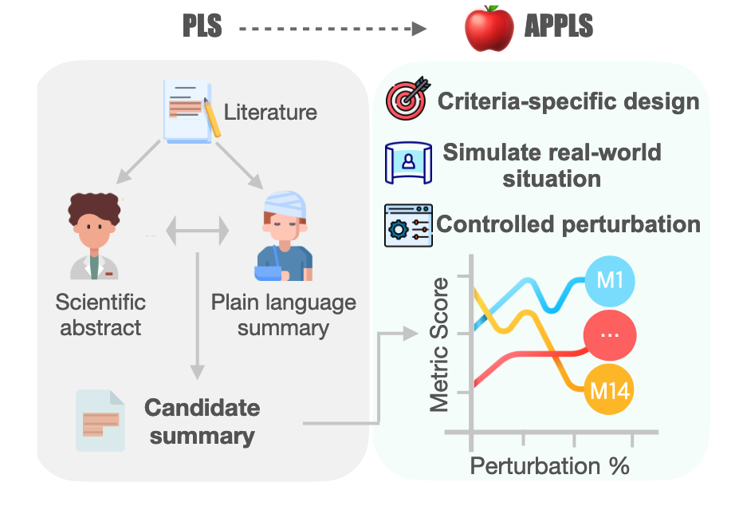
Method
Applying perturbations to texts and assess sensitivity of the metrics
4 criteria(informativeness, coherence, simplification and faithfulness), 11 perturbations, 14 metrics, 2 datasets
scientific abstract
breakdown to sentences
round translation
perturbations
Notes:
需要的数据包括一个科学语言的摘要和白话摘要的对，将科学语言的摘要分为一个个句子，将这些句子从英文翻译到德文再翻译回英文获得语言的变体，即candidate summary，最后再在这些句子上施加不同程度的扰动，将扰动后的candidate summary与人工生成的白话摘要做计算，得到如rouge等一系列评价指标，观测评价指标随着扰动程度变化的变化趋势，就可以得出某种评价指标对特定扰动的敏感性。

Slide 5
Method-Criteria and perturbations
informativeness
delete sentences, add sentences, add definitions
simplification
replace sentences
coherence
reorder sentences
faithfulness
number/verb/entity swap, negate sentences
Notes:
使用llm来进行数据合成

Slide 6
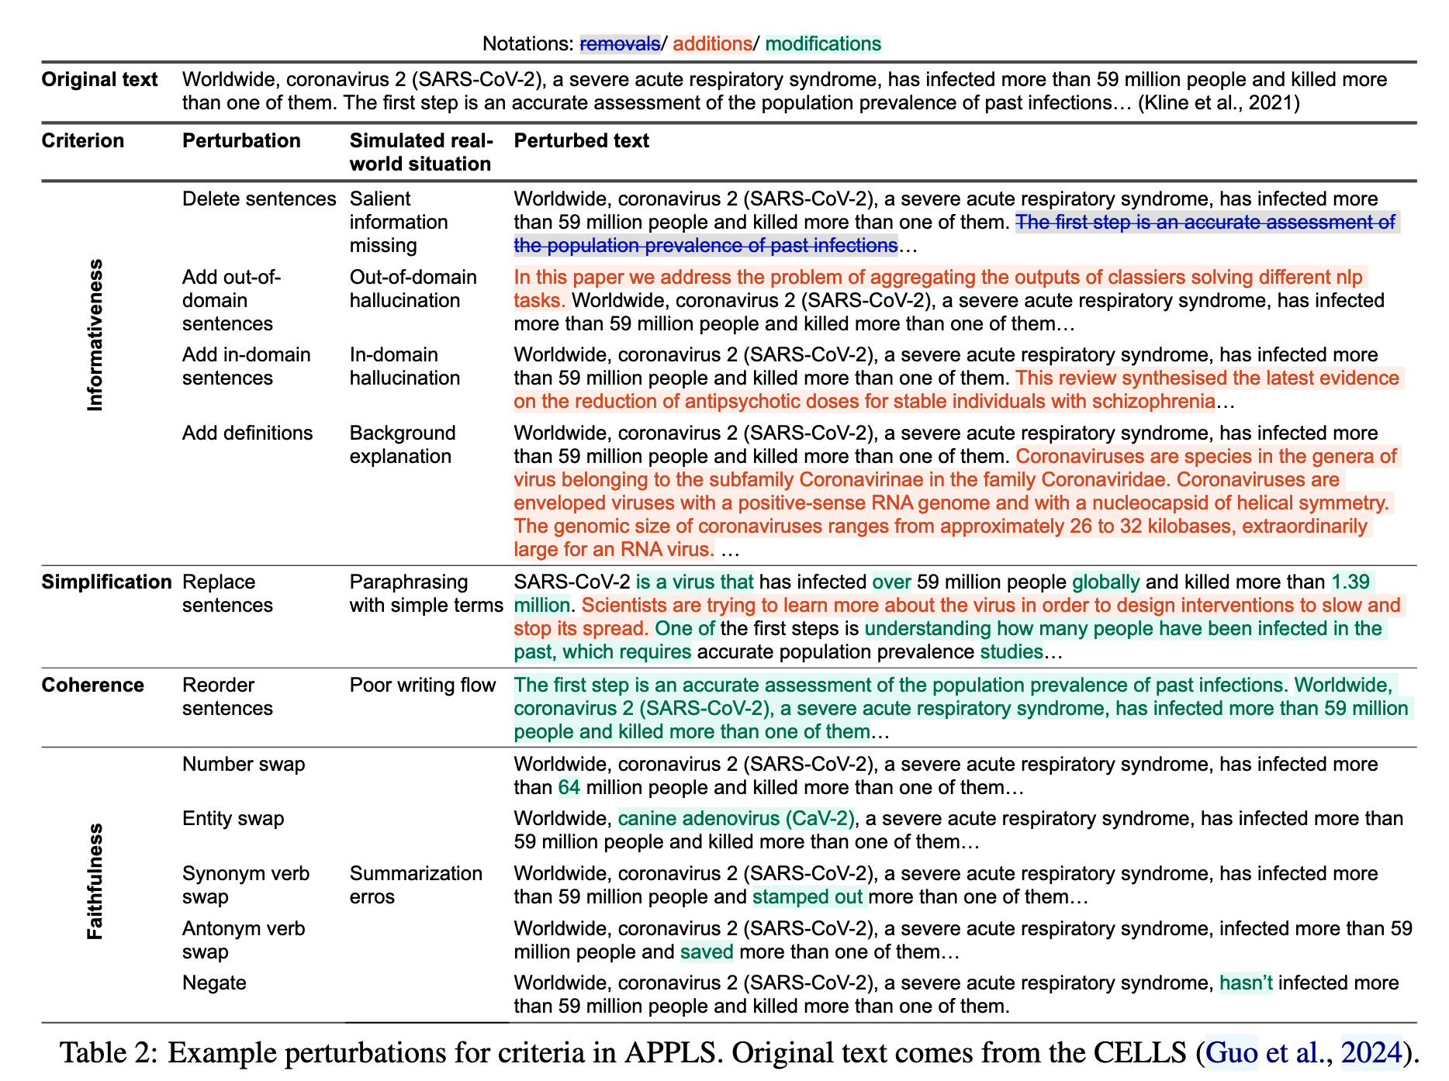
Motivation

Slide 7
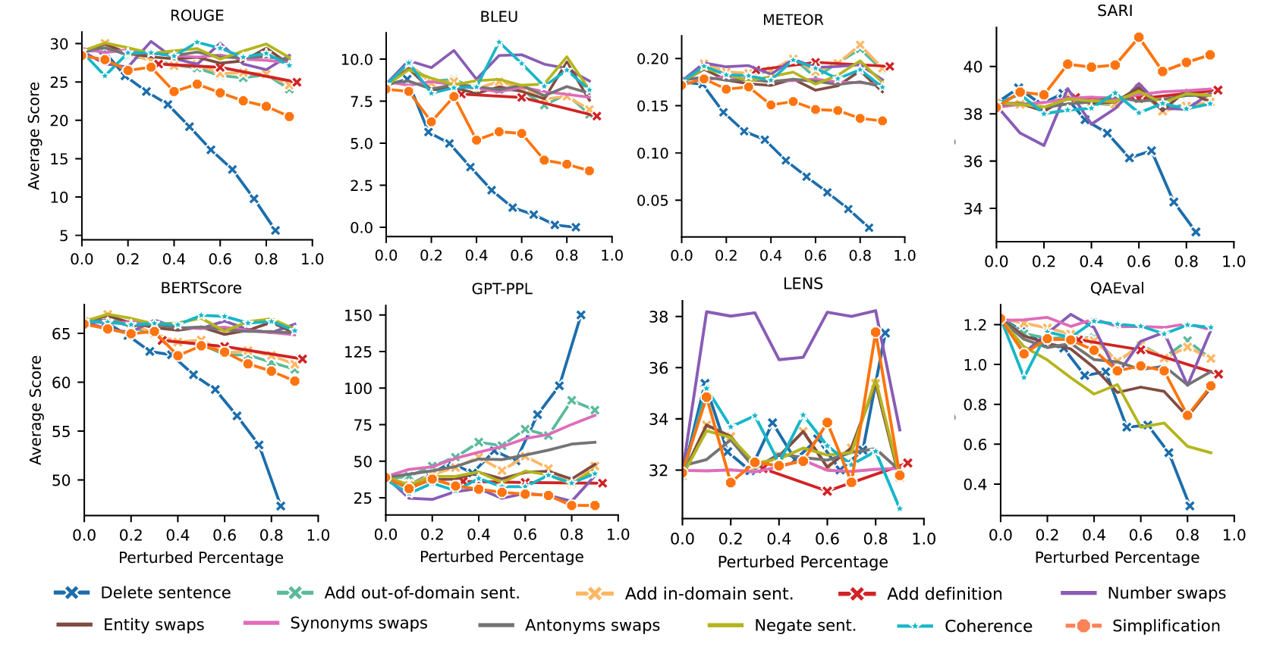
Results
Aside from SARI, current metrics exhibit shortcomings in evaluating simplicity.

Slide 8
Results
Metrics effectively capture informativeness, coherence, and faithfulness, with room for improvement.

Slide 9
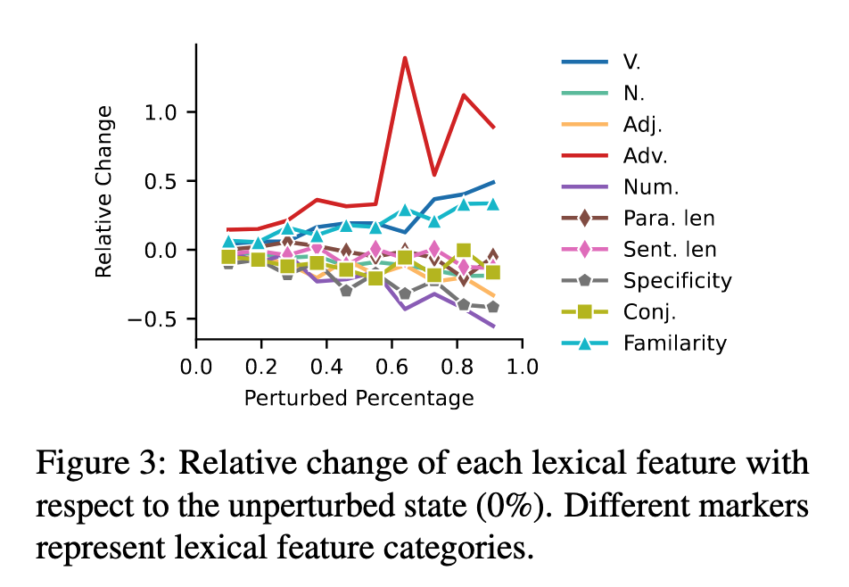
Results
Lexical features are useful measures of text simplicity.

Slide 10
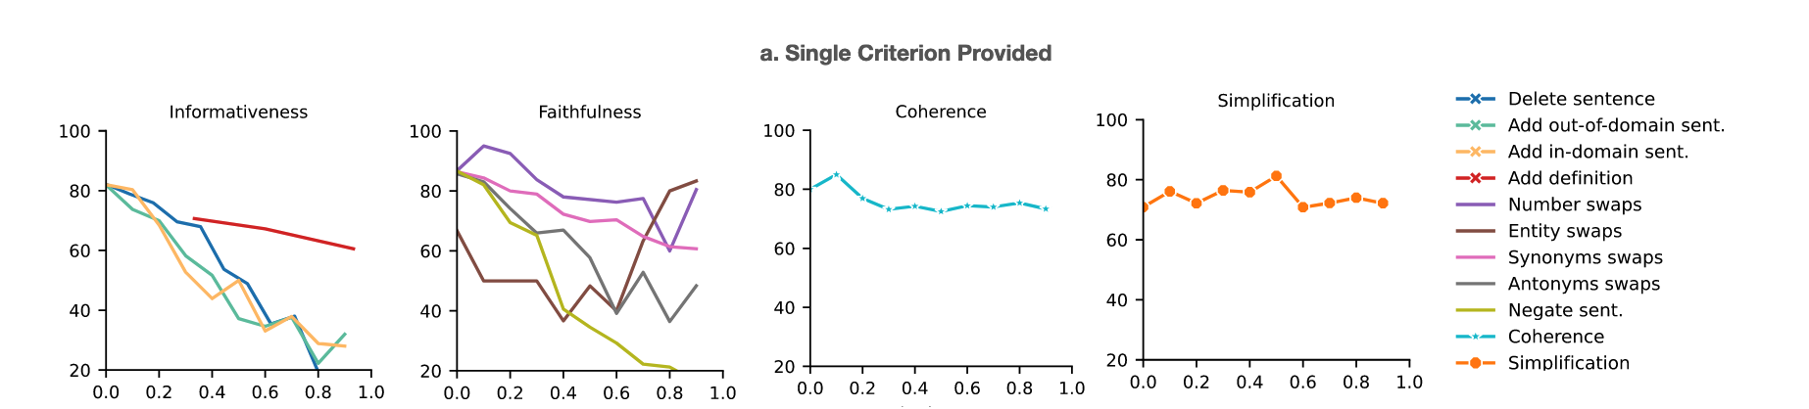
Results
Promptbased scores demonstrate sensitivity to perturbations in informativeness, faithfulness, and simplification, while showing less sensitivity to changes in coherence

Slide 11
Useful conclusion
No single metric is sensitive to all perturbations across criteria.
Consider using a metric suite.
SARI for simplicity, GPT-PPL for informativeness, LENS for coherence, and QAEval for faithfulness.

Slide 12
FineSurE: Fine-grained Summarization Evaluation using LLMs
ACL 2024
Hwanjun Song1,∗ Hang Su2,†, Igor Shalyminov2,†, Jason Cai2,†, Saab Mansour2,†
1 Korea Advanced Institute of Science and Technology
2 AWS AI Labs
Notes:
使用llm的细粒度的摘要评价

Slide 13
Motivation
Problem
Traditional methods like ROUGE do not correlate well with human judgment.
LLM-based metrics provide only summary-level assessment using Likertscale scores.
Criteria like ‘coherence’ and ‘relevance’ are difficult to evaluate even for human.
Contribution
Propose FineSurE, use more clear criteria through sentence-level keyfact alignment and fact checking, to enhance correlation with human preference.

Slide 14
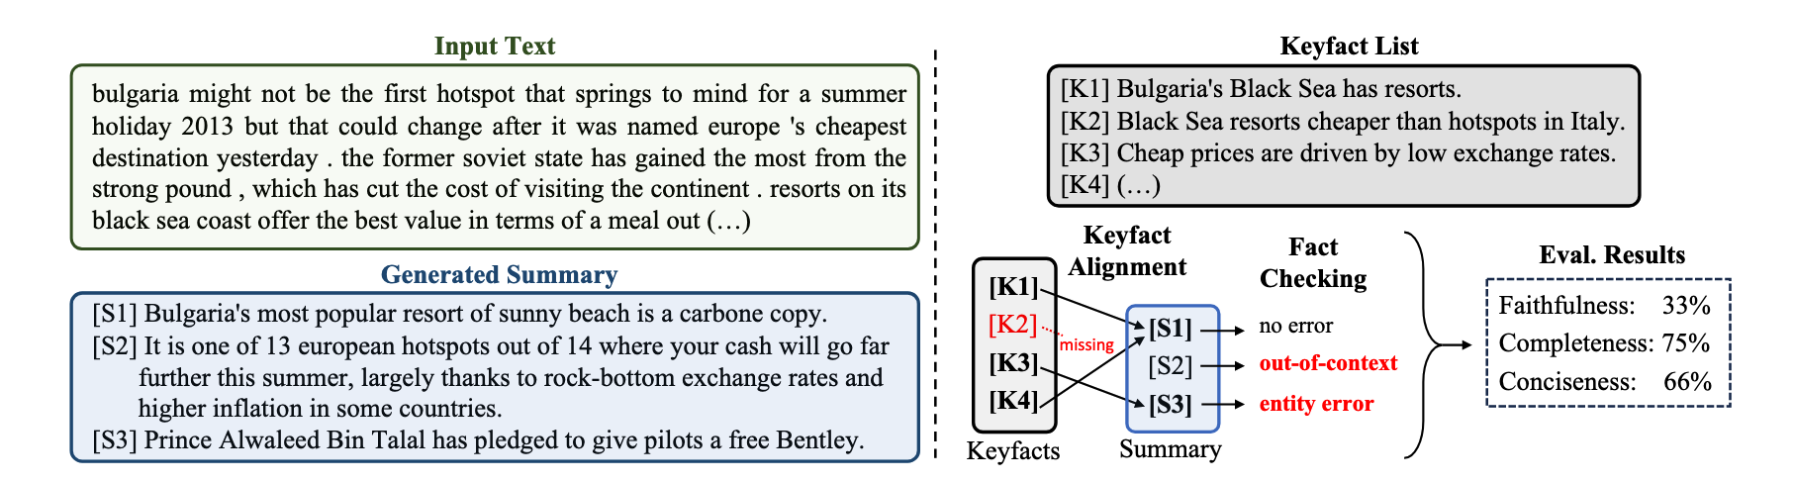
Method
keyfact extraction(LLM/human)
3 criteria
breakdown summary to sentences
More clear criteria: faithfulness, completeness, conciseness
Sentence-level evaluation through keyfact alignment and fact checking by LLM

Slide 15
Method-details
Use human-extracted keyfacts as default, or use LLM to extract keyfacts from a reference summary(lower quality)
Prompt LLM to carry out keyfacts alignment(instruction format) and fact checking(instruction format + categorization)

Slide 16
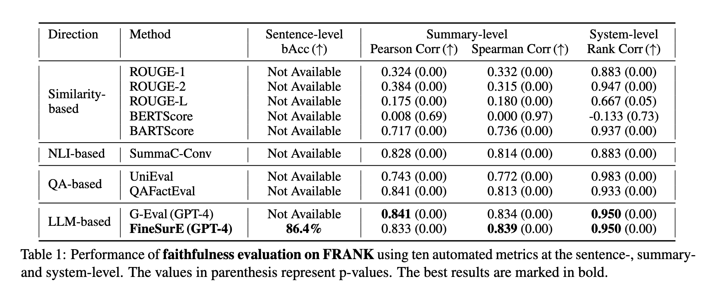
Evaluation-faithfulness
FRANK：summary dataset with sentence-level factuality error types.
Notes:
SummaC（Laban等人，2022）提出了一种轻量级模型，通过将输入文本分割为句子单元并聚合句子对之间的得分来促进自然语言推理。尽管性能有所提升，该模型仅专注于评估忠实度。
bacc=真阳和真阴的平均
皮尔森相关系数和斯皮尔曼相关系数都是衡量两个变量之间相关性的方法，皮尔森相关系数用于衡量两个变量之间的线性关系, 斯皮尔曼相关系数用于衡量两个变量之间的单调关系
系统级别衡量不同的摘要系统（不同模型）的平均finesure得分排序与人工标注的得分排序之间的相关性

Slide 17
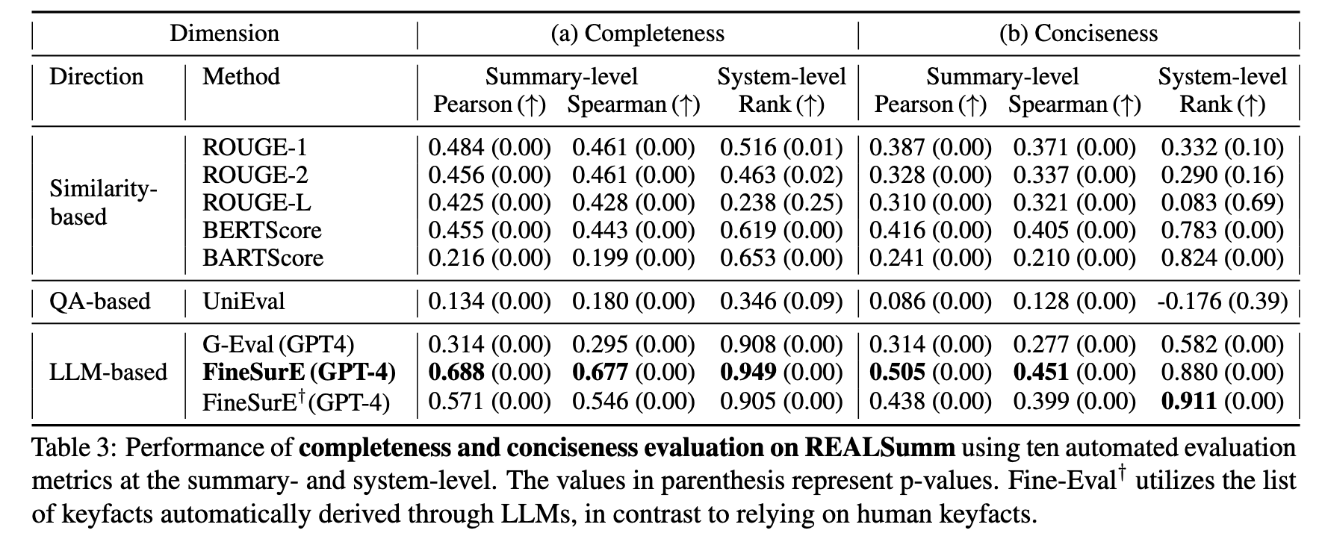
Evaluation-completeness and conciseness
REALSumm: summary dataset with human-extracted keyfacts

Slide 18
Conclusion
FineSurE, based on keyfact lists and using LLMs to generate the keyfacts, align them to the summary sentences and categorize the errors automatically
More clear criteria
fine-grained
Using of keyfacts

