Slide 1
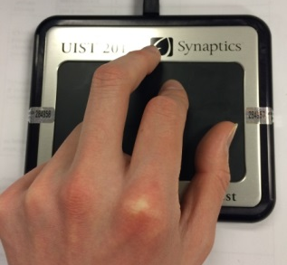
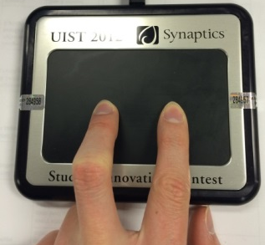
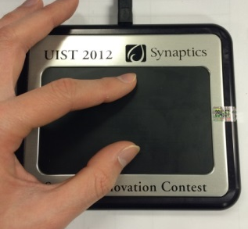
Interface Overview
Walking Mode
Segway Mode
Surfing Mode

Slide 2
Walking Mode
Alternate swiping on the Forcepad to move your character in walking mode
Press on the left or right sides of the Forcepad to turn left or right
The larger your “step” is, the further you move
The faster you switch fingers, the faster you move.

Slide 3
Segway Mode
Place two of your fingers horizontally on the Forcepad to switch to Segway mode
Rotate your fingers to rotate your Segway with the same angle
Your first touch with two fingers will be the baseline
The further you push away from baseline the faster you move

Slide 4
Surfing Mode
Place two of your fingers Vertically on the Forcepad to switch to Surfing mode
Rotate your fingers to rotate your Surf Board
The distance between your two fingers is your flying speed
The Surf Board will tilt forward or back depending on which finger presses harder

