Slide 1
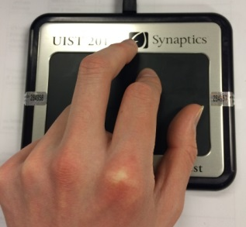
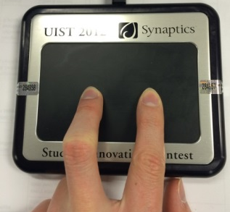
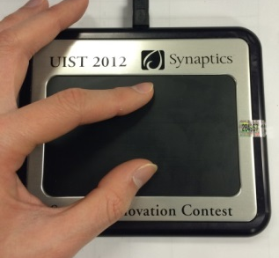
Interface Overview
Walking Mode
Segway Mode
Surfing Mode

Slide 2
Walking Mode
Alternate swiping on the Forcepad to move your character in walking mode
Press on the left or right sides of the Forcepad to turn left or right
The larger your “step” is, the further you move
The faster you switch fingers, the faster you move.

Slide 3
Segway Mode
Place two of your fingers horizontally on the Forcepad to switch to Segway mode
Rotate your fingers to rotate your Segway with the same angle
Your first touch with two fingers will be the baseline
The further you push away from baseline the faster you move

Slide 4
Surfing Mode
Orient two fingers, one in front of the other, on the Forcepad to switch to Surfing mode
Rotate your fingers to rotate your Surf Board
The distance between your fingers is your flying speed
The Surf Board will tilt forward or back depending on which finger presses harder

Slide 5
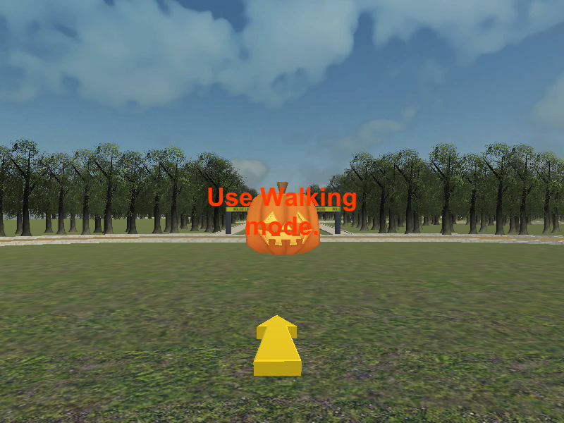
Swipe your fingers to use walking mode.
Collect the pumpkin the yellow arrow is pointing at.
Collect all the pumpkins as fast as you can.

Slide 6
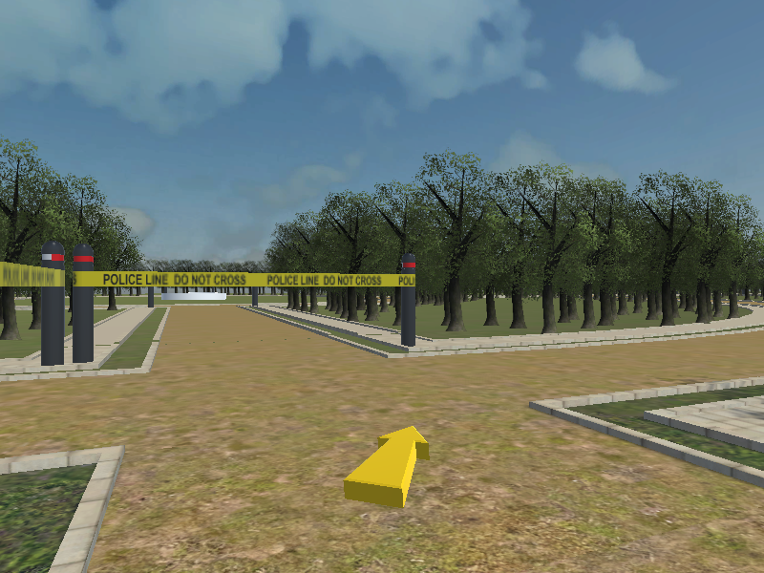
Place your finger horizontally to use Segway mode.
Follow the yellow arrow.
The arrow’s direction will change at intersections.
The final goal is a white ring. Try to reach the goal as fast as you can. (Primary Goal)
Try not to run into the forest or barrier tape.

Slide 7
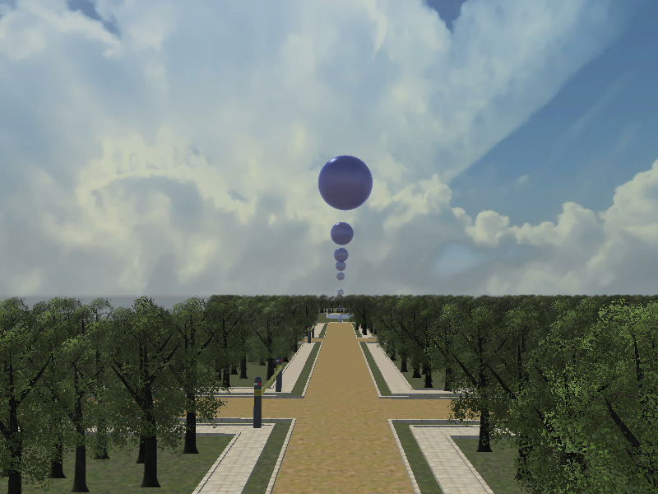
Place your finger on in front of the other to use Surfing mode.
Use the blue spheres as a guide and try to stay as close as possible. (Secondary Goal)
The final goal is a white ring. Reach it as fast as you can (Primary Goal)

