Slide 1
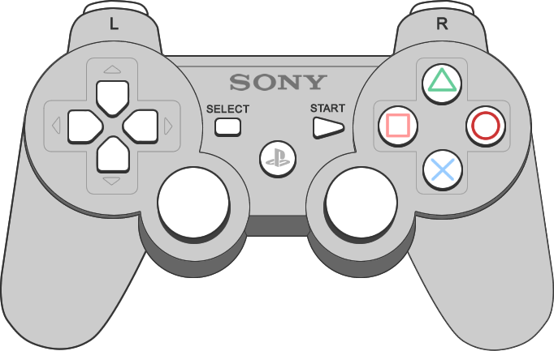

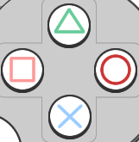
Interface Overview
Walking Mode
Segway Mode
Surfing Mode
Double Press To Reset Position

Slide 2
Walking Mode
Use left joystick to move your character
Use right joystick to rotate your view horizontally

Slide 3
Segway Mode
Use vertical axis of left joystick to move forward and backward
Use horizontal axis of left joystick to rotate left and right

Slide 4
Surfing Mode
Use left joystick to tilt your surf board
Use right joystick to control surfing speed

Slide 5
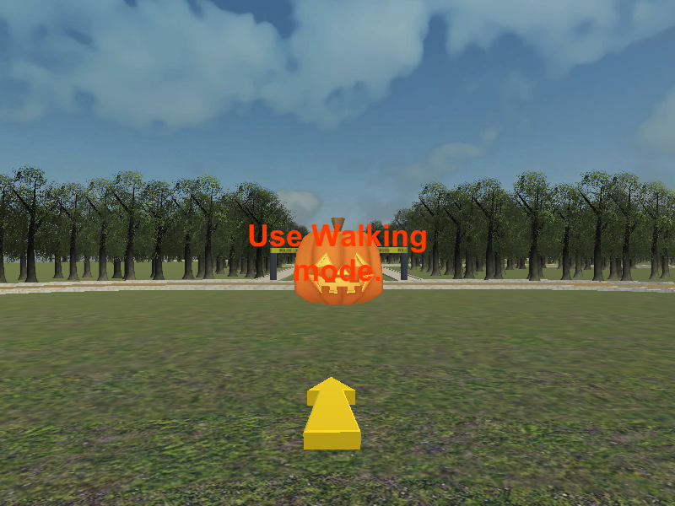
Press the button to use walking mode.
Collect the pumpkin the yellow arrow is pointing at.
Collect all the pumpkins as fast as you can.

Slide 6
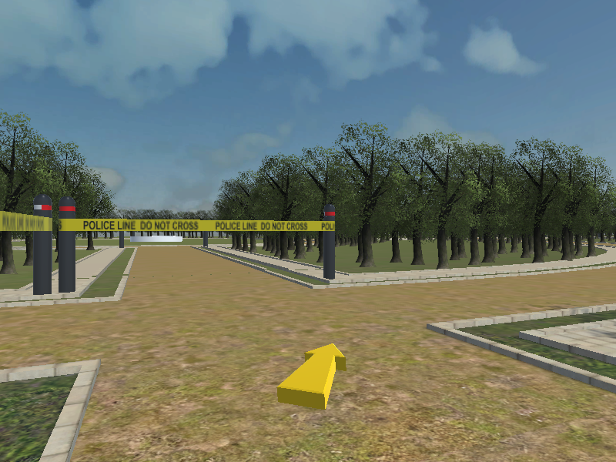
Press the button to use Segway mode.
Follow the yellow arrow.
The arrow’s direction will change at intersections.
The final goal is a white ring. Try to reach the goal as fast as you can. (Primary Goal)
Try not to run into the forest or barrier tape.

Slide 7
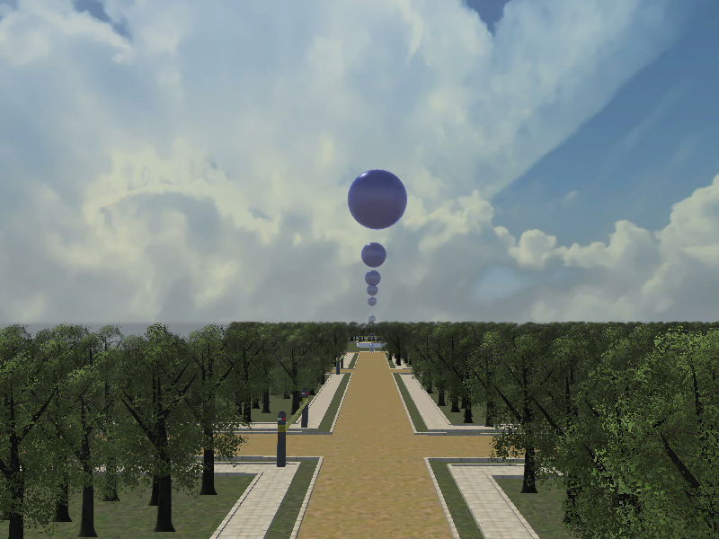
Press the button to use Surfing mode.
Use the blue spheres as a guide and try to stay as close as possible. (Secondary Goal)
The final goal is a white ring. Reach it as fast as you can (Primary Goal)

