Slide 1
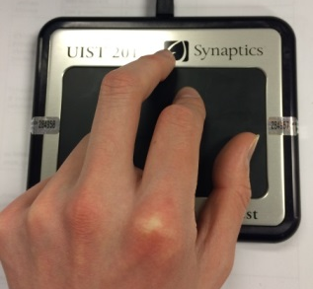
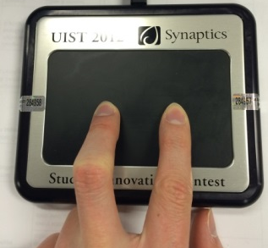
Interface Overview
Walking Mode
Segway Mode

Slide 2
Walking Mode
Alternate swiping on the Forcepad to move your character in walking mode
Press on the left or right sides of the Forcepad to turn left or right
The larger your “step” is, the further you move
The faster you switch fingers, the faster you move.

Slide 3
Segway Mode
Place two of your fingers horizontally on the Forcepad to switch to Segway mode
Rotate your fingers to rotate your Segway with the same angle
Your first touch with two fingers will be the baseline
The further you push away from baseline the faster you move

Slide 4
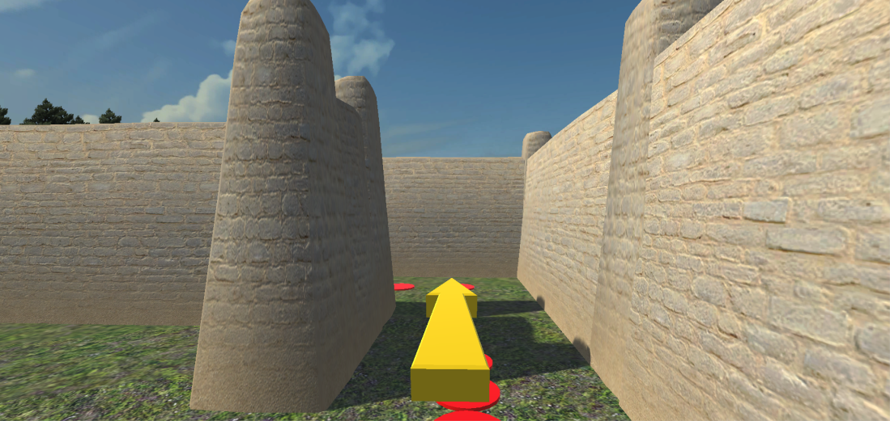
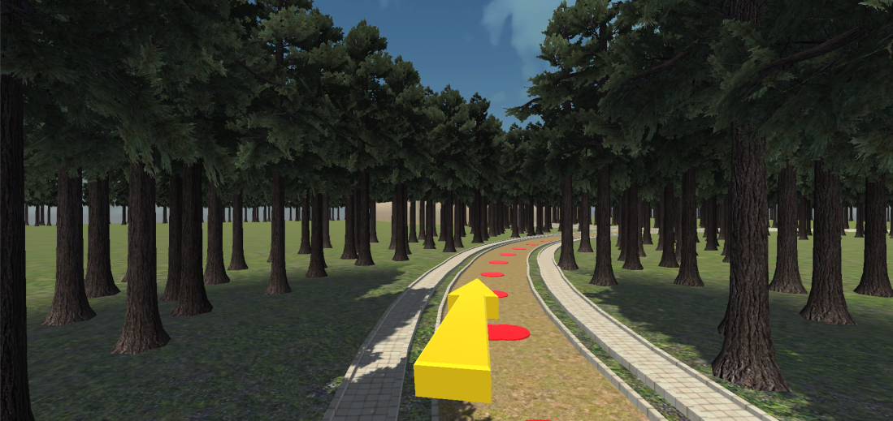
Follow the yellow arrow and the red dots
The distance between red dots could be different

