Slide 1
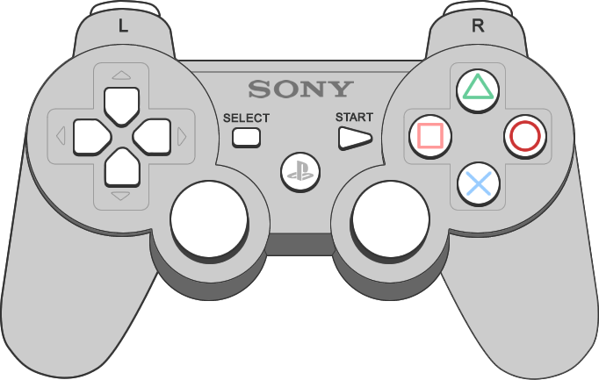
Interface Overview
1
2
2
Use left joystick to move your character
Use right joystick to rotate your view horizontally
Press to accelerate; Release to slow down

Slide 2
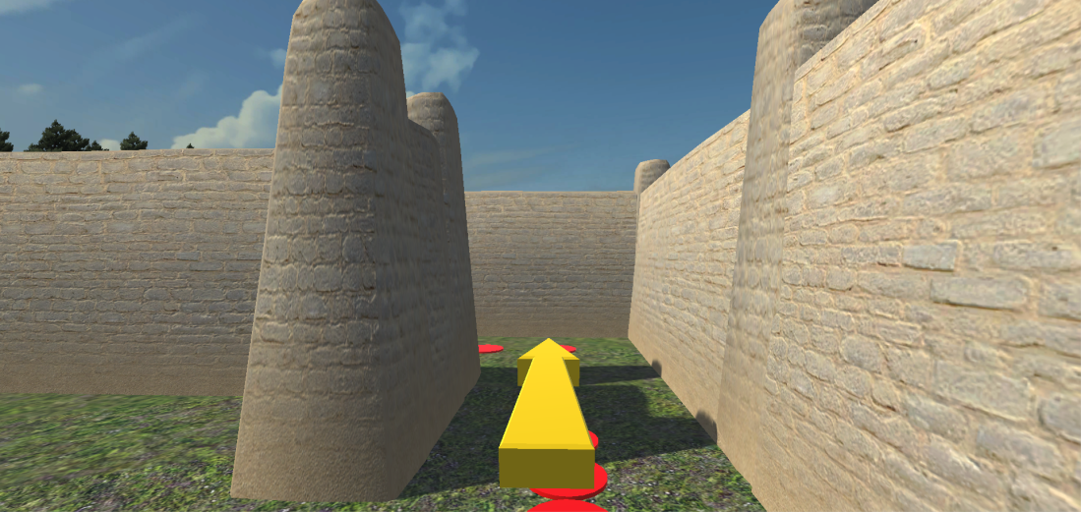
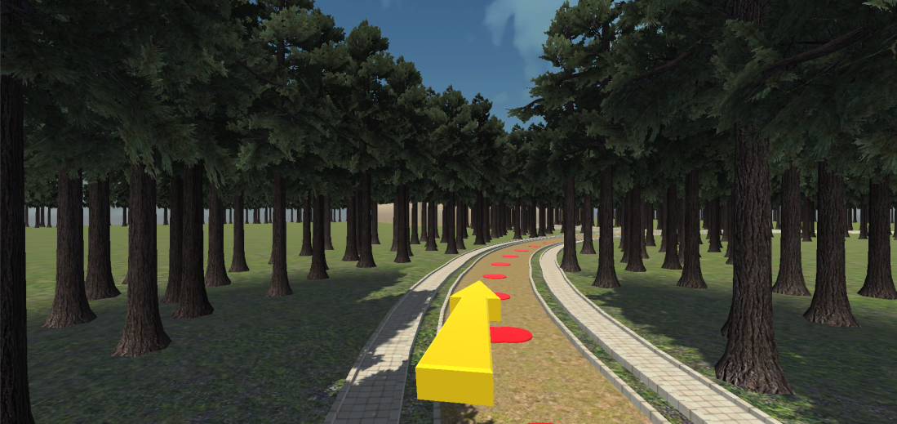
Follow the yellow arrow and the red dots
The distance between red dots could be different

