Slide 1
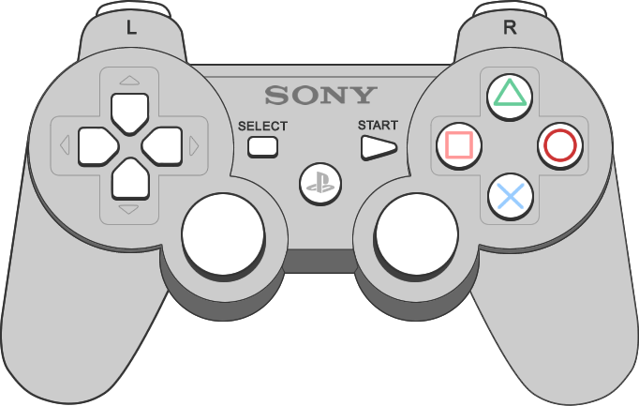

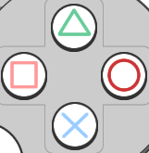
Interface Overview
Walking Mode
Segway Mode
Double Press To Reset Position

Slide 2
Walking Mode
Use left joystick to move your character
Use right joystick to rotate your view horizontally

Slide 3
Segway Mode
Use vertical axis of left joystick to move forward and backward
Use horizontal axis of left joystick to rotate left and right

Slide 4
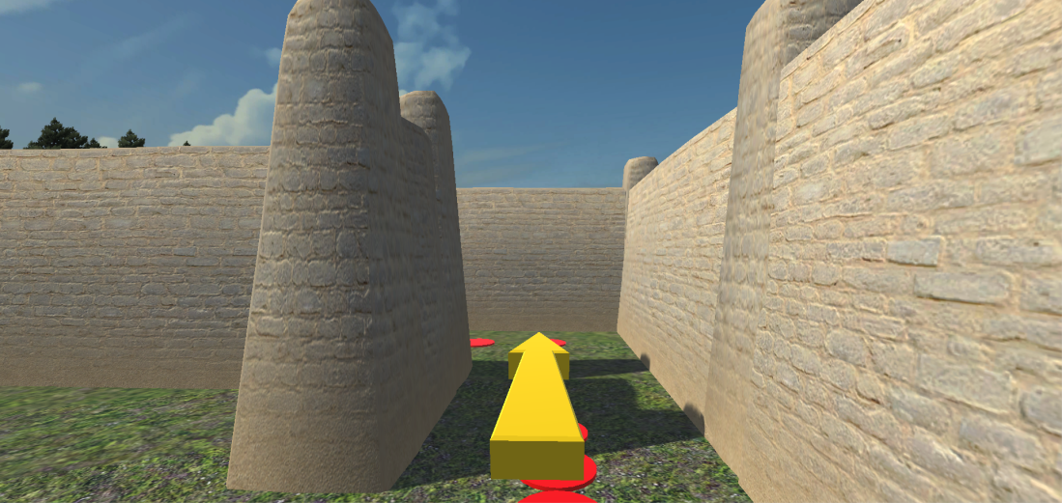
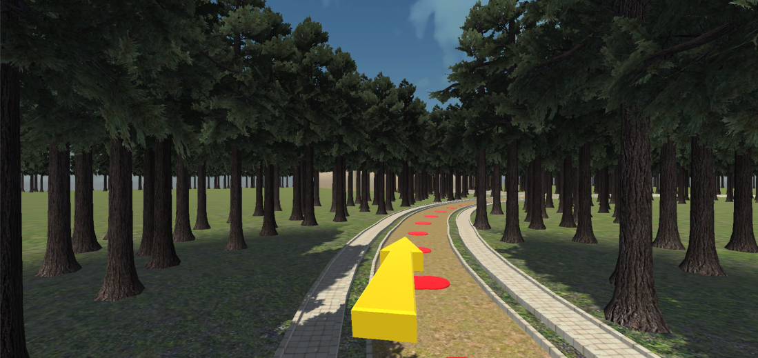
Follow the yellow arrow and the red dots
The distance between red dots could be different

