Slide 1
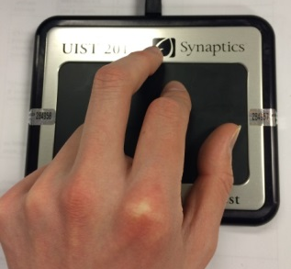
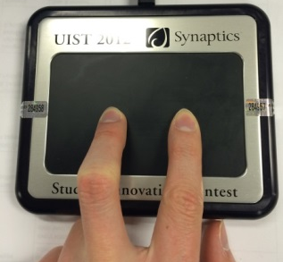
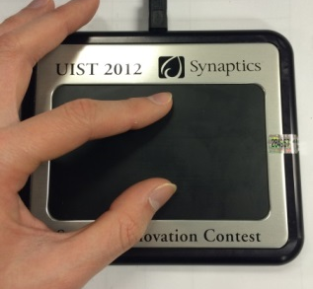
Interface Overview
Walking Mode
Segway Mode
Surfing Mode

Slide 2
Walking Mode
Swipe on the Forcepad to move your character in walking mode
The larger your “step” is, the further you move
The faster you switch finger, the faster you move.
Click on left or right side of Forcepad to turn left or right

Slide 3
Segway Mode
Place two of your fingers horizontally on Forcepad to switch to Segway mode
Your first touch with two fingers will be the baseline
The further you push away from baseline the faster you move
Rotate your fingers to rotate your “Segway” with the same angle

Slide 4
Surfing Mode
Place two of your fingers Verticallyon Forcepad to switch to Surfing mode
Distance between your two fingers is your flying speed
The “surfing board” will tilt to the side your finger press harder
Rotate your fingers to rotate your “surfing board”

