Slide 1
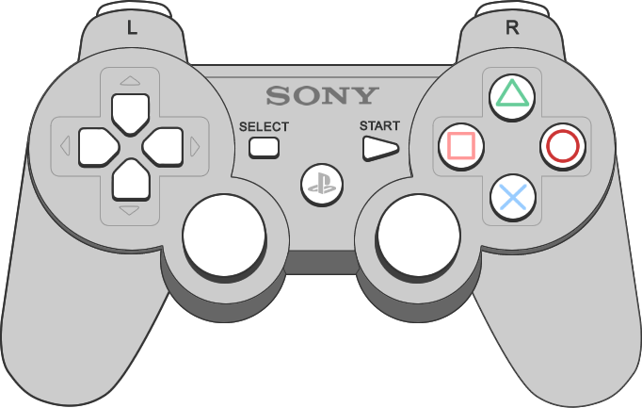

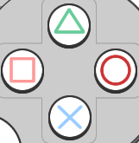
Interface Overview
Walking Mode
Segway Mode
Surfing Mode
Double Click To Reset Position

Slide 2
Walking Mode
Use left joystick to move your character
Use right joystick to rotate your view horizontally

Slide 3
Segway Mode
Use vertical axis of left joystick move forward and back
Use horizontal axis of left joystick to rotate left/right

Slide 4
Surfing Mode
Use left joystick to tilt your “surfing board”
Use right joystick to control surfing speed

