Slide 1
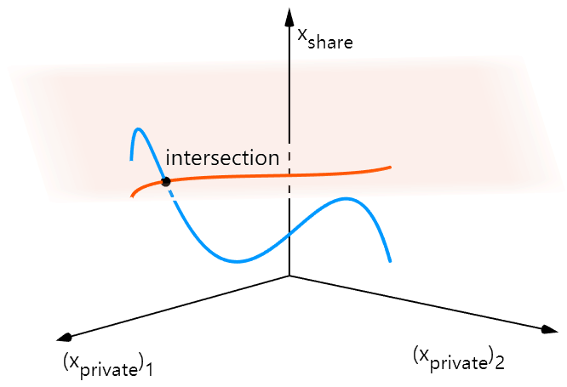
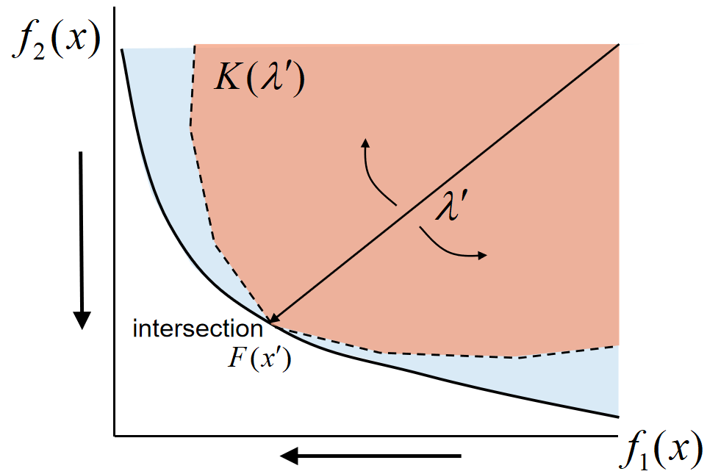

Slide 3
intersection

Slide 4
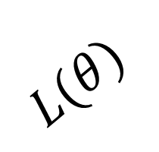
$$L(θ)$$

Slide 5




$$λ^{1}$$
$$λ^{2}$$
…
$$λ^{N}$$
$$F\left(x^{i}\right)$$

Slide 6

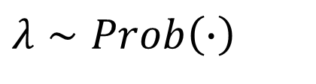
$$λ∼Prob\left(∙\right)$$
$$F(P)$$

Slide 7
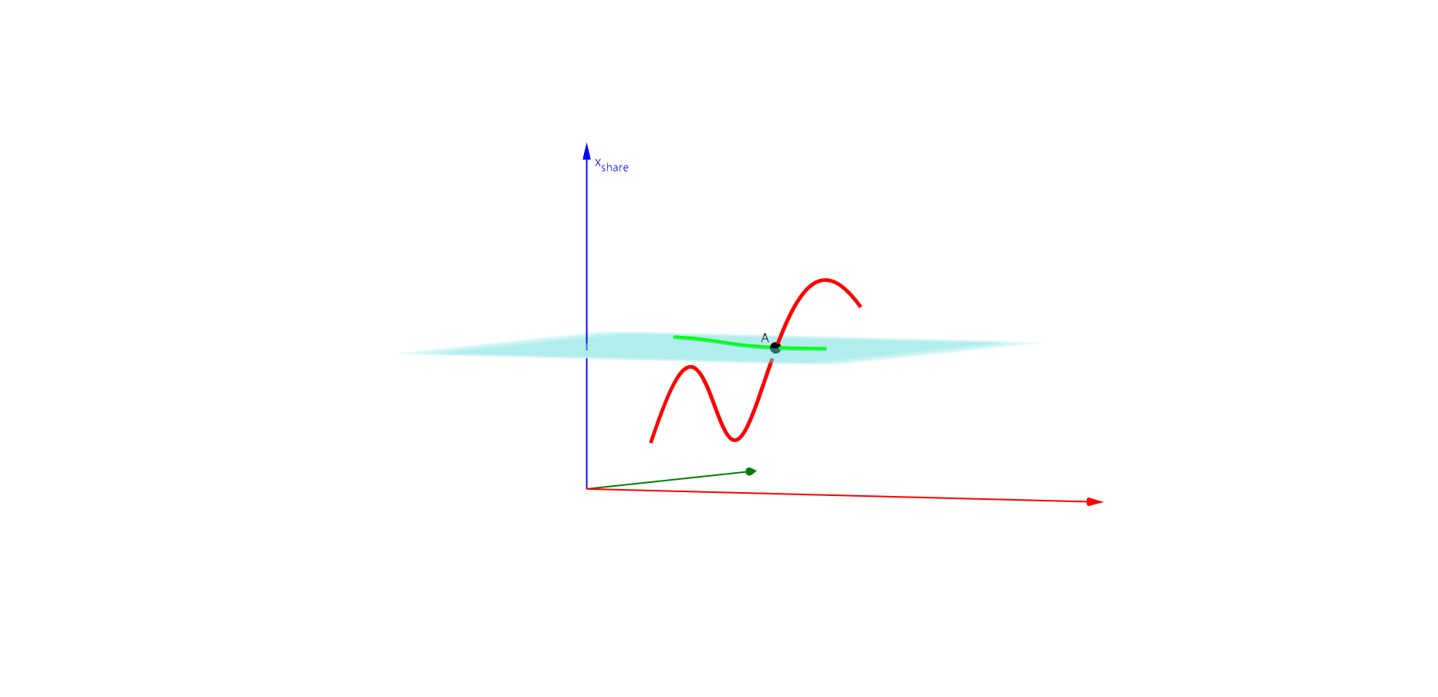
(t, (cos(2t) + 1) / 2, cos(4t - 1) / 2 + sin(t), t, 0, 2)
(t, (cos(2t) + 1) / 2, 1, t, 0.2, 1.8)

Slide 8
Task 2 Preference
generator
Task 1 Preference
a) Pareto Solution Generator
b) Pareto Set
c) Pareto Front

Slide 9
Obj 2 Preference
generator
Obj 1 Preference
a) Pareto Solution Generator
b) Pareto Set
c) Pareto Front

Slide 11

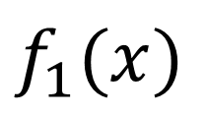

$$f_{2}(x)$$
$$\tilde{λ}$$
$$f_{1}(x)$$

Slide 12

$$f_{2}(x)$$
$$\tilde{λ}$$
$$f_{1}(x)$$

Slide 13

$$f_{2}(x)$$
$$\tilde{λ}$$
$$f_{1}(x)$$

Slide 14

$$f_{2}(x)$$
$$\tilde{λ}$$
$$f_{1}(x)$$

Slide 38
intersection

Slide 40
HyperNet
MTL Net
MTL Net
a) MTL
b) Controllable Pareto MTL

Slide 41
HyperNet
MTL Net

Slide 42
embd1：
HyperNet
embd2：
...
...
embdk：

Slide 43
HyperNet
Shared Params

Slide 44
HyperNet
Shared Params

Slide 45
HyperNet

Slide 46
a) Multiobjective Optimization
b) Controllable Pareto Optimization

Slide 47
...
a) Traditional Multiobjective Optimization
b) Pareto Solution Generator

Slide 48
...
a) Traditional Multiobjective Optimization
b) Pareto Solution Generator

Slide 49
a) Multiobjective Optimization
b) Controllable Pareto Optimization

Slide 50
model 1
model 2
...
model m

Slide 51
HyperNet
MTL Net
...

Slide 52
Task 1
Task 2
...
Task m

Slide 53
T1
T2
C1

Slide 54
T1
┴ T1
T2
┴ T2

Slide 55
T1
┴ T1
T2
┴ C1
C1
┴ T2

Slide 56
T1
┴ T1
┴ C2
T2
┴ C1
C1
C2
┴ T2

Slide 57
T1
T2
C1

Slide 58
Chapter 2:
Pareto MTL
extend
Chapter 3:
Continual Learning
improve
Chapter 4:
Controllable Pareto MTL
generalize
Chapter 5:
Expensive Optimization

Slide 59
Chapter 2:
Pareto MTL
extend
Chapter 3:
Continual Learning
improve
Chapter 4:
Controllable Pareto MTL
generalize
Chapter 5:
Expensive Optimization

Slide 60
Chapter 2:
Pareto MTL
extend
Chapter 3:
Continual Learning
improve
Chapter 4:
Controllable Pareto MTL
generalize
Chapter 5:
Expensive Optimization

Slide 61
Chapter 2:
Pareto MTL
extend
Chapter 3:
Continual Learning
improve
Chapter 4:
Controllable Pareto MTL
generalize
Chapter 5:
Expensive Optimization

Slide 62
Chapter 1:
Intro & Motivation
Chapter 2:
Pareto MTL
extend
Chapter 3:
Continual Learning
improve
Chapter 4:
Controllable Pareto MTL
generalize
Chapter 5:
Expensive Optimization
Chapter 6:
Conclusion

Slide 63
Chapter 1:
Intro & Motivation
Chapter 2:
Pareto MTL
extend
Chapter 3:
Continual Learning
improve
Chapter 4:
Controllable Pareto MTL
generalize
Chapter 5:
Expensive Optimization
Chapter 6:
Conclusion

Slide 64
Chapter 1:
Intro & Motivation
Chapter 2:
Pareto MTL
extend
Chapter 3:
Continual Learning
improve
Chapter 4:
Controllable Pareto MTL
generalize
Chapter 5:
Expensive Optimization
Chapter 6:
Conclusion

Slide 65
Chapter 1:
Intro & Motivation
Chapter 2:
Pareto MTL
extend
Chapter 3:
Continual Learning
improve
Chapter 4:
Controllable Pareto MTL
generalize
Chapter 5:
Expensive Optimization
Chapter 6:
Conclusion

Slide 66
Chapter 1:
Intro & Motivation
Chapter 2:
Pareto MTL
extend
Chapter 3:
Continual Learning
improve
Chapter 4:
Controllable Pareto MTL
generalize
Chapter 5:
Expensive Optimization
Chapter 6:
Conclusion

Slide 67
Chapter 1:
Intro & Motivation
Chapter 2:
Pareto MTL
extend
Chapter 3:
Continual Learning
improve
Chapter 4:
Controllable Pareto MTL
generalize
Chapter 5:
Expensive Optimization
Chapter 6:
Conclusion

Slide 68
WP 1:
Efficient Decomposition
theoretical support
WP 2:
Manifold Learning
basic component
WP 3:
Constrained Manifold
Application:
Antenna Design
Application:
Multi-Task Learning

