Slide 1


Evidence-Checking Agentic RAG for Radiology Report-Grounded Question Answering with Linked X-ray Cases
Case-Scoped, Evidence-Checked, Reproducible
P2 Research Project Presentation
Presenter: Zhang Yue (22097191)
Supervisor: Dr. Uzair Ishtiaq
Programme: Master of Artificial Intelligence, Universiti Malaya
Date: August 2026
www.um.edu.my
Notes:
[Sources]
- Project manuscript: docs/P2_FINAL_MANUSCRIPT.md

Slide 2
P2 Defence Route: Problem, Evidence, Results, Demo
1.
Problem and research questions
2.
Real data and two-stage design
3.
Evidence-checking Agent workflow
4.
V1 open-corpus results
5.
V2 case-scoped results
6.
Dashboard, V3 status, conclusions
2
Notes:
[Sources]
- Project manuscript: docs/P2_FINAL_MANUSCRIPT.md

Slide 3
The core problem is not just hallucination
Why RAG still fails
Study focus
•
Generic questions may not identify a unique radiology case.
Domain
Radiology report-grounded QA
•
A retriever can select a clinically similar but wrong patient.
Evidence
Real IU X-Ray/OpenI cases
•
Top-k evidence can combine findings from several reports.
Core variable
V1: open-corpus stress test
Comparison
V2: patient-known workflow
•
The generator may omit evidence or add unsupported claims.
Goal
Separate scope, retrieval, answer, support
•
A verifier may approve evidence from the wrong patient.
Key message: evidence faithfulness and patient correctness must be evaluated separately.
3
Notes:
[Sources]
- Lewis et al. (2020): https://proceedings.neurips.cc/paper/2020/hash/6b493230205f780e1bc26945df7481e5-Abstract.html
- Project validity audit: experiments/final_optimized/validity_audit/research_validity_audit.json

Slide 4
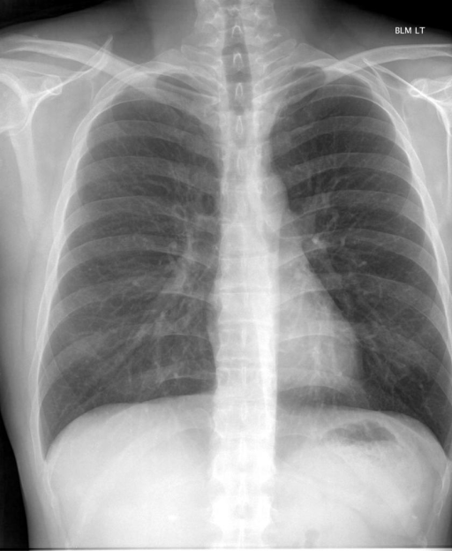
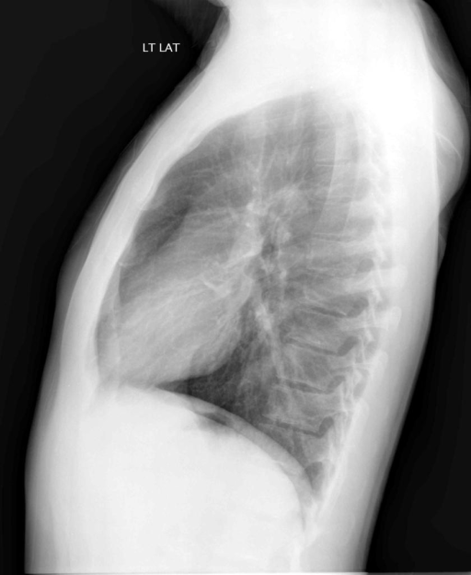
Three failure modes compound across the pipeline
1. Identifiability failure
2. Retrieval and contamination
3. Verification blind spot
Pooled evidence can hide the error
Q: Which case is intended?
Rank 1
Wrong case is clinically similar.
A: Not uniquely known.
generic question; many compatible cases
Top-k
Several reports enter one prompt.
Answer
A coherent mixed-case response is generated.
Retrieved case
Wrong patient
Semantic similarity cannot establish patient identity.
Support audit
83.4%
Local support can exist even when case ownership is wrong.
Target match
No
Risk: the task may be under-specified.
The checker asks whether the answer follows from retrieved evidence.
Risk: cross-case contamination.
But retrieved evidence may belong to the wrong case.
Evidence faithfulness and patient correctness are different properties.
4
Notes:
[Sources]
- Project validity audit: experiments/final_optimized/validity_audit/research_validity_audit.json

Slide 5
Research questions and delivered contributions
Aim: preserve case boundaries and distinguish retrieval correctness from evidence faithfulness.
Research questions
Delivered contributions
RQ1
How does RAG affect report-grounded answer quality versus LLM-only?
Data
real OpenI case records with reports and linked image metadata
RQ2
How do sparse, dense, hybrid, reranked, and adaptive retrieval compare?
lexical, dense, hybrid, adaptive, generation, and extractive baselines
Compare
RQ3
Where does evidence checking fail to protect against wrong-patient retrieval?
Audit
cross-case contamination, oracle retrieval, verifier stress, abstention
RQ4
What changes when patient identity is supplied as explicit case scope?
Deliver
reproducible dashboard, traces, frozen results, and a preserved blinded-review protocol
Contribution: reproducible boundary-aware failure analysis, not a clinical deployment claim.
5
Notes:
[Sources]
- Project manuscript: docs/P2_FINAL_MANUSCRIPT.md

Slide 6
Two benchmarks answer different questions
V1: open-corpus stress test
V2: patient-scoped workflow
Controls and evaluation
Cases
120 cases / 360 questions
Generator
Qwen2.5-1.5B-Instruct
Main
600 previously unused cases
Split
84 development / 36 held-out
Retrieval
BM25, MedCPT, hybrid, adaptive
Confirm
120 disjoint confirmation cases
rules + Medical-NLI audit
Verifier
Task
retrieve one target from the corpus
Scope
case ID supplied; evidence case-filtered
Statistics
grouped bootstrap + paired tests
Risk
query ambiguity and wrong-patient retrieval
Human review
Protocol retained; no ratings or validation claim
V1 tests open-corpus retrieval; V2 tests patient-isolated workflow control. Scores are not directly comparable.
6
Notes:
[Sources]
- Final result registry: experiments/final_submission/final_results_registry.json

Slide 7
Real OpenI data with case-disjoint evaluation
Linked report and X-ray case example
Processed inventory
V2 confirmation
Cases
3,851
120 unseen cases / 360 questions
stable case ID + report sections
•
case-disjoint cohort
Images
7,466
•
three report-derived prompts per case
linked projection metadata
•
explicit patient ID supplied
•
text-only model evidence
V1 held-out
36 cases
•
linked images shown, not modeled
PA view
Lateral view
108 questions; no case overlap
Case ID: CXR2041 Image refs: CXR2041_IM-0685-*
All records preserve case ownership and source sections.
Report evidence from XML
Why the split matters
FINDINGS: No pneumothorax. No large pleural effusions. Heart size is normal. No acute focal space opacities.
Grouping is by case, not by question row.
IMPRESSION: No acute cardiopulmonary abnormalities.
Modeled evidence is report text; linked X-rays support traceability and dashboard presentation only.
7
Notes:
[Sources]
- Demner-Fushman et al. (2016): https://doi.org/10.1093/jamia/ocv080
- Project data manifest: docs/DATA.md

Slide 8
The Agent acts through explicit, auditable stages
1. Scope
2. Plan and retrieve
3. Generate
4. Audit and act
case ID or allowed corpus + ownership boundary
infer intent rank evidence + adaptive abstention
evidence-only prompt + structured answer
claim checks preserve | flag review | abstain
Why this is an Agent
Important boundary
•
It selects retrieval or abstention actions.
This is not an autonomous clinical agent. Images are not model inputs, and verification is advisory.
•
It emits an inspectable action trace.
•
A calibrated policy controls preserve, flag, or abstain.
8
Notes:
[Sources]
- Project Agent design: docs/AGENTIC_RAG.md
- Final result registry: experiments/final_submission/final_results_registry.json

Slide 9
V1 retrieval remains the dominant bottleneck
Locked retrieval metrics
Retrieval-conditioned answer quality
Hit@1
0.287: only 31 of 108 targets at rank 1
Correct case
Token-F1 0.451
Hit@20
0.509
Wrong case
Token-F1 0.117
MRR
0.331
Oracle evidence
verified Token-F1 0.425
Final system
verified Token-F1 0.206
Coverage
0.926
Oracle gap
+0.219
Abstention
0.074
Retrieval failure caps every downstream component: generation cannot recover evidence it never receives.
9
Notes:
[Sources]
- Final result registry: experiments/final_submission/final_results_registry.json

Slide 10
V1 gains are not statistically conclusive
Held-out Token-F1
Statistical interpretation
LLM only
0.079
95% confidence interval
[0.167, 0.246]
Report-RAG + checker
0.153
vs Case-BM25
+0.035
Case-BM25 + checker
0.172
Unadjusted p
0.0145
Holm-adjusted p
0.0870
Previous hybrid
0.204
RadGraph F1
0.163
Final adaptive system
0.206
The point estimate improves, but family-wise adjustment prevents a definitive superiority claim.
10
Notes:
[Sources]
- Final result registry: experiments/final_submission/final_results_registry.json
- Grouped statistics: experiments/final_optimized/statistics/held_out_test_grouped_bootstrap.json

Slide 11
A verifier can be faithful to the wrong patient
1. Wrong case selected
2. Local support found
3. Patient answer fails
Verifier reads retrieved evidence
Target: intended case finding
Claim
Answer sentence is plausible.
Retrieved: similar case
ranked first by semantic similarity
Evidence
A matching sentence is present.
Decision
Checker returns supported.
Wrong-case rows
69 of 108
The answer is conditioned on the wrong report.
Support rate
83.4%
Local entailment succeeds inside the wrong case.
Answer F1
0.117
Retrieval ownership is already broken.
The verifier is answering the wrong question correctly.
Support is not patient correctness.
Case ownership must be enforced first.
The verifier asks 'supported here?', not 'correct patient's record?'
11
Notes:
[Sources]
- Cross-case audit: experiments/final_optimized/contamination/report_rag_cross_case_contamination.json
- Project validity audit: experiments/final_optimized/validity_audit/research_validity_audit.json

Slide 12
V2 isolates the patient, but the task is easy
Confirmation cohort
Validity audit
Evidence recall
0.994
Extractive baseline
Token-F1 0.997
Qwen Token-F1
0.570
Qwen minus extractive
-0.427
95% confidence interval
[0.556, 0.584]
Candidate pool = qrels
100% of queries
Routed Hit@1
1.000; routing check
Evidence support
0.830
Verifier policy
audit_only; filtering reduced F1
Answer abstention
0.612
V2 validates case isolation and workflow control, not semantic retrieval or a generation gain.
12
Notes:
[Sources]
- V2 confirmation results: experiments/benchmark_v2/confirmation_evaluation/test_generation_summary.json
- V2 validity audit: experiments/benchmark_v2/validity_audit/benchmark_v2_validity_audit.json

Slide 13
The contribution is boundary-aware evaluation
Patient scope
Enforce record ownership before semantic retrieval.
Cross-case contamination
Quantify when pooled evidence mixes patient records.
Retrieval correctness
Report target-case retrieval separately from answer support.
Verifier limits
Stress-test polarity and expose wrong-patient confidence.
Evidence faithfulness
Measure whether each claim follows from selected evidence.
Reproducibility
Freeze splits, policies, result registry, and action traces.
Answer correctness
Keep reference match distinct from local evidence support.
Core contribution
A reproducible method for showing which patient record was selected, what evidence was used, whether the answer followed from it, and when the system should abstain or request review.
13
Notes:
[Sources]
- Project manuscript: docs/P2_FINAL_MANUSCRIPT.md
- Final result registry: experiments/final_submission/final_results_registry.json

Slide 14
Demonstration and V3 status
Live dashboard
Agent actions
V3: conditional RadQA extension
•
Select an explicit patient case
1
Scope the allowed case
•
Official SQuAD-style parser ready
•
Ask a report-grounded question
Plan and retrieve evidence
•
Answerable and unanswerable metrics ready
2
•
Inspect retrieved evidence
•
Patient-disjoint split guard ready
3
Generate and audit claims
•
Read the Agent action trace
•
Threshold selection restricted to development
•
Observe answer, abstention, or review flag
4
Explain the final action
•
Official credentialed files not yet available
Demo flow
Select
Scope
Retrieve
Audit
Explain
Limits
No independent human evaluation
V1 query ambiguity
V2 routing is too easy
Text-only evidence
RadQA needs credentialed data
No clinical deployment
V3 enters the thesis only after legal PhysioNet access; synthetic fixtures are software tests, not results.
14
Notes:
[Sources]
- V3 runbook: docs/BENCHMARK_V3_RADQA_RUNBOOK.md
- Soni et al. (2022): https://aclanthology.org/2022.lrec-1.672/
- Official RadQA access page: https://physionet.org/content/radqa/1.0.0/

Slide 15
Conclusion: patient scope must precede retrieval
What the project establishes
•
RAG beats LLM-only, but absolute V1 answer quality remains low.
•
Correct-case retrieval is the dominant measured bottleneck.
Thank You
•
Evidence support does not prove patient correctness.
Questions & Answers
•
Explicit case scope prevents cross-case retrieval in V2.
•
V2 does not show that generation adds value over extraction.
Zhang Yue Master of Artificial Intelligence
•
Agent decisions are auditable and controlled by calibrated policies.
•
Automated evidence metrics are reported; no human or clinical validation is claimed.
15
Notes:
[Sources]
- Project manuscript: docs/P2_FINAL_MANUSCRIPT.md
- Final result registry: experiments/final_submission/final_results_registry.json

