Slide 1
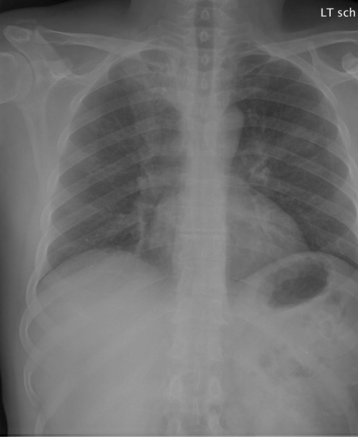
MASTER OF ARTIFICIAL INTELLIGENCE
Retrieval-Augmented
Medical Question Answering
over Paired Radiology
Images and Reports
Zhang Yue | 22097191
Final V9 study and system demonstration
Notes:
Open by defining the final task as new-patient similar-case evidence retrieval, not target-report identification.
[Sources]
- Local V9 study record: docs/V9_TECHNICAL_FREEZE.md
- Image: data/raw/openi_official_images/CXR1000_IM-0003-1001.png (OpenI/IU X-Ray source; Demner-Fushman et al., 2016, https://doi.org/10.1038/sdata.2016.43)
[/Sources]

Slide 2
V9 FINAL STUDY
The task is evidence retrieval for a new patient
Available at inference
01
Target chest radiograph
Hidden during inference
The image being interpreted belongs to the new case.
Target report
02
Clinical indication
Used only after generation for offline retrieval relevance and report-reference QA scoring.
Pre-report clinical context, not the hidden reference report.
03
Medical question
A findings or impression question to be answered.
Retrieved reports come from other cases and are labelled as historical analogies, not proof about the target patient.
This framing removes the closed-set shortcut that dominated the preliminary studies.
02
Notes:
Emphasize the separation between target-case inputs, hidden reference information, and other-case evidence.
[Sources]
- docs/V9_TECHNICAL_FREEZE.md
- docs/P2_V9_FINAL_MANUSCRIPT.md, Sections 1.2 and 3.14
[/Sources]

Slide 3
V9 FINAL STUDY
The research question is now clinically coherent
Can aligned image information improve retrieval of clinically similar historical cases and, in turn, improve report-reference-consistent answers?
RQ1
Retrieval
RQ2
Alignment
Does learned multimodal retrieval improve graded relevance over the strongest frozen component?
Does the gain depend on the correct target image rather than arbitrary image content?
RQ3
QA transfer
RQ4
Agent control
Does better retrieved evidence improve MedGemma answers over no retrieval?
Can a bounded agent suppress unsupported historical-support claims?
03
Notes:
State the four questions before describing architecture so every later result has a clear purpose.
[Sources]
- docs/P2_V9_FINAL_MANUSCRIPT.md, Section 1.4
- docs/V9_TECHNICAL_FREEZE.md
[/Sources]

Slide 4
V9 FINAL STUDY
V5-V8 identified the shortcut; V9 changed the task
V5
V6
V7
V8
V9
Closed-set
Modernized
Adaptive fusion
External gate
Final task
Correct image improved target-report reranking and QA.
MedSigLIP and MedGemma replicated alignment-specific gains.
Query-conditional alpha did not beat global alpha; mixed result retained.
CheXpert Plus local subset was too small; prespecified no-go.
New-patient image plus other-case historical evidence.
V9 is the primary final study. Earlier versions remain preliminary evidence and are not re-tuned.
04
Notes:
Use this slide to explain continuity without presenting version history as the contribution itself.
[Sources]
- README.md, Study Structure
- docs/V9_TECHNICAL_FREEZE.md
[/Sources]

Slide 5
V9 FINAL STUDY
The complete source was reallocated before modelling
3,851
3,759
2,608
752
OpenI source cases
Primary stratifiable cases
Report-bearing Train bank
Untouched Test cases
70%
10%
20%
Train: 2,631
Validation: 376
Test: 752
Reranker training and the historical evidence bank.
Checkpoint and decision selection only.
One frozen confirmation evaluation.
Primary split and fixed artifacts are deterministic; no V9 outcome changed a case, prompt, threshold, or metric.
05
Notes:
Explain why the 279-case external subset was not used as the main study and why all 3,851 OpenI cases were instead reallocated.
[Sources]
- docs/V9_TECHNICAL_FREEZE.md
- data/splits/v9_full_source_split_freeze.json
- docs/V8_TECHNICAL_FREEZE.md
[/Sources]

Slide 6
V9 FINAL STUDY
Target and historical evidence stay separate
1
2
3
4
5
Target inputs
Shortlist
Learned reranker
MedGemma QA
Bounded audit
Image + indication + question
BM25 over 2,608 other-case reports
9 features -> 32 -> 16 -> 1
Target answer + labelled analogies
One retry or remove unsupported support
The hidden target report is absent from every inference stage.
It appears only in offline qrels and QA reference scoring after the answer is produced.
06
Notes:
Walk left to right. The agent audits only claims attributed to retrieved historical reports; it does not inspect target-image pixels.
[Sources]
- docs/P2_V9_FINAL_MANUSCRIPT.md, Sections 3.17-3.21
- docs/V9_TECHNICAL_FREEZE.md
[/Sources]

Slide 7
V9 FINAL STUDY
Five retrieval systems isolate the value of each modality
R0
BM25
Indication + question -> report text
Text baseline
R1
Image-image
Target image -> historical image
Strongest frozen component
R2
Image-report
Target image -> report chunks
Cross-modal diagnostic
R3
Fixed multimodal
Predefined score fusion
No learned parameters
R4
Learned MLP
Candidate-level 9-feature reranking
Primary model
07
Notes:
Make clear that R4 is compared with R1, not only BM25, because image-image was already the strongest frozen component.
[Sources]
- docs/V9_RETRIEVAL_DEVELOPMENT_DECISION_RECORD.md
- docs/V9_RETRIEVAL_CONFIRMATION_PROTOCOL.md
- docs/V9_TECHNICAL_FREEZE.md
[/Sources]

Slide 8
V9 FINAL STUDY
The only trained model has 865 parameters
Candidate feature vector
9 -> 32 -> 16 -> 1
01 BM25 score
02 image-image score
MLP reranker
03 image-report score
04 rank features
05 score gaps
06 cross-modal agreement
307,176
07 query state
weighted training pairs
MedSigLIP and MedGemma remained frozen.
08
Notes:
The methodological contribution is a small trainable fusion/ranking component, not foundation-model fine-tuning.
[Sources]
- docs/V9_LEARNED_RERANKER_DEVELOPMENT_PROTOCOL.md
- docs/V9_LEARNED_RERANKER_DEVELOPMENT_DECISION_RECORD.md
- docs/V9_TECHNICAL_FREEZE.md
[/Sources]

Slide 9
V9 FINAL STUDY
Evaluation uses graded similarity, not self-retrieval
Primary retrieval metrics
Relevance evidence
nDCG@10
MRR
01
Report labels
CheXpert-style overlap and report-derived findings.
graded ranking quality
first relevant rank
02
RadGraph facts
Entity and relation agreement in historical reports.
03
Image similarity
Frozen MedSigLIP similarity for target and candidate images.
Primary comparison: R4 learned MLP vs R1 image-image
752 Test cases; case-grouped bootstrap confidence intervals.
09
Notes:
Stress that the relevance labels are automated and report-derived, not physician-adjudicated clinical similarity.
[Sources]
- docs/V9_RETRIEVAL_CONFIRMATION_PROTOCOL.md
- docs/V9_QA_AGENT_VALIDITY_AUDIT.md
- docs/P2_V9_FINAL_MANUSCRIPT.md, Sections 3.16 and 5.5
[/Sources]

Slide 10
V9 FINAL STUDY
Learned fusion produced the best retrieval ranking
nDCG@10 (%)
+0.0124
R4 - R1 nDCG@10
95% CI [+0.0092, +0.0156]
MRR
0.332
0.328
Learned MLP
Image-image
10
Notes:
The learned model adds a small but statistically resolved gain over a strong image-only component. Do not frame BM25 as the strongest baseline.
[Sources]
- experiments/v9/retrieval_confirmation_summary.json
- docs/V9_TECHNICAL_FREEZE.md
[/Sources]

Slide 11
V9 FINAL STUDY
The retrieval gain depends on the correct image
nDCG@10 (%)
100/100
shuffled assignments below aligned
p = .0099
plus-one Monte Carlo
The control recomputed the full visual state for each fixed-point-free assignment.
11
Notes:
The shuffled-image control is the key evidence that the contribution is alignment-specific rather than generic score perturbation.
[Sources]
- experiments/v9/alignment_control_summary.json
- docs/V9_ALIGNMENT_CONTROL_PROTOCOL.md
- docs/V9_TECHNICAL_FREEZE.md
[/Sources]

Slide 12
V9 FINAL STUDY
Retrieval gains transfer to downstream QA
Token-F1 (%)
+0.0392
G3 - G0 Token-F1
95% CI [+0.0326, +0.0457]
G3 exceeded G2 by +0.0057, but its 95% CI crossed zero.
Claim: learned multimodal RAG beats no retrieval. No confirmed QA superiority over fixed multimodal RAG.
12
Notes:
Keep the claim hierarchy precise: the primary QA transfer result is G3 versus G0; G3 versus G2 is numerical only.
[Sources]
- experiments/v9/qa_confirmation_summary.json
- docs/V9_QA_CONFIRMATION_PROTOCOL.md
- docs/V9_TECHNICAL_FREEZE.md
[/Sources]

Slide 13
V9 FINAL STUDY
The bounded agent controls historical claims
1
2
3
4
Generate
Audit
Retry once
Abstain
Target answer plus optional historical support.
Check only the claim attributed to retrieved reports.
Use a backup route under the same frozen policy.
Remove unsupported historical support; keep target answer.
16.42%
0.00%
1.164
initial unsupported support rows
after bounded action
mean generation calls
Token-F1 remained 0.1848 by design: the agent changed historical-support claims, not target answers.
13
Notes:
Do not call this clinical verification. It is bounded claim suppression over historical-report support only.
[Sources]
- experiments/v9/agent_confirmation_summary.json
- docs/V9_AGENT_CONFIRMATION_PROTOCOL.md
- docs/V9_TECHNICAL_FREEZE.md
[/Sources]

Slide 14
V9 FINAL STUDY
The qualitative review remains deliberately bounded
Complete
Still required
01
Deterministic case extraction
01
Student row-by-row review
24 cases selected from frozen output by a committed rule.
Confirm, refine, or exclude each provisional interpretation.
02
Assistant proposals
02
No clinical adjudication
Provisional labels, notes, and audit fields generated.
No radiologist similarity, correctness, or safety score is claimed.
No V9 qualitative category count appears in the final conclusions until the review sheet is signed.
14
Notes:
This slide protects the evidence boundary. If the review is completed later, update only the qualitative section without changing frozen V9 quantitative results.
[Sources]
- docs/V9_QUALITATIVE_REVIEW_GUIDE.md
- docs/V9_QUALITATIVE_ERROR_ANALYSIS.md
- docs/V9_TECHNICAL_FREEZE.md
[/Sources]

Slide 15
V9 FINAL STUDY
The result is useful, but not a clinical validation
Supported
Not established
01 Same-source retrospective retrieval gain
01 Physician-adjudicated clinical similarity
02 Correct-image dependence under 100 shuffles
02 Diagnostic accuracy or treatment utility
03 Report-reference QA improvement over no retrieval
03 External-dataset generalization
04 Bounded suppression of unsupported historical claims
04 Clinical safety or deployment readiness
Historical analogies support reasoning; they do not replace radiologist review.
15
Notes:
Use these limits verbatim if asked whether the system diagnoses patients or is ready for deployment.
[Sources]
- docs/V9_TECHNICAL_FREEZE.md
- docs/P2_V9_FINAL_MANUSCRIPT.md, Section 5.5
[/Sources]

Slide 16
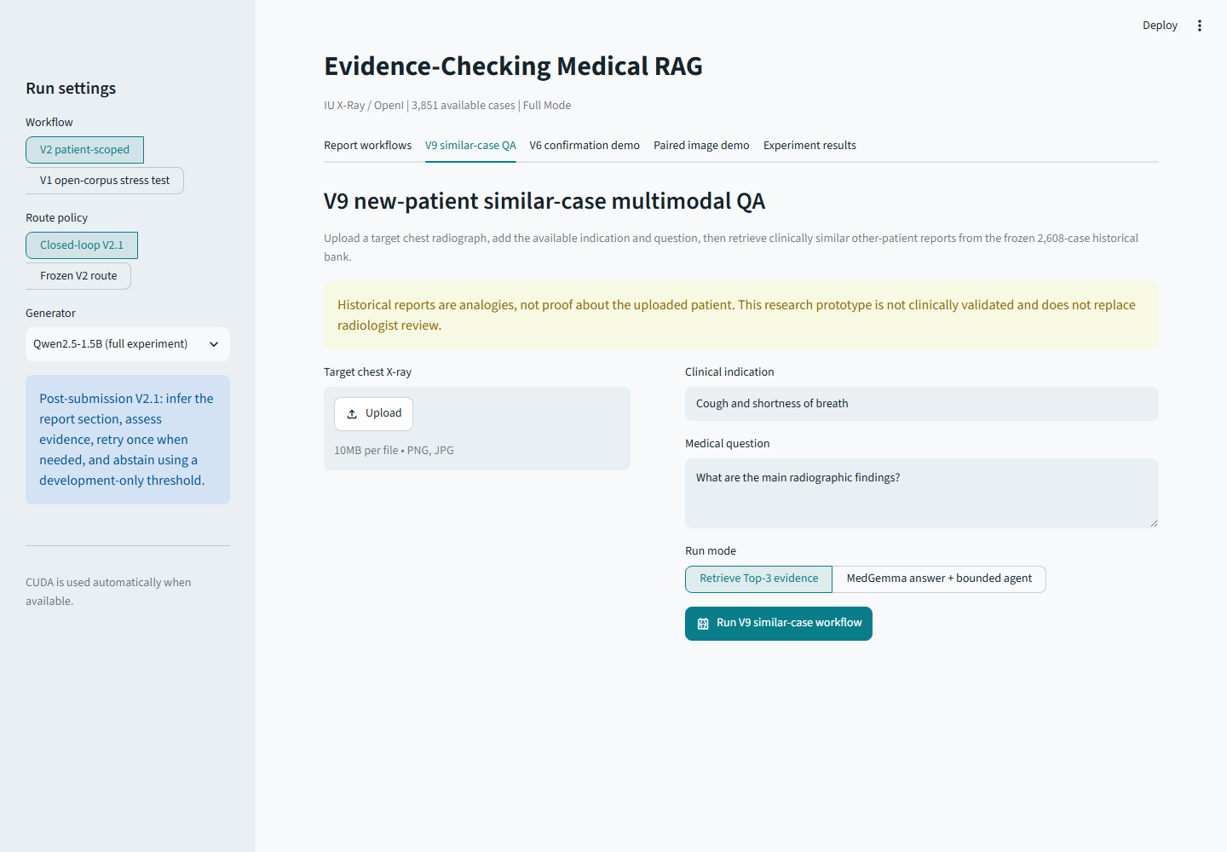
V9 FINAL STUDY
The dashboard demonstrates the actual V9 workflow
Live demo
01
Upload
Target chest X-ray
02
Enter
Indication + question
03
Retrieve
Top-3 historical reports
04
Answer
MedGemma + bounded audit
16
Notes:
For the defence, demonstrate upload, retrieval, evidence inspection, optional generation, and the explicit historical-analogy warning.
[Sources]
- Image: outputs/v9_dashboard_visual/desktop_v9.png
- app.py
- README.md, Interactive Dashboard
[/Sources]

Slide 17
V9 FINAL STUDY
V9 contributes an evidence contract, not just a higher score
Task
Method
A coherent new-patient, other-case similar-evidence formulation.
Frozen foundation models plus an auditable 865-parameter reranker.
Evaluation
Agent
Graded retrieval, case-grouped CIs, shuffled alignment control, and QA transfer.
Target answer and historical support are separated before bounded verification.
Better retrieval, better answer consistency, and stricter evidence attribution are related but distinct claims.
17
Notes:
Summarize the four contributions and return to the distinction between retrieval relevance, answer consistency, and clinical truth.
[Sources]
- docs/P2_V9_FINAL_MANUSCRIPT.md, Section 5.3
- docs/V9_TECHNICAL_FREEZE.md
[/Sources]

Slide 18
FINAL TAKEAWAY
Aligned multimodal retrieval can make historical evidence more useful for new-patient chest X-ray QA.
The strongest claim is not diagnosis: it is a reproducible improvement in similar-case retrieval and report-reference consistency under an explicit evidence boundary.
Questions
Notes:
Close by resolving the opening task. Invite questions on cohort construction, relevance labels, alignment controls, and the agent boundary.
[Sources]
- docs/V9_TECHNICAL_FREEZE.md
- docs/P2_V9_FINAL_MANUSCRIPT.md, Section 5.7
[/Sources]

