Slide 1
A glance of SDP
Walter Fan
WebEx Telephony Server Department
6/10/2020

Slide 2
SDP: Session Description Protocol
http://www.rfcreader.com/#rfc4566
An SDP session description includes the following:
Session name and purpose
Time(s) the session is active
The media comprising the session o Information needed to receive those media (addresses, ports, formats, etc.)

Slide 3
An Offer/Answer Model with the SDP
每当需要 Offer/Answer 交换时，发起方都会通过调用 createOffer() API 创建 Offer。
然后，应用程序使用该 Offer 通过 setLocalDescription() API来设置其本地配置。 offer 最终通过其首选的信令机制（例如WebSockets）发送到远程端；收到该 offer 后，远程方将使用 setRemoteDescription()API进行安置。
为了完成 Offer/Answer 交换，远程方使用 createAnswer() API生成适当的 answer，使用 setLocalDescription()`API应用该`answer，并将 answer 通过信令通道发送回发起方。 启动器获得该`answer`后，它将使用 setRemoteDescription() API进行安装，并且初始设置已完成。可以重复此过程以进行其他 Offer/Answer 交换。
https://tools.ietf.org/html/rfc3264

Slide 4
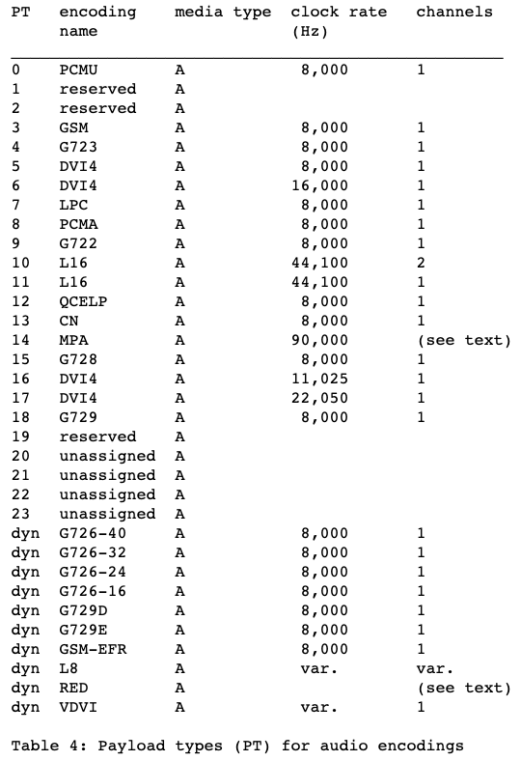
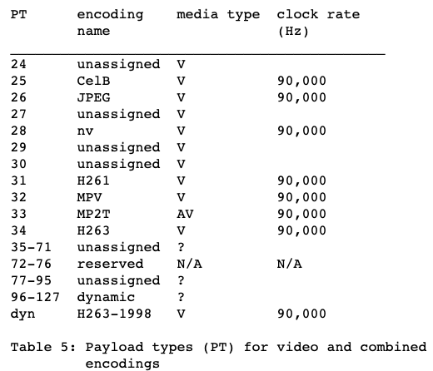
RTP Profile for Audio and Video Conferences with Minimal Control (rfc3551)

Slide 5
SDP Interaction
ICE
DTLS
Media parameters
DTLS extension to establish keys for SRTP
https://tools.ietf.org/html/rfc5764

Slide 6
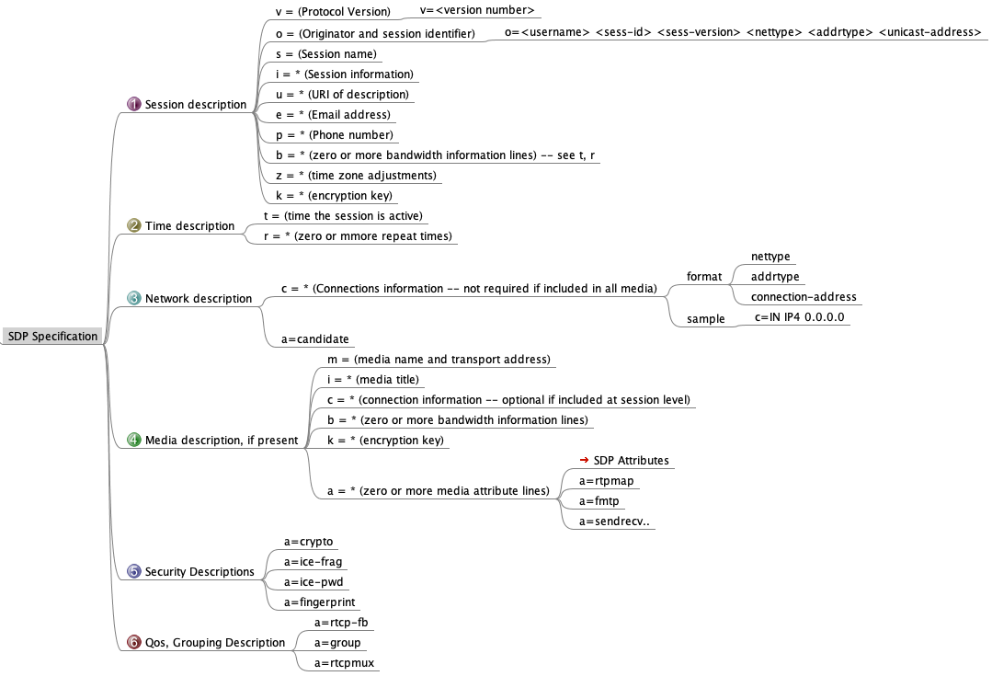
SDP
rfc4566

Slide 7
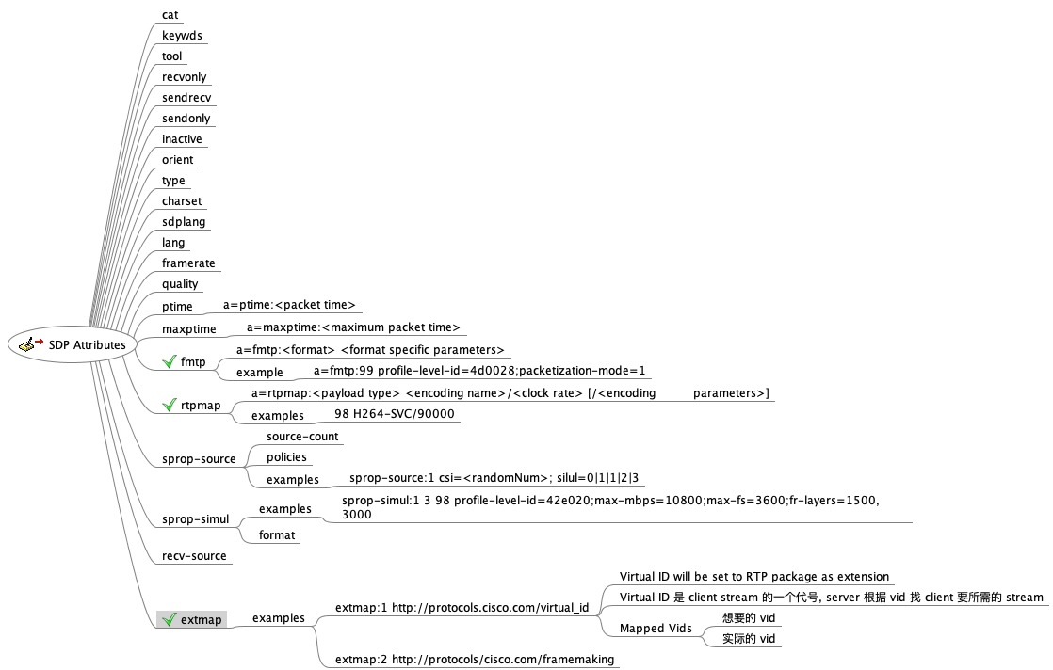
SDP Attributes
a=…

Slide 8
SDP extension
DTLS fingerprint for SRTP (a=fingerprint)
RTP/RTCP Multiplexing (a=rtcp-mux)
RTCP Feedback support (a=rtcp-fb)
Host and server-reflexive candidate lines (a=candidate)
SRTP Setup framework parameters (a=setup)
RTCP attribute (a=rtcp)
RTP header extension indicating audio-levels from client to the mixer(a=extmap:1 urn:ietf:params:rtp-hdrext:ssrc-audio-level)

Slide 9
WCB SDP example
v=0 o=Webex-WCB-1.0 5584561489438489 2 IN IP4 127.0.0.1 s=- c=IN IP4 173.39.234.17 t=0 0 a=fingerprint:sha-256 F4:48:E1:65:E0:4E:F3:5F:65:00:2E:18:C6:1F:BB:09:9B:2B:77:A9:B1:22:6F:D8:83:16:82:D3:CF:B3:C1:79 a=group:BUNDLE 0 1 2 3 4 5 6 a=msid-semantic:WMS *

Slide 10
SDP example
https://gist.github.com/walterfan/7df686f3f6b94004fc3adc203f383362
v=0
o=Webex-WCB-1.0 5584561489438489 2 IN IP4 127.0.0.1
s=-
c=IN IP4 173.39.234.17
t=0 0
a=fingerprint:sha-256 F4:48:E1:65:E0:4E:F3:5F:65:00:2E:18:C6:1F:BB:09:9B:2B:77:A9:B1:22:6F:D8:83:16:82:D3:CF:B3:C1:79
a=group:BUNDLE 0 1 2 3 4 5 6
a=msid-semantic:WMS *
m=video 9000 RTP/SAVPF 126
a=rtcp-fb:126 nack
a=rtcp-fb:126 nack pli
a=rtpmap:126 H264/90000
a=sendonly
a=mid:0
a=msid:4d42ec20-a2ed-9293-1418-1fde0391b151 4619b584-38fa-b620-5672-5091054268b3
a=ice-ufrag:wcb+2418779459/177054503883769896/0
a=ice-pwd:dCPB4aSLv3z2lcxraln6aIei
a=setup:passive
a=rtcp-mux
a=ice-lite
a=candidate:1 1 udp 2130706431 173.39.234.17 9000 typ host
a=candidate:2 1 tcp 2120220671 173.39.234.17 80 typ host tcptype passive
b=TIAS:1500000
a=fmtp:126 profile-level-id=42e01f;level-asymmetry-allowed=1;packetization-mode=1;max-fs=3600;max-mbps=108000
a=ssrc:2418779459 cname:4d42ec20-a2ed-9293-1418-1fde0391b151
Notes:
TIAS - Transport Independent Application Specific maximum, a bandwidth modifier

Slide 11
Other SDP example https://tools.ietf.org/html/draft-nandakumar-rtcweb-sdp-08
5.3. MultiResolution, RTX, FEC Examples
5.3.1. Sendonly Simulcast Session with 2 cameras and 2 encodings per camera
5.3.2. Successful SVC Video Session
5.3.3. Successful Simulcast Video Session with Retransmission
5.3.4. Successful 1-way Simulcast Sessio with 2 resolutions and RTX - One resolution rejected
5.3.5. Simulcast Video Session with Forward Error Correction 79
5.4. Others
5.4.1. Audio Session - Voice Activity Detection
5.4.2. Audio Conference - Voice Activity Detection
5.4.3. Successful legacy Interop Fallaback with bundle-only
5.4.4. Legacy Interop with RTP/AVP profile
5. WebRTC Session Description Examples
5.1. Some Conventions
5.2. Basic Examples
5.2.1. Audio Only Session
5.2.2. Audio/Video Session
5.2.3. Data Only Session
5.2.4. Audio Call On Hold
5.2.5. Audio with DTMF Session
5.2.6. One Way Audio/Video Session - Document Camera
5.2.7. Audio, Video Session with BUNDLE Support Unknown
5.2.8. Audio, Video and Data Session
5.2.9. Audio, Video Session with BUNDLE Unsupported
5.2.10. Audio, Video BUNDLED, but Data (Not BUNDLED)
5.2.11. Audio Only, Add Video to BUNDLE

Slide 12
Negotiating Media Multiplexing Using SDP
https://datatracker.ietf.org/doc/html/rfc8843
该扩展可以与SDP提供/应答机制一起使用，以协商使用单个传输（5元组）来发送和接收由多个SDP媒体描述所描述的媒体
5-tuple：client ip, client port, server ip, server port, protocol
Allow an SDP 'group' attribute to contain an identification-tag that identifies a "m=" section with the port set to zero.
It is to use a single transport(BUNDLE transport) for multiple media streams, defines a new SDP Grouping Framework [RFC5888] extension called 'BUNDLE'.

Slide 13
SDP via ROAP
RTCWeb Offer/Answer Protocol (ROAP) draft-jennings-rtcweb-signaling-01
https://datatracker.ietf.org/doc/html/draft-jennings-rtcweb-signaling-01
CMSC extension
https://wiki.cisco.com/display/PAN/ROAP+Protocol+and+Its+Extensions+for+CMSC
https://wiki.cisco.com/display/PAN/Roap+state+machine
Calliope API of ROAP v2
https://sqbu-github.cisco.com/Calliope/documentation/blob/master/apis/websocket/api.md
https://sqbu-github.cisco.com/Calliope/documentation/blob/master/apis/roap/api.md
https://sqbu-github.cisco.com/Calliope/documentation/blob/master/apis/roap/api_v2.md

Slide 14
SDP Grouping Framework
The Session Description Protocol (SDP) Grouping Framework
https://datatracker.ietf.org/doc/html/rfc5888
Use of "group" and "mid"
Flow Identification (FID)
For each participant, the session is defined by a particular pair of destination transport addresses
But a single media instance maybe sent using more than one RTP session

Slide 15
Source-Specific Media Attributes in SDP
https://datatracker.ietf.org/doc/html/rfc5576
Defines a mechanism to describe RTP sources, identified by their synchronization source (SSRC) identifier, in SDP, to associate attributes with these sources, and to express relationships among individual sources.
a=ssrc:<ssrc-id> <attribute>
a=ssrc:<ssrc-id> <attribute>:<value>
a=ssrc-group:<semantics> <ssrc-id> ...

Slide 16
Reference
An Offer/Answer Model with the Session Description Protocol (SDP)
https://datatracker.ietf.org/doc/html/rfc3264
WebRTC 之 SDP
https://www.jianshu.com/p/bd397f73d2b2
WebRTC 协议之 ROAP (RTCWeb Offer/Answer Protocol)
https://www.jianshu.com/p/58678471ec13

Slide 17
Backup

Slide 18
Protocol extension
The specification defines a new SDP attribute, 'bundle-only', which can be used to request that a specific "m=" section (and the associated media) is used only used if kept within a BUNDLE group.
The specification updates RFC 3264 [RFC3264], to also allow assigning a zero port value to a "m=" section in cases where the media described by the "m=" section is not disabled or rejected.
The specification defines a new RTP Control Protocol (RTCP) [RFC3550] source description (SDES) item, 'MID', and a new RTP SDES header extension that can be used to associate RTP streams with "m=" sections.
The specification updates [RFC7941], by adding an exception, for the MID RTP header extension, to the requirement regarding protection of an SDES RTP header extension carrying an SDES item for the MID RTP header extension.

Slide 19
MediaMgr SDP manipulation
MediaMgr.getLocalDescription Cb
a=ice-ufraq:serverPeerId
setMaxVideoBitrate → b=TIAS: maxBitRate
max-fs=8160
MediaMgr. sendToRemoteDesc
"a=sprop-source:1;csi=" + _sessionConfig.csi + "\r\na=ice-ufrag";

