Slide 1
A Glance of SRTP
Walter Fan
Feb. 26, 2013

Slide 2
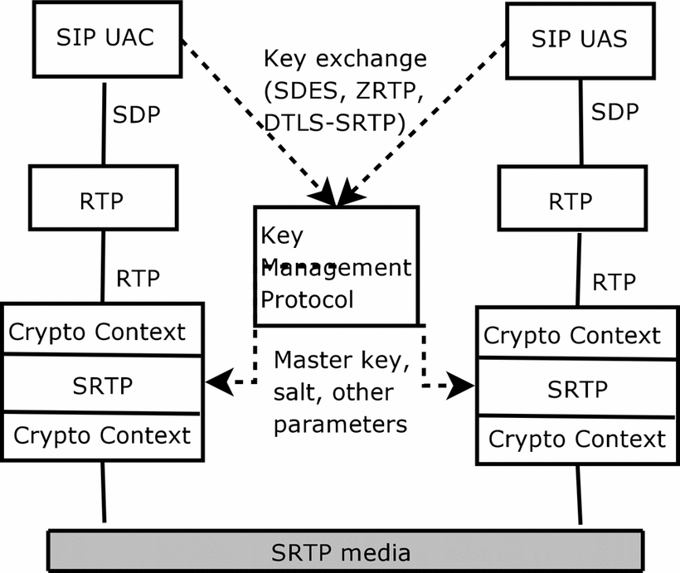
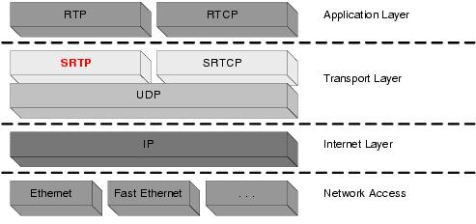
SRTP overview
SRTP provides a framework for encryption and message authentication of RTP and RTCP streams
Confidentiality →Encryption
Integrity → Authentication
http://tools.ietf.org/html/rfc3711
Notes:
SRTP defines a set of default cryptographic transforms, and it allows new transforms to be introduced in the future with appropriate key management
SRTP can achieve high throughput and low packet expansion.
Based on an additive stream cipher for encryption, a keyed-hash based function for message authentication, and an "implicit" index for sequencing/synchronization based on the RTP sequence number for SRTP and an index number for Secure RTCP (SRTCP).

Slide 3
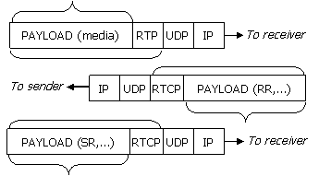
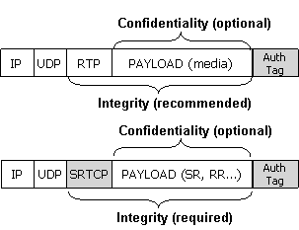
SRTP packet
The security goals for SRTP are to ensure:
the confidentiality of the RTP and RTCP payloads
the integrity of the entire RTP and RTCP packets, together with protection against replayed packets.
Replay attack protection

Slide 4
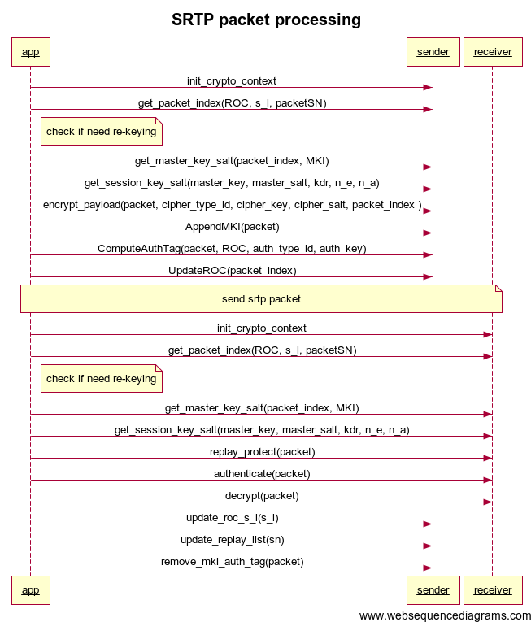
SRTP Packet process
Sender
Re-keying if need
Deviate session key by master key
Encrypt payload
Compute authenticate tag
Update packet
Receiver
Re-keying if need
Deviate session key by master key
Replay protect
Authenticate packet
Decrypt payload
Update roc
Update replay list
Remove MKI and auth tag
Notes:
title SRTP packet processing
participant app
participant sender
participant receiver
app->sender: init_crypto_context
app->sender: get_packet_index(ROC, s_l, packetSN)
note right of app: check if need re-keying
app->sender:get_master_key_salt(packet_index, MKI)
app->sender: get_session_key_salt(master_key, master_salt, kdr, n_e, n_a)
app->sender: encrypt_payload(packet, cipher_type_id, cipher_key, cipher_salt, packet_index )
app->sender: AppendMKI(packet)
app->sender: ComputeAuthTag(packet, ROC, auth_type_id, auth_key)
app->sender: UpdateROC(packet_index)
note over app, receiver: send srtp packet
app->receiver: init_crypto_context
app->receiver: get_packet_index(ROC, s_l, packetSN)
note right of app: check if need re-keying
app->receiver: get_master_key_salt(packet_index, MKI)
app->receiver: get_session_key_salt(master_key, master_salt, kdr, n_e, n_a)
app->receiver: replay_protect(packet)
app->receiver: authenticate(packet)
app->receiver: decrypt(packet)
app->sender: update_roc_s_l(s_l)
app->sender: update_replay_list(sn)
app->sender: remove_mki_auth_tag(packet)

Slide 5
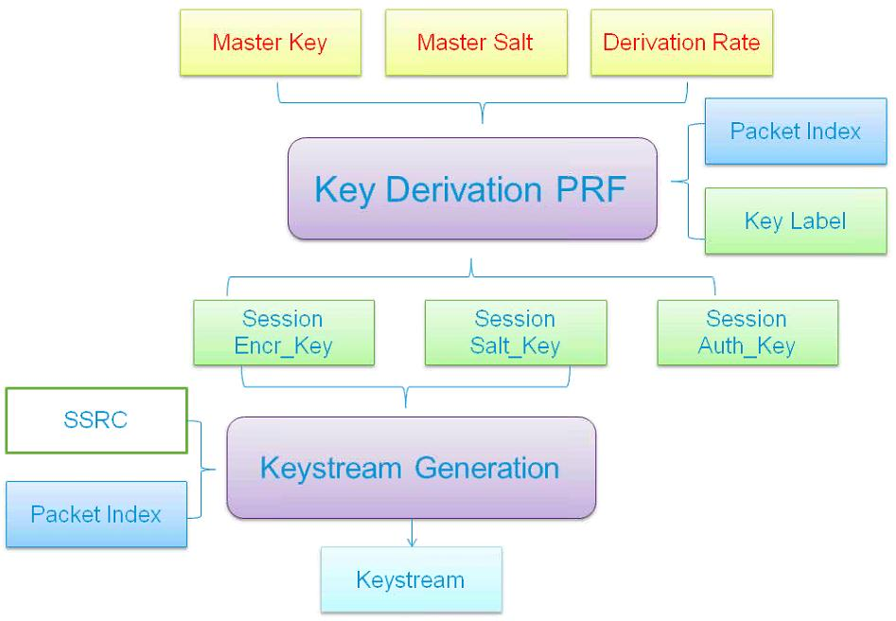
SRTP key stream
PRF: Pseudo-random function
package index: 48 bits
rtp: i = 2^16 * ROC(32bits) + SEQ(16bits)
rtcp: RTCP index (31 bit)
Key Label: rtp/rtcp
encr_key
salt_key
auth_key

Slide 6
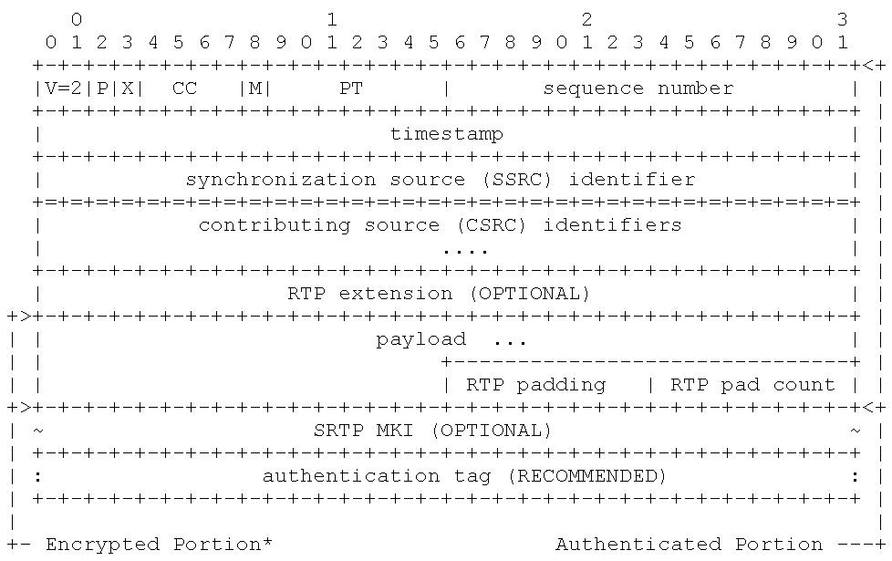
SRTP Packet

Slide 7
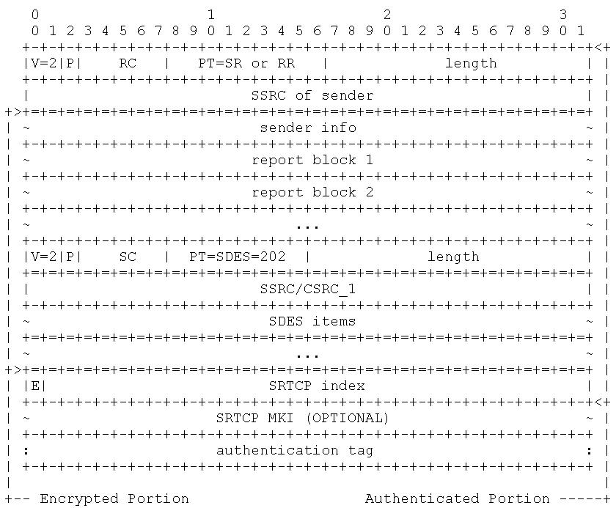
SRTCP Packet
Three mandatory new fields
E: Encrypt-Flag(1bit)
SRTCP index(31 bit)
Authenticate tag configurable length
One optional field
MKI
Recommend use same crypt context as SRTP

Slide 8
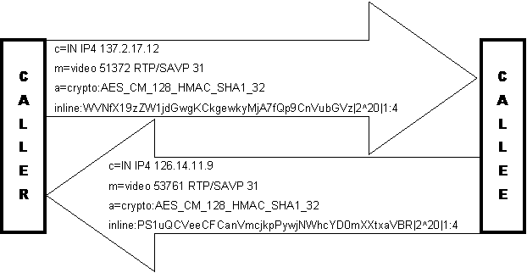
SRTP signal
SIP/SDP--RFC4568
(MIKEY – RFC3830)
Crypto-suite
Key parameter
Inline: key||salt
Lifetime
MKI:Length
Session parameters
KDR: key derivation rate
UNENCRYPTED_SRTP
UNENCRYPTED_SRTP
UNAUTHENTICATED_SRTP
FEC_ORDER
FEC_KEY
WSH: window size hint
Extension

Slide 9
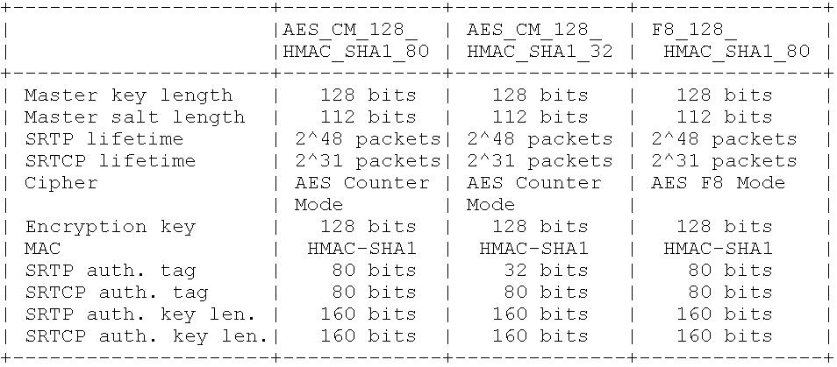
Encryption and authenticate algorithm
CST_NULL_CIPHER_HMAC_SHA1_80, // NULL cipher with HMAC-SHA1, [RFC3711-SRTP]
CST_AES_CM_128_HMAC_SHA1_80, // AES_CM_128_HMAC_SHA1_80, [RFC4568-SDESC]
CST_AES_CM_SW_128_HMAC_SHA1_80, // SRTP with ESN, [Multi-stream Switchable SRTP]
CST_AES_CM_SW_128_HMAC_SHA1_OSW_80, // SRTP with ESN and optimized authentication, [Multi-stream Switchable SRTP]

Slide 10
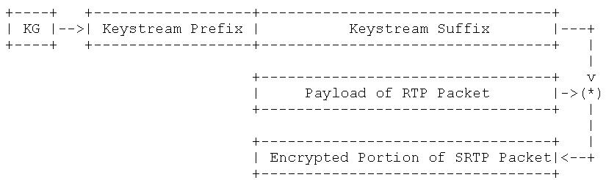
Encryption and authenticate algorithm
BLOCK_CIPHER_MODE, n_b, k_e, n_e, k_s, n_s
SRTP_PREFIX_LENGTH (for authentication, not for encryption)
SRTP suffix length of keystream equals the length of payload
A keystream segment concatenated with 128 bit blocks of AES
E(k, IV) || E(k, IV + 1 mod 2^128) || E(k, IV + 2 mod 2^128) ...
IV = (k_s * 2^16) XOR (SSRC * 2^64) XOR (i * 2^16)
Note: i is packet index

Slide 11
Message Authenticate
SRTP: Authenticate RTP header and encrypted payload || ROC
SRTCP: Authenticate RTCP header and content
Common parameters:
* AUTH_ALG is the authentication algorithm
* k_a is the session message authentication key
* n_a is the bit-length of the authentication key
* n_tag is the bit-length of the output authentication tag
* SRTP_PREFIX_LENGTH is the octet length of the keystream prefix as defined above, a parameter of AUTH_ALG
Compare with Authentication tag as the compute result as the authenticate key and algorithm; HMAC(k_a, M)

Slide 12
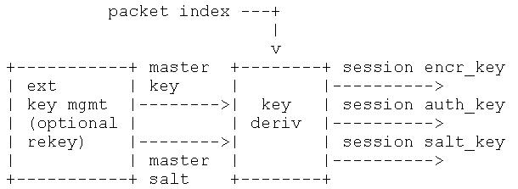
Key Derive method
Master key and salt will derive the session keys as KDR(Key Derivate Rate)
r = packet_index/KDR
key_id=<lable>||r
x= key_id XOR master_salt
Key = PRF_n(k_master, x)
The session keys and salt SHALL now be derived using:
k_e (SRTP encryption): <label> = 0x00, n = n_e.
k_a (SRTP message authentication): <label> = 0x01, n = n_a.
k_s (SRTP salting key): <label> = 0x02, n = n_s.
where n_e, n_s, and n_a are from the cryptographic context.

Slide 13
Key derivation rate
Key_limit_ctx_t
xtd_seq_num_t num_left → initial value is 2^48-1 , decrease one by one
key_state_t state → soft_limit: 0x1000, hard_limit: 1
Currently, we only report but not handle the following events
typedef enum {
event_ssrc_collision, /**< * An SSRC collision occured. */
event_key_soft_limit, /**< An SRTP stream reached the soft key usage limit and will expire soon. */
event_key_hard_limit, /**< An SRTP stream reached the hard key usage limit and has expired */
event_packet_index_limit /**< An SRTP stream reached the hard packet limit (2^48 packets). */
} srtp_event_t;

Slide 14
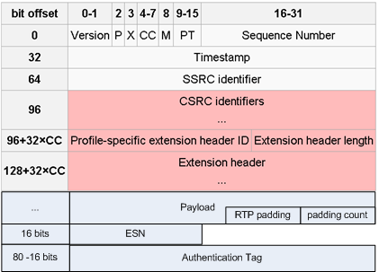
Protect RTP packet
RTP Header:
12 bytes
(96 bit at least)
SSRC is stream ID
Stream direction
Inbound
Outbound
Default implementation
Encryption: AES_128_ICM, key length=128bits (AES Integer Counter Mode)
Authentication: HMAC-SHA1, key length=160 bits (20 bytes), length=80bits (10 bytes)
Key Derivation: AES_CM PRF
Authenticate portion
Extensions
VID
Frame making
Audio level
Encrypt
portion

Slide 15
Protect RTCP packet
SRTCP Packet Header: 8 bytes
SRTCP Packet Content: n bytes(RR/SR/SES…)
SRTCP Packet Trailer : 4 bytes (1bit E_Flag + 31bit packet index)
SRTCP Packet Tag length: 10 bytes
SRTCP Packet EKT: 1 byte or 42 bytes
EKT plain text(26 bytes) = Master key(16 bytes) + SSRC(4 bytes) + ROC(4 bytes) + ISN(2 bytes)
EKT cipher text(40 bytes) = AESKW Cipher text(32 bytes) + AESKW Tag(8 bytes)
EKT Full format (42 bytes) = EKT cipher text(40 bytes) + SPI(2 bytes)
Total Length = 8 + n + 4 + 10 + 1/42
V=2 | P | RC | PT | Length |SSRC
n bytes payload
E_Flag| Packet index
Authentication Tag
EKT

Slide 16
SRTP issues
Problem: Guess ROC in receiver side
i= 2^16 * v + SEQ , v maybe {ROC-1, ROC, ROC + 1}
接收端需要猜ROC来得知packet index
And sync ROC may have issue between client and server
Solution: RCC– Roll-over Counter Carrying Transform (http://tools.ietf.org/html/rfc4771)
Allows the ROC to be transmitted in SRTP packets as part of the authentication tag
Problem: Need re-encryption if sequence number change in server side( translator and mixer)
虽然只是转发，却要因为SN的改变进行重新解密加密，代价比较高
Solution:
Separation of the encryption sequence number (ESN) from the sequence number defined in the RTP header

Slide 17
Reference
Secure RTP is defined in RFC 3711. The counter mode definition is in Section 4.1.1.
SHA-1 is defined in FIPS PUB 180-4.
HMAC is defined in RFC 2104 and HMAC-SHA1 test vectors are available in RFC 2202.
AES-GCM usage in SRTP is defined in RFC 7714
RFC6904 of Header Extensions in the Secure Real-time Transport Protocol (SRTP)
RFC5506 for Reduced-Size Real-Time Transport Control Protocol (RTCP):Opportunities and Consequences

Slide 18
Change of libsrtp

Slide 19
libsrtp
http://srtp.sourceforge.net/srtp.html
The libSRTP library is an open-source implementation of the Secure Real-time Transport Protocol (SRTP) originally authored by Cisco Systems, Inc. It is available under a BSD-style license.
SRTP is a security profile for RTP that adds confidentiality, message authentication, and replay protection to that protocol. It is specified in RFC 3711. More information on the SRTP protocol itself can be found on the Secure RTP Page. Frequently Asked Questions are answered in the SRTP FAQ.

Slide 20
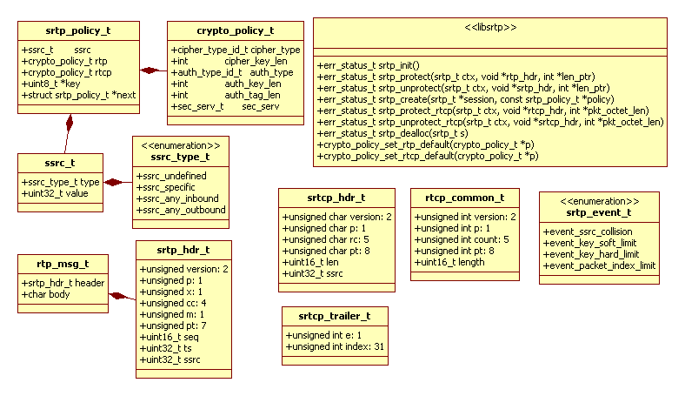
libsrtp
srtp_t represents a srtp session that created by srtp_create()
srtp_policy_t represents a set of policies of security(crypto_policy_t)
API: srtp_init(), srtp_create(), srtp_protect(), srtp_unprotect(), srtp_add_stream(), and srtp_remove_stream()

Slide 21
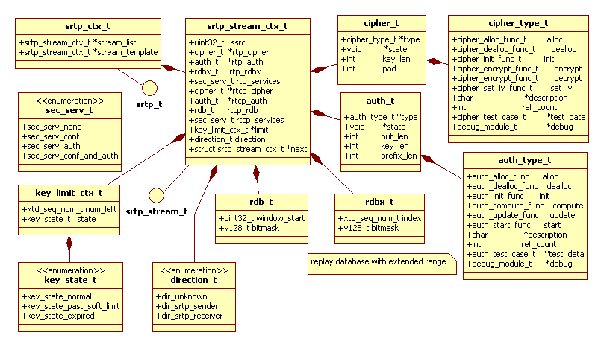
libsrtp
srtp_stream represents a media stream identified by ssrc

Slide 22
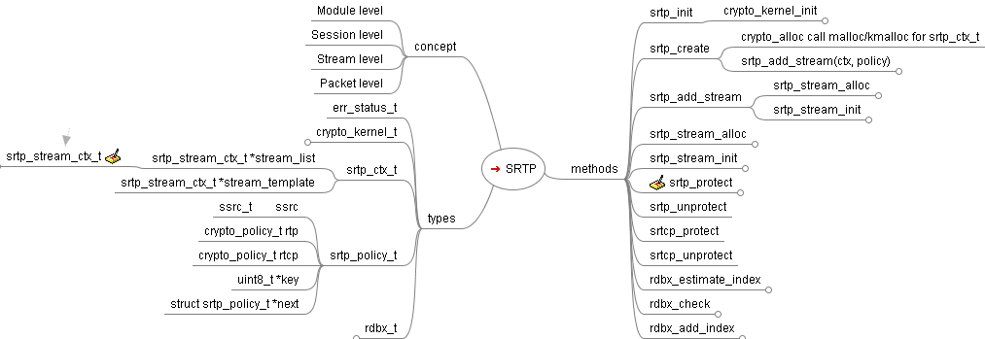
SRTP codes

Slide 23
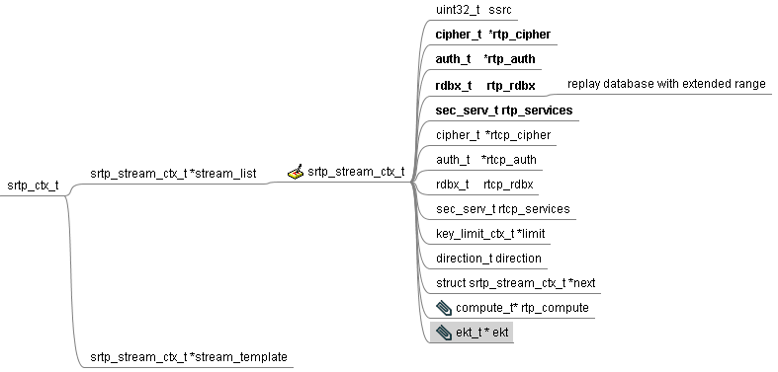
Libsrtp ekt
Every SRTP session have some srtp streams identified by ssrc
Srtp stream
Generate session key by srtp_kdf_generate
Notes:
/*
* We handle EKT by performing some additional steps before
* authentication (copying the auth tag into a temporary location,
* zeroizing the "base tag" field in the packet)
*
* With EKT, the tag_len parameter is actually the base tag
* length
*/

Slide 24
Build libsrtp
Step 1: configure the libary
./configure --libcryptodir=/usr/local/ssl
Step 2: compile libsrtp
make libsrtp.a
or
make libsrtp.so
Step 3: This step is optional, test the library
export LD_LIBRARY_PATH=/usr/local/ssl
make
make runtest

Slide 25
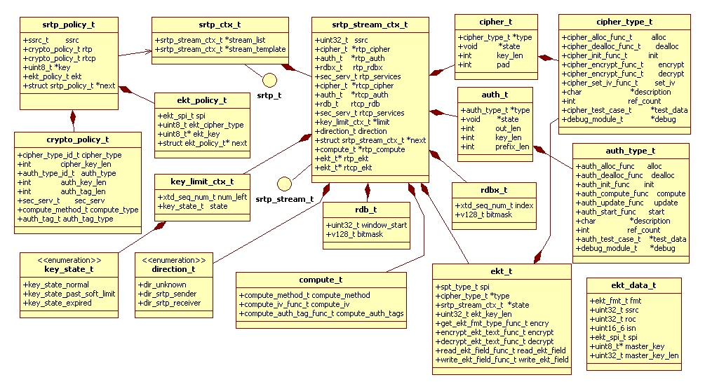
Change of libsrtp

Slide 26
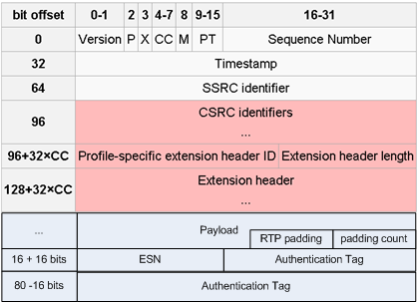
Change of libsrtp – Add ESN
Libsrtp → libssrtp? for SSRTP, server may change ssrc/sequence number
Add payload hash besides packet hash
Add ESN in the EKT field, so server side need not decrypt/encrypt, need re-auth
1) the package index algorithm need to be changed
i = 2^16 * ROC + SEQ
to
i = 2^16 * ROC + ESN
2) the auth algorithm need to be changed for payload hmac including ESN

Slide 27
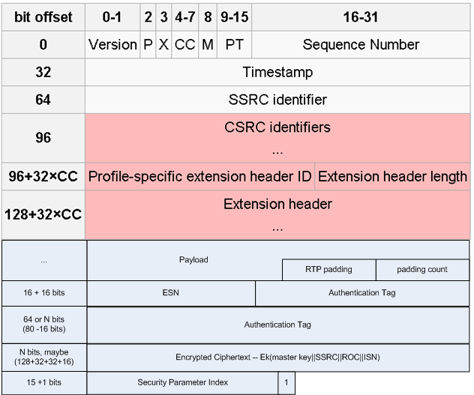
Change of libsrtp – Add EKT
SRTP master key is encrypted by a KEK(Key encryption Key)
ISN(16 bits) – Initial Sequence Number
SPI(15 bits) – Security Parameter Index
It indicates
Which KEK used
Which EKT cipher
Which other SRTP parameters
Which master salt associated
Final bit
0 – Full format
1 – Short format

Slide 28
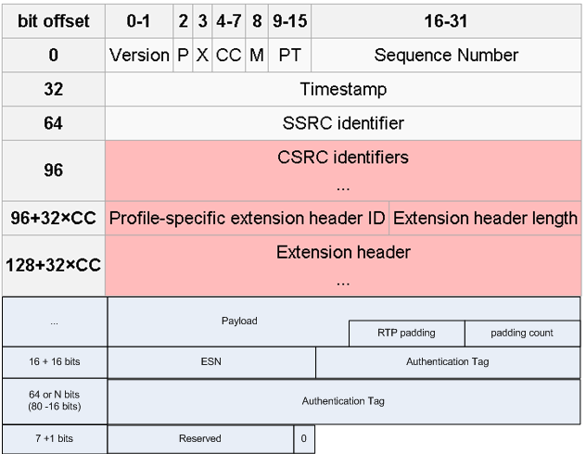
Change of libsrtp – Add EKT
EKT may add more 8 bits for short format or more bits for long format
128 + 32 + 32 = 192 bits
(24 bytes)
So it’s not appropriate for short RTP packet, such as Audio packet
And if it’s hybrid session including telephony endpoint,
The decrypt/encrypt are necessary, the EKT is inapplicable

Slide 29
Usage of libsrtp
Module Level →srtp_init()
Session Level → srtp_create()
Contains multi streams, distinguished by the src/dest address
set srtp_ctx_t that contains srtp_stream_ctx_t list
set policy for session level – srtp_policy_t contains 2 crypto_policy_t
Stream Level → srtp_add_stream(), srtp_remove_stream()
Distinguished by ssrc,
Key(master/session), parameters of crypt, auth, anti-replay
Packet level → srtp_protect(), srtp_unprotect()
Conversion:
SecurityPolicy → srtp_stream_ctx_t
ssrc_any_inbound/ ssrc_any_outbound for CRTPPacket/CRTCPPacket
only auth for CRTPAggregatePacket, direction is dir_srtp_sender
wrtp::CRTPPacket → srtp_hdr_t → wrtp::CRTPPacket
wrtp::CRTPAggregatePacket → srtp_hdr_t → wrtp::CRTPAggregatePacket
wrtp::CRTCPPacket → srtcp_hdr_t → wrtp::CRTCPPacket
Notes:
Protect steps
Find or create a srtp stream as the stream template to the SSRC
Verify if its direction is dir_srtp_sender. Otherwise, raise a collision error if it’s dir_srtp_receiver
Update the key usage limit, return if the key is expired
find the encrypt portion start address: standard header + extension header
Set the auth_start to the header begin and auth_tag pointer
Estimate the packet index by replay window start, sequence number?
Set est???
Put the keystream prefix into to auth tag
Encrypt by cipher_encrypt
Authenticate by auth_update over packet, auth_compute over ROC, put result into auth tag
Unprotect steps
ssrc_any_inbound for unprotect
ssrc_any_outbound for protect

Slide 30
SRTP modules
Debug-able module
srtp/srtp/srtp.c: "srtp"
srtp/crypto/cipher/aes_cbc.c: "aes cbc"
srtp/crypto/cipher/aes_icm.c: "aes icm"
srtp/crypto/cipher/cipher.c: "cipher"
srtp/crypto/kernel/alloc.c: "alloc"
srtp/crypto/kernel/crypto_kernel.c: "crypto kernel"
srtp/crypto/math/stat.c: "stat test"
srtp/crypto/hash/hmac.c: "hmac sha-1"
srtp/crypto/hash/sha1.c: "sha-1"
srtp/crypto/hash/auth.c: "auth func"
srtp/test/srtp_driver.c: "driver"

Slide 31
Use cases on client side
1. send RTP + RTCP packet to server
Add a unify srtp policy: policy->ssrc.type==ssrc_any_outbound
(stream_template->direction = dir_srtp_sender)
2. receive RTP + RTCP packet from server : RTP + RTCP
Add a unify srtp policy: policy->ssrc.type==ssrc_any_inbound
(stream_template->direction = dir_srtp_receiver)
3. receive aggregation packet from server
Add a specific policy: policy->ssrc.type==ssrc_specific (PT type==121)

Slide 32
User cases on server side
1. send RTP + RTCP packet to client
Add a unify srtp policy: policy->ssrc.type==ssrc_any_outbound
(stream_template->direction = dir_srtp_sender)
2. receive RTP + RTCP packet from client: RTP + RTCP
Add a unify srtp policy: policy->ssrc.type==ssrc_any_inbound
(stream_template->direction = dir_srtp_receiver)
3. Send aggregation packet to client
Add a specific policy: policy->ssrc.type==ssrc_specific (PT type==121)
Server only auth the aggregation packet, encry and auth the video packet
sec_serv_t is 3 ( sec_serv_auth)

Slide 33
EKT
http://tools.ietf.org/html/draft-ietf-avt-srtp-ekt-03

Slide 34
EKT: Encrypted Key Transport for SRTP
http://tools.ietf.org/html/draft-ietf-avtcore-srtp-ekt-00
An extension to SRTP, transmit master key, ROC, etc. within SRTP or SRTCP packet
Encrypted master key
Rollover Counter (ROC)
Initial Sequence Number (ISN):
Security Parameter Index (SPI)
Outbound processing
Inbound processing
EKT_Plaintext = SRTP_Master_Key || SSRC || ROC || ISN
EKT_Ciphertext = EKT_Encrypt(EKT_Key, EKT_Plaintext)
Full_EKT_Field = EKT_Ciphertext || SPI || '1'
Short_EKT_Field = Reserved || '0'

Slide 35
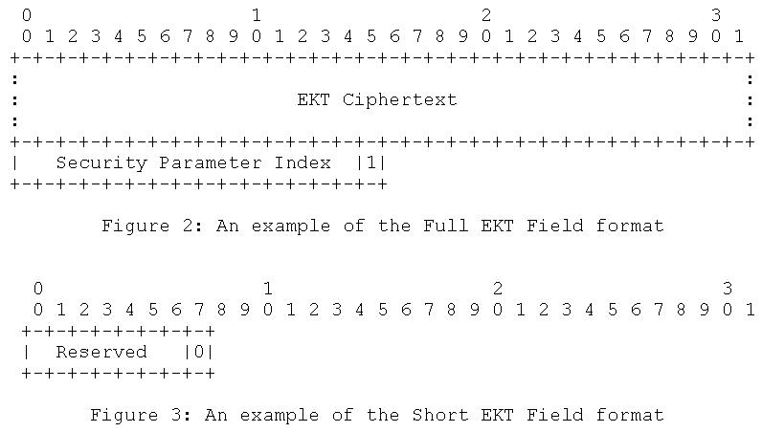
EKT Field append to SRTP/SRTCP packet
EKT_Plaintext = SRTP_Master_Key || SSRC || ROC || ISN
EKT_Ciphertext = EKT_Encrypt(EKT_Key, EKT_Plaintext)

Slide 36
SDP for EKT
SRTP SDP
Crypto-suite
Key parameters
Session parameters
Crypto attributes for EKT:
EKT_Cipher
AESKW_128
EKT_KEY
FE9C (KEK)
EKT_SPI
AAE0
v=0
o=sam 2890844526 2890842807 IN IP4 192.0.2.5
s=SRTP Discussion
i=A discussion of Secure RTP
u=http://www.example.com/seminars/srtp.pdf
e=marge@example.com (Marge Simpson)
c=IN IP4 192.0.2.12
t=2873397496 2873404696
m=audio 49170 RTP/SAVP 0
a=crypto:1 AES_CM_128_HMAC_SHA1_80
inline:WVNfX19zZW1jdGwgKCkgewkyMjA7fQp9CnVubGVz|2^20|1:4
FEC_ORDER=SRTP_FEC EKT=AESKW_128|FE9C|AAE0
a=crypto:2 F8_128_HMAC_SHA1_80 inline:MTIzNDU2Nzg5QUJDREUwMTIzNDU2Nzg5QUJjZGVm|2^20|1:4; inline:QUJjZGVmMTIzNDU2Nzg5QUJDREUwMTIzNDU2Nzg5|2^20|2:4
FEC_ORDER=FEC_SRTP EKT=AES_128|FE9C|AAF0

Slide 37
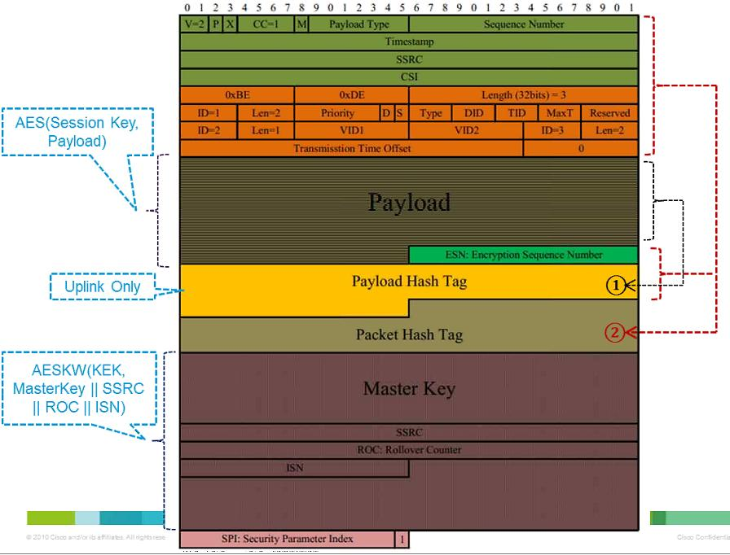

Slide 38
Change of libsrtp

Slide 39
Initialization Process
Alloc the cipher type AESKW_128 in srtp init
Create ekt_stream by ekt_policy in srtp_create/srtp_add_stream/srtp_stream_alloc
EKT cipher, EKT key, SPI, master salt
Init ekt_stream in srtp_stream_init
Select relative methods to encrypt, decrypt,

Slide 40
Outbound Process
1. Decided use full format or short format
Full format for initial rtp packet and rtcp packet
Short format use an all-zero reserved octet that append the rtp/rtcp packet
2. Fill the Master key into the EKT plain text
It’s the master key of current srtp stream negotiated by signal
3. Fill the SSRC into the EKT plain text
The ssrc of current srtp stream
4 .Fill the ROC into the EKT plain text
It’s the current value of the SRTP ROC – uint32_t in network byte order
5. Fill the ISN into the EKT plain text
It’s the initial sequence number of RTP packet that protected/unprotected by the new master key – uint16_t
6. Encrypt the EKT plain text to encrypt text
Default cipher method is AESKW_128, we only support it for now
7. Append the SPI after the EKT cipher text
It’s 15 bit indicating the current parameter set that negotiated by signal
8. Append one bit 0x1 after SPI to indicate it’s full format

Slide 41
Inbound process
1 Check final bit to see it's full format of short format
2 If full format, find relative ekt_stream_ctx as the SPI, if it matches the current SPI in context, continue otherwise, find next element in the ekt_stream_ctx link list if find it, switch to the ekt_stream_ctx otherwise, return error
3 Decrypt the EKT_Ciphertext to masterkey||ssrc||roc|isn
4 Compare the ssrc in ekt and the ssrc in rtp headr if not match , return error
5 Check ROC if the ROC less than the current ROC in context, return error otherwise, update ROC in context by the new ROC in packet

Slide 42
Inbound process
6 check ISN, append the new ISN after current ROC as a uint48_t it's the from index of the new master key shall we change the num_left of key_limit_ctx_t?
7 re-key: use the new master from the ROC+ISN deviate the new session encryption and authentication key as the new master key → new stream but the old master key need keep for a while to later packet →Old stream
Question
how to deal with the case if the SPI in packet is different with current SPI?
Find a corresponding ekt_stream_ctx by the SPI
how to deal with the case that two master key
We do not consider the rekey case in current version
a srtp_stream_ctx_t for new packet, use new session key derived by the new master key < ROC+ISN:
a srtp_stream_ctx_t for old packet, use old session key derived by the old master key

Slide 43
Use case
When we got a srtp packet with short ekt field
Pass decrypt/auth by current master key in context
Not pass decrypt/auth by current master key in context, discard the packet
When we got a srtp packet with full ekt field
Pass decrypt/auth by the master key in ekt fields of the rtp packet
Create or reuse the ssrc_specified stream (EKT)
Not consider Re-key case
Master key pass by EKT field of SRTP packet
Stream1: ssrc_any for intial rtp stream that master key nego by signal
Stream2: ssrc_specified for new stream that master key past by ekt
Notes:
Client and Server negotiate a master key by signal
Client A and WCS1 user master key A
Client B and WCS1 user master key B
…A ssrc, EKT tell mk a, B ssrc, EKT tell mk B
RTP stream level timeout mechanism? RTCP bye….
New join attendee need to know the master key, ROC

Slide 44
Change for libsrtp
Framework level:
Ekt policy, ekt_stream_ctx , and some methods type definition
Encrytion/Decryption:
AESKW_128
Current methods change
srtp_init/crypto_kernel_init for AESKW_128
srtp_add_stream/srtp_stream_alloc/srtp_stream_init to initialize ekt_t
srtp_protect/srtp_unprotect
srtcp_protect/srtcp_unprotect
Hint:
ROC, ISN process simplify because not consider re-key
Create/init stream as policy: kek, cipher, spi
Use the common master salt (ssrc_any stream)
Save master key to the new stream created by EKT
Two Authentication Tags

Slide 45
SSRTP
Switchable Secure Real-time Transport Protocol

Slide 46
Switchable SRTP (S-SRTP)
A new data security protocol based on SRTP and EKT
Separation of the encryption sequence number (ESN) from the sequence number defined in the RTP header
Signaling in SDP
http://tools.ietf.org/html/draft-ietf-avtcore-srtp-ekt-03
OSW is optimized
a=crypto:1 AES_CM_SW_128_HMAC_SHA1_OSW_80
inline:WVNfX19zZW1jdGwgKCkgewkyMjA7fQp9CnVubGVz|2^20|1:4
EKT=AES_128|FE9C|AAE0
Common EKT parameters for all clients
EKT_Cipher
EKT_KEY
EKT_SPI

Slide 47
ESN
ESN – Encryption Sequence Number, a 6 bytes new field in RTP header
Generate IV for encryption based on ESN
The key derivation algorithm changed for ESN
We use 16 bits ESN append the RTP packet before the authentication tag
WCS may change the 3 fields
VID: need authenticate again
TTO – Transmission Time Offset : need authenticate again
SEQ : need authenticate again It causes package index change, need decrypt and encrypt beside authenticate

Slide 48
S-SRTP concept
Sequence number change but ESN not change
Client C
…
Rtp(seq-n)
hd ext + payload
Ekt(ESN=7)
Pkts:
Pkts:
…
Rtp(seq-1)
hd ext + payload
Ekt(ESN=7)
Server
Client A
…
Rtp(seq-m)
hd ext + payload
Ekt(ESN=7)
Pkts:
Client B
Assume ESN is included in EKT parameters
Use ESN in calculating IV
Need authentication and recalculate the authentication tag

Slide 49
S-SRTP implementation Optimization
RTP Header + ext B
Payload hash for Payload
Packet hash for header and payload hash
New RTP Header + ext B
Payload body
Remove after calculation
Payload body
Payload Hash A
Payload Hash A
Packet Hash B
RTP Header+ext A
Packet Hash B
Client B
Payload body
Server
Re-calculated
Payload Hash A
Packet Hash A
RTP Header + ext A
New RTP Header + ext C
Client C
Payload body
Payload body
RTP Header + ext C
Client A
Payload Hash A
Payload Hash A
Payload body
Packet Hash A
Packet Hash C
verification
Payload Hash A
Re-calculated
Remove after calculation
Packet Hash C

Slide 50
S-SRTP Pros and Cons
Cons:
Larger size of packet and more bandwidth
Pros
Lesser computation of payload re-hash
Server side do not authenticate the payload
Client side do authentication for payload and RTP header/extension
RTP Header+ext A
Payload body
SRTP seqno (16bits)
Payload Hash A
Packet Hash A

Slide 51
Two Authentication Tag
Packet Authentication Tag
Based on RTP header and payload tag, removed in server side
Payload Authentication Tag
Based on RTP payload
Standard method
only one packet authentication tag based on RTP header and payload
So the encrypted payload need to be decrypted to compute authentication tag
Extended method
Two authentication tag, one is payload tag, the other one is packet tag based on payload tag
So server side switcher need not decrypt payload, just need to authenticate again

Slide 52
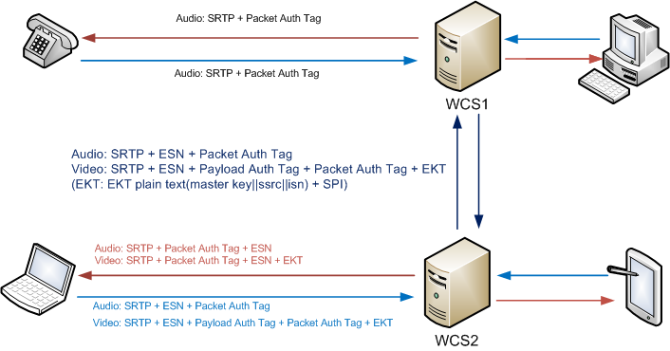
Switch media by SRTP with two tags

Slide 53
Backup

Slide 54
Packet index estimation
Packet index(uint32_t ROC and uint16_t sn)
Local packet index = local ROC * 2^16 + local SN/ESN
The packet index = guess ROC* 2^16 + packet SN/ESN
We received a packet, we need to know the packet index as the Initial Vector to authenticate/decrypt the packet by session key
But packet only contain the SN, how to know the ROC?
Guess by local roc and sn
For example: local roc = 1, local sn = 65000, received packet sn = 10, we guess the ROC = local roc + 1 = 2, packet index = 2 * 2^16 + 10

Slide 55
RTCP protect and unprotect
SRTCP Packet Header: 8 bytes
SRTCP Packet Content: n bytes(RR/SR/SES…)
SRTCP Packet Trailer : 4 bytes (1bit E_Flag + 31bit packet index)
SRTCP Packet Tag length: 10 bytes
SRTCP Packet EKT: 1 byte or 42 bytes
EKT plain text(26 bytes) = Master key(16 bytes) + SSRC(4 bytes) + ROC(4 bytes) + ISN(2 bytes)
EKT cipher text(40 bytes) = AESKW Cipher text(32 bytes) + AESKW Tag(8 bytes)
EKT Full format (42 bytes) = EKT cipher text(40 bytes) + SPI(2 bytes)
Total Length = 8 + n + 4 + 10 + 1/42
V=2 | P | RC | PT | Length |SSRC
n bytes payload
E_Flag| Packet index
Authentication Tag
EKT

Slide 56
SRTP Policy
typedef struct srtp_policy_t {
ssrc_t ssrc; /**SSRC_ANY_INBOUND or SSRC_ANY_OUTBOUND */
switch_flag_t switchable; /** 1 -- switchable, 0 - not switchable by default*/
replay_flag_t replayable; /** 1 -- replayable, 0 - not replayable by default*/
crypto_policy_t rtp; /**< SRTP crypto policy. */
crypto_policy_t rtcp; /**< SRTCP crypto policy. */
uint8_t *key; /**< Pointer to the SRTP master key for this stream. */
ekt_policy_t* ekt; /** ekt policy. */
struct srtp_policy_t *next; /**< Pointer to next stream policy. */
} srtp_policy_t;
crypto_policy_t
ekt_policy_t
Notes:
typedef struct crypto_policy_t {
cipher_type_id_t cipher_type; /**< An integer representing
* the type of cipher. */
int cipher_key_len; /**< The length of the cipher key
* in octets. */
auth_type_id_t auth_type; /**< An integer representing the
* authentication function. */
int auth_key_len; /**< The length of the authentication
* function key in octets. */
int auth_tag_len; /**< The length of the authentication
* tag in octets. */
sec_serv_t sec_serv; /**< The flag indicating the security
* services to be applied. */
compute_method_t compute_type; /** The flag indicating the compute method type */
auth_tag_t auth_tag_type;/** The flag indicating the auth tag type and count */
} crypto_policy_t;
typedef struct ekt_policy_t {
cipher_type_id_t ekt_cipher_type; /*which cipher method as signal */
uint32_t rtp_full_fmt_rate; /* how may packets that the full format need to send*/
uint32_t rtcp_full_fmt_rate; /* how may packets that the full format need to send*/
uint32_t ekt_spi; /*which security parameter identity */
uint32_t ekt_key_len; /*KEK len */
uint8_t* ekt_key; /*KEK */
struct ekt_policy_t* next; /*next ekt policy with different spi */
} ekt_policy_t;

Slide 57
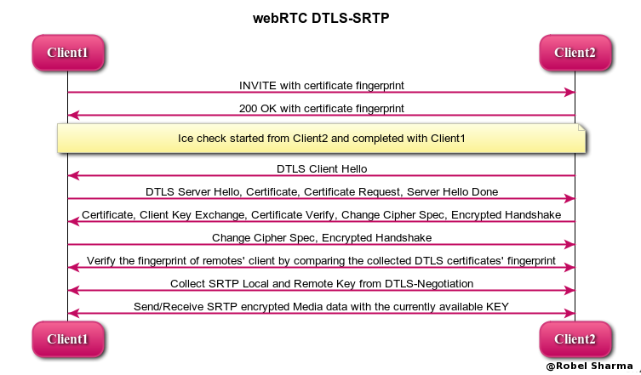
WebRTC DTLS-SRTP

