Slide 1
WebRTC DTLS and SRTP
Walter Fan
WebEx Telephony Server Department
6/10/2020

Slide 2
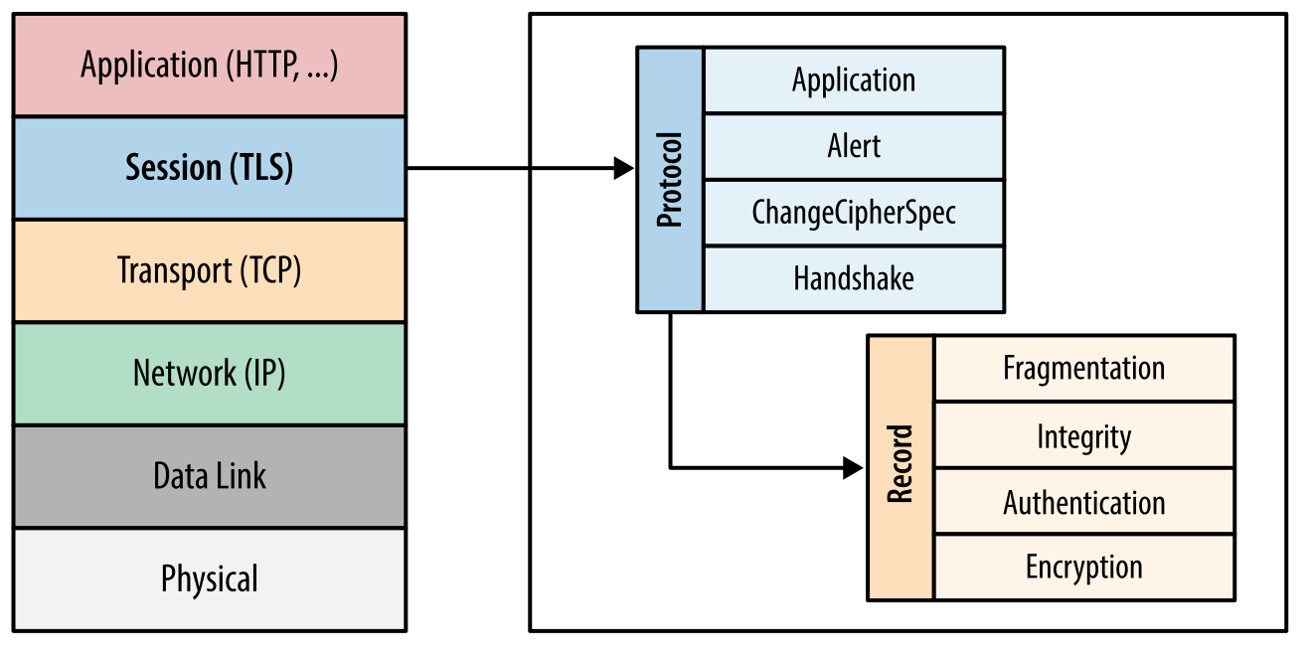
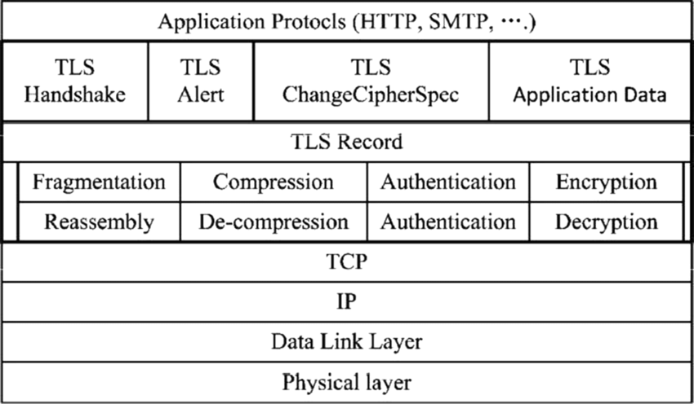
TLS
Secure Socket Layer over TCP
A suite of protocols to provide secure communication
- Confidentiality by applying block & stream ciphers
- Integrity with MACs
- Authenticity with certificates

Slide 3
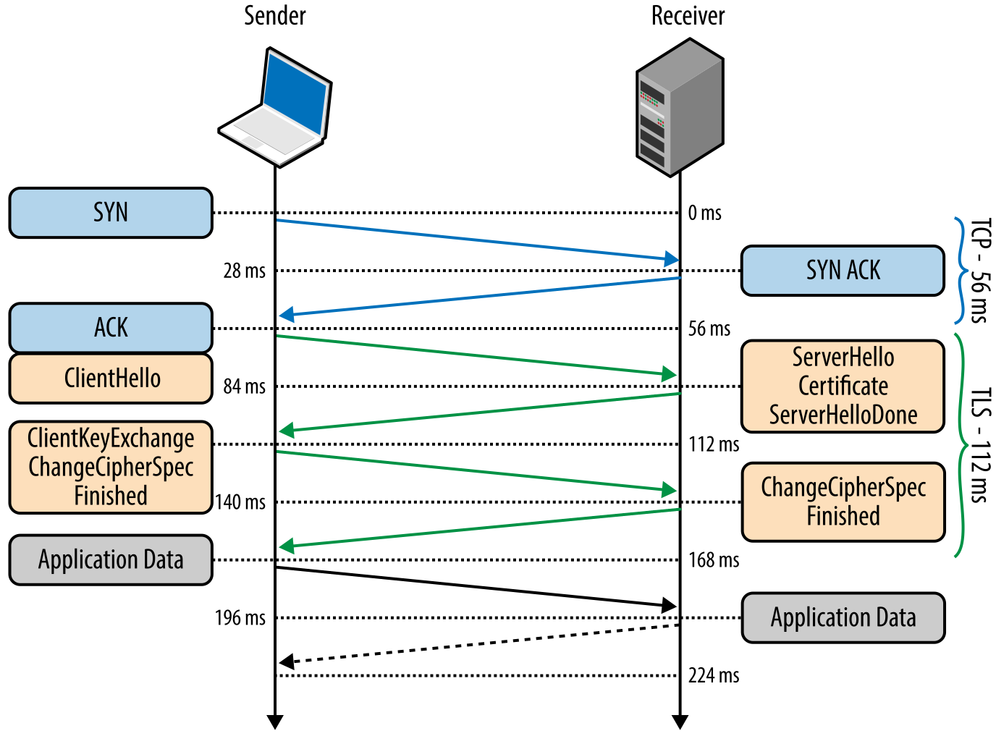
TLS handshake
Key steps
svr->cli: certificate(公钥)
cli -> svr: KeyExchange(encrypt by公钥)
svr -> cli: finished(decrypt by 私钥)

Slide 4
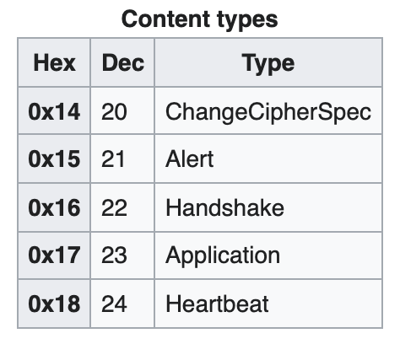
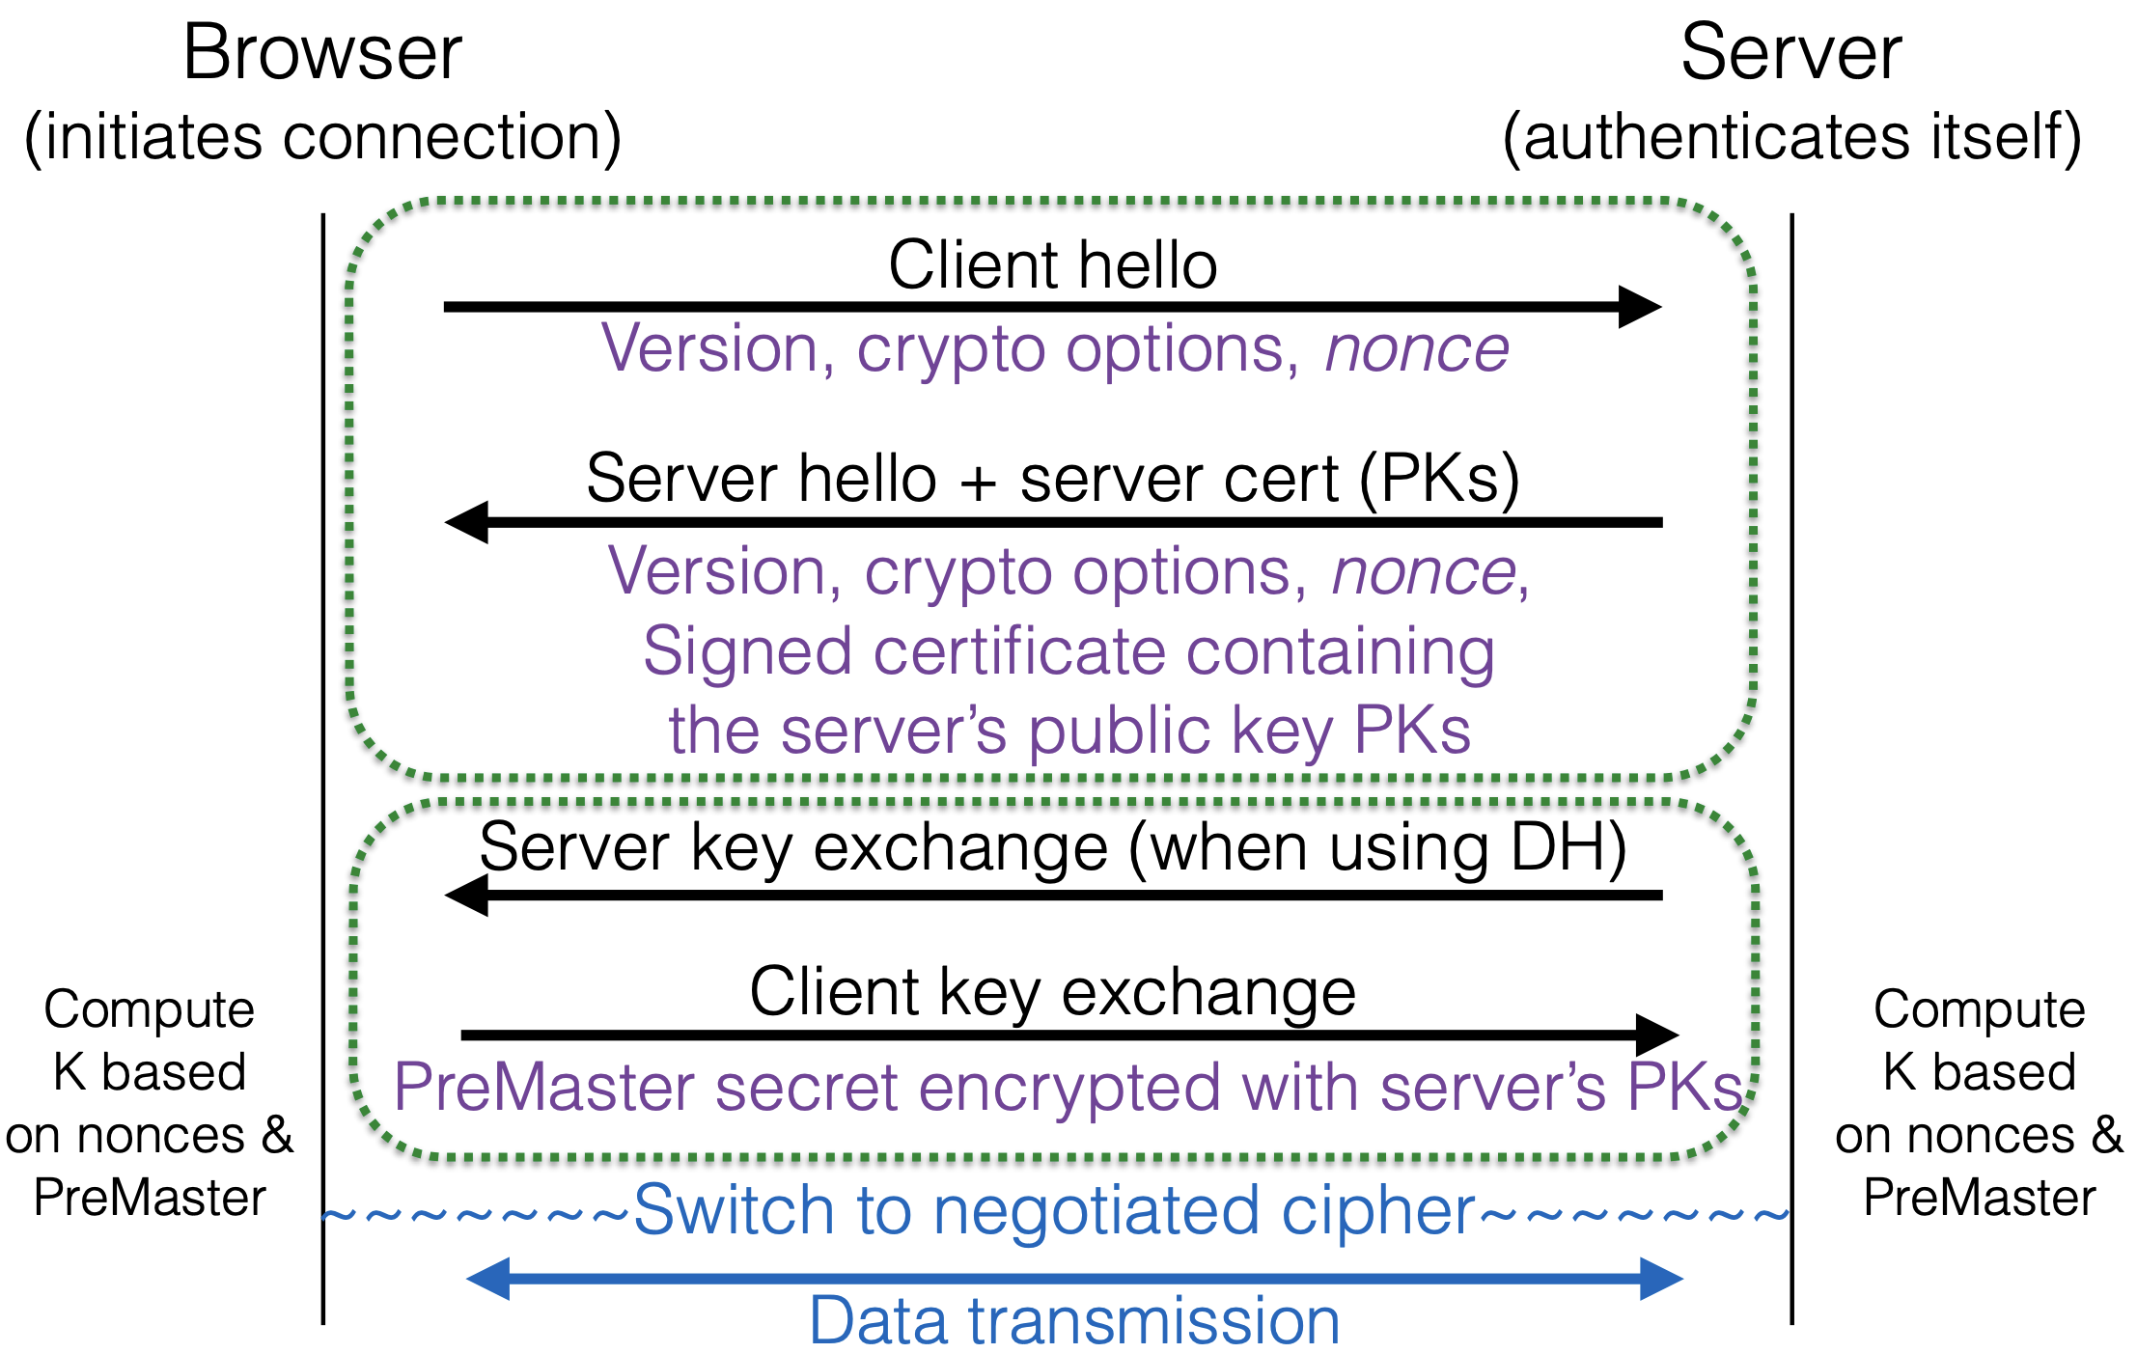
Handshake protocol

Slide 5
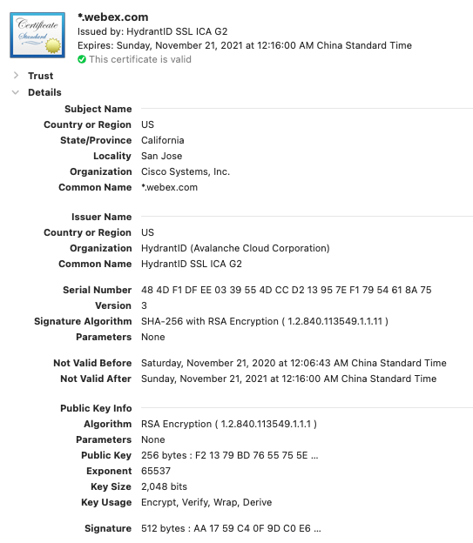
X.509 Certificate
https://en.wikipedia.org/wiki/X.509
.pem – (Privacy-enhanced Electronic Mail) Base64 encoded DER certificate, enclosed between "-----BEGIN CERTIFICATE-----" and "-----END CERTIFICATE-----"
.cer, .crt, .der – usually in binary DER form, but Base64-encoded certificates are common too

Slide 6
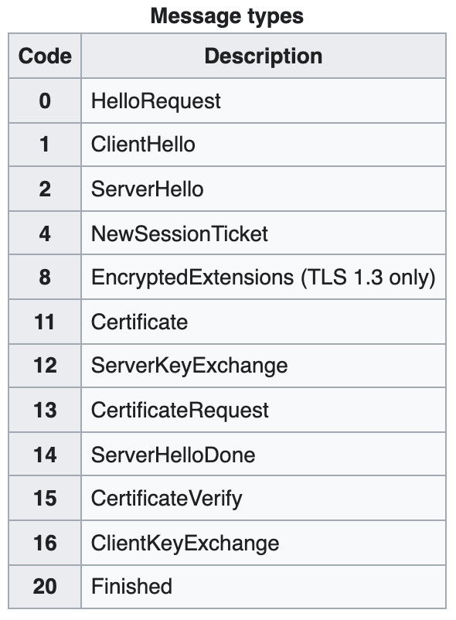
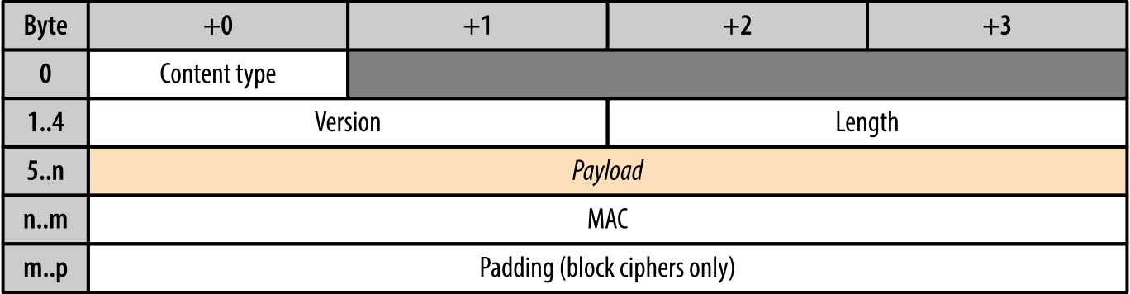
TLS Record
struct {
ContentType type; ProtocolVersion version; uint16 length; opaque fragment[TLSPlaintext.length]; } TLSPlaintext;
https://en.wikipedia.org/wiki/Transport_Layer_Security

Slide 7
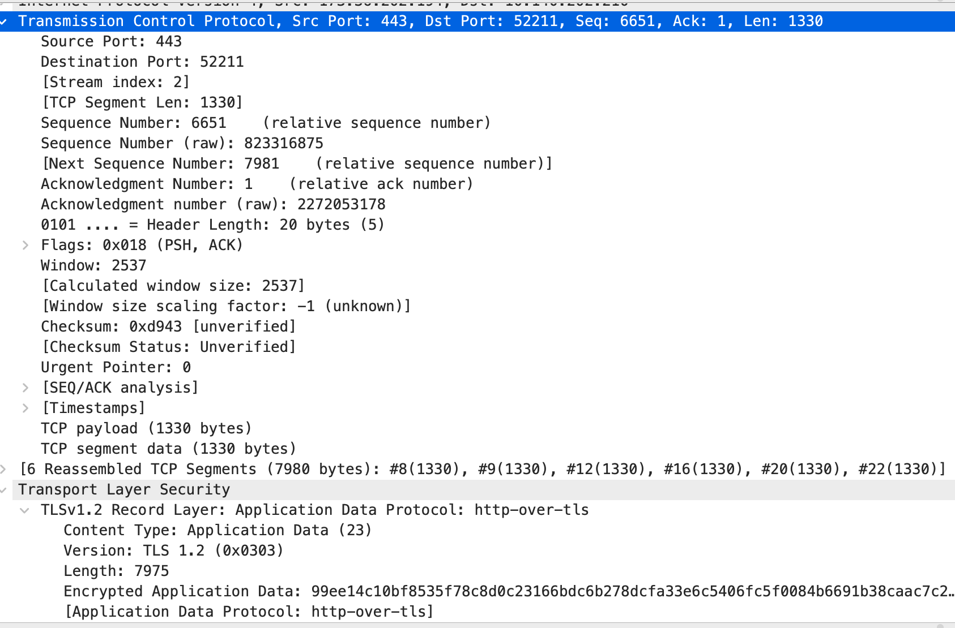
TLS record of application data

Slide 8
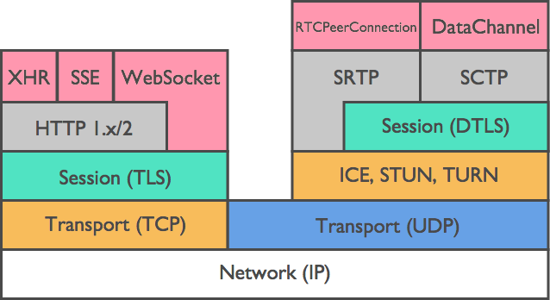
DTLS
struct {
ContentType type;
ProtocolVersion version;
uint16 epoch; // New field uint48
sequence_number; // New field
uint16 length;
opaque fragment[DTLSPlaintext.length];
} DTLSPlaintext;

Slide 9
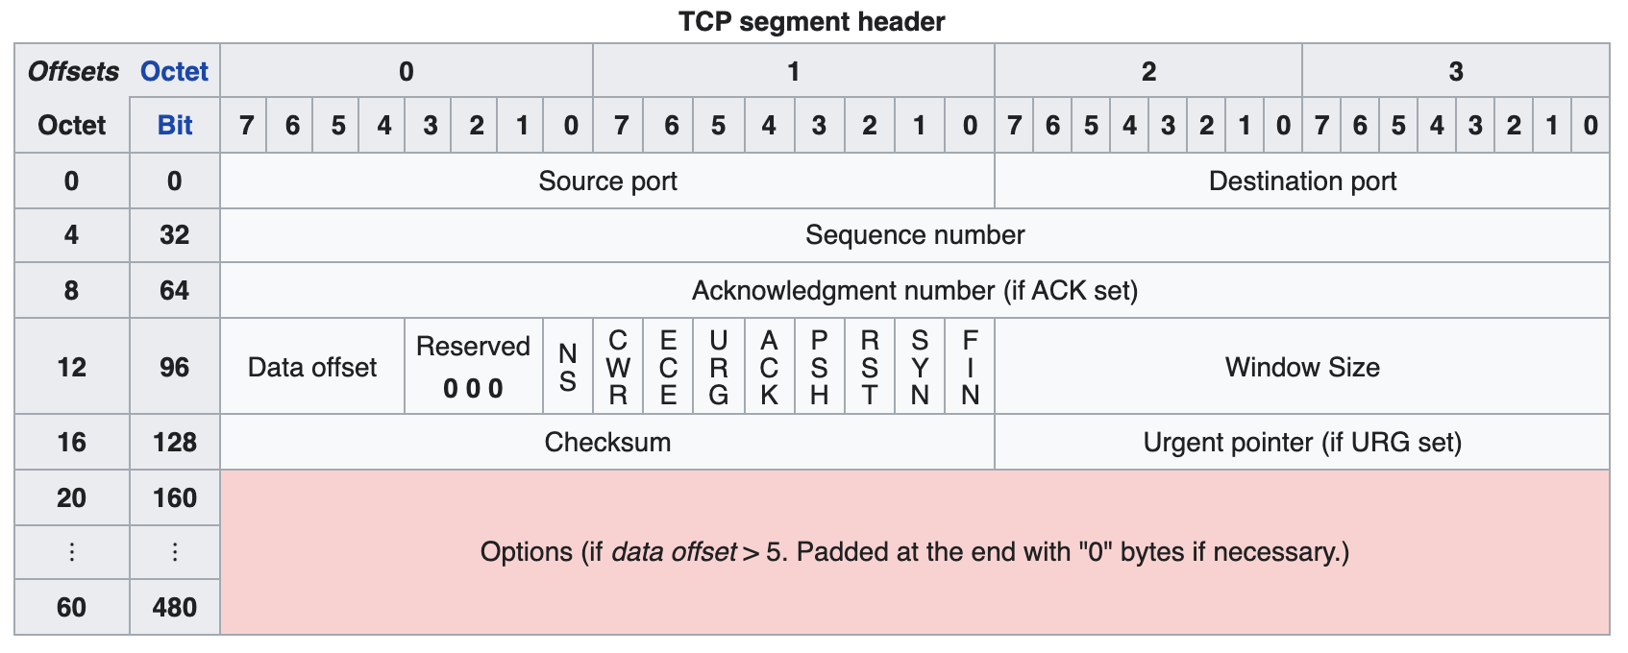
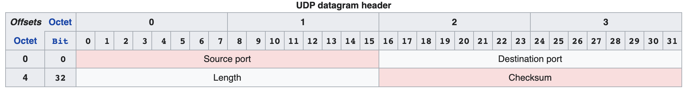
TCP vs. UDP

Slide 10
Issues due to UDP
DTLS Solution
Loss-insensitive Message
Ban stream ciphers
Adding explicit SN
Handshake reliable and ordering
Retransmission timer
Message SN within handshake
Message fragmented to N DTLS records
Maintain a bitmap window of received records for Replay Detection
Loss-insensitive Message, but:
Inter-record dependency
Handshake need relible and ordering, but:
Packet Loss
Recording
Message Size
Duplication

Slide 11
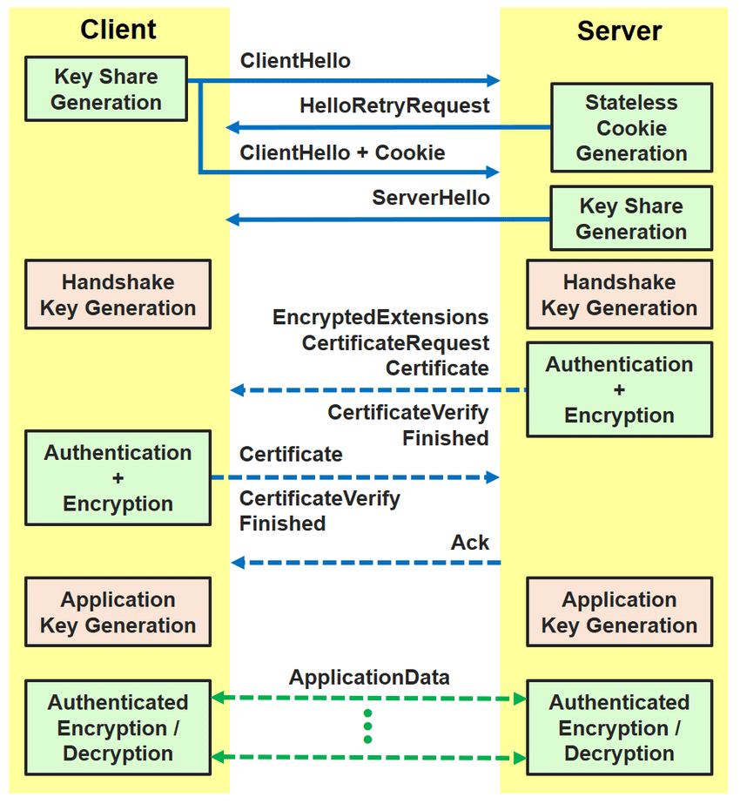
DTLS handshake
Compared TLS
A stateless cookie exchange has been added to prevent denial- of-service attacks.
Modifications to the handshake header to handle message loss, reordering, and DTLS message fragmentation (in order to avoid IP fragmentation).
fragment_offset
fragment_length
Retransmission timers to handle message loss.

Slide 12
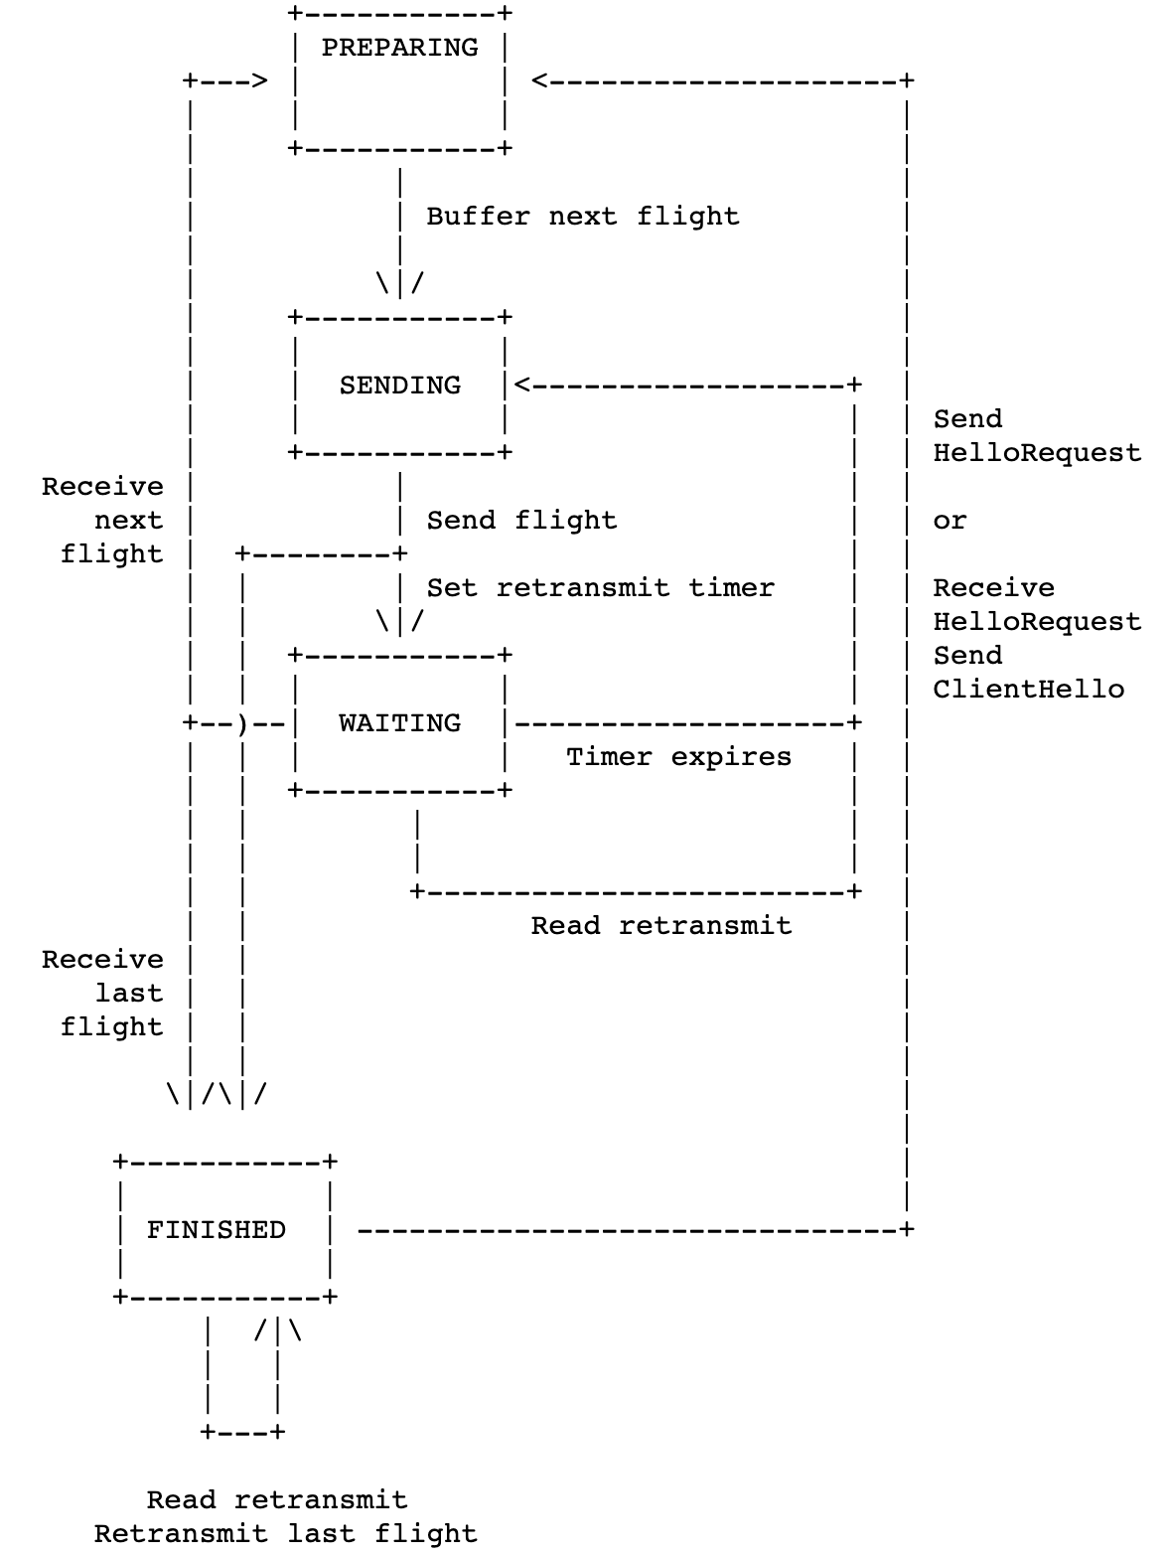
DTLS Timeout and Retransmission State Machine
There are 3 ways to exit the WAITING state:
1. The retransmit timer expires
2. The implementation reads a retransmitted flight from the peer:
3. The implementation receives the next flight of messages

Slide 13
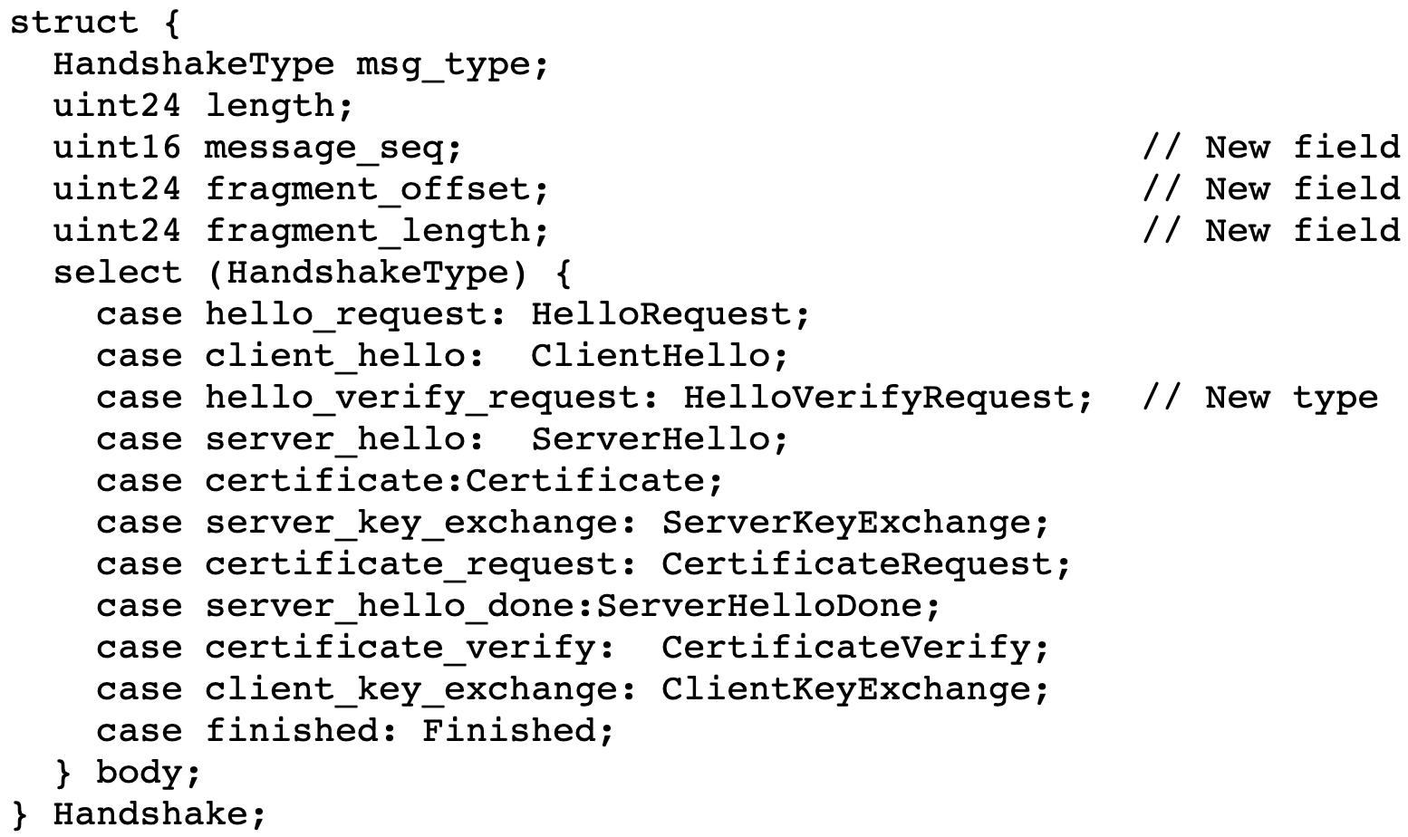
Handshake message

Slide 14
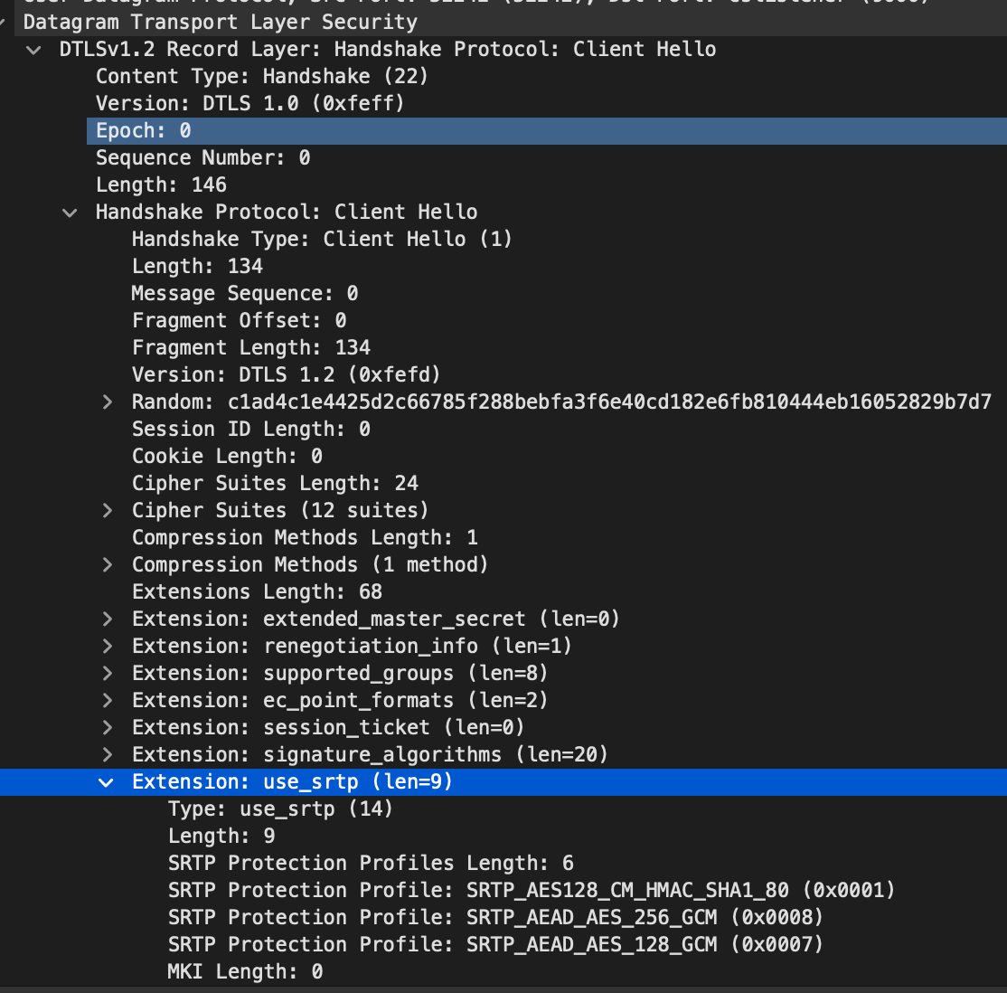
ClientHello
struct {
ProtocolVersion client_version; Random random; SessionID session_id; opaque cookie<0..2^8-1>; // New field CipherSuite cipher_suites<2..2^16-1>; CompressionMethod compression_methods<1..2^8-1>; } ClientHello;

Slide 15
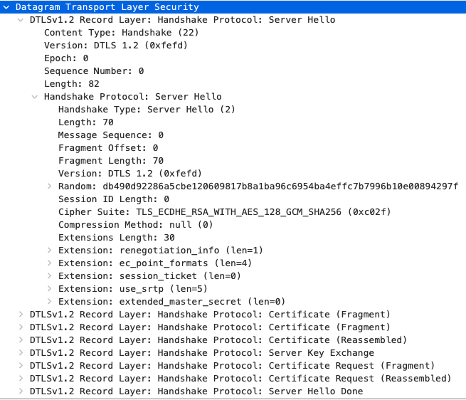
ServerHello

Slide 16
DTLS-SRTP
application data is protected using SRTP
the DTLS handshake is used to establish keying material, algorithms, and parameters for SRTP
a DTLS extension is used to negotiate SRTP algorithms
other DTLS record-layer content types are protected using the ordinary DTLS record format.
For each RTP or RTCP flow the peers do a DTLS handshake on the same source and destination port pair to establish a DTLS association.

Slide 17
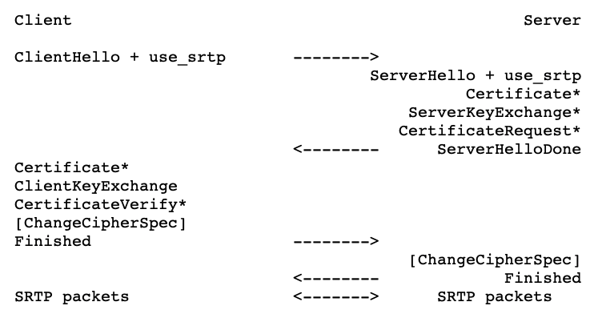
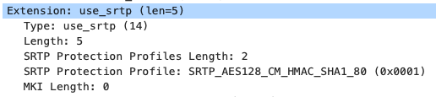
Extension use_srtp

Slide 18
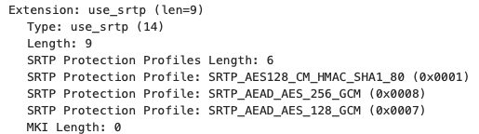
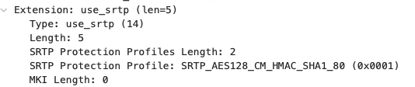
DTLS Hello Message
Client Hello
Server Hello

Slide 19
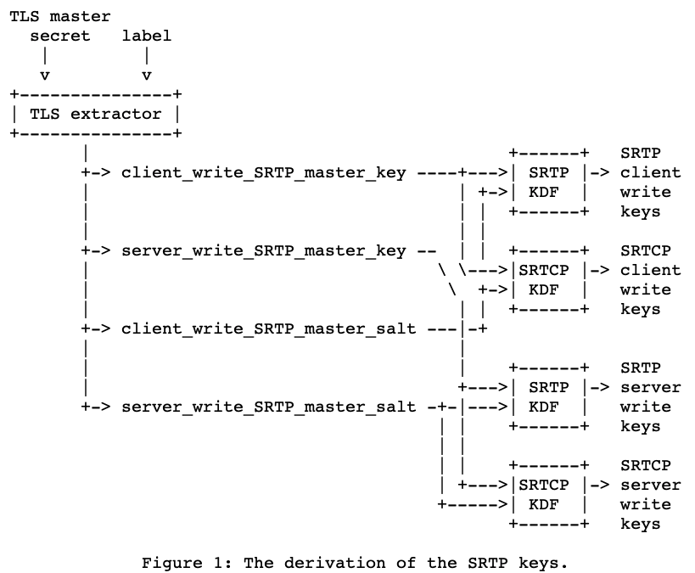
KDF

Slide 20
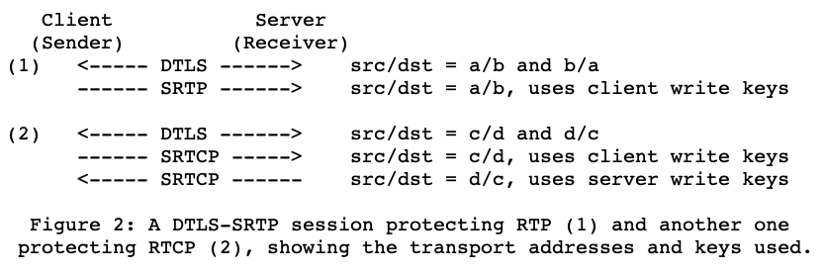
SRTP Session

Slide 21
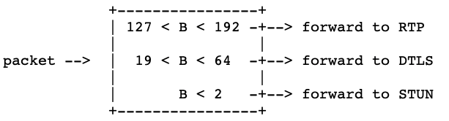
demultiplex
Looks at the first byte of packet

Slide 22
Multiple stream over one transport
For each local host/port pair, the DTLS-SRTP implementation maintains a table listing all the SSRCs it knows about and the DTLS-SRTP associations they correspond to
1. If the SSRC is already known for that endpoint, then the corresponding DTLS-SRTP association and its keying material is used to decrypt and verify the packet.
2. If the SSRC is not known, then the receiver tries to decrypt it with the keying material corresponding to each DTLS-SRTP association for that endpoint.
3. If the decryption and verification succeeds (the authentication tag verifies), then an entry is placed in the table mapping the SSRC to that association.
4. If the decryption and verification fails, then the packet is silently discarded.
5. When a DTLS-SRTP association is closed (for instance, because the fork is abandoned), its entries MUST be removed from the mapping table.

Slide 23
Key Material Extract
RFC5705 Keying Material Exporters for TLS
client_master_key
server_master_key
client_salt
server_salt
void CWCBDtlsHandle::exportDtlsKey()
{
//WCB_INFO("CWCBSrtpHandle::exportDtlsKey, ");
const char *label = "EXTRACTOR-dtls_srtp";
unsigned char keyMaterial[60];
int nRet, nError;
nRet = tls1_export_keying_material(m_Ssl, keyMaterial, 60, label,
strnlen_s(label, 100), NULL, 0, 0);
nError = SSL_get_error(m_Ssl, nRet);
if (nError != SSL_ERROR_NONE) {
WCB_ERR("CWCBDtlsHandle::GetDtlsMsterKey:" <<
" tls1_export_keying_material failed." <<
" Error Code:" << nError);
}
m_clientDtlsMasterKey.append((char *)keyMaterial, 16);
m_serverDtlsMasterKey.append((char *)keyMaterial+16, 16);
m_clientDtlsMasterKey.append((char *)keyMaterial+32, 14);
m_serverDtlsMasterKey.append((char *)keyMaterial+46, 14);
}

Slide 24
TLS Record Protocol
Four protocols
the handshake protocol,
the alert protocol,
the change cipher spec protocol
the application data protocol
The record layer will use the security parameters to generate the following six items (some of which are not required by all ciphers, and are thus empty):
client write MAC key
server write MAC key
client write encryption key
server write encryption key
client write IV
server write IV

Slide 25
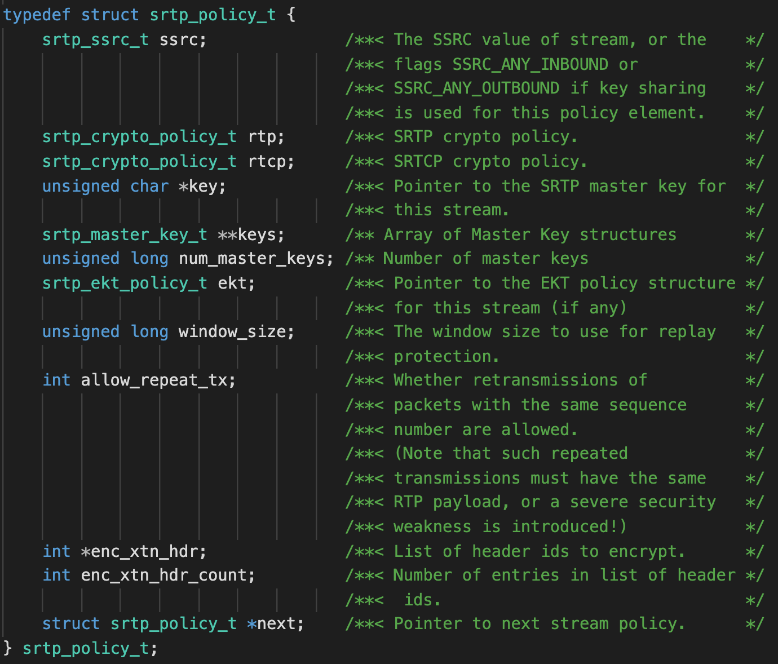
SRTP
RFC3711
libsrtp
srtp_protect()
srtp_unprotect()

Slide 26
CWCBSrtpHandle
// check if completed. If yes, set up SRTP module.
if (m_dtlsHandle.IsDtlsCompleted()) {
WCB_INFO("CWCBPeerConnection::OnReceiveRawData," <<
" m_userId = " << m_userId <<
" DTLS-SRTP Completed. Retrieve the master key");
string clientDtlsMasterKey, serverDtlsMasterKey;
m_dtlsHandle.GetDtlsMasterKey(clientDtlsMasterKey, serverDtlsMasterKey);
m_srtpHandle.Init(clientDtlsMasterKey, serverDtlsMasterKey, m_userId);
}
int Init(string &clientDtlsMasterKey,
string &serverDtlsMasterKey,
u32 userId);
// decrypt srtp/srtcp data from the caller and decrypt it to plain rtp/rtcp
int DecryptRtpData(u8 *pInRtp, int &inLen, bool &bRtcp); // encrypt the plain rtp/rtcp to srtp/srtcp.
// An extra space (80bytes) must be reserved before calling this function.
int EncryptRtpData(u8 *pInRtp, int &inLen, bool bRtcp);
-------------------------
// decrypt it in-place with the new length returned
srtp_err_status_t status;
if (bRtcp) {
status = srtp_unprotect_rtcp(m_srtp_recv, pInRtp, &inLen);
} else {
status = srtp_unprotect(m_srtp_recv, pInRtp, &inLen);
}
void CWCBPeerConnection::DecryptRawData_n(u8 *pData, u32 len)
{
bool bRtcp = false;;
int ret = m_srtpHandle.DecryptRtpData(pData, (int &)len, bRtcp);
if (ret) { return;} // error in decryption
ProcessPacket_n(pData, len, bRtcp);
}

Slide 27
Reference
Datagram Transport Layer Security (DTLS) Extension to Establish Keys for the Secure Real-time Transport Protocol (SRTP)
https://datatracker.ietf.org/doc/html/rfc5764
The Transport Layer Security (TLS) Protocol Version 1.2
https://datatracker.ietf.org/doc/html/rfc5246
Datagram Transport Layer Security Version 1.2
https://datatracker.ietf.org/doc/html/rfc6347
Keying Material Exporters for Transport Layer Security (TLS)
https://datatracker.ietf.org/doc/html/rfc5705

