Slide 1
Application Layer
World Wide Web
Electronic Mail
Domain Name System
P2P File Sharing
Readings: Chapter 2: section 2.1-2.6

Slide 2
Objectives
Understand
Service requirements applications placed on network infrastructure
Protocols distributed applications use to implement applications
Conceptual + implementation aspects of network application protocols
client server paradigm
peer-to-peer paradigm
Learn about protocols by examining popular application-level protocols
World Wide Web
Electronic Mail
P2P File Sharing
Application Infrastructure Services: DNS

Slide 3
Some network apps
e-mail
web
instant messaging
remote login
P2P file sharing
multi-user network games
streaming stored video clips
social networks
voice over IP
real-time video conferencing
cloud computing
Internet of Things (IoT) services ??

Slide 4

Creating a network app
application
transport
network
data link
physical
write programs that
run on (different) end systems
communicate over network
e.g., web server software communicates with browser software
No need to write software for network-core devices
Network-core devices do not run user applications
applications on end systems allows for rapid app development, propagation
application
transport
network
data link
physical
application
transport
network
data link
physical
4

Slide 5
Applications and Application-Layer Protocols
Application: communicating, distributed processes
running in network hosts in “user space”
exchange messages to implement app
e.g., email, file transfer, the Web
Application-layer protocols
one “piece” of an app
define messages exchanged by apps and actions taken
user services provided by lower layer protocols
application
transport
network
data link
physical
application
transport
network
data link
physical
application
transport
network
data link
physical

Slide 6

How two applications on two different computers communicate?

Slide 7

Analogy: Postal Service

Slide 8
Step 1: Find out the machine
Internet Protocol (IP)
200 Union Street SE
Minneapolis, MN

Slide 9
Addressing Machines (Hosts)
Remembering IP addresses is a pain in the neck (for humans)
Host (or domain) names
e.g., mail.cs.umn.edu, or www.google.com
DNS translates domain names to IP addresses
Given the IP address,
Network performs routing & forwarding to deliver msgs between (end) hosts
To receive messages, each machine (e.g., a web or a desktop/laptop) must an “address”
host device has unique 32-bit IP(v4) address
Exercise:
On Windows, use ipconfig from command prompt to get your IP address
On Mac, use ifconfig from command prompt to get your IP address
9

Slide 10
IP Addresses
Used to identify machines (network interfaces)
Each IP address is 32-bit
IPv6 addresses are 128-bit
Represented as x1.x2.x3.x4
Each xi corresponds to a byte
E.g.: 192.168.200.10
Each IP packet contains a destination IP address

Slide 11
Hostnames
206.207.85.33 67.99.176.30
www.home.com www.funnymovies.com
Machines are good at remembering numbers, while human beings are good at remember names.
The name (e.g., www.cs.umn.edu) consists of multiple parts:
First part is a machine name (or special identifier like www)
Each successive part is a domain name which contains the previous domain

Slide 12
Domain Name Service (DNS)
IP routing uses IP addresses
Need a way to convert hostnames to IP addresses
DNS is a distributed mapping service
Maintains “table” of name-to-address mapping
Used by most applications. E.g.: Web, email, etc.
Advantages
Easier for programmers and users
Can change mapping if needed
more next week …..

Slide 13
Internet Routing
The Internet consists of a number of routers
Each router forwards packets onto the next hop
Goal is to move the packet closer to its destination
Each router has a table
Matches packet address to determine next hop

Slide 14
Step 2: Find out the process
Transport layer Protocol

Slide 15
Addressing Processes
Q: does IP address of host on which process runs suffice for identifying the process?
A: No, many processes can be running on same
Identifier includes both IP address and port numbers associated with process on host.
Example port numbers:
HTTP server: 80
Mail server: 25
to receive messages, process must have identifier
host device has unique 32-bit IPv4 address
Exercise:
On Windows, use ipconfig from command prompt to get your IP address
On Mac, use ifconfig from command prompt to get your IP address
15

Slide 16
Identifying Remote Processes
IP addresses and hostnames allow you to identify machines
But what about processes on these machines?
Can we use PIDs?

Slide 17
Ports
Identifiers for remote processes
Each application communicates using a port
Communication is addressed to a port on a machine
Delivers the packets to the process using the port
Both TCP and UDP have their own port numbers
Many applications use well-known port numbers
HTTP: 80, FTP: 21

Slide 18
Analogy
House address: name Vs. IP address: Port number
Bob
200 Union Street SE
Minneapolis, MN

Slide 19
Summary: to communicate
Sender shall include both IP address and port numbers associated with process on host.
Example port numbers:
HTTP server: 80
Mail server: 25
For example, to send HTTP message to gaia.cs.umass.edu web server:
IP address: 128.119.245.12
Port number: 80
more shortly…

Slide 20
Step 3: What kind of service you need
Transport layer Protocol

Slide 21
Network Transport Services
end host to end host communication services
Connection-Oriented, Reliable Service
Mimic “dedicated link”
Messages delivered in correct order, without errors
Transport service aware of connection in progress
Stateful, some “state” information must be maintained
Require explicit connection setup and teardown
Connectionless, Unreliable Service
Messages treated as independent
Messages may be lost, or delivered out of order
No connection setup or teardown, “stateless”

Slide 22
Internet Transport Protocols
TCP service:
connection-oriented: setup required between client, server
reliable transport between sender and receiver
flow control: sender won’t overwhelm receiver
congestion control: throttle sender when network overloaded
UDP service:
unreliable data transfer between sender and receiver
does not provide: connection setup, reliability, flow control, congestion control
Q:Why UDP?
Notes:
Internet protocol stack provides two types of end to end transport services corresponding to two protocols. TCP is transmission control protocol and UDP is user datagram protocol.
TCP provides, connection oriented reliable transport between sender and receiver. It also does flow control such that sender wont transmit faster than receiver can consume. It also reduces the sending rate when the network is loaded.
UDP on the other hand provides unreliable connectionless datagram service. It provides demultiplexing and error checking beyond what is provided by the IP. IP knows how to deliver the packet to a host but not to a specific application on the host.
TCP service is the most commonly used one since many applications want reliable transport. Why then UDP. There are cases where you have only one request and short response. In that case it is too much of overhead to setup and tear down a connection. You might have noticed that there are some applications that use UDP.

Slide 23
What transport service does an app need?
Data loss
some apps (e.g., audio) can tolerate some loss
other apps (e.g., file transfer, telnet) require 100% reliable data transfer
Throughput
some apps (e.g., multimedia) require minimum amount of throughput to be “effective”
other apps (“elastic apps”) make use of whatever throughput they get
Security
Encryption, data integrity, …
Timing
some apps (e.g., Internet telephony, interactive games) require low delay to be “effective”
23

Slide 24
Transport service requirements of common apps
Application
file transfer
e-mail
Web documents
real-time audio/video
stored audio/video
interactive games
Instant messaging
Data loss
no loss
no loss
loss-tolerant
loss-tolerant
loss-tolerant
loss-tolerant
no loss
Bandwidth
elastic
elastic
elastic
audio: 5Kb-1Mb
video:10Kb-5Mb
same as above
few Kbps up
elastic
Time Sensitive
no
no
no
yes, 100’s msec
yes, few secs
yes, 100’s msec
yes and no

Slide 25
Internet apps: their protocols and transport protocols
Application
layer protocol
smtp [RFC 821]
telnet [RFC 854]
http [RFC 2068]
ftp [RFC 959]
proprietary
(e.g. RealNetworks)
NSF
proprietary
(e.g., Vocaltec)
Underlying
transport protocol
TCP
TCP
TCP
TCP
TCP or UDP
TCP or UDP
typically UDP
Application
e-mail
remote terminal access
Web
file transfer
streaming multimedia
remote file server
Internet telephony

Slide 26
Processes communicating
Process: program running within a host.
within same host, two processes communicate using inter-process communication (defined by OS).
processes in different hosts communicate by exchanging messages
Client process: process that initiates communication
Server process: process that waits to be contacted
Note: applications with P2P architectures have client processes & server processes
26

Slide 27
Network Applications: some jargon
A process is a program that is running within a host.
Within the same host, two processes communicate with interprocess communication defined by the OS.
Processes running in different hosts communicate with an application-layer protocol
A user agent is an interface between the user and the network application.
Web: browser
E-mail: mail reader
streaming audio/video: media player

Slide 28
App-layer protocol defines
Types of messages exchanged,
e.g., request, response
Message syntax:
what fields in messages & how fields are delineated
Message semantics
meaning of information in fields
Rules for when and how processes send & respond to messages
Public-domain protocols:
defined in RFCs
allows for interoperability
e.g., HTTP, SMTP, BitTorrent
Proprietary protocols:
e.g., Skype, ppstream
28

Slide 29
Application Programming Interface
API: application programming interface
defines interface between application and transport layer
socket: Internet API
two processes communicate by sending data into socket, reading data out of socket
Q: how does a process “identify” the other process with which it wants to communicate?
IP address of host running other process
“port number” - allows receiving host to determine to which local process the message should be delivered
API: (1) choice of transport protocol; (2) ability to fix a few parameters (lots more on this later)

Slide 30
Sockets
process sends/receives messages to/from its socket
socket analogous to door
sending process shoves message out door
sending process relies on transport infrastructure on other side of door which brings message to socket at receiving process
host or
server
host or
server
controlled by
app developer
process
process
socket
socket
TCP with
buffers,
variables
TCP with
buffers,
variables
Internet
controlled
by OS
30

Slide 31
Application Structure
Internet applications distributed in nature!
- Set of communicating application-level processes
(usually on different hosts) provide/implement services
Programming Paradigms:
Client-Server Model: Asymmetric
Server: offers service via well defined “interface”
Client: request service
Example: Web; cloud computing
Peer-to-Peer: Symmetric
Each process is an equal
Example: telephone, p2p file sharing (e.g., Kazaar)
Hybrid of client-server and P2P
All require transport of “request/reply”, sharing of data!

Slide 32
Client-server architecture
server:
always-on host
permanent IP address
server farms for scaling
clients:
communicate with server
may be intermittently connected
may have dynamic IP addresses
do not communicate directly with each other
client/server

Slide 33
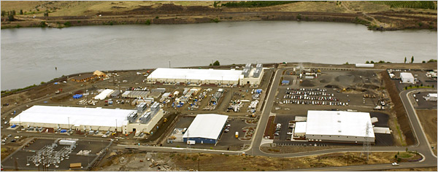
Google Data Centers
Estimated cost of data center: $600M
Google spent $2.4B in 2007 on new data centers
Each data center uses 50-100 megawatts of power

Slide 34
Pure P2P architecture
no always-on server
arbitrary end systems directly communicate
peers are intermittently connected and change IP addresses
Highly scalable but difficult to manage
peer-peer
34

Slide 35
Peer-to-Peer Paradigm
How do we implement peer-to-peer model?
Is email peer-to-peer or client-server application?
How do we implement peer-to-peer using
client-server model?
Difficulty in implementing “pure” peer-to-peer model?
How to locate your peer?
Centralized “directory service:” i.e., white pages
Napters
Unstructured: e.g., “broadcast” your query: namely, ask your friends/neighbors, who may in turn ask their friends/neighbors,
Freenet
Structured: Distributed hashing table (DHT)

Slide 36
Hybrid of client-server and P2P
Skype
voice-over-IP P2P application
centralized server: finding address of remote party:
client-client connection: direct (not through server)
Instant messaging
chatting between two users is P2P
centralized service: client presence detection/location
user registers its IP address with central server when it comes online
user contacts central server to find IP addresses of buddies
36

Slide 37
Client-Server Paradigm Recap
Typical network app has two pieces: client and server
application
transport
network
data link
physical
Client:
initiates contact with server (“speaks first”)
typically requests service from server,
for Web, client is implemented in browser; for e-mail, in mail reader
Server:
provides requested service to client
e.g., Web server sends requested Web page, mail server delivers e-mail
request
reply
application
transport
network
data link
physical

Slide 38
Client-Server: The Web Example
some jargon
User agent for Web is called a browser:
MS Internet Explorer
Netscape Communicator
Server for Web is called Web server:
Apache (public domain)
MS Internet Information Server
Web page:
consists of “objects”
addressed by a URL
Most Web pages consist of:
base HTML page, and
several referenced objects.
URL has two components: host name and path name:
www.someSchool.edu/someDept/pic.gif

Slide 39
The Web: the HTTP protocol
HTTP: hypertext transfer protocol
Web’s application layer protocol
client/server model
client: browser that requests, receives, “displays” Web objects
server: Web server sends objects in response to requests
http1.0: RFC 1945
http1.1: RFC 2068
http/2: RFC7540 (May 2015)
http request
PC running
Explorer
http response
http request
Server
running
NCSA Web
server
http response
Mac running
Navigator

Slide 40


HTTP overview
HTTP: hypertext transfer protocol
Web’s application layer protocol
client/server model
client: browser that requests, receives, (using HTTP protocol) and “displays” Web objects
server: Web server sends (using HTTP protocol) objects in response to requests
TCP port: 80; over TLS/SSL (https): TCP port 443
HTTP request
PC running
Firefox browser
HTTP response
HTTP request
server
running
Apache Web
server
HTTP response
iPhone running
Safari browser

Slide 41
HTTP overview (continued)
uses TCP:
client initiates TCP connection (creates socket) to server, port 80
server accepts TCP connection from client
HTTP messages (application-layer protocol messages) exchanged between browser (HTTP client) and Web server (HTTP server)
TCP connection closed
HTTP is “stateless”
server maintains no information about past client requests
aside
protocols that maintain “state” are complex!
past history (state) must be maintained
if server/client crashes, their views of “state” may be inconsistent, must be reconciled

Slide 42
HTTP connections
non-persistent HTTP
at most one object sent over TCP connection
connection then closed
downloading multiple objects required multiple connections
persistent HTTP
multiple objects can be sent over single TCP connection between client, server

Slide 43
Non-persistent HTTP
(contains text,
references to 10
jpeg images)
suppose user enters URL:
www.someSchool.edu/someDepartment/home.index
1a. HTTP client initiates TCP connection to HTTP server (process) at www.someSchool.edu on port 80
1b. HTTP server at host www.someSchool.edu waiting for TCP connection at port 80. “accepts” connection, notifying client
2. HTTP client sends HTTP request message (containing URL) into TCP connection socket. Message indicates that client wants object someDepartment/home.index
3. HTTP server receives request message, forms response message containing requested object, and sends message into its socket
time

Slide 44
Non-persistent HTTP (cont.)
4. HTTP server closes TCP connection.
5. HTTP client receives response message containing html file, displays html. Parsing html file, finds 10 referenced jpeg objects
time
6. Steps 1-5 repeated for each of 10 jpeg objects

Slide 45
Non-persistent HTTP: response time
RTT (definition): time for a small packet to travel from client to server and back
HTTP response time:
one RTT to initiate TCP connection
one RTT for HTTP request and first few bytes of HTTP response to return
file transmission time
non-persistent HTTP response time =
2RTT+ file transmission time
initiate TCP
connection
RTT
request
file
RTT
time to
transmit
file
file
received
time
time

Slide 46
Persistent HTTP
persistent HTTP:
server leaves connection open after sending response
subsequent HTTP messages between same client/server sent over open connection
client sends requests as soon as it encounters a referenced object
as little as one RTT for all the referenced objects
non-persistent HTTP issues:
requires 2 RTTs per object
OS overhead for each TCP connection
browsers often open parallel TCP connections to fetch referenced objects

Slide 47
HTTP request message
two types of HTTP messages: request, response
HTTP request message:
ASCII (human-readable format)
carriage return character
request line
(GET, POST,
HEAD commands)
line-feed character
GET /index.html HTTP/1.1\r\n
Host: www-net.cs.umass.edu\r\n
User-Agent: Firefox/3.6.10\r\n
Accept: text/html,application/xhtml+xml\r\n
Accept-Language: en-us,en;q=0.5\r\n
Accept-Encoding: gzip,deflate\r\n
Accept-Charset: ISO-8859-1,utf-8;q=0.7\r\n
Keep-Alive: 115\r\n
Connection: keep-alive\r\n
\r\n
header
lines
carriage return,
line feed at start
of line indicates
end of header lines
* Check out the online interactive exercises for more examples: http://gaia.cs.umass.edu/kurose_ross/interactive/

Slide 48
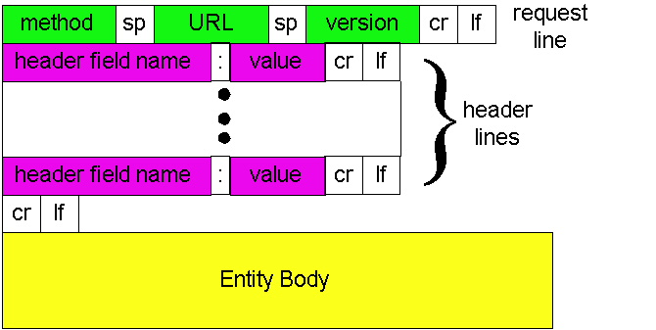
http request message: general format

Slide 49
Uploading form input
POST method:
web page often includes form input
input is uploaded to server in entity body
URL method:
uses GET method
input is uploaded in URL field of request line:
www.somesite.com/animalsearch?monkeys&banana

Slide 50
Method types
HTTP/1.0:
GET
POST
HEAD
asks server to leave requested object out of response
HTTP/1.1:
GET, POST, HEAD
PUT
uploads file in entity body to path specified in URL field
DELETE
deletes file specified in the URL field

Slide 51
HTTP response message
status line
(protocol
status code
status phrase)
HTTP/1.1 200 OK\r\n
Date: Sun, 26 Sep 2010 20:09:20 GMT\r\n
Server: Apache/2.0.52 (CentOS)\r\n
Last-Modified: Tue, 30 Oct 2007 17:00:02 GMT\r\n
ETag: "17dc6-a5c-bf716880"\r\n
Accept-Ranges: bytes\r\n
Content-Length: 2652\r\n
Keep-Alive: timeout=10, max=100\r\n
Connection: Keep-Alive\r\n
Content-Type: text/html; charset=ISO-8859-1\r\n
\r\n
data data data data data ...
header
lines
data, e.g.,
requested
HTML file
* Check out the online interactive exercises for more examples: http://gaia.cs.umass.edu/kurose_ross/interactive/

Slide 52
HTTP response status codes
status code appears in 1st line in server-to-client response message.
some sample codes:
200 OK
request succeeded, requested object later in this msg
301 Moved Permanently
requested object moved, new location specified later in this msg (Location:)
400 Bad Request
request msg not understood by server
404 Not Found
requested document not found on this server
505 HTTP Version Not Supported

Slide 53
Trying out HTTP (client side) for yourself
1. Telnet to your favorite Web server (if it does not require HTTPs!):
telnet gaia.cs.umass.edu 80
opens TCP connection to port 80
(default HTTP server port)
at gaia.cs.umass. edu.
anything typed in will be sent
to port 80 at gaia.cs.umass.edu
2. type in a GET HTTP request:
GET /kurose_ross/interactive/index.php HTTP/1.1
Host: gaia.cs.umass.edu
by typing this in (hit carriage
return twice), you send
this minimal (but complete)
GET request to HTTP server
3. look at response message sent by HTTP server!
(or use Wireshark to look at captured HTTP request/response)

Slide 54
Web and HTTP Summary
Transaction-oriented (request/reply), use TCP, port 80
Non-persistent (HTTP/1.0) vs. persistent (HTTP/1.1)
Client
Server
GET /index.html HTTP/1.0
HTTP/1.0
200 Document follows
Content-type: text/html
Content-length: 2090
-- blank line --
HTML text of the Web page

Slide 55
User-server interaction: authentication
client
server
Authentication goal: control access to server documents
stateless: client must present authorization in each request
authorization: typically name, password
authorization: header line in request
if no authorization presented, server refuses access, sends
WWW authenticate:
header line in response
usual http request msg
401: authorization req.
WWW authenticate:
usual http request msg
+ Authorization:line
usual http response msg
usual http request msg
+ Authorization:line
Browser caches name & password so
that user does not have to repeatedly enter it.
usual http response msg
time

Slide 56
User-server interaction: cookies
client
server
server sends “cookie” to client in response mst
Set-cookie: 1678453
client presents cookie in later requests
cookie: 1678453
server matches presented-cookie with server-stored info
authentication
remembering user preferences, previous choices
usual http request msg
usual http response +
Set-cookie: #
usual http request msg
cookie: #
cookie-
speccific
action
usual http response msg
usual http request msg
cookie: #
cookie-
specific
action
usual http response msg

Slide 57
A Few Words about HTTP/2
Standardized by IESG as RFC 7540 in May 2015
developed based on Google’s earlier SPDY protocol
Main Goal: decrease latency to improve page load speed in web browser via several mechanisms
data compression of HTTP headers
pipelining of HTTP requests
fixing the “head-of-line” problem in HTTP 1.1
HTTP/2 server push
Other features:
negotiation mechanisms between clients and servers for using HTTP 1.x, HTTP 2.0 or other protocols
maintain backward compatibility with HTTP 1.1 and existing use case of HTTP (e.g., proxy server, firewall, content distribution network, …)

Slide 58
Electronic Mail
outgoing
message queue
user mailbox
Three major components:
user agents
mail servers
simple mail transfer protocol: smtp
User Agent
a.k.a. “mail reader”
composing, editing, reading mail messages
e.g., Eudora, Outlook, pine, Netscape Messenger
outgoing, incoming messages stored on server
user
agent
mail
server
user
agent
SMTP
mail
server
user
agent
SMTP
SMTP
mail
server
user
agent
user
agent
user
agent

Slide 59
Electronic Mail: mail servers
Mail Servers
mailbox contains incoming messages (yet to be read) for user
message queue of outgoing (to be sent) mail messages
smtp protocol between mail servers to send email messages
client: sending mail server
“server”: receiving mail server
user
agent
mail
server
user
agent
SMTP
mail
server
user
agent
SMTP
SMTP
mail
server
user
agent
user
agent
user
agent

Slide 60
Electronic Mail:SMTP [RFC 821]
uses tcp to reliably transfer email msg from client to server, port 25
direct transfer: sending server to receiving server
three phases of transfer
handshaking (greeting)
transfer of messages
closure
command/response interaction
commands: ASCII text
response: status code and phrase
messages must be in 7-bit ASCII

Slide 61
Sample SMTP Interaction
S: 220 hamburger.edu
C: HELO crepes.fr
S: 250 Hello crepes.fr, pleased to meet you
C: MAIL FROM: <alice@crepes.fr>
S: 250 alice@crepes.fr... Sender ok
C: RCPT TO: <bob@hamburger.edu>
S: 250 bob@hamburger.edu ... Recipient ok
C: DATA
S: 354 Enter mail, end with "." on a line by itself
C: Do you like ketchup?
C: How about pickles?
C: .
S: 250 Message accepted for delivery
C: QUIT
S: 221 hamburger.edu closing connection

Slide 62
Try SMTP interaction yourself
telnet servername 25
see 220 reply from server
enter HELO, MAIL FROM, RCPT TO, DATA, QUIT commands
above lets you send email without using email client (reader)

Slide 63
SMTP: final words
smtp uses persistent connections
smtp requires that message (header & body) be in 7-bit ascii
certain character strings are not permitted in message (e.g., CRLF.CRLF). Thus message has to be encoded (usually into either base-64 or quoted printable)
smtp server uses CRLF.CRLF to determine end of message
Comparison with http
http: pull
email: push
both have ASCII command/response interaction, status codes
http: each object is encapsulated in its own response message
smtp: multiple objects message sent in a multipart message

Slide 64
Mail message format
smtp: protocol for exchanging email msgs
RFC 822: standard for text message format:
header lines, e.g.,
To:
From:
Subject:
different from smtp commands!
body
the “message”, ASCII characters only
header
blank
line
body

Slide 65
Message format: multimedia extensions
MIME: multimedia mail extension, RFC 2045, 2056
additional lines in msg header declare MIME content type
From: alice@crepes.fr
To: bob@hamburger.edu
Subject: Picture of yummy crepe.
MIME-Version: 1.0
Content-Transfer-Encoding: base64
Content-Type: image/jpeg
base64 encoded data .....
.........................
......base64 encoded data
MIME version
method used
to encode data
multimedia data
type, subtype,
parameter declaration
encoded data

Slide 66
MIME types Content-Type: type/subtype; parameters
Text
example subtypes: plain, html
Image
example subtypes: jpeg, gif
Audio
example subtypes: basic (8-bit mu-law encoded), 32kadpcm (32 kbps coding)
Video
example subtypes: mpeg, quicktime
Application
other data that must be processed by reader before “viewable”
example subtypes: msword, octet-stream

Slide 67
Multipart Type
From: alice@crepes.fr
To: bob@hamburger.edu
Subject: Picture of yummy crepe.
MIME-Version: 1.0
Content-Type: multipart/mixed; boundary=98766789
--98766789
Content-Transfer-Encoding: quoted-printable
Content-Type: text/plain
Dear Bob,
Please find a picture of a crepe.
--98766789
Content-Transfer-Encoding: base64
Content-Type: image/jpeg
base64 encoded data .....
.........................
......base64 encoded data
--98766789--

Slide 68


Mail access protocols
SMTP
SMTP
POP3 or
IMAP
user
agent
user
agent
sender’s mail
server
receiver’s mail
server
SMTP: delivery/storage to receiver’s server
Mail access protocol: retrieval from server
POP: Post Office Protocol [RFC 1939]
authorization (agent <-->server) and download
TCP port: 110; over TLS/SSL: 995
IMAP: Internet Mail Access Protocol [RFC 1730]
more features (more complex)
manipulation of stored msgs on server
TCP port: 143; over TLS/SSL: 993
HTTP: Hotmail , Yahoo! Mail, etc.

Slide 69
POP3 protocol
S: +OK POP3 server ready
C: user alice
S: +OK
C: pass hungry
S: +OK user successfully logged on
authorization phase
client commands:
user: declare username
pass: password
server responses
+OK
-ERR
transaction phase,
client:
list: list message numbers
retr: retrieve message by number
dele: delete
quit
C: list
S: 1 498
S: 2 912
S: .
C: retr 1
S: <message 1 contents>
S: .
C: dele 1
C: retr 2
S: <message 1 contents>
S: .
C: dele 2
C: quit
S: +OK POP3 server signing off

Slide 70
Email Summary
“client”
Alice
TCP port: 587 (25,465)
Message
transfer
agent
(MTA)
Message
user agent
(MUA)
SMTP
Alice’s
mail server
outgoing mail queue
SMTP
over TCP
(RFC 821)
TCP port: 25
POP3 (RFC 1225)/ IMAP (RFC 1064)
for accessing mail
“server”
port 25
Bob
Message
transfer
agent
(MTA)
Message
user agent
(MUA)
Bob’s
mail server
user mailbox

Slide 71
Internet: Naming and Addressing
Names, addresses and routes:
According to Shoch (1979)
name: identifies what you want
address: identifies where it is
route: identifies a way to get there
Internet names and addresses
Notes:
Show an example of congestion control in another slide??
-- in case I have time???

Slide 72
IP addresses
Two-level hierarchy: network id. + host id.
(or rather 3-level, subnetwork id.)
32 bits long usually written in dotted decimal notation
e.g., 128.101.35.34
No two hosts have the same IP address
host’s IP address may change, e.g., dial-in hosts
a host may have multiple IP addresses
IP address identifies host interface
Mapping of IP address to MAC (physical) IP done using IP ARP (this is called address resolution)
one-to-one mapping
Mapping between IP address and host name done using Domain Name System (DNS)
many-to-many mapping

Slide 73
Internet Domain Names
Hierarchical: anywhere from two to possibly infinity
Examples: afer.cs.umn.edu, lupus.fokus.gmd.de
edu, de: organization type or country (a “domain”)
umn, fokus: organization administering the “sub-domain”
cs, fokus: organization administering the host
afer, lupus: host name (have IP address)
. (root)
. com
. uk
. edu
umn.edu
yahoo.com
cs.umn.edu
itlabs.umn.edu
www.yahoo.com
afer.cs.umn.edu

Slide 74
Domain Name Resolution and DNS
hierarchy of redundant servers with time-limited cache
13 logical root servers (A, B, …, M), with currently 400 (physical) root servers, each knowing the global top-level domains (e.g., edu, gov, com) , refer queries to them
each server knows the 13 logical root servers
each domain has at least 2 servers (often widely distributed) for fault distributed
DNS has info about other resources, e.g., mail servers
DNS: Domain Name System:
distributed database implemented in hierarchy of many name servers
application-layer protocol host, routers, name servers to communicate to resolve names (address/name translation)
note: core Internet function implemented as application-layer protocol
complexity at network’s “edge”

Slide 75
DNS name servers
Why not centralize DNS?
single point of failure
traffic volume
distant centralized database
Maintenance
no server has all name-to-IP address mappings
doesn’t scale!
top-level domain (TLD) servers:
Such as com, org, net, edu, ... and all of the country top-level domains (uk, fr, cn…)
Provide IP for authoritative name servers
authoritative name server:
for a host: stores that host’s IP address, name
can perform name/address translation for that host’s name
local name servers:
each ISP, company has local (default) name server
host DNS query first goes to local name server

Slide 76
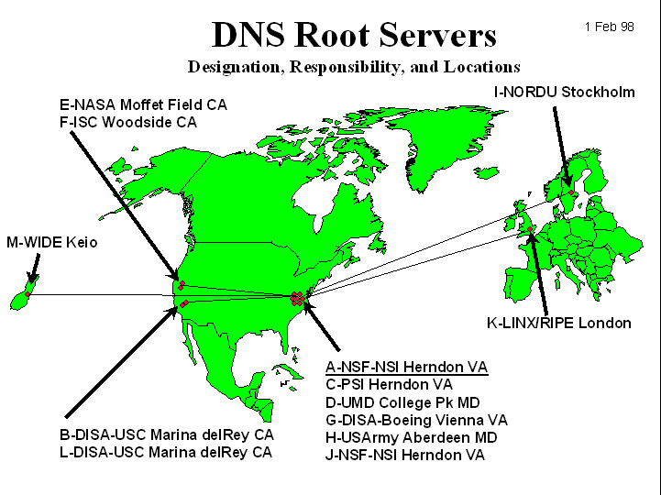
DNS: Root name servers
contacted by local name server that can not resolve name
root name server:
contacts TLD server if name mapping not known
gets mapping
returns mapping to local name server
13 logical root servers (A, B, …, M), with hundreds of (physical) root name servers worldwide

Slide 77
Simple DNS example
root name server
2
6
7
3
host homeboy.aol.com wants IP address of afer.cs.umn.edu
1. Contacts its local DNS server, dns.aol.com
2. dns.aol.com contacts root name server, if necessary
3. root name server contacts authoritative name server, dns.umn.edu, if necessary
TLD server
edu
4
5
local name server
dns.aol.com
1
8
authorititive name server
dns.umn.edu
requesting host
homeboy.aol.com
afer.cs.umn.edu

Slide 78
DNS example
root name server
2
8
9
3
Root name server:
may not know authoritative name server
may know intermediate name server: who to contact to find authoritative name server
TLD server
edu
4
7
local name server
dns.aol.com
Intermediate
name server
dns.umn.edu
1
10
5
6
requesting host
homeboy.aol.com
authoritative name server
dns.cs.umn.edu
afer.cs.umn.edu

Slide 79
DNS: iterated queries
root name server
iterated query
recursive query:
puts burden of name resolution on contacted name server
heavy load?
iterated query:
contacted server replies with name of server to contact
“I don’t know this name, but ask this server”
2
4
3
5
6
9
local name server
dns.aol.com
intermediate name server
dns.umn.edu
1
10
7
8
authoritative name server
dns.cs.umn.edu
requesting host
homeboy.aol.com
afer.cs.umn.edu

Slide 80
DNS: caching and updating records
once (any) name server learns mapping, it caches mapping
cache entries timeout (disappear) after some time
update/notify mechanisms under design by IETF
RFC 2136
http://www.ietf.org/html.charters/dnsind-charter.html

Slide 81
DNS records
DNS: distributed db storing resource records (RR)
RR format: (name, value, type,ttl)
Type=A (or AAAA)
name is hostname
value is IPv4 (IPv6) address
Type=CNAME
name is an alias name for some “canonical” (the real) name
value is canonical name
Type=NS
name is domain (e.g. foo.com)
value is IP address of authoritative name server for this domain
Type=MX
value is hostname of mailserver associated with name

Slide 82
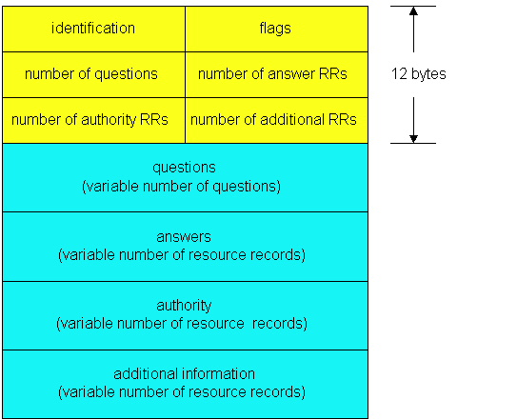
DNS protocol, messages
DNS protocol : query and reply messages, both with same message format
msg header
identification: 16 bit # for query, reply to query uses same #
flags:
query or reply
recursion desired
recursion available
reply is authoritative

Slide 83
DNS protocol, messages
Name, type fields
for a query
RRs in reponse
to query
records for
authoritative servers
additional “helpful”
info that may be used

Slide 84
DNS Protocol
Query/Reply: use UDP, port 53
Transfer of DNS Records between authoritative and replicated servers: use TCP

Slide 85
P2P File Sharing
Example
Alice runs P2P client application on her notebook computer
Intermittently connects to Internet; gets new IP address for each connection
Asks for “Hey Jude”
Application displays other peers that have copy of Hey Jude.
Alice chooses one of the peers, Bob.
File is copied from Bob’s PC to Alice’s notebook: HTTP
While Alice downloads, other users uploading from Alice.
Alice’s peer is both a Web client and a transient Web server.
All peers are servers = highly scalable!

Slide 86
P2P: Centralized Directory
Bob
original “Napster” design
1) when peer connects, it informs central server:
IP address
content
2) Alice queries for “Hey Jude”
3) Alice requests file from Bob
centralized
directory server
1
peers
1
1
3
2
1
Alice

Slide 87
P2P: problems with centralized directory
file transfer is decentralized, but locating content is highly centralized
Single point of failure
Performance bottleneck
Copyright infringement

Slide 88
Query Flooding: Gnutella
overlay network: graph
edge between peer X and Y if there’s a TCP connection
all active peers and edges is overlay net
Edge is not a physical link
Given peer will typically be connected with < 10 overlay neighbors
fully distributed
no central server
public domain protocol
many Gnutella clients implementing protocol

Slide 89
Gnutella: protocol
File transfer:
HTTP
Query message sent over existing TCP connections
peers forward Query message
QueryHit sent over reverse path
Query
QueryHit
Query
Query
QueryHit
Query
QueryHit
Scalability:
limited scope flooding
Query

Slide 90
Gnutella: Peer Joining
Joining peer X must find some other peer in Gnutella network: use list of candidate peers
X sequentially attempts to make TCP with peers on list until connection setup with Y
X sends Ping message to Y; Y forwards Ping message.
All peers receiving Ping message respond with Pong message
X receives many Pong messages. It can then setup additional TCP connections
Peer leaving: see homework problem 16 in Textbook!

Slide 91

P2P Case study: Skype
Skype clients (SC)
inherently P2P: pairs of users communicate.
proprietary application-layer protocol (inferred via reverse engineering)
hierarchical overlay with SNs
Index maps usernames to IP addresses; distributed over SNs
Skype
login server
Supernode
(SN)

Slide 92
Peers as relays
Problem when both Alice and Bob are behind “NATs”.
NAT prevents an outside peer from initiating a call to insider peer
Solution:
Using Alice’s and Bob’s SNs, Relay is chosen
Each peer initiates session with relay.
Peers can now communicate through NATs via relay

Slide 93
Exploiting Heterogeneity: KaZaA
Each peer is either a group leader or assigned to a group leader.
TCP connection between peer and its group leader.
TCP connections between some pairs of group leaders.
Group leader tracks the content in all its children.

Slide 94
KaZaA: Querying
Each file has a hash and a descriptor
Client sends keyword query to its group leader
Group leader responds with matches:
For each match: metadata, hash, IP address
If group leader forwards query to other group leaders, they respond with matches
Client then selects files for downloading
HTTP requests using hash as identifier sent to peers holding desired file

Slide 95
KaZaA Tricks
Limitations on simultaneous uploads
Request queuing
Incentive priorities
Parallel downloading
For more info:
J. Liang, R. Kumar, K. Ross, “Understanding KaZaA,”
(available via cis.poly.edu/~ross)

Slide 96
Summary
Application Service Requirements:
reliability, bandwidth, delay
Client-server vs. Peer-to-Peer Paradigm
Application Protocols and Their Implementation:
specific formats: header, data;
control vs. data messages
stateful vs. stateless
centralized vs. decentralized
Specific Protocols:
http
smtp, pop3
dns

Slide 97
Optional Material

Slide 98
Distributed Hash Table (DHT)
DHT = distributed P2P database
Database has (key, value) pairs;
key: ss number; value: human name
key: content type; value: IP address
Peers query DB with key
DB returns values that match the key
Peers can also insert (key, value) peers

Slide 99
DHT Identifiers
Assign integer identifier to each peer in range [0,2^{n}-1].
Each identifier can be represented by n bits.
Require each key to be an integer in same range.
To get integer keys, hash original key.
eg, key = h(“Led Zeppelin IV”)
This is why they call it a distributed “hash” table

Slide 100
How to assign keys to peers?
Central issue:
Assigning (key, value) pairs to peers.
Rule: assign key to the peer that has the closest ID.
Convention in lecture: closest is the immediate successor of the key.
Ex: n=4; peers: 1,3,4,5,8,10,12,14;
key = 13, then successor peer = 14
key = 15, then successor peer = 1

Slide 101
Circular DHT (1)
1
3
15
4
12
5
10
8
Each peer only aware of immediate successor and predecessor.
“Overlay network”

Slide 102
Circle DHT (2)
O(N) messages
on avg to resolve
query, when there
are N peers
0001
Who’s resp
for key 1110 ?
I am
0011
1111
1110
1110
0100
1110
1100
Define closest as closest successor
1110
0101
1110
1110
1010
1000

Slide 103
Circular DHT with Shortcuts
1
Who’s resp
for key 1110?
3
15
4
12
5
10
8
Each peer keeps track of IP addresses of predecessor, successor, short cuts.
Reduced from 6 to 2 messages.
Possible to design shortcuts so O(log N) neighbors, O(log N) messages in query

Slide 104
Peer Churn
1
To handle peer churn, require
each peer to know the IP address
of its two successors.
Each peer periodically pings its two successors to see if they are still alive.
3
15
4
12
5
10
8
Peer 5 abruptly leaves
Peer 4 detects; makes 8 its immediate successor; asks 8 who its immediate successor is; makes 8’s immediate successor its second successor.
What if peer 13 wants to join?

Slide 105
BitTorrent
Files are shared by many users (as chunks: around 256KB)
Active participation: peers download and upload chunks
A torrent is a group of peers that contain chunks of a file.
Each torrent has a tracker that keeps track of participating peers

Slide 106
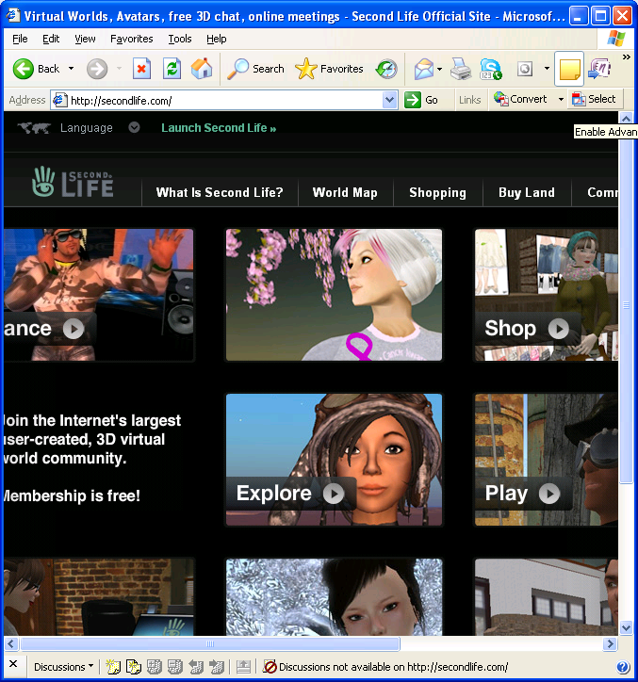
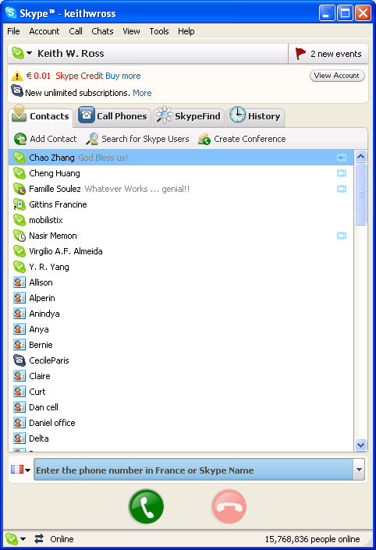
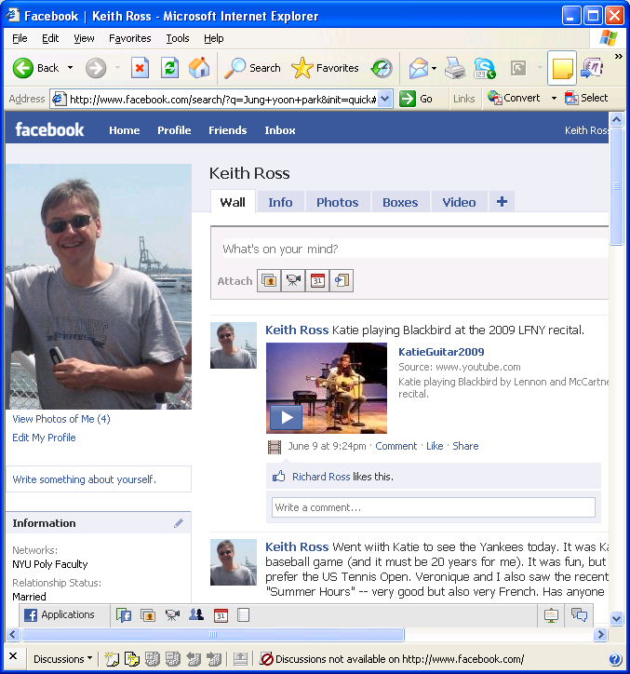
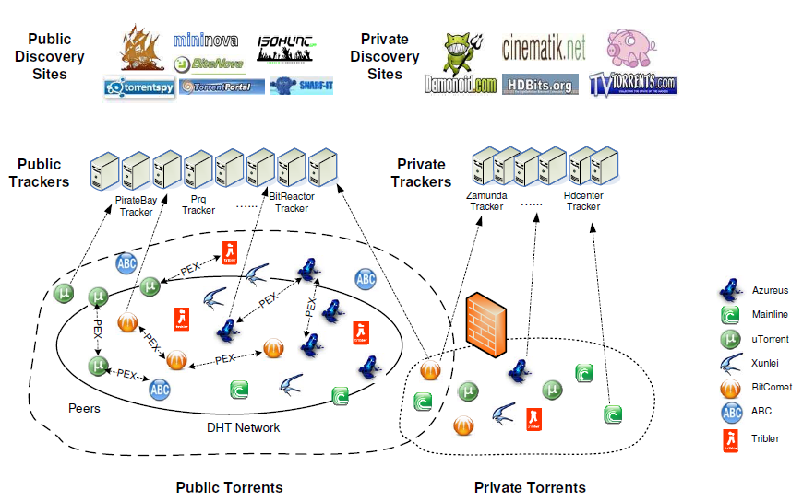
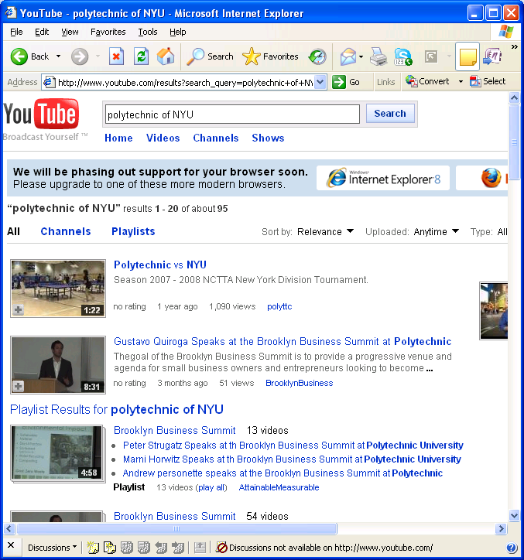

Slide 107


Torrent Setup
Tracker
p2p_1
p2p_1, p2p3
chunks
Register
p2p_2
Alice
chunks
p2p_3

Slide 108
Trading chunks
What does Alice know?
Subset of chunks she have.
Which chunks her neighbors have.
Which chunks she requests first form neighbors?
Use rarest first (chunks with least repeated copies).
Which requests should Alice respond to?
Priority is given to neighbors supplying her data at the highest rate.
Utilize unchoked and optimistically unchocked peers.
Tit-for-tat

Slide 109
Optional Material
Cloud Computing
and
Content Distribution Networks
(and role of DNS for location-aware server IP resolution)

Slide 110
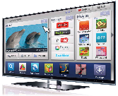
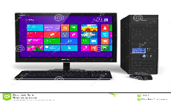

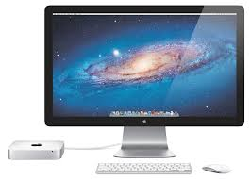
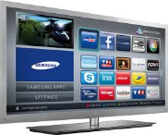
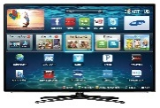
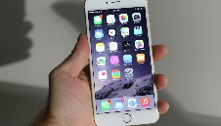
Content Distribution Ecosystem
Multiple major entities involved!
content providers (CPs), content distribution networks (CDNs), ISPs and of course, end systems & users
some entities may assume multiple roles
Complex business relationships: sometimes cooperative, but often competitive
CP2
CDN₂ & its servers
data centers
CDN₁ & its servers
CP1
ISP
data centers
media
players
ISP
ISP
users

Slide 111
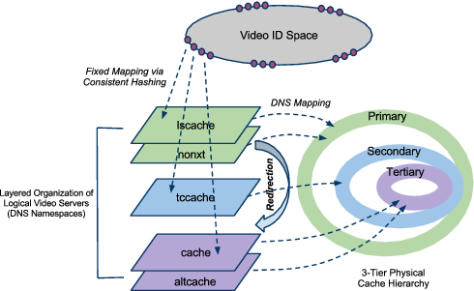
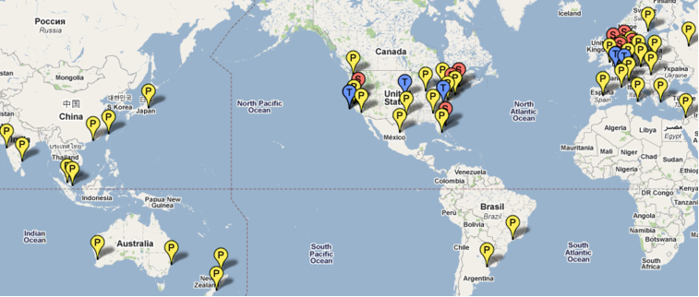
Static Content Distribution:
YouTube as a Case Study: world’s largest video sharing site
User interaction with content (e.g., search for a video) is separated from video delivery
Employs a combination of various “tricks” and mechanisms to scale with YouTube size & handle video delivery dynamics

Slide 112
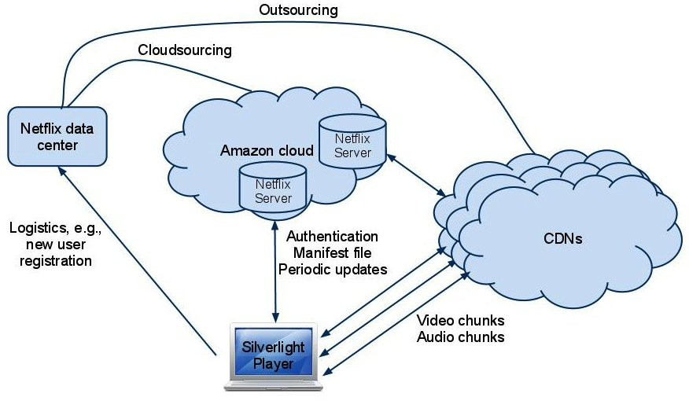
Static Content Distribution:
Netflix as a Case Study: “first” large-scale cloud-sourcing success
Has its own “data center” for certain crucial operations (e.g., user registration, …)
Most web-based user-video interaction, computation/storage operations are cloud-sourced to Amazon AWS
Users need to use MS Silverlight or other players for video streaming
Video delivery was/is partly out/cloud-sourced to 3 CDNs;
but now most utilizes its “own” OpenConnect boxes placed at participating ISPs, forming its own CDN
OpenConnect
CDN

Slide 113
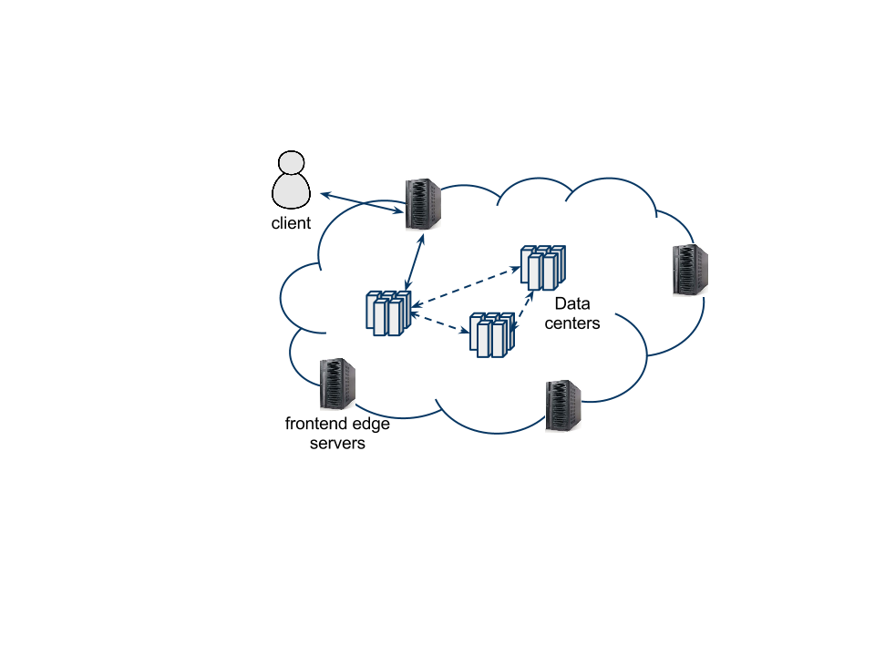
Dynamic Content Distribution
Web search as (dynamic) content delivery – e-commerce, social networking services have similar architectures
response contains both static content (e.g., banner, css files) and dynamically generated search response (dynamic content)
User QoE metric: end-to-end search response time (SRT)
Generic Web Search System Architecture
backend data centers processing search
queries & generating responses
front-end edge servers (CDN)
handling search query delivery
Google: deploy its own CDN
Bing: utilized Akamai CDN
(it now also builds its own CDN)
Amazon and Facebook have also built its own CDNs
Back-end (BE)
Data Centers
Front-End (FE) Servers
(Edge Cloud/CDN)

Slide 114
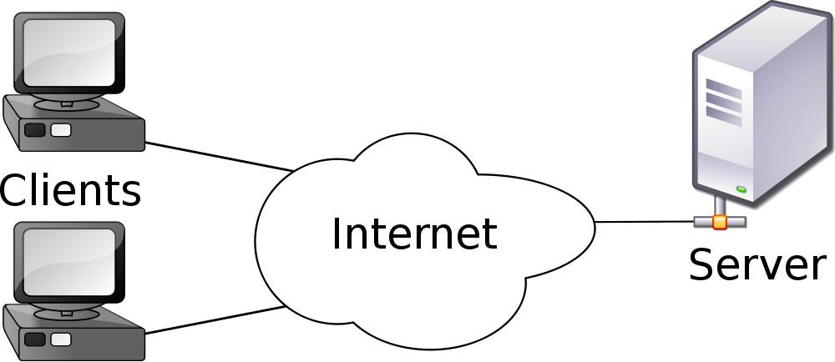








Cloud Content Distribution
request
Web: from simple client-server model for file downloads
➔ Cloud Computing + CDNs
reply
-- vast, complex networked systems spanning large geographically dispersed areas
-- scale out with user demands; meet user QoE
CDN₁ & its servers
CDN₂ & its servers
data centers
CP2
CP1
ISP
data centers
media
players
ISP
ISP
users
Notes:
Traffic must be chained through vNF entities → policy routing becomes inflexible and traffic choke points get created in the network.
SDN controller does not have full visibility into the vNFs.
The vNF entities remain foreign to and isolated from the SDN framework. Therefore, there is a need for an “NFV Controller”.
The NFs tend to change the state of the packets. And such changes are invisible to the SDN control plane, e.g., NAT boxes.

