Slide 1
Data Link Layer: Part I
Data Link Layer Functions
deliver frames over a single link
framing, media access, error checking (error correction), …
Local Area Networks (LANs) and MAC Addresses
MAC addresses (vs. IP address)
point-to-point vs. shared access
IP Address Resolution Protocol (ARP) and IP datagram forwarding (revisited!)
Extending LANs & Switched LANs:
Self-learning
Spanning tree algorithms
Readings: Textbook, Chapter 6: Sections 6.1 and 6.4.1-6.4.3

Slide 2
Data Link Layer: Introduction
“link”
Some terminology:
hosts and routers are nodes
(bridges and switches too)
communication channels that connect adjacent nodes along communication path are links
wired links
wireless links
LANs (local area networks)
layer 2 PDU (“packet”) referred to as frame, which encapsulates a layer-3 packet, e.g., an IP datagram

Slide 3
What Does Data Link Layer Do?
Data link layer has responsibility of
transferring frames from one node to adjacent node over a single link
An IP packet from host A to host B may traverses different links using different data link protocols
e.g., Ethernet on first link, frame relay on intermediate links, 802.11 on last link
Each link protocol provides different services
e.g., may or may not provide reliable data delivery
Different link protocols are not inter-operable!
IP packets are encapsulated/decapsulated with appropriate data link protocol header over each link
IP protocol and IP routers glue the links (“physical networks”) together and provide end-to-end data delivery!

Slide 4
Data Link Layer Functions
Framing
sender (transmitter): encapsulate datagram into frame, adding header, trailer, transmit frame
receiver: detect beginning of frames, receive frame, decapsulate frame, stripping off header, trailer
Link Access (Media Access Control)
determine whether it’s Okay to transmit over the link
particularly important when link shared by many nodes
also an issue over “half-duplex” point-to-point link (why?)
need media access control (MAC)
“physical addresses” identify sender/receiver on a link!
particularly important when link shared by many nodes, while over point-to-point link, not necessary
“physical addresses” often referred to as “MAC” addresses
different from IP addresses (which are logical & global)!

Slide 5
Other Data Link Layer Functions
Error Detection (commonly implemented)
errors caused by signal attenuation, noise, etc.
sender computes “checksum”, attaches to frame
receiver detects presence of errors by verifying “checksum”
drops corrupted frame, may ask sender for retransmission
Commonly used “checksum”: cyclic redundancy code (CRC)
Reliable delivery between adjacent nodes (optional)
using, e.g., go-back-N or selective repeat protocol
seldom used on low bit error link (fiber, some twisted pair)
wireless links: high error rates
Q: why both link-level and end-end reliability?
Error Correction (optional)
receiver identifies and corrects bit error(s) without resorting to retransmission, using forward error correction (FEC) codes
Flow Control (optional)
negotiating transmission rates between two nodes

Slide 6
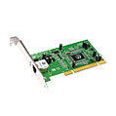
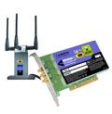

Where is the link layer implemented?
in each and every host
link layer implemented in “adaptor” (aka network interface card NIC) or on a chip
Ethernet card, 802.11 card; Ethernet chipset
implements link, physical layer
attaches into host’s system buses
combination of hardware, software, firmware
application
transport
network
link
cpu
memory
link
physical
host
bus
(e.g., PCI)
controller
physical
transmission
network adapter
card

Slide 7
Adaptors Communicating
datagram
datagram
controller
controller
sending host
receiving host
datagram
frame
sending side:
encapsulates datagram in frame
adds error checking bits, rdt, flow control, etc.
receiving side
looks for errors, rdt, flow control, etc.
extracts datagram, passes to upper layer at receiving side

Slide 8





Multiple Access Links and LANs
Two types of “links”:
point-to-point, e.g.,
PPP for dial-up access,
point-to-point link between Ethernet switch, host
broadcast (shared wire or medium), e.g.
traditional Ethernet
802.11 wireless LAN
shared wire (e.g.,
cabled Ethernet)
shared RF
(e.g., 802.11 WiFi)
shared RF
(satellite)
humans at a
cocktail party
(shared air, acoustical)

Slide 9
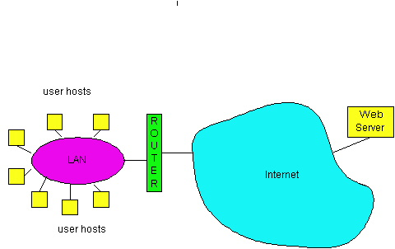
LAN: Issues & Technologies
Issues:
addressing: physical (or MAC) addresses
media access control (MAC) for broadcast LANs
expanding LANs: connecting multiple LAN segments
Various commonly used LAN technologies
Ethernet
802.11(WiFi)
PPP

Slide 10
MAC (Physical, or LAN) Addresses
used to get frames from one interface to another physically-connected interface (same physical network, i.e., p2p or LAN)
48 bit MAC address (for most LANs)
fixed for each adaptor, burned in the adapter ROM
MAC address allocation administered by IEEE
1st bit: 0 unicast, 1 multicast.
all 1’s : broadcast
MAC flat address -> portability
can move LAN card from one LAN to another
MAC addressing operations on a LAN:
each adaptor on the LAN “sees” all frames
accept a frame if dest. MAC address matches its own MAC address
accept all broadcast (MAC= all1’s) frames
accept all frames if set in “promiscuous” mode
can configure to accept certain multicast addresses (first bit = 1)

Slide 11
MAC vs. IP Addresses
32-bit IP address:
network-layer address, logical
i.e., not bound to any physical device, can be re-assigned
IP hierarchical address NOT portable
depends on IP network to which an interface is attached
when move to another IP network, IP address re-assigned
used to get IP packets to destination IP network
Recall how IP datagram forwarding is performed
IP network is “virtual,” actually packet delivery done by the underlying physical networks
from source host to destination host, hop-by-hop via IP routers
over each link, different link layer protocol used, with its own frame headers, and source and destination MAC addresses
Underlying physical networks do not understand IP protocol and datagram format!

Slide 12
IP Datagram Forwarding Model
forwarding table in A
Dest. Net. next router Nhops
223.1.1 1
223.1.2 223.1.1.4 2
IP datagram:
223.1.3 223.1.1.4 2
misc
fields
source
IP addr
dest
IP addr
data
A
223.1.1.1
datagram remains unchanged, as it travels source to destination
addr fields of interest here
223.1.2.1
223.1.1.2
223.1.1.4
223.1.2.9
B
223.1.2.2
E
223.1.1.3
223.1.3.27
223.1.3.1
223.1.3.2

Slide 13
IP Forwarding: Destination in Same Net
forwarding table in A
Dest. Net. next router Nhops
misc
fields
223.1.1.1
223.1.1.3
data
223.1.1 1
223.1.2 223.1.1.4 2
Starting at A, send IP datagram addressed to B:
look up net. address of B in forwarding table
find B is on same net. as A
link layer will send datagram directly to B inside link-layer frame
B and A are directly connected
223.1.3 223.1.1.4 2
A
223.1.1.1
223.1.2.1
223.1.1.2
223.1.1.4
223.1.2.9
B
223.1.2.2
E
223.1.1.3
223.1.3.27
223.1.3.1
223.1.3.2

Slide 14
Recall: IP Datagram Forwarding
Starting at A, given IP datagram addressed to B:
look up net. address of B, find B on same net. as A
link layer send datagram to B inside link-layer frame
A
223.1.1.1
223.1.2.1
223.1.1.2
223.1.1.4
223.1.2.9
B
223.1.2.2
E
223.1.1.3
223.1.3.27
frame source,
dest address
datagram source,
dest address
223.1.3.1
223.1.3.2
B’s MAC
addr
A’s MAC
addr
A’s IP
addr
B’s IP
addr
IP payload
datagram
frame

Slide 15
IP Forwarding: Destination in Diff. Net
misc
fields
forwarding table in A
223.1.1.1
223.1.2.3
data
Dest. Net. next router Nhops
Starting at A, dest. E:
look up network address of E in forwarding table
E on different network
A, E not directly attached
routing table: next hop router to E is 223.1.1.4
link layer sends datagram to router 223.1.1.4 inside link-layer frame
datagram arrives at 223.1.1.4
continued…..
223.1.1 1
223.1.2 223.1.1.4 2
223.1.3 223.1.1.4 2
A
223.1.1.1
223.1.2.1
223.1.1.2
223.1.1.4
223.1.2.9
B
223.1.2.2
E
223.1.1.3
223.1.3.27
223.1.3.1
223.1.3.2

Slide 16
IP Datagram Format
IP protocol version
number
32 bits
total datagram
length (bytes)
header length
(bytes)
ver
head.
len
type of
service
length
“type” of data
fragment
offset
16-bit identifier
flgs
max number
remaining hops
(decremented at
each router)
time to
live
upper
layer
Internet
checksum
32 bit source IP address
upper layer protocol
to deliver payload to
32 bit destination IP address
Options (if any)
E.g. timestamp,
record route
taken, specify
list of routers
to visit.
how much overhead with TCP?
20 bytes of TCP
20 bytes of IP
= 40 bytes + app layer overhead
data
(variable length,
typically a TCP
or UDP segment)

Slide 17
Ethernet Frame Structure
sending adapter encapsulates IP datagram (or other network layer protocol packet) in Ethernet frame
preamble:
7 bytes with pattern 10101010 followed by one byte with pattern 10101011
used to synchronize receiver, sender clock rates
type
preamble
dest.
address
source
address
data (payload)
CRC

Slide 18
LAN Addresses and ARP
each adapter on LAN has unique LAN address
1A-2F-BB-76-09-AD
LAN
(wired or
wireless)
adapter
71-65-F7-2B-08-53
58-23-D7-FA-20-B0
0C-C4-11-6F-E3-98

Slide 19


ARP: Address Resolution Protocol
Question: how to determine
MAC address of B
knowing B’s IP address?
Each IP node (host, router) on LAN has ARP table
ARP Table: IP/MAC address mappings for some LAN nodes
< IP address; MAC address; timer>
timer: time after which address mapping will be forgotten (typically 20 min)
try out “arp –a” command
137.196.7.78
1A-2F-BB-76-09-AD
137.196.7.23
137.196.7.14
LAN
71-65-F7-2B-08-53
58-23-D7-FA-20-B0
0C-C4-11-6F-E3-98
137.196.7.88

Slide 20
ARP Protocol
A wants to send datagram to B, and A knows B’s IP address.
A looks up B’s MAC address in its ARP table
Suppose B’s MAC address is not in A’s ARP table.
A broadcasts (why?) ARP query packet, containing B's IP address
destination MAC address = FF-FF-FF-FF-FF-FF
all machines on LAN receive ARP query
B receives ARP packet, replies to A with its (B's) MAC address
frame sent to A’s MAC address (unicast)
A caches (saves) IP-to-MAC address pair in its ARP table until information becomes old (times out)
soft state: information that times out (goes away) unless refreshed
ARP is “plug-and-play”:
nodes create their ARP tables without intervention from net administrator

Slide 21
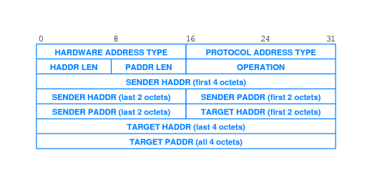
ARP Messages
Hardware Address Type: e.g., Ethernet
Protocol address Type: e.g., IP
Operation: ARP request or ARP response
Notes:
Here is the structure of an ARP packet. Whether it’s a request or reply is specified by the operation.

Slide 22
ARP Request & Response Processing
The requester broadcasts ARP request
The target node unicasts (why?) ARP reply to requester
With its physical address
Adds the requester into its ARP table (why?)
On receiving the response, requester
updates its table, sets timer
Other nodes upon receiving the ARP request
Refresh the requester entry if already there
No action otherwise
Some questions to think about:
Shall requester buffer IP datagram while performing ARP?
What shall requester do if never receive any ARP response?
Notes:
We can categorize the nodes in the local network into requester node, target node and all others. Lets see what each of them do in turn.
The target node responds only to the sender with its hardware address. Why not broadcast the reply also? All others may not necessarily be interested in communicating with target node and a broadcast incurs processing overhead at every node in the network. The target node adds the requester’s IP and hardware addresses into its ARP cache (if not already there). Why? It is likely that target node would also send IP packets to the requester node later and so it makes sense to avoid an ARP request broadcast by the target node that time.
The requester node on receiving the response, updates its ARP table.
All other nodes, receive only the request not the reply. They check if the requester has an entry in their caches. If found, they refresh that entry. Otherwise, no action taken. Why not add an entry for the requester? We don’t want to grow the ARP table unnecessarily.
Finally, a lifetime is associated with each entry in the ARP cache and an entry is deleted if it not refreshed within that time.

Slide 23
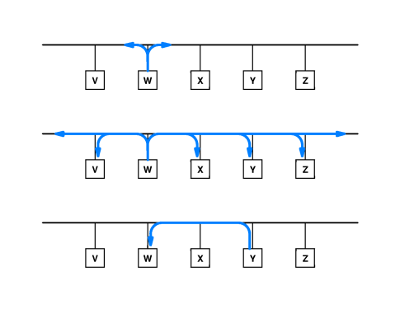
ARP Operation Illustration
Notes:
Here is an illustration of ARP broadcast by W requesting hardware address of Y. As you can see, every node in the local physical network receive this request. Only Y sends the reply and also only to W.

Slide 24
IP Forwarding: Destination in Diff. Net …
misc
fields
forwarding table in router
223.1.1.1
223.1.2.3
data
Dest. Net router Nhops interface
223.1.1 - 1 223.1.1.4
Arriving at 223.1.4, destined for 223.1.2.2
look up network address of E in router’s forwarding table
E on same network as router’s interface 223.1.2.9
router, E directly attached
link layer sends datagram to 223.1.2.2 inside link-layer frame via interface 223.1.2.9
datagram arrives at 223.1.2.2!!! (hooray!)
223.1.2 - 1 223.1.2.9
223.1.3 - 1 223.1.3.27
A
223.1.1.1
223.1.2.1
223.1.1.2
223.1.1.4
223.1.2.9
B
223.1.2.2
E
223.1.1.3
223.1.3.27
223.1.3.1
223.1.3.2

Slide 25
Forwarding to Another LAN
walkthrough: send datagram from A to B via R
focus on addressing – at IP (datagram) and MAC layer (frame)
assume A knows B’s IP address
assume A knows IP address of first hop router, R (how?)
assume A knows R’s MAC address (how?)
A
B
R
111.111.111.111
222.222.222.222
74-29-9C-E8-FF-55
49-BD-D2-C7-56-2A
222.222.222.220
1A-23-F9-CD-06-9B
111.111.111.112
111.111.111.110
222.222.222.221
CC-49-DE-D0-AB-7D
E6-E9-00-17-BB-4B
88-B2-2F-54-1A-0F

Slide 26
Forwarding to Another LAN
A creates IP datagram with IP source A, destination B
A creates link-layer frame with R's MAC address as destination address, frame contains A-to-B IP datagram
MAC src: 74-29-9C-E8-FF-55
MAC dest: E6-E9-00-17-BB-4B
IP
Eth
Phy
IP src: 111.111.111.111
IP dest: 222.222.222.222
A
B
R
111.111.111.111
222.222.222.222
74-29-9C-E8-FF-55
49-BD-D2-C7-56-2A
222.222.222.220
1A-23-F9-CD-06-9B
111.111.111.112
111.111.111.110
222.222.222.221
CC-49-DE-D0-AB-7D
E6-E9-00-17-BB-4B
88-B2-2F-54-1A-0F

Slide 27
Forwarding to Another LAN
frame sent from A to R
frame received at R, datagram removed, passed up to IP
MAC src: 74-29-9C-E8-FF-55
MAC dest: E6-E9-00-17-BB-4B
IP src: 111.111.111.111
IP dest: 222.222.222.222
IP
Eth
Phy
IP src: 111.111.111.111
IP dest: 222.222.222.222
IP
Eth
Phy
A
B
R
111.111.111.111
222.222.222.222
74-29-9C-E8-FF-55
49-BD-D2-C7-56-2A
222.222.222.220
1A-23-F9-CD-06-9B
111.111.111.112
111.111.111.110
222.222.222.221
CC-49-DE-D0-AB-7D
E6-E9-00-17-BB-4B
88-B2-2F-54-1A-0F

Slide 28
Forwarding to Another LAN
R forwards datagram with IP source A, destination B
R creates link-layer frame with B's MAC address as destination address, frame contains A-to-B IP datagram
MAC src: 1A-23-F9-CD-06-9B
MAC dest: 49-BD-D2-C7-56-2A
IP
Eth
Phy
IP
Eth
Phy
IP src: 111.111.111.111
IP dest: 222.222.222.222
A
B
R
111.111.111.111
222.222.222.222
74-29-9C-E8-FF-55
49-BD-D2-C7-56-2A
222.222.222.220
1A-23-F9-CD-06-9B
111.111.111.112
111.111.111.110
222.222.222.221
CC-49-DE-D0-AB-7D
E6-E9-00-17-BB-4B
88-B2-2F-54-1A-0F

Slide 29
Forwarding to Another LAN
R forwards datagram with IP source A, destination B
R creates link-layer frame with B's MAC address as destination address, frame contains A-to-B IP datagram
MAC src: 1A-23-F9-CD-06-9B
MAC dest: 49-BD-D2-C7-56-2A
IP
Eth
Phy
IP
Eth
Phy
IP src: 111.111.111.111
IP dest: 222.222.222.222
A
B
R
111.111.111.111
222.222.222.222
74-29-9C-E8-FF-55
49-BD-D2-C7-56-2A
222.222.222.220
1A-23-F9-CD-06-9B
111.111.111.112
111.111.111.110
222.222.222.221
CC-49-DE-D0-AB-7D
E6-E9-00-17-BB-4B
88-B2-2F-54-1A-0F

Slide 30
Forwarding to Another LAN
R forwards datagram with IP source A, destination B
R creates link-layer frame with B's MAC address as dest, frame contains A-to-B IP datagram
MAC src: 1A-23-F9-CD-06-9B
MAC dest: 49-BD-D2-C7-56-2A
IP src: 111.111.111.111
IP dest: 222.222.222.222
IP
Eth
Phy
A
B
R
111.111.111.111
222.222.222.222
74-29-9C-E8-FF-55
49-BD-D2-C7-56-2A
222.222.222.220
1A-23-F9-CD-06-9B
111.111.111.112
111.111.111.110
222.222.222.221
CC-49-DE-D0-AB-7D
E6-E9-00-17-BB-4B
88-B2-2F-54-1A-0F

Slide 31
Ethernet Switch
link-layer device: takes an active role
store, forward Ethernet frames
examine incoming frame’s MAC address, selectively forward frame to one-or-more outgoing links when frame is to be forwarded on segment, uses CSMA/CD to access segment
transparent
hosts are unaware of presence of switches
plug-and-play, self-learning
switches do not need to be configured

Slide 32
Ethernet Frame Structure
sending adapter encapsulates IP datagram (or other network layer protocol packet) in Ethernet frame
preamble:
7 bytes with pattern 10101010 followed by one byte with pattern 10101011
used to synchronize receiver, sender clock rates
type
preamble
dest.
address
source
address
data (payload)
CRC

Slide 33
Ethernet Frame Structure (More)
addresses: 6 byte source, destination MAC addresses
if adapter receives frame with matching destination address, or with broadcast address (e.g. ARP packet), it passes data in frame to network layer protocol
otherwise, adapter discards frame
type: indicates higher layer protocol (mostly IP but others possible, e.g., Novell IPX, AppleTalk)
CRC: cyclic redundancy check at receiver
error detected: frame is dropped
type
preamble
dest.
address
source
address
data (payload)
CRC

Slide 34
Ethernet: Unreliable, Connectionless
connectionless: no handshaking between sending and receiving NICs
unreliable: receiving NIC doesn't send acks or nacks to sending NIC
data in dropped frames recovered only if initial sender uses higher layer rdt (e.g., TCP), otherwise dropped data lost
Ethernet’s MAC protocol: unslotted CSMA/CD with binary backoff
Will discuss Ethernet MAC CSMA/CD protocol later!

Slide 35

Switch: Multiple Simultaneous Transmissions
hosts have dedicated, direct connection to switch
switches buffer packets
Ethernet protocol used on each incoming link, but no collisions; full duplex
each link is its own collision domain
switching: A-to-A’ and B-to-B’ can transmit simultaneously, without collisions
A
C’
B
6
1
2
5
4
3
B’
C
A’
switch with six interfaces
(1,2,3,4,5,6)

Slide 36
Switch Forwarding Table
Q: how does switch know A’ reachable via interface 4, B’ reachable via interface 5?
A
C’
B
A: each switch has a switch table, each entry:
(MAC address of host, interface to reach host, time stamp)
looks like a routing table!
1
6
2
5
3
4
B’
C
A’
Q: how are entries created, maintained in switch table?
something like a routing protocol?
switch with six interfaces
(1,2,3,4,5,6)

Slide 37
Self Learning
A bridge/switch has a forwarding (or switch) table
entry in forwarding table:
(MAC Address, Interface, Time Stamp)
stale entries in table dropped (TTL can be 60 min)
Bridge/switch learns which hosts can be reached through which interfaces
when frame received, switch “learns” location of sender: incoming LAN segment
records sender/location pair in forwarding table

Slide 38
Self-learning, forwarding: example
Source: A
switch learns which hosts can be reached through which interfaces
when frame received, switch “learns” location of sender: incoming LAN segment
records sender/location pair in switch table
Dest: A’
A
A A’
C’
B
6
1
2
5
4
3
B’
C
A’
MAC addr interface TTL
A
1
60
Switch table
(initially empty)

Slide 39
Filtering/Forwarding
when frame received at switch:
1. record incoming link, MAC address of sending host
2. index switch table using MAC destination address
3. if entry found for destination then {
if destination on segment from which frame arrived then drop frame
else forward frame on interface indicated by entry
}
else flood /* forward on all interfaces except arriving
interface */

Slide 40
Self-learning, forwarding: example
Source: A
Dest: A’
A
A A’
frame destination, A’, location unknown:
flood
C’
B
destination A location known:
6
1
2
A A’
A A’
A A’
A A’
selectively send
on just one link
A A’
5
4
3
B’
C
A’ A
MAC addr interface TTL
A’
A
1
60
switch table
(initially empty)
A’
4
60

Slide 41

Interconnecting switches
self-learning switches can be connected together:
S₄
S₁
S₃
A
S₂
F
I
B
C
D
E
G
H
Q: sending from A to G - how does S₁ know to forward frame destined to G via S₄ and S₃?
A: self learning! (works exactly the same as in single-switch case!)

Slide 42
Self-learning multi-switch example
Suppose C sends frame to I, I responds to C
S₄
S₁
S₃
A
S₂
F
I
B
C
D
E
G
H
Q: show switch tables and packet forwarding in S₁, S₂, S₃, S₄

Slide 43
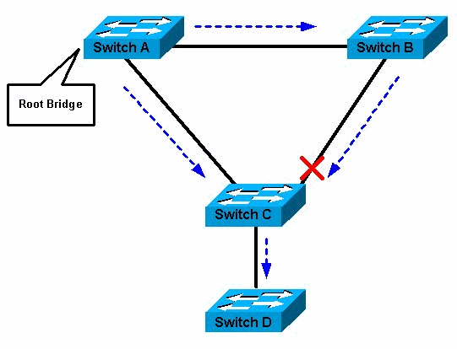
Spanning Tree Protocol
for increased reliability, desirable to have redundant, alternative paths from source to destination
with multiple paths, cycles result - switches may multiply and forward frame forever
solution: organize switches in a spanning tree by disabling subset of interfaces

Slide 44
Switch Spanning Tree Algorithm: Algorhyme
I think that I shall never see
A graph more lovely than a tree.
A tree whose crucial property
Is loop-free connectivity.
A tree that must be sure to span
So packets can reach every LAN.
First, the root must be selected.
By ID, it is elected.
Least cost paths from root are traced.
In the tree, these paths are placed.
A mesh is made by folks like me,
Then bridges find a spanning tree
-- Radia Perlman

Slide 45
Some Switch Features
Isolates collision domains resulting in higher total max throughput
limitless number of nodes and geographical coverage
Can connect different Ethernet types
Transparent (“plug-and-play”): no configuration necessary

Slide 46
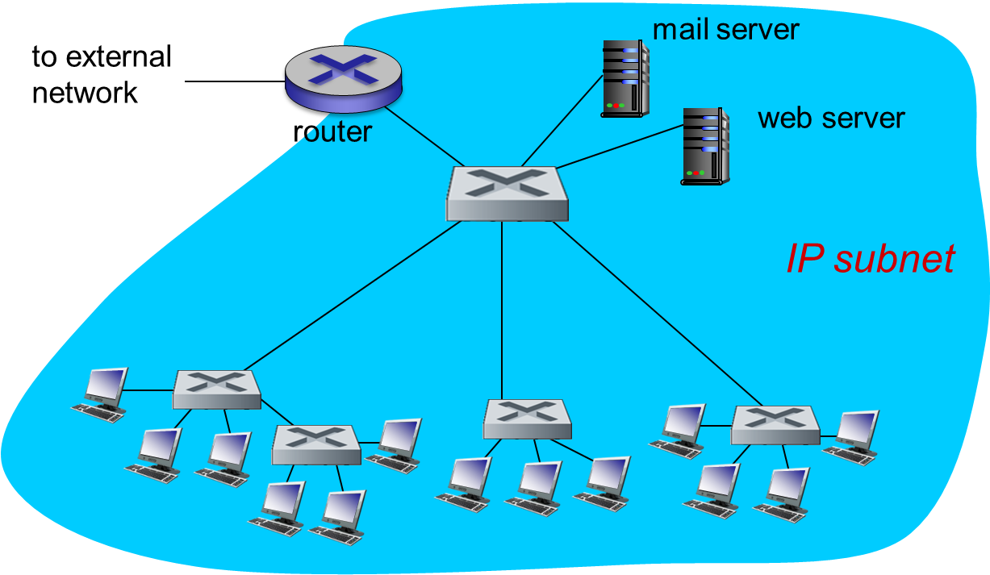
Institutional Network

Slide 47
Switches vs. Routers
application
transport
network
link
physical
both are store-and-forward:
routers: network-layer devices (examine network-layer headers)
switches: link-layer devices (examine link-layer headers)
both have forwarding tables:
routers: compute tables using routing algorithms, IP addresses
switches: learn forwarding table using flooding, learning, MAC addresses
datagram
frame
link
physical
frame
switch
network
link
physical
datagram
frame
application
transport
network
link
physical

Slide 48
Routers vs. Switches
Switches+ and -
+ Switch operation is simpler requiring less packet processing
+ Switch tables are self learning
- All traffic confined to spanning tree, even when alternative bandwidth is available
- Switches do not offer protection from broadcast storms

Slide 49
Routers vs. Switches
Routers + and -
+ arbitrary topologies can be supported, cycling is limited by TTL counters (and good routing protocols)
+ provide protection against broadcast storms
- require IP address configuration (not plug and play)
- require higher packet processing
switches do well in small (few hundred hosts) while routers used in large networks (thousands of hosts)

