Slide 1
Data Link Layer: Part 2
Data Link Layer Functions: Recap
Point-to-Point Data Link Protocols
Broadcast LAN and Media Access Control
Taxonomy of MAC Protocols
Static Partitions: TDMA, FDMA, CDMA, etc.
(Demand Adaptive) Controlled Access: (master-slave based) polling (e.g., Bluetooth/802.15); token-passing (e.g., Token Bus/802.4, Token Ring/802.5, FDDI); …
Random Access: e.g., Aloha and slotted Aloha; CSMA and CSMA/CD (Ethernet/802.3); CSMA/CA (WiFi/802.11); …
Ethernet and Its Evolution
Token Ring; DOCSIS
Ethernet vs. Token Ring: “battle of technology”
Readings: Textbook, Chapter 6: Sections 6.2, 6.3 and 6.4.2

Slide 2
Data Link Layer: Basic Functions Recap
“link”
Some terminology:
hosts and routers are nodes
(bridges and switches too)
communication channels that connect adjacent nodes along communication path are links
wired links
wireless links
LANs (local area networks)
layer 2 PDU (“packet”) referred to as frame, which encapsulates a layer-3 packet, e.g., an IP datagram

Slide 3
What Does Data Link Layer Do?
Data link layer has responsibility of
transferring frames from one node to adjacent node over a single link
An IP packet from host A to host B may traverses different links using different data link protocols
e.g., Ethernet on first link, frame relay on intermediate links, 802.11 on last link
Each link protocol provides different services
e.g., may or may not provide reliable data delivery
Different link protocols are not inter-operable!
IP packets are encapsulated/decapsulated with appropriate data link protocol header over each link
IP protocol and IP routers glue the links (“physical networks”) together and provide end-to-end data delivery!

Slide 4
Data Link Layer Functions
Framing
sender (transmitter): encapsulate datagram into frame, adding header, trailer, transmit frame
receiver: detect beginning of frames, receive frame, decapsulate frame, stripping off header, trailer
Link Access (Media Access Control)
determine whether it’s Okay to transmit over the link
particularly important when link shared by many nodes
also an issue over “half-duplex” point-to-point link (why?)
need media access control (MAC)
“physical addresses” identify sender/receiver on a link!
particularly important when link shared by many nodes, while over point-to-point link, not necessary
“physical addresses” often referred to as “MAC” addresses
different from IP addresses (which are logical & global)!

Slide 5
Other Data Link Layer Functions
Error Detection (commonly implemented)
errors caused by signal attenuation, noise, etc.
sender computes “checksum”, attaches to frame
receiver detects presence of errors by verifying “checksum”
drops corrupted frame, may ask sender for retransmission
Commonly used “checksum”: cyclic redundancy code (CRC)
Reliable Delivery between adjacent nodes (optional)
using, e.g., go-back-N or selective repeat protocol
seldom used on low bit error link (fiber, some twisted pair)
wireless links: high error rates
Q: why both link-level and end-end reliability?
Error Correction (optional)
receiver identifies and corrects bit error(s) without resorting to retransmission, using forward error correction (FEC) codes
Flow Control (optional)
negotiating transmission rates between two nodes

Slide 6
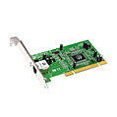
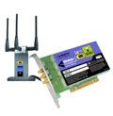

Where is the Link Layer Implemented?
in each and every host
link layer implemented in “adaptor” (aka network interface card NIC) or on a chip
Ethernet card, 802.11 card; Ethernet chipset
implements link, physical layer
attaches into host’s system buses
combination of hardware, software, firmware
application
transport
network
link
cpu
memory
link
physical
host
bus
(e.g., PCI)
controller
physical
transmission
network adapter
card

Slide 7
Adaptors Communicating
datagram
datagram
controller
controller
sending host
receiving host
datagram
frame
sending side:
encapsulates datagram in frame
adds error checking bits, rdt, flow control, etc.
receiving side
looks for errors, rdt, flow control, etc.
extracts datagram, passes to upper layer at receiving side

Slide 8
Ethernet Frame Structure
sending adapter encapsulates IP datagram (or other network layer protocol packet) in Ethernet frame
preamble:
7 bytes with pattern 10101010 followed by one byte with pattern 10101011
used to synchronize receiver, sender clock rates
type
preamble
dest.
address
source
address
data (payload)
CRC

Slide 9
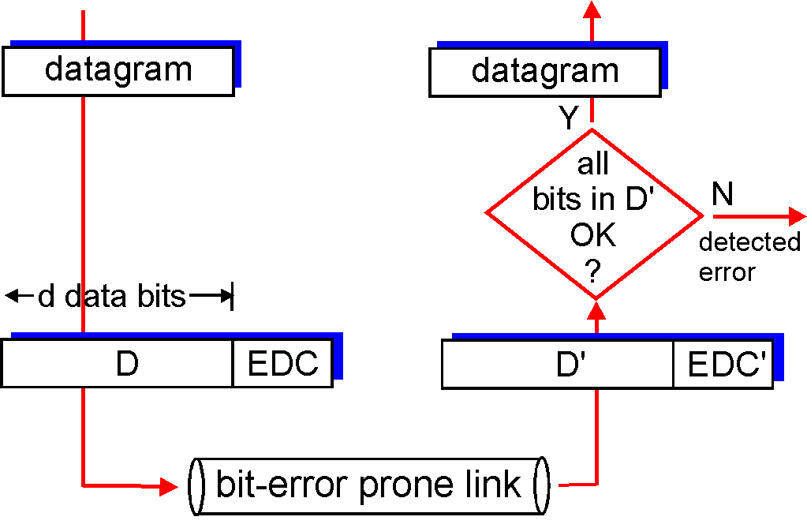
Error Detection
EDC= Error Detection and Correction bits (redundancy)
D = Data protected by error checking, may include header fields
Error detection not 100% reliable!
protocol may miss some errors, but rarely
larger EDC field yields better detection and correction

Slide 10
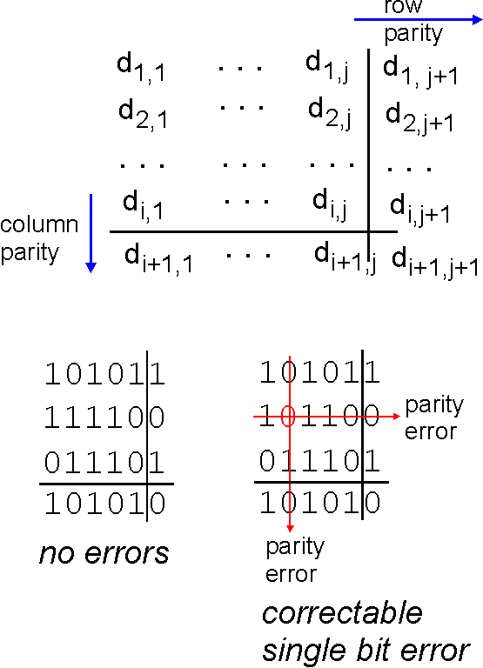
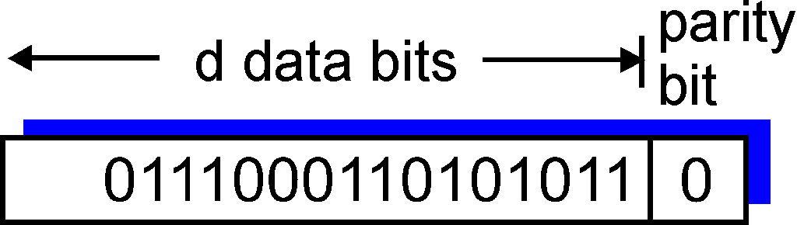
Parity Checking
Two Dimensional Bit Parity:
Detect and correct single bit errors
Single Bit Parity:
Detect single bit errors
1
0
0
0

Slide 11
Internet Checksum (Review)
Goal: detect “errors” (e.g., flipped bits) in transmitted segment (note: used at transport layer only)
Sender:
treat segment contents as sequence of 16-bit integers
checksum: addition (1’s complement sum) of segment contents
sender puts checksum value into UDP checksum field
Receiver:
compute checksum of received segment
check if computed checksum equals checksum field value:
NO - error detected
YES - no error detected. But maybe errors nonetheless? More later ….

Slide 12
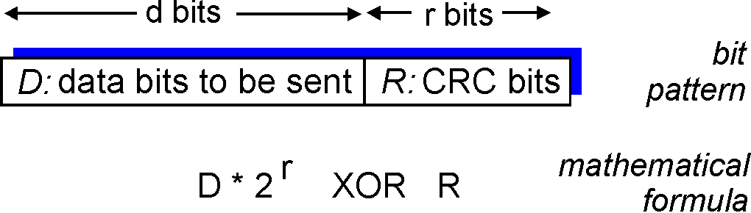
Checksumming: Cyclic Redundancy Check
view data bits, D, as a binary number
choose r+1 bit pattern (generator), G
goal: choose r CRC bits, R, such that
<D,R> exactly divisible by G (modulo 2)
receiver knows G, divides <D,R> by G. If non-zero remainder: error detected!
can detect all burst errors less than r+1 bits
widely used in practice (Ethernet, 802.11 WiFi, ATM)

Slide 13
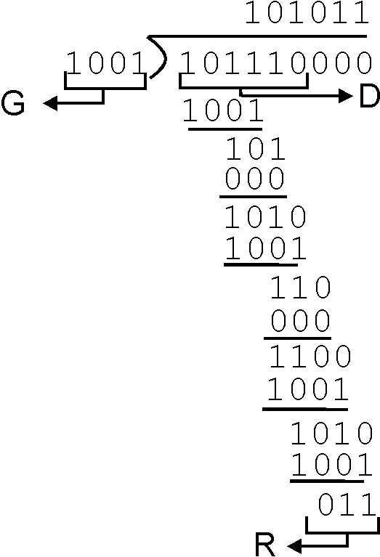
CRC Example
Want:
D.2^{r} XOR R = nG
equivalently:
D.2^{r} = nG XOR R
equivalently:
if we divide D.2^{r} by G, want remainder R
D.2^{r}
G
R = remainder[ ]

Slide 14
Point to Point Data Link Control
one sender, one receiver, one link: easier than broadcast link:
no Media Access Control
no need for explicit MAC addressing
e.g., dialup link, ISDN line
popular point-to-point DLC protocols:
PPP (point-to-point protocol)
HDLC: High level data link control
data link layer used to be considered “high layer” in protocol stack!

Slide 15
PPP Design Requirements [RFC 1557]
packet framing: encapsulation of network-layer datagram in data link frame
carry network layer data of any network layer protocol (not just IP) at same time
ability to demultiplex upwards
bit transparency: must carry any bit pattern in the data field
error detection (no correction)
connection liveness: detect, signal link failure to network layer
network layer address negotiation: endpoint can learn/configure each other’s network address

Slide 16
PPP Non-Requirements
no error correction/recovery
no flow control
out of order delivery OK
no need to support multipoint links (e.g., polling)
Error recovery, flow control, data re-ordering
all relegated to higher layers!

Slide 17
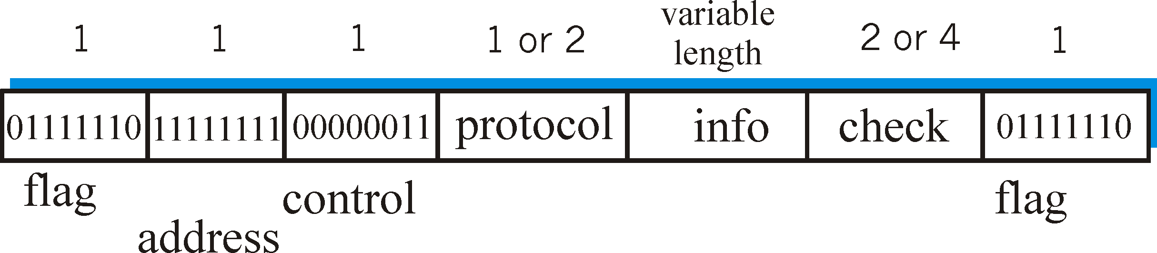
PPP Data Frame
Flag: delimiter (framing)
Address: does nothing (only one option)
Control: does nothing; in the future possible multiple control fields
Protocol: upper layer protocol to which frame delivered (eg, PPP-LCP, IP, IPCP, etc)

Slide 18
PPP Data Frame
info: upper layer data being carried
check: cyclic redundancy check for error detection

Slide 19
Byte Stuffing
“data transparency” requirement: data field must be allowed to include flag pattern <01111110>
Q: is received <01111110> data or flag?
Sender: adds (“stuffs”) extra < 01111110> byte after each < 01111110> data byte
Receiver:
two 01111110 bytes in a row: discard first byte, continue data reception
single 01111110: flag byte

Slide 20
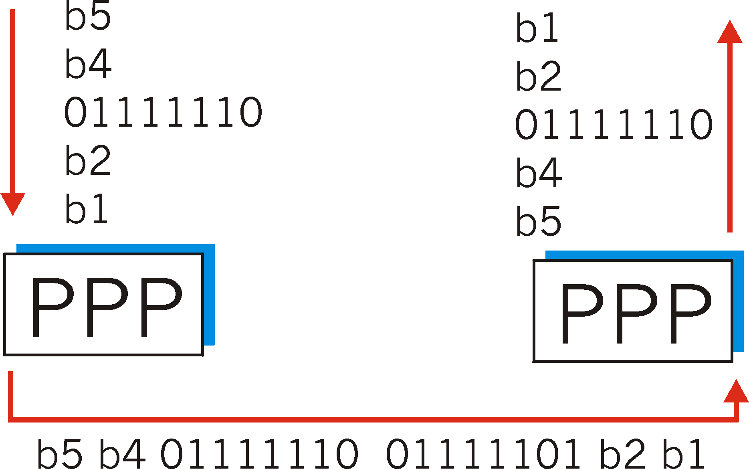
Byte Stuffing
flag byte
pattern
in data
to send
0 1 1 1 1 1 1 0
0 1 1 1 1 1 1 0
flag byte pattern plus
stuffed byte in transmitted data

Slide 21
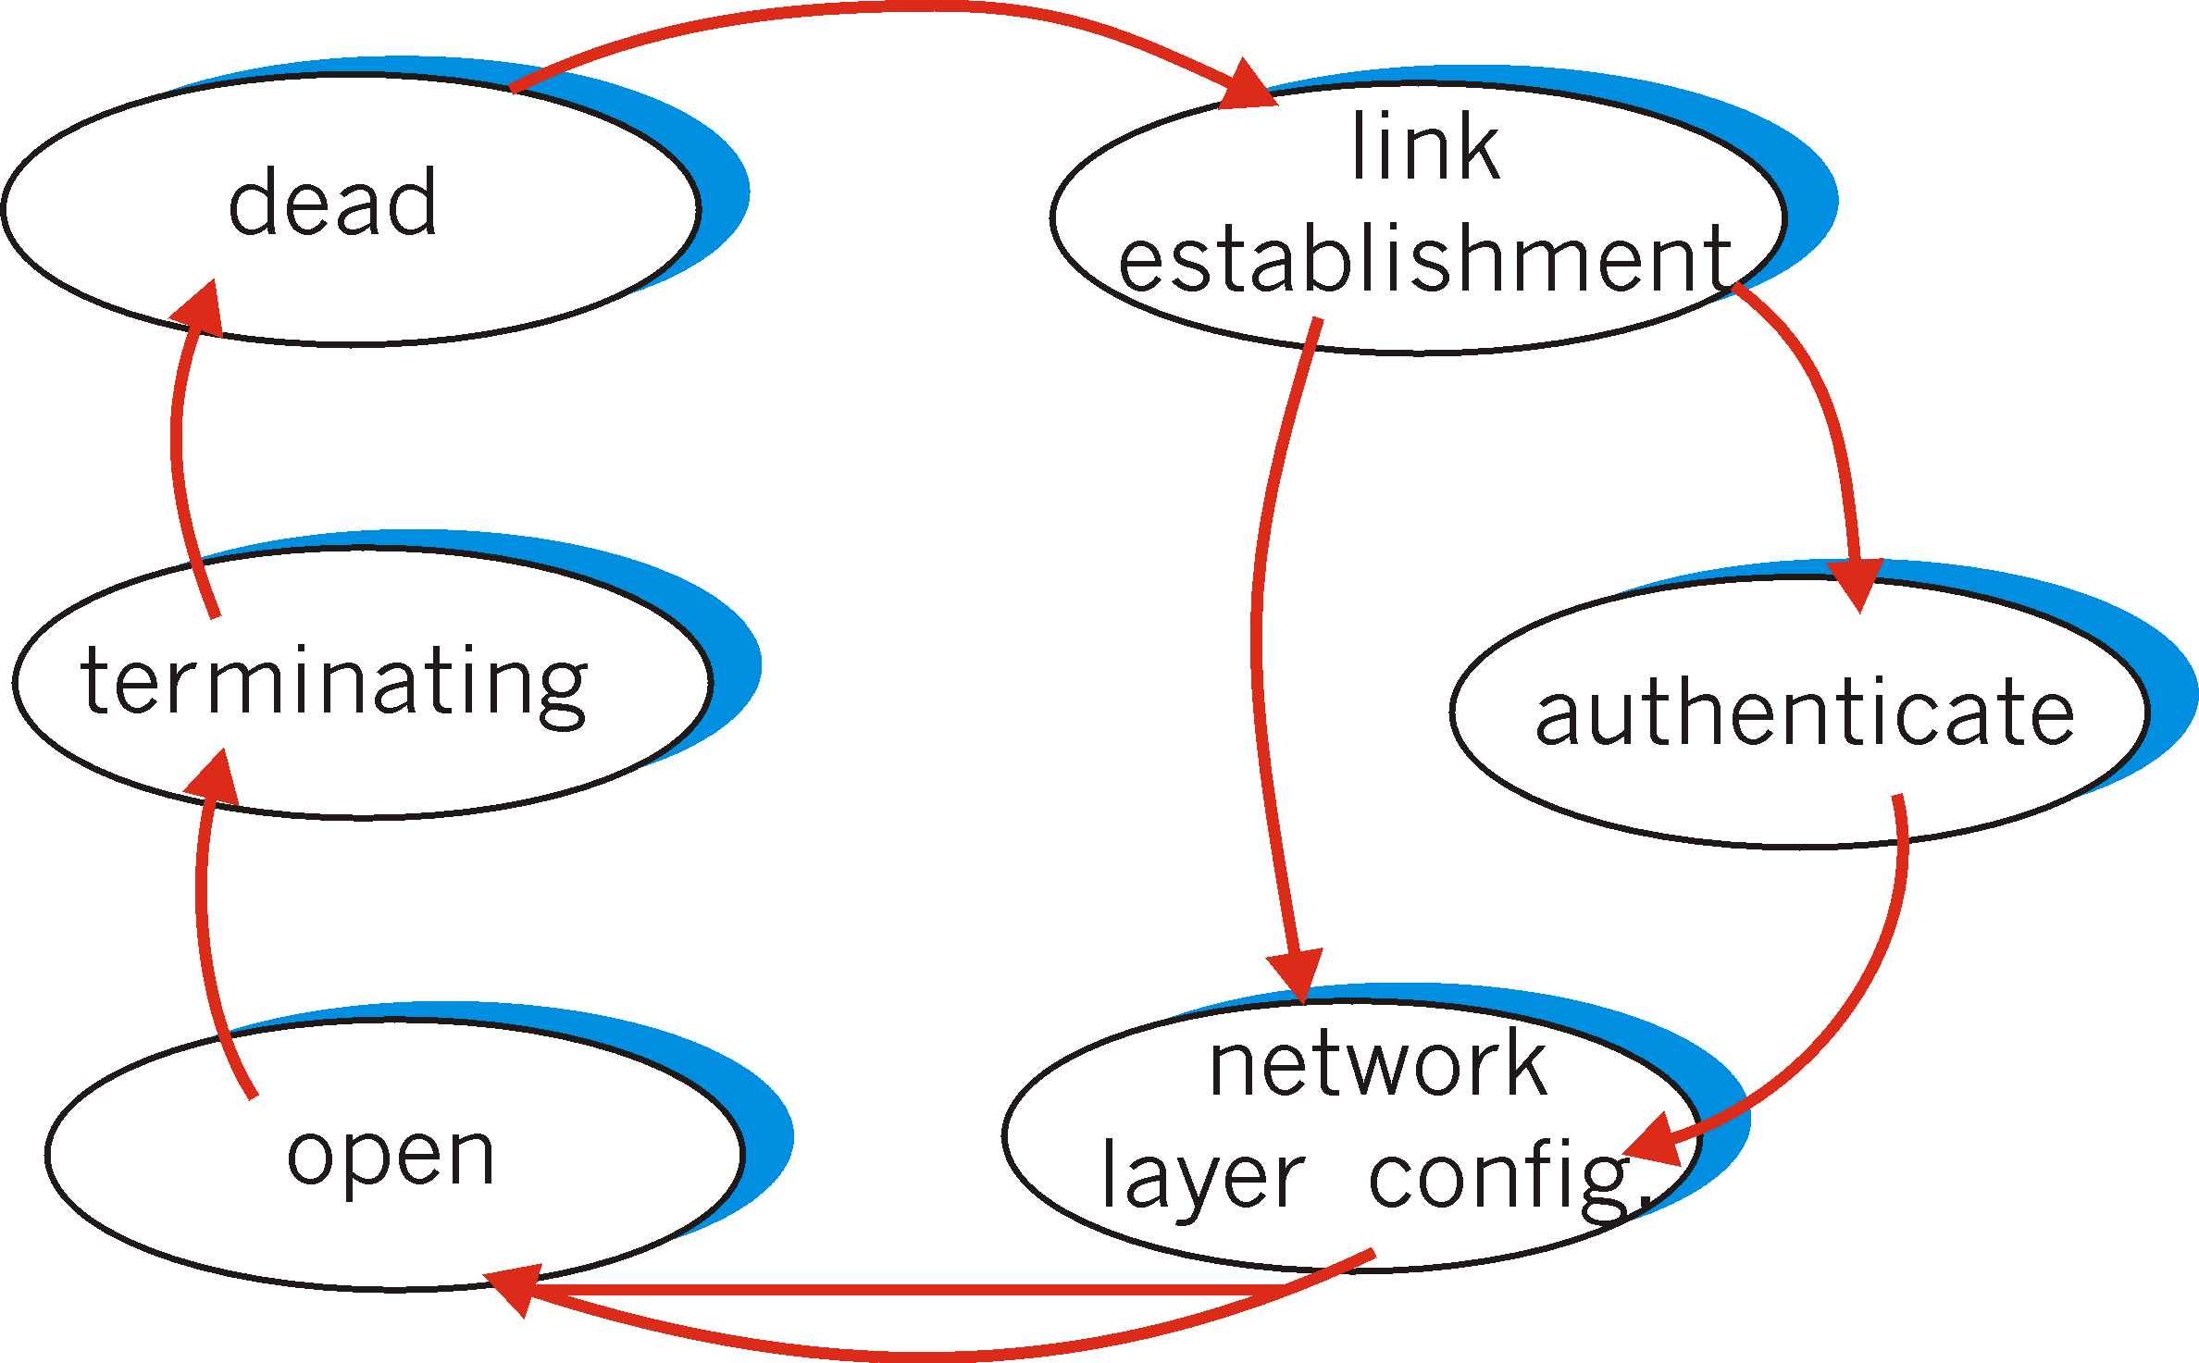
PPP Link/Network Control Protocols
Before exchanging network-layer data, data link peers must
configure PPP link (max. frame length, authentication)
learn/configure network
layer information
for IP: carry IP Control Protocol (IPCP) msgs (protocol field: 8021) to configure/learn IP address

Slide 22





Multiple Access Links: MAC Protocols
two types of “links”:
point-to-point
PPP for dial-up access
point-to-point link between Ethernet switch, host (PPPoE)
broadcast (shared wire or medium)
old-fashioned Ethernet
upstream HFC
802.11 wireless LAN
humans at a
cocktail party
(shared air, acoustical)
shared wire (e.g.,
cabled Ethernet)
shared RF
(e.g., 802.11 WiFi)
shared RF
(satellite)

Slide 23
Broadcast LAN: Media Access Control
Broadcast LAN: single shared broadcast channel
two or more simultaneous transmissions by nodes: interference!
collision if node receives two or more signals at the same time
only one node can send successfully at a time!
How to share a broadcast channel?
Humans use multi-access protocols all the time
Multiple Access Protocol
distributed algorithm that determines how nodes share channel, i.e., determine when node can transmit
communication about channel sharing must use channel itself!
what to look for in multiple access protocols:
synchronous or asynchronous
information needed about other stations
robustness
performance: access delay and throughput

Slide 24
MAC Protocols: a Taxonomy
Three broad classes:
Channel Partitioning (static controlled access)
divide channel into smaller “pieces” (e.g., time slots -> TDMA, frequency->FDMA, code->CDMA)
allocate piece to node for exclusive use
“Demand Adaptive” Controlled Access: e.g., Polling or Taking Turns
tightly coordinate shared access to avoid collisions
Random Access
channel not divided, allow collisions
“recover” from collisions

Slide 25
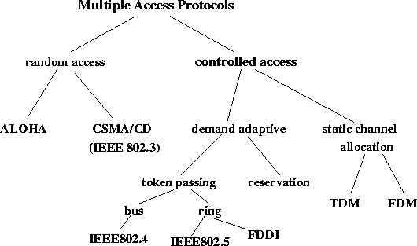
Taxonomy of MAC Protocols
CSMA/CA
(WiFi/802.11)
polling

Slide 26
Channel Partitioning MAC protocols: TDMA
TDMA: time division multiple access
access to channel in "rounds"
each station gets fixed length slot (length = packet transmission time) in each round
unused slots go idle
example: 6-station LAN, 1,3,4 have packets to send, slots 2,5,6 idle
6-slot
frame
6-slot
frame
1
3
4
1
3
4

Slide 27
Channel Partitioning MAC Protocols: FDMA
FDMA: frequency division multiple access
channel spectrum divided into frequency bands
each station assigned fixed frequency band
unused transmission time in frequency bands go idle
example: 6-station LAN, 1,3,4 have packet to send, frequency bands 2,5,6 idle
time
frequency bands
FDM cable

Slide 28
“Taking Turns” MAC protocols
channel partitioning MAC protocols:
share channel efficiently and fairly at high load
inefficient at low load: delay in channel access, 1/N bandwidth allocated even if only 1 active node!
“Demand-Adaptive” Controlled Protocols
Human analogy:
traffic control with green/red light
fixed time vs. adaptive time vs. no lights at all
(Master-Slave based) Polling:
e.g., in a classroom: I am the “master” ;-)
“Taking Turns” via token-passing:
e.g., a round-table panel with a single microphone

Slide 29
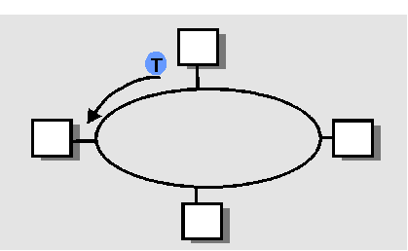
“Taking Turns” MAC Protocols
Polling:
centralized
master node “invites” slave nodes to transmit in turn
concerns:
polling overhead
latency
single point of failure (master)
Token passing:
distributed
control token passed from one node to next sequentially.
what is a token? a special control message
concerns:
token overhead
latency
single point of failure (token)
master
slaves

Slide 30
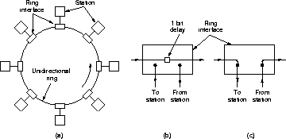
Token Ring Topology
Using token-passing, nodes do not have to form a physical ring! E.g., token bus: all nodes connected via a bus, forming a logical ring!)

Slide 31
Token Release
T
oken
Frame
T
oken
Frame
Release after Reception
(used by Token Ring)
Release after Transmission
(used by FDDI)

Slide 32
Token Ring Performance
Efficiency with “release after reception”
where
What is the efficiency with “release after transmission” ?

Slide 33
Random Access Protocols
When node has packet to send
transmit at full channel data rate R.
no a priori coordination among nodes
two or more transmitting nodes -> “collision”,
random access MAC protocol specifies:
how to detect or avoid collisions
how to recover from collisions (e.g., via delayed retransmissions)
Examples of random access MAC protocols:
ALOHA
slotted ALOHA
CSMA, CSMA/CD, CSMA/CA

Slide 34
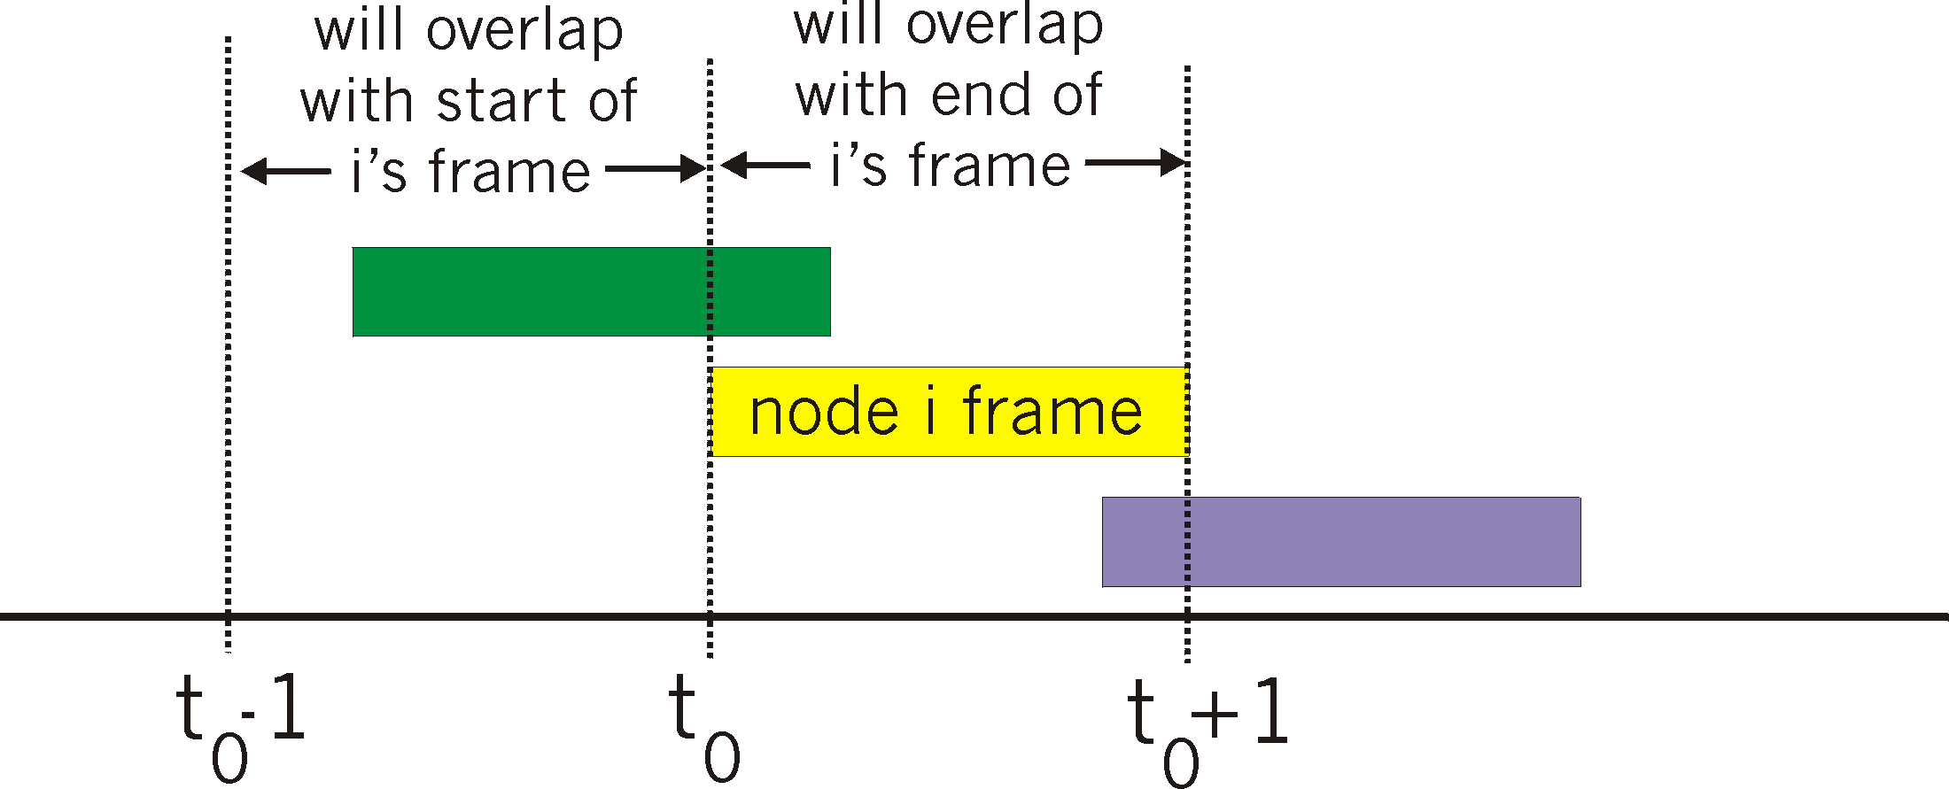
Pure (unslotted) ALOHA
unslotted Aloha: simple, no synchronization
when frame first arrives
transmit immediately
collision can happen!
frame sent at t₀ collides with other frames sent in [t₀-1,t₀+1]

Slide 35
Slotted ALOHA
Assumptions
all frames same size
time is divided into equal size slots, time to transmit 1 frame
nodes start to transmit frames only at beginning of slots
nodes are synchronized
if 2 or more nodes transmit in slot, all nodes detect collision
Operation
when node obtains fresh frame, it transmits in next slot
no collision, node can send new frame in next slot
if collision, node retransmits frame in each subsequent slot with prob. p until success

Slide 36
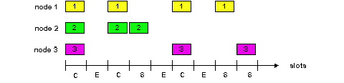
Slotted ALOHA
Success (S), Collision (C), Empty (E) slots
Pros
single active node can continuously transmit at full rate of channel
highly decentralized: only slots in nodes need to be in sync
simple
Cons
collisions, wasting slots
idle slots
nodes may be able to detect collision in less than time to transmit packet

Slide 37
Slotted Aloha efficiency
Efficiency is the long-run fraction of successful slots when there’s many nodes, each with many frames to send
For max efficiency with N nodes, find p* that maximizes Np(1-p)^{N-1}
For many nodes, take limit of Np*(1-p*)^{N-1} as N goes to infinity, gives 1/e = .37
Suppose N nodes with many frames to send, each transmits in slot with probability p
prob that 1st node has success in a slot = p(1-p)^{N-1}
prob that any node has a success = Np(1-p)^{N-1}
At best: channel
used for useful
transmissions 37%
of time!

Slide 38
Pure Aloha Efficiency
P(success by given node) = P(node transmits) .
P(no other node transmits in [p₀-1,p₀] .
P(no other node transmits in [p₀,p₀+1]
= p . (1-p)^{N-1 .} (1-p)^{N-1}
= p . (1-p)^{2(N-1)}
… choosing optimum p and then letting n -> infty ...
^{= 1/(2e) = .18}
Efficiency is even worse !

Slide 39
Performance of Aloha Protocols
0.4
0.3
S = throughput = “goodput”
(success rate)
Slotted Aloha
0.2
0.1
Pure Aloha
0.5
1.0
1.5
2.0
G = offered load = Np
Can we do better with random access?
Notes:
This shows the performance of aloha protocols. On x axis we have the average number of transmission attempts in a frame time. If there are N stations and p is the probability that a station attempts a transmission in a slot, then the average load per slot is Np. Note that this is only an average and it is possible that in a particular slot they could be more or less load. On y axis we have the probability of success, i.e., exactly one transmission.
It can be seen that as the average load increases, the success probability decreases. This is expected because more number of stations transmit in a slot, they are more likely to collide. The peak performance for aloha occurs at G = 0.5 and for slotted aloha at G = 1.0. The corresponding throughputs are 18% and 37% respectively.
In other words, in aloha the best channel utilization you can hope for (when everyone has something to transmit) is 18%. This is the case when on the average there is one transmission in two slot times. This is the performance penalty you pay for transmitting at will. By having everyone transmit only at the beginning of a slot, the throughput can be doubled to 37%.

Slide 40
Carrier Sense Multiple Access
Aloha is inefficient (and rude):
doesn’t listen before talking
CSMA: Listen before transmit
Human analogy: don’t interrupt others!
If channel idle, transmit entire packet
If busy, defer transmission
How long should we wait?
Persistent vs. Nonpersistent CSMA
Nonpersistent:
if idle, transmit
if busy, wait random amount of time
p-persistent
If idle, transmit with probability p
If busy, wait till it becomes idle
If collision, wait random amount of time
Can carrier sense avoid collisions completely?
Notes:
W have seen that throughput with aloha is low. We can do better by listening to see if anyone else is transmitting before we transmit. This is referred to carrier sensing. A station transmits only if it senses that channel is idle and defers transmission if it is busy. Question is how long should a station wait. Also can collisions be eliminated completely with carrier sensing? Let us address the first question.

Slide 41
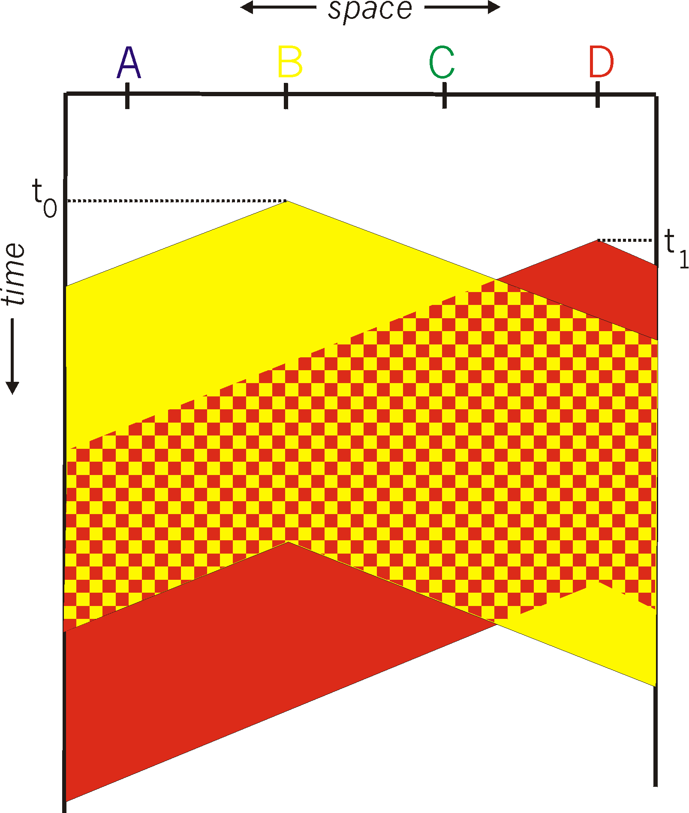
CSMA Collisions
spatial layout of nodes
collisions can still occur:
propagation delay means
two nodes may not hear
each other’s transmission
collision:
entire packet transmission
time wasted
note:
role of distance & propagation delay in determining collision probability

Slide 42
CSMA/CD (Collision Detection)
CSMA/CD: carrier sensing, deferral as in CSMA
collisions detected within short time
colliding transmissions aborted, reducing channel wastage
human analogy: the polite conversationalist
talking while keep listening, stop if collision detected
How to detect collision?
easy in wired LANs: measure signal strengths, compare transmitted, received signals
difficult in wireless LANs: receiver shut off while transmitting

Slide 43
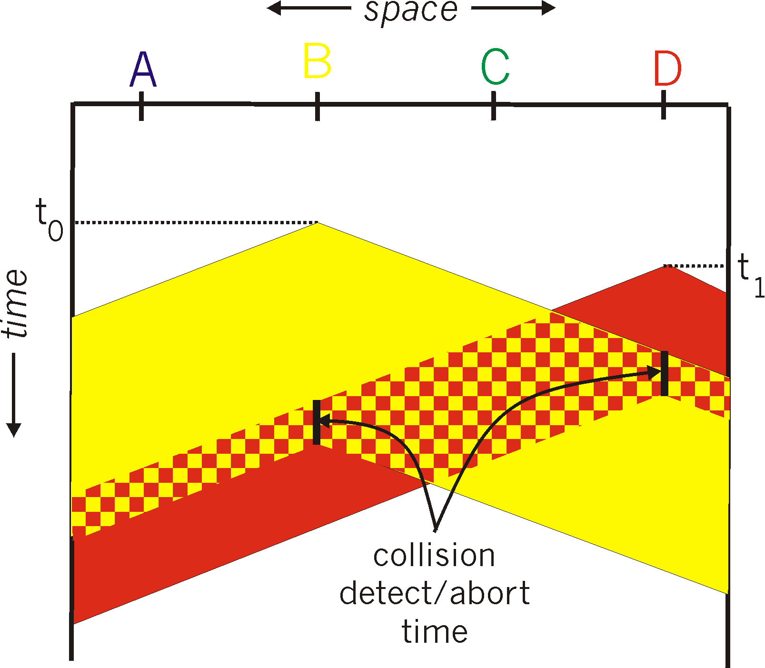
CSMA/CD: Illustration
Notes:
This illustrates the savings due to collision detection and transmission abortion. If you comparing this with earlier similar slide you will notice the savings.

Slide 44
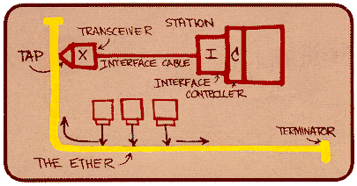
Ethernet
“Dominant” LAN technology today:
cheap $20 or less for 100 Mbps or even 1Gbps!
first widely used LAN technology
Simpler, cheaper than alternative technologies such as token ring LANs
Kept up with speed race: 10, 100, 1 Gbps, 10 Gbps, 40 Gbps, and now 100 Gbps
Metcalfe’s Ethernet
sketch

Slide 45
Ethernet Frame Format
Sending adapter encapsulates IP datagram (or other network layer protocol packet) in Ethernet frame
DIX frame format
8 bytes
6
6
2
0-1500
4
Preamble
Dest
Src
Type
Data
CRC
addr
addr
IEEE 802.3 format
8 bytes
6
6
2
0-1500
4
Preamble
Dest
Src
Length
Data
CRC
addr
addr
Ethernet has a maximum frame size: data portion <=1500 bytes
It has imposed a minimum frame size: 64 bytes (excluding preamble)
If data portion <46 bytes, pad with “junk” to make it 46 bytes
Q: Why minimum frame size in Ethernet?

Slide 46
Fields in Ethernet Frame Format
Preamble:
7 bytes with pattern 10101010 followed by one byte with pattern 10101011 (SoF: start-of-frame)
used to synchronize receiver, sender clock rates, and identify beginning of a frame
Addresses: 6 bytes
if adapter receives frame with matching destination address, or with broadcast address (eg ARP packet), it passes data in frame to net-layer protocol
otherwise, adapter discards frame
Type: indicates the higher layer protocol, mostly IP but others may be supported such as Novell IPX and AppleTalk)
802.3: Length gives data size; “protocol type” included in data
CRC: checked at receiver, if error is detected, the frame is simply dropped

Slide 47
Ethernet and IEEE 802.3
1-persistent CSMA/CD
Carrier sense: station listens to channel first
Listen before talking
If idle, station may initiate transmission
Talk if quiet
Collision detection: continuously monitor channel
Listen while talking
If collision, stop transmission
One talker at a time
Notes:
CSMA/CD protocol is standardized and referred to as IEEE 802.3. Ethernet employs 1-persistent CSMA/CD. It senses the channel and transmits if idle. Otherwise it will wait till it becomes idle and attempts transmission. In case of a collision, it backs off for a random time.

Slide 48
Ethernet CSMA/CD Algorithm
1. Adaptor gets datagram from and creates frame
2. If adapter senses channel idle, it starts to transmit frame. If it senses channel busy, waits until channel idle and then transmits
3. If adapter transmits entire frame without detecting another transmission, the adapter is done with frame ! Signal to network layer “transmit OK”
4. If adapter detects another transmission while transmitting, aborts and sends jam signal
5. After aborting, adapter enters exponential backoff: after the mth collision, adapter chooses a K at random from {0,1,2,…,2^{m}-1}. Adapter waits K*512 bit times and returns to Step 2
6. Quit after 16 attempts, signal to network layer “transmit error”

Slide 49
Ethernet’s CSMA/CD (more)
Jam Signal: make sure all other transmitters are aware of collision; 48 bits;
Bit time: .1 microsec for 10 Mbps Ethernet ; for K=1023, wait time is about 50 msec
Exponential Backoff:
Goal: adapt retransmission attempts to estimated current load
heavy load: random wait will be longer
first collision: choose K from {0,1}; delay is K x 512 bit transmission times
after second collision: choose K from {0,1,2,3}…
after ten collisions, choose K from {0,1,2,3,4,…,1023}
See/interact with Java
applet on AWL Web site:
highly recommended !

Slide 50
IEEE 802.3 Parameters
1 bit time = time to transmit one bit
10 Mbps ➔ 1 bit time = 0.1 microseconds
Maximum network diameter <= 2.5km
Maximum 4 repeaters
“Collision Domain”
Distance within which collision can be detected
IEEE 802.3 specifies:
worst case collision detection time: 51.2
Why minimum frame size?
51.2 => minimum # of bits can be transited at 10Mpbs is 512 bits => 64 bytes is required for collision detection
Notes:
Ethernet specification limits the cable length to be no more than 2.5 Km with at most 4 repeaters. This corresponds to a round trip propagation delay of approximately 51.2 microseconds. As pointed out earlier this gives the worst case time to detect a collision. So only after 51.2 microseconds a station would know for sure that it has seized the channel and there would not be a collision during its transmission.
This also puts a constraint on the minimum frame size. In case of 10Mbps Ethernet, transmission of 64 bytes takes 51.2 micro seconds. If the packet size is less than 64 bytes, packet transmission time would be less than the worst case collision detection time. Transmission would be complete before the station can be sure that it has seized the channel. This is not desirable and so the frame size should be at least 64 bytes.
This implies that data in Ethernet frame should be at least 46 bytes considering that SA, DA, LEN, CRC together take up 18 bytes. If the data is smaller than 46 bytes, it is padded to fill out the frame to minimum size.

Slide 51
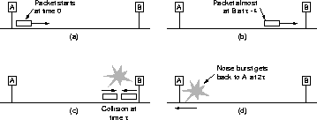
Worst Case Collision Detection Time
Notes:
Here is an illustration of the worst case. If the two stations are farthest apart, it takes up to twice the signal propagation time to realize that collision occurred. So a station would know whether it has seized the channel or not only after round trip propagation delay.

Slide 52
CSMA/CD Efficiency
Relevant parameters
cable length, signal speed, frame size, bandwidth
T_{prop} = max prop between 2 nodes in LAN
t_{trans} = time to transmit max-size frame
Efficiency goes to 1 as t_{prop} goes to 0
Goes to 1 as t_{trans} goes to infinity
Much better than ALOHA, but still decentralized, simple, and cheap

Slide 53
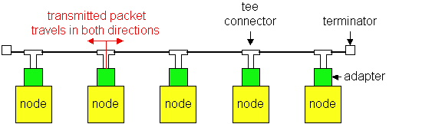
Ethernet Technologies: 10Base2
10: 10Mbps; 2: under 200 meters max cable length
thin coaxial cable in a bus topology
repeaters used to connect up to multiple segments
repeater repeats bits it hears on one interface to its other interfaces: physical layer device only!
has become a legacy technology

Slide 54
10BaseT and 100BaseT
10/100 Mbps rate; latter called “fast ethernet”
T stands for Twisted Pair
Nodes connect to a hub: “star topology”; 100 m max distance between nodes and hub
Hubs are essentially physical-layer repeaters:
bits coming in one link go out all other links
no frame buffering
no CSMA/CD at hub: adapters detect collisions
provides net management functionality
nodes
(repeating) hub

Slide 55
100Base T (Fast) Ethernet: Issues
1 bit time = time to transmit one bit
100 Mbps ➔ 1 bit time = 0.01 (microseconds)
If we keep the same “collision domain”, i.e.,
worst case collision detection time kept at 51.2 (microseconds
Q: What will be the minimum frame size?
51.2 => minimum # of bits can be transited at 100Mpbs is 5120 bits => 640 bytes is required for collision detection
This requires change of frame format and protocol!
Or we can keep the same minimum frame size, but reduce “collision domain” or network diameter!
from 51.2 to 5.12 !
maximum network diameter 100 m!

Slide 56
Gigabit Ethernet & Beyond
Gigabit Ethernet:
use standard Ethernet frame format
allows for point-to-point links and shared broadcast channels
in shared mode, CSMA/CD is used; short distances between nodes to be efficient
also uses hubs, called “Buffered Distributors”
Full-Duplex at 1 Gbps for point-to-point links
Now: 10 & 40 Gbps are widely available
And 100 Gbps is also here !
All are used in “point-to-point” settings with Ethernet switches

Slide 57
Ethernet Summary
1-persistent CSMA/CD
10Base Ethernet
51.2 to seize the channel
Collision not possible after 51.2
Minimum frame size of 64 bytes
Binary exponential backoff
Works better under light load
Delivery time non-deterministic
Evolution of Ethernet: Fast (100BaseT) and Gigabit Ethernet, and beyond
Notes:
Why 51.2 micro seconds? According to Ethernet specification maximum distance between any two stations to 2,500 meters and there could be at most four repeaters. Given this specification, the round trip delay has been determined to be 51.2 micro seconds. This takes into account the signal speed, round trip length of 5000 meters and delay at the repeaters. The key thing to note here is that the collision detection time and thus the minimum frame size depend on the round trip propagation delay.
Lets take a hypothetical example. Suppose length of the cable is 1000 meters. That means no two stations are farther than 1000 meters apart. Suppose also that signal speed is 10⁸ meters/sec. And assume that no repeaters. From this we can compute the round trip propagation delay to 20 micro seconds (2000 / 10⁸). Now suppose the data transmission rate is 10Mbps which means each bit would take 0.1 micro seconds for transmission. So in 20 micro seconds, a station can transmit 200 bits or 25 bytes. So in this case, size of a frame has to be at least 25 bytes so that a station can detect a collision before it completes the transmission.

Slide 58
Token Ring (IEEE 802.5)
Station
Wait for token to arrive
Hold the token and start data transmission
Maximum token holding time ➔ max packet size
Strip the data frame off the ring
After it has gone around the ring
When done, release the token to next station
When no station has data to send
Token circulates continuously
Ring must have sufficient delay to contain the token

Slide 59
Ring Topology

Slide 60
Token Release after Reception
Release after Reception
T
oken
Frame
In token passing protocols, sender is always responsible for removing the frame it has transmitted! (Why?)

Slide 61
Tokens and Data Frames
8
8
8
48
48
Variable
32
8
8
Start
Access
Frame
Dest
Src
Body
Checksum
End
Frame
delimiter
control
control
addr
addr
delimiter
status

Slide 62
Token Ring Frame Fields
Access Control
Token bit: 0 ➔ token 1 ➔ data
Monitor bit: used for monitoring ring
Priority and reservation bits: multiple priorities
Frame Status
Set by destination, read by sender
Frame control
Various control frames for ring maintenance

Slide 63
Priority and Reservation
Token carries priority bits
Only stations with frames of equal or higher priority can grab the token
A station can make reservation
When a data frame goes by
If a higher priority has not been reserved
A station raising the priority is responsible for lowering it again

Slide 64
Ring Maintenance
Each ring has a monitor station
How to select a monitor?
Election/self-promotion: CLAIM_TOKEN
Responsibilities
Insert additional delay
To accommodate the token
Check for lost token
Regenerate token
Watch for orphan frames
Drain them off the ring
Watch for garbled frames
Clean up the ring and regenerate token

Slide 65
Fault Scenarios
What to do if ring breaks?
Everyone participates in detecting ring breaks
Send beacon frames
Figure out which stations are down
By-pass them if possible
What happens if monitor dies?
Everyone gets a chance to become the new king
What if monitor goes berserk?

Slide 66
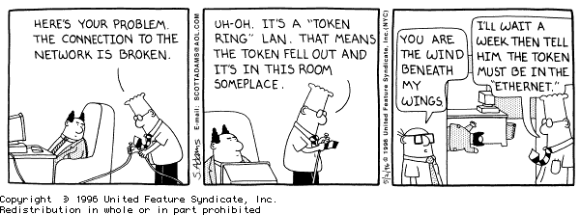
CSci4211: Data Link Layer: Part 2

Slide 67
Token Ring Summary
Stations take turns to transmit
Only the station with the token can transmit
Sender receives its own transmission
Drains its frame off the ring
Releases token after transmission/reception
Deterministic delivery possible
High throughput under heavy load

Slide 68
Ethernet vs Token Ring
Non-deterministic
No delays at low loads
Low throughput under heavy load
No priorities
No management overhead
Large minimum size
Deterministic
Substantial delays at low loads
High throughput under heavy load
Multiple priorities
Complex management
Small frames possible

Slide 69
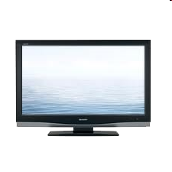


Cable Access Network
CMTS:
cable modem
termination system
Internet frames, TV channels, control transmitted
downstream at different frequencies
cable headend
…
CMTS
…
splitter
cable
modem
cable modem
termination system
ISP
upstream Internet frames, TV control, transmitted
upstream at different frequencies in time slots
multiple 40Mbps downstream (broadcast) channels (each: 6MHz)
single CMTS transmits into channels
multiple 30 Mbps upstream channels (each: 6.4MHz)
multiple access: all users contend for certain upstream channel time slots (others assigned)

Slide 70
Cable Access Network
cable headend
MAP frame for
Interval [t1, t2]
CMTS
Downstream channel i
Upstream channel j
t₁
t₂
Residences with cable modems
Minislots containing
minislots request frames
Assigned minislots containing cable modem
upstream data frames
DOCSIS: data over cable service interface spec
FDM over upstream, downstream frequency channels
TDM upstream: some slots assigned, some have contention
downstream MAP frame: assigns upstream slots
request for upstream slots (and data) transmitted random access (binary backoff) in selected slots (“content slots”)

Slide 71
Summary of MAC Protocols
Why media access control?
Shared media: only one user can send at a time
Media access control: determine who has access
MAC issues:
distributed, using the same channel for regulating access
What do you do with a shared media?
Channel Partitioning, by time, frequency or code
Time Division, Code Division, Frequency Division
Random Access (dynamic)
ALOHA, S-ALOHA, CSMA, CSMA/CD
carrier sensing easy in some technologies (wire), hard in others (wireless)
CSMA/CD used in Ethernet; CSMA/CA used in WiFi/802.11
Taking Turns
polling from a central site, token passing (Bluetooth, Token Ring, FDDI)

