Slide 1
Network Data Plane Part 2
Router/Switch Architecture Overview
Generalization of IP Router and Ethernet Switch Data Plane Operations
“match-action” forwarding abstraction
Openflow and Software-Defined Networking (SDN)
Openflow switches
Openflow protocol: control messages
SDN controller (POX)
Software Switch (OVS) and Mininet
Readings: Textbook: Chapter 4: Sections 4.2 and 4.4; Chapter 5: Section 5.5 (in particular, Section 5.5.2)

Slide 2
Recall: Network Layer Functions
Addressing
Globally unique address for each routable device
Routing: building a “map” of network
Which path to use to forward packets from src to dest
Forwarding: delivery of packets hop by hop
from input port to appropriate output port in a router
Forwarding is the “data plane” operation (often performed by “specialized” hardware
–-- we have learned:
how IP routers forward IP datagrams based on destination IP addresses
how layer 2 switches forward (Ethernet) frames based on destination MAC addresses
➔ now let’s examine how it is done in hardware in general (whether in layer-2 switches or layer-3 routers)

Slide 3
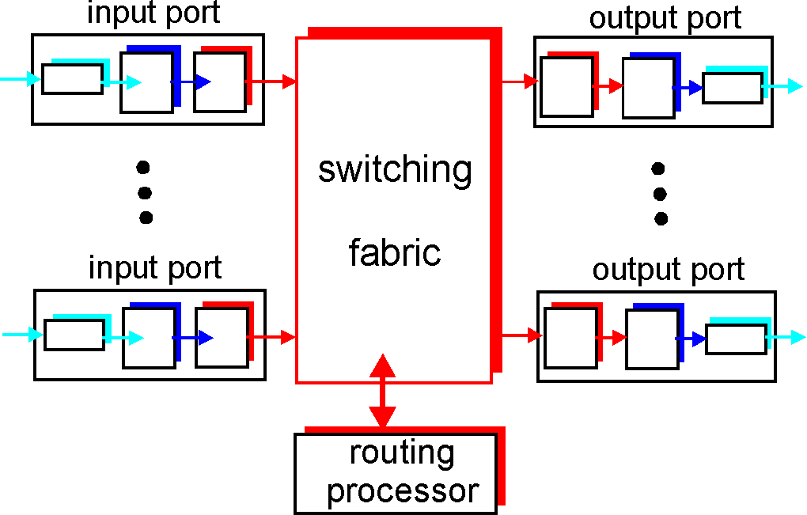
Router/Switch Architecture Overview
A key router/switch data plane function:
forwarding packets (e.g., IP datagrams, or Ethernet frames) from incoming to outgoing link (or drop them if no forwarding table entries, or flood them if no switching table entries
NICs -- special hardware (ASICs)
varies depending on
“generations”
forwarding
operations
control
operations
General CPU

Slide 4
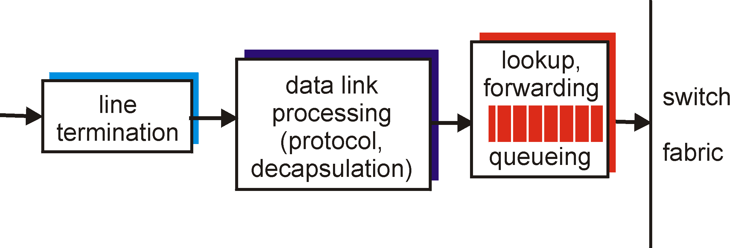
Input Port Functions
Physical layer:
bit-level reception
Decentralized switching:
using header field values, lookup output port using forwarding table in input port memory
goal: complete input port processing at ‘line speed’
queuing: if datagrams arrive faster than forwarding rate into switch fabric
Data link layer:
e.g., Ethernet
see chapter 6

Slide 5
Switching Fabrics
transfer packet from input buffer to appropriate output buffer
switching rate: rate at which packets can be transfer from inputs to outputs
often measured as multiple of input/output line rate
N inputs: switching rate N times line rate desirable
three types of switching fabrics
memory
memory
bus
crossbar

Slide 6
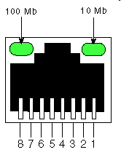
Switching Via Memory
First generation routers:
traditional computers with switching under direct control of CPU
packet copied to system’s memory
speed limited by memory bandwidth (2 bus crossings per datagram)
input
port
(e.g.,
Ethernet)
output
port
(e.g.,
Ethernet)
memory
system bus

Slide 7
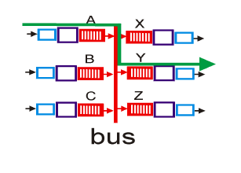
Switching Via a Bus
datagram from input port memory
to output port memory via a shared bus
bus contention: switching speed limited by bus bandwidth
32 Gbps bus, Cisco 5600: sufficient speed for access and enterprise routers

Slide 8
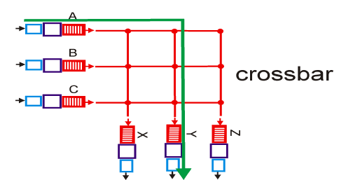
Switching Via An Interconnection Network
overcome bus bandwidth limitations
banyan networks, crossbar, other interconnection nets initially developed to connect processors in multiprocessor
advanced design: fragmenting datagram into fixed length cells, switch cells through the fabric.
Cisco 12000: switches 60 Gbps through the interconnection network

Slide 9
Input Port Queuing
Fabric slower than input ports combined -> queueing may occur at input queues
queueing delay and loss due to input buffer overflow!
Head-of-the-Line (HOL) blocking: queued datagram at front of queue prevents others in queue from moving forward
switch
fabric
switch
fabric
output port contention:
only one red datagram can be transferred. lower red packet is blocked
one packet time later: green packet experiences HOL blocking

Slide 10
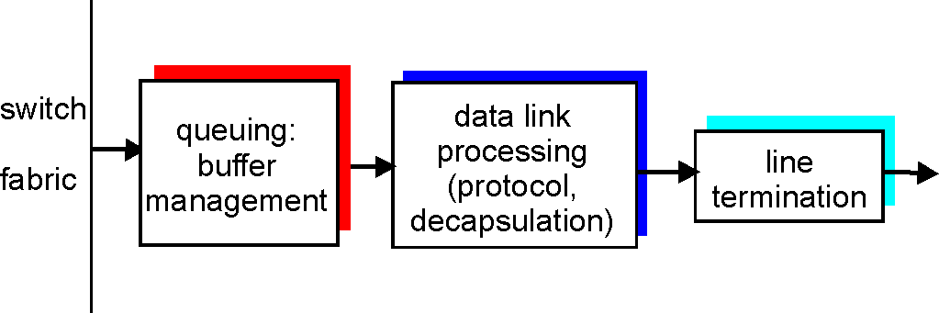
Output Ports
Buffering required when datagrams arrive from fabric faster than the transmission rate
Scheduling discipline chooses among queued datagrams for transmission
Datagram (packets) can be lost due to congestion, lack of buffers
Priority scheduling – who gets best performance, network neutrality

Slide 11
Output Port Queueing
switch
fabric
switch
fabric
at t, packets more
from input to output
one packet time later
buffering when arrival rate via switch exceeds output line speed
queueing (delay) and loss due to output port buffer overflow!

Slide 12
Router/Switch Data Plane Operations: Forwarding Abstraction
We have learned:
How IP routers forward IP datagrams based on destination IP addresses
take the dest. IP address from an IP packet
look up the IP forwarding table using the longest prefix matching
if there’s a match, forwarding the packet to the outgoing port specified; otherwise drop it
How layer 2 switches forward (Ethernet) frames based on destination MAC addresses
take the dest. MAC address from an Ethernet frame
look up the switch table using the exact matching
if there’s a match, forwarding the packet to the outgoing port specified; otherwise flood it to all other ports
What are common and what are different?
Common: match a header field against a table, then take an action
Different: how table is constructed, what header fields to match, how to match it, and what actions to take

Slide 13
Router/Switch Data Plane Operations: Forwarding Abstraction
We have learned:
How IP routers forward IP datagrams based on destination IP addresses
take the dest. IP address from an IP packet
look up the IP forwarding table using the longest prefix matching
if there’s a match, forwarding the packet to the outgoing port specified; otherwise drop it
How layer 2 switches forward (Ethernet) frames based on destination MAC addresses
take the dest. MAC address from an Ethernet frame
look up the switch table using the exact matching
if there’s a match, forwarding the packet to the outgoing port specified; otherwise flood it to all other ports
What are common and what are different?
Common: match a header field against a table, then take an action
Different: how table is constructed, what header fields to match, how to match it, and what actions to take
“Hardware” components (forwarding operations – match via table lookup, actions, etc. ) are (nearly) the same;
“Software” computations (how tables/rules are configured) differ
That’s why you can buy a generic WiFi router/modem from Best Buy, and configure it either as a WiFi IP router (layer 3 device), or simply as a WiFI LAN switch (layer 2 device)!

Slide 14
Generalized Forwarding and SDN
Each switch contains a flow table that is computed and distributed by a logically centralized routing controller
logically-centralized routing controller
control plane
data plane
local flow table
headers counters actions
1
0100 1101
3
2
values in arriving
packet’s header

Slide 15
OpenFlow data plane abstraction
flow: defined by header fields
generalized forwarding: simple packet-handling rules
Pattern: match values in packet header fields
Actions: for matched packet: drop, forward, modify, matched packet or send matched packet to controller
Priority: disambiguate overlapping patterns
Counters: #bytes and #packets
Flow table in a router (computed and distributed by controller) define router’s match+action rules

Slide 16
OpenFlow data plane abstraction
flow: defined by header fields
generalized forwarding: simple packet-handling rules
Pattern: match values in packet header fields
Actions: for matched packet: drop, forward, modify, matched packet or send matched packet to controller
Priority: disambiguate overlapping patterns
Counters: #bytes and #packets
* : wildcard
src=1.2.*.*, dest=3.4.5.* → drop
src = *.*.*.*, dest=3.4.*.* → forward(2)
3. src=10.1.2.3, dest=*.*.*.* → send to controller

Slide 17
OpenFlow: Flow Table Entries
Rule
Action
Stats
Packet + byte counters
Forward packet to port(s)
Encapsulate and forward to controller
Drop packet
Send to normal processing pipeline
Modify Fields
Switch
Port
VLAN
ID
MAC
src
MAC
dst
Eth
type
IP
Src
IP
Dst
IP
Prot
TCP
sport
TCP
dport
Link layer
Network layer
Transport layer
Notes:
Now I’ll describe the API that tries to meet these goals.
17

Slide 18
Examples
Destination-based forwarding:
Switch
Port
MAC
src
MAC
dst
Eth
type
VLAN
ID
IP
Src
IP
Dst
IP
Prot
TCP
sport
TCP
dport
Action
*
*
*
*
*
*
51.6.0.8
*
*
*
port6
IP datagrams destined to IP address 51.6.0.8 should be forwarded to router output port 6
Firewall:
Switch
Port
MAC
src
MAC
dst
Eth
type
VLAN
ID
IP
Src
IP
Dst
IP
Prot
TCP
sport
TCP
dport
Forward
*
*
*
*
*
*
*
*
*
22
drop
do not forward (block) all datagrams destined to TCP port 22
Switch
Port
MAC
src
MAC
dst
Eth
type
VLAN
ID
IP
Src
IP
Dst
IP
Prot
TCP
sport
TCP
dport
Forward
*
*
*
*
*
128.119.1.1
*
*
*
*
drop
do not forward (block) all datagrams sent by host 128.119.1.1

Slide 19
OpenFlow Abstraction
match+action: unifies the data-plane operations of different kinds of routers, switches, and other devices
IP Router
match: longest destination IP prefix
action: forward out a link
Layer-2 (Ethernet) Switch
match: destination MAC address
action: forward or flood
Firewall
match: IP addresses and TCP/UDP port numbers
action: permit or deny
NAT
match: IP address and port
action: rewrite address and port

Slide 20


OpenFlow example
Example: datagrams from hosts h5 and h6 should be sent to h3 or h4, via s1 and from there to s2
match
action
IP Src = 10.3.*.*
IP Dst = 10.2.*.*
forward(3)
Host h6
10.3.0.6
1
s3
controller
2
3
4
Host h5
10.3.0.5
1
s1
s2
1
2
Host h4
10.2.0.4
4
2
4
Host h1
10.1.0.1
3
3
Host h2
10.1.0.2
match
action
match
action
Host h3
10.2.0.3
ingress port = 2
IP Dst = 10.2.0.3
ingress port = 2
IP Dst = 10.2.0.4
forward(3)
ingress port = 1
IP Src = 10.3.*.*
IP Dst = 10.2.*.*
forward(4)
forward(4)

Slide 21
Traditional Network Devices
L3 Router
If dst-ip == X then
ttl = ttl – 1
checksum = updateChecksum(packet)
dst-mac = xx:xx:xx:xx:xx:xx
send to output port P
end
Control Plane
Control Plane
Packet
Data Plane
Data Plane
Control Plane
Control Plane
Data Plane
Data Plane
Control Plane
Control Plane
Data Plane
Data Plane

Slide 22
Simple SDN Network
L2 Forwarding
Controller APIs
POX, Floodlight, …
Controller
Communication Protocol
Software or Hardware
Switch
Ethernet,IP,ARP,TCP,HTTP,…
Host1
Host2

Slide 23
Communication Protocol (OpenFlow)

Slide 24
OpenFlow (Main Components)
Flow tables
Matching
Manipulation
Counters
Communication messages
Controller to switch
Asynchronous
Symmetric
Controller
Pipeline
Secure Channel
Flow Table
Flow Table

Slide 25
Flow Tables (Structure)
A flow-table consists of
a set of flow entries
a table miss configuration
Drop packet
Send to controller
Process using the next flow-table
Match fields | Counters | Instructions

Slide 26
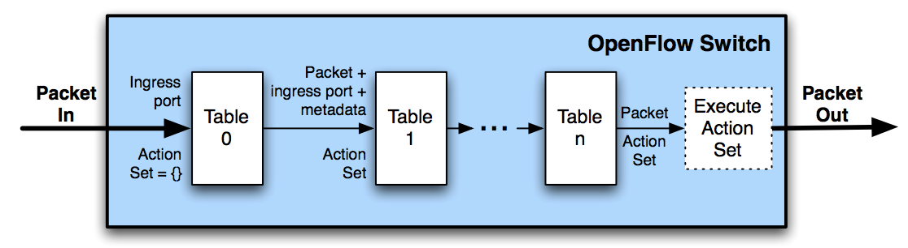
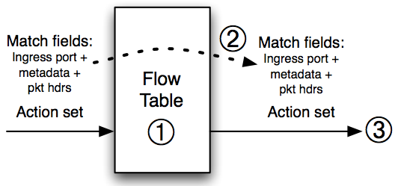
Flow Tables (Processing)
Pipeline processing
Per table processing
Find highest-priority matching ﬂow entry
Apply instructions
Modify packet & update match fields
Update action set
Update metadata
Send match data and action set to next table

Slide 27
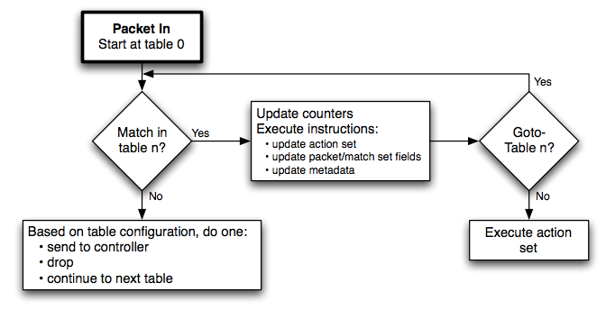
Flow Tables (Matching)
Physical → Ingress port
Metadata
L2 → MAC src/dst, EtherType, VLAN, MPLS
L3 → IP src/dst, IP proto, IP ToS, ARP code
L4 → TCP/UDP src/dst, ICMP

Slide 28
Flow Tables (Counters)
Table counters
e.g. Packet lookups/matches
Flow counters
e.g. packets/bytes received
Port counters
e.g. packets/bytes transmitted/received, drops

Slide 29
Flow Tables (Instructions)
Apply actions Apply the specified list action(s) immediately without modifying the action set
Clear actions Clear all actions in the action set immediately
Write actions Merge the specified set action(s) to the action set
Write metadata Write the specified bits to the metadata register
Goto table Indicate the next-table in the pipeline

Slide 30
Flow Tables (Actions)
Output
IN_PORT → send packet to ingress port
CONTROLLER → encapsulate and send to controller
FLOOD → send packet to ports except ingress port
Drop
Push/Pop VLAN/MPLS tag
Set-Field
IPv4 src/dst addresses
MAC src/dst addresses
TCP src/dst ports

Slide 31
Communication Messages (Controller to Switch)
Features Switch replies with list of ports, ports speeds, supported tables and actions
Modify state Add, delete, or modify flow tables
Read state Controller queries table, flow, or port counters
Packet out Used by controller to send packets out of a specified port on the switch
Barrier Used to ensure message dependencies have been met

Slide 32
Communication Messages (Asynchronous)
Packet in All packets that do not have a matching flow entry are encapsulated and sent to the controller
Flow removed Sent to controller when flow expires due to idle or hard timeouts
Port status Generated if a port is brought down

Slide 33
Communication Messages (Symmetric)
Hello Sent during the handshake i.e. secure channel setup
Echo Sent to verify liveness and measure channel latency

Slide 34
SDN Controller (POX)

Slide 35
POX
SDN controller written in Python
Many build-in modules
Python APIs to enable user extensions

Slide 36
POX (Built-in Modules)
Hub flood packets
L2 forwarding MAC learning
L3 forwarding IP learning
Topology discovery Underlying topology discovery
Spanning tree protocol Implementation of the standard STP
…

Slide 37
POX (Python APIs)
Publish-Subscribe system
A module can raise events
A module can register for events provides by other modules
A module must have a launch function

Slide 38
POX (Python APIs)
Firewall
L2 forwarding
openflow
Raise PacketIn
Event
Handle
PacketIN
(priority=100)
Handle
PacketIN
Packet
Packet
Register
Register
Event Management
POX Core
Switch
Switch
Packet

Slide 39
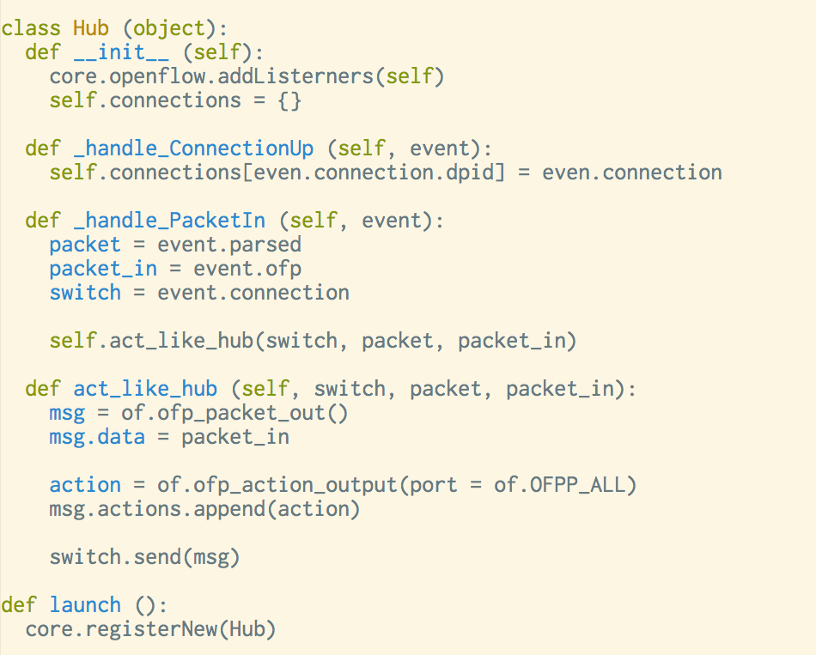
POX (Python APIs)

Slide 40
Software Switch (Open vSwitch)

Slide 41
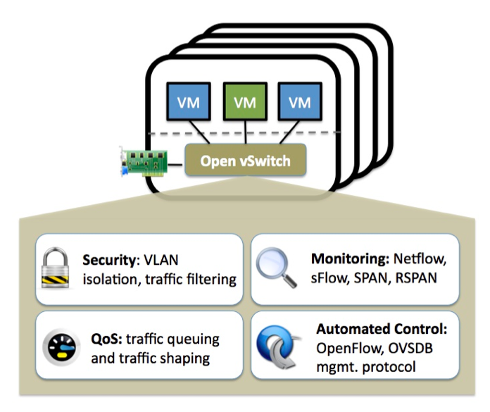
Open vSwitch (In a Nutshell)

Slide 42
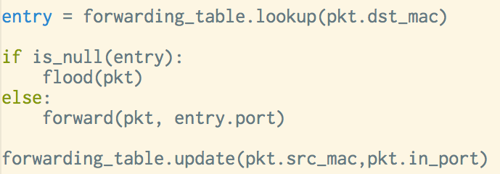
L2 Switching
MAC learning
VLANs (will be discussed later)
Learning table per VLAN ID
Packets can only be forwarded between ports with the same VLAN ID

Slide 43
Open vSwitch (Features)
Enables Linux to become part of the SDN architecture
Features
L2-L4 matching
VLANs with trunking
Tunneling protocols such as GRE
Remote configuration protocol
Multi-table forwarding pipeline
Monitoring via NetFlow, sFlow
Spanning Tree Protocol
Fine-grained QoS
OpenFlow support
Runs in either
Standalone mode
OpenFlow mode

Slide 44
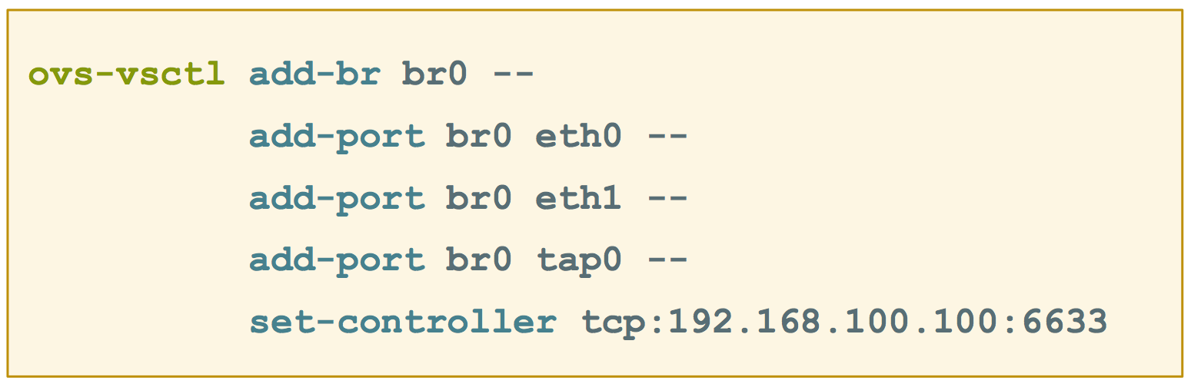
Open vSwitch (Configuration)
Add a bridge and connect to controller
Host 1
VM1
SDN
Controller
tap0
br1
eth0
eth1
eth2

Slide 45
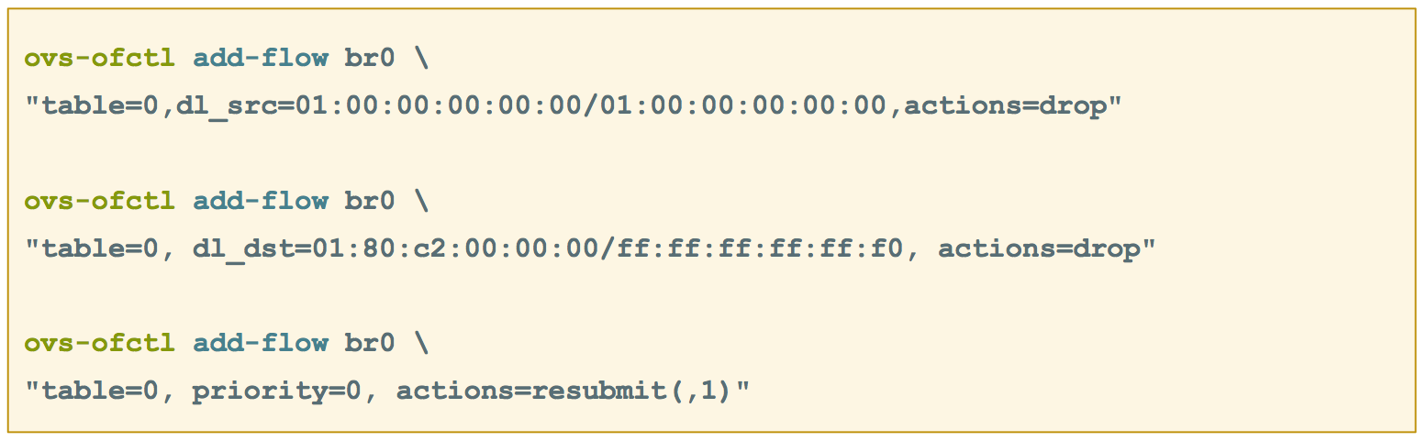
Open vSwitch (Configuration)
Add a bridge and connect to controller

Slide 46
A Network in a Laptop (Mininet)

Slide 47
Mininet
Mininet is a system for rapidly prototyping large networks on a single laptop
Lightweight OS-level virtualization
Isolated network namespace
Constrained CPU usage on isolated namespace
CLI and Python APIs
Can
Create custom topologies
Run real programs
Custom packet forwarding using OpenFlow

Slide 48
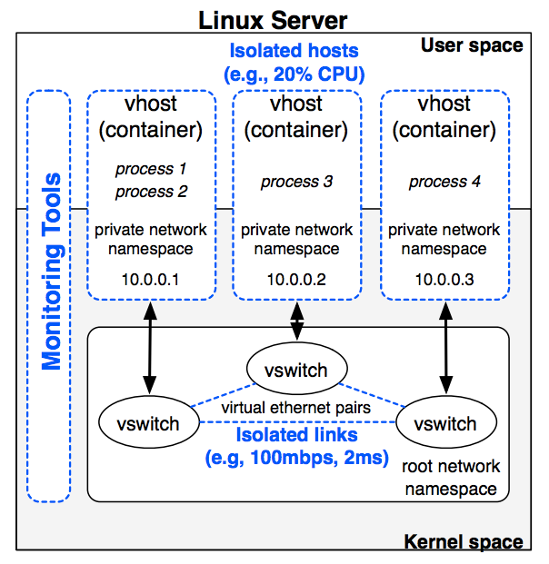
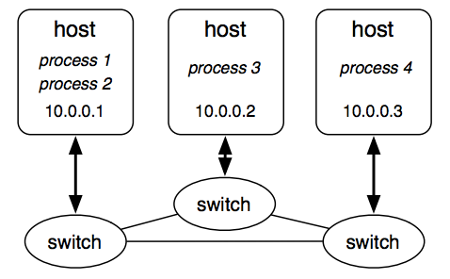
Mininet (Architecture)

Slide 49
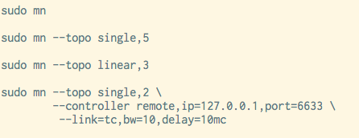
Mininet (Examples)

Slide 50
References
OpenFlow http://www.openflow.org
Open vSwitch http://www.openvswitch.org
POX https://openflow.stanford.edu/display/ONL/POX+Wiki
Mininet http://mininet.org

