Slide 1
Network Layer:
Control Plane Part II
Routing in the Internet: Intra vs. Inter-AS Routing
  Intra-AS: RIP and OSPF (quick recap)
Inter-AS: BGP and Policy Routing
Internet Control Message Protocol: ICMP
network management and SNMP
Readings: Textbook: Chapter 5, Sections 5.4 & 5.6-5.8

Slide 2
Routing in the Real World
Our routing study thus far - idealization
all routers identical
network “flat”
How to do routing in the Internet
scalability and policy issues
administrative autonomy
internet = network of networks
each network admin may want to control routing in its own network
scale: with 200+ million destinations:
can’t store all dest’s in routing tables!
routing table exchange would swamp links!
Note: destinations here are “networks” (network prefixes), not individual hosts!

Slide 3
Internet Structure
Internet: “networks of networks”!
International lines
IXPs
or private peering
National or tier-1 ISP
National or tier-1 ISP
Internet eXcange
Points
Regional ISPs
Regional or local ISP
company
university
local ISPs
company
LANs
Home users
access via WiFi hotspots
Home users

Slide 4
Routing in the Internet
The Global Internet consists of Autonomous Systems (AS) interconnected with each other:
  Stub AS: small corporation: one connection to other AS’s
  Multi-homed AS: large corporation (no transit): multiple connections to other ASes
  Transit AS: provider, hooking many ASes together
Each AS is assigned an AS number (ASN)
  Originally 16 bits, as of Dec 1, 2006: 32 bits
Two-level routing:
  Intra-AS: administrator responsible for choice of routing algorithm within network
  Inter-AS: unique standard for inter-AS routing: BGP

Slide 5
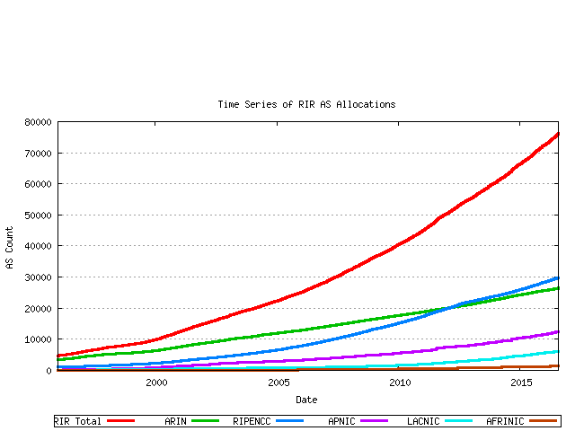
Number of Used ASNs
Source: Geoff Huston, http://bgp.potaroo.net
32-bit ASN up to present

Slide 6
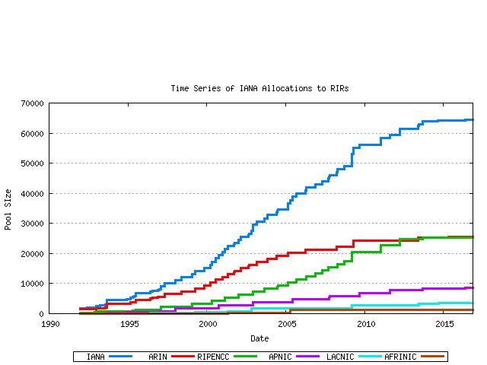
Number of Allocated ASNs
Source: Geoff Huston, http://bgp.potaroo.net
16-bit ASN up to present

Slide 7
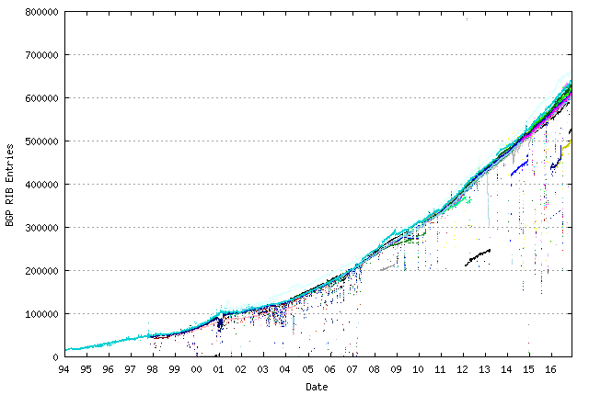
Growth of Destination Net Prefixes
(measured by # of BGP routes or FIB)
Source: Geoff Huston, http://bgp.potaroo.net,

Slide 8
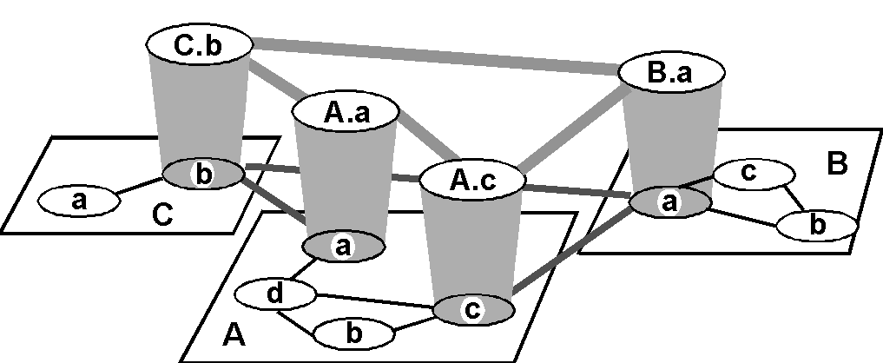
Internet AS Hierarchy
Inter-AS border (exterior gateway) routers
Intra-AS interior (gateway) routers

Slide 9
Intra-AS vs. Inter-AS Routing
Inter-AS
routing
between
A and B
C.b
B.a
A.a
Host
h2
b
A.c
c
a
C
a
b
a
B
Host
h1
d
c
Intra-AS routing
within AS B
A
b
Intra-AS routing
within AS A

Slide 10
Why Different Intra- and Inter-AS Routing?
Policy:
Inter-AS: admin wants control over how its traffic routed, who routes through its net.
Intra-AS: single admin, so no policy decisions needed
Scale:
hierarchical routing saves table size, update traffic
Performance:
Intra-AS: can focus on performance
Inter-AS: policy may dominate over performance

Slide 11
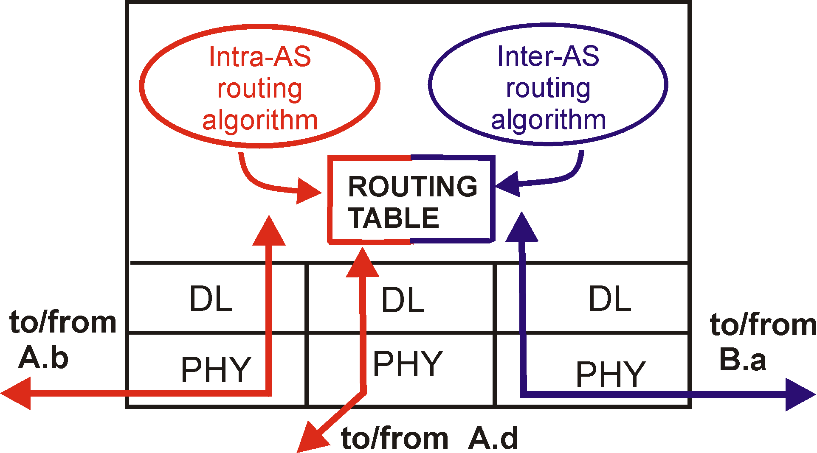
Intra-AS and Inter-AS Routing
C.b
“Gateways”:
  perform inter-AS routing amongst themselves
  perform intra-AS routers with other routers in their AS
B.a
A.a
b
A.c
c
a
C
a
a
B
b
d
c
A
b
network layer
inter-AS, intra-AS routing in
gateway A.c
link layer
physical layer

Slide 12
Intra-AS Routing
Also known as Interior Gateway Protocols (IGP)
Most common Intra-AS routing protocols:
  RIP: Routing Information Protocol
  OSPF: Open Shortest Path First
  IS-IS: Intermediate System to Intermediate System (OSI Standard)
  EIGRP: Extended Interior Gateway Routing Protocol (Cisco proprietary)

Slide 13
RIP ( Routing Information Protocol)
Distance vector algorithm
Included in BSD-UNIX Distribution in 1982
Distance metric: # of hops (max = 15 hops)
Distance vectors: exchanged among neighbors every 30 sec via Response Message (also called advertisement)
Each advertisement: list of up to 25 destination nets within AS

Slide 14
RIP: Link Failure and Recovery
If no advertisement heard after 180 sec --> neighbor/link declared dead
  routes via neighbor invalidated
  new advertisements sent to neighbors
  neighbors in turn send out new advertisements (if tables changed)
  link failure info quickly propagates to entire net
  poison reverse used to prevent ping-pong loops (infinite distance = 16 hops)

Slide 15
RIP Table Processing
RIP routing tables managed by application-level process called route-d (daemon)
advertisements sent in UDP packets, periodically repeated
routed
routed
Transprt
(UDP)
Transprt
(UDP)
network forwarding
(IP) table
network
(IP)
forwarding
table
link
link
physical
physical

Slide 16
OSPF (Open Shortest Path First)
“open”: publicly available
Uses Link State algorithm
  LS packet dissemination
  Topology map at each node
  Route computation using Dijkstra’s algorithm
OSPF advertisement carries one entry per neighbor router
Advertisements disseminated to entire AS (via flooding)
  Carried in OSPF messages directly over IP (rather than TCP or UDP)

Slide 17
OSPF “Advanced” Features (not in RIP)
Security: all OSPF messages authenticated (to prevent malicious intrusion)
Multiple same-cost paths allowed (only one path in RIP)
For each link, multiple cost metrics for different TOS (“Type-of-Services”)
  e.g., satellite link cost set “low” for best effort; high for real time)
Hierarchical OSPF in large domains.

Slide 18

Hierarchical OSPF

Slide 19
Hierarchical OSPF
Two-level hierarchy: local area, backbone.
  Link-state advertisements only in area
  each nodes has detailed area topology; only know direction (shortest path) to nets in other areas.
Area border routers: “summarize” distances to nets in own area, advertise to other Area Border routers.
Backbone routers: run OSPF routing limited to backbone.
Boundary routers: connect to other AS’s.

Slide 20
Inter-AS Routing in the Internet: BGP

Slide 21
BGP (Border Gateway Protocol)
The de facto standard (BGP-4)
Path Vector protocol:
  similar to Distance Vector protocol
  each Border Gateway broadcast to neighbors (peers) entire path (i.e., sequence of ASes) to destination
  BGP routes to networks (ASes), not individual hosts
E.g., Gateway X may announce to its neighbors it “knows” a (AS) path to a destination network, Z, via a series of ASes:
Path (X,Z) = X,Y1,Y2,Y3,…,Z
BGP border gateways referred to as BGP speakers

Slide 22
BGP Operations: Policy Routing
Q: What does a BGP border gateway do?
Receiving and filtering route advertisements from directly attached neighbor(s)
  To accept or not accept route advertisements depends on policies (e.g., whether you “trust” your neighbors)
Route selection (rank diff. routes to same dest. network).
  to route to destination X, which path (of several advertised) will be taken?
  route selection based on policies (e.g., always prefer route advertisement from “good old” neighbor Y)
Filtering and sending (certain) route advertisements to neighbors
  what/whether to advertise to your neighbors also depends on policies (e.g., don’t tell your neighbor Z that you know a route to destination X)

Slide 23
Customers and Providers
provider
provider
customer
IP traffic
customer
Customer pays provider for access to the Internet

Slide 24
The Peering Relationship
Peers provide transit between
their respective customers
Peers do not provide transit
between peers
Peers (often) do not exchange $$$
peer
peer
provider
customer
traffic
allowed
traffic NOT
allowed

Slide 25
Peering Provides Shortcuts
Peering also allows connectivity between
the customers of “Tier 1” providers.
peer
peer
provider
customer

Slide 26
U of Minnesota (Old AS) Neighborhood
AS 1
Genuity
(was part of Level3, not part of CenturyLink)
AS 7018
AT&T
AS 3908
SuperNet (CenturyLink)
AS 57
UMN
GigaPoP
AS 1998
State of
Minnesota
AS 217
UMN
128.101.0.0/16

Slide 27
Internet Inter-AS Routing: BGP
BGP (Border Gateway Protocol): the de facto inter-domain routing protocol
  “glue that holds the Internet together”
allows subnet to advertise its existence to rest of Internet: “I am here” (network reachability)
BGP provides each AS a means to select a route:
  eBGP: obtain subnet reachability information and available routes from neighboring ASes
  iBGP: propagate reachability information and available routes to all AS-internal routers.
  determine “good” routes to other networks based on reachability information, available routes and policy

Slide 28
eBGP, iBGP Connections
2b
∂
2a
2c
1b
3b
2d
∂
1a
1c
3a
3c
AS 2
1d
3d
AS 1
eBGP connectivity
AS 3
iBGP connectivity
1c
gateway routers run both eBGP and iBGP protocols

Slide 29
BGP Messages
BGP messages exchanged using TCP.
BGP messages:
  OPEN: opens TCP connection to peer and authenticates sender
  KEEPALIVE keeps connection alive in absence of UPDATES; also ACKs OPEN request
    OPEN/KEEPALIVE establish & maintain BGP neighbor relation
  UPDATE: advertises new path (or withdraws old)
  NOTIFICATION: reports errors in previous msg; also used to close connection

Slide 30
BGP Basics
BGP session: two BGP routers (“peers”) exchange BGP messages over semi-permanent TCP connection:
  advertising paths to different destination network prefixes (BGP is a “path vector” protocol)
when AS3 gateway router 3a advertises path AS3,X to AS2 gateway router 2c:
  AS3 promises to AS2 it will forward datagrams towards X
AS 3
3b
AS 1
1b
3a
3c
1a
1c
AS 2
2b
3d
X
1d
2a
2c
BGP advertisement:
AS3, X
2d

Slide 31
BGP Example
Speaker for AS2 advertises reachability to P and Q
  network 128.96/16, 192.4.153/24, 192.4.32/24, and 192.4.3/24, can be reached directly from AS2
Speaker for backbone advertises
  networks 128.96/16, 192.4.153/24, 192.4.32/24, and 192.4.3/24 can be reached along the path (AS1, AS2).
Speaker can cancel previously advertised paths (by sending withdrawal messages)
Customer P
128.96/16
(AS 4)
192.4.153/24
Regional provider A
(AS 2)
Customer Q
192.4.32/24
Backbone network
(AS 5)
192.4.3/24
(AS 1)
Customer R
192.12.69/24
Regional provider B
(AS 6)
(AS 3)
Customer S
192.4.54/24
(AS 7)
192.4.23/24

Slide 32
Path Attributes and BGP Routes
advertised prefix includes BGP attributes
  prefix + attributes = “route”
two important attributes:
  AS-PATH: list of ASes through which prefix advertisement has passed
  NEXT-HOP: indicates specific internal-AS router to next-hop AS
Policy-based routing:
  gateway receiving route advertisement uses import policy to accept/decline path (e.g., never route through AS Y).
  AS policy (export policy) also determines whether to advertise path to other other neighboring ASes

Slide 33
BGP Path Advertisement
AS3
3b
AS1
1b
3a
3c
1a
1c
AS2
2b
3d
X
1d
AS3,X
AS2,AS3,X
2a
2c
2d
AS2 router 2c receives path advertisement AS3,X (via eBGP) from AS3 router 3a
Based on AS2 policy, AS2 router 2c accepts path AS3,X, propagates (via iBGP) to all AS2 routers
Based on AS2 policy, AS2 router 2a advertises (via eBGP) path AS2, AS3, X to AS1 router 1c

Slide 34
BGP Path Advertisement
AS3
3b
AS1
1b
AS3,X
3a
3c
1a
1c
AS2
2b
3d
X
1d
AS3,X
AS2,AS3,X
2a
2c
2d
gateway router may learn about multiple paths to destination:
AS1 gateway router 1c learns path AS2,AS3,X from 2a
AS1 gateway router 1c learns path AS3,X from 3a
Based on policy, AS1 gateway router 1c chooses path AS3,X, and advertises path within AS1 via iBGP

Slide 35
AS Path Attribute
AS 1129
135.207.0.0/16
AS Path = 1755 1239 7018 6341
Global Access
AS 1755
135.207.0.0/16
AS Path = 1239 7018 6341
135.207.0.0/16
AS Path = 1129 1755 1239 7018 6341
Ebone
AS 1239
AS 12654
135.207.0.0/16
AS Path = 7018 6341
RIPE NCC
RIS project
Sprint
AS7018
135.207.0.0/16
AS Path = 3549 7018 6341
135.207.0.0/16
AS Path = 6341
AT&T
AS 3549
AS 6341
135.207.0.0/16
AS Path = 7018 6341
AT&T Research
Global Crossing
135.207.0.0/16
Prefix Originated
How to detect loop using AS path?

Slide 36
BGP: AS Path Advertisement and Policy Routing
Suppose: gateway X send its path to peer gateway W
W may or may not select path offered by X
  cost, policy (don’t route via competitors AS), loop prevention reasons
  Policy-based Routing Selection (using BGP attributes)
If W selects path advertised by X, then:
Path (W,Z) = W, Path (X,Z)
Note: X can control incoming traffic by controlling its route advertisements to peers:
  e.g., don’t want to route traffic to Z → don’t advertise any routes to Z
  route filtering and export policy (by manipulating attributes)

Slide 37
BGP Attributes
Value Code Reference
----- --------------------------------- ---------
1 ORIGIN [RFC1771]
2 AS_PATH [RFC1771]
3 NEXT_HOP [RFC1771]
4 MULTI_EXIT_DISC [RFC1771]
5 LOCAL_PREF [RFC1771]
6 ATOMIC_AGGREGATE [RFC1771]
7 AGGREGATOR [RFC1771]
8 COMMUNITY [RFC1997]
9 ORIGINATOR_ID [RFC2796]
10 CLUSTER_LIST [RFC2796]
11 DPA [Chen]
12 ADVERTISER [RFC1863]
13 RCID_PATH / CLUSTER_ID [RFC1863]
14 MP_REACH_NLRI [RFC2283]
15 MP_UNREACH_NLRI [RFC2283]
16 EXTENDED COMMUNITIES [Rosen]
...
255 reserved for development
Most
important
attributes
Not all attributes
need to be present in
every announcement
From IANA: http://www.iana.org/assignments/bgp-parameters

Slide 38
BGP Route Processing
Open ended programming.
Constrained only by vendor configuration language
Receive
BGP
Updates
Apply Policy =
filter routes &
tweak attributes
Apply Policy =
filter routes &
tweak attributes
Transmit
BGP
Updates
Based on
Attribute
Values
Best
Routes
Apply Import
Policies
Best Route
Selection
Best Route
Table
Apply Export
Policies
Install forwarding
Entries for best
Routes.
IP Forwarding Table

Slide 39
BGP Route Selection
router may learn about more than one route to destination AS, selects route based on:
  local preference value attribute: policy decision
  shortest AS-PATH
  closest NEXT-HOP router: hot potato routing
  additional criteria …

Slide 40
Tweak Tweak Tweak
For inbound traffic
  Filter outbound routes
  Tweak attributes on outbound routes in the hope of influencing your neighbor’s best route selection
For outbound traffic
  Filter inbound routes
  Tweak attributes on inbound routes to influence best route selection
outbound
routes
inbound
traffic
outbound
traffic
inbound
routes
In general, an AS has more
control over outbound traffic

Slide 41
BGP: Controlling Who Routes to You
Export Policy for a Provider AS?
Export Policy for a Customer AS?
A,B,C are provider networks
X,W,Y are customer (of provider networks)
X is dual-homed: attached to two networks
  C tells X networks belonging to C, i.e., a route to them via C
  X does not want to carry traffic from B via X to C
  .. so X will not advertise to B any route to networks in C learned from C

Slide 42
BGP: Controlling Who Routes to You
Export Policy for a Peer AS?
A advertises to B the path AW
B advertises to X the path BAW
Should B advertise to C the path BAW?
  No way! B gets no “revenue” for routing CBAW since neither W nor C are B’s customers
  B wants to force C to route to W via A
  B wants to route only to/from its customers!
What about route selection?
which should you prefer? a route learned from a customer AS, a peer AS or a provider AS?
Hint: think how money flows!

Slide 43
AS (Bilateral) Relationships
peer
provider
customer
C
peer
peer
peer
L
traffic
A
B
peer
no payment
peer
provider
provider
G
customer
traffic
provider
customer
customer
peer
peer
M
N
money
provider
provider
provider
customer
customer
customer
customer
W
X
Y
Z
Provider provides global connectivity for customer
peering allows (limited) connectivity between “Tier 1” providers & their customers; it also allows “short-cut” between, say, two “lower-tier” ISPs to bypass their providers
peer
peer
provider
customer

Slide 44
BGP Policy Routing Summary: a) What Route to Use for a Destination (Net Prefix) b) Controlling Who Can Route to/via You
A,B,C are provider networks
X,W,Y are customer (of provider networks)
X is dual-homed: attached to two networks
Best Route Selection
pick among routes learned from
providers vs. peers vs. customers?
b) Export Policy
Export Policy for a Customer AS?
Export Policy for a Peer AS?
Export Policy for a Provider AS?

Slide 45
BGP Policy Routing Summary a) What Route to Use for a Destination (Net Prefix)
A,B,C are provider networks
X,W,Y are customer (of provider networks)
X is dual-homed: attached to two networks
Best Route Selection: General “Rule of Thumb” or Policy
always prefer routes learned from customer AS (over peers or providers)
if customer routes not available, generally prefer peer routes over provider routers
if no customer or peer routes, pick provider routes
Secondary criteria:
among routes with the same preference (e.g., multiple customer routes),
pick routes with shorter AS paths;
among routes w/same AS path length, pick “next-hop” routers that are closest, based on IGP cost (i.e., intra-domain path cost, e.g., OSPF);
otherwise, use a “tie-breaker” (e.g., pick route from the BGP router w/ smallest id)

Slide 46
BGP Policy Routing Summary b) Controlling Who Can Route to/via You
A,B,C are provider networks
X,W,Y are customer (of provider networks)
X is dual-homed: attached to two networks
b) Export Policy: General “Rule of Thumb” (Do’s and Don’t’s
If a neighboring AS is a customer AS (i.e., you are the provider), export the best route (to any network prefix) you have learned (from other ASes)
This is what being a provider means!
ii) If a neighboring AS is a peer AS (you two are peers), export only the routes to network prefixes you own, and the best routes you learned (& picked) from your customers – i.e., only export routes to you & your customers to your peer
This is what a peering relationship means! Don’t export routes learned from providers or another peer to a peer!
iii) If a neighboring AS is a provider AS (i.e., you are the customer), export only the routes to you own, and the best routes you learned (& picked) from your customers – i.e., only export routes to you & your customers to your provider
Don’t export routes learned from one provider or a peer to another provider, only customer routes!

Slide 47
Shedding Inbound Traffic with ASPATH Padding Hack
AS 1
provider
192.0.2.0/24
ASPATH = 2
192.0.2.0/24
ASPATH = 2 2 2
primary
backup
Padding will (usually)
force inbound
traffic from AS 1
to take primary link
customer
192.0.2.0/24
AS 2
CSci4211: Network Layer: Control Plane Part II

Slide 48
Padding May Not Shut Off All Traffic
AS 1
AS 3
provider
provider
192.0.2.0/24
ASPATH = 2
192.0.2.0/24
ASPATH = 2 2 2 2 2 2 2 2 2 2 2 2 2 2
primary
backup
AS 3 will send
traffic on “backup”
link because it prefers
customer routes and local
preference is considered
before ASPATH length!
Padding in this way is often
used as a form of load
balancing
customer
192.0.2.0/24
AS 2
CSci4211: Network Layer: Control Plane Part II

Slide 49
Early Exit or Hot Potato Routing:
Go for the Closest Egress Point
192.44.78.0/24
egress 1
egress 2
IGP distances
56
15
This Router has two BGP routes to 192.44.78.0/24.
Hot potato: get traffic off of your network as
soon as possible. Go for egress 1!
CSci4211: Network Layer: Control Plane Part II

Slide 50
Hot Potato Routing (from authors’ lecture notes)
AS3
3b
AS1
1b
1a
1c
3a
3c
1d
AS2
2b
3d
X
112
152
AS3,X
AS1,AS3,X
2a
263
2c
201
OSPF link weights
2d
Traffic to X
2d learns (via iBGP) it can route to X via 2a or 2c
hot potato routing: choose local gateway that has least intra-domain cost (e.g., 2d chooses 2a, even though more AS hops to X): don’t worry about inter-domain cost! (this statement is incorrect! AS-Path attribute precedes the IGP weight criteria in best route selection: hence 2d will select route the from 2c !)
there is a way to prefer the route from 2a (using local preference attribute) – but this is no longer hot potato routing

Slide 51
Getting Burned by the Hot Potato
2865
Heavy
Content
Web Farm
High bandwidth
Provider backbone
17
SFO
NYC
Low bandwidth
customer backbone
56
15
San Diego
Many customers want
their provider to
carry the bits!
tiny http request
huge http reply
CSci4211: Network Layer: Control Plane Part II

Slide 52
BGP, OSPF, Forwarding Table Entries
Q: how does router set forwarding table entry to distant prefix?
AS3
3b
AS1
1b
AS3,X
1
AS3,X
3a
3c
1a
2
1c
local link interfaces
at 1a, 1d
AS2
2b
3d
X
2
1d
1
AS3,X
AS2,AS3,X
2a
2c
physical link
2d
dest
interface
recall: 1a, 1b, 1c learn about dest X via iBGP from 1c: “path to X goes through 1c”
…
…
…
…
X
1
1d: OSPF intra-domain routing: to get to 1c, forward over outgoing local interface 1

Slide 53
BGP, OSPF, Forwarding Table Entries
Q: how does router set forwarding table entry to distant prefix?
AS3
3b
AS1
1b
1
3a
3c
1a
2
1c
AS2
2b
3d
X
1d
2a
2c
2d
dest
interface
recall: 1a, 1b, 1c learn about dest X via iBGP from 1c: “path to X goes through 1c”
…
…
…
…
X
2
1d: OSPF intra-domain routing: to get to 1c, forward over outgoing local interface 1
1a: OSPF intra-domain routing: to get to 1c, forward over outgoing local interface 2

Slide 54
Recap: Why Different Intra-, Inter-AS Routing ?
policy:
inter-AS: admin wants control over how its traffic routed, who routes through its net.
intra-AS: single admin, so no policy decisions needed
scale:
hierarchical routing saves table size, reduced update traffic
performance:
intra-AS: can focus on performance
inter-AS: policy may dominate over performance

Slide 55
Network Layer
Control Plane Summary
Routing is a Key Function in the control plane
  Basic Issues: topology, path selection, …
Distributed (intra-AS) routing algorithms: LS vs. DV
  Link State (LS): How does it work?
  Distance Vector (DV): How does it work? Issues?
Centralized control plane and SDN controllers
  Openflow; POX, OpenDayLight (ODL), ONOS, ..
Routing in the Internet:
  Intra-AS vs. Inter-AS routing
  Distributed intra-AS routing protocols: RIP and OSPF
Inter-domain (inter-AS) routing: BGP and Policy Routing

Slide 56
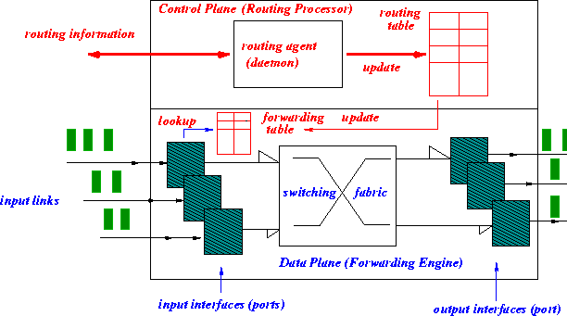
Routing & Forwarding:
Logical View of a Router
5
B
3
C
2
5
A
2
1
F
3
1
2
D
1
E
Notes:
Here is an abstract view of the internals of a typical router. We can separate the functionality of a router into control plane and data plane. The control plane is responsible for exchanging routing information (control packets) with other routers and making routing decisions. Generally, there exists a route processor to process these control packets and to update the routing table. This routing table is then condensed into a form known as forwarding table for quick lookup by the data plane. The job of data plane is to switch packets from input ports to output ports, which is essentially a forwarding.engine. Data packets flow thru this faster data plane while control packets are processed by slower control plane. Another way to look at is that routing decisions are made by control plane and forwarding lookups done by data plane.

Slide 57
IP Forwarding & IP/ICMP Protocol
Transport layer: TCP, UDP
Routing protocols
path selection
RIP, OSPF, BGP
IP protocol
addressing conventions
packet handling conventions
Network
layer
routing
table
ICMP protocol
error reporting
router “signaling”
Data Link layer (Ethernet, WiFi, PPP, …)
Physical Layer (SONET, …)
Notes:
This shows the different components of network layer under Internet protocol stack. IP protocol is concerned with addressing and packet forwarding.
The routing table itself is either setup manually or using routing protocols such as Routing Information Protocol (RIP), Open Shortest Path First (OSPF) and Border Gateway Protocol (BGP). These protocols are used to exchange information about the network between routers and update routing tables in response to link and node failures.
Internet Control Message Protocol (ICMP) is for reporting errors such as destination not reachable, number of hops exceeded the specified maximum etc.

Slide 58
ICMP: Internet Control Message Protocol
used by hosts & routers to communicate network-level information
  error reporting: unreachable host, network, port, protocol
  echo request/reply (used by ping)
network-layer “above” IP:
  ICMP msgs carried in IP datagrams
ICMP message: type, code plus first 8 bytes of IP datagram causing error
Type Code description
0 0 echo reply (ping)
3 0 dest. network unreachable
3 1 dest host unreachable
3 2 dest protocol unreachable
3 3 dest port unreachable
3 6 dest network unknown
3 7 dest host unknown
4 0 source quench (congestion
control - not used)
8 0 echo request (ping)
9 0 route advertisement
10 0 router discovery
11 0 TTL expired
12 0 bad IP header
Notes:
HTTP example
IP router was unable to find the path.
ICMP considered to be part of IP layer however architecturally they are above IP.
ICMP messages are part of the IP payload.

Slide 59

Traceroute and ICMP
source sends series of UDP segments to destination
  first set has TTL =1
  second set has TTL=2, etc.
  unlikely port number
when datagram in nth set arrives to nth router:
  router discards datagram and sends source ICMP message (type 11, code 0)
  ICMP message include name of router & IP address
when ICMP message arrives, source records RTTs
stopping criteria:
UDP segment eventually arrives at destination host
destination returns ICMP “port unreachable” message (type 3, code 3)
source stops
3 probes
3 probes
3 probes

Slide 60
What is Network Management?
autonomous systems (aka “network”): 1000s of interacting hardware/software components
other complex systems requiring monitoring, control:
  jet airplane
  nuclear power plant
  others?
"Network management includes the deployment, integration
and coordination of the hardware, software, and human
elements to monitor, test, poll, configure, analyze, evaluate,
and control the network and element resources to meet the
real-time, operational performance, and Quality of Service
requirements at a reasonable cost."

Slide 61


Infrastructure for Network Management
definitions:
managing entity
agent
data
managing
entity
managed devices contain managed objects whose data is gathered into a Management Information Base (MIB)
data
managed device
network
management
protocol
agent
data
managed device
agent
data
managed device
agent
data
agent
data
managed device
managed device
Notes:
A managed device is a piece of network residing on the managed network. Might be host, router, switch, etc.
Within these managed devices, there may be many managed objects.
Managed objects are actual pieces of hardware, e.g. NIC, configuration params for h/w and s/w
Each managed object’s information is collected into an MIB.
An MIB can be a
-- counter of IP datagrams discarded due to errors,
-- number of UDP segments received at a host,
-- descriptive info about version of software on DNS server, etc.
Network Management agent is resident to every managed device, a process that communicated with the managing server/entity
Network management protocol allows the communication between different devices. It allows managing server to query the managed devices via the agent.
The protocol does not by itself managed the network but provides capabilities to the network admin to manage the network.

Slide 62
SNMP Protocol
Two ways to convey MIB info, commands:
managing
entity
managing
entity
request
trap msg
response
agent
data
agent
data
managed device
managed device
request/response mode
trap mode
Notes:
Query MIB objects
Trap messages to notify e.g. link interface going up/down, loss of neighbor

Slide 63
SNMP Protocol: Message Types
Message type
Function
GetRequest
GetNextRequest
GetBulkRequest
manager-to-agent: “get me data”
(data instance, next data in list, block of data)
InformRequest
manager-to-manager: here’s MIB value
SetRequest
manager-to-agent: set MIB value
Response
Agent-to-manager: value, response to Request
Agent-to-manager: inform manager
of exceptional event
Trap

Slide 64
SNMP Protocol:
Message Formats
Get/set header
Variables to get/set
PDU
type
(0-3)
Error
Status
(0-5)
Request
ID
Error
Index
Name
Value
Name
Value
….
PDU
type
4
Trap
Type
(0-7)
Enterprise
Agent
Addr
Specific
code
Time
stamp
Name
Value
….
Trap header
Trap info
SNMP PDU
More on network management: see earlier editions of textbook!

Slide 65
Network Layer Summary
Network Layer Functions and Service Models
  Addressing, Routing and Forwarding
  Virtual Circuit vs. Datagram; Programmable Data Plane via SDN
  Distributed vs. Centralized Control Plane
IP Addressing Scheme: CIDR; DHCP
IP Forwarding and IP Protocol
  IP Datagram Forwarding Model: dest. in same net vs. diff. net
  IPv4: Datagram Format, IP Fragmentation, …; IPv6
Network Layer Routing
  Fundamental Issues
  Two Basic Distributed Algorithms: LS and DV
  Routing in the Internet: Intra-AS vs. Inter-AS routing
    Intra-AS: RIP and OSPF (distributed routing protocols)
    Inter-AS: BGP and Policy Routing
Openflow switches, SDN Controllers & Centralized Control Plane
ICMP & SNMP

