Slide 1
CSCI 4211 (revised)
February 10-12, 2020
Tim Salo
Jason Carpenter

Slide 2
CSCI 4211
Topics
E-Mail protocols
Sockets and Sockets Programming
Project 1 (Jason)
Useful networking utilities

Slide 3
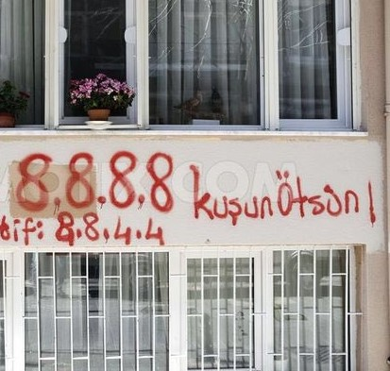
CSCI 4211

Slide 4
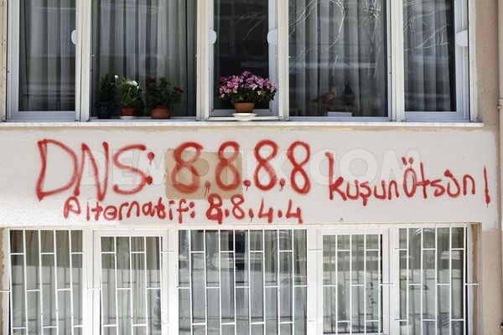
CSCI 4211

Slide 5
Socket Programming
Background
Sockets
Socket Programming

Slide 6
Background
IP Addresses
IP addresses are assigned to interfaces
Not hosts
IP protocol uses IP addresses
Not domain names
Socket API uses IP addresses
Application must translate domain name => IP address
Such as, gethostbyname()

Slide 7
Background
Flows
A flow (session) is specified by:
Source IP address
Source port number
Destination IP address
Destination port number
Protocol (e.g., TCP or UDP)
Referred to as a “five-tuple”:
(Src IP, Src port, Dest IP, Dest port, Protocol)

Slide 8
Background
Network Byte Order
Different hardware architectures store multibyte values in different orders
Big-endian architectures store most significant byte first
OpenRISC

Slide 9
Background
Network Byte Order (continued)
Little-endian architectures store least significant byte first
x86
How should 16- or 32-bit values be transmitted over the Internet?
“Network byte order” is big endian

Slide 10
Background
Network Byte Order (continued)
Your code should convert from host to network byte order when necessary
htons(), htonl(), ntohs(), ntohl()
Only necessary when storing multi-byte values
int, long
Not necessary when storing strings (single-byte chars)

Slide 11
Background
Network Byte Order (continued)
Some day, you will look at a packet in memory or on the wire and think that the bytes are in the wrong order
Now you know why

Slide 12
Background
Transport Protocols
Most common transport protocols are:
UDP (User Datagram Protocol)
Provides one-way, connectionless, best-effort, datagram (packet) service
Hope packet gets there
SOCK_DGRAM

Slide 13
Background
Transport Protocols (continued)
Most common transport protocols are:
TCP (Transmission Control Protocol)
Provides two-way, connection-oriented, reliable stream of bytes
Correct bytes, in order
SOCK_STREAM

Slide 14
Sockets
Sockets are an API for:
Accessing network services?
Connecting to a remote process?
Inter-process communications (IPC)?
All of the above

Slide 15
Sockets
Sockets are an API for accessing network services
Originally called “Berkeley Sockets”
Developed in BSD 4.2
Standardized by POISX
Specified in C
Most languages use similar APIs
Often call C sockets

Slide 16
Sockets
You
You
Socket API (library calls)
Application
User Space
Library
System Calls
Kernel
Kernel Space
TCP/UDP
Network Interface
IP
intf

Slide 17
Sockets
Application
Port Number
(Process within the host)
User Space
Library
Kernel
Kernel Space
TCP/UDP
IP Address
(Interface on the network)
IP
intf

Slide 18
Sockets
Application
User Space
GNU C Library
glibc Reference Manual: ~1200 pages
Library
Kernel
Kernel Space
TCP/UDP
IP
intf

Slide 19
Sockets
Process
When you create a socket, you get an int.
Kernel
TCB
int is an index into the process’ list of open files in Task Control Block
Open Files

Slide 20
Sockets
Sockets are largely just another type of file
You can open, read from / write to, and close a socket
Some file operations not supported
Opening a socket is more involved than opening a file
Need to (sometimes) specify
Protocol
Port number
IP address / port number of destination
...

Slide 21
Socket Programming API
API: Application Programming Interface
Socket analogous to door
sending process shoves message out door
sending process assumes transport infrastructure on other side of door which brings message to socket at receiving process
host-local, application created/owned, OS-controlled
connection between sockets set-up/managed by OS
host or
server
host or
server
controlled by
app developer
process
process
socket
socket
TCP with
buffers,
variables
TCP with
buffers,
variables
Internet
controlled
by OS

Slide 22
Socket Programming
The general sequence of using a socket is:
Get the remote host IP address
Create a socket
Open a socket
Read from / write to socket
Close socket

Slide 23
Socket Programming
Step 1: Get remote host IP address
gethostbyname() gets the IP address(es) of a specified domain name
Calls DNS to do the work
Sample code at:
http://www-users.cselabs.umn.edu/classes/Spring-2020/csci4211/code/gethost.c
<CSCI 442 home page>/code/gethost.c (code)
<CSCI 442 home page>/code/gethost.txt (output)

Slide 24
Socket Programming
Step 1: Get remote host IP address
To run code, log onto favorite Linux machine with your favorite terminal program
csel-kh1250-XX.cselabs.umn.edu csel-kh4250-XX.cselabs.umn.edu Where the XX is a number from 01 to about 30
Perhaps, XX is (last two digits of student id) mod 30

Slide 25
Socket Programming
Step 1: Get remote host IP address
To run code
wget http://www-users.cselabs.umn.edu/classes/Spring-2020/csci4211/code/gethost.c
gcc gethost.c
./a.out

Slide 26
Socket Programming
Steps 2-5: create/open/read/write/close
Sample code at:
http://www-users.cselabs.umn.edu/classes/Spring-2020/csci4211/code/webclient.c
<CSCI 442 home page>/code/webclient.c (code)
<CSCI 442 home page>/code/webclient.txt (output)

Slide 27
Socket Programming
Steps 2-5: create/open/read/write/close
To run code:
wget http://www-users.cselabs.umn.edu/classes/Spring-2020/csci4211/code/webclient.c
gcc webclient.c
./a.out

Slide 28
Socket Programming
Resources
Linux man pages – general information
man 7 ip
man 7 socket
man 7 tcp
man 7 udp

Slide 29
Socket Programming
Resources
Linux man pages – C sockets API
man <socket library call>
socket connect bind listen
accept send sendmsg recv
recvmsg close
gethostbyname gethostbyaddr
Sockets have a lot of capabilities you don’t need: ignore them

Slide 30
Socket Programming
Resources
C Socket tutorials
https://www.cs.rpi.edu/~moorthy/Courses/os98/Pgms/socket.html
Sample client/server code
https://www.geeksforgeeks.org/socket-programming-cc/
Nice state table, sample code
Google for more!

Slide 31
Socket Programming
Resources
Python 3
Socket Programming HOWTO https://docs.python.org/3/howto/sockets.html
socket — Low-level networking interface https://docs.python.org/3/library/socket.html

Slide 32
Socket Programming
Resources
Python 2
Socket Programming HOWTO https://docs.python.org/2/howto/sockets.html
socket — Low-level networking interface https://docs.python.org/2/library/socket.html

Slide 33
Socket Programming
Resources
Python Tutorials
Socket Programming in Python (Guide) https://realpython.com/python-sockets/
Lots of sample code
Google for many more

Slide 34
Socket Programming
Resources
Java
Networking Basics https://docs.oracle.com/javase/tutorial/networking/overview/networking.html
Lesson: All About Sockets https://docs.oracle.com/javase/tutorial/networking/sockets/index.html

Slide 35
Socket Programming
Resources
Java
java.net documentation https://docs.oracle.com/javase/8/docs/api/index.html

Slide 36
Networking Utilities
Useful Linux networking utilities
Most are available on MacOS
Windows has similar programs
Sometimes spelled differently
Sometimes need to be installed
Most of these are command line tools
Usually interactive with no parameter
Often accept a command line parameter (non-interactive)

Slide 37
Networking Utilities
Useful Linux networking utilities
Many of these tools can configure the host’s networking software, when run as root (sudo)

Slide 38
Networking Utilities
Useful Linux networking utilities
wireshark – graphical packet sniffer
tcpdump – command line packet sniffer
ping – probe remote host
traceroute – display path to host
tracert in windows
mtr – network diagnostic tool
Essentially, a continuous traceroute

Slide 39
Networking Utilities
Useful Linux networking utilities
whois – administrative info about domain name, ip address, ...
Windows version available (from Microsoft)
host – get info about host or address
netstat – get network status
Need to install net-tools on Linux
Many options
Start with “netstat –h”

Slide 40
Networking Utilities
Useful Linux networking utilities
ifconfig – configure interfaces
ipconfig in windows
route – manipulate routing tables
ip – recent IP configuration tool

Slide 41
Networking Utilities
Useful Linux networking utilities
nmap – map network
Caution: this is a powerful tool and its use on University networks generally violates University policies
Finds hosts, open ports on your network
Very useful in auditing network security
snort – open source intrusion detection tool
metasploit – penetration testing framework

Slide 42
What APIs Needed?
Connection-Oriented TCP
Connectionless UDP
How to send/recv data
How to establish connection
Client connects to a server
Server accepts client req.
How to create socket (door)
How to close socket (door)
How to identify socket
Bind to local address/port
How to send/recv data
How to create socket
How to close socket
How to identify socket
Notes:
If you are developing a network program, what services you would like the transport layer to provide? Of course, possibly the first thing come into your mind is that, you want to be able to send something to another party, or receive something from another party. If you want to use connection-oriented TCP, you would also possibly want the system to take care of the connection establishment procedure.

Slide 43
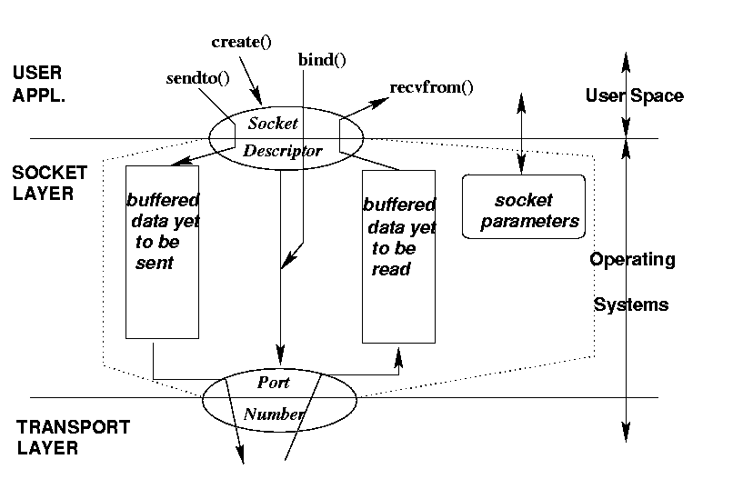
Socket: Conceptual View
socket()

Slide 44
Creating a Socket
Format: int socket(family, type, protocol);
domain, service and protocol parameters:
family: PF_INET/AF_INET, PF_UNIX/AF_UNIX
service:
SOCK_DGRAM: datagram service (i.e., UDP)
SOCK_STREAM: byte stream service (i.e.,TCP)
protocol: usually 0 for default type
return a socket descriptor, like a file descriptor in Unix
#include <sys/types.h>
#include <sys/socket.h>
if (sd = socket(PF_INET, SOCK_STREAM, 0) <0 ){
perror (”socket”); /* socket creation error */
}

Slide 45
Socket Address Structures
Predefined data structures:
generic socket address:
struct sockaddr_in { /* INET socket addr info */
short sin_family; /* set me to PF_INET */
u_short sin_port; /* 16 bit num, network byte order*/
struct in_addr sin_addr; /* 32 bit host address */
char sin_zero[8]; /* not used */
};
IP address (32-bit numeric representation):
struct in_addr {
u_long s_addr; /* 32 bit host address, network byte order */
};

Slide 46
Binding to a Local Address
Format: int bind(int sockid, struct sockaddr *addr, int addresslen);
Servers and connectionless clients need to call it
optional for connection-oriented clients
#include <system/types.h>
#include <sys/socket.h>
#include <netinet/in.h>
int sd; struct sockaddr_in myaddr;
if (sd = socket(PF_INET, SOCK_DGRAM,0) )<0 {/*socket error*/};
myaddr.sin_family = PF_INET;
myaddr.sin_port = htons(5100); /* > 5000 */
myaddr.sin_addr.s_addr = htonl(INADDR_ANY);
/* INADDR_ANY: allow OS to choose IP address for any interface */
if ( bind(sd, (struct sockaddr *) &myaddr, sizeof(myaddr)) < 0)
{ /* bind error */ }

Slide 47
CO Server: listen() and accept()
listen():
int listen (int sd, int backlog);
notify OS/network ready to accept requests
backlog: max. listen queue size while waiting for accept()
does not block/wait for requests
accept():
int accept (int sd, struct sockaddr *fromaddr, int addrlen);
use socket (sd) for accepting incoming connection requests
create new socket (return value) for data exchange w/ client
block until client connects, cannot selectively accept

Slide 48
Connecting to Server: connect()
Format:
int connect (int sd, struct sockaddr *toaddr, int addrlen);
Client issues connect() to
establish remote address, port (connection-oriented, connectionless)
establish connection with server (connection-oriented only)
CO: block until accepted or error
fails: server/host not listening to port, timeout

Slide 49
Sending and Receiving Data
Connection-oriented
send() and recv(); or read() and write()
Format
int send(int sockfd, char *buff, int nbytes, int flags)
int recv(int sockfd, char *buff, int nbytes, int flags)
Connectionless
sendto() and recvfrom()
Format
int sendto(int sockfd, char *buff, int nbytes, int flags,
struct sockaddr *to, int addrlen)
int recvfrom(int sockfd, char *buff, int nbytes, int flags,
struct sockaddr *from, int addrlen)

Slide 50
Closing a Socket
Format – int close(int fd)
Call this function to close a created socket.
System takes care of buffered data.

Slide 51
A summary of BSD Socket
protocol
localAddr,localPort
remoteAddr, remotePort
conn-oriented server
socket()
bind()
listen(), accept()
conn-oriented client
socket()
connect()
connectionless server
socket()
bind()
recvfrom()
connectionless client
socket()
bind()
sendto()

Slide 52
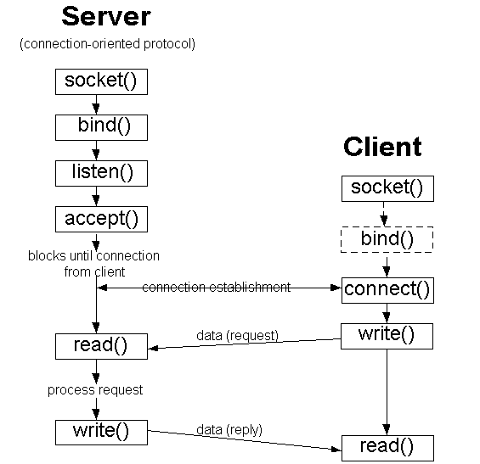
BSD Socket Programming Flows (connection-oriented)

Slide 53
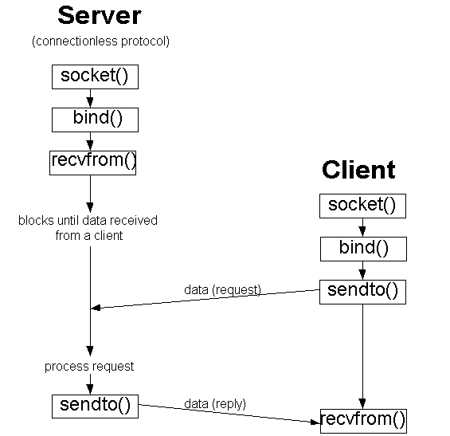
BSD Socket Programming (connectionless)

Slide 54
Data Conversion & Name/Address Translation
Integers:
little endian: least significant bit first (e.g., DEC, Intel)
big endian: most significant bit first (e.g., Sun, HP, SGI)
network byte order: big endian
ntohl(): network-to-host byte order conversion, long(32 bits)
htonl(): host-to-network byte order conversion, long(32 bits)
ntohs(), htons(): for short integer (16 bits)
Host name to IP address (numeric): gethostbyname()
Host IP address to name: gethostbyaddr()
IP address conversion:
from numeric to dotted quad: inet_ntoa()
you may need this for printing the IP address of a host
from dotted quad to numeric: inet_addr()

Slide 55
Example of Stream Server: echo
/* stream server: echo what is received from client */
#include <sys/types.h>
#include <sys/socket.h>
#include <netinet/in.h>
#include <arpa/inet.h>
#include <string.h>
#include <unistd.h>
#include <stdlib.h>
#include <stdio.h>
int main (int argc, char *argv[])
{
int s, t, sinlen;
struct sockaddr_in sin;
char msg[80];

Slide 56
Example of Stream Server: echo (cont’d)
if (argc < 2) {
printf (”%s port\n”, argv[0] ); /* input error: need port no! */
return -1;
}
if ( (s = socket(PF_INET, SOCK_STREAM, 0 ) ) < 0) { /* create socket*/
perror(”socket”); /* socket error */
return -1;
}
sin.sin_family = PF_INET; /*set protocol family to Internet */
sin.sin_port = htons(atoi(argv[1])); /* set port no. */
sin.sin_addr.s_addr = INADDR_ANY; /* set IP addr to any interface */
if (bind(s, (struct sockaddr *)&sin, sizeof(sin) ) < 0 ){
perror(”bind”); return -1; /* bind error */
}

Slide 57
Example of Stream Server: echo (cont’d)
/* server indicates it’s ready, max. listen queue is 5 */
if (listen(s, 5)) {
printf (”listen”); /* listen error*/
return -1;
}
sinlen = sizeof(sin);
while (1) {
/* accepting new connection request from client,
socket id for the new connection is returned in t */
if ( (t = accept(s, (struct sockaddr *) &sin, &sinlen) ) < 0 ){
perror(”accept ”); /* accpet error */
return -1;
}

Slide 58
Example of Stream Server: echo (cont’d)
printf( ”From %s:%d.\n”,
inet_ntoa(sin.sin_addr), ntohs(sin.sin_port) );
if ( read(t, msg, sizeof(msg) ) <0) { /* read message from client */
perror(”read”); /* read error */
return -1;
}
if ( write(t, msg, strlen(msg) ) < 0 ) { /* echo message back */
perror(”write”); return -1; /* write error */
}
/* close connection, clean up sockets */
if (close(t) < 0) { perror(”close”); return -1;}
} // not reach below
if (close(s) < 0) { perror(”close”); return -1;}
return 0;
}

Slide 59
Example of Stream Client: echo
/* stream client: send a message to server */
#include <sys/types.h>
#include <sys/socket.h>
#include <netinet/in.h>
#include <arpa/inet.h>
#include <string.h>
#include <unistd.h>
#include <stdlib.h>
#inlcude <stdio.h>
#include <netdb.h>
int main (int argc, char *argv[] )
{
int s, n;
struct sockaddr_in sin; struct hostent *hptr;
char msg[80] = ”Hello World!”;

Slide 60
Example of Stream Client: echo (cont’d)
if ( argc < 3 ) {
printf ( ”%s host port\n”, argv[0] ); /* input error: need host & port */
return -1;
}
if ( (s = socket(PF_INET, SOCK_STREAM, 0 ) ) < 0) { /* create socket*/
perror(”socket”); /* socket error */
return -1;
}
sin.sin_family = PF_INET; /*set protocol family to Internet */
sin.sin_port = htons(atoi(argv[2])); /* set port no. */
if ( (hptr = gethostbyname(argv[1]) ) == NULL){
fprintf(stderr, ”gethostname error: %s”, argv[1]);
return = -1;
}
memcpy( &sin.sin_addr, hptr->h_addr, hptr->h_length);

Slide 61
Example of Stream Client: echo (cont’d)
if (connect (s, (struct sockaddr *)&sin, sizeof(sin) ) < 0 ){
perror(”connect”); return -1; /* connect error */
}
if ( write(s, msg, strlen(msg) +1) < 0 ) { /* send message to server */
perror(”write”); return -1; /* write error */
}
if ( ( n = read(s, msg, sizeof(msg) ) ) <0) { /* read message from server */
perror(”read”); return -1; /* read error */
}
printf (” %d bytes: %s\n”, n, msg); /* print message to screen */
/* close connection, clean up socket */
if (close(s) < 0) {
perror(”close”); /* close error */
return -1;}
return 0;
}

Slide 62
Compiling and Executing
kepler% g++ -o echo-server echo-server.c -lsocket -lnsl
kepler% g++ -o echo-client echo-client.c -lsocket -lnsl
kepler% echo-server 5700 &
kepler% echo-client kepler 5700
From 128.101.34.75:32938.
12 bytes: Hello World!
A Few Words about Port Numbers
1-255: standard services (21 ftp, 25 SMTP, 80 HTTP)
1-1023: available only to system
1024-4099: usable by system & users
5000 - : usable only by users

Slide 63
What We Have Learned
BSD Unix C Socket Programming API
Socket operations: system calls into OS
Java Socket Programming API
What We Will Learn Next

Slide 64
Java Socket Programming API
Class ServerSocket
Connection-oriented server side socket
Class Socket
Regular connection-oriented socket (client)
Class DatagramSocket
Connectionless socket
Class InetAddress
Encapsulates Internet IP address structure

Slide 65
TCP Socket
Create a server side TCP socket (class ServerSocket)
ServerSocket(int localPort)
ServerSocket(int localPort, int queueLimit)
ServerSocket(int localPort, int queueLimit, InetAddress localAddress)
Accept incoming TCP client request
Socket serverSocket.accept()
Close an existing TCP socket
socket.close()

Slide 66
TCP Socket (Cont’d)
Create a (client side) TCP socket (class Socket)
Socket(InetAddress remoteAddr, int remotePort)
Socket(String remoteHost, int remotePort)
Socket(InetAddress remoteAddress, int remotePort,
InetAddress localAddress, int localPort)
Read from/write to a socket through stream
InputStream socket.getInputStream()
OutputStream socket.getOutputStream()
Close an existing socket
socket.close()

Slide 67
UDP Socket
Create a UDP socket (class DatagramSocket)
DatagramSocket()
DatagramSocket(int localPort)
DatagramSocket(int localPort, InetAddress localAddress)
Receive/send data
void receive(DatagramPacket packet)
void send(DatagramPacket packet)
Close a UDP socket
datagramSocket.close()

Slide 68
UDP DatagramPacket
UDP endpoints exchange self-contained message (class DatagramPacket)
DatagramPacket(byte[] buffer, int length)
DatagramPacket(byte[] buffer, int length, InetAddress remoteAddress, int remotePort)
import java.net.*;
DatagramPacket sendPacket = new DatagramPacket(
byteToSend, byteToSend.length, serverAddress, serverPort);

Slide 69
A summary of Java Socket
protocol
localAddr,localPort
remoteAddr, remotePort
conn-oriented server
ServerSocket()
accept()
conn-oriented client
Socket()
connectionless server
DatagramSocket()
receive()
connectionless client
DatagramSocket()
send()

Slide 70
Java Socket Programming Flows (TCP)
Server (running on hostid)
Client
create socket,
port=x, for
incoming request:
welcomeSocket =
ServerSocket()
wait for incoming
connection request
create socket,
connect to hostid, port=x
connectionSocket =
welcomeSocket.accept()
clientSocket =
Socket()
TCP
connection setup
send request using
clientSocket
read request from
connectionSocket
write reply to
connectionSocket
read reply from
clientSocket
close
connectionSocket
close
clientSocket

Slide 71
Java Socket Programming (UDP)
Server (running on hostid)
Client
create socket,
port=x, for
incoming request:
welcomeSocket =
DatagramSocket()
create socket
welcomeSocket.receive()
clientSocket = DatagramSocket()
Blocks until data
received from a client
Data (request)
send request using
clientSocket.send()
Process request
Data (reply)
read reply from
clientSocket.receive()
welcomeSocket.send()
close
clientSocket

Slide 72
Example: Java Client (TCP)
import java.io.*;
import java.net.*;
class TCPClient {
public static void main(String argv[]) throws Exception
{
String sentence;
String modifiedSentence;
BufferedReader inFromUser =
new BufferedReader(new InputStreamReader(System.in));
Socket clientSocket = new Socket("hostname", 6789);
DataOutputStream outToServer =
new DataOutputStream(clientSocket.getOutputStream());
Create
input stream
Create
client socket,
connect to server
Create
output stream
attached to socket

Slide 73
Example: Java Client (TCP), cont.
BufferedReader inFromServer =
new BufferedReader(new
InputStreamReader(clientSocket.getInputStream()));
sentence = inFromUser.readLine();
outToServer.writeBytes(sentence + '\n');
modifiedSentence = inFromServer.readLine();
System.out.println("FROM SERVER: " + modifiedSentence);
clientSocket.close();
}
}
Create
input stream
attached to socket
Send line
to server
Read line
from server

Slide 74
Example: Java Server (TCP)
import java.io.*;
import java.net.*;
class TCPServer {
public static void main(String argv[]) throws Exception
{
String clientSentence;
String capitalizedSentence;
ServerSocket welcomeSocket = new ServerSocket(6789);
while(true) {
Socket connectionSocket = welcomeSocket.accept();
BufferedReader inFromClient =
new BufferedReader(new
InputStreamReader(connectionSocket.getInputStream()));
Create
welcoming socket
at port 6789
Wait, on welcoming
socket for contact
by client
Create input
stream, attached
to socket

Slide 75
Example: Java Server (TCP), cont
Create output
stream, attached
to socket
DataOutputStream outToClient =
new DataOutputStream(connectionSocket.getOutputStream());
clientSentence = inFromClient.readLine();
capitalizedSentence = clientSentence.toUpperCase() + '\n';
outToClient.writeBytes(capitalizedSentence);
}
}
}
Read in line
from socket
Write out line
to socket
End of while loop,
loop back and wait for
another client connection

Slide 76
Compiling and Running
To compile
javac TCPServer.java
javac TCPClient.java
To run
java TCPServer
java TCPClient
A few words about byte order
DataOutput and DataInput streams
provide mechanisms for assuring correct data
transmission

Slide 77
Two Different Server Behaviors
Iterative server
At any time, only handles one client request
Concurrent server
Multiple client requests can be handled simultaneously
create a new process/thread to handle each request
for (;;) {
accept a client request;
handle it
}
for (;;) {
accept a client request;
create a new process / thread to handle request;
parent process / thread continues
}

Slide 78
Example of Concurrent Server (Unix C)
for (;;) {
/* wait for a connection from a client process.
* this is an example of a concurrent server. */
clilen = sizeof(cli_addr);
newsockfd = accept(sockfd, (struct sockaddr *)
&cli_addr, &clilen);
if (newsockfd < 0) {/*something wrong*/}
if ((childpid = fork()) < 0) {/*something wrong*/}
else if (childpid == 0) {/*child process*/
close(sockfd);
/*process the new client request*/
exit(0);
}
close(newsockfd);
}

Slide 79
What We have Learned So Far
BSD Unix Socket Programming API
Java Socket Programming API

