Slide 1
Wireless and Mobile Networks
Wireless and 802.11 LANs
wireless links:
  shared, fading, interference, hidden terminal problem
IEEE 802.11 (“wi-fi”)
  CSMA/CA reflects wireless channel characteristics
  DIFS, SIFS, receiver ACK, RTS/CTS, NAV, …
Cellular Network Architectures (and its Evolution): an Overview
An overview of cellular network architecture
3G and 4G LTE cellular networks
Mobility
principles: addressing, routing to mobile users
  home, visited networks
  direct, indirect routing
  care-of-addresses
case studies
  mobile IP; mobility management in cellular networks
Readings: Textbook, Chapter 7

Slide 2
Ch. 6: Wireless and Mobile Networks
Background:
# wireless (mobile) phone subscribers now exceeds # wired phone subscribers (5-to-1)!
# wireless Internet-connected devices equals # wireline Internet-connected devices
  laptops, Internet-enabled phones promise anytime untethered Internet access
two important (but different) challenges
  wireless: communication over wireless link
  mobility: handling the mobile user who changes point of attachment to network

Slide 3
Chapter 7 outline
7.1 Introduction
Wireless
7.2 Wireless links, characteristics
  CDMA
7.3 IEEE 802.11 wireless LANs (“wi-fi”)
7.4 Cellular Internet Access
  architecture
  standards (e.g., GSM)
Mobility
7.5 Principles: addressing and routing to mobile users
7.6 Mobile IP
7.7 Handling mobility in cellular networks
7.8 Mobility and higher-layer protocols
7.9 Summary

Slide 4
Elements of a Wireless Network
wireless hosts
laptop, PDA, IP phone
run applications
may be stationary (non-mobile) or mobile
  wireless does not always mean mobility
network
infrastructure

Slide 5
Elements of a Wireless Network
base station
typically connected to wired network
relay - responsible for sending packets between wired network and wireless host(s) in its “area”
  e.g., cell towers 802.11 access points
network
infrastructure

Slide 6
Elements of a Wireless Network
wireless link
typically used to connect mobile(s) to base station
also used as backbone link
multiple access protocol coordinates link access
various data rates, transmission distance
network
infrastructure

Slide 7
Characteristics of selected wireless links
1300
802.11 ac
450
802.11n
54
802.11a,g
802.11a,g point-to-point
5-11
802.11b
4G: LTWE WIMAX
4
3G: UMTS/WCDMA-HSPDA, CDMA2000-1xEVDO
Data rate (Mbps)
1
802.15
.384
2.5G: UMTS/WCDMA, CDMA2000
.056
2G: IS-95, CDMA, GSM
Indoor
10-30m
Outdoor
50-200m
Mid-range outdoor
200m – 4 Km
Long-range outdoor
5Km – 20 Km

Slide 8
Wireless Link Characteristics (1)
Differences from wired link ….
  decreased signal strength: radio signal attenuates as it propagates through matter (path loss)
  interference from other sources: standardized wireless network frequencies (e.g., 2.4 GHz) shared by other devices (e.g., phone); devices (motors) interfere as well
  multipath propagation: radio signal reflects off objects ground, arriving ad destination at slightly different times
…. make communication across (even a point to point) wireless link much more “difficult”

Slide 9
Wireless Link Characteristics (2)
SNR: signal-to-noise ratio
  larger SNR – easier to extract signal from noise (a “good thing”)
SNR versus BER tradeoffs
  given physical layer: increase power -> increase SNR->decrease BER
  given SNR: choose physical layer that meets BER requirement, giving highest thruput
    SNR may change with mobility: dynamically adapt physical layer (modulation technique, rate)
10⁻¹
10⁻²
10⁻³
BER
10⁻⁴
10⁻⁵
10⁻⁶
10⁻⁷
10
20
30
40
SNR(dB)
QAM256 (8 Mbps)
QAM16 (4 Mbps)
BPSK (1 Mbps)

Slide 10


Wireless Network Characteristics
Multiple wireless senders and receivers create additional problems (beyond multiple access):
A
B
C
C
A’s signal
strength
C’s signal
strength
B
A
Hidden terminal problem
B, A hear each other
B, C hear each other
A, C can not hear each other means A, C unaware of their interference at B
space
Signal attenuation:
B, A hear each other
B, C hear each other
A, C can not hear each other interfering at B

Slide 11
Optional: A Brief Intro to
Code Division Multiple Access (CDMA)
unique “code” assigned to each user; i.e., code set partitioning
  all users share same frequency, but each user has own “chipping” sequence (i.e., code) to encode data
  allows multiple users to “coexist” and transmit simultaneously with minimal interference (if codes are “orthogonal”)
encoded signal = (original data) X (chipping sequence)
decoding: inner-product of encoded signal and chipping sequence

Slide 12
CDMA Encode/Decode
channel output Z_{i,m}
Z_{i,m}= d_{i}.c_{m}
data
bits
d₀ = 1
1
1
1
1
1
d₁ = -1
1
1
1
-
-
-
-
1
-
-
-
1
-
1
1
1
1
1
sender
1
1
slot 1
channel
output
slot 0
channel
output
1
1
1
1
1
code
1
1
-
-
-
1
-
1
1
1
-
-
-
1
-
1
1
1
slot 1
slot 0
M
D_{i} = Σ Z_{i,m}.c_{m}
m=1
M
received
input
1
1
1
1
1
1
1
1
d₀ = 1
-
-
-
-
1
-
-
-
1
-
1
1
1
1
1
1
d₁ = -1
1
slot 1
channel
output
slot 0
channel
output
1
1
1
1
1
code
1
1
-
-
-
1
-
1
1
1
-
-
-
1
-
1
1
1
receiver
slot 1
slot 0

Slide 13

CDMA: Two-sender Interference
channel sums together transmissions by sender 1 and 2
Sender 1
Sender 2
using same code as sender 1, receiver recovers sender 1’s original data from summed channel data!

Slide 14
Back to Wireless Networks:
A Taxonomy
single hop
multiple hops
host connects to
base station (WiFi,
WiMAX, cellular)
which connects to
larger Internet
host may have to
relay through several
wireless nodes to
connect to larger
Internet: mesh net
infrastructure
(e.g., APs)
no base station, no
connection to larger
Internet. May have to
relay to reach other
a given wireless node
MANET, VANET
no
infrastructure
no base station, no
connection to larger
Internet (Bluetooth,
ad hoc nets)

Slide 15
Elements of a Wireless Network
infrastructure mode
base station connects mobiles into wired network
handoff: mobile changes base station providing connection into wired network
network
infrastructure

Slide 16
Elements of a Wireless Network
Ad hoc mode
no base stations
nodes can only transmit to other nodes within link coverage
nodes organize themselves into a network: route among themselves

Slide 17
IEEE 802.11 Wireless LAN
802.11g
  2.4-5 GHz range
  up to 54 Mbps
802.11n
  MIMO, 20/40MHz channels in 2.4 GHz
  up to 600 Mbps
802.11ac
  wider RF band per station (80/160 MHz), more MIMO, multi-user MIMO, 5 GHz
  at least 1 Gbps total, 500 Mbps per link
All use CSMA/CA for multiple access
All have base-station and ad-hoc network versions
802.11b
  2.4-5 GHz unlicensed radio spectrum
  up to 11 Mbps
  direct sequence spread spectrum (DSSS) in physical layer
    all hosts use same chipping code
  widely deployed, using base stations
802.11a
  5-6 GHz range
  up to 54 Mbps

Slide 18
802.11 LAN Infrastructure Mode
Internet
wireless host communicates with base station
  base station = access point (AP)
Basic Service Set (BSS) (aka “cell”) in infrastructure mode contains:
  wireless hosts
  access point (AP): base station
  ad hoc mode: hosts only
hub, switch
or router
AP
BSS 1
AP
BSS 2

Slide 19
802.11: Channels, Association
802.11b: 2.4GHz-2.485GHz spectrum divided into 11 channels at different frequencies
  AP admin chooses frequency for AP
  interference possible: channel can be same as that chosen by neighboring AP!
host: must associate with an AP
  scans channels, listening for beacon frames containing AP’s name (SSID) and MAC address
  selects AP to associate with
  may perform authentication [Chapter 8]
  will typically run DHCP to get IP address in AP’s subnet

Slide 20



802.11: Passive/Active scanning
BBS 1
BBS 2
BBS 1
BBS 2
1
AP 2
AP 1
2
2
AP 1
1
1
AP 2
3
2
4
3
H1
H1
active scanning:
Probe Request frame broadcast from H1
Probe Response frames sent from APs
Association Request frame sent: H1 to selected AP
Association Response frame sent from selected AP to H1
passive scanning:
beacon frames sent from APs
association Request frame sent: H1 to selected AP
association Response frame sent from selected AP to H1

Slide 21
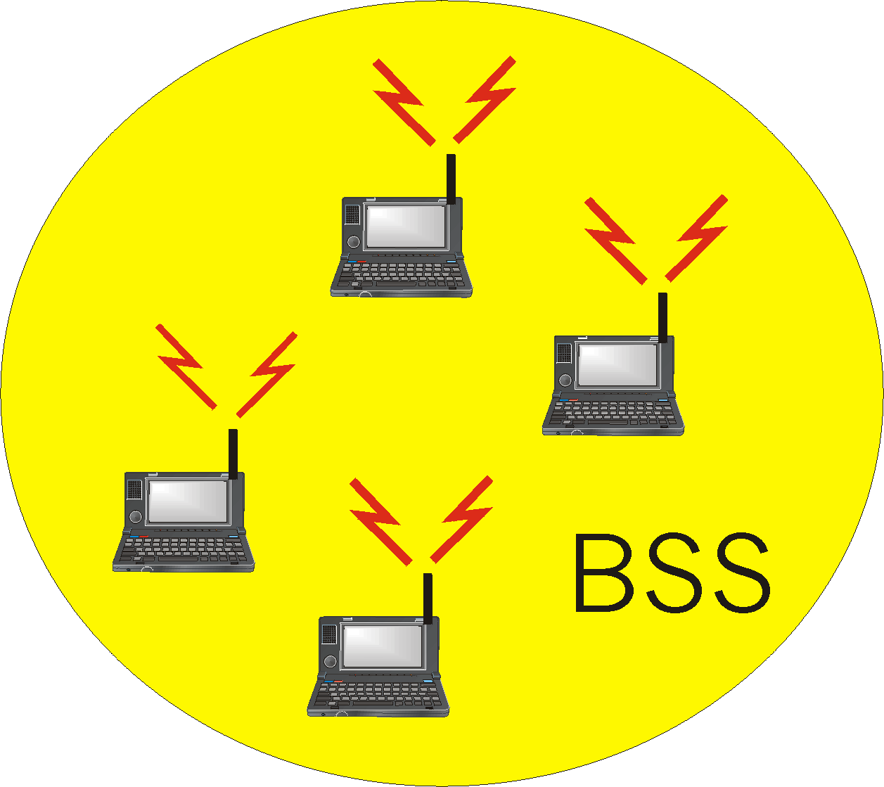
Ad Hoc Network Approach
No access point (i.e., base station)
  “peer-to-peer” mode
wireless hosts communicate with each other
  to get packet from wireless host A to B may need to route through wireless hosts X,Y,Z
Applications:
  “laptop” meeting in conference room, car
  interconnection of “personal” devices
  battlefield
IETF MANET
(Mobile Ad hoc Networks)
working group

Slide 22
Wireless Network Characteristics (again!)
Multiple wireless senders and receivers create additional problems (beyond multiple access):
A
B
C
C
A’s signal
strength
C’s signal
strength
B
A
Hidden terminal problem
B, A hear each other
B, C hear each other
A, C can not hear each other
means A, C unaware of their interference at B
space
Signal fading:
B, A hear each other
B, C hear each other
A, C can not hear each other interferring at B

Slide 23
Hidden and Exposed Terminal Problems
Wireless networks: hidden and exposed nodes
  A->B and C->B: A can’t hear C’s transmission
    C hidden from A, can cause collision!
  B->A and C->D: won’t interfere with each other, despite B can hear C’s transmission
    C exposed to B,
    unnecessary backoff by B!

Slide 24
IEEE 802.11: Multiple Access
avoid collisions: 2⁺ nodes transmitting at same time
802.11: CSMA - sense before transmitting
  don’t collide with ongoing transmission by other node
802.11: no collision detection!
  difficult to receive (sense collisions) when transmitting due to weak received signals (fading);
    often need to switch between transmitting vs. receiving mode
  can’t sense all collisions in any case: hidden terminal, fading
  goal: avoid collisions: CSMA/C(ollision)A(voidance)
A
B
C
C
A’s signal
strength
C’s signal
strength
B
A
space

Slide 25
IEEE 802.11 MAC Protocol: CSMA/CA
802.11 sender
1 if sense channel idle for DIFS then
  transmit entire frame (no CD)
2 if sense channel busy then
  start random backoff timer
  timer counts down while channel idle
  transmit when timer expires
if no ACK (e.g., due to collision or bit error), increase random backoff interval, repeat 2
802.11 receiver
- if frame received OK
return ACK after SIFS (ACK needed due to hidden terminal problem)
sender
receiver
DIFS
data
SIFS
ACK

Slide 26
IEEE 802.11 MAC Protocol: CSMA/CA
Key Design decisions/questions:
a) why DIFS & SIFS intervals?
b) why requiring ACK?
c) why DIFS > SIFS?
802.11 sender
1 if sense channel idle for DIFS then
  transmit entire frame (no CD)
2 if sense channel busy then
  start random backoff timer
  timer counts down while channel idle
  transmit when timer expires
if no ACK (e.g., due to collision or bit error), increase random backoff interval, repeat 2
802.11 receiver
- if frame received OK
return ACK after SIFS (ACK needed due to hidden terminal problem)
sender
receiver
DIFS
data
SIFS
ACK
What issues we may still have?
What can we do better?

Slide 27
IEEE 802.11 MAC Protocol: CSMA/CA
Key Design decisions/questions:
a) why DIFS & SIFS intervals?
b) why requiring ACK?
c) why DIFS > SIFS?
What issues we may still have?
What can we do better?
sender
receiver
DIFS
data
SIFS
ACK

Slide 28
Collision Avoidance Mechanisms
Problem:
  two nodes, hidden from each other, transmit complete frames to base station
  wasted bandwidth for long duration !
Solution:
  small reservation packets
  nodes track reservation interval with internal “network allocation vector” (NAV)

Slide 29
Avoiding Collisions (cont’d)
idea: allow sender to “reserve” channel rather than random access of data frames: avoid collisions of long data frames
sender first transmits small request-to-send (RTS) packets to BS using CSMA
  RTSs may still collide with each other (but they’re short)
BS broadcasts clear-to-send CTS in response to RTS
RTS heard by all nodes
  sender transmits data frame
  other stations defer transmissions
Avoid (large) data frame collisions
using small reservation packets!

Slide 30
Collision Avoidance: Some Details
Sender transmits RequestToSend (RTS) frame
Receiver replies with ClearToSend (CTS) frame
Neighbors…
  see CTS: keep quiet
  see RTS but not CTS: ok to transmit
Receiver sends ACK when has frame
  neighbors silent until see ACK
Collisions
  no collisions detection
  known when don’t receive CTS
  exponential backoff

Slide 31
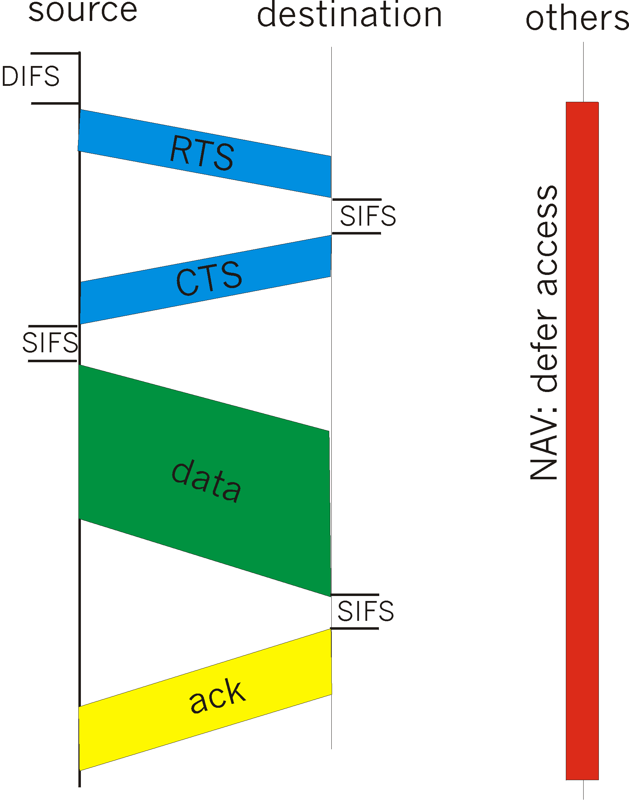
Collision Avoidance:
RTS-CTS Exchange
sender transmits short RTS (request to send) packet: indicates duration of transmission
receiver replies with short CTS (clear to send) packet
  notifying (possibly hidden) nodes
hidden nodes will not transmit for specified duration: NAV

Slide 32
Collision Avoidance: RTS-CTS Exchange
A
B
AP
RTS(B)
RTS(A)
reservation collision
RTS(A)
CTS(A)
CTS(A)
DATA (A)
defer
time
ACK(A)
ACK(A)

Slide 33
802.11 Frame: Addressing
2
2
6
6
6
2
6
0 - 2312
4
frame
control
duration
address
1
address
2
address
3
seq
control
address
4
payload
CRC
Address 4: used when frames are forwarded from one AP to another AP (MAC address of actual source)
Address 1: MAC address
of wireless host or AP
to receive this frame
Address 3: MAC address of original (i.e., actual!) source or target (i.e., actual) destination when frames are forwarded by AP
Address 2: MAC address
of wireless host or AP
transmitting this frame

Slide 34
802.11 Frame: More
frame seq #
(for reliable ARQ)
duration of reserved
transmission time (RTS/CTS)
2
2
6
6
6
2
6
0 - 2312
4
frame
control
duration
address
1
address
2
address
3
seq
control
address
4
payload
CRC
2
2
4
1
1
1
1
1
1
1
1
Protocol
version
Type
Subtype
To
AP
From
AP
More
frag
Retry
Power
mgt
More
data
WEP
Rsvd
frame type
(RTS, CTS, ACK, data)

Slide 35

802.11 Frame: Addressing
802.11 Frame: Addressing
H1
W
IP datagram
from H1 to W
Internet
dst IP addr
src IP addr
R1
router
W’s IP
addr
H1’s IP
addr
AP
src & dst IP addresses in IP datagram are never altered on its journey from H1 to W!
Not AP’s MAC address!
R1 MAC addr H1 MAC addr
dest. address
source address
802.3 frame
AP MAC addr H1 MAC addr R1 MAC addr
address 1
address 2
address 3
To-AP=1; From-AP=0;
802.11 frame

Slide 36
802.11 Frame: Addressing
IP datagram
from W to H1
dst IP addr
src IP addr
W
H1’s IP
addr
W’s IP
addr
Internet
H1
R1
router
src & dst IP addr’s in IP datagram is never changed on its journey from W to H!
AP
H1 MAC addr R1 MAC addr
dest. address
source address
802.3 frame
H1 MAC addr AP MAC addr R1 MAC addr
address 1
address 2
address 3
To-AP=0; From-AP=1;
802.11 frame

Slide 37
802.11 Frame: Use of Address 4
mobile host A on AP1 sends an IP datagram to mobile host B on AP2
A
B
AP1
AP2
AP1 & AP2 are connected wireless
as a “wireless mess” network
from A to AP1 using WiFi 802.11
AP1 MAC addr A MAC addr B MAC addr
NULL
address 1
address 2
address 3
address 4
To-AP=1; From-AP=0;
802.11 frame

Slide 38
802.11 Frame: Use of Address 4
mobile host A on AP1 sends an IP datagram to mobile host B on AP2
A
B
AP1
AP2
AP1 & AP2 are connected wireless
as a “wireless mess” network
From AP1 to AP2 using WiFi 802.11
AP2 MAC addr AP1 MAC addr B MAC addr
A’s MAC addr
address 1
address 2
address 3
address 4
To-AP=1; From-AP=1;
802.11 frame

Slide 39
802.11 Frame: Use of Address 4
mobile host A on AP1 sends an IP datagram to mobile host B on AP2
A
B
AP1
AP2
AP1 & AP2 are connected wireless
as a “wireless mess” network
from AP2 to B using WiFi 802.11
B MAC addr AP2 MAC addr A MAC addr
NULL
address 1
address 2
address 3
address 4
To-AP=0; From-AP=1;
802.11 frame

Slide 40

Exercise for You!
W
B
Ethernet
switch
A
router
Internet
R
S
AP2
AP1
802.3 Ethernet link
AP1 & AP2 are connected wireless
as a 802.11 “wireless mess” network
What about A sending an IP datagram to a web server W on the Internet?
Please work out the addresses in the 802.11/802.3 frame step-by-step from A to AP1, via AP2, then via switch S, finally to router R, as well as the reply from W to A from router R to host A via, S, AP2 and AP1!

Slide 41
802.11: Mobility within Same Subnet
router
H1 remains in same IP subnet: IP address can remain same
switch: which AP is associated with H1?
  self-learning (Ch. 6): switch will see frame from H1 and “remember” which switch port can be used to reach H1
hub or
switch
BBS 1
AP 1
AP 2
H1
BBS 2

Slide 42
Mobility with a Subnet(cont’d)
Scanning (selecting an AP)
  node sends Probe frame
  all AP’s w/in reach reply with ProbeResponse frame
  node selects one AP; sends it AssociateRequest frame
  AP replies with AssociationResponse frame
  new AP informs old AP via tethered network
When
  active: when join or move
  passive: AP periodically sends Beacon frame

Slide 43
802.11: Advanced Capabilities
Rate adaptation
base station, mobile dynamically change transmission rate (physical layer modulation technique) as mobile moves, SNR varies
10⁻¹
10⁻²
10⁻³
BER
10⁻⁴
10⁻⁵
10⁻⁶
10⁻⁷
10
20
30
40
SNR(dB)
1. SNR decreases, BER increase as node moves away from base station
QAM256 (8 Mbps)
2. When BER becomes too high, switch to lower transmission rate but with lower BER
QAM16 (4 Mbps)
BPSK (1 Mbps)
operating point

Slide 44
802.11: Advanced Capabilities
power management
node-to-AP: “I am going to sleep until next beacon frame”
  AP knows not to transmit frames to this node
  node wakes up before next beacon frame
beacon frame: contains list of mobiles with AP-to-mobile frames waiting to be sent
  node will stay awake if AP-to-mobile frames to be sent; otherwise sleep again until next beacon frame

Slide 45
A Word about Bluetooth
Low-power, small radius, wireless networking technology
  10-100 meters
omnidirectional
  not line-of-sight infrared
Interconnects gadgets
2.4-2.5 GHz unlicensed radio band
up to 721 kbps
Interference from wireless LANs, digital cordless phones, microwave ovens:
  frequency hopping helps
MAC protocol supports:
  error correction
  ARQ
Each node has a 12-bit address

Slide 46
802.15: Personal Area Network
less than 10 m diameter
replacement for cables (mouse, keyboard, headphones)
ad hoc: no infrastructure
master/slaves:
  slaves request permission to send (to master)
  master grants requests
802.15: evolved from Bluetooth specification
  2.4-2.5 GHz radio band
  up to 721 kbps
S
P
P
radius of
coverage
M
S
S
P
P
M
Master device
Slave device
Parked device (inactive)
S
P

Slide 47
Cellular Network Architectures:
A Primer
Basics of Cellular Networks
Survey of 2G/3G Cellular Network Standards
  2G
  2.5G
  3G
  3.5G
  2.5G/3G Voice/Data Network Architectures
4G LTE/LTE Advanced Network Architectures

Slide 48

Cellular Network Architecture: basic terminology & components
MSC
connects cells to wide area net
manages call setup
handles mobility
cell
covers geographical region
base station (BS) analogous to 802.11 AP
mobile users attach to network through BS
air-interface: physical and link layer protocol between mobile and BS
Mobile
Switching
Center
Public telephone
network, and
Internet
Mobile
Switching
Center
wired network

Slide 49
Cellular networks: the first hop
Two basic techniques for sharing mobile-to-BS radio spectrum
combined FDMA/TDMA: divide spectrum in frequency channels, divide each channel into time slots
CDMA: code division multiple access
4G LTE also uses:
OFDM (orthogonal FDM)
time slots
frequency
bands

Slide 50
Cellular Standards: Brief Survey
1G systems: analog voice systems; no standards
2G systems: digital voice channels
  IS-136 TDMA: combined FDMA/TDMA (North America)
  GSM (global system for mobile communications): combined FDMA/TDMA
    started by Europeans, most widely deployed in the world
  IS-95 CDMA: code division multiple access
2.5G: packet switched data channels “bolted-on” 2G
  General Packet Radio Service (GPRS)
    evolved from GSM, multiple data channels, up to 80 Kbps
  Enhanced data rates for global evolution (EDGE)
    also evolved from GSM, data rates up to 236.8K
  CDMA-2000 (phase 1)
    evolved from IS-95; data rates up to 144K

Slide 51
Cellular Standards: Brief Survey
3G systems: supporting both voice/data
  Universal Mobile Telecommunications Service (UMTS)
    new spectrum and air interfaces, wideband CDMA (W-CDMA)
    achieve higher data rates; up to from 384Kbps to 7.2 Mbps
    both circuited switched and packet switched
  CDMA-2000 (1xRTT): CDMA in TDMA slots
    1xEvolution Data Optimized (1xEVDO): up to 14 Mbps
3.5G systems: evolved from 3G UMTS
  High Speed Packet Access (HSPA)
    includes High Speed Downlink/Uplink Packet Access (HS[D/U]PA)
  Evolved HSPA (HSPA+)
    data rates theoretically up to 84 Mbps or more
CDMA-2000
TDMA/FDMA
GPRS
EDGE
UMTS
Don’t drown in a bowl
of alphabet soup: use this
for reference only
IS-136
GSM
IS-95

Slide 52
2G Voice Network Architecture
Gateway
MSC
Base station system (BSS)
MSC
VLR
G
BTS
BSC
Public
telephone
network
Mobile subscribers
SS7 control network
BSC
MSC
HLR
AuC
authen. center
BSC
BTS
Legend
Base transceiver station (BTS)
VLR
BSC
Base station controller (BSC)
Mobile Switching Center (MSC)
home/visitor location registers
HLR
VLR

Slide 53
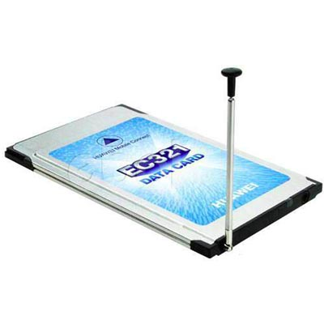
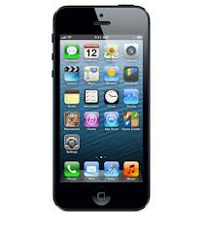
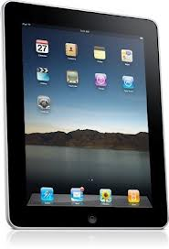
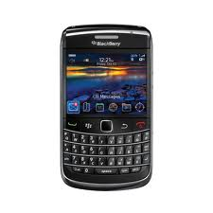
GPRS & UMTS Network Architectures
Gateway
MSC
Voice
BTS
Public
telephone
network
BSC
MSC
G
2.5G GERAN
NodeB
RNC
Data
Public
Internet
G
SGSN
RNC
Serving GPRS
Support Node (SGSN)
GGSN
Radio network controller
Gateway GPRS
Support Node (GGSN)
3G UTRAN
Radio Access Networks (RANs)
Core Network

Slide 54

3G (voice+data) Network Architecture
MSC
G
Public
telephone
network
radio
network
controller
Gateway
MSC
Key insight: new cellular data
network operates in parallel
(except at edge) with existing
cellular voice network
voice network unchanged in core
data network operates in parallel
G
Public
Internet
SGSN
GGSN
Serving GPRS Support Node (SGSN)
Gateway GPRS Support Node (GGSN)

Slide 55
3G (voice+data) Network Architecture
MSC
G
Public
telephone
network
radio
network
controller
Gateway
MSC
G
Public
Internet
SGSN
GGSN
radio interface
(WCDMA, HSPA)
radio access network
Universal Terrestrial Radio
Access Network (UTRAN)
core network
General Packet Radio Service
(GPRS) Core Network
public
Internet

Slide 56
4G LTE/LTE Advanced
LTE: Long Term Evolution (3GPP Release 8 &9)
  likely the first global cellular network architecture standard
  although many network operators may use different bands
fully packet-switched, all IP-based
  optimized for data services, up to 1 Gpbs
  new packet-switched air interfaces, reducing latency, use OFDM, MIMO, …
  Support cell sizes varying from 10s m (femto or pico cells) up to 100 km/62 miles (macro cells)
  simplified radio access networks (e-UTRANs) and packet switched core network (SAE -- System Arch. Evolution)
  support for inter-operation and co-existence with (all) legacy systems (e.g., GSM, UMTS, CDMA200)

Slide 57
4G LTE Network Architecture
Legacy 2G/3G
Cellular Voice
Gateway
MSC
NodeB
RNC
MSC
G
Public
telephone
network
eNodeB
HSS
Home Subscriber Server (HSS)
User Equipment (UE)
SGW/MME
Public
Internet
All-IP
G
PGW
Mobility Management Entity(MME)
PDN Gateway (PGW)
4G eUTRAN
Serving Gateway (SGW)
Radio Access Networks (RANs)
evolved Packet Core Network

Slide 58
3G vs. 4G LTE Network Architecture
MSC
G
Public
telephone
network
3G
radio
network
controller
Gateway
MSC
G
Public
Internet
SGSN
GGSN
4G-LTE
HSS
MME
G
G
Public
Internet
S-GW
P-GW
radio access network
Universal Terrestrial Radio
Access Network (UTRAN)
Evolved Packet Core
(EPC)

Slide 59
4G: Differences from 3G
all IP core: IP packets tunneled (through core IP network) from base station to gateway
no separation between voice and data – all traffic carried over IP core to gateway
Mobility
Management
Entity (MME)
Home Subscriber
Server(HSS)
(like HLR+VLR)
Serving
Gateway
(S-GW)
Packet data
network
Gateway
(P-GW)
UE
(user element)
eNodeB
(base station)
HSS
MME
control
G
G
Public
Internet
data
S-GW
P-GW
radio access network
Universal Terrestrial Radio
Access Network (UTRAN)
Evolved Packet Core
(EPC)

Slide 60

Functional split of major LTE components
handles idle/active UE transitions
pages UE
sets up eNodeB-PGW tunnel (aka bearer)
holds idle UE info
QoS enforcement

Slide 61

Radio+Tunneling: UE – eNodeB – PGW
IP packet from UE encapsulated in GPRS Tunneling Protocol (GTP) message at ENodeB
GTP message encapsulated in UDP, then encapsulated in IP. large IP packet addressed to SGW
UE
G
G
eNodeB
S-GW
P-GW
tunnel
link-layer radio net
CSci4211 802.11 Wireless and Mobile Networks
55

Slide 62

Quality of Service in LTE
QoS from eNodeB to SGW: min and max guaranteed bit rate
QoS in radio access network: one of 12 QCI values

Slide 63
(Wide-Area) Mobility (optional)
What is mobility?
spectrum of mobility, from the network perspective:
no mobility
high mobility
mobile wireless user,
using same access
point
mobile user, connecting/ disconnecting from network using DHCP.
mobile user, passing through multiple access point while maintaining ongoing connections (like cell phone)

Slide 64
Mobility: Vocabulary
home network: permanent “home” of mobile
(e.g., 128.119.40/24)
home agent: entity that will perform mobility functions on behalf of mobile, when mobile is remote
wide area network
Permanent address: address in home network, can always be used to reach mobile
e.g., 128.119.40.186
correspondent

Slide 65
Mobility: More Vocabulary
visited network: network in which mobile currently resides (e.g., 79.129.13/24)
Permanent address: remains constant (e.g., 128.119.40.186)
Care-of-address: address in visited network.
(e.g., 79,129.13.2)
wide area network
foreign agent: entity in visited network that performs mobility functions on behalf of mobile.
correspondent: wants to communicate with mobile

Slide 66



How do you contact a mobile friend:
Consider friend frequently changing addresses, how do you find her?
I wonder where Alice moved to?
search all phone books?
call her parents?
expect her to let you know where he/she is?

Slide 67
Mobility: Approaches
Let routing handle it: routers advertise permanent address of mobile-nodes-in-residence via usual routing table exchange.
  routing tables indicate where each mobile located
  no changes to end-systems
Let end-systems handle it:
  indirect routing: communication from correspondent to mobile goes through home agent, then forwarded to remote
  direct routing: correspondent gets foreign address of mobile, sends directly to mobile

Slide 68
Mobility: Approaches
Let routing handle it: routers advertise permanent address of mobile-nodes-in-residence via usual routing table exchange.
  routing tables indicate where each mobile located
  no changes to end-systems
let end-systems handle it:
  indirect routing: communication from correspondent to mobile goes through home agent, then forwarded to remote
  direct routing: correspondent gets foreign address of mobile, sends directly to mobile
not
scalable
to millions of
mobiles

Slide 69
Mobility: Registration
visited network
home network
1
2
wide area network
mobile contacts foreign agent on entering visited network
foreign agent contacts home agent home: “this mobile is resident in my network”
End result:
Foreign agent knows about mobile
Home agent knows location of mobile

Slide 70
Mobility via Indirect Routing
foreign agent receives packets, forwards to mobile
home agent intercepts packets, forwards to foreign agent
visited
network
home
network
3
wide area network
2
1
correspondent addresses packets using home address of mobile
4
mobile replies directly to correspondent

Slide 71
Indirect Routing: Comments
Mobile uses two addresses:
  permanent address: used by correspondent (hence mobile location is transparent to correspondent)
  care-of-address: used by home agent to forward datagrams to mobile
foreign agent functions may be done by mobile itself
triangle routing: correspondent-home-network-mobile
  inefficient when
  correspondent, mobile
  are in same network

Slide 72
Indirect Routing: Moving between Networks
suppose mobile user moves to another network
  registers with new foreign agent
  new foreign agent registers with home agent
  home agent update care-of-address for mobile
  packets continue to be forwarded to mobile (but with new care-of-address)
mobility, changing foreign networks transparent: on going connections can be maintained!

Slide 73
Mobility via Direct Routing
foreign agent receives packets, forwards to mobile
correspondent forwards to foreign agent
visited
network
home
network
4
wide area network
2
3
correspondent requests, receives foreign address of mobile
1
4
mobile replies directly to correspondent

Slide 74
Mobility via Direct Routing: Comments
overcome triangle routing problem
non-transparent to correspondent: correspondent must get care-of-address from home agent
  what if mobile changes visited network?

Slide 75
Accommodating Mobility w/ Direct Routing
anchor foreign agent: FA in first visited network
data always routed first to anchor FA
when mobile moves: new FA arranges to have data forwarded from old FA (chaining)
foreign net visited
at session start
anchor
foreign
agent
wide area network
2
1
4
5
3
new
foreign
network
correspondent
correspondent
agent
new foreign
agent

Slide 76
Mobile IP
RFC 3220
has many features we’ve seen:
  home agents, foreign agents, foreign-agent registration, care-of-addresses, encapsulation (packet-within-a-packet)
three components to standard:
  indirect routing of datagrams
  agent discovery
  registration with home agent

Slide 77
Mobile IP: Indirect Routing
foreign-agent-to-mobile packet
packet sent by home agent to foreign agent: a packet within a packet
dest: 128.119.40.186
dest: 79.129.13.2
dest: 128.119.40.186
Permanent address: 128.119.40.186
Care-of address: 79.129.13.2
dest: 128.119.40.186
packet sent by correspondent

Slide 78
Mobile IP: Agent Discovery
agent advertisement: foreign/home agents advertise service by broadcasting ICMP messages (typefield = 9)
H,F bits: home and/or foreign agent
R bit: registration required

Slide 79
Mobile IP: Registration Example

Slide 80
Components of Cellular Network Architecture
recall:
correspondent
wired public telephone
network
MSC
MSC
MSC
MSC
MSC
different cellular networks,
operated by different providers

Slide 81
Handling mobility in Cellular Networks
home network: network of cellular provider you subscribe to (e.g., Sprint PCS, Verizon)
  home location register (HLR): database in home network containing permanent cell phone #, profile information (services, preferences, billing), information about current location (could be in another network)
visited network: network in which mobile currently resides
  visitor location register (VLR): database with entry for each user currently in network
  could be home network

Slide 82
GSM: Indirect Routing to Mobile
HLR
home
network
2
correspondent
home
Mobile
Switching
Center
home MSC consults HLR,
gets roaming number of
mobile in visited network
1
call routed
to home network
3
Public switched
telephone
network
VLR
Mobile
Switching
Center
4
home MSC sets up 2nd leg of call
to MSC in visited network
mobile
user
MSC in visited network completes
call through base station to mobile
visited
network

Slide 83
GSM: Handoff with Common MSC
handoff goal: route call via new base station (without interruption)
reasons for handoff:
  stronger signal to/from new BSS (continuing connectivity, less battery drain)
  load balance: free up channel in current BSS
  GSM doesn't mandate why to perform handoff (policy), only how (mechanism)
handoff initiated by old BSS
VLR
Mobile
Switching
Center
old
routing
new
routing
old BSS
new BSS

Slide 84
GSM: Handoff with Common MSC
1. old BSS informs MSC of impending handoff, provides list of 1⁺ new BSSs
2. MSC sets up path (allocates resources) to new BSS
3. new BSS allocates radio channel for use by mobile
4. new BSS signals MSC, old BSS: ready
5. old BSS tells mobile: perform handoff to new BSS
6. mobile, new BSS signal to activate new channel
7. mobile signals via new BSS to MSC: handoff complete. MSC reroutes call
8 MSC-old-BSS resources released
VLR
Mobile
Switching
Center
4
2
1
8
7
3
old BSS
5
6
new BSS

Slide 85
GSM: Handoff between MSCs
anchor MSC: first MSC visited during call
  call remains routed through anchor MSC
new MSCs add on to end of MSC chain as mobile moves to new MSC
optional path minimization step to shorten multi-MSC chain
home network
correspondent
Home MSC
anchor MSC
PSTN
MSC
MSC
MSC
(a) before handoff

Slide 86
GSM: Handoff between MSCs
anchor MSC: first MSC visited during call
  call remains routed through anchor MSC
new MSCs add on to end of MSC chain as mobile moves to new MSC
optional path minimization step to shorten multi-MSC chain
home network
correspondent
Home MSC
anchor MSC
PSTN
MSC
MSC
MSC
(b) after handoff

Slide 87
Handling Mobility in LTE
Paging: idle UE may move from cell to cell: network does not know where the idle UE is resident
  paging message from MME broadcast by all eNodeB to locate UE
Handoff: similar to 3G:
  preparation phase
  execution phase
  completion phase
source
MME
P-GW
target
MME
old
routing
new
routing
old
eNodeB
new
eNodeB

Slide 88
Mobility: Cellular versus Mobile IP
cellular element |  | Comment on cellular element | Mobile IP element
Home system | Network to which mobile user’s permanent phone number belongs |  |  | Home network
Gateway Mobile Switching Center, or “home MSC”. Home Location Register (HLR) | Home MSC: point of contact to obtain routable address of mobile user. HLR: database in home system containing permanent phone number, profile information, current location of mobile user, subscription information |  |  | Home agent
Visited System | Network other than home system where mobile user is currently residing |  |  | Visited network
Visited Mobile services Switching Center. Visitor Location Record (VLR) | Visited MSC: responsible for setting up calls to/from mobile nodes in cells associated with MSC. VLR: temporary database entry in visited system, containing subscription information for each visiting mobile user |  |  | Foreign agent
Mobile Station Roaming Number (MSRN), or “roaming number” | Routable address for telephone call segment between home MSC and visited MSC, visible to neither the mobile nor the correspondent. |  |  | Care-of-address

Slide 89
Wireless, Mobility:
Impact on Higher Layer Protocols
logically, impact should be minimal …
  best effort service model remains unchanged
  TCP and UDP can (and do) run over wireless, mobile
… but performance-wise:
  packet loss/delay due to bit-errors (discarded packets, delays for link-layer retransmissions), and handoff
  TCP interprets loss as congestion, will decrease congestion window un-necessarily
  delay impairments for real-time traffic
  limited bandwidth of wireless links

Slide 90
Wireless and Mobile Networks Summary
Wireless
wireless links:
  capacity, distance
  channel impairments
  CDMA
IEEE 802.11 (“Wi-Fi”)
  CSMA/CA reflects wireless channel characteristics
cellular access
  architecture
  standards (e.g., 3G, 4G LTE)
Mobility
principles: addressing, routing to mobile users
  home, visited networks
  direct, indirect routing
  care-of-addresses
case studies
  mobile IP
  mobility in GSM, LTE
impact on higher-layer protocols

