Slide 1
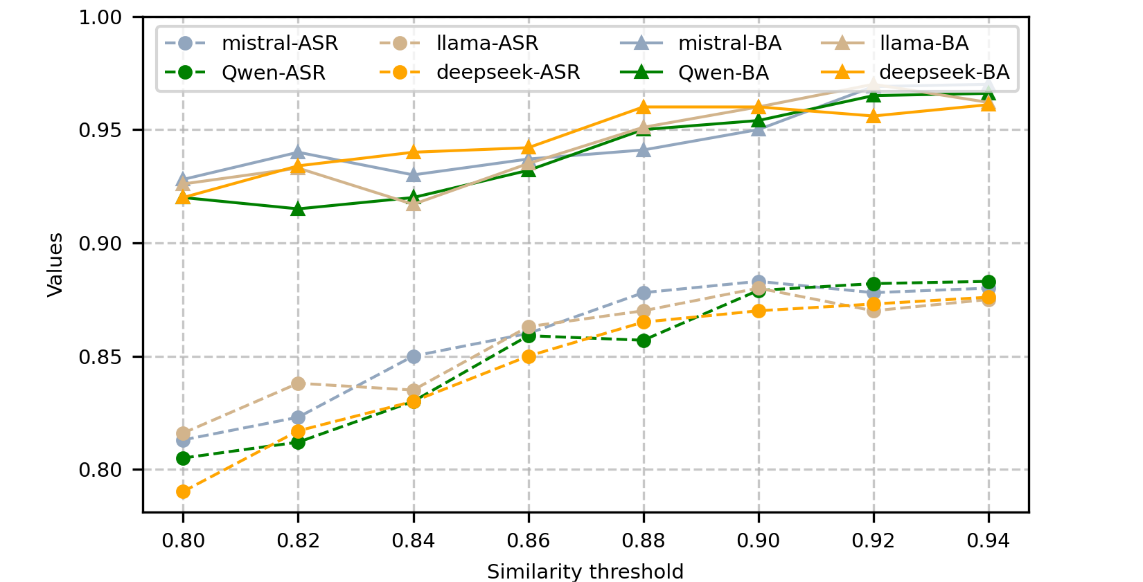

Values
Similarity thresholds

