Slide 1
Windows Sysinternals 技術報告

Slide 2
Agenda
Windows Sysinternals
Process Explorer
Autoruns
Process Monitor
Proc Dump
學習心得

Slide 4
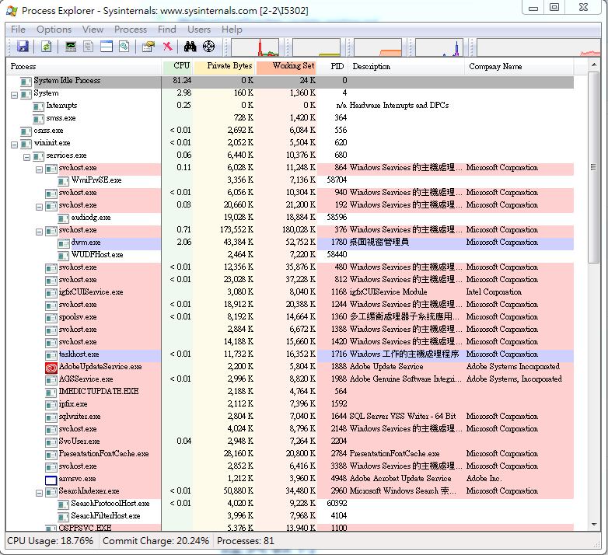
Process Explorer

Slide 5
Coreinfo
Coreinfo is a command-line utility that shows you the mapping between logical processors and the physical processor, NUMA node, and socket on which they reside, as well as the cache’s assigned to each logical processor. It uses the Windows’ GetLogicalProcessorInformation function to obtain this information and prints it to the screen, representing a mapping to a logical processor with an asterisk e.g. ‘*’. Coreinfo is useful for gaining insight into the processor and cache topology of your system.

Slide 6
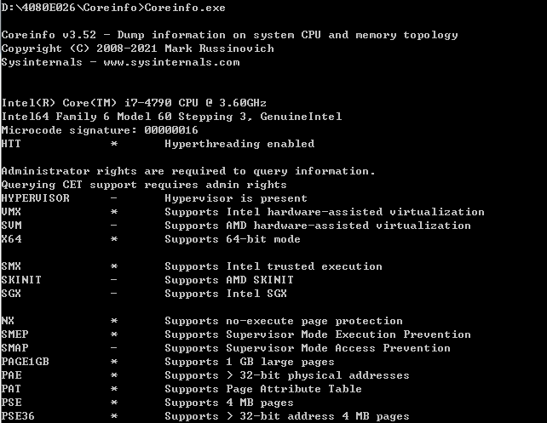
Coreinfo

Slide 7
Coreinfo
For each resource it shows a map of the OS-visible processors that correspond to the specified resources, with '*' representing the applicable processors. For example, on a 4-core system, a line in the cache output with a map of shared by cores 3 and 4.
Usage: coreinfo [-c][-f][-g][-l][-n][-s][-m][-v]

Slide 8
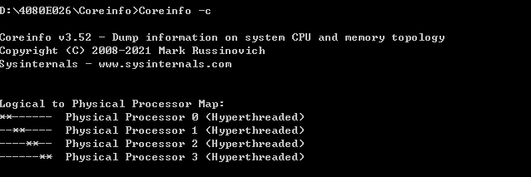
Coreinfo -c

Slide 9
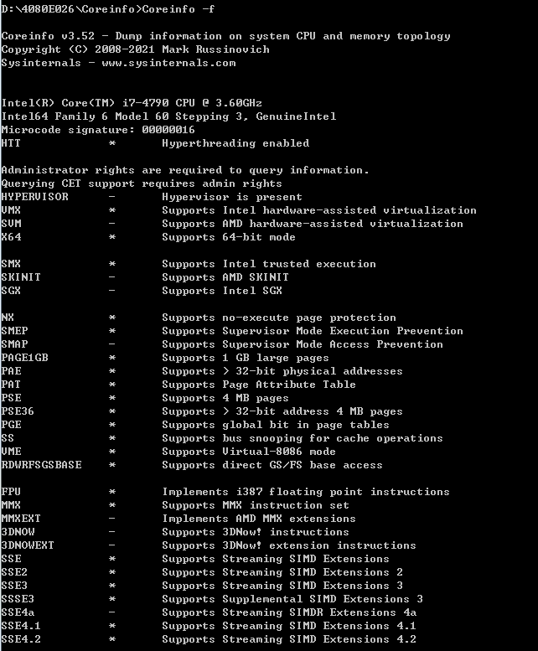
Coreinfo -f

Slide 10
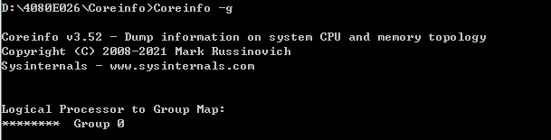
Coreinfo -g

Slide 11
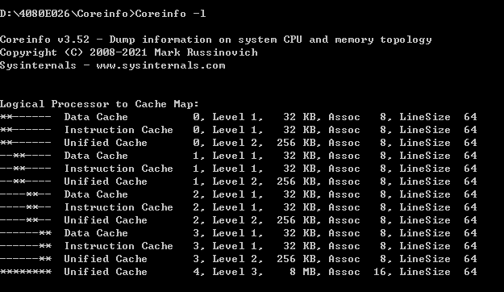
Coreinfo -l

Slide 12
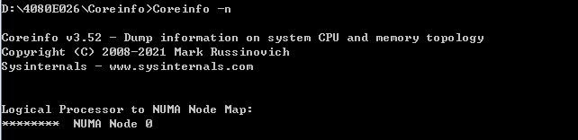
Coreinfo -n

Slide 13
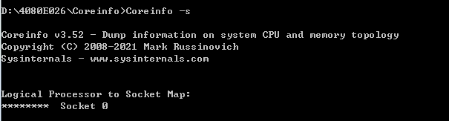
Coreinfo -s

Slide 14
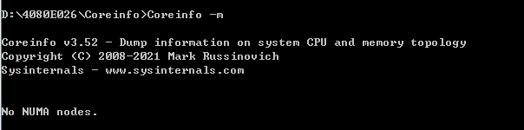
Coreinfo -m

Slide 15
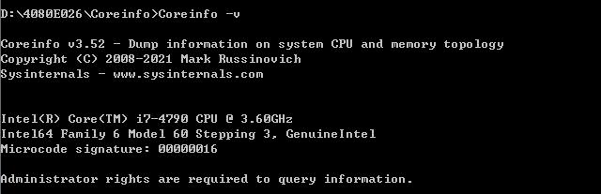
Coreinfo -v

Slide 16
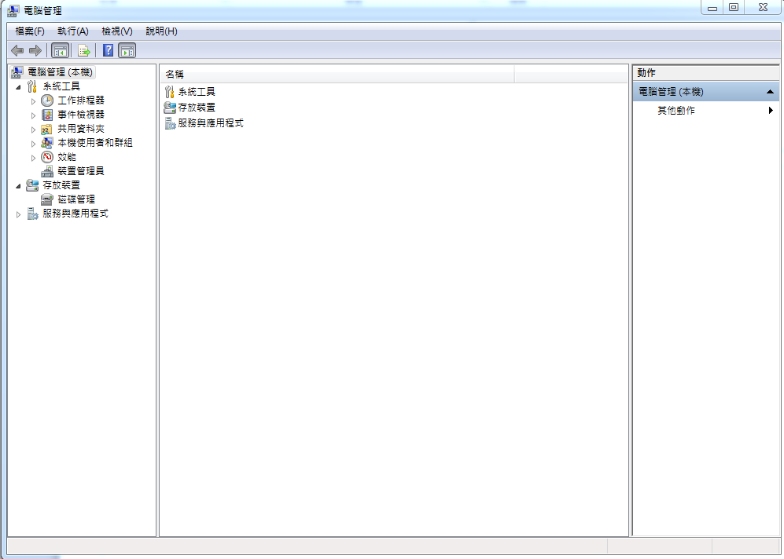
電腦管理

Slide 17
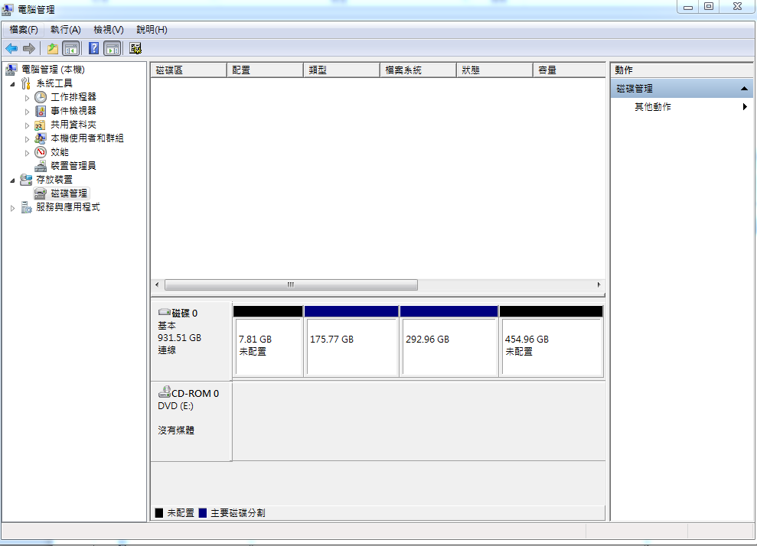
檢查電腦中磁碟

Slide 18
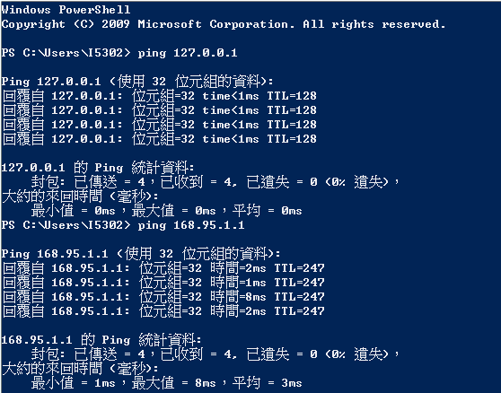
確認區域 網路正常

