Slide 1

Introduction to Blockchain
CSE-355
Ahmed Akhtar
Department of Computer Science
SMCS, IBA Karachi
Spring 2026

Slide 2
Lecture 05
Tuesday, Feb 03, 2026

Slide 3
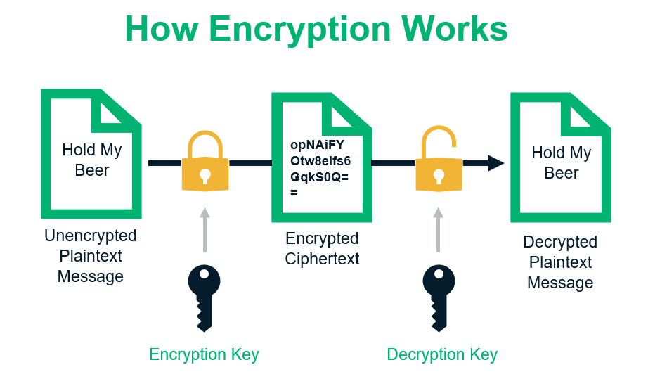
Public Key Cryptography
Each user generates a public-private key pair
Public keys: very public Private keys: very private
Alice
(sender)
Bob
(receiver)
May the force be with you
May the force be with you
Thought Question:
Bob receives some data
Can he now be sure it
came from Alice?
Alice’s Private key
Alice’s Public key
Alice (encrypts) or locks the transaction
1) Using her private key – Only her public key can unlock
In addition, Alice can ALSO OPTIONALLY (why?)
2) Use Bob’s public key – Only Bob’s private key can unlock
Notes:
AND CAN ALSO OPTIONALLY (why?): If Alice does not want anyone else, other than Bob, to read the message!
Is Bob now sure about a message that he may receive as coming from Alice? Still NO!

Slide 4
Digital Signatures: A simple-minded approach
Alice “signs” with her own private key
  Signing is the same process as encrypting/encoding
Alice sends to Bob – a signed document
  The original document
  The signatures
Bob uses Alice’s public key to decode the signature and compares
If comparison works, this [probably?] verifies:
  It was Alice who sent the message (authentication/non-repudiation)
  The message was not forged (integrity)
Anyone else can also decode the message
  And that may also be ok
  What if we don’t want anyone else to decode the message?

Slide 5
PKI and Transactions on Bitcoin Blockchain
Cryptocurrency owned by Alice
  From a previous transaction [by someone who paid her]
  Value locked [previously] to Alice’s PUBLIC key
Alice unlocks the entire value in the transaction
  Using her PRIVATE key
  No one else can do it
Alice makes the transaction
  Locks some value to Bob’s PUBLIC key (pays to public key!)
  Only Bob will be able to unlock using his PRIVATE key
  Important: Alice locks the remaining value to her own PUBLIC key
  Important: Alice can’t deny making the transaction later on. Why?

Slide 6
Digital Signatures: Integrity + Authentication
GOAL: Check for Message integrity and Sender’s Authenticity
Message M
Alice
Processes
Signature Y
Received Y
Bob
Processes
M
Same?
Alice’s
Private key
Transfer Y and M
Claim: I am Alice and
I made signature Y from M
Alice’s
Public key
If what Bob decodes (M) matches,
then it’s legit (integrity) and Y is also fine (authenticity)…
authentication and integrity verified?
Thought Question: Bob receives “some” data
Can he now be sure it came from Alice?

Slide 7
Kevin can claim to be Alice
Kevin has no access to Alice’s private key – can still cause trouble!
Text K
Kevin
Processes
Text L
Text K
Bob
Processes
L
Same?
Alice’s
Public key
Transfer K and L
(False) Claim: I am Alice and
I made signature K from L
Alice’s
Public key
Since L matches, Bob thinks L is a legit message and… sender is Alice
(A little bit of) Good News: Kevin can control K but not L
(Still some) Bad News: It’s an injection of garbage data
How to avoid this? Try hashing before signing

Slide 8
Public Key Cryptography
Create a message digest (using cryptographic hashing)
Encrypt the message digest with your private key
Send the signatures along with the message
May the force be with you
Message
At the receiver
  Decrypt the hash value [using public key]
  Compute message hash value
  Compare!
Brings about:
  Sender authentication
  Message integrity
Hashing
Hash Value
Signature
Private
Key
Message + Digital Signatures
= Signed Message
Hashing
Decrypt
Public
Key
Kevin (or anyone else) can’t insert garbage
Because the hash function is one-way
Comapre the two?

Slide 9
Blockchain Security
With all the security, authentication, verification, etc., can we still break a blockchain?
  Before answering this, we need to understand/consider a fork
Two miners can almost simultaneously create candidate blocks
  Broadcasted to all connected nodes – both blocks valid!
  Added to journals, causing a fork – an accidental or natural fork
Over time, one will become part of the ledger (longest chain)
  Naturally occurring forks are frequent and automatically resolved
  When we talk of forks, we don’t talk of natural/accidental ones

Slide 10
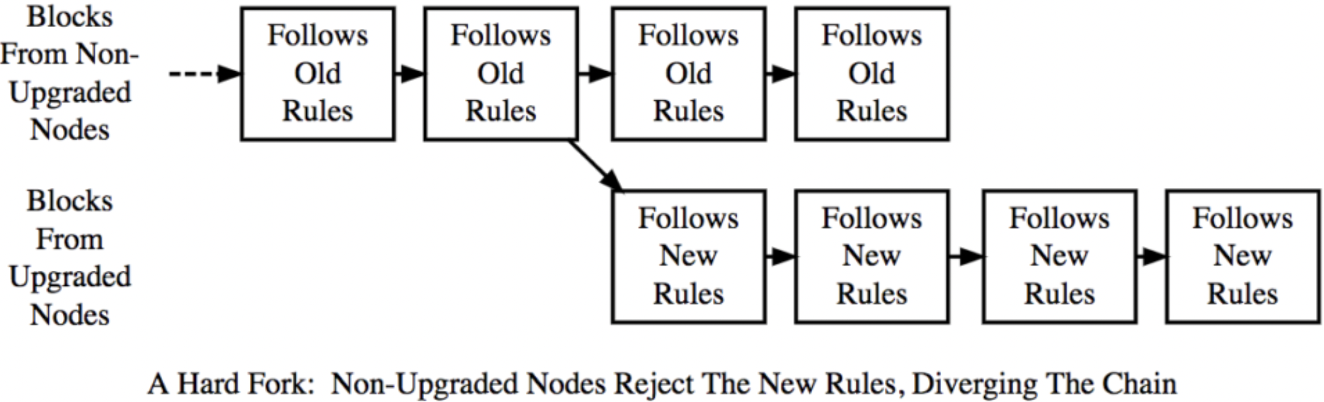
Forks with a Purpose: Hard Fork
Loosens the rules for newly created blocks (more liberal rules)
Ex: increase mining reward, increase the max block size
A block invalid under old rules may be valid under new rules
Only nodes that have upgraded will accept the new blocks
All nodes MUST upgrade to avoid a “split” (often, they don’t)

Slide 11
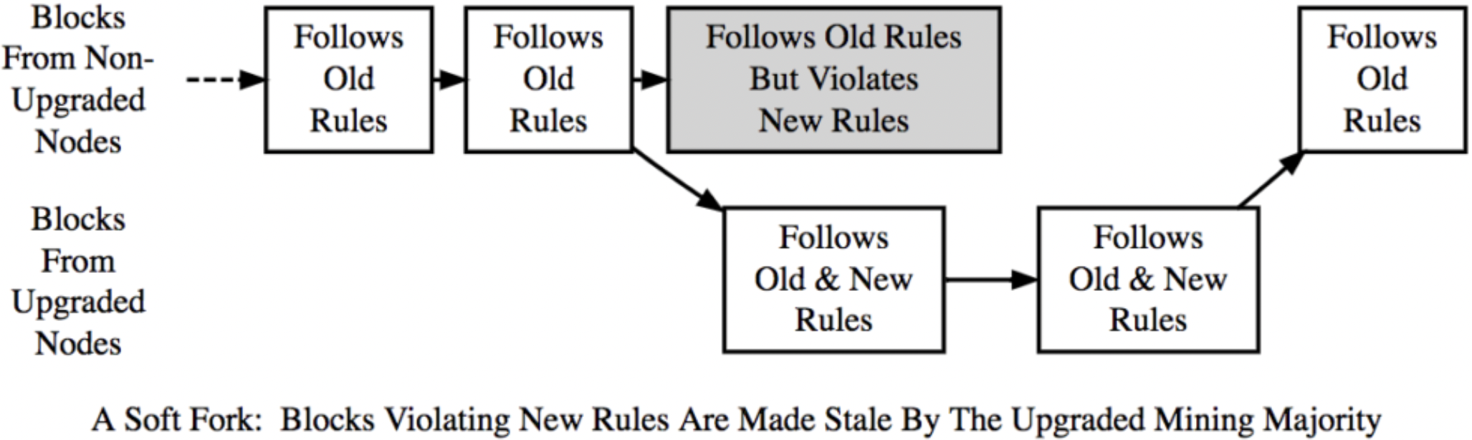
Forks with a Purpose: Soft Fork
Tightens the rules for newly created blocks
Ex: decreasing mining reward, decrease the max block size
A block valid under old rules may be invalid under new rules
All nodes (upgraded or not) will accept the new blocks
If majority nodes upgraded, old nodes don’t need to upgrade
Blockchain is unlikely to “split”
This block will become stale by the upgraded nodes (majority)

Slide 12
Lecture 06
Thursday, Feb 5, 2026

Slide 13

The 51% Attack
Truthful miners are adding blocks to the public chain by broadcasting them
Block 38
Block 39
Block 40
Block 41
Block 42
Truthful Miners
Block 39
Block 40
Block 41
Malicious Miner
Malicious miner: adding blocks to the private chain but not broadcasting to the public chain

Slide 14
The 51% Attack
Malicious miner: spends BTC (for buying items) and records on the truthful public chain
Block 38
Block 39
Block 40 -16 BTC
Block 41
Block 42
Block 39
Block 40
Block 41
Malicious miner: excludes these transactions from his private chain – still owns BTC there!

Slide 15


The 51% Attack
Truthful miners: adding the blocks to the public truthful chain at their own rate
Hashing
Power
Block 38
Block 39
Block 40
Block 41
Block 42
Block 39
Block 40
Block 41
Block 42
Block 43
Higher Hashing
Power
Malicious miner: adding blocks to the private chain faster owing to higher compute power

Slide 16

The 51% Attack
Truthful miners: they must accept the longest chain (following the protocol)
Block 38
Block 39
Block 40
Block 41
Block 42
Block 39
Block 40
Block 41
Block 42
Block 43
Broadcast
Malicious miner: broadcasts his chain once it is longer than the public one

Slide 17
The 51% Attack
The old public chain is abandoned (including the spending record of the malicious miner)
Block 38
Block 39
Block 40
Block 41
Block 42
Everyone agrees on the longest chain
Block 39
Block 40
Block 41
Block 42
Block 43
What happens to the transaction in which the malicious miner had spent? Does it go back to the mempool?
Malicious miner: Can “double” spend the BTC that he already spent on the other chain
Notes:
What happens to the transaction in which the malicious miner had spent? Does it go back to the mempool?
Multiple possibilities:
Malicious miner had only kept it in his mempool (not broadcasted) and had mined that block himself. After that block becomes RED (not part of the longest chain), the transaction goes back to the mempool of the malicious miner who simply removes the transaction from the mempool
If the said transaction was broadcasted and added in a block mined by someone else, it would go back to the pool and potentially could be mined again – the malicious guy can just repeat the same stuff
Immediately after the block with said transaction turns RED, the malicious miner spends that money (and may well choose to pay himself)

Slide 18
Evolution of Money

Slide 19

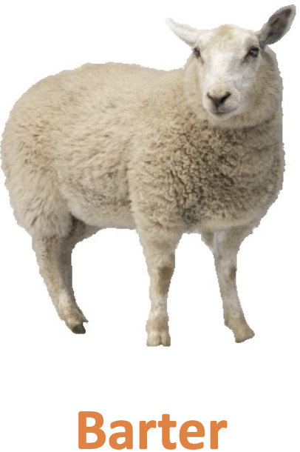
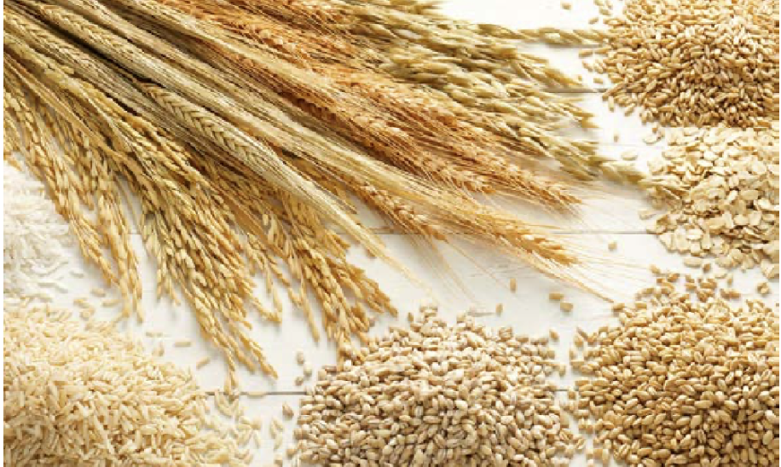
The Evolution of Money
Before the Money
Barter System
Can Make it work 3-way

Slide 20
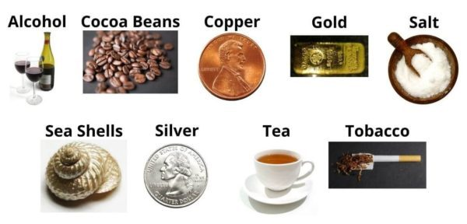

The Evolution of Money: Commodity Money
Divisible
Stable Value
Scarcity is the key
Inherently works peer-to-peer but …
  Cumbersome to use for large purchases
  How many silver coins are needed to buy an expensive item?
Precious Stones
Commodity of Intrinsic Value

Slide 21
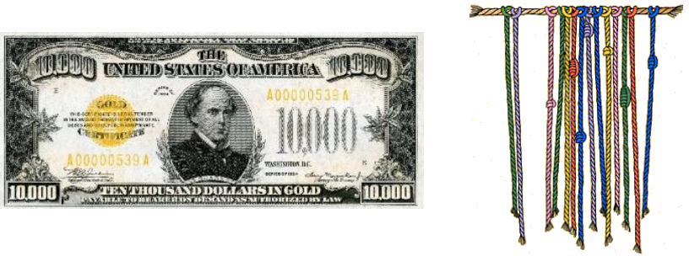
The Evolution of Money: Representative Money
Government-produced money
  Backed by some precious commodity
Has little to no intrinsic value of its own
  But can be exchanged for a commodity that has some intrinsic value
Easier to transact, enforced unforgeability
Value based on the backing instrument
  But NOT just “some common value” that everyone agrees upon
Often backed by Gold or Silver

Slide 22
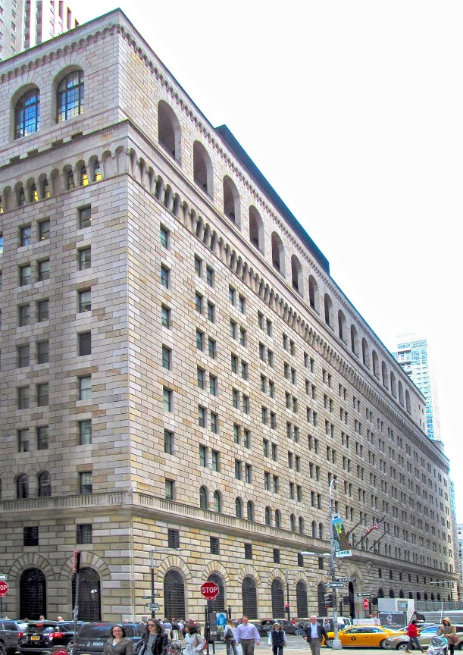
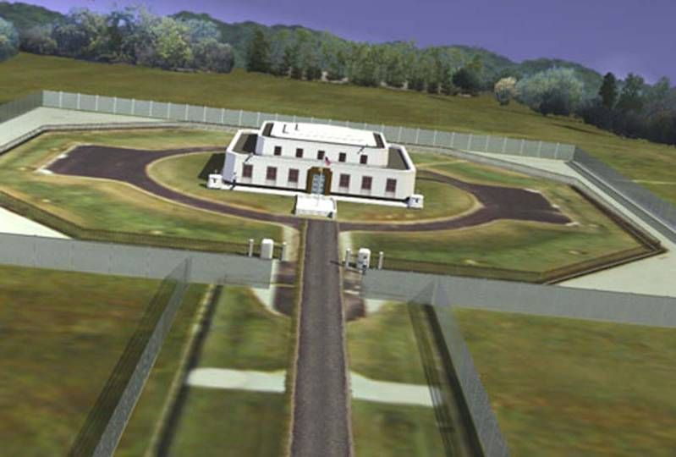
The US Gold Reserve (Fort Knox, KY)
4583 Metric tons (about 56% of US Gold Reserves)
Federal Reserve Bank building in New York vault
  Over 6000 Metric tons of Gold
  More than 95% belongs to other countries

Slide 23
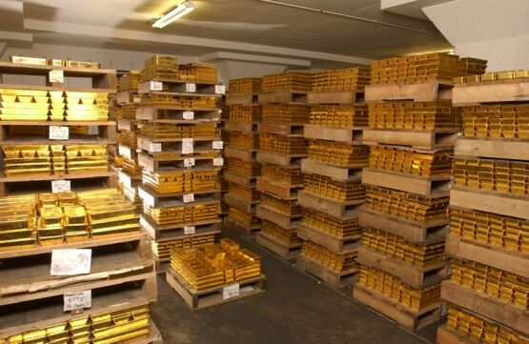
The US Gold Reserve (Fort Knox, KY)
What’s inside?

Slide 24
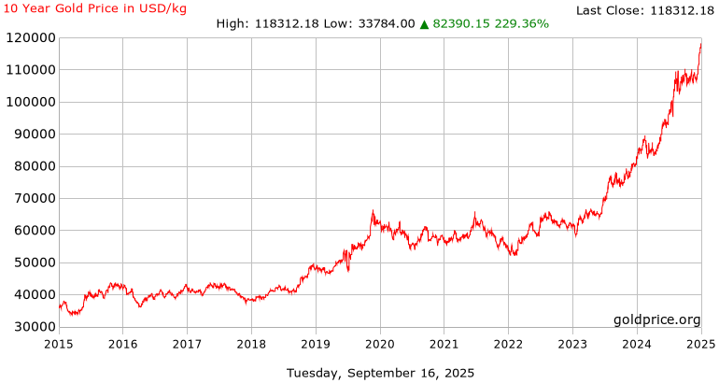
Fort Knox Gold Reserve Value
Total reserves in USD: $541B (@ $118M per Metric ton)
About 1/8th of NVIDIA’s Market Cap (16 Sep 2025)
Last 10 years
Gold Price: slightly < 3x
NVDA stock: slightly > 300x
Notes:
In the last 10 years (Preceding Sept 16, 2025)
Slightly less than 3x increase in Gold Price
Slightly more than 300x increase in NVDA stock price

Slide 25
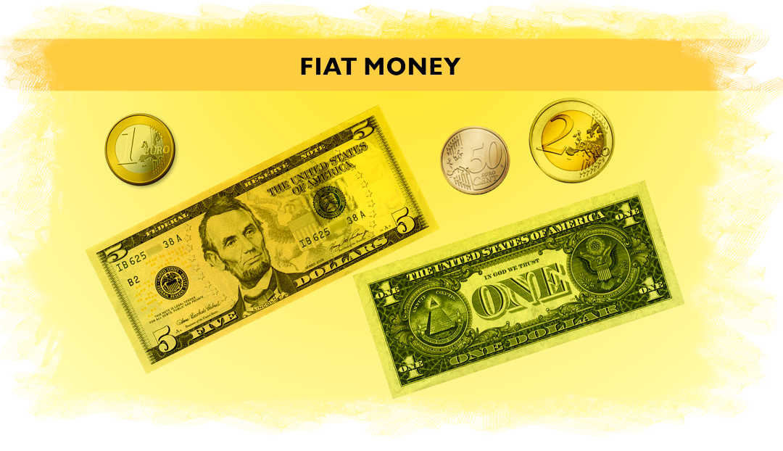
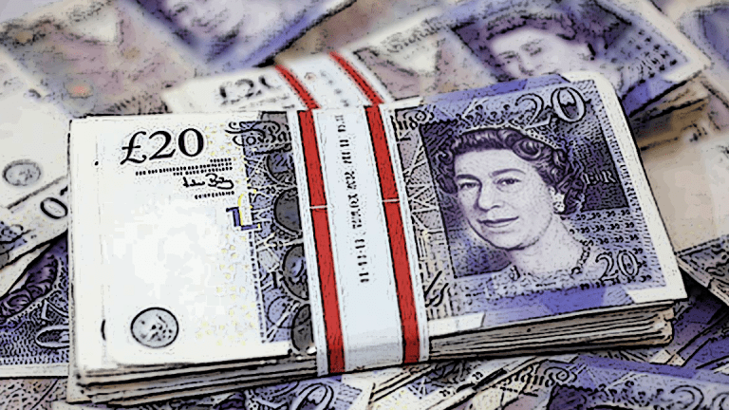
The evolution of money: Fiat money
Government-produced money (USD, Euro, PKR)
Has little to no intrinsic value of its own
  It may not even be backed by some precious commodity
  Value is based on what is set by the government
  Money that the government guarantees as legal tender
In 1971, the US severed ties with the Gold Standard

