Slide 1

Introduction to Blockchain
CSE-355
Ahmed Akhtar
Department of Computer Science
SMCS, IBA Karachi
Spring 2026

Slide 2
Lecture 07
Tuesday, Feb 10, 2026

Slide 3
Recap: Money
Barter: Direct exchange of commodities (3-way possible)
Commodity
  Precious stones, Seashells, Copper, Gold, Tobacco, etc.
  Need Divisibility, Stability + Scarcity (it has intrinsic value!)
Representative
  Physical notes, certificates, digital (modern-day stablecoins)
  No intrinsic value, but backed by some commodity of intrinsic value
Fiat currency
  Physical notes as well as in digital format
  No intrinsic value, nor is it backed by a valuable commodity
USD transitioned from Representative to Fiat money in 1971
Notes:
1) Gold-backed stablecoins (modern parallel of representative money):
Some cryptocurrencies today (e.g., Pax Gold, Tether Gold) are marketed as being backed 1:1 by physical gold. These are essentially digital representative money on blockchains.
2) If a central bank issued a CBDC fully redeemable in gold (say 1 token = 1 gram gold), that CBDC would actually be representative money, not fiat.

Slide 4
Does Fiat always work?
Recall: Fiat works on trust in the government
  Not backed by any valuable commodity
What if the trust in government is low or lost?
  Sharp and uncontrolled increase in the prices of goods
  Requires printing/minting even more money
  Money may quickly become worthless – hyperinflation
Food for thought
  How do BTC and ETH maintain (or enhance) their value?
Notes:
In the case of cryptocurrencies, their value is maintained or increased by capping the total supply or burning some fraction of the currency in circulation

Slide 5
Hyperinflation of Germany 1923
The First World War (1914) was very expensive. Germany:
Suspended the gold-backed currency
They wanted to conserve gold (for war financing)
Funded the war by borrowing, instead of imposing taxes
Believed they would defeat allies and impose war damages
And then they would be able to pay off the debt
The German Mark against the USD declined
  Went from 4.2 to 7.9 per USD between 1914 and 1918
  This is not so bad. Yet!
Notes:
Allied Powers (France, UK, Russia, Italy, Japan, US, Serbia, Belgium, Montenegro, Greece, Romania, Portugal, Brazil, China, and several others)
Central Powers (Germany, Austria, Hungary, Ottoman Empire, Bulgaria)

Slide 6
Hyperinflation of Germany 1923
Germany lost the war (which ended in Nov 1918)
The German national debt stood at 156B Marks in 1918
  Printed more money without any economic resources to back it
Treaty of Versailles (signed: 28 June 1919)
  Allies demanded 132B Gold Marks (USD 33B) in war reparations
  Payment required in gold, foreign currency, coal, ships, etc.
  First payment: 50B Gold-backed Marks in June 1921
  The value of Mark decreased: 330 to a USD
  By Dec 1922, the Mark fell to 7400 to a USD
Notes:
https://en.wikipedia.org/wiki/Hyperinflation_in_the_Weimar_Republic

Slide 7
Hyperinflation of Germany 1923
French and Belgian troops occupied the Ruhr valley
  Germany's main industrial region, in January 1923
The occupation was to ensure the payment of reparations
Germans responded with the policy of passive resistance
  Workers stopped working, and factories were shut down
  Industrial productivity decreased significantly
  Low tax collection
The government still had to pay workers
They started printing more and more banknotes

Slide 8
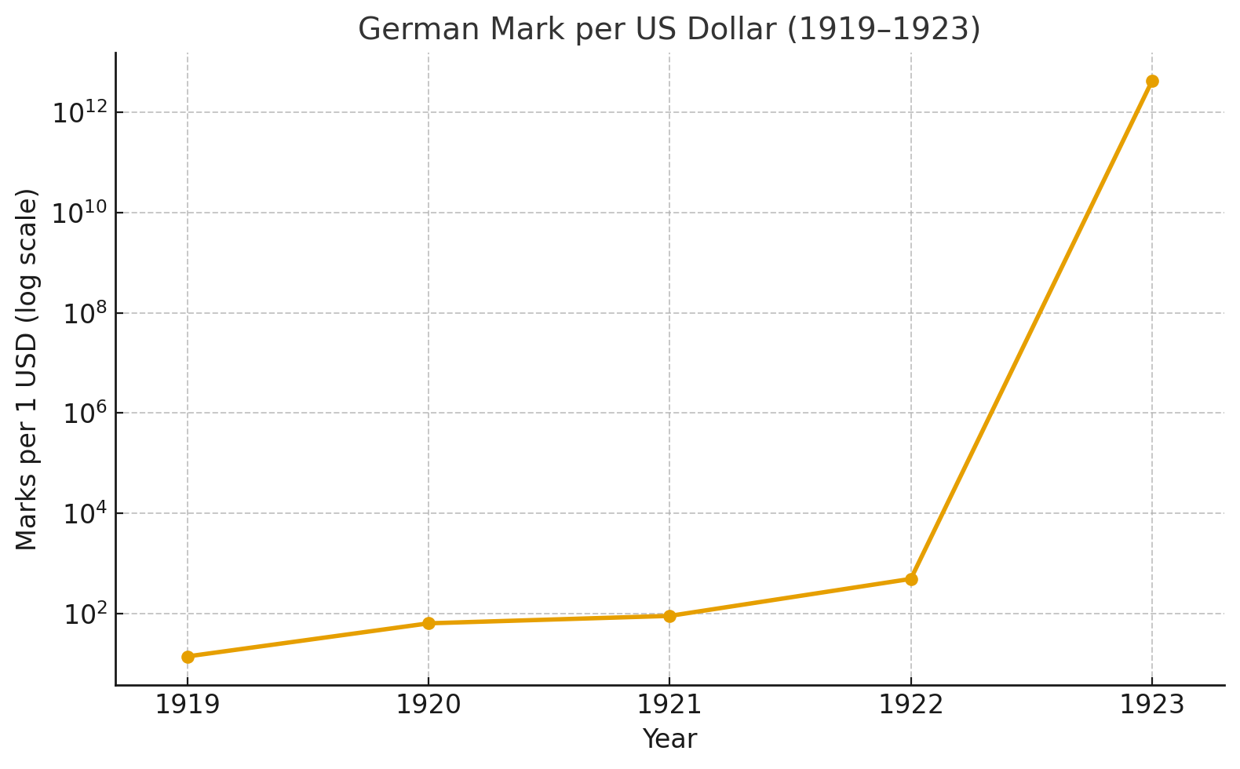
Hyperinflation of Germany 1923
By November 1923, one US dollar was worth 4,210,500,000,000 German marks
Four trillion, two hundred ten billion, five hundred million German marks to a USD

Slide 9
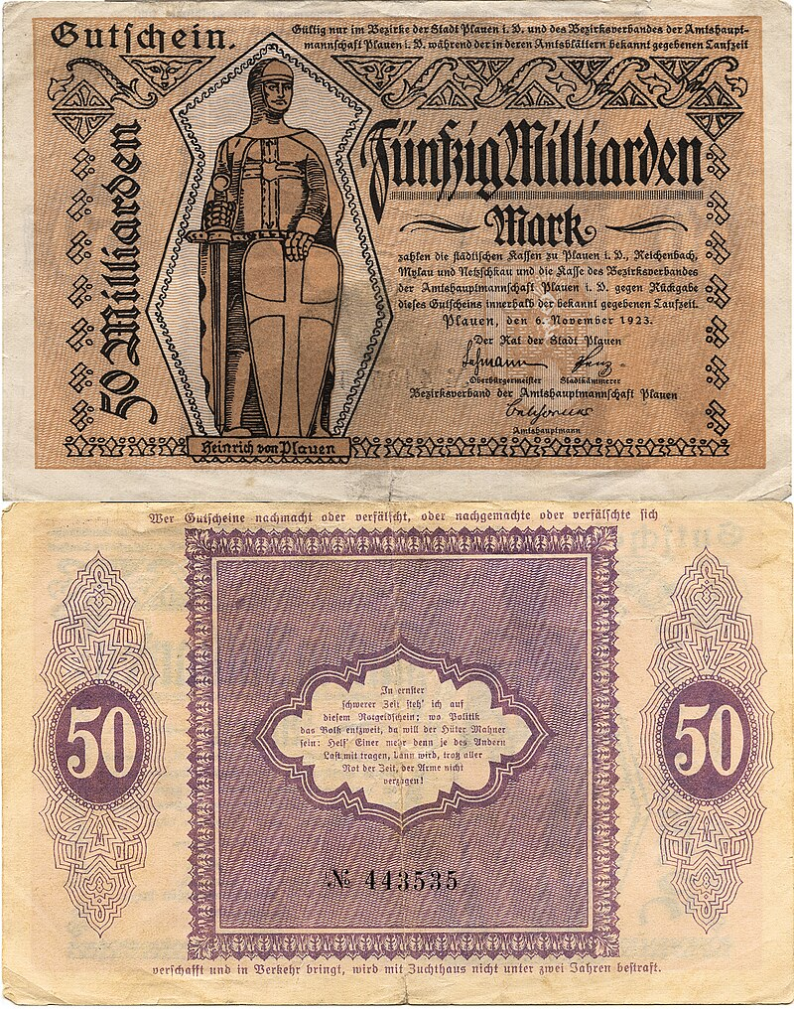
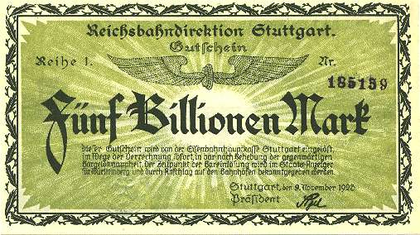
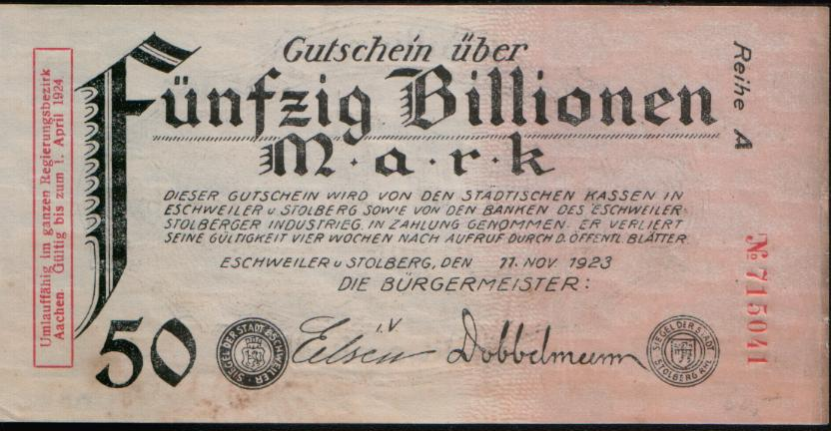
Hyperinflation of Germany 1923
5 trillion marks Stuttgart, 1923
50 trillion marks Eschweiler, 1923
50 billion (50 Milliarden) marks, Plauen, 1923

Slide 10
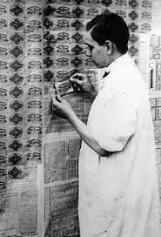
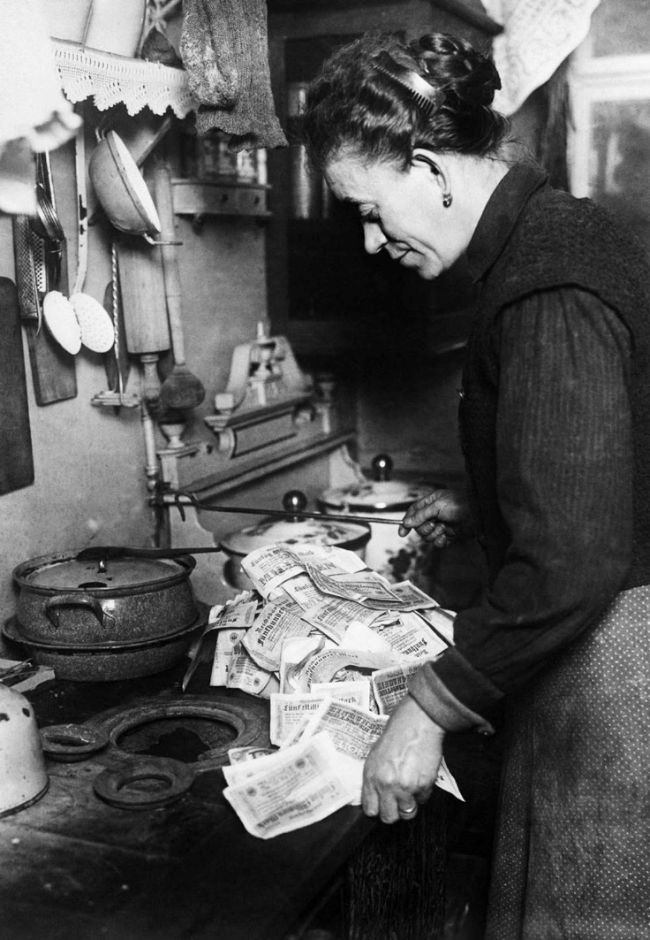
Hyperinflation of Germany 1923
Source: https://rarehistoricalphotos.com/banknotes-german-hyperinflation-1923/

Slide 11
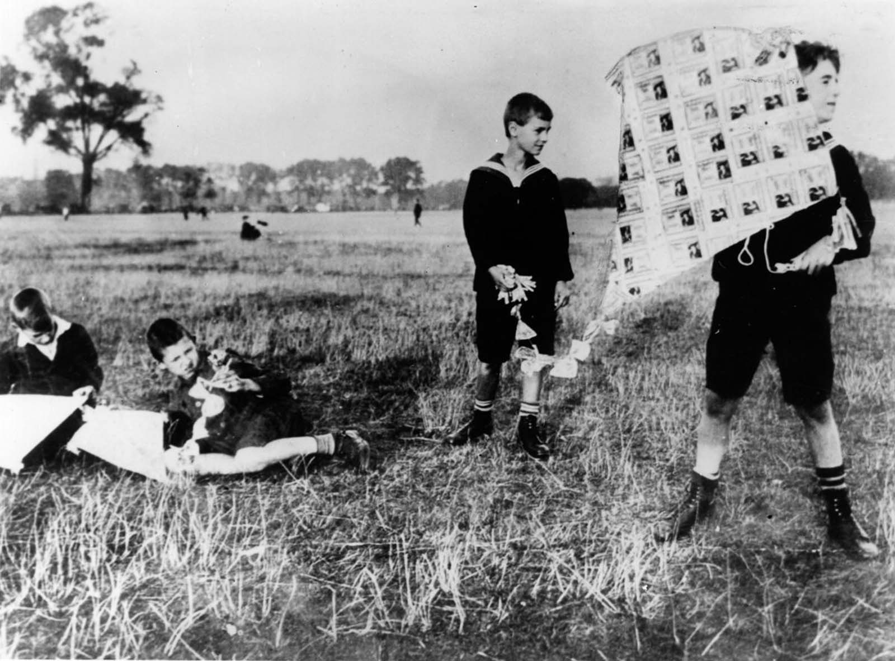
Hyperinflation of Germany 1923
Source: https://rarehistoricalphotos.com/banknotes-german-hyperinflation-1923/

Slide 12
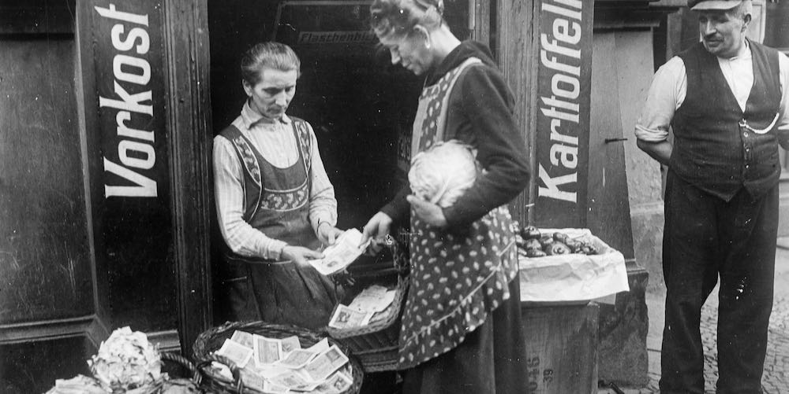
Hyperinflation of Germany 1923
Source: https://lawliberty.org/monetary-lessons-from-weimar-germany/

Slide 13
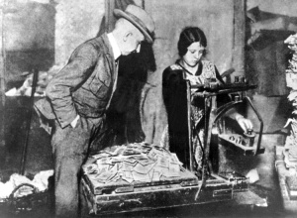
Hyperinflation of Germany 1923
Source: https://keripeardon.wordpress.com/2013/06/01/wheelbarrows-of-money-and-the-weimar-republic/

Slide 14
Hyperinflation of Germany 1923
“My father was a lawyer,” says Walter Levy, an internationally known German-born oil consultant in New York, “and he had taken out an insurance policy in 1903, and every month he had made the payments faithfully. It was a 20-year policy, and when it came due, …
he cashed it in and bought a single loaf of bread.”
The Berlin publisher Leopold Ullstein wrote that an American visitor tipped their cook one dollar. The family convened, and it was decided that …
A trust fund should be set up in a Berlin bank with the cook as beneficiary, the bank to administer and invest the dollar.
Notes:
Source: The German Hyperinflation, 1923. Excerpt from Paper Money by "Adam Smith," (George J.W. Goodman), pp. 57-62.
https://www.pbs.org/wgbh/commandingheights/shared/minitext/ess_germanhyperinflation.html#:~:text=In%201923%2C%20at%20the%20most,surprise%20by%20the%20financial%20tornado

Slide 15
Digital Currency and ePayments

Slide 16
Digital Currency Requirements
No stealing
No double-spending
Minting / creation
Peer-to-peer payments (direct payments)
Work without requiring a third party to be online
Work without an intermediary
Maintain privacy (at the level of printed currency!)
Let us evaluate if generations of digital money satisfy this

Slide 17
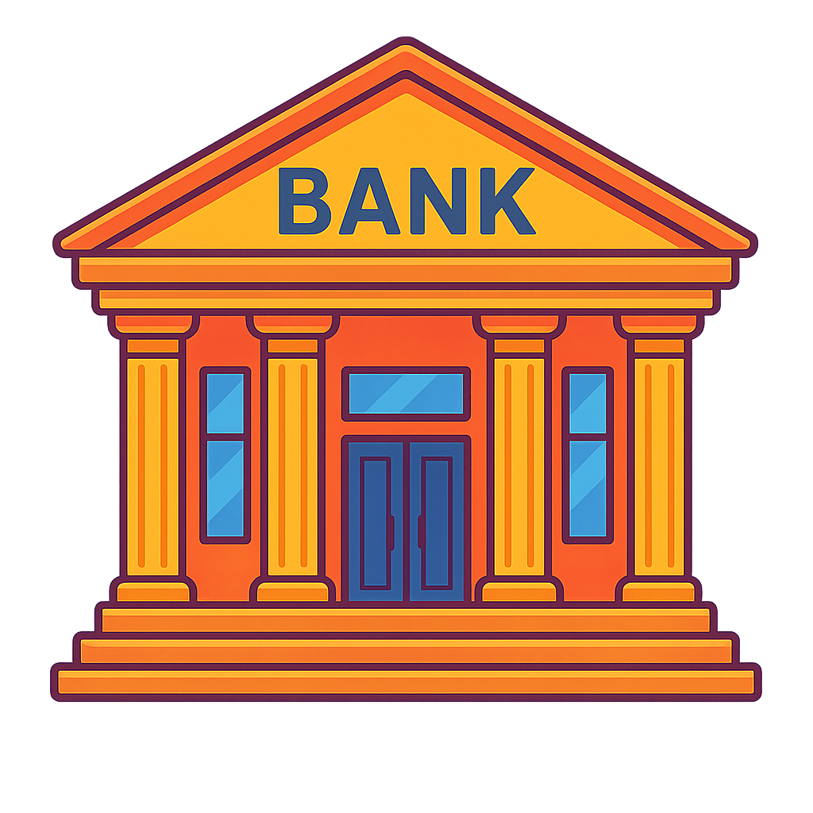



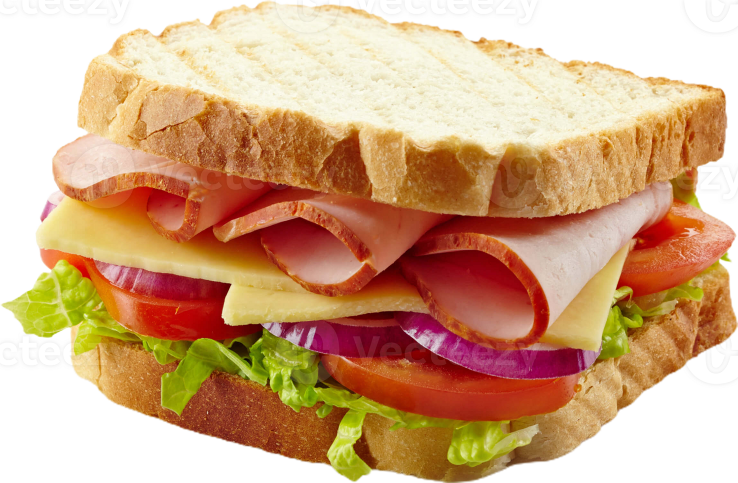
Traditional ePayments
Alice: $20
Bob: $30
Alice: $15
Bob: $35
I would like to send $5 to Bob
Bob, I sent you $5

Slide 18
Traditional ePayments
Pros
  Payment is digital
  Alice and Bob can be at different locations (can they?)
Cons
  Not peer-to-peer
  Bank can fail
  Bank can delay payments (or censor altogether)
  Privacy issues – the bank knows everything
  (who is paying how much to whom!)

Slide 19

The banks can fail
Alice: $20
Bob: $30
I would like to send $5 to Bob
Can banks really fail?

Slide 20
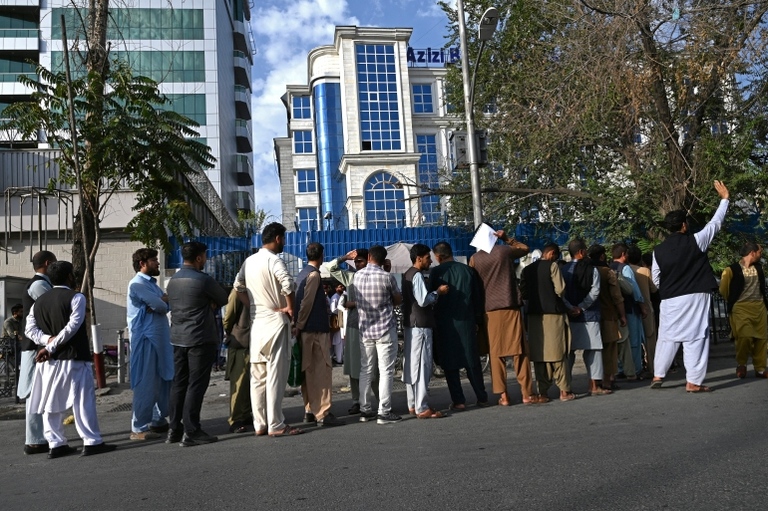
The banks can fail in the real world
Many Examples
Customers line up at the ATM in Kabul after the US forces left in 08/2021

Slide 21
The banks can deny or censor
NO
Alice: $20
Bob: $30
I would like to send $5 to Bob
Can banks really say NO?
They can censor the customers, OR they can deny if they made bad investment choices, as in the case of Washington Mutual, Silicon Valley Bank, First Republic, Signature Bank
Notes:
Can banks really say NO?
1) For specific customers 2) If they made bad investments and are about to go bankrupt

Slide 22
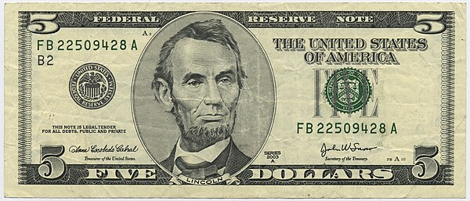
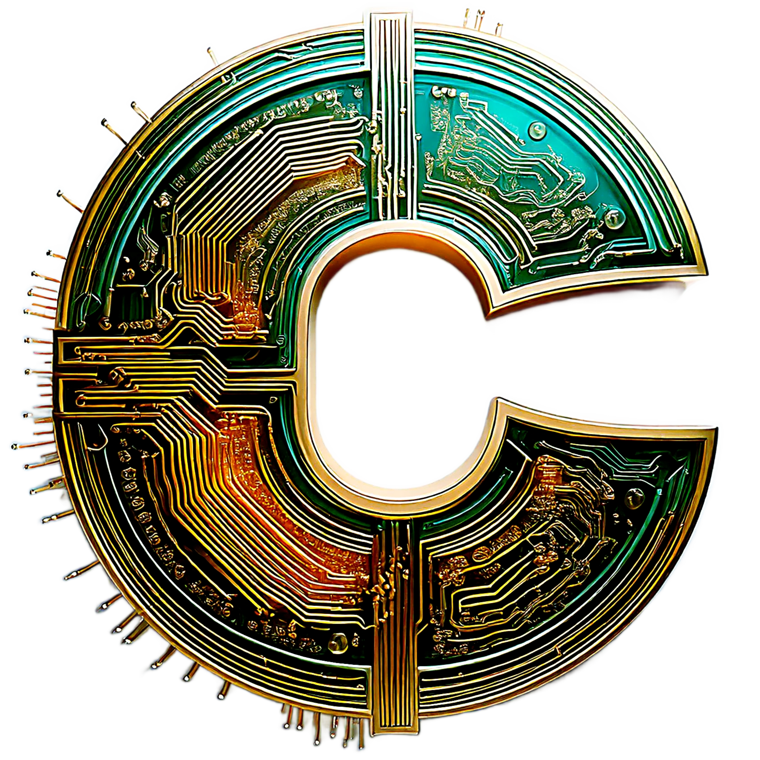
First Attempt on P2P Payments: Simple E-Cash
A digital token (coin) can be copied just like a file. Alice can give the same token to Charlie!
Sometimes later …
I would like to get a $5 digital coin
Do we see a problem?
Double Spending
Notes:
A digital token can be copied like a file. Without precautions, I could spend the same $1 token twice.

Slide 23
Simple E-Cash without double spending
SN37
…
A double-spend later on can easily be “detected”!!!
I would like to get a $5 digital coin
Adds a serial number
Removes the serial number

Slide 24
Simple E-Cash
Pros
  Payment is digital
  Alice and Bob can be at different locations
  Peer to Peer (which is great!)
Cons
  Full P2P means: double-spending can be detected (but not avoided)
  Avoiding double-spending requires the bank to always be online
  The bank can fail, delay payments, or censor altogether
  Privacy: Can the bank identify the payer, payee, or the payment?
    Think of the serial number (SN), which is used to avoid double-spending
    Knowing the SN, the bank knows who is paying how much to whom!!!

Slide 25
Chaumian E-Cash using blinded signatures
Solves the privacy issue in Simple E-cash
SN
Bank doesn’t
see the SN
I would like to get a $5 digital coin and here is b(SN)
Bank signs sig(b(SN))
What about
double-spending?
sig(SN), SN
Verifies?
Alice chooses a serial number SN and blinds it
Alice provided sig(SN), SN to Bob
Alice can retrieve sig(SN)
Notes:
Solves the privacy issue that is seen in Simple E-cash

Slide 26
Chaumian E-Cash
Pros
  Payment is digital
  Payer and Payee can be at different locations
  Peer to Peer (which is great!)
  Privacy is maintained: SN is known to Alice, but not to the bank
  Same privacy guarantee as the physical paper money!
Cons
  The bank is still the middle party that everyone is forced to trust
  The bank can censor payments
What about double-spending?
  Detection and identification possible (only after the fact!)

Slide 27
Recap: Money
Barter, Representative, Fiat
Banks
  Always are in-the-way
Simple E-cash
  Privacy is violated
Chaumian e-cash
  Maintains privacy (via blinding factor)
  Can even avoid deter from double spending
Getting rid of the central entity (bank) requires decentralization
  Case for blockchain? (leads to cryptocurrency)

Slide 28
Acceptability of Chaumian E-Cash
Why did Chaumian E-Cash not fly commercially?
It was considered too private
  Anon digital payments lead to tax evasion, money laundering, etc.
Online verification required: poor user experience
  Over a possibly unreliable or unavailable (1990s) network
  Cash and credit cards remained the champions!
Business Model issues: no incentive for banks
  Less control to banks, more privacy to customers
Too private for the government, too inconvenient for users,
too unattractive for banks
Notes:
Central Bank Digital Currencies (CBDCs) are the opposite vision:
A digital form of national currency (like a digital rupee, yuan, or dollar).
Issued and controlled by central banks.
Transactions can be fully traceable by design.
Instead of Chaum’s unlinkability, CBDCs aim for maximum transparency & control.

Slide 29
Desirable Features of Money
What do we need the money to be?
Durable
Portable
Divisible
Fungible
Acceptable
Stable – limited Supply – hard to counterfeit
Are these features desirable for Non-digital or digital money?
Notes:
Are these features desirable for Non-digital or digital money?
BOTH

Slide 30
Early Digital Currencies: Shortcomings
Why did the earlier digital currencies fail? In other words:
What shortcomings of digital payments did Bitcoin address?
Is it Peer-to-peer?
Does it avoid stealing?
Is it widely accepted by the merchants?
Is there a well-defined process for minting/creation?
Does it offer an agreeable form of a record book/ledger?
Does it allow the transacting parties to remain private?
Does it avoid double-spending?

Slide 31
(Crypto)currency Challenges
No stealing
  Only Alice can move her money. Solution?
  Cryptographic digital signatures
  Who runs the PKI?
No double-spending
  Alice can not duplicate her money. Solution?
  Global ledger
  Who maintains the public view?
Minting
  Fair money creation. Solution?
  Proof of Work
  Who hands out money for solving puzzles?
Notes:
Who hands out money for solving puzzles?
Coinbase transaction is included in every mined block. This is a special type of transaction that awards the reward to the public address specified by the miner.

Slide 32
CBDC, Bitcoin, Chaumian E-cash
Feature | Chaumian e-cash | Bitcoin | CBDCs
Introduced | 1980s–1990s (DigiCash by David Chaum) | 2009 (Satoshi Nakamoto) | 2020s (various pilots: China, EU, etc.)
Issuer | Central bank or licensed bank | No issuer (decentralized network) | Central bank
Privacy | ✅ Strong — blind signatures unlink withdrawal from spending (cash-like anonymity) | ⚖️ Pseudonymous — transactions are public, but identities can be hidden unless addresses are deanonymized | ❌ None — transactions are fully traceable by the central bank
Double spending solution | Bank’s spent-coin database + cheater-revealing protocol | Public blockchain consensus (proof-of-work, miners) | Central bank’s centralized ledger
Centralization | Centralized (depends on a single issuer) | Decentralized (peer-to-peer nodes) | Centralized (one official ledger)
Government stance | 🚫 Rejected — too much privacy, undermines AML/KYC | ⚖️ Tolerated but regulated — transparent enough for surveillance via exchanges | ✅ Actively promoted — governments want control & oversight
Adoption outcome | Failed commercially (DigiCash bankrupt in 1998) | Global adoption, large ecosystem | Pilots and rollouts ongoing (e-CNY, digital euro, etc.)
Main strength | Cash-like anonymity online | Decentralization, censorship resistance | Efficiency, surveillance, policy control
Main weakness | Needed banks to cooperate; governments disliked its privacy | Price volatility, scalability, partial privacy | Raises privacy concerns, potential for abuse of control

Slide 33
Lecture 08
Thursday, Feb 12, 2026

Slide 34
Consensus in Blockchains
What is consensus?
  Reaching an agreement in a group
  Blockchain requires it to be done dynamically, on-the-fly
  Practical constraint: Can not take forever to reach an agreement
Why is consensus needed?
  Avoids conflicting transactions T1 and T2
  Say T1 and T2 are conflicting (double spending, for example)
  Assume that T1 and T2 are in separate journals
  What assures that T1 and T2 can’t be part of the same ledger?
Dishonest nodes may not reach consensus, and that’s okay!
Notes:
What assures that T1 and T2 can’t be part of the same ledger?
CONSENSUS
Dishonest nodes may not reach consensus, and that’s okay!
AS LONG AS SUCH NODES ARE IN MINORITY

Slide 35
Consensus via Majority
How is consensus reached
  For two nodes: if both are honest
  For many nodes: ???
Unified and correct view (ledger) evolves:
  If the majority of the nodes are honest
  Double-spending (conflicting transactions, in general) is avoided
What is “Majority”?
  An individual?
  A computer?
  What about one user creating multiple (dishonest) nodes?
  A weighted majority is considered – each node is assigned a weight

Slide 36
Proof of Work (PoW) Consensus
Roots in SPAM filtering
  A moderately expensive, but not intractable, puzzle to solve
  No impact on good users, but disincentivizes spammers
How is it used in Blockchain?
  A node that solves a computationally intensive puzzle first wins
  It is telling the truth (i.e., all transactions are valid)
  The result of the computation is easy to verify by other nodes
  The block of the winner node is added to the blockchain
Food for thought
  What if the “work” is minimal (or none!) in a PoW blockchain?
Notes:
Q: What if the “work” is minimal (or none!) in a PoW blockchain?
Ans: 1) Higher chance of forks' → unstable consensus. 2) blockchain bloating too fast, 3) The supply cap will be finished quickly
Q: If the work is too high to create a block → , miners will leave the system → , making it easy to do a 51% attack → low security

Slide 37
Proof of Stake (PoS) Consensus
Designed to address high energy consumption in PoW
  Initially, both Bitcoin (BTC) and Ethereum (ETH) used PoW
  ETH switched from PoW to PoS
Process (specific to Ethereum)
  Validators (miners!) “stake” their ETH to participate
  The system chooses a random validator node to create new blocks
  A node with a higher stake is more likely to be chosen
  The chosen validator shares the block with the network
  No heavy computation is needed – staking is required
  If the node is found to be cheating, it will lose its security deposit
  51% or more of staked ETH is needed to defraud the system
Notes:
Q: If the node is found to be cheating, it will lose its security deposit. How does a node cheat?
1) A validator signs two conflicting blocks for the same slot/height. This can cause forks and threaten consensus. Penalty: stake is slashed.
2) A validator includes invalid transactions (e.g., double-spends, bad signatures). The block will be rejected, and the validator may be punished.
3) Downtime / inactivity → validator frequently goes offline or fails to propose/attest, it loses rewards and may face gradual stake reduction

Slide 38
Other Consensus Mechanisms
Proof of Activity
  A hybrid of PoW (for header only) and PoS
Proof of Storage
  Node importance is proportional to the storage capacity
And many others: Proof of …
  Authority, Burn, Capacity, Assignment, Transfer, Elapsed Time
Practical Byzantine Fault Tolerance (PBFT)
  A 3-phase protocol
  Consensus reached if more than 2/3 nodes are honest
  Used when the number of participating nodes is known
Notes:
Proof of Storage Mechanism
Nodes required to keep data in memory or on a hard drive
Also required to provide proof of data storage
Random locations are checked by the verifier
Example (in a different context)
Verifier provides free email addresses
Does not want to allow (large number of) fake addresses that are often used for spamming
Requires a user to allocate 100GB of space per address

Slide 39
Popular and Recent Topics
Smart Contracts, Stablecoins, and Tokenization

Slide 40
Smart Contracts
A program that runs on the blockchain
  Encodes a self-executing agreement based on predefined events
  Settlements in a smart contract are automatically triggered
  When the pre-agreed conditions in the contract are met
Example: Crop insurance for weather risk protection
  Typical terms: if rainfall is below a certain level, payout is made
  Farmer(s): premium (in crypto) locked in the smart contract
  Investor(s): payout (also in crypto) locked in the same contract
Result: Automatic Transactions without intermediary
Rainfall determined externally; instant payment transfers

Slide 41

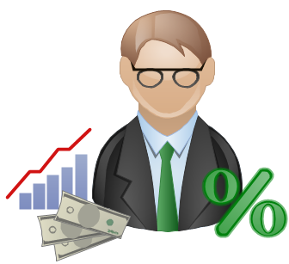
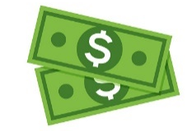
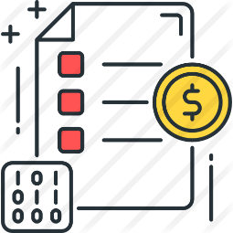
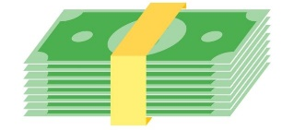



Smart Contracts: Example
premium
Farmer
Investor
Real-world data to smart contracts
Chainlink
decentralized oracle network
Payout
deposit
receives payout
smart contract
end of term
rainfall levels below 75% of the 30-year historical average
weather API
low crop yield

Slide 42
[Digital] Assets Across Multiple Systems
Trend: Representing assets of value in different systems
Why needed?
  Some things can be done better in the new system
Examples
  Why wBTC for BTC?
  Why create USDC pegged to USD?
  Why tokenize the stock of Apple?
  Why tokenize the Roosevelt Hotel?
  Why tokenize gold?

Slide 43
[Digital] Assets Across Multiple Systems
Trend: Representing assets of value in different systems
Why needed?
  Some things can be done better in the new system
Examples
  Unlock huge value and use programmatically
  P2P transactions, fast and cheap
  Access to those who don’t have it
  Allow fractional ownership
  Convenience in gold trading
  Why wBTC for BTC?
  Why create USDC pegged to USD?
  Why tokenize the stock of Apple?
  Why tokenize the Roosevelt Hotel?
  Why tokenize gold?

Slide 44
Representing digital assets across systems
Does a stock exchange do the same?
Does a stock exchange bring transfer of value across systems?
  Value of the company represented as stocks
  Purpose: Public fundraising
What does tokenization of stocks bring to the table?
  Trading and transactions made P2P
Can the stock exchange be bypassed?

Slide 45

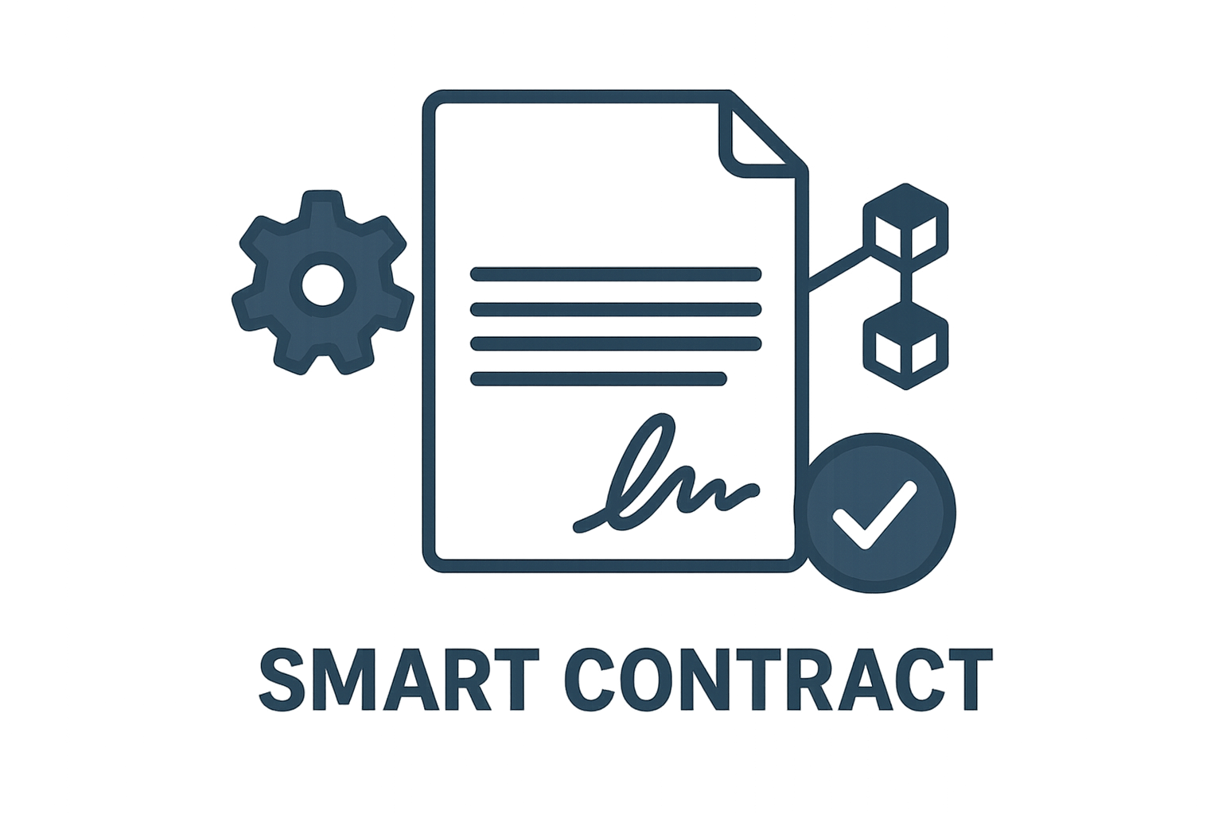




Example: Buying Tokenized Stock
SEC-regulated safe custodian of securities
Buy me $50 worth of Apple stock
(in tokens)
Typically: Not SEC regulated
Order Fulfilled
Mint a Token
Release payments
An end user gets access to the stock AND can also perform direct trades with other users

Slide 46
Layer 2
What is Layer 2?
  Secondary protocol built on top of an existing blockchain system
Main goal(s) of Layer 2?
  Provision of higher transaction speeds
  Possibly bringing in functionality that the mainchain may not offer
Examples of Layer 2?
  Stacks for Bitcoin
  Polygon for Ethereum

Slide 47
CBDC
A government-issued stablecoin
  Recall: Stablecoin is a token (modern-day representative money)
Noting: Most fiat is NOT printed (only a small percentage!)
  It is already “digital”
Why then use CBDC instead of digital fiat?
  CBDC is governed by the central bank
  Digital fiat by commercial banks

