Slide 1

Introduction to Blockchain
CSE-355
Ahmed Akhtar
Department of Computer Science
SMCS, IBA Karachi
Spring 2026

Slide 2
Lecture 13
Tuesday, Mar 3, 2026

Slide 3
Blockchain Block Header
Block b-1
Block b
Block b+1
Block Header (80B)
Transaction
Transaction
-----
Transaction
Block Header (80B)
Transaction
Transaction
-----
Transaction
Block Header (80B)
Transaction
Transaction
-----
Transaction
There are 6 fields in the block header:
Version (4B) – for exchanging messages and signaling the protocol rules
Previous block hash (32B) – for linking current block to its parent block
Merkle root hash (32B) – for summarizing & maintaining integrity of transactions in the block
Timestamp (4B) – for recording block creation time; up to 2 hour variation is acceptable because Bitcoin nodes are not concerned about timing synchronization
Target_Hash (4B) – for defining the difficulty of finding the block header hash; adjusts every 2016 blocks (~ two weeks) to ensure 10 minute average block generation time
Nonce (4B) – for iterating values during hash attempts to find a valid block header
Block_Header = [Version+PreviousBlockHash+MerkelRoothash+Timestamp+DifficultyTarget+Nonce]
Block_Header_Hash = SHA256(SHA256(Block_Header))

Slide 4
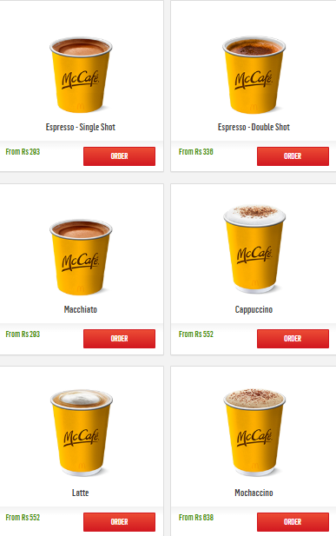
Can We Pay for Coffee in BTC?
Bitcoin price are too high for a single cup of coffee
Average block generation time is 10 minutes, so do we want to wait this long every time for a coffee payment to go through?
Do we really want every cup of coffee we drink broadcast to the whole world?
Billions of coffee cups are consumed every day so can bitcoin process all these coffee transactions?
Notes:
On average a coffee costs around 1 to 2 usd.. The average transaction fee is in the same range..

Slide 5
Bitcoin Statistics: Jan 22, 2026
Bitcoins in circulation: 19.98 Million (over $2T market cap)
Total will be 21 Million (last will be mined about in the year 2140)
Bitcoins left to be mined: 1.02 Million (Total issued: 95.1%)
Blockchain Size: 715 GB
New Bitcoin Blocks per day (presently): 144 (on average)
New Bitcoins per day (presently): 450 (144 x 3.125)
About 4 Million Bitcoins were lost forever (estimate)
Transactions per second: 7 (VISA has about 24k)
Bitcoin Price: $ 66k
Does Bitcoin look like a peer-to-peer electronic cash system?

Slide 6
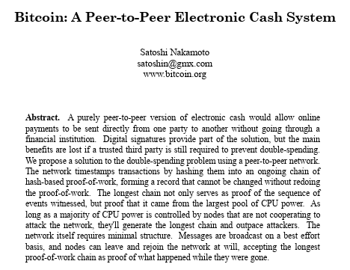
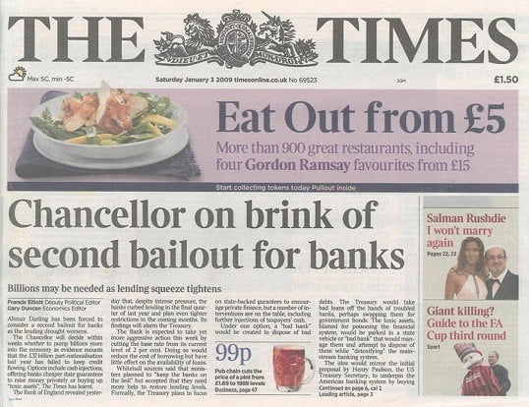
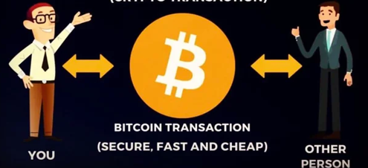
Bitcoin – Decentralized Digital Currency
Satoshi envisioned Bitcoin as a peer-to-peer digital currency for all kind of online payments
https://news.bitcoin.com/10-years-ago-bitcoins-genesis-block-changed-the-course-of-history/
Notes:
Bitcoin is fast but it is not cheap and fast

Slide 7
Bitcoin as a Micropayment Platform?
Is there a way to make bitcoin a micropayment platform without sacrificing the decentralization or security?
Notes:
Bitcoin cannot handle global scale micropayments alone
Consensus requires every node to know all transactions, which makes the payment processing too slow and also limits scalability
Global transaction volume would overwhelm the network if every transaction is processed on-chain

Slide 8
Bitcoin Scripts Revisited
What Can Bitcoin Opcodes Do?
Check signatures
Opcodes like OP_CHECKSIG verify that a transaction is authorized by the owner of a private key
Combine conditions
Opcodes like OP_IF, OP_ELSE, and OP_ENDIF allow multiple spending conditions (e.g., Alice OR Bob can spend)
Require multiple approvals
Opcodes like OP_CHECKMULTISIG allow M-of-N signatures (e.g., 2 out of 3 people must approve)
Lock funds by time
Opcodes like OP_CHECKLOCKTIMEVERIFY (CLTV) can prevent spending until a certain date or block height
Lock funds by delay
Opcodes like OP_CHECKSEQUENCEVERIFY (CSV) require waiting some time after a transaction is created

Slide 9
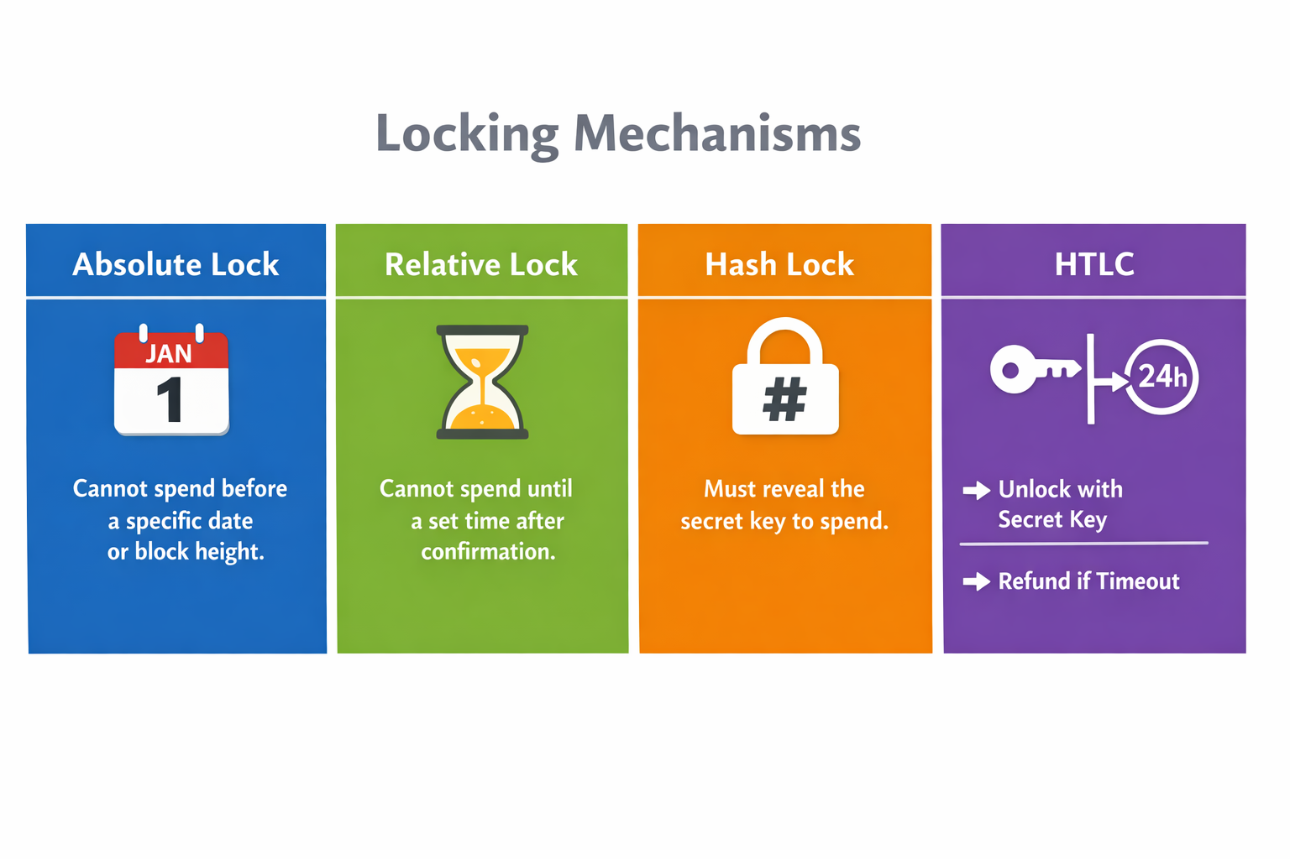
What is possible with Bitcoin Scripts?
Lock BTC with different spending conditions inside Bitcoin transactions
Key & Script locks
  Spending via Pay-to-Pubkey-Hash (P2PKH)
  Spending via Pay-to-Multisig (P2MS) (M of N type)
  Spending via Pay-to-Script-Hash (P2SH)
  Spending via Pay-to-Witness-Public-Key-Hash (P2WPKH)
  Spending via Pay-to-Witness-Script-Hash (P2WSH)
  Spending via Pay-to-Taproot (P2TR)
Time locks
  Spending via absolute-time-based lock (nLockTime & CheckLockTimeVerify (CLTV))
  Spending via relative-time-based lock (nSequence & CheckSequenceVerify (CSV))
Hash locks
  Spending via Hash locks
  Spending via Hashed Time lock Contract (HTLC)
Legacy
SegWit v0
SegWit v1 (Taproot)
But scripts are low-level and hard to write
Bitcoin Script is stack-based and not designed to be human-friendly
Notes:
An HTLC is a smart contract that allows funds to be locked with two conditions: reveal a secret before time runs out, or get refunded after the timelock.
More private flexible spending paths (key path and script paths)
Miniscript is not a spending conditions it is a framework to write spending conditions safely.
It only reorganizes and standardizes the existing Bitcoin Script opcodes (like OP_CHECKSIG, OP_CHECKMULTISIG, OP_CHECKLOCKTIMEVERIFY, etc.).

Slide 10
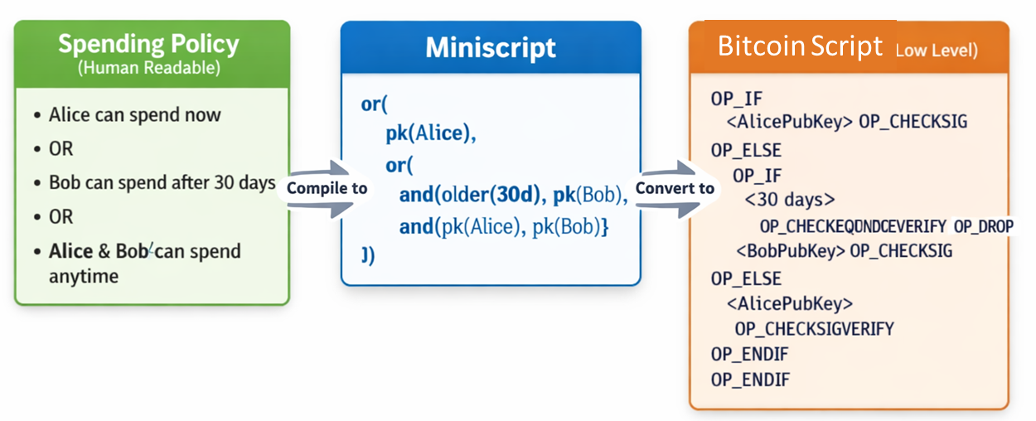
Miniscript
Miniscript is like TypeScript for Bitcoin
Just as TypeScript turns into JavaScript so browsers can read it, Miniscript turns into Bitcoin Script so the blockchain can read it
It allows developers to build "Smart Contracts" on Bitcoin without needing a PhD in Opcodes

Slide 11
Comparison
RAW Bitcoin Script
Hard to read
Easy to mess up
Not intuitive
Hard to verify
Miniscript
Structured
Readable
Matches the policy
Easier to reason about

Slide 12
Bitcoin Transactions – UTXO Model
Bitcoin transactions are created using unspent transaction output (UTXO model)
  A UTXO has well-defined inputs (one or more) and outputs (one or more)
Transaction-Level Fields (Version, nLockTime, Flags)
Input(s)
Output(s)
Rules for creating inputs and outputs
Each output should mention a value and a ‘scriptPubKey’
  scriptPubKey is the locking script that defines the spending condition for the output
Each input must reference exactly one output from a past txn (parent txn)
  The input contains a ‘scriptSig’
  scriptSig is the unlocking script for the referenced output in legacy transactions
  scriptSig is empty in SegWit transactions (instead witness field contains the unlocking script)
The sum of input values should be greater than or equal to the sum of output values
With these rules, Bitcoin does not require user accounts
Notes:
Flags are in segwit txn to indicate witness data

Slide 13
Spending an Output
Parent transaction is also referred to as the funding transaction
Child transaction is also referred to as the spending transaction
Parent transaction
Child transaction
Value
scriptPubKey
Prev Txid: A1234A
Idx: 0
scriptSig
Txid: A1234A
Txid: 01C56A
The value is locked at the scriptPubKey field at the output of the parent transaction
The input of the child transaction identifies the output of the parent transaction that it wants to spend and provides the required scriptSig to unlock the output
scriptSig + scriptPubKey is executed on the stack and if the result is TRUE, the output is unlocked and completely spent via the new outputs of the child transaction
13

Slide 14
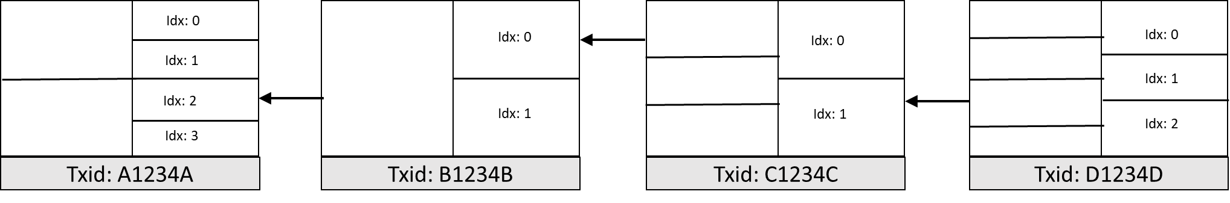
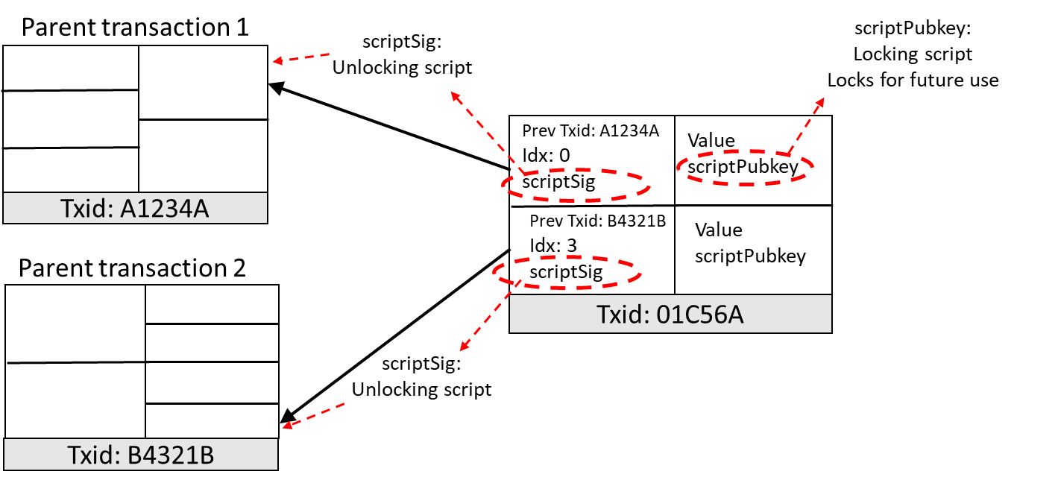
Transaction Chaining
Bitcoin transactions also form a chain: each transaction spends output(s) of previous transaction(s) and creates new outputs for future use
A transaction can have multiple inputs

Slide 15
UTXO Database
UTXOs are scattered in the blocks
  Nodes maintain a UTXO database (called chainstate.db in Bitcoin core)
  The purpose of this database is to speed up the transaction validation process
Transaction outputs that have not been spent at a given time
Simplified Transaction Validation & Database Update Algorithm
For each input in a new TXN (child txn):
  If parent UTXO is not in the DB, return an error
  If the provided signature on child txn does not match the owner (Pubkeyhash) of the parent UTXO, return an error
If the total value of all the referenced parent UTXOs is less than the total value of all the outputs of child txn, return an error
If successful, remove all parent UTXOs and add all child UTXOs to the database
UTXO Database
Notes:
https://github.com/in3rsha/bitcoin-chainstate-parser LevelDB is a key:value store
Validation algorithm is from Vatalik’s Ethereum Whitepaper
https://ethereum.org/en/whitepaper/

Slide 16
Lecture 14
Thursday, Mar 5, 2026

Slide 17
UTXO Model
Which child txn is valid assuming signatures match and total value of outputs is less than the value of referenced UTXO?
Child transaction 1
Value
scriptPubkey
✓
Parent transaction
Prev Txid: A1234A
Idx: 1
scriptSig
Idx: 0
Value
scriptPubkey
Idx: 1
Idx: 2
Txid: F001A9
Idx: 3
Child transaction 2
Txid: A1234A
Value
scriptPubkey
Prev Txid: A1234A
Idx: 2
scriptSig
✓
Value
scriptPubkey
Txid: 2345AA
Both are valid because they are pointing to two different outputs Idx 1 and Idx 2 respectively

Slide 18
Race between Transactions
The two child transactions are in a so-called ‘race’
Child transaction 1
Prev Txid: A1234A
Idx: 2
scriptSig
Value
scriptPubkey <Alice>
Parent transaction
Prev Txid: FB235C
Idx: 3
scriptSig
Value
scriptPubkey
Idx: 0
Idx: 1
Double spending
Txid: F001A9
Idx: 2
Idx: 3
Child transaction 2
Txid: A1234A
Prev Txid: A1234A
Idx: 2
scriptSig
Value
scriptPubkey <Bob>
The transaction which gets confirmed wins the race:
  the one created earlier?
  the one with higher fee?
Prev Txid: 23ABCD
Idx: 1
scriptSig
Txid: D1C223

Slide 19
Making payments
Alice wants to pay 0.5 BTC to Bob. Alice owns 1.5 BTC at index 0 of Txid: A1234A
Parent transaction
Is this a valid child txn?
Child transaction created by Alice
Alice owns 1.5 BTC on this output
Idx: 1
Prev Txid: A1234A
Idx: 0
scriptSig <Alice>
Value: 0.5 BTC
scriptPubKey
<Bob>
Idx: 2
✓
Idx: 3
Txid: A1234A
Alice owns a valid UTXO, and sum of inputs > sum of outputs, so this is perfectly fine
Any difference between the inputs and outputs is retained by the miner as txn fee so Alice will loose 1 BTC in this example
Notes:
As a rule, parent txn’s output is considered completely spent.

Slide 20
Payment with a ‘Change Output’
Child transaction created by Alice
Parent transaction
Alice owns 1.5 BTC on this output
Value: 0.5 BTC
scriptPubKey
<Bob>
Output for Bob
Idx: 1
Prev Txid: A1234A
Idx: 0
scriptSig <Alice>
Idx: 2
✓
Value: 1 BTC
scriptPubKey
<Alice>
‘Change output’ for Alice
Idx: 3
Txid: A1234A
Alice must pay herself the remaining BTC by creating a second output – this is equivalent to receiving a change for her future use
This is a typical Bitcoin payment transaction with two outputs – one payment output to the intended recipient, and a change output returning the remaining funds to the sender

Slide 21
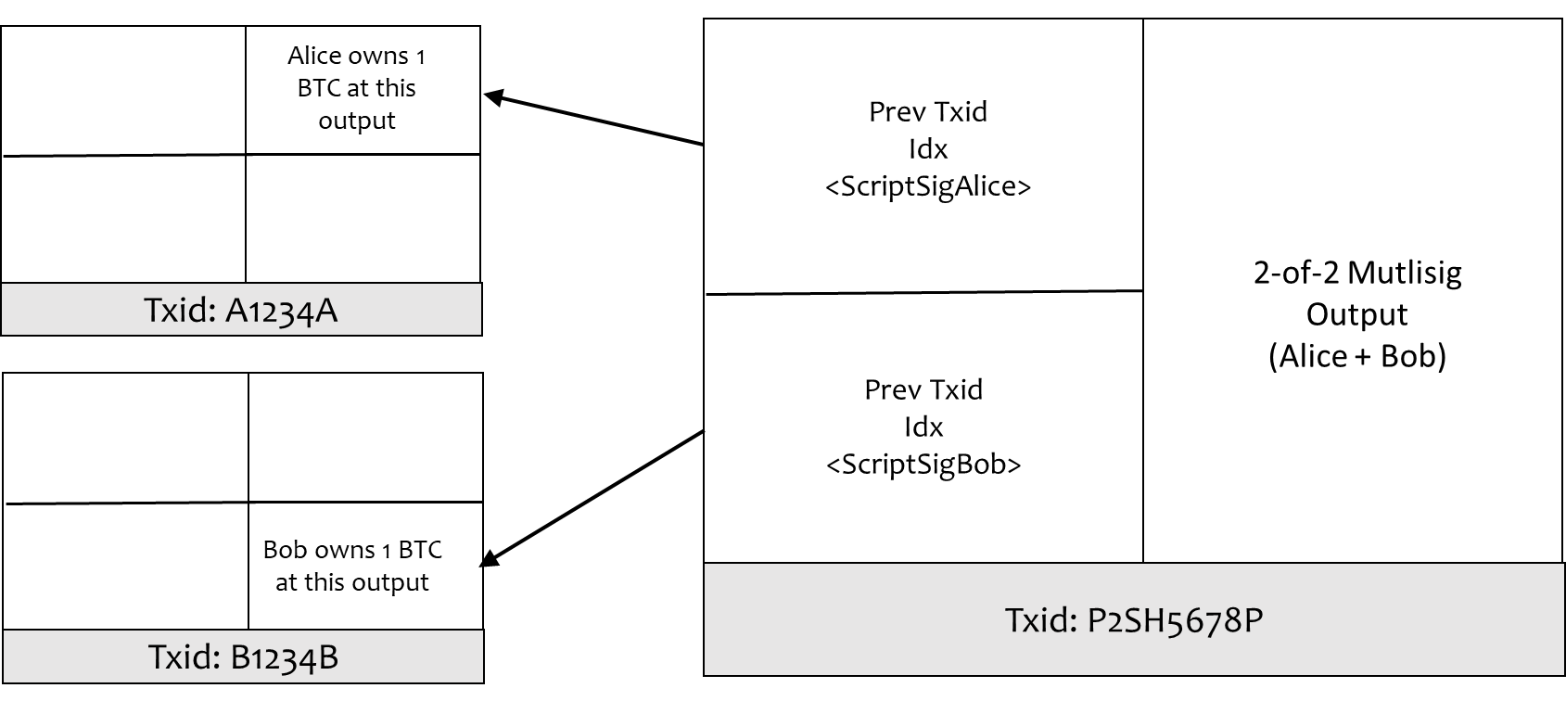
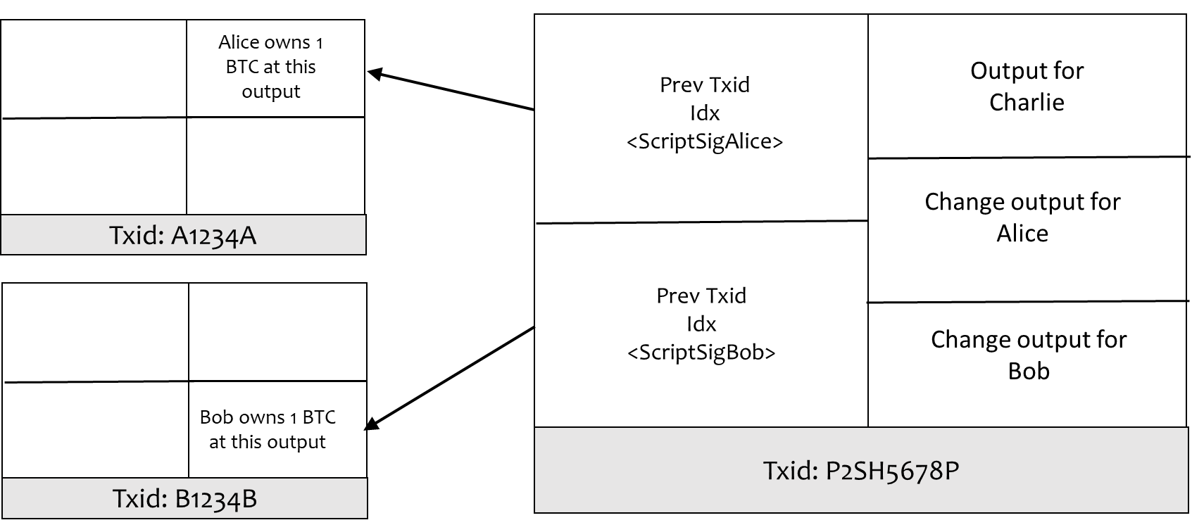
Collaborative Transaction
Alice and Bob collaborate and agree on all the inputs and all the outputs (value, spending conditions)
Either Alice or Bob creates an ‘unsigned transaction’
  Unsigned transaction is shared with other party
Alice signs the unsigned transaction (all the inputs and all the outputs) with her private key (produces <SigAlice> for this txn)
Bob signs the unsigned transaction (all the inputs and all the outputs) with his private key (produces <SigBob> for this txn)
To obtain a fully signed transaction, both parties exchange their signatures
  The party holding all the signatures has the fully-signed transaction
  The party with only some signatures holds a so-called partially signed bitcoin transaction (PSBT)
Only the fully signed transaction can be broadcast to the Bitcoin network

Slide 22
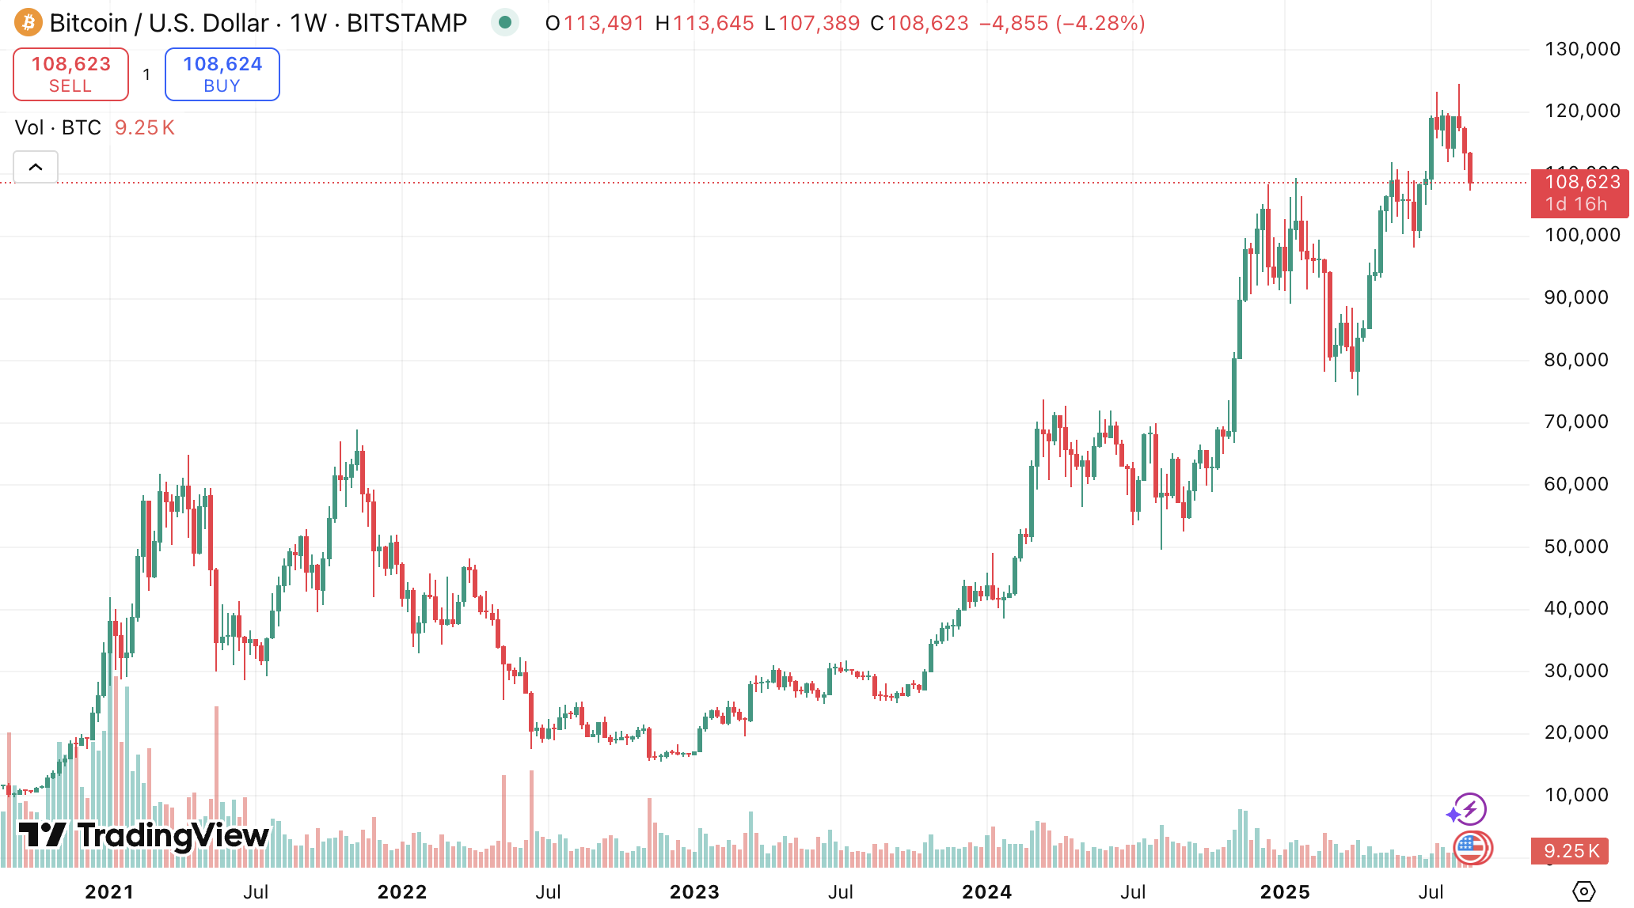
BTC Price vs a Cup of Coffee
Bitcoin seems better suited for buying the entire coffee shop than a single cup!

Slide 23
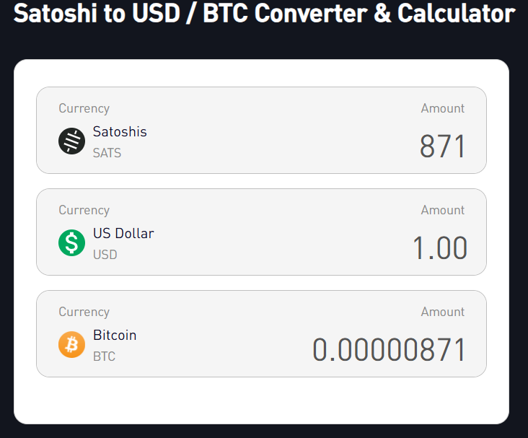
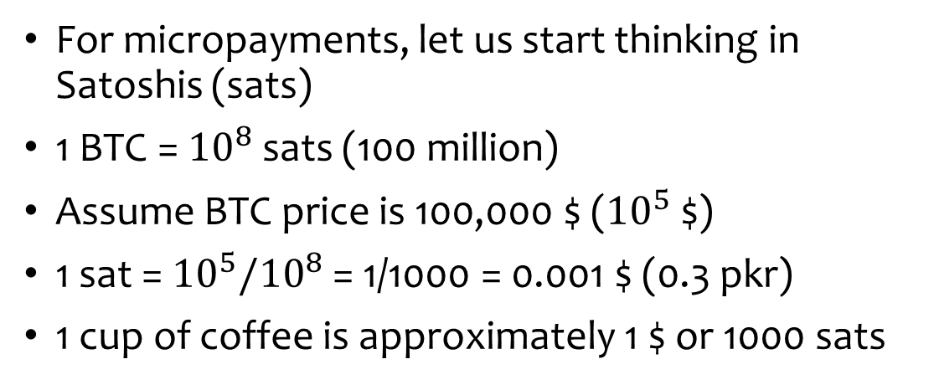
Start Thinking in Satoshis!
For micropayments, let us start thinking in Satoshis (sats)
1 BTC = ${10}^{8}$ sats (100 million)
Assume BTC price is 100,000 $ (${10}^{5}$ $)
1 sat = ${10}^{5}/{10}^{8}$ = 1/1000 = 0.001 $ (0.3 pkr)
1 cup of coffee is approximately 1 $ or 1000 sats
https://bitbo.io/tools/satoshi-usd/
Now bitcoin starts to feel like a usable currency

Slide 24
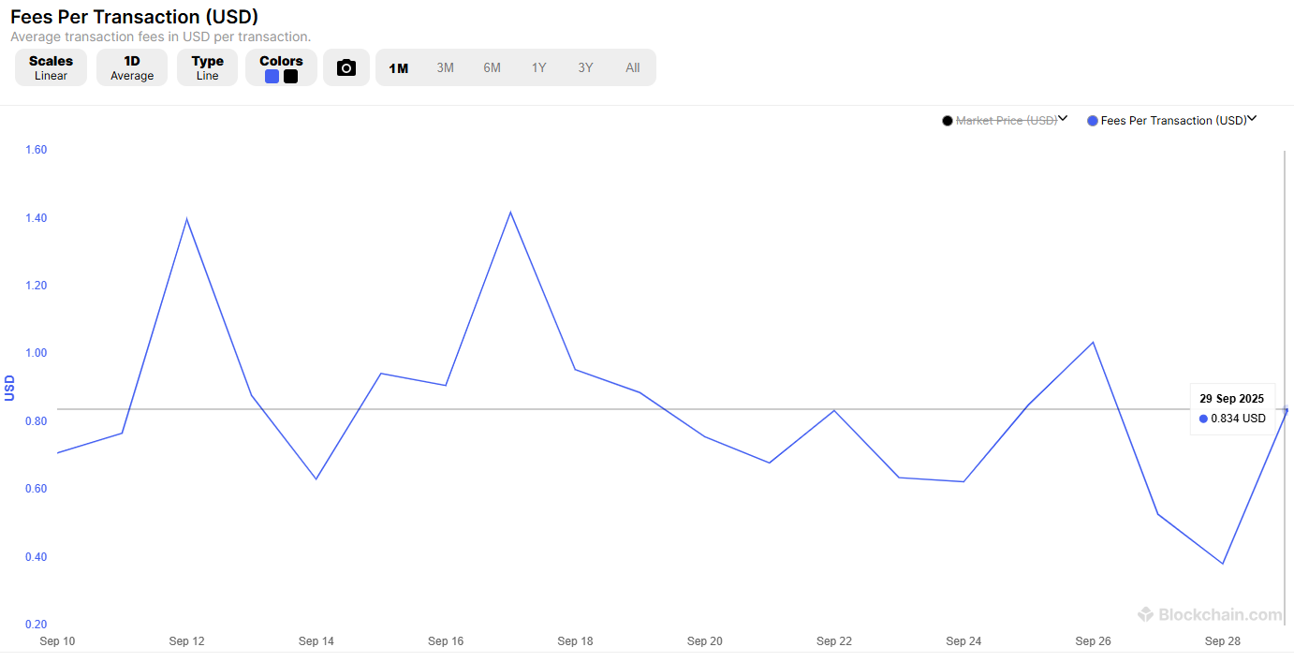
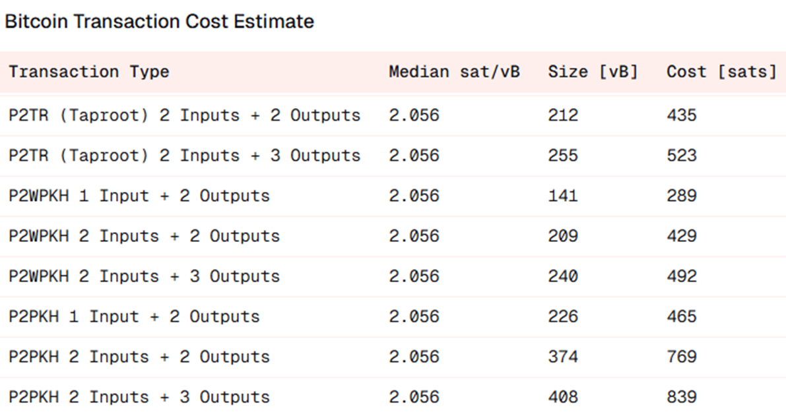
Transaction Fee
1 cup of coffee is approximately 1 $ or 800 to 1000 sats
Average transaction fee is around 0.5 to 1.5 $ ~ 400 to 800 sats
It still seems difficult to use BTC for micropayments due to high transaction fee!
Notes:
https://dune.com/dataalways/bitcoin-fee-tracker

Slide 25
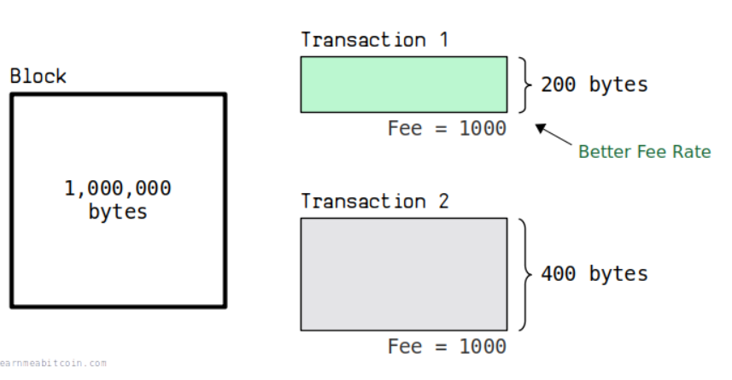
Transaction Fee Depends on Size
In Bitcoin, transaction fee does not depend on the transaction value
Transaction fee depends on the transaction size
  Large sized transactions (more bytes) are costly
A 1 $ coffee payment transaction can end up paying the same fee as a 100,000 $ BTC transfer if the transaction size in bytes is the same
Can we exploit this property to reduce the fees for micropayments?
Notes:
https://learnmeabitcoin.com/technical/transaction/fee/
Fee rate is mentioned in sats/byte

Slide 26
Reducing the Fee for Micropayments
Suppose we make a single high-value transaction with an output of 1 lac sats
  This transaction is confirmed on blockchain
  We pay the transaction fee (e.g., 500 sats)
  We call it the ‘Funding transaction’
We use the funding transaction to make several micropayments
  After every micropayment, we only update the balances off-chain by creating ‘commitment transactions’
  After several micropayments, we settle the final balances on-chain
  We pay the transaction fee for the last commitment transaction that is confirmed on the blockchain (e.g., 500 sats fee)
We pay the fee for the initial funding transaction and the last commitment transaction as they enter the bitcoin blockchain (only 1000 sats in transaction fees)
Commitment transactions exist off-chain, so the challenge is to make them as secure as the on-chain Bitcoin transaction

Slide 27

Funding & Commitment Transactions
Funding transaction:
2-of-2 multisig transaction on blockchain used to lock funds in shared ownership
Commitment transaction:
A transaction or a number of transactions that return the funds of a two-party channel to their owner
Funding TX
Outputs:
0. Alice locks 1 lac sats in a 2-of-2 multisig with coffee shop (Bob)
Commitment TX
(Monday)
Outputs:
0. Alice 98,000 sats
1. Bob 2000 sats
Before publishing the funding transaction, the funder first obtains a pre-signed spending transaction from the counterparty so the funds can always be recovered even if cooperation stops
Once the funding transaction is safe to publish, the peers move forward by creating the commitment transactions
Notes:
A commitment is a transaction or a number of transactions that return the funds of a two-party channel to their owner
The commitment is signed before the funding transaction to ensure that no funds can be taken hostage by one party, as the other party already holds the means to recover its stake
The channel can be funded by one or both parties but before they start and to avoid from funds being locked due to non cooperation, the funding party asks for a signed spending transaction from the counterparty that spends the funding tx. Suppose Alice funds so Alice asks Bob to provide him a child transaction that allows her to spend the funding tx output. Once Bob provides it then Alice published the funding tx on blockchain. Now if Bob does not cooperate Alice has the way to spend them. If Bob cooperates and they do micropayments then they have new commitment transactions. So the process can advance
An unobserved event is a transaction between a limited set of participants that does not need to be immediately known or recorded by all nodes in the blockchain network
If only you and the coffee shop care about your coffee purchase, there is no need for the entire Bitcoin network to immediately know about it

Slide 28

Unobserved Events
After every coffee purchase, Alice & Bob create new commitment transactions and update their balances
Either Alice or Bob can enforce the settlement by broadcasting and enforcing the latest agreed state without needing cooperation from the other party
Commitment TX
(Monday)
Outputs:
0. Alice 98,000 sats
1. Bob 2000 sats
Commitment TX
(Tuesday)
Outputs:
0. Alice 95,000 sats
1. Bob 5000 sats
Commitment TX
(Wednesday)
Outputs:
0. Alice 90,000 sats
1. Bob 10,000 sats
Alice buys 2 coffees on Monday for 2000 sats
Alice buys 3 coffees on Tuesday for 3000 sats
Alice buys 5 coffees on Wednesday for 5000 sats
Never went on-chain
(unobserved event)
Never went on-chain
(unobserved event)
They settle on Wed
Funding TX is spent
The last commitment TX is published on the blockchain
All the intermediate transactions remain unobserved, which is also good for privacy
Notes:
An unobserved event is a transaction between a limited set of participants that does not need to be immediately known or recorded by all nodes in the blockchain network
If only you and the coffee shop care about your coffee purchase, there is no need for the entire Bitcoin network to immediately know about it

Slide 29


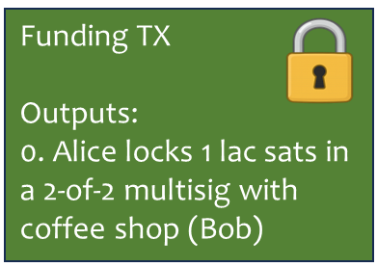
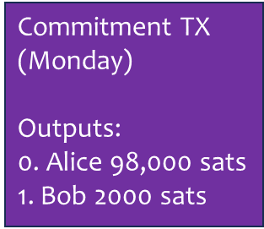
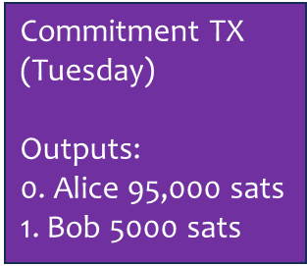
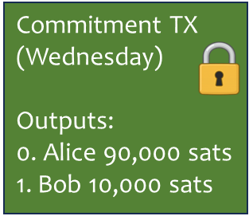

Payment Channel
Payment Channel is a setup that allows two parties to make payments without contacting the blockchain
Payment Channel between Alice & Bob
Alice & Bob update their balances as frequently as they like inside their payment channel, without the need for making an on-chain Bitcoin transaction until they want to close their channel
As soon as this Tx is on blockchain, the payment channel is closed, because funding Tx is spent
Bitcoin
Blockchain
Making this payment channel secure and trustless is a major challenge
Notes:
Payment channels are multisignature contracts between peers. Payments are made inside these payment channels and can be settled on the Blockchain (lightning documents)
Channel design
Two parties lock funds on-chain
They exchange updated, pre-signed Bitcoin transactions off-chain to reflect each micropayment
Only the opening and final settlement appear on the blockchain in usual circumstances

Slide 30

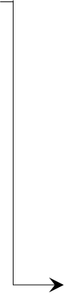
Payment Channel
Alice & Bob decide to open a payment channel
Suppose Alice funds the channel with 100,000 sats
Alice & Bob create a 2-of-2 multisig funding tx
Bob signs a commitment transaction to pay back Alice
Once Alice has the commitment transaction, the funding transaction is broadcast and confirmed on-chain
Alice buys coffee and together with Bob decides to update the channel
Alice & Bob create a new commitment transaction with updated balances
Alice buys another coffee and together they decide to update the channel
They update their balances in the new commitment transaction
The process continues till they decide to close the channel
100,000
100,000
Alice
Bob
0
Funding
0
Commitment
98,000
2000
Commitment
95,000
5000
Commitment

Slide 31
Lecture 15
Tuesday, Mar 24, 2026

Slide 32
Security Risks
Each commitment transaction is a valid bitcoin transaction, but it is not posted on-chain in usual circumstances
What if one party tries to cheat and broadcasts an old commitment transaction?
What if one party disappears or goes offline?
What measures are required to ensure a trustless payment channel?
Notes:
For this payment channel, the contract terms are that both parties commit to broadcasting only the most recent transaction

Slide 33
Preventing Old Commitment Publishing
All the old commitment transactions are valid transactions
  Peers can try to publish old commitment transactions that award them a higher balance
It is therefore necessary to prevent old commitment transactions from being broadcast for this method to work in practice
Notes:
The old commitment transactions are valid bitcoin transactions but they do not represent the true balances of Alice and Bob
Peers can try to publish previous transactions that award them a higher balance

Slide 34
Trustless Payment Channel
Alice & Bob decide to open a payment channel
Suppose Alice funds the channel with 100,000 sats
Alice & Bob create a 2-of-2 multisig funding tx
Bob signs a commitment transaction to pay back Alice
Once Alice has the commitment transaction, the funding transaction is broadcast and confirmed on-chain
Alice buys coffee and together with Bob decides to update the channel
Alice and Bob revoke the old commitment
Alice & Bob create a new commitment transaction with updated balances
Alice buys another coffee and together they decide to update the channel
They revoke the old commitment & update their balances in the new commitment
The process continues till they decide to close the channel
100,000
100,000
Alice
Bob
0
Funding
0
Commitment
98,000
2000
Commitment
95,000
5000
Commitment

Slide 35
Fundamental Challenges
There is no way to cancel a valid Bitcoin transaction
However, to make payment channels work, we need to find a way to revoke old commitments
There are two fundamental challenges that need to be addressed to create trustless payment channels
How to ascribe blame for broadcasting an old transaction?
How to penalize the party that tries to publish the old commitment?

Slide 36
Assigning Blame
Create two different commitment transactions for every update
  Commitment transaction C1a for Alice which only she can broadcast
  Commitment transaction C1b is for Bob which only he can broadcast
Both C1a and C1b
  Spend the same funding transaction (same parent)
  Reflect the same balance split between Alice & Bob
  Outputs are constructed differently, which makes them uniquely identifiable
If C1a appears on-chain, everyone knows Alice published it
If C1b appears on-chain, everyone knows Bob published it
Creating two different commitment transactions solves the blame assignment problem

Slide 37
Add Asymmetric Time Delays
To make the commitment transactions different and assign blame correctly, we add asymmetric time delays in the outputs according to the following rule:
  Whoever broadcasts a commitment transaction (old or new) must wait before spending their funds, while the counterparty can immediately spend
C1a (held by Alice) spends from the funding transaction and has two outputs:
  Alice’s output is time-locked (she must wait to redeem it)
  Bob’s output is immediately spendable
C1b (held by Bob) spends from the funding transaction and has two outputs:
  Alice’s output is immediately spendable
  Bob’s output is time-locked (he must wait to redeem it)
Commitment TX (Alice can broadcast)
(C1a)
Outputs:
0. Alice 98,000 sats (time locked)
1. Bob 2000 sats
Commitment TX (Bob can broadcast)
(C1b)
Outputs:
0. Alice 98,000 sats
1. Bob 2000 sats (time locked)
Notes:
Alice has signed C1b for Bob, while Bob has signed C1a for Alice.. So Alice can add her signatures in C1a and it already has Bob’s signature so it becomes a valid commitment tx.. Similarly, Bob can add his signature to C1b and it already has Alice’s signatures so C1b also becomes a valid tx
Bob cannot create C1a himself with different values because then Alice won’t sign it.. Similarly Alice cannot create C1b herself with different values because then Bob won’t sign it..

Slide 38
Commitment Transaction Creation
Bob creates C1a for Alice
  Bob creates an output for himself that is immediately spendable
  Bob creates an output for Alice with an agreed upon time lock
  Bob signs the transaction & gives the half-signed transaction to Alice
  Alice adds her own signature but never gives the fully signed C1a back to Bob
  Since the funding transaction is 2-of-2 multisig so Bob cannot broadcast the half-signed C1a
  Therefore, if C1a ever appears on the network, everyone knows that it must have come from Alice
Alice creates C1b for Bob using similar procedure
Neither party can fabricate a different version of C1a or C1b because each commitment requires both signatures

Slide 39
Do We Need SegWit?
Prior to SegWit, transaction id (Txid) was computed by taking the hash of all the transaction data (signature included) in a well-defined serialization order
Legacy Txid=SHA256(SHA256(All txn data))
Transaction-Level Fields (Version, nLockTime, Flags)
Txid identifies a transaction for referencing it on blockchain network
A Merkel tree of all the Txids in a block is also created and its root is stored in the block header
Prev Txid: Funding Tx
Idx: 0
<scriptSig> =
<sigAlice> <sigBob>
Alice 98,000 sats (time locked)
Legacy Txid = Hash
Bob 2000 sats
(no time lock)
Legacy transaction format cannot be used for payment channels because when signatures are part of the inputs, both signatures are required to compute the txid
If someone malleates the txid, the child transactions that spend those commitment transactions become invalid
Notes:
Final input contains signatures so for signing keep the signature field empty, then sign the txn (all inputs and outputs) and then put the signature back in
Hashes can be used to name stuff, reference stuff, point to stuff and commit to some message
Transaction malleability can be used to alter the unique ID of a monetary transaction before it is confirmed.
This is possible because signatures can be slightly changed without impacting the ownership (and they still remain valid) but due to the avalanche effect of hashing Txid completely changes. A user who created a txn gives txid to someone for verification. However, a malicious actor can change the txid which can get picked up by the miner and added to the block, now the user who identifies the same txn with a different txnid cannot trace it. The change makes it possible for someone to pretend that a transaction didn't happen, if all the right conditions are in place.

Slide 40
SegWit Solves the Problem
Txid=SHA256(SHA256(….))
Transaction-Level Fields
(Version, nLockTime, Flags)
Txid cannot be malleated because scriptSig is kept empty
Prev Txid
Idx
<scriptSig> = empty
Value
scriptPubKey =
OP_0 <pkh>
Txid= Hash
Witness field contains the signatures as well as any other spending condition(s)
  Not considered part of the txn so not used in computing Txid
  Stored in the block but it is not committed directly into the Merkel root of Txids in the block header
scriptPubKey is treated as a witness program
Witness Field
<signature> <-->
In our payment channel, to assign blame, Bob creates C1a for Alice and provides the signatures separately
Removing signatures form the input allows Bob to know the Txid before Alice even signs it
Bob can safely link his child transactions to Alice’s commitment transactions
Notes:
Signatures constituted more than 65% of the block size
Witness field is also transmitted on the network as part of the txn and is included in the block

Slide 41
Lecture 16
Thursday, Mar 26, 2026

Slide 42
P2WPKH
P2WPKH (Pay-to-Witness-Public-Key-Hash)
  Output (parent txn): <scriptPubKey> = OP_0 <wpkh>
  Input (child txn): <scriptsig> = empty
  Witness (child txn): <sig> <wpk>
Parent Transaction
Child Transaction
Transaction-Level Fields
(Version, nLockTime, Flags)
Transaction-Level Fields
(Version, nLockTime, Flags)
Value
scriptPubKey =
OP_0 <wpkh>
Prev Txid
Idx
scriptSig=empty
Txid: P2WPKH1234P
Txid: P2WPKH5678C
Witness Field (parent txn)
<--> <-->
Witness Field (child txn)
<signature> <witness public key (wpk)>
Notes:
https://bitcoindev.network/guides/bitcoinjs-lib/native-segwit-p2wpkh/
Validity is defined by exclusion: a block or transaction is valid if no condition exists that marks it failed.
In p2wsh the standardness rules require redeem script to be 3600 B long
OP_SHA256 takes SHA256 hash
OP_HASH256 takes double SHA256 i.e., SHA(SHA(x))
Standardness rules allow 3600 B in p2wsh

Slide 43
P2WSH
P2WSH (Pay-to-Witness-Script-Hash)
  Output (parent txn): OP_0 <wsh>
  Input (child txn): <scriptsig> = empty
  Witness (child txn): <sig> <ws>
Parent Transaction
Child Transaction
Transaction-Level Fields
(Version, nLockTime, Flags)
Transaction-Level Fields
(Version, nLockTime, Flags)
Value
OP_0 <wsh>
Prev Txid
Idx
scriptSig=empty
Txid: P2WSH1234P
Txid: P2WSH1234C
Witness Field (parent txn)
<--> <-->
Witness Field (child txn)
<signature> <witness script (ws)>
Notes:
https://bitcoindev.network/guides/bitcoinjs-lib/native-segwit-p2wpkh/
Validity is defined by exclusion: a block or transaction is valid if no condition exists that marks it failed.
In p2wsh the standardness rules require redeem script to be 3600 B long
OP_SHA256 takes SHA256 hash
OP_HASH256 takes double SHA256 i.e., SHA(SHA(x))
Standardness rules allow 3600 B in p2wsh

Slide 44
SegWit Transaction Validation
Transaction validation by the Old Nodes
Old nodes run the older version of the software that recognizes the legacy transaction format
The old nodes find the signature field empty
  They validate without the signature because they do not find it anywhere inside the transaction
  Old nodes validate SegWit transactions as “anyone-can-spend”
In the output script, the old nodes first pop a zero (OP_0) on the stack followed by <wpkh> or <wsh>
  A non-zero number at the top of the stack is interpreted as True, therefore, validation succeeds
Transaction Validation by New Nodes
New nodes see OP_0 in the scriptPubKey, which indicates that it is a SegWit output
They check the witness field and execute the witness program
The type of program depends on the length of data in the scriptPubKey
  20B – they run p2wpkh program that verifies the hash of public key in the witness field
  32B – they run p2wsh program that verifies the hash of witness script and also runs the script
Notes:
https://bitcoindev.network/guides/bitcoinjs-lib/native-segwit-p2wpkh/
Validity is defined by exclusion: a block or transaction is valid if no condition exists that marks it failed.
In p2wsh the standardness rules require redeem script to be 3600 B long
OP_SHA256 takes SHA256 hash
OP_HASH256 takes double SHA256 i.e., SHA(SHA(x))
Standardness rules allow 3600 B in p2wsh

Slide 45
Conditional Spending Rules using P2WSH
Conditional spending rules are implemented using P2WSH
Suppose we want to create a P2WSH output that Alice can spend only with her signature (private key), while Bob can spend with a secret S whose hash is H=SHA256(S)
Parent Transaction
Transaction-Level Fields
(Version, nLockTime, Flags)
Witness Script (its hash goes into the scriptPubKey field of the parent txn):
OP_IF
<PubKeyAlice> OP_CHECKSIG
OP_ELSE
OP_SHA256 <H> OP_EQUALVERIFY
<PubKeyBob> OP_CHECKSIG
OP_ENDIF
<wsh> = SHA256(Witness Script) – 32B hash is used in the scriptPubKey of the parent txn
Value
OP_0 <wsh>
Txid: P2WSH5678P
Witness Field (parent txn)
<--> <-->
Notes:
Stack works in LIFO.. Last in first out
https://learnmeabitcoin.com/technical/script/p2wsh/
https://learnmeabitcoin.com/technical/transaction/witness/

Slide 46
Spending Transactions – P2WSH
Parent Transaction
Child Transaction (Alice)
Witness Script (ws):
OP_IF
<PubKeyAlice> OP_CHECKSIG
OP_ELSE
OP_SHA256 <H> OP_EQUALVERIFY
<PubKeyBob> OP_CHECKSIG
OP_ENDIF
<wsh> = SHA256(ws)
Transaction-Level Fields
(Version, nLockTime, Flags)
Transaction-Level Fields
(Version, nLockTime, Flags)
Value
OP_0
<wsh>
Prev Txid
Idx
scriptSig=empty
Txid: P2WSH5678P
Txid: P2WSH5678CA
Witness Field
<--> <-->
Witness Field
<sigAlice> 1 <ws>
Alice uses 1 in her scriptSig because she can spend via the IF branch according to the witness script
Bob uses 0 in his scriptSig because he can spend via the ELSE branch according to the witness script
Bob also provides the secret <S> in his witness field
Only one child transaction will be confirmed and as soon as it gets into a block, the other one is invalidated because double spending is not allowed
Parent Transaction
Child Transaction (Bob)
Transaction-Level Fields
(Version, nLockTime, Flags)
Transaction-Level Fields
(Version, nLockTime, Flags)
Value
OP_0
<wsh>
Prev Txid
Idx
scriptSig=empty
Txid: P2WSH5678P
Txid: P2WSH5678CB
Witness Field
<--> <-->
Witness Field
<sigBob> <S> 0 <ws>
Notes:
IF branch needs true so we use 1 (or any other non zero number) to enter this branch
Else branch needs false so we use 0 to enter this branch
Nested IF/Else follows similar structure.. So if else and then another if else so to reach the last else else we have to provide 00 in the witness field

Slide 47
Custom Locking using P2WSH
Design the Witness Script
  Write the spending rules in Bitcoin Script (OP_IF / OP_ELSE, OP_SHA256, OP_CHECKSIG, OP_CHECKMULTISIG)
  Arrange operations & checks so they are in the required order
Compute the Witness script hash
  <sh> = SHA256(Witness Script)
  In P2WSH we use SHA256 hash of the witness script
Create the scriptPubKey
  OP_0 <wsh>
  Use it to lock the value in a parent transaction, OP_0 indicates it is a segWit program
Create a child transaction for spending the output
  Create/gather the required data according to the path used for unlocking
  Create the Witness (the required sequence of unlocking data items must be followed)
To validate & execute, nodes interpret it is a witness program when they find OP_0 in the scriptPubKey of the parent and the 32B length tells them it is a p2wsh program
  Nodes first check if the witness script in the child txn hashes to the correct value <wsh>
  If correct, the witness script also gets executed (special handling)
  Finally, the signatures are verified
Notes:
https://medium.com/@sinkec.mihael/pay-to-script-hash-p2sh-resurrection-3ec1516e244e
https://learnmeabitcoin.com/technical/script/p2wsh/

Slide 48
Storing Data on Bitcoin Blockchain
OP_RETURN is used to store arbitrary data on blockchain
Transaction-Level Fields
(Version, nLockTime, Flags)
OP_RETURN creates a valid data transaction output that is provably unspendable, so it is not stored in the UTXO database
Value
OP_0
<wsh>
OP_RETURN
<DATA>
Any output with OP_RETURN is known to contain data, so these outputs are not stored in the UTXO database
Txid: P2WSH5678P
Witness Field
<--> <-->

Slide 49
Coinbase Transaction
It is a special txn created by the miner attempting to create a block
It is also the first txn in a candidate block
Value:
3.125 + fees
OP_0
<pwpkh_Miner>
3.125 BTC + fees
Prev Txid: 00..00
Idx: 0xFF..FF
Locked to Miner’s PubKey
No parent
For inclusion of additional data
OP_RETURN
<Data>
Witness Field
<--> <-->
Notes:
Additional data can be added in empty scriptSig field of coinbase txn. For example, Genesis Block of Bitcoin was mined by Satoshi and he included Headline from Financial Times:
‘The Times 03/Jan/2009 Chancellor on brink of second bailout for banks’

Slide 50
Committing Witness Data to the Block
To ensure that witness data cannot be altered, a separate witness txid (wtxid) is calculated and a Merkel tree of all wtxids is created whose root is stored in one of the coinbase txn output using OP_RETURN
Store in block header
hash
hash
0,1
hash
2,3
txid 0 (coinbase)
txid 1
txid 2
txid 3
Coinbase Transaction (Miner)
Value:
3.125+fee
OP_0 <wpkh>
wtxid 1
wtxid 2
wtxid 3
Prev Txid: 00..00
Idx: 0xFF..FF
OP_RETURN
<hash>
hash
1,2
hash
3
Witness Field
32 B witness reservation value (wrv) (arbitrary value)
hash
1,wrv
wtxids are also double SHA256 hashes of the complete transaction data along with its witness
hash
Notes:
Coinbase txn is the first txn of a block created by the miner and its txn number is 0
Wtxids are also doubl sha256
https://learnmeabitcoin.com/technical/transaction/wtxid/

Slide 51
Lecture 17
Tuesday, Mar 31, 2026

Slide 52
Prevent Cheating in Payment Channels
Suppose Alice broadcasts an old commitment (C1a) where she has a higher balance
  Bob and everyone else know that Alice has published C1a
  Bob can immediately redeem his (smaller) output but that does not stop Alice
  Once the time lock expires, Alice still walks away with more funds than her share
Bob could try to counter Alice by publishing his own old commitment (C1b) to make it a race
  There is no guarantee of winning this race
Time Locks alone cannot prevent cheating

Slide 53
Add Punishment for Cheating
The addition of an economic penalty that is higher than the intended reward gained from cheating is the only effective way to discourage the publication of an old state
Suppose Alice publishes an old commitment (C1a) where she has a higher balance
  Her output is time locked
  If Bob could also take Alice’s output immediately, then this would make publishing an old commitment truly uneconomical (Alice loses everything)
Add a spending condition with the help of a revocation key that lets either party immediately claim the counterparty’s time-locked output if an outdated commitment is ever published
IF (revocation path is used)
Require: Signature from the Revocation key // For Bob to punish Alice
ELSE (normal time lock path)
Require: Time lock // Alice must wait
Require: Signature from Alice Key // Alice claims her output after delay
END

Slide 54
Revocation Key – Naïve Construction
To enable punishment through revocation key, lets try a straightforward key construction method
  Bob generates a key pair (r_b, R_b)
  Lowercase letters denote private key, uppercase letter denotes public key
  He uses R_b as the revocation key in C1a, signs and gives it to Alice
  The revocation path lets Bob take Alice’s funds immediately because Bob knows private key r_b
However, there is a serious flaw with this method
  If Alice honestly publishes the latest commitment, she must wait to claim her funds
  Bob already knows r_b, so he can steal everything even when Alice does nothing wrong
We need a revocation key that
  Can punish only if an outdated commitment is published
  Cannot be used against the latest commitment
A revocation public key is required at the time of constructing a commitment transaction, but the corresponding revocation private key should remain hidden from both the parties until they advance to a new commitment

Slide 55
Safe Revocation Key
A safe revocation key enables punishment only when a commitment becomes outdated
Each commitment transaction (C1a, C1b, C2a, …) has its own revocation key pair (r, R)
Let’s focus on constructing a safe revocation key for C1a, which Bob creates for Alice
  Bob should be able to punish Alice only if she publishes this state after it’s obsolete
  Bob must not be able to take Alice’s funds if she publishes it honestly while it's the latest state
Alice generates a key pair (r_a, R_a)
Bob generates a key pair (r_b, R_b)
They exchange the public keys R_a and R_b
Bob combines them to make a revocation public key R=R_a+R_b
Bob constructs C1a and adds a revocation path with the revocation public key R and gives half-signed C1a to Alice
Neither Bob nor Alice knows the private key which is r=r_a+r_b
Bob cannot steal Alice’s funds if she publishes C1a honestly
Notes:
Elliptic curve cryptography: R=r*G where G is the generator point if we break r=r_a+r_b then R=(r_a+r_b)*G = r_a*G + r_b*G = R_a + R_b.. So the operations are linear which enables us to use the method described on this slide.

Slide 56
Revoking the Old Commitment
Suppose Alice and Bob agree to move on to a new state with updated balances
Bob has to create a new commitment C2a, which will make C1a outdated but before that he has to revoke C1a
Bob asks Alice to reveal r_a
If Alice wants to continue the channel for further micropayments, she will give r_a to Bob
Once Bob knows r_a, he gets the private key: r=r_a+r_b
  Bob can easily check if the key provided by Alice is correct by generating R
If Alice tries to publish C1a, Bob can claim her funds too
Alice does not know r because Bob never reveals r_b
Now, Bob is safe to move forward and constructs C2a for Alice
Alice has no incentive to publish C1a because she will lose all her funds
This effectively revokes C1a

Slide 57
The Complete Picture
100,000
100,000
Alice
Bob
0
Funding
0
Commitment
98,000
2000
Commitment
95,000
5000
Commitment

Slide 58
Watch Tower
If the honest party isn’t online when an outdated commitment is published, the cheater can wait out the time lock and steal the funds
Job of monitoring the blockchain can be outsourced to a dedicated service called a watchtower
With payment channels, revocation mechanism, and watchtowers in place, Bitcoin can be securely used for micropayments while avoiding the high on-chain fees for every transaction

Slide 59
Time locks
Time locks are encumbrance that stop a transaction or its output from being confirmed or spent until a certain time or block height is reached
Absolute time lock: Locks until a specific block height or time
Relative time lock: Locks for a period of time after confirmation
Absolute Time lock
Relative Time lock
nLockTime
Transaction level –
Earliest block/time before a transaction can be included in a block
CHECKLOCKTIMEVERIFY (CLTV)
Output level –
UTXO becomes spendable after a certain block/time
nSequence
Input level –
Relative delay after confirmation
CHECKSEQUENCEVERIFY (CSV)
Output level –
UTXO becomes spendable after relative delay
Notes:
Encumbrance is a more technical and formal word for a lock and is well known in legal and financial discussions
Unix timestamp: 500,000,000 – Sep 18, 2025 11:05 AM (1758175447 seconds since Jan 1, 1970).. 500,000,000 give us a date in the past Tue Nov 05 1985 05:53:20 GMT+0500 (Pakistan Standard Time).. Why we use it like this because we want to use the same number for block height as well..
Max = 2,147,483,647 (which is Jan 19, 2038 → the Year 2038 problem).
Default value is 0 which means no lock or if it is in the past it means no lock.

Slide 60
Lecture 18
Thursday, Apr 2, 2026

Slide 61
Absolute Time Lock
Absolute time lock: Locks until a specific block height or time
If L < 500,000,000 – considered as a block height
If L ≥ 500,000,000 – considered as a Unix timestamp which is the number of seconds since Jan 1, 1970
Example: Suppose current block height is 915,600 and we want a transaction to get into a block roughly after two week from now. What should be the value of L in block height?
  Average block time is 10 minutes – 2016 blocks in two weeks (6 x 24 x 14 = 2016 blocks): nLockTime = 917,616
Example: Suppose we want a transaction to get confirmed after April 30, 2026, 10 am. What should be the value of L in Unix timestamp?
  Using a Unix timestamp calculator, we find that nLockTime = 1777525200 https://www.unixtimestamp.com/ (Unix timestamp calculator)

Slide 62
Transaction Lock
Suppose current block height & time at which this transaction is created are B & T respectively
nLockTime = L
Value
OP_0
<wsh>
nLockTime = L : This whole transaction cannot be mined and included in a block until the absolute block height or absolute time L has reached
Txid: ATL1234
Witness Field
<--> <-->
If L < 500M → valid when B ≥ L
If L ≥ 500M → valid when T ≥ L

Slide 63
CHECKLOCKTIMEVERIFY (CLTV)
nLockTime = 0
Witness Script (ws):
<L> OP_CHECKLOCKTIMEVERIFY OP_DROP
<pubkey> OP_CHECKSIG
<wsh> = SHA256(ws)
Value
OP_0
<wsh>
Txid: CLTV1234
Witness Field
<--> <-->
CLTV Lock: The transaction can be immediately mined and included in any block (B+1, B+2, …). However, its output has a CLTV lock, which prevents its spending by a child transaction until the time lock condition L is met
<L> OP_CHECKLOCKTIMEVERIFY OP_DROP
If the absolute time lock condition fails, the script fails, otherwise, the script succeeds, and OP_DROP removes <L> from the stack, allowing the execution and checking of the subsequent operations on the stack

Slide 64
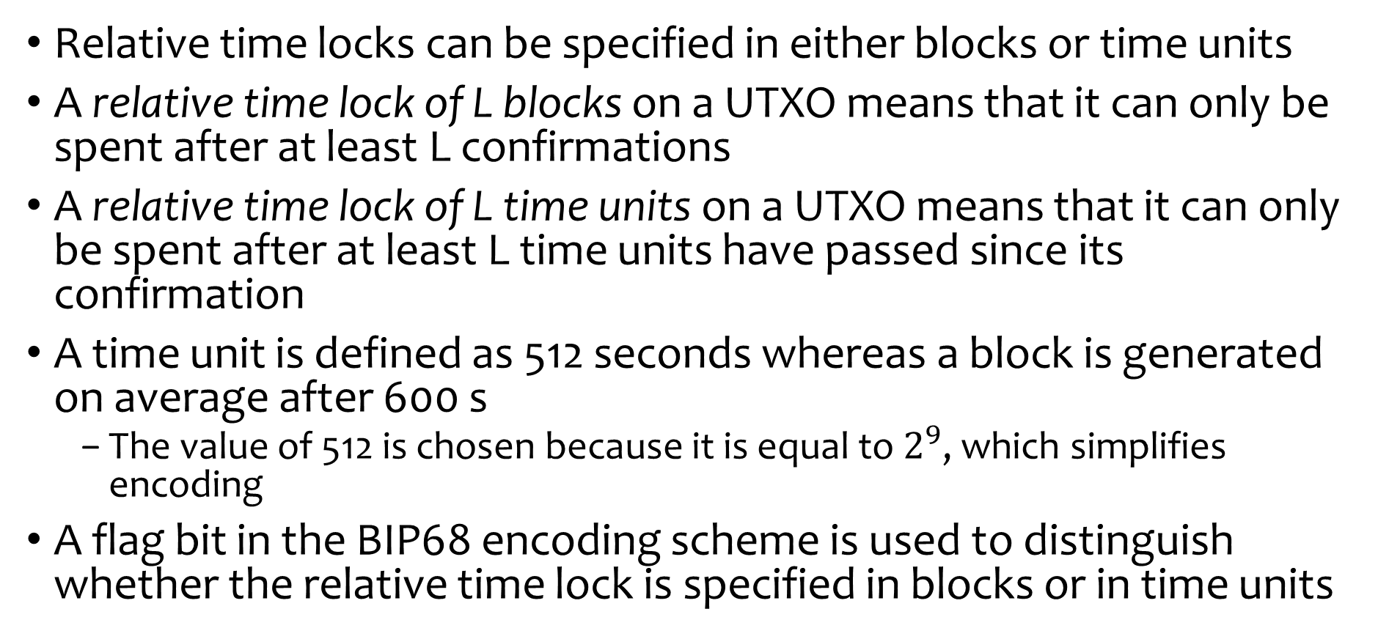
Relative Time Lock
Relative time locks can be specified in either blocks or time units
A relative time lock of L blocks on a UTXO means that it can only be spent after at least L confirmations
A relative time lock of L time units on a UTXO means that it can only be spent after at least L time units have passed since its confirmation
A time unit is defined as 512 seconds whereas a block is generated on average after 600 s
  The value of 512 is chosen because it is equal to $2^{9}$, which simplifies encoding
A flag bit in the BIP68 encoding scheme is used to distinguish whether the relative time lock is specified in blocks or in time units
Notes:
Converting from a sequence number to seconds is performed by multiplying by 512 = 2^9, or equivalently shifting up by 9 bits.
Lower bits are least significant bits
BIP68 encoding scheme
The lower 16 bits encode the relative lock time value
Bit 22 is a flag that specifies whether the relative lock is time-based or block-based
Remaining bits are set to 0 – reserved for future use

Slide 65
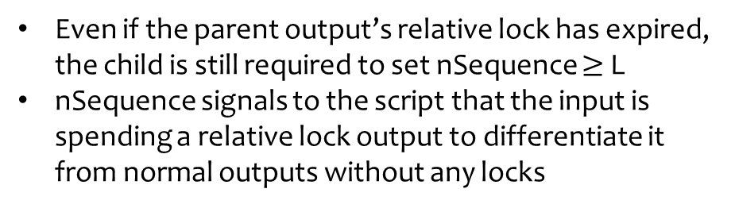
CSV + nSequence
Relative time lock is enforced through a combination of CSV script and nSequence field
nLockTime = 0
nLockTime = 0
Value
OP_0
<wsh>
Prev Txid
Idx
scriptSig=empty
nSequence = L
Txid: CSV1234
Txid: CSVnseq1234
Witness Field
<--> <-->
Witness Field
<signature> <ws>
Even if the parent output’s relative lock has expired, the child is still required to set nSequence $≥$ L
nSequence signals to the script that the input is spending a relative lock output to differentiate it from normal outputs without any locks
Witness Script (ws):
<L> OP_CHECKSEQUENCEVERIFY OP_DROP
<pubkey> OP_CHECKSIG
<wsh> = SHA256(ws)
Notes:
<60> OP_CHECKSEQUENCEVERIFY OP_DROP

Slide 66
Relative Time Lock: nSequence Only
Suppose a normal transaction is confirmed in block B and it has no time lock on its output
We want to spend it after a delay of L blocks by creating a child transaction by appropriately setting its nSequence value
What is the problem with this method and why it won’t work?
nLockTime = 0
nLockTime = 0
Value
OP_0
<wsh>
Prev Txid
Idx
scriptSig=empty
nSequence = L
Txid: P2WSH1234
Txid: nseq1234
Witness Field
<--> <-->
Witness Field
<signature> <ws>
nSequence cannot enforce the lock without CSV
  This transaction is immediately spendable because nSequence has no effect (miners ignore nSequence field without a CSV lock)

Slide 67
Summary of Time Locks
Block 1000 – Parent Txn mined (if applicable)
nLockTime (L=1010): Block 1000-1009 → Txn rejected
Block 1010 → Txn mined
CLTV Output (L=1010): Output remains locked until 1010
Block 1000-1009 → child Txn rejected (cannot spend)
Block 1010 → child Txn mined (output spent)
CSV + nSequence: Output relative lock = 100 blocks
Block 1001 → child Txn rejected (nSequence = 100)
Block 1100 → child Txn still rejected (age check)
Block 1101 → child Txn mined
nSequence only on normal output: Block 1001 → child Txn mined immediately
Block 1002 → competing Txn can also spend parent

Slide 68

Payment Routing
Alice wants to buy coffee from Bob and pay in BTC
  Alice does not have a direct payment channel with Bob
Can Alice route her payment to Bob through Charlie who is connected to both in a trustless way?
3. Alice creates a commitment locked to Charlie’s public key plus H (backed by Alice-Charlie funding TX)
4. Charlie creates a commitment locked to Bob’s public key plus H (backed by Charlie-Bob funding TX)
6. Charlie learns S, so he can spend Alice’s output
5. Bob can spend Charlie’s output because he knows the secret S (now S is revealed to everyone)
Bob gets payment by Alice routed through Charlie
2. Bob tells H to Alice but keeps S hidden
1. Bob creates a secret S
Computes H=SHA256(S)
Theft of funds is not possible with a hash lock, but funds can be held hostage
  Bob can hold Charlie’s funds hostage if he never reveals S (never claims funds so never gets paid too)
  Charlie can hold Alice’s funds hostage if he never creates a transaction for Bob
Notes:
In payment routing, nothing happens on chain.. Still everything is off chain.. On chain settlements only happen in case of disputes or when they want to close the channels

Slide 69
Hash Lock
A Hash lock is a type of lock that restricts the spending of an output until the corresponding preimage of a specified hash (H) is publicly revealed
  OP_SHA256 <H> OP_EQUALVERIFY
  Once any hash lock is opened publicly, any other hash lock secured using the same preimage can also be opened
  This makes it possible to create multiple outputs that are all encumbered by the same hash lock and which all become spendable at the same time
Hash locks allow payments to be routed through third parties without any risk that the third-parties will take the payment for themselves

Slide 70
Hash Lock Transactions & Scripts
Alice gives this txn to Charlie
Charlie learns S and spends Alice’s output
Transaction-Level Fields
(Version, nLockTime, Flags)
Transaction-Level Fields
(Version, nLockTime, Flags)
Witness Script (ws_A_C):
OP_SHA256 <H> OP_EQUALVERIFY
<PubKeyCharlie> OP_CHECKSIG
<wsh_A_C> = SHA256(ws_A_C)
Value
OP_0
<wsh_A_C>
Prev Txid
Idx
scriptSig=empty
Value
OP_0
<wpkh_Charlie>
Txid: HL1234A
Txid: HL1234C
Witness Field
<--> <-->
Witness Field
<sigCharlie> <S> <ws_A_C>
Charlie gives this txn to Bob
Bob spends and reveals the secret S
Transaction-Level Fields
(Version, nLockTime, Flags)
Transaction-Level Fields
(Version, nLockTime, Flags)
Witness Script (ws_C_B):
OP_SHA256 <H> OP_EQUALVERIFY
<PubKeyBob> OP_CHECKSIG
<wsh_C_B> = SHA256(ws_C_B)
Value
OP_0
<wsh_C_B>
Prev Txid
Idx
scriptSig=empty
Value
OP_0
<wpkh_Bob>
Txid: HL5678C
Txid: HL5678B
Witness Field
<--> <-->
Witness Field
<sigBob> <S> <ws_C_B>

Slide 71
Hash Time Lock Contract (HTLC)
HTLC solves the funds hostage problem by creating a refund path with the help of time lock
Along with creating a hash lock spending condition for Charlie, Alice also creates a CSV locked spending condition for herself
  Charlie can immediately spend the output with the help of the secret S if Bob reveals it
  If Charlie does not cooperate or if Bob never reveals the secret S, Alice can reclaim her funds after an agreed upon relative time delay enforced through the CSV lock
Witness Script (ws_HTLC_A_C):
OP_IF
# Hashlock branch: Charlie needs preimage S of H
OP_SHA256 <H> OP_EQUALVERIFY
<PubKeyCharlie> OP_CHECKSIG
OP_ELSE
# Time lock branch: Alice refunds after L blocks
<L> OP_CHECKSEQUENCEVERIFY OP_DROP
<PubKeyAlice> OP_CHECKSIG
OP_ENDIF
<wsh> = SHA256(ws_HTLC_A_C)
Charlie can spend via the hash lock path:
  scriptSig = empty
  Witness = <SigCharlie> <S> 1 < ws_HTLC_A_C >
  Condition: SHA256(S) = H and Charlie’s signature are valid
Alice can refund via time lock path:
  scriptSig = empty
  Witness: <SigAlice> 0 < ws_HTLC_A_C >
  Condition: L blocks (CSV) after the confirmation of the funding transaction by Alice & Alice’s signature

Slide 72
HTLC – Spending Paths
Child Transaction (Charlie)
Alice can reclaim her funds after the expiry of the time lock
As soon as Alice claims her funds, the parent output is spent
Transaction-Level Fields
(Version, nLockTime, Flags)
Prev Txid
Idx
scriptSig=empty
Value
OP_0
<wpkh_Charlie>
Parent Transaction (Alice)
Spending path for Charlie
Transaction-Level Fields
(Version, nLockTime, Flags)
Txid: HTLC1234C
Witness Field
<SigCharlie> <S> 1 < ws_HTLC_A_C >
Value
OP_0
<wsh_A_C>
Child Transaction (Alice)
Txid: HTLC1234A
Transaction-Level Fields
(Version, nLockTime, Flags)
Spending path for Alice
Witness Field
<--> <-->
Prev Txid Idx
scriptSig=empty
nSequence >= L
Value
OP_0
<wpkh_Alice>
Txid: HTLC1234AR
All these transactions remain off-chain in the payment channels
However, either party can broadcast them to the bitcoin blockchain to settle and close their channels
Witness Field
<SigAlice> 0 < ws_HTLC_A_C >

Slide 73
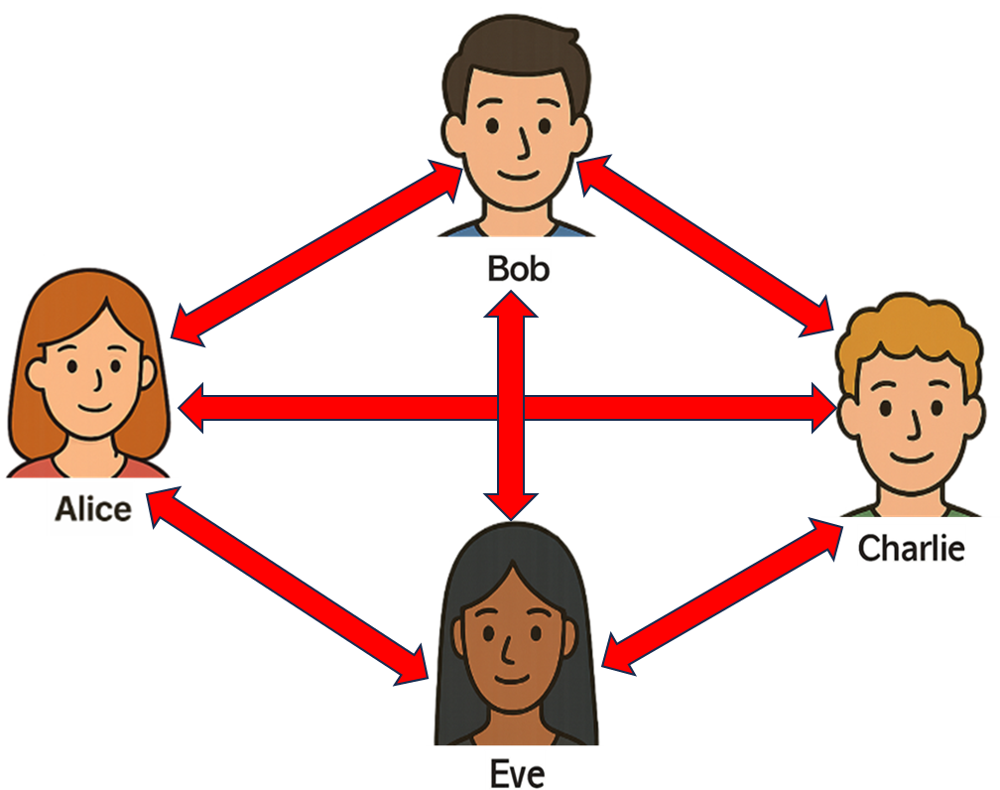
Scalability Issues in Payment Channels
Direct payment channel between all the peers is not scalable
On-chain funding transaction with everyone
Channel management & monitoring overheads
Locked funds in every channel (liquidity problems)
HTLC solves the scalability problem because it ensures secure payment routing

Slide 74
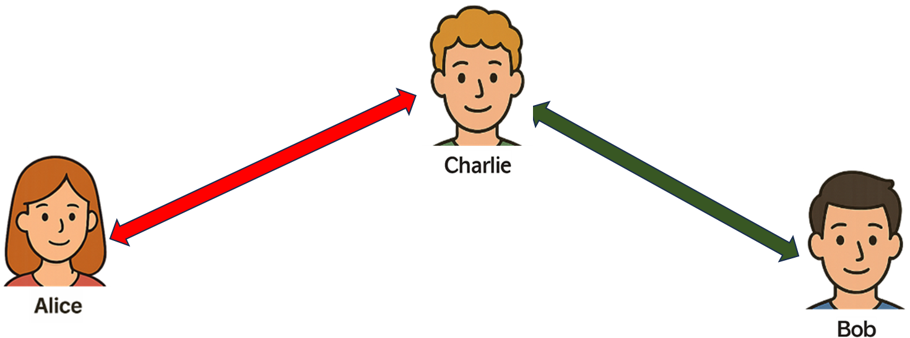
Micropayments with Routing
Bob (cafe owner) creates and displays a QR code that contains the required payment and the routing information including the hash of the secret to facilitate routing
Alice scans the QR code, creates an HTLC in her payment channel with Charlie (assuming the payment is routed through Charlie)
In the background, Charlie creates another HTLC in his payment channel with Bob
Bob receives the payment from Charlie, and consolidates his balance in his commitment transactions with Charlie
Charlie receives the payment from Alice, and consolidates his balance in his commitment transactions with Alice
Payment received message is displayed in Bob’s wallet, payment debited in Alice’s wallet
Bob gives coffee to Alice
Routing nodes charge very small fees (1 to 2 sats as base fee and some component proportional to txn value)

Slide 75
Commitment Transaction with HTLC Output
Transaction-Level Fields
(Version, nLockTime, Flags)
Alice’s output script (output_alice_script)
OP_IF # Revocation path for Charlie if Alice cheats
<revocationpubkey>
OP_ELSE # Normal delayed spend path
<to_self_delay> OP_CHECKSEQUENCEVERIFY OP_DROP
<pubkeyAlice> # Alice's delayed spend key
OP_ENDIF
OP_CHECKSIG
<wsh_ouptput_1>=SHA256(output_alice_script)
Alice’s output (2 spending paths)
Alice can spend after time lock
Charlie can immediately spend Alice’s funds with revocation key
Charlie’s output (1 spending path)
Charlie can immediately spend his funds
Funding TX
Charlie’s output has no script
OP_0 <p2wpkh_Charlie>
HTLC output (3 spending paths)
Anyone can claim with preimage of H
Alice can reclaim after time lock
Charlie can immediately spend with revocation key
HTLC output script (output_htlc_script)
OP_IF # Revocation path for Charlie if Alice cheats
<revocationpubkey>
OP_ELSE
OP_IF # Anyone can claim HTLC with preimage of H before timeout
OP_SHA256 <H> OP_EQUALVERIFY
<recoverpubkey>
OP_ELSE # Alice refunds after CLTV timeout
<cltv_expiry> OP_CHECKLOCKTIMEVERIFY OP_DROP
<pubkeyAlice>
OP_ENDIF
OP_ENDIF
OP_CHECKSIG
<wsh_ouptput_htlc>=SHA256(output_htlc_script)
Txid: C1a (Alice-Charlie-HTLC)
Witness Field
<Placeholder for Alice Sig> <SigCharlie><2-of-2 redeemScript>
Notes:
Alice has no direct channe with Bob so she routes here payment through Charlie.. She has a channel with Charlie were they already have a balance split according to their transaction history from the

Slide 76



Network of Payment Channels
A network of payment channels emerges with the help of trustless routing enforced through HTLC
Each channel becomes an edge in a graph and payment can be safely routed across multiple hops
Typical pathfinding algorithms like Dijkstra algorithms can be used to find the optimal paths (shortest path or with lowest fees)
1
Routing
2
3
Some nodes (1, 2, 3 in the graph) become highly connected hubs, offering routing as a service and earning small routing fee
Notes:
Alice can use her bitcoin to buy stuff from merchants..

Slide 77
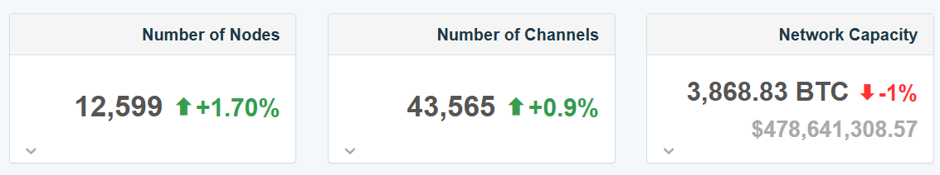
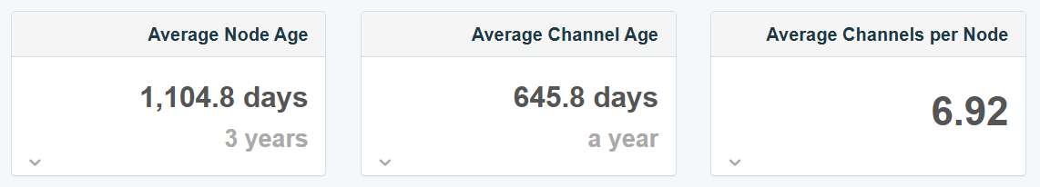
Lightning Network
The concept of payment channels for off-chain Bitcoin transactions was introduced in 2015 in a Whitepaper by Joseph Poon & Thaddeus Dryja
  “The Bitcoin Lightning Network: Scalable On-Chain Instant Payments”
Lightning network (LN) was launched by Lightning Labs in 2018
  After the activation of SegWit on the Bitcoin blockchain that solved the transaction malleability problem
  The ideas that we discussed are at the core principles of the LN
LN is called a layer 2 protocol for Bitcoin
  It is neither a blockchain nor a cryptocurrency
LN continues to grow and adapt
The LN is a critical component of Bitcoin scalability, and many ideas for Bitcoin’s future evolution revolve around it
https://1ml.com/statistics
Notes:
https://1ml.com/statistics
Live lightning network statistics

Slide 78
Privacy Evolution in Bitcoin

Slide 79
Privacy Evolution in Bitcoin
Privacy: The goal is to hide how you are using your coins; it is not about hiding your identity or making you anonymous
  In banking, your transactions are hidden from public view and only the bank knows how you are spending your money
  Bitcoin is a public ledger with all the transactions available on-chain
How to hide the spending scripts in Bitcoin?
Legacy transactions (Very poor privacy)
  The outputs reveal a lot of information including the pubkeyhash, multisig public keys, spending paths, complexity of the lock, full script structure
Segwit transactions (Some privacy improvements)
  Standardized the output formats and reduced them to only two types
  Outputs still reveal the transaction type (p2wpkh, or p2wsh) but the spending paths, script structure remain hidden initially
  Spending conditions are revealed in the child transaction when the coins are spent and once again the entire script structure becomes visible
Can we further improve privacy?
Notes:
Anonymity is hiding your identity which is not bitcoin goal.. The goal is to hide your spending like banking transactions

Slide 80
Privacy Improvements
Make all the outputs same i.e., only one type
Do not reveal the entire script or all the spending paths when unlocking the coins
Only one type of output
Reveal only one path when spending the output
Transaction-Level Fields
(Version, nLockTime, Flags)
HTLC output script (output_htlc_script)
OP_IF # Revocation path for Charlie if Alice cheats
<revocationpubkey>
OP_ELSE
OP_IF # Anyone can claim HTLC with preimage of H before timeout
OP_SHA256 <H> OP_EQUALVERIFY
<recoverpubkey>
OP_ELSE # Alice refunds after CLTV timeout
<cltv_expiry> OP_CHECKLOCKTIMEVERIFY OP_DROP
<pubkeyAlice>
OP_ENDIF
OP_ENDIF
OP_CHECKSIG
<wsh_ouptput_htlc>=SHA256(output_htlc_script)
Value
OP_1
<32-byte data>
Txid
Bitcoin supports both these privacy improvements through the ‘Taproot upgrade’

Slide 81
Taproot Upgrade
Transaction-Level Fields
(Version, nLockTime, Flags)
Taproot is the second major Bitcoin upgrade
  Activated in Nov 2021 at the block height 709,632, as a soft fork
It has only one output type for all type of spending conditions called pay-to-taproot (P2TR)
  OP_1 <32-byte data>
  OP_1 is an indication that it is a taproot transaction
Legacy as well as SegWit nodes accept taproot transactions
  Legacy nodes treat them as “anyone can spend”
  SegWit V0 nodes know it is a future version with OP_1 so they accept them
The witness field in the child transaction contains the required data that allows to unlock the taproot output
  While unlocking, only one spending path is revealed, and all the other branches in the script remain hidden
Value
OP_1
<32-byte data>
Txid: TAPROOT1234
Witness Field
<--> <-->
Technical improvements:
Signature: Replaced ECDSA with Schnor Signature (only one output structure, batch verification, privacy benefits)
MAST: Merkelized Abstract Syntax Tree (only reveal the script branch that is used for spending, while keep all other options hidden)
Tapscript: New op-code, new interpretation of some op-codes to validate Schnor and MAST

Slide 82
Privacy Advantages of Schnorr Signature
Hides the mutlisig public keys through key aggregation
Suppose Alice, Bob and Charlie want to create a 3-of-3 multisig
  They first aggregate their public keys <pkAgg> = <pkA>+<pkB>+<PkC>
  They then derive a 32 B tweaked public key Q from <pkAgg>
  Lock funds in a P2TR transaction output: OP_1 <Q>
To unlock, they cooperate to create a spending transaction because they only know their individual private keys
  Each party individually signs the spending transaction with the help of its private key and produce partial signatures <sigA>, <sigB> and <sigC>
  They aggregate the signatures: <sigAgg> = <sigA>+<sigB>+<sigC>
  The witness field of the spending transaction only contains <sigAgg> (transaction size is also reduced so lower fee becomes an added advantage)
The spending transaction now reveals nothing about the number of participants or their individual public keys (great for privacy)
Notes:
Create an internal key of 32 B where P=x (the point on the EC remains the same if y coordinate is even but if y coordinate is odd the corresponding point becomes –P so x is still the same but we flip y)
Once we get P we create a tweaked public key of 32 B Q, where Q=P+h(P||m)G where m is the merket root of the script tree and G is the generator point on the EC

Slide 83
Batch Verification
Key aggregation and signature aggregation are powerful features of Schnorr signatures that also accelerate transaction verification
In a single multisig transaction, multiple public keys and signatures can be aggregated into one, improving efficiency and privacy
At the block level, validators can use batch verification, where multiple Schnorr signatures from independent transactions are combined into a single verification equation
If this batch check succeeds, all signatures are validated simultaneously
If it fails, the validator falls back to individual verification to identify the invalid signature

Slide 84
Merkelized Abstract Syntax Tree (MAST)
Only reveal the script branch that is actually used for spending, while keeping all other spending conditions hidden
HTLC output script (output_htlc_script)
OP_IF # Revocation path for Charlie if Alice cheats
<revocationpubkey>
OP_ELSE
OP_IF # Anyone can claim HTLC with preimage of H before timeout
OP_SHA256 <H> OP_EQUALVERIFY
<recoverpubkey>
OP_ELSE # Alice refunds after CLTV timeout
<cltv_expiry> OP_CHECKLOCKTIMEVERIFY OP_DROP
<pubkeyAlice>
OP_ENDIF
OP_ENDIF
OP_CHECKSIG
<wsh_ouptput_htlc>=SHA256(output_htlc_script)
3 spending conditions – 3 leafs in the MAST
Leaf 1 (h1): Script for the first path (revocation key)
Leaf 2 (h2): Script for the second path (HTLC path)
Leaf 3 (h3): Script for the third path (Refund path)
Hash
(h12,h3)
Merkel Root of the Tap Tree (h)
h12 = hash
(h1,h2)
h1
h2
h3
Script
(1st Path)
Script (2nd Path)
Script
(3rd Path)
Notes:
https://rubin.io/projects/MAST/

Slide 85
Witness Elements
Spending from Key path
Spending from Script path
Transaction-Level Fields
(Version, nLockTime, Flags)
Transaction-Level Fields
(Version, nLockTime, Flags)
Value
OP_1
<32-byte data>
Value
OP_1
<32-byte data>
Txid: TAPROOT1234
Txid: TAPROOT1234
Witness Field
<Signature>
Witness Field
<Leaf Script arguments> <Leaf Script> <Control Block>
The script of the spending path only along with the arguments needed by the script (such as signature, hash, something else)
The control block proves that the included script is part of the committed taproot key in the tweaked public key (provides the Merkel path hashes)
Only one witness element, which is the signature created with the tweaked private key
Notes:
In the control block the internal key is revealed so the public key is exposed in the script path.. When we are using the key path (although the name is the key path), we are just providing the signatures with the corresponding tweaked private key so the internal public key is never exposed. So script path exposes the internal public key but key path does not.

Slide 86
Public Key Privacy
Public keys are sensitive privacy identifiers
Bitcoin design has evolved to minimize the on-chain visibility of raw public keys
  In P2WPKH & P2WSH, raw public keys are exposed in the spending transactions (single user public key in p2wpkh, and multisig public keys in p2wsh)
  Taproot improves privacy by locking funds to a tweaked public key and in the spending transaction only the signature is required
  In taproot multisig transactions, key aggregation and signature aggregation techniques, which are the key features of Schnorr signature conceal the public keys (multisig looks like a single sig transaction)
  The actual public key is only exposed when spending through the script path in taproot
A growing best practice is to generate a new key pair for every transaction
  Exposing public key only to the counterparty and never broadcasting it unnecessarily

Slide 87
Scope & Limits of Privacy in Bitcoin
Wallet level
  Some privacy features can be implemented entirely within the wallet software, without requiring any change to Bitcoin’s consensus rules
Protocol level
  Some privacy features require a consensus-level change, usually via a soft fork, to introduce new transaction rules, opcodes, or validation logic
There are three dimensions of transaction privacy
Sender privacy
  Solutions exist to achieve sender privacy entirely at the wallet level (e.g., PayJoin protocol)
Receiver privacy
  Silent or Stealth Payments (wallet level): Sender derives a one-time address from the receiver’s public key using cryptography
  Receiver continuously scans the blockchain to detect payments but only they can unlock them, breaking the payer–payee link
Value privacy
  Conceals transaction amounts using cryptographic proofs (solutions exist)
  Requires consensus-level changes and likely a hard fork – Not currently possible on Bitcoin

