Slide 1

Introduction to Blockchain
CSE-355
Ahmed Akhtar
Department of Computer Science
SMCS, IBA Karachi
Spring 2026

Slide 2
Lecture 21
Tuesday, Apr 14, 2026

Slide 3
Risks of Turing-Completeness
Ethereum is Turing-complete, which allows immense flexibility in writing smart contracts
Are there any challenges and risks of Turing-Completeness?
There are several risks:
Security risks: Due to complexities and vulnerabilities that are difficult to anticipate
Difficulty in formal verification: Proving or verifying the correctness of a program becomes challenging
Scalability concerns: Arbitrary and computationally resource-intensive programs can be created
Potential for misuse or abuse: The flexibility of Turing-complete languages can also be exploited for malicious purposes, e.g., malicious actors may create smart contracts to conceal malicious behavior, making it harder to detect and mitigate security risks
Infinite loops that never terminate can be easily created
Unintended never-ending loops can also arise without warning
Bitcoin’s scripting language is intentionally Turing-incomplete to ensure predictable outcomes

Slide 4
Introduce Computational Cost: Gas
To address the disadvantages of Turing-completeness, Ethereum introduced a computational cost mechanism called ‘Gas’
Every transaction that requires computational effort must include sufficient gas
Instructions such as computations and data access have predetermined computational costs measured in gas units
Computation terminates prematurely if the gas limit is exhausted and there are still some instructions pending
  In such cases, the transaction fails and gas spent is lost
Ethereum does not require users to provide the exact gas amount for their smart contracts
  Users may include a higher amount, as any unused gas is returned if the transactions executes successfully
The use of gas as the fundamental unit of computational effort allows Ethereum to limit resource consumption and prevent misuse by malicious actors

Slide 5
Gas Cost of Instructions
Value | Mnemonic | Gas Used | Notes
0x31 | BALANCE | 400 | Get balance of the given account
0x32 | ORIGIN | 2 | Get execution origination address
0x33 | CALLER | 2 | Get caller address
0x3b | EXTCODESIZE | 700 | Get size of an account’s code
0x54 | SLOAD | 200 | Load word from storage
0xf0 | CREATE | 53,000 | Create a new account with code (smart contract deployment)
0x37 | CALLDATACOPY | FORMULA | Copy input data in current environment to memory
0x38 | CODESIZE | 2 | Get size of code running in current environment
0x39 | CODECOPY | FORMULA | Copy code running in current environment to memory
Value | Mnemonic | Gas Used | Notes
0x00 | STOP | 0 | Halts execution
0x01 | ADD | 3 | Addition operation
0x02 | MUL | 5 | Multiplication operation
0x03 | SUB | 3 | Subtraction operation
0x04 | DIV | 5 | Integer division operation
0x05 | SDIV | 5 | Signed integer division operation (truncated)
0x06 | MOD | 5 | Modulo remainder operation
0x07 | SMOD | 5 | Signed modulo remainder operation
0x08 | ADDMOD | 8 | Modulo addition operation
0x09 | MULMOD | 8 | Modulo multiplication operation
https://docs.google.com/spreadsheets/d/1n6mRqkBz3iWcOlRem_mO09GtSKEKrAsfO7Frgx18pNU/edit#gid=0
Notes:
https://github.com/crytic/evm-opcodes

Slide 6
Transactions are Atomic
A transaction is treated as an atomic operation that cannot be divided or interrupted
All (completely done) or Nothing (zero effect)
If an insufficient amount of gas is included in a transaction, all the state changes are rolled back except for the gas, which gets consumed while performing the computational steps
Introduction of gas to measure computational effort and treatment of transaction as atomic operation are Ethereum’s innovations to overcome the disadvantages of Turing-completeness

Slide 7
Attack Scenario: Example
Attack Scenario: An attacker creates a contract which runs an infinite loop and then sends a transaction activating that loop to the miner/validator. The miner/validator does not know about the infinite loop and starts processing the transaction
Will this attack succeed?
  No
Why?
  A valid txn must include gas limit, therefore, the execution will stop when this limit is reached
Is this txn included in the block?
  Yes, it is included as a failed txn
  The fee for the computational effort goes to the miner/validator
Notes:
https://ethereum.org/en/whitepaper/

Slide 8
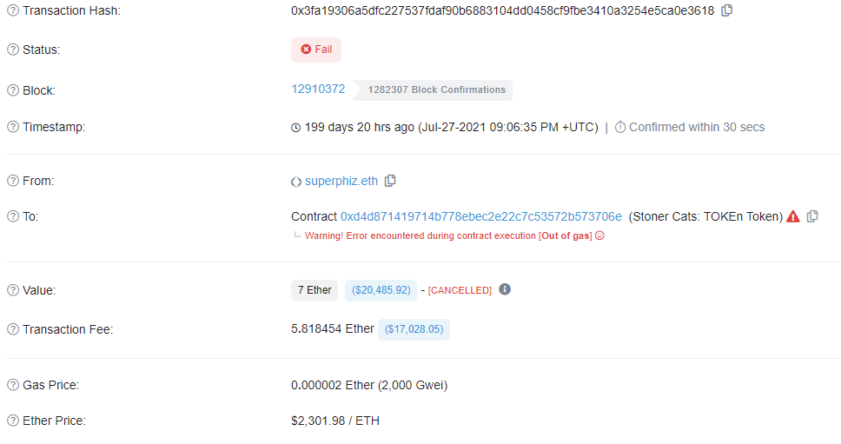
Failed Transaction: Example
https://etherscan.io/
Fee paid by the user for this failed txn
https://etherscan.io/tx/0x3fa19306a5dfc227537fdaf90b6883104dd0458cf9fbe3410a3254e5ca0e3618
Notes:
https://etherscan.io/tx/0x3fa19306a5dfc227537fdaf90b6883104dd0458cf9fbe3410a3254e5ca0e3618 [failed transaction example)

Slide 9
Attack Scenario: Example
Attack Scenario: An attacker creates a very long loop with the intent of forcing the miner/validator to keep computing for such a long time that by the time computation finishes a few more blocks will have come out and it will not be possible for the miner/validator to include the transaction to claim the fee
Will this attack succeed?
  No
Why?
  A valid txn includes gas limit that will allow the miner/validator to estimate the computation time before deciding to process it
Notes:
https://ethereum.org/en/whitepaper/

Slide 10
Attack Scenario: Example
Attack Scenario: Suppose there is a contract on blockchain that allows withdrawal from an account followed by updating the account balance. An attacker who can withdraw amount creates a txn to execute this contract but includes just enough gas to run the first step i.e., making a withdrawal but not letting his balance go down
Will this attack succeed?
  No
Why?
  Transactions are treated as atomic operations. If this execution stops halfway through, the changes will be reverted, and withdrawal of funds request will be cancelled
Notes:
https://ethereum.org/en/whitepaper/

Slide 11
Gas is Purchased with Ether
Gas is an essential requirement for anyone to use Ethereum
Gas can only be purchased with Ether (the cryptocurrency of Ethereum)
Ether is identified on crypto exchanges as ‘ETH’
Purchasing gas for various computations (txns and smart contracts) is one of the major use of Ethereum’s cryptocurrency (Ether)
Purchase gas for payment of txn fees
Digital store of value like Bitcoin
Decentralized Finance (crypto loans/staking)
The smallest denomination, base unit, of ether is called Wei:
1ETH = ${10}^{18}$ wei
Gas price is generally specified in Gwei
The number of gas units required for specific computations always remain the same, but the gas price varies

Slide 12
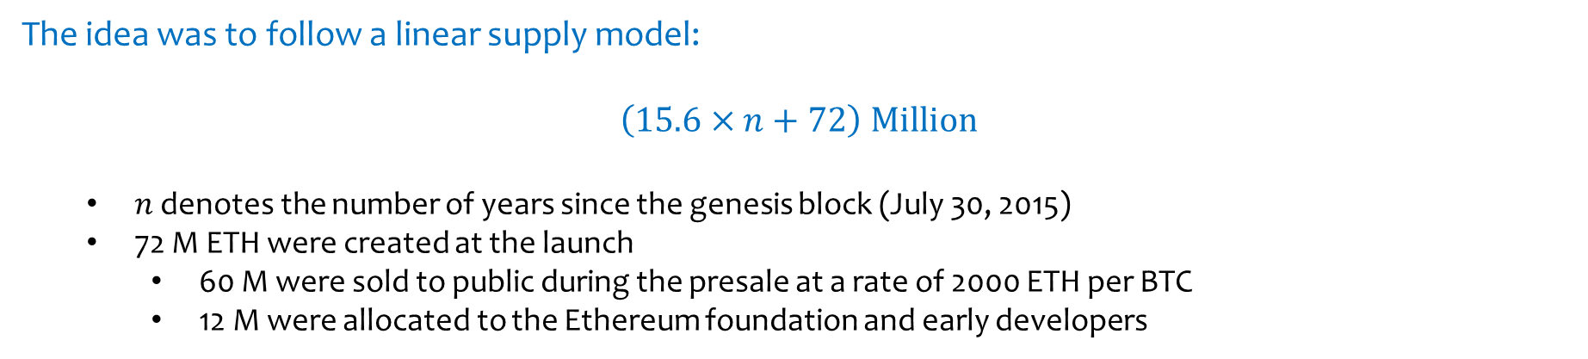
ETH Supply Model
When Ethereum launched in 2015, Vitalik Buterin chose not to cap the supply of Ether
The idea was to follow a linear supply model:
$$\left(15.6×n+72\right) Million$$
  $n$ denotes the number of years since the genesis block (July 30, 2015)
  72 M ETH were created at the launch
    60 M were sold to public during the presale at a rate of 2000 ETH per BTC
    12 M were allocated to the Ethereum foundation and early developers
Assuming $n=10$ years since genesis, the total Ether supply would be approximately 228 million
Mining reward was gradually reduced from 5 ETH to 2 ETH, and after the Merge, it became 0 ETH (no more miners)
New ETH is now generated only to pay staking rewards to validators
Ether burning, which permanently removes some ETH from circulation, began in August 2021 after the London upgrade
Current ETH supply is only: 120.7 M < 228 M
https://ethereum.org/en/whitepaper/
Notes:
https://blog.ethereum.org/2014/07/22/launching-the-ether-sale

Slide 13
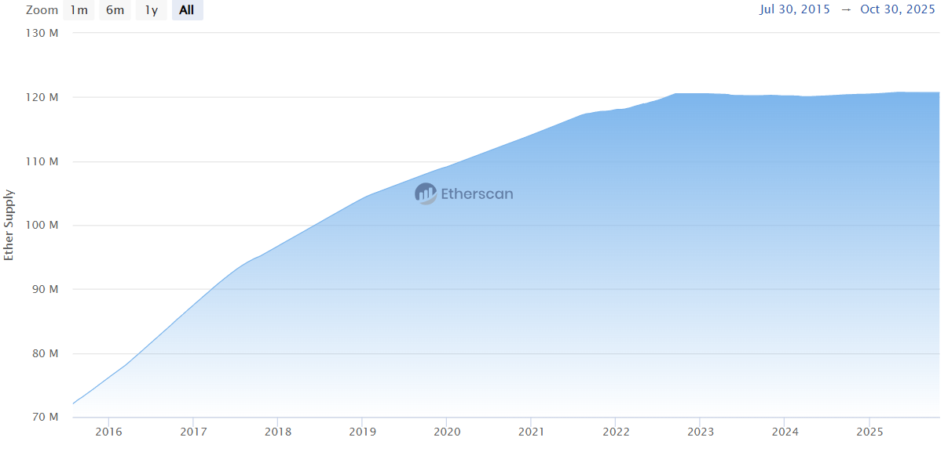
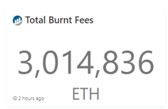
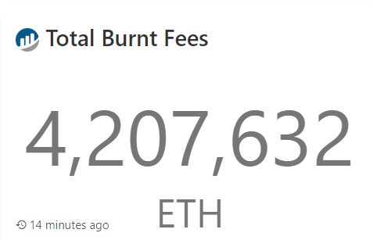
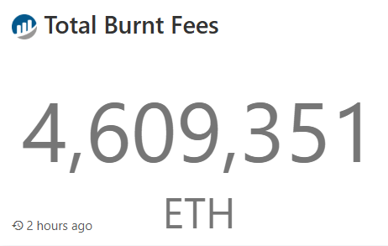
ETH Supply & ETH Burning
The ETH supply has stabilized around 120 M due to EIP-1559 (London upgrade, Aug 2021) and the Merge (Sept 2022), which reduced ETH issuance and introduced ETH burning
March 21, 2023
March 28, 2024
Oct 31, 2025
More than 4.6 million ETH has been burned till now
https://etherscan.io/chart/ethersupplygrowth
https://etherscan.io/chart/dailyethburnt
Notes:
https://www.coindesk.com/markets/2022/05/02/apecoin-drops-ether-trades-flat-after-record-200m-gas-burn/
https://etherscan.io/chart/ethersupplygrowth

Slide 14
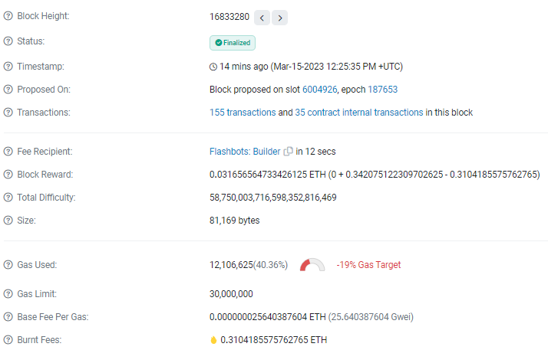
ETH Burning
Txn fees for the validator
Total Transaction fees paid by users
Burnt fees
https://etherscan.io/block/16833280
Burnt fees = Gas used in block * Base fee per gas = 12,106,625*25.640387
Notes:
https://etherscan.io/block/14205496

Slide 15
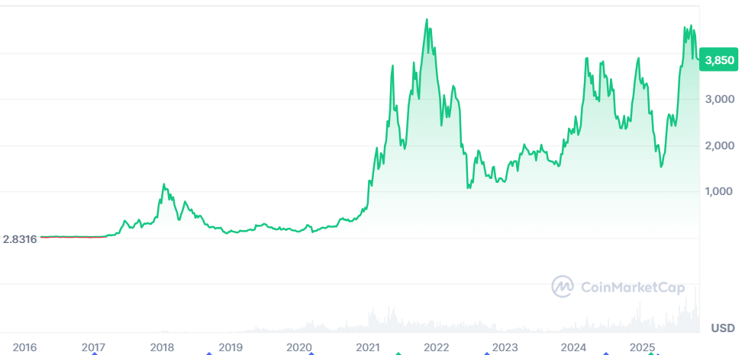
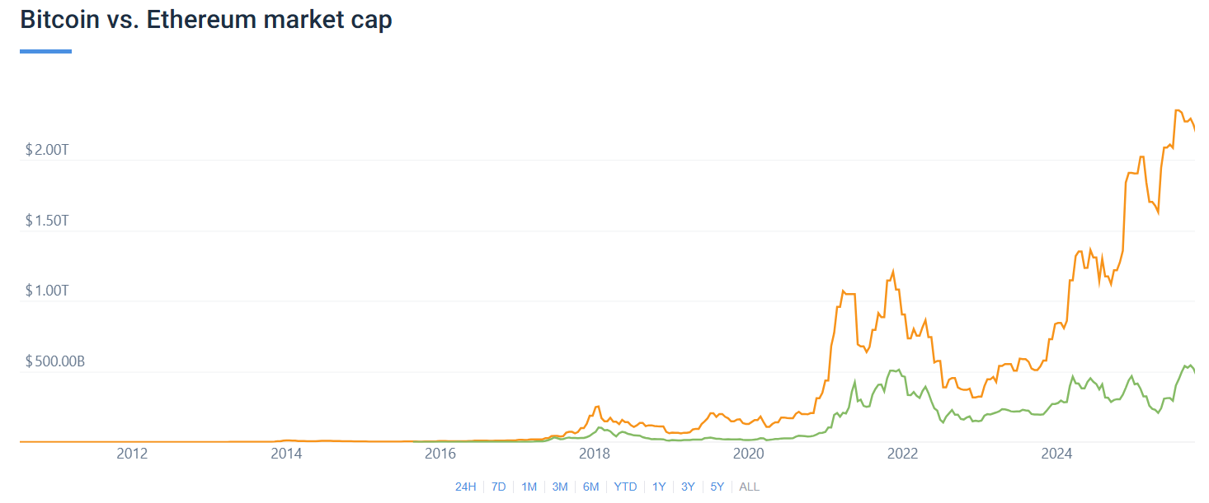
Price vs Market Cap
ETH price = $3.8k, ETH current supply = 120.7 M
BTC price = $110k, BTC current supply = 19.7 M
Market Capitalization (cap): Price x Supply
ETH market cap: $458B (~ $500B)
BTC market cap: $2.16T
Bitcoin is roughly four times as valuable as Ethereum
Market cap provides a more complete picture of a network’s overall worth
Bitcoin market cap has increased more rapidly in recent years compared to ETH

Slide 16
Lecture 22
Thursday, Apr 16, 2026

Slide 17
Ethereum: Technical Details

Slide 18

Account Types in Ethereum
Ethereum uses account based model and there are no UTXOs like Bitcoin
There are two types of Ethereum accounts
Externally Owned Account (EOA)
Contract Account (CA)
Private Key
Sender’s address that deploys contract
(sender can be EOA or another contract)
Sender’s Nonce
Public Key
Keccak(RLP(Sender_address+Sender_nonce))
[right 160 bits only as CA address]
Keccak-256 Hash [right 160 bits only as EOA address]
Address
(160 bits)
Address
(160 bits)
RLP (recursive length prefix) is an encoding or serialization technique while Keccak-256 is the hashing algorithm used by Ethereum
Notes:
Contract account can be created either by EOA or by another smart contract e.g., smart contract factory which is a template smart contract that when triggered by an external transaction creates a new smart contract.. The address of new smart contract is the sender address + nonce (sender in this case can be EOA or parent smart contract)..
RLP (recursive length prefix) is an encoding or serialization technique while Keccak-256 is the hashing algorithm used by Ethereum

Slide 19
Externally Owned Account (EOA)
A user or a wallet can create an EOA: Creating an EOA costs nothing
1 Keypair = 1 EOA
EOA is made up of a cryptographic key pair: public and private
First a private key (32B) is generated whose purpose is to sign the transactions (like Bitcoin) – it is randomly generated from a seed
A public key (64B) is derived from the private key using Elliptic curve digital signature algorithm (ECDSA)
Account address (20B) is the last 160 bits of the Keccak-256 hash of the public key
Can initiate txns
Receive, hold and send ETH
Interact with txns and deployed smart contracts
Txns between EOAs can only be ETH/token transfers
Notes:
https://ethereum.org/en/developers/docs/accounts/

Slide 20
Contract Account (CA)
CA is the address of a smart contract deployed to the network
  It is controlled by its code
  Creating a contract account has cost in terms of gas
Contract address (20B) becomes available after its deployment
  It comes from contract creator’s address (either EOA or another smart contract) and number of transactions sent form that address (nonce)
CA cannot initiate transactions
CA can interact with txns and other smart contracts
CA can receive, hold and send ETH or tokens
CA can create and deploy new smart contracts e.g., factory contract or smart contract factory
Only EOAs can start a transaction
Notes:
Factory contract: https://enlear.academy/factory-contracts-in-blockchain-technology-a-simple-explanation-and-use-case-2e740ec0874f
For example every time a new student enrolls a new smart contract is created by calling the factory smart contract using the name and date of birth of the student..

Slide 21
Account State
Nonce is a counter that is incremented every time a txn is made by an account
  It is used to protect against replay attacks
  EOA Nonce is number of transactions performed by the account
  CA Nonce is the number of contracts created by the account
Storage Hash: The storage mechanism provides a verifiable summary of a contract’s stored data (e.g., token balances)
  A Merkel like tree is constructed and a 256-bit hash of its root node is stored as part of the account state
Code Hash: This refers to the hash of the bytecode associated with an account
  EOA: hash of an empty string
  CA: hash of the smart contract code
nonce
Address
balance
Storage hash
Account storage
Code hash
EVM Code
https://ethereum.org/en/developers/docs/accounts/
Notes:
(e.g., smart contract factory address + smart contract factory contract nonce)

Slide 22
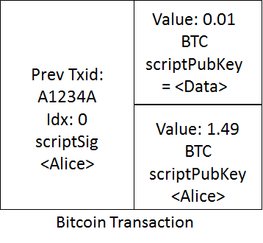
Blockchain
Chain of blocks
In case of Bitcoin, transactions are stored in blocks and all the required information is included in a Bitcoin txn
What about Ethereum? Do we store txns in blocks? What’s inside a txn? Account information, code, data, something else?

Slide 23
Alternate View of Blockchain – World State
Due to account based model, we adopt a different approach to understand Ethereum
Every Ethereum account has a state that is represented by a nonce, balance, codehash and storagehash
The world state (simply state) of Ethereum at any time t is defined as the state of all the accounts
Single Account State
World State
Address
nonce
Address 1
Account state 1
balance
Address 2
Account state 2
Storage hash
Address 3
Account state 3
Code hash
Account storage
.
.
.
.
EVM Code

Slide 24
Transaction
A transactions is a single cryptographically signed instruction initiated by an EOA that changes Ethereum world state
Transaction
World State at time t
World State at time t+1
Only valid transactions change the world state because invalid txns are rejected by the network

Slide 25
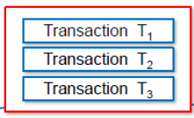
Block
An Ethereum block is a collection of transactions & all the transactions inside a block collectively change the world state
Block
World State at time t
World State at time t+1
The update rate of world state is equal to the block generation rate

Slide 26
Blockchain
To preserve the transaction history, blocks are strictly ordered and every new block contains a reference to its parent block
Block b-1
Blocks are chained
Block b
World State at time t-1
World State at time t
World State at time t+1

Slide 27
Transactions Change World State
By default, the Ethereum execution environment is lifeless
  The state of every account remains the same
However, any user can trigger action by sending a transaction from an EOA
  If the destination of the transaction is another EOA, then the transaction may transfer some ether but otherwise does nothing
  However, if the destination is a contract, then it is activated, and runs its code
The code of has the ability to:
  Read and write its own internal storage
  Access the data of the incoming message (sender, value, data, gas)
  Send messages (function calls) to other contracts, which can trigger their execution
  Send ETH or tokens that it already holds to other contracts or EOAs
  Increase the balance of an EOA by sending ETH to it (the EOA’s balance in the global state increases)

Slide 28

Transactions
Transactions are initiated by EOAs and there are two important categories of Ethereum transactions
Regular Transaction
Contract Deployment Transaction
External Actor
External Actor
Contract Deployment Transaction
Regular Transaction
Message
Creates
EOA
EOA or CA
Contract Account

Slide 29
EIP-1559 Transaction
The receiving address (if an EOA, the regular txn will transfer value. If a CA, the regular txn will execute the contract code). In case of contract deployment txn, this field is empty
Transaction
Unique identifier – should be consistent with the account nonce at the time of txn creation (protection against replay attacks)
Nonce
Recipient
Signature
Identifies the sender – txn is signed with sender’s private key
Amount of ETH from sender to recipient (in Wei)
Value
Max amount of gas units to be consumed by txn (generally a guess for complicated txns)
Data
Arbitrary data or code (optional). In case of contract deployment txn, this field contains bytecode
Gas Limit
Max price in Gwei per gas unit the sender is willing to pay for the txn
Max Priority Fee per Gas
Tip in Gwei per gas unit that the sender is willing to pay to the validator
Max Fee per Gas
Replay protection on different chains (main chain id is 1)
Chain ID
Notes:
Max fee per gas ensures protection against base fee increase.. Max fee per gas must be greater than the base fee per block plus the max priority fee per gas (miner tip)

Slide 30
Accounts & Transactions
Transaction
Nonce
Account State
Recipient
Signature
Address
nonce
Value
balance
Data
Storage hash
Gas Limit
Account storage
Max Priority Fee per Gas
Code hash
Max Fee per Gas
EVM Code
Chain ID

Slide 31
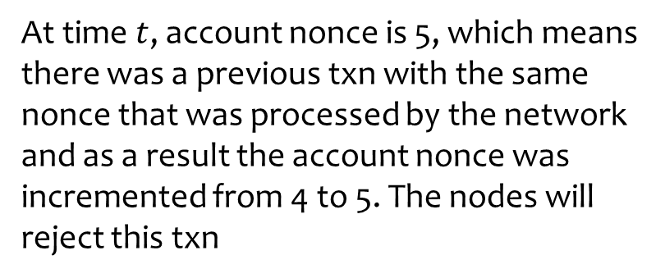
Nonce Role
Will this replay attack succeed?
No
Alice’s account nonce in world state at time t
Previous txn replayed by an attacker at time t
Why?
.
.
.
.
.
.
.
.
At time$t$, account nonce is 5, which means there was a previous txn with the same nonce that was processed by the network and as a result the account nonce was incremented from 4 to 5. The nodes will reject this txn
Account Nonce = 5
Txn Nonce = 5
Nonce prevents the replay attacks

Slide 32
Nonce Role
Alice’s account nonce in world state at time t
Txn 1 created by Alice at time t
Txn 2 created by Alice at time t
.
.
.
.
.
.
.
.
.
.
.
.
Account Nonce = 5
Txn Nonce = 6
Txn Nonce = 7
Which txn is valid?
Both txns are valid
Alice has created two valid txns that are unconfirmed. Nodes can see both the txns. The network will process txn 1 followed by txn 2 and will update account nonce to 7 in the world state. This technique may be used to accelerate txn 1 processing that might get stuck due to lower fee
Nonce allows to choose the order in which transactions will be executed

Slide 33
Nonce Role
Two txns are created by Alice at the same time with the same nonce
Txn 1 created by Alice at time t
Which txn is valid?
.
.
Both txns are valid. However, as soon as one of them gets confirmed, the other txn will become invalid
Txn Nonce = 6
Alice’s account nonce in world state at time t
Max priority fee per gas = 1 Gwei
It is highly likely that the validator will process txn 2 with higher max priority fee (tip). After txn processing, the account state nonce will also be updated to 6 in the world state
.
.
.
.
.
Account Nonce = 5
Txn 2 created by Alice at time t
.
.
This technique may be used to cancel a pending txn that is taking too long to process. Replace it with a new txn with the same nonce but with a higher txn fee
Txn Nonce = 6
Max priority fee per gas = 5 Gwei
.
We can cancel an unconfirmed txn by invalidating its nonce

Slide 34
Lecture 23
Tuesday, Apr 21, 2026

Slide 35
Contract Deployment
Smart contract deployment on blockchain means creation of a new address in Ethereum world state
Contract Deployment Transaction
Contract account has a permanent storage, and it is controlled by its EVM code
Code in Data Field
Address 1
Account state 1
Address 1
Account state 1
Address 2
Account state 2
Address 2
Account state 2
Address N
Account state N
Create
code
storage
World State at time t
World State at time t+1
Once on blockchain the contract is controlled by its code
Contracts cannot initiate transactions, but can send message calls (function calls) to other contracts or EOAs
Notes:
In CA deployment txn recipient field is empty.. CA address is automatically generated from EOA’s address and nonce

Slide 36
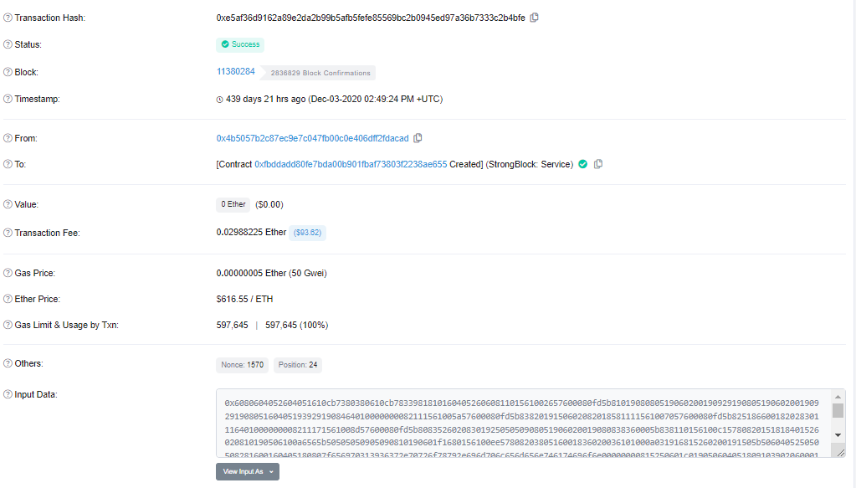
Contract Deployment Transaction – Example
0xe5af36d9162a89e2da2b99b5afb5fefe85569bc2b0945ed97a36b7333c2b4bfe
Is there any limit on the size of contract code?
No
EOA address
The txn from EOA created a new CA
Contract code (hexcode) – user writes contract code in high-level language like Solidity, which is converted to bytecode for deployment on blockchain
https://etherscan.io/tx/0xe5af36d9162a89e2da2b99b5afb5fefe85569bc2b0945ed97a36b7333c2b4bfe
Notes:
Hexcode generated from the binary code..

Slide 37
Size of Contract Code
There is no limit on the size of contract code field
Suppose someone writes a very long code (several hundred MB), includes all the required gas and a huge tip in the txn and then try to deploy this smart contract on Ethereum. Will this attempt succeed?
No
  Ethereum avoids this problem by setting an upper limit on block size in terms of gas units
Max Block Limit (gas):
30 million gas units (can slightly exceed this limit)
Target Block Limit (gas):
15 million gas units
A single smart contract that consumes more than 30M gas units cannot be deployed on Ethereum blockchain
Notes:
Target block size is average block size in gas units that Ethereum tries to maintain

Slide 38
Maintaining a Target Gas Limit
The network adjusts the block base fee to maintain a target block gas limit of 15 million units
If the last block used more than 50% gas, base fee for the next block will increase
If the last block used less than 50% gas, base fee for the next block will decrease
The change in the base fee (increase or decrease) from one block to the next is not more than 12.5%
This base fee is not linked to block generation time (note: Ethereum block is produced every 12 seconds)
Notes:
Block generation time is controlled by adjusting the network difficulty

Slide 39
Percentage Gas Used and Gas Target
Percentage gas used in a block = (Gas used in million / 30 M) x 100
Percentage gas target = ((Gas used in million – 15 M) / 15 M) x 100
Percentage gas used in a block can vary between 0% to 100%
Percentage gas target can vary between -100% to +100%
  Negative % means gas consumed is less than 15 M
  Positive % means gas consumed in greater than 15 M

Slide 40

Block Base Fee calculation
Change in base fee for the next block = (% gas used in current block– 50) /4
Base fee for the next block =
Base fee for current block * [1 + Change in base fee for the next block )]
Base fee for block 14396888 = 17.484043191 Gwei
Gas used in block 14396888 is 11.06%
% change in base fee for block 14396889 = (11.06 - 50)/4 = -9.375%
Block: 14396888
Gas used = 3.31 M
% gas used = 11.06 %
% gas target = -78 %
Base Fee = 17.484 Gwei
Base fee for block 14396889 = 17.484043191 x [1 + (-9.375 / 100)] = 15.782 Gwei
https://etherscan.io/block/14396889
Notes:
Base fee for the next block = Base fee for current block * [1 + (% gas used in current block – 50) / 400)]

Slide 41
Is Storing Transactions in Blocks Sufficient?
Ethereum block is a collection of transactions and all the transactions inside a block collectively change the world state
Block
World State at time t
World State at time t+1
Ethereum blocks contain transactions but are transactions sufficient to reproduce and verify everything that happened on blockchain?
No, txns alone are not sufficient

Slide 42
Storing Transactions is Not Sufficient
Suppose Alice wants to send 1 ETH to Bob, she creates a txn and broadcasts it on the network
Transaction created by Alice
Nonce=5
Just by looking at this txn, we do not get any information about Alice’s account balance
Suppose Ethereum changes its txn format and adds an account balance field inside the txn. Would this solve the problem?
  No
Why?
  Alice can lie and provide wrong balance
We do not encounter this problem in Bitcoin because the child txn inputs are always pointing towards the parent UTXOs that Alice wants to spend
Ethereum’s account based model therefore necessitates storing and tracking the world state
Recipient=Bob
Signature=Alice
Value=1ETH
Data (empty)
Gas Limit=21,000
Max Priority Fee per Gas=10Gwei
Max Fee per Gas=100Gwei
Chain ID=1
How to keep track of Alice’s and all other Ethereum account states?

Slide 43
Where is the World State Stored?
Block
Transaction
Nonce
World State at time t
World State at time t+1
Recipient
Signature
Value
Account state
Data
Address
nonce
Address 1
Account state 1
Gas Limit
balance
Address 2
Account state 2
Max Priority Fee per Gas
Storage hash
Address 3
Account state 3
Max Fee per Gas
Code hash
Account storage
.
.
.
.
Chain ID
EVM Code
Where is the world state stored?

Slide 44
World State Trie
Solution: Create a world state trie – pack all the Ethereum account states into a deterministic and cryptographically verifiable structure and then store the state root in the block header
Alice Address
Alice account state
Bob Address
Bob account state
State Root
Address 3
Account state 3
.
.
.
.
The word trie is taken from retrieval (pronounce it as tree)
Hash
Hash
Alice’s account
Alice Address
nonce
balance
Alice’s account state [nonce, balance, storage hash, code hash]
Bob’s account state
Account state 3
Storage hash
Code hash
Account storage
Account states are stored in a modified Merkle Patricia Trie or modified MPT (it is not the same as Merkle tree)
EVM Code

Slide 45
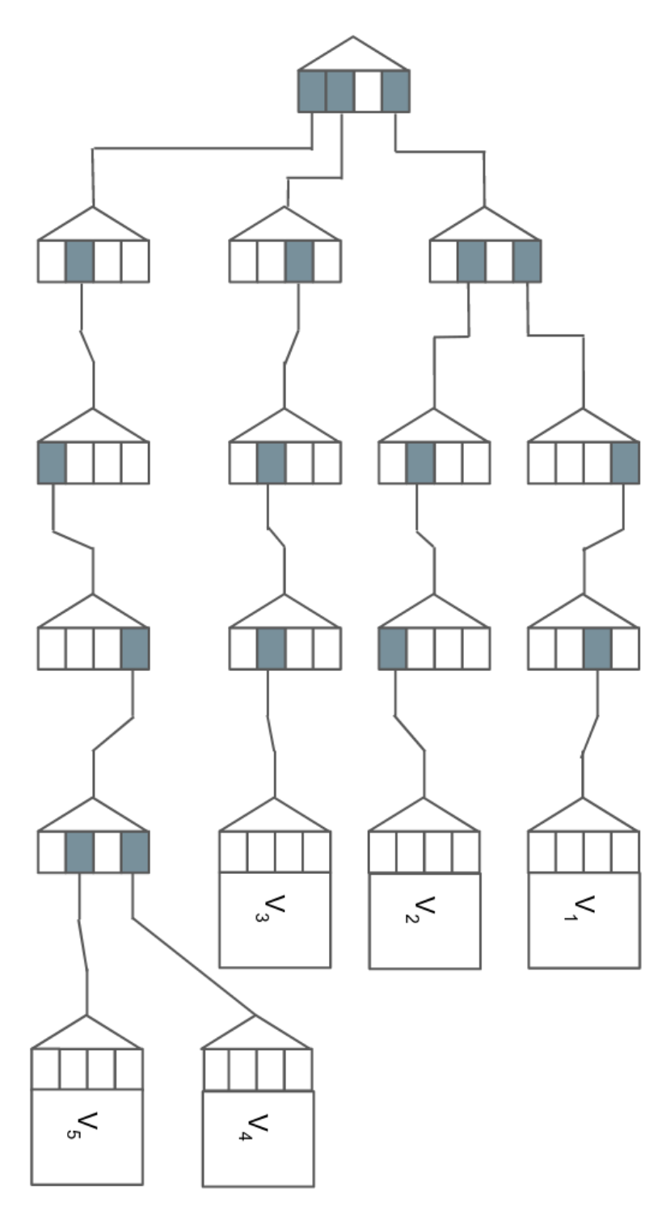
Merkle Patricia Trie (MPT)
Patricia - Practical Algorithm To Retrieve Information Coded In Alphanumeric (1968 paper)
Basic idea: A node's position in a tree defines the key with which it is associated
The path to reach value V2:
3-1-1-0
The path to reach value V5:
0-1-0-3-1
Ethereum uses hexary Patricia tree with 16 choices at each node (a modified version of MPT). It also uses hashing so that the root node becomes a cryptographic fingerprint of the entire data structure. The trie is implemented as a key-value database
V3
V2
V1
V5
V4
0 | 1 | 2 | 3
https://blog.ethereum.org/2019/12/30/eth1x-files-state-of-stateless-ethereum/

Slide 46
Lecture 24
Thursday, Apr 23, 2026

Slide 47
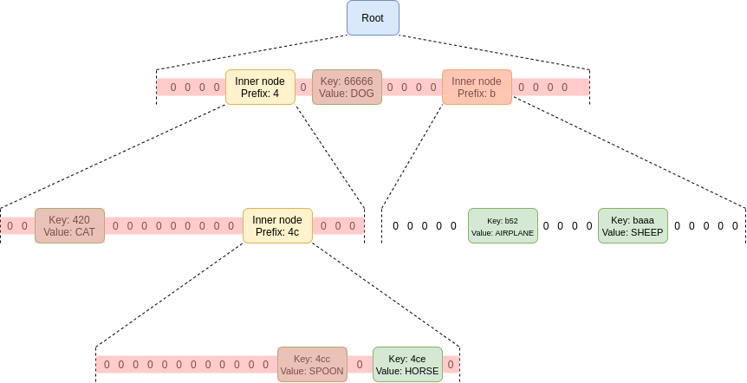
Hexary MPT
Hexary Patricia tree with 16 choices at each node
How to get to the node with key 4ce?
Start at the root, then go down to the child at position 4, then go down to the child at position c (remember: c = 12 in hexadecimal), and then go down again to the child at position e
In Ethereum, key to reach an account state in the MPT is the 256-bit hash of its Ethereum address
https://vitalik.ca/general/2021/06/18/verkle.html

Slide 48
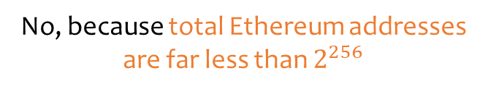





Hexary MPT
0 1 2 3 4 5 6 7 8 9 a b c d e f
Root node level
$${16}^{1}$$
0 -- f
0 -- f
-------
0 -- f
0 -- f
$${16}^{2}$$
0 -- f
---
0 -- f
0 -- f
---
0 -- f
-------
0 -- f
---
0 -- f
0 -- f
---
0 -- f
$${16}^{3}$$
0 -- f
0 -- f
$${16}^{64}$$
Total positions or keys at the 64th level are ${16}^{64}=2^{256}$
Do we need all the $2^{256}$ leafs (keys)?
In a tree like structure, a leaf has no child
No, because total Ethereum addresses are far less than $2^{256}$

Slide 49
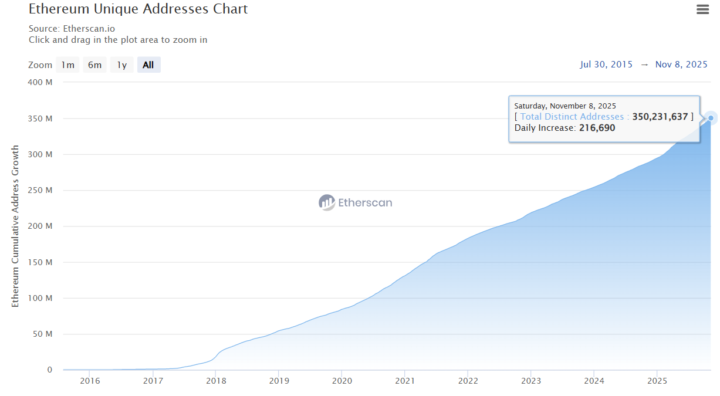
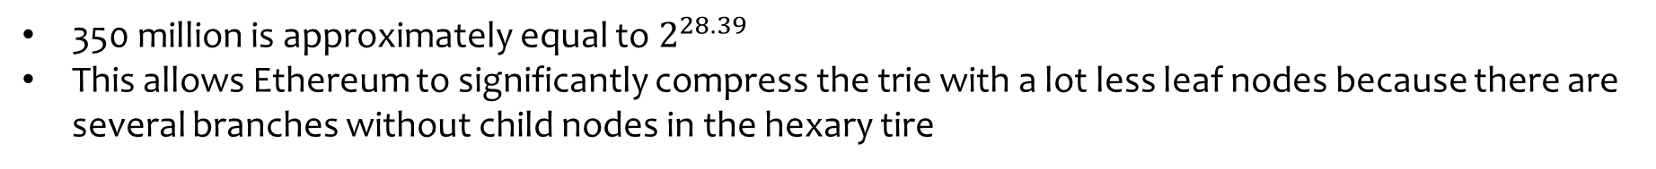
Ethereum Unique Addresses
https://etherscan.io/chart/address
There are almost 350 million unique addresses on Ethereum
350 million is approximately equal to $2^{28.39}$
This allows Ethereum to significantly compress the trie with a lot less leaf nodes because there are several branches without child nodes in the hexary tire

Slide 50
Ethereum’s Modified MPT
Ethereum defines three types of nodes in its modified MPT
  Leaf Node: A node with no child
  Extension node: A node with only one child node
  Branch node: A node with more than one child node (any number from 2 to 16)
This distinction of nodes allow Ethereum to compress the MPT
  Leaf node stores a key and a value (value is account state)
  Extension node also stores a key and a value (value is the hash of the child node)
  Branch node has 17 items that include 16 slots (for hex digits 0-f) and a value (either empty or non-empty if some key ends here). The next nibble of the key determines which branch slot to follow
Notes:
Does not store a key. Instead, it has 16 slots (for hex digits 0–f) plus a value slot. The next nibble of the key determines which branch slot to follow.

Slide 51
Ethereum’s Modified MPT
To differentiate between the leaf and the extension nodes (because both store two items), following prefixes are used:
  0000 (0x0): Extension node with even number of nibbles
  0001 (0x1): Extension node with odd number of nibbles
  0010 (0x2): Leaf node with even number of nibbles
  0011 (0x3): Leaf node with odd number of nibbles
Computers cannot store half of byte, so padding is also used with the prefix to convert the key into bytes
Even nibbles
Example: [4,5,6,7]
Extension node: After prefix padding [00,45,67]
Leaf node: After prefix padding [20,45,67]
Odd nibbles
Example: [5,6,7,8,9]
Extension node: After prefix padding [15,67,89]
Leaf node: After prefix padding [35,67,89]

Slide 52
Simplified Modified MPT Example
Develop an Ethereum-like Modified MPT for the following simplified world state
There are four accounts (4 addresses) so there will be a total of 4 leaf nodes. All the addresses are 7 nibble long
We develop MPT from the root node and start from the first nibbles of the account addresses
All the accounts have the same first two nibbles i.e., a7. Therefore, we group these two nibbles (compression)
The third nibbles of the addresses are 1, 7, f, 7 respectively. The next node would therefore be a branch node and since there is only one child of root node, the root node is an extension node
Root node key contains even number of nibbles; therefore, we also add a prefix 0x00
The complete key of the root node is 0x00a7
Simplified World State
Account Keys |  |  |  |  |  |  | Values
a | 7 | 1 | 1 | 3 | 5 | 5 | 45.0 ETH
a | 7 | 7 | d | 3 | 3 | 7 | 1.00 WEI
a | 7 | f | 9 | 3 | 6 | 5 | 1.1 ETH
a | 7 | 7 | d | 3 | 9 | 7 | 0.12 ETH
Root: Extension Node
Prefix | Shared nibble(s) | Next node
0x00 | a7
Only one child that is a branch node

Slide 53
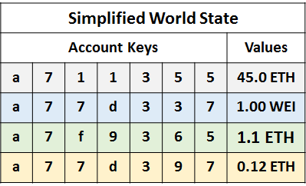
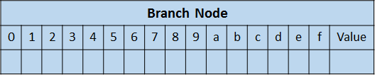
Simplified Modified MPT Example
The branch node originating from the root node has 17 items, but it has only three child nodes that originate from the positions 1, 7, and f
The child node originating from position 1 of the branch node can be declared a leaf node for account 1 by grouping the remaining four nibbles 1355 (compression). We add a prefix 0x20 since the leaf node has even number of nibbles. The key for this leaf node becomes 0x201355 and the value is 45.0 ETH
Leaf Node
Prefix | Key-end | Value
0x20 | 1355 | 45.0 ETH
Similarly, the child node originating from position f of the branch node can also be declared a leaf node for account 3 by grouping the remaining four nibbles 9365 (compression). We add a prefix 0x20 since the leaf node has even number of nibbles. The key for this leaf node becomes 0x209365 and the value is 1.1 ETH
Leaf Node
Prefix | Key-end | Value
0x20 | 9365 | 1.1 ETH
The child node originating from position 7 has common nibbles, therefore it is an extension node. We group two common nibbles d3 (compression) and add a prefix 0x00 since the extension node has even number of nibbles. The key for this extension node becomes 0x00d3
Extension Node
Prefix | Shared nibble(s) | Next node
0x00 | d3
Notes:
The branch node does not store a key. Instead, it has 16 slots (for hex digits 0–f) plus a value slot. The next nibble of the key determines which branch slot to follow.

Slide 54
Simplified Modified MPT Example
Extension Node
Prefix | Shared nibble(s) | Next node
0x00 | d3
The child node of this extension node (0x00d3) is a branch node because the second last nibbles of accounts 2 and 4 are different: 3 and 9 respectively
There are two child nodes of this branch node and both of them are leaf nodes
The child node originating from position 3 is a leaf node for account 2. We add a prefix 0x3 since the leaf node has odd number of nibbles (only one). The key for this node becomes 0x37 and the value is 1.00 WEI
The child node originating from position 9 is a leaf node for account 4. We add a prefix 0x3 since the leaf node has odd number of nibbles (again only one). The key for this node becomes 0x37 and the value is 0.12 ETH
Leaf Node
Prefix | Key-end | Value
0x3 | 7 | 1.00 WEI
Leaf Node
Prefix | Key-end | Value
0x3 | 7 | 0.12 ETH

Slide 55
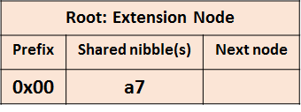

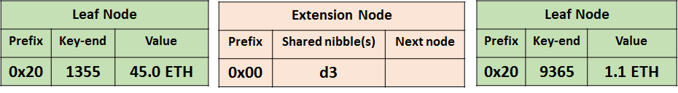
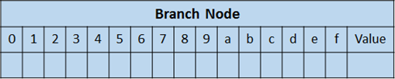
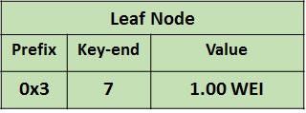
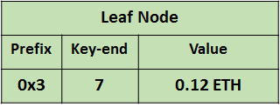
Simplified Modified MPT Example
The values of the intermediate nodes (extension and branch) are the hashes of their respective child node contents (keys and values)

Slide 56
Ethereum Unique Addresses
Is the requirement to keep track of all the account states makes Ethereum less efficient?
https://etherscan.io/chart/address

Slide 57
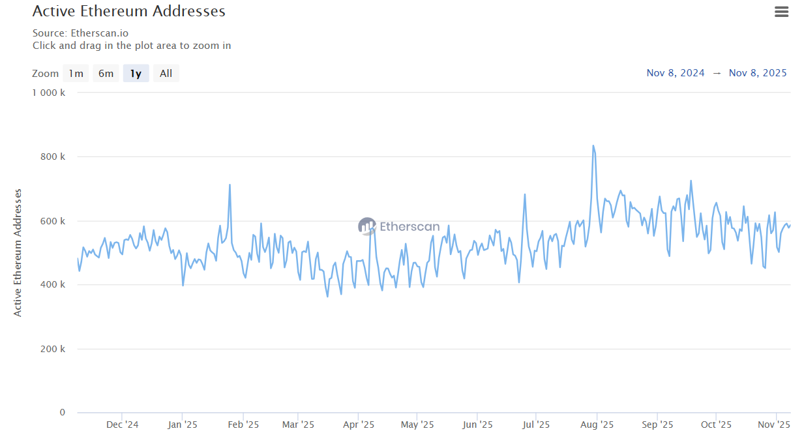
Daily Active Ethereum Addresses
https://etherscan.io/chart/active-address
Daily active Ethereum addresses are only around 0.5 M to 0.8 M. This is just a small fraction of total Ethereum addresses (0.8/225)x100 = 0.355%
The number of accounts touched in a single block is even small (few hundred)
After every block only a small part of the tree needs to be changed. Thus, between two adjacent blocks the vast majority of the trie remains the same, which makes the problem manageable

Slide 58
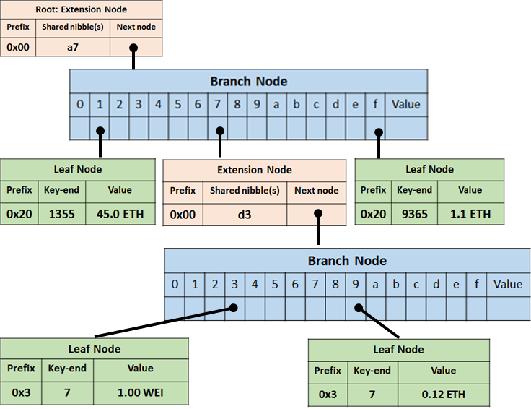
State Trie Update – Example
Simplified World State
Account Keys |  |  |  |  |  |  | Values
a | 3 | 5 | 1 | 2 | 3 | 4 | 10.0 ETH
a | 7 | 1 | 1 | 3 | 5 | 5 | 35.0 ETH
a | 7 | 7 | d | 3 | 3 | 7 | 1.00 WEI
a | 7 | f | 9 | 3 | 6 | 5 | 1.1 ETH
a | 7 | 7 | d | 3 | 9 | 7 | 0.12 ETH
Suppose a new (5th) Ethereum account (0xa351234) is created in our simplified world state, and it receives 10 ETH from 0xa711355 account
Create a new state trie?

Slide 59
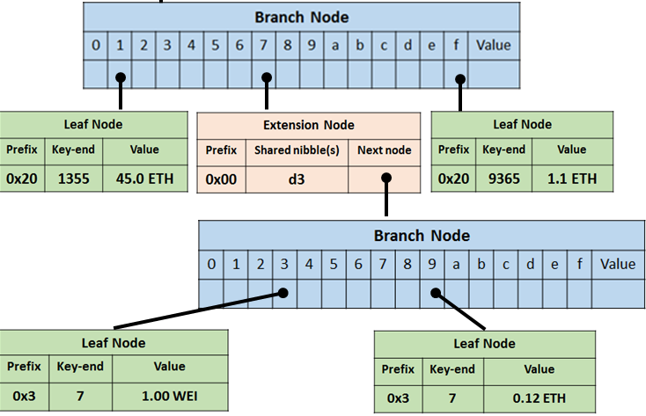
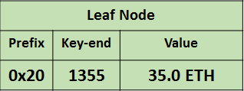
State Trie Update – Example
Simplified World State
Account Keys |  |  |  |  |  |  | Values
a | 3 | 5 | 1 | 2 | 3 | 4 | 10.0 ETH
a | 7 | 1 | 1 | 3 | 5 | 5 | 35.0 ETH
a | 7 | 7 | d | 3 | 3 | 7 | 1.00 WEI
a | 7 | f | 9 | 3 | 6 | 5 | 1.1 ETH
a | 7 | 7 | d | 3 | 9 | 7 | 0.12 ETH
Root: Extension Node
Prefix | Shared nibble(s) | Next node
0x1 | a
Root node is once again an extension node with only one child – child is a branch node
Leaf Node
Prefix | Key-end | Value
0x3 | 51234 | 10.0 ETH
This portion of the trie remains the same (account 0xa711355 state is updated)

Slide 60
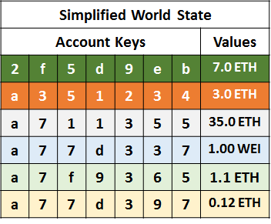
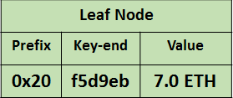
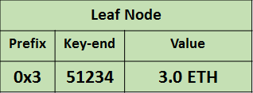
State Trie Update – Example
Suppose another (6th) Ethereum account (0x2f5d9eb) is created in our simplified world state, and it receives 7.0 ETH from 0xa351234 account
Root node is a branch node with two child nodes originating from positions 2 and a
Only a small part of the trie is updated, which makes the problem manageable
This portion of the trie remains the same (account 0xa351234 state is updated)

Slide 61
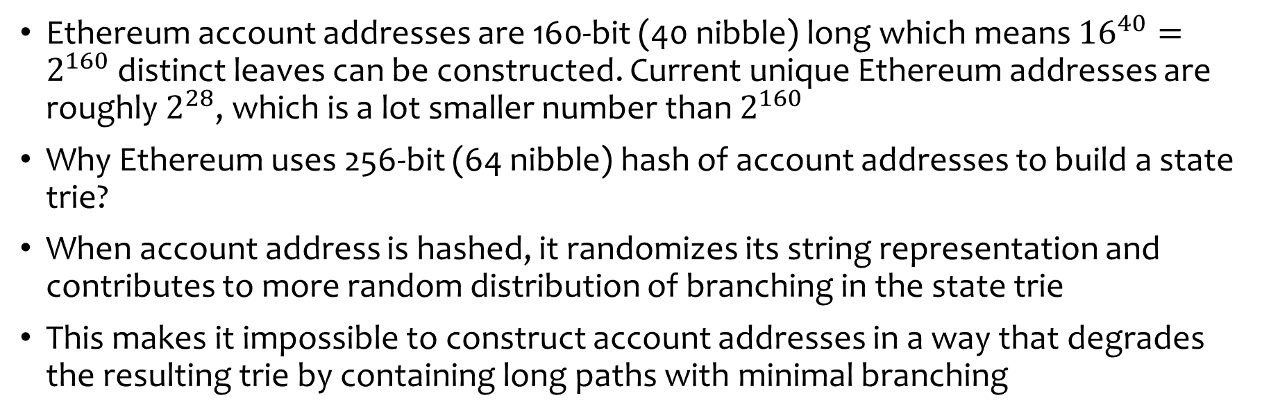
Why hash of addresses as path key?
Account Address = last 160 bits of hash(public key)
Public key: uncompressed ECDSA public key (512 b / 64 B)
Hash: Keccak-256 (256-bit output)
Take the rightmost 160 bits (20 bytes) → Ethereum address
Trie key = hash(account address)
Input: Ethereum address (160 bits / 20 bytes)
Hash: Keccak-256 (256-bit output)
Output: 256-bit key used in the state trie
Ethereum account addresses are 160-bit (40 nibble) long which means ${16}^{40}=2^{160}$ distinct leaves can be constructed. Current unique Ethereum addresses are roughly $2^{28}$, which is a lot smaller number than $2^{160}$
Why Ethereum uses 256-bit (64 nibble) hash of account addresses to build a state trie?
When account address is hashed, it randomizes its string representation and contributes to more random distribution of branching in the state trie
This makes it impossible to construct account addresses in a way that degrades the resulting trie by containing long paths with minimal branching

Slide 62
Ethereum Tries
In Ethereum, the universal data structure is Merkle Patricia Trie (MPT)
State Trie
It is a representation of the world state containing all the addresses of all the accounts and maps them to the account states (MPT structure)
Transaction Trie
With every new block, a new transaction trie (MPT) is built up, containing all the transactions from the block
Transaction Receipt Trie
Transaction receipts are used to record the outcomes of the transaction execution. Information such as transaction status code, cumulative gas used in the block, logs (logger’s address, log data, log topic), and a bloom filter (256-bit hash of logs) are used to build this trie (MPT structure)
Storage Trie
For every account, there is a storage trie, which contains the storage contents and storage addressing scheme of this account. Every account state in the world trie contains the root of the storage trie of this account (storagehash)
Roots of state trie, transaction trie, and transaction receipt trie are hashed (Keccak-256 hash) and included in the block header

Slide 63
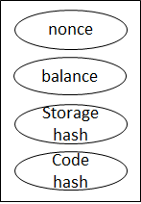
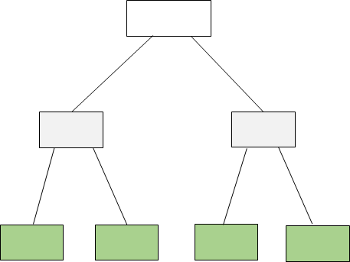
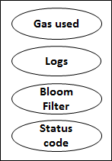
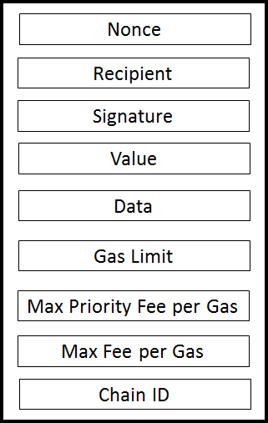
State Tries in Block Header
World State Trie
Account State
Account Storage Trie
Block
Parent Hash
State Root
Receipt Root
Txn Root
Tx Execution Data
Intricate interlink of hundreds of millions of tiny cryptographic proofs (trie nodes) to secure the chain
Receipt Trie
.
.
Transaction
Txn 1
Transaction Trie
Txn 2
.
Txn N

Slide 64
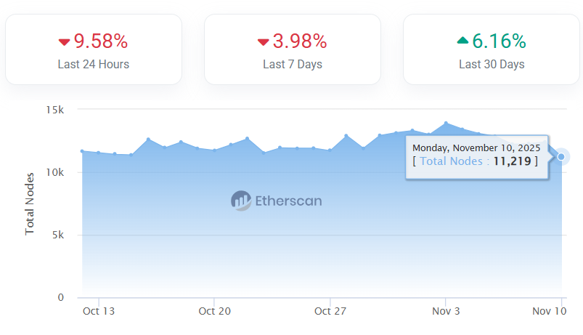
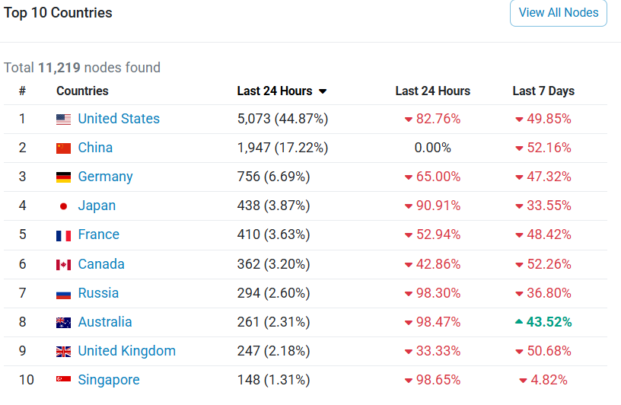
Ethereum Full Node
Running an Ethereum full node requires
  Downloading all the blocks
  Downloading the world state trie (a data structure with 350 M accounts and billions of MPT nodes)
  Cross-checking the information in blocks and executing the codes to validate states
There are roughly 11,000 synchronized Ethereum full nodes spread across the world, which are validating the transactions and constantly updating the world state trie
The interest in a blockchain project (health) may be gauged from the number of full nodes in the network
Notes:
https://etherscan.io/nodetracker

Slide 65
Full Node Limitation
Suppose Alice’s account balance on Mar 14 was 5 ETH, and then she made the following transactions:
  Sent 0.1 ETH to Bob on Mar 15
  Sent 0.2 ETH to Kevin on Mar 16
  Received 0.6 ETH from her mom on Mar 17
  Paid 2 ETH to buy NFT on Mar 18
Alice’s account balance changed in the following way
Mar 14 | Mar 15 | Mar 16 | Mar 17 | Mar 18
5 ETH | 4.9 ETH | 4.7 ETH | 5.3 ETH | 3.3 ETH
Assume, Alice has not made any other transaction after Mar 18
Suppose you are running a full node and want to check Alice’s account balance. What value will you find in the state trie?
3.3 ETH
Why?
State trie only stores the updated information about the accounts, there is no archive of all historical states
Suppose you want to know Alice’s account balance on Mar 15. Will you be able to find it in the state trie?
No
Notes:
Full node can build the archive on demand..

Slide 66
Ethereum Node Types
Full Node
Stores full blockchain data
Participates in block validation, verifies all blocks and states
Serves the network and provides data on request
All states can be derived from a full node
Light Node
Stores the headers and requests everything else
Can verify the validity of the data against the state roots in the block headers
Useful for low-capacity devices (embedded devices or mobile phones)
Archive Node
An archive node stores everything kept in the full node
Builds and stores an archive of all the historical states
This node contains the complete information including all the past and present states of all the Ethereum accounts
Bitcoin has full nodes and light nodes but there is no concept of archive node in Bitcoin
https://ethereum.org/en/developers/docs/nodes-and-clients/

Slide 67
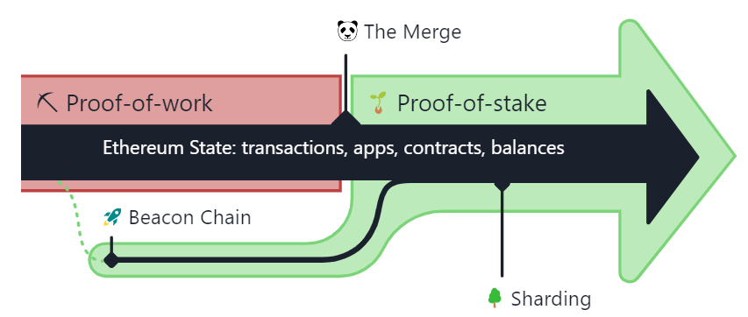
The Merge – Switch to PoS Consensus
Ethereum switched from PoW to PoS on Sep 15, 2022, and this event is known as
‘The Merge’
Ethereum Mainent was launched on July 30, 2015, with PoW consensus layer. On Dec 1, 2020, the Beacon Chain (with new PoS consensus layer) was created as a separate blockchain to Mainnet, running in parallel
The Merge was the joining of the original execution layer of Ethereum with the PoS Beacon Chain
The Merge represents the formal adoption of the Beacon Chain as the new consensus layer to the original Mainnet execution layer
Notes:
The Merge was when these two systems finally came together, and proof-of-work was permanently replaced by proof-of-stake.
https://ethereum.org/en/upgrades/merge/#:~:text=by%20~99.95%25.-,What%20was%20The%20Merge%3F,be%20secured%20using%20staked%20ETH.
https://ethereum.org/en/developers/docs/consensus-mechanisms/pos/

Slide 68
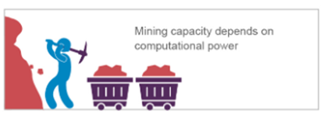
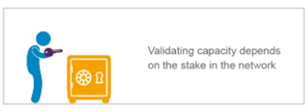
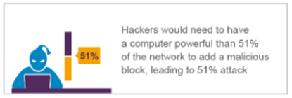
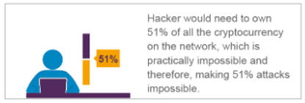
PoW vs PoS
Miners
Validators
https://www.alchemy.com/overviews/what-is-the-ethereum-beacon-chain

Slide 69
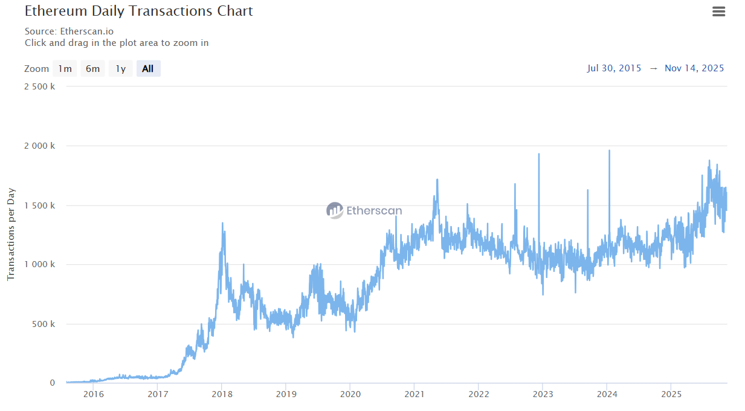
Scalability
Ethereum Throughput = 17.36 txns/s
Ethereum throughput is 3 to 4 times greater than Bitcoin’s througput
https://etherscan.io/chart/tx
Ethereum also suffers from throughput and scalability problems, and these issues are much more serious because Ethereum is an enabling platform for stablecoins, Web 3 and decentralized applications
The switch from PoW to PoS did not directly solve the scalability issue
The throughput is almost the same because block size and block generation rate were kept same
  Block size: around 100 to 200 kB
  Block generation rate: 12 s

Slide 70
Reasons for the Merge
Ethereum’s switch from PoW to PoS did not change its block size or block generation rate
So, why did Ethereum made this switch?
Massive energy reduction
  PoS reduced Ethereum’s energy usage by >99.9%, eliminating the environmental cost of PoW
Stronger economic security
  Attacks become more expensive because malicious validators ETH can be slashed
Better long-term sustainability
  PoS requires far lower creation of ETH, allowing ETH to become deflationary
Broader decentralization
  No dependence on any specialized hardware enabling many more participants to join validation
Foundation for future scalability
  PoS is required for sharding

Slide 71
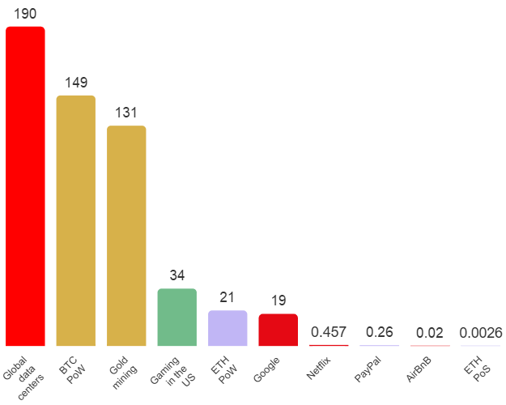
Ethereum PoS Energy Consumption
PoS Ethereum:
  0.0026 TWh = 2.6 million energy units per year
  7123.28 units per day
  296.8 units per hour
  0.989 (~ 1) energy units per block (12s block generation)
= 2.6 million kWh
Annual Energy Consumption in TWh/yr
https://ethereum.org/en/energy-consumption/#:~:text=This%20yielded%20an%20estimate%20of,regional%2Dspecific%20carbon%20intensity%20factors.
Notes:
Per transaction calculated from daily numbers = energy units per day (7123.28) / transactions per day (1.25 million)
1 Tera = 10^12

Slide 72
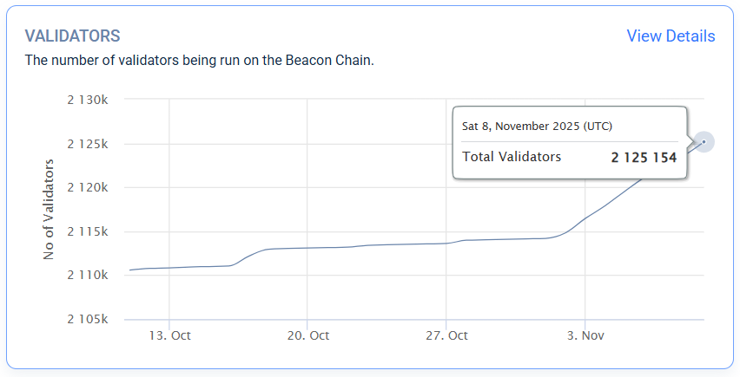
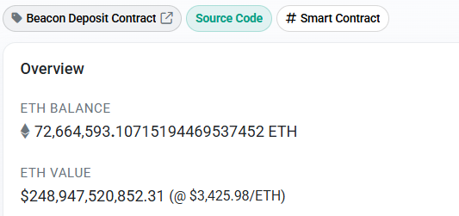
Ethereum PoS
ETH are locked in a smart contract called Beacon Deposit Contract deployed on Ethereum blockchain
https://beaconscan.com/statistics
https://etherscan.io/address/0x00000000219ab540356cbb839cbe05303d7705fa
Notes:
https://ethereum.org/en/developers/docs/consensus-mechanisms/pos/
Institutional support (regulators, markets, investment funds) due to lower energy consumption and interest paid on staked ETH

Slide 73
Ethereum PoS – Validators
Validators are nodes who have staked 32 ETH to participate in the system
https://beaconscan.com/statistics
More stake means more chance of creating the next block. For example, if Alice has staked 320 ETH and Bob has only 32 ETH, then Alice can activate 10 validators and has 10 times more probability of creating the next block than Bob
A validator is chosen at random by the network (using RANDAO mechanism) to create new blocks, share them with the network and earn rewards (no intense computational puzzles are solved)
Becoming a validator is a commitment because a validator is expected to maintain sufficient hardware and connectivity to participate in block validation and proposal
Notes:
A PoS system is kept secure by the fact that 51% of the total staked ETH is needed to defraud the chain, and that the stake is slashed for malicious behavior
A validator's record is created when its deposit is first processed. Sending multiple deposits does not create multiple validator records: deposits with the same public key are aggregated in one record. Validator records never expire; they are stored permanently, even after the validator has exited the system.
If someone has more than 51% staked Ether then more than 50% blocks will be created by them. But if such an entity is dishonest then its stake will be slashed thus reducing its stake and if it continues malicious behavior the stake can be slashed further below 50%
Validators are responsible for the same thing as miners in proof-of-work: ordering transactions and creating new blocks so that all nodes can agree on the state of the network

Slide 74
Roles of Validator and Network
Validator Role
Proposer Role: Create blocks when chosen
Attester Role: Attest blocks and confirm chain heads and checkpoints
Pseudo-randomly select proposers and form attestation committees
Network Role
Reward validators for block creation and attestation
Network is not any separate physical entity, it is the collection of all the stakeholders such as validators, full nodes, users, etc.
Slash stake for creating or attesting malicious blocks
https://ethereum.org/en/developers/docs/consensus-mechanisms/pos/
Notes:
Network is not any separate entity.. There are protocols and verifiable ways in which all the system entities are operating so collectively we call them network.. For example, pseudorandom numbers are generated in verifiable ways using RANDAO, rewards are given and verified, slashing occurs etc..

Slide 75
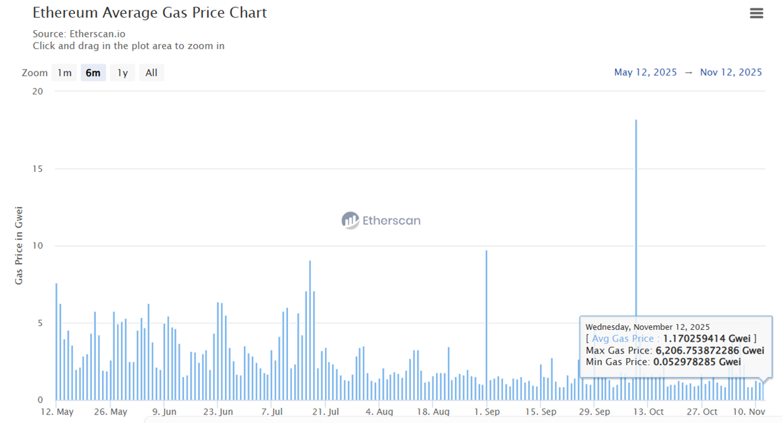
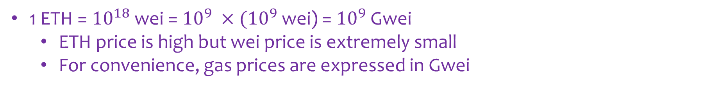
Transaction Fee
1 ETH = ${10}^{18}$ wei = ${10}^{9} ×{(10}^{9}$ wei) = ${10}^{9}$ Gwei
  ETH price is high but wei price is extremely small
  For convenience, gas prices are expressed in Gwei
A typical ETH transfer costs 21k gas units
An ERC-20 token transfer requires around 45k to 75k gas units
Contract deployment costs millions of gas units depending on code complexity
Ethereum gas prices are variable, so transaction costs can have a significant financial impact

Slide 76
More Transactions More Gas
Consider the following five accounts in a world state
Account | Account Keys |  |  |  |  |  |  | Balance
Alice | a | 1 | 5 | 1 | 2 | 3 | 4 | 2.5 ETH
Bob | b | 2 | 1 | 1 | 3 | 5 | 5 | 3.5 ETH
Charlie | c | 3 | 7 | d | 3 | 3 | 7 | 1.2 ETH
Dan | d | 4 | f | 9 | 3 | 6 | 5 | 1.5 ETH
Eve | e | 5 | 7 | d | 3 | 9 | 7 | 0.5 ETH
Let’s consider the following set of transactions:
Alice pays Bob 0.5 ETH,
Bob pays Dan 0.2 ETH,
Dan pays Alice 0.8 ETH,
Charlie pays Eve 0.7 ETH,
Eve pays Dan 0.1 ETH
Assuming all the transactions are successfully executed:
Alice’s Balance: 2.5-0.5+0.8 = 2.8 ETH
Bob’s Balance: 3.5+0.5-0.2 = 3.8 ETH
Charlie’s Balance: 1.2-0.7 = 0.5 ETH
Dan’s Balance: 1.5+0.2-0.8+0.1 = 1 ETH
Eve’s Balance: 0.5+0.7-0.1 = 1.1 ETH
On Ethereum, each transaction is posted individually and each pays gas
How can we reduce the fee, while retaining Ethereum security?

Slide 77



Rollup
In all these examples, individual sheets are rolled up into a single unit through compression & aggregation
Can many Ethereum transactions be rolled up like this to reduce transaction fee & achieve scalability without losing Ethereum’s Mainnet security guarantees?

Slide 78
Take Transaction Processing off-chain
Transactions are atomic so if users directly post them on Ethereum they are supposed to be individually processed
However, if we process the transactions off-chain (like we did in the payment channels), we can find some low-cost and more scalable solution
We may be tempted to develop a payment channel type off-chain solution, but we must remember:
  Ethereum supports smart contracts,
  it has user accounts, and
  it maintains a world state which is the ultimate source of truth
The idea is to enable ETH or ERC-tokens transfers, while retaining Ethereum security

Slide 79
Lock Funds in a Smart Contract
To develop a solution, the funds (ETH or tokens) must be locked on the Ethereum blockchain
Any interested user should lock their desired amount of ETH or tokens in a smart contract
  It does not matter who deploys this smart contract because once it is on blockchain the code governs its behavior independently
  This step is analogous to posting a funding transaction in a payment channel or a channel factory
It is also easier to support many users because
  The smart contract defines all the required rules
  The user enters the rollup by depositing ETH or tokens in the rollup smart contract
  The user exits the rollup by withdrawing ETH or tokens from the same smart contract
  The world state provides a reliable and consistent view of contract’s data

Slide 80
Off-Chain Transaction Batching
Transaction creation, batching and processing is done off-chain
  A rollup operator is responsible for receiving, ordering, executing, and batching transactions off-chain
  The operator creates a summary of all the state changes that result from these transactions and commits it to Ethereum
Off-chain transactions are not Ethereum transactions, instead they have a different format
  The rollup operator posts the transactions as ‘data’ on Ethereum for security & verification
  Traditional method for posting data is through the transaction calldata field, which is the data passed along with a transaction for sending messages to other entities or interact with smart contracts
Calldata method is expensive and costs a significant amount of gas
  4 units for each zero byte
  16 units for each non-zero byte
Notes:
https://www.quicknode.com/guides/ethereum-development/transactions/ethereum-transaction-calldata

Slide 81

Rollups
Rollups or Ethereum L2 (layer 2) reduce computation on the main Ethereum chain by processing transactions off-chain, offering significant improvements in processing speeds
Notes:
Processing of transactions in Nitro. The sequencer establishes an ordering on transactions and publishes the order as a real-time feed and as compressed data batches on the L1 chain. Sequenced transactions are processed one at a time by a deterministic state transition function, which updates the chain state and produces L2 blocks. These blocks are later settled to the L1 chain.
Transactions are executed off-chain
Computation and state storage is moved off-chain

Slide 82

Optimistic Rollup
Optimistic rollups assume every transaction to be valid by default and don’t publish validity proofs
Optimistic rollups have a challenge period (usually 7 days) during which anyone can create a dispute
A fraud proof mechanism is used only to resolve the disputes
If successful, the disputed states are rolled back and penalties are also enforced (such as, sequencer blacklisting, stake slashing)
Notes:
https://www.mdpi.com/1999-5903/16/9/315

Slide 83

ZK-Rollup
ZK-rollups additionally produce cryptographic proofs during off-chain computations
The proofs are also posted on-chain to verify that the computations were performed correctly, and all the state transitions followed the pre-defined rules without revealing the underlying data or the exact computational steps
Notes:
https://www.mdpi.com/1999-5903/16/9/315

Slide 84
How Rollups Guarantee Ethereum Security?
A rollup operator deploys a smart contract on Ethereum, which serves as the main security anchor
Users lock their funds and tokens in the smart contract
Users create transactions and submit them to the rollup operator (generally a centralized server)
The rollup aggregates, batches and compresses transactions and ensures data availability
  Keeps a local copy of the data
  Posts data on Ethereum as a data blob – a new and special type of Ethereum transaction introduced to support rollups
The rollup operator executes transactions off-chain and computes the state transitions & posts them on Ethereum
In case of ZK-rollup, the validity proofs are also submitted
In optimistic rollup, if someone detects an incorrect state update, they can create a dispute that triggers a fraud proof mechanism to ensure correctness
This process ensures that rollups inherit Ethereum’s security, as the Ethereum smart contract enforces finality and correctness
Notes:
Data blobs is a new concept in Ethereum and implemented in 2024. Previously, the arbitrum used transaction calldata field to post raw data but this was expensive so in 2024, Ethereum upgraded to a new transaction type called type 3 or EIP-4844. The size of this transaction is limited to 128 kB and costs less and exclusively included for the rollups to make them cheap. This is a special transaction as it is not executed and is just included to include raw data from the layer 2 to Ethereum to make data available. The blob data is then pruned after 28 days to avoid blockchain growing exponentially. So the blob data is discarded (this data is no longer immutable on Ethereum), but the transaction and other fields are always permanently stored in the block. So this is called danksharding and allows data availability and then due to subsequent discarding the raw data avoids exponential blockchain growth.. So with the implementation of this idea, Ethereum is not keen on implementing sharding where they were supposed to divided Ethereum into 64 mini blockchains or shards because even with 64 shards the growth would have been exponential and storing the full blockchain would become impossible as its size would have grown too much.. So data pruning in blobs is their way forward..

Slide 85

Rollup Ecosystem
TVL is the Total value locked in the rollup’s Ethereum smart contract
  Used as a measure of project’s adoption
Average Transaction fee is few cents
  Optimistic rollups fees are 3x to 8x less than Mainent
  ZK-rollups fees are 40x to 100x cheaper than Mainnet due to better data compression
Ethereum actively supports rollups
  Considers them essential for its long-term scalability & growth
https://blog.mexc.com/news/layer-2-revolution-ethereums-scaling-superstars-in-2025-where-speed-meets-billions-in-tvl/

Slide 86

EIP-4844: Shard Blob Transactions
To reduce the costs of posting data through the transaction calldata field, Ethereum introduced a new transaction type called proto-danksharding or Type 3 transactions in March 2024
EIP-4844 transactions are “blob-carrying transactions” or data transactions
These transactions contain a large amount of data blob that cannot be accessed by EVM execution, but whose commitment can be accessed
Regular tx: EIP-1559 format (Type 2)
Data tx: EIP-4844 format (Type 3)
https://hacken.io/discover/eip-4844-explained/
Notes:
https://eips.ethereum.org/EIPS/eip-4844

Slide 87


Data Blobs
Each data transaction has a data blob (raw data)
The maximum size of blob transaction is 128 KiB (131,072 bytes)
A maximum of 6 data transactions can be attached to a block
This approach provides a maximum increase in data bandwidth of around 768KiB
Blob gas price is set extremely low (1 wei per gas unit)
Blob transactions are significantly cheaper than posting an equivalent amount of data via calldata method

Slide 88

Blob Transaction Example
The ‘To’ field points to the rollup’s L1 smart contract that receives and records the blob commitments
A single blob always consumes about 131,072 blob-gas units, regardless of how much of the 128 KiB is actually used
Before blobs (pre-EIP-4844), rollups posted their L2 data as transaction calldata, which was far more expensive and permanently stored on Ethereum, causing long-term chain bloat
https://blobscan.com/tx/0x2a0353844c354ead92379cd6b63b2594634ed86239e10f43fb83963de22a6067
Notes:
https://blobscan.com/tx/0x2a0353844c354ead92379cd6b63b2594634ed86239e10f43fb83963de22a6067

Slide 89
Blobs are not Stored Permanently
The blobs are temporarily stored in the beacon chain by the consensus nodes for around 18 to 21 days before being pruned
After pruning, the blob data is removed and it is only represented by it’s KZG commitment (a small cryptographic hash) that was included in its corresponding data transaction
This design significantly improves gas efficiency by separating blob data from the main execution layer, avoiding the high gas costs of permanently storing large amounts of data on-chain
Pruning blob data undermines the idea of permanent blockchain history
However, Ethereum has adopted blob pruning for scalability to keep the blockchain size manageable, while the KZG commitment ensures the integrity and correctness of the pruned data
Notes:
https://eips.ethereum.org/EIPS/eip-4844

Slide 90

Blob Transaction Life Cycle
https://crypto.com/en/research/ethereum-proto-danksharding-dencun

Slide 91
KZG Commitment
Blob pruning creates a challenge: once the blob data is deleted, how can nodes verify the integrity of that pruned data safely?
  Ethereum solves this problem using KZG commitments
The blob data is divided into bytes which are used as coefficients of a polynomial
  If there are N bytes, the resulting polynomial is of degree N-1
A secret point s was generated by Ethereum in a KZG ceremony – an event that lasted for several months and concluded in early 2024
  The idea was that no one should know the full s
After the ceremony, Ethereum used the secret s to compute and publish a structured reference string (SRS)
The KZG commitment is computed by taking the dot product of the data byte vector with the SRS vector, which is stored in the data transaction
To prove that a specific coefficient (i.e., a piece of blob data) belongs to the committed polynomial, the prover computes a small KZG proof using the same SRS
The verifier then checks a pairing equation that confirms the coefficient is correct without needing the blob itself

Slide 92

From Sharding to DankSharding
Ethereum has since replaced chain sharding with so-called danksharding (also called data sharding)
This new approach was informally called “Dankrad’s sharding design” that quickly shortened to “Danksharding
The idea of sharding was to divide Ethereum blockchain into 64 mini blockchains called shards
Each shard chain was supposed to process its own transactions and store its own state (with possible cross-shard communication)
The consensus layer was supposed to be shared among all the shards as they all rely on the same PoS validator set
Shard chains are no longer part of the Ethereum roadmap

Slide 93
DankSharding
Danksharding is the full realization of the rollup scaling that began with Proto-Danksharding or EIP-4844
The blobs attached to blocks will be increased from 6 in Proto-Danksharding to 64 in full Danksharding
The rest of the changes required are all updates to the way consensus clients operate to enable them to handle the new large blobs
Danksharding once fully implemented aims to make transactions on Layer 2 as cheap as possible for users and should scale Ethereum to >100,000 transactions per second

Slide 94
Data Sharding
With full danksharding the block size will become 8 MB
Ethereum produces a block every 12 s
  5 blocks per minute
  300 blocks per hour
  7200 blocks per day
Without danksharding blockchain growth
  40 MB per minute
  2.4 GB per hour
  57.6 GB per day
  1.72 TB per month
Very quickly becomes unmanageable – explains the need for data sharding instead of chain sharding

Slide 95
Entities Required for Automation
Suppose, Alice wants to set up a trust fund to pay Bob $100 at the start of each month for the next 12 months. She writes an Ethereum smart contract (encode conditions) and lock ETH into it
Smart contract cannot initiate transactions, therefore, some entity with EOA must create transactions at the start of each month
Who performs this job?
Smart contract needs the date information; therefore, some entity must provide the current date reliably
Who performs this job?
Smart contract needs to do the ETH/USD conversion; therefore, some entity must provide the conversion rate
Who performs this job?
Smart contract has the ability to check whether the required conditions (according to the code) are met before initiating the funds transfer
Some other entities are needed to automate smart contract execution

Slide 96

Keepers & Oracles
Keepers: These are external entities that provide services to trigger state updates
  Keepers, are generally financially incentivized to trigger such state updates
Oracles: These are external entities for reliably providing off-chain data to the smart contracts
  Decentralized oracle: multiple nodes maintained by a separate network to provide data feeds (e.g., Chainlink); rely on incentives for accurate and honest reporting
Oracles also post the queried data on the blockchain in the form of transactions. Why?
Blockchain is deterministic and therefore nodes at any point in time should be able to validate the transactions using the stored data feed transaction
Notes:
Oracles also post the queried data on the blockchain in the form of transactions. Why?
Blockchain is deterministic and therefore nodes at any point in time can validate the transaction using the stored data feed transaction

Slide 97
Keepers & Oracles for Full Automation
Suppose, Alice wants to set up a trust fund to pay Bob $100 at the start of each month for the next 12 months. She can write an Ethereum smart contract (encode conditions) and lock funds into it
Smart contract cannot initiate transactions, therefore, some entity with EOA must create transactions at the start of each month
Keepers perform this job
Smart contract needs the date information; therefore, some entity must provide the current date reliably
Oracles perform this job
Smart contract needs to do the ETH/USD conversion; therefore, some entity must provide the conversion rate
Oracles perform this job
Smart contract has the ability to check whether the required conditions (according to the code) are met before initiating the funds transfer
Smart contract performs this job
Keepers and oracles are essential to achieve full automation

Slide 98

Value Transfer from one World to Another
Moving the value of any non-native asset from one world to another
Moving the value of any non-programmable asset to a programmable blockchain
Stable coins
Real world Asset (RWA) tokenization
Wrapped BTC
Cross-chain bridges

Slide 99




Programmable Value
Notes:
Automation: Bound by rules enforced through code
Composable: Different applications seamlessly work together
Efficiency: No settlement delays, no manual processing
Trust Minimization: Reduces intermediaries

