Slide 1

Introduction to Blockchain CSE-355
Ahmed Akhtar
Department of Computer Science
SMCS, IBA Karachi
Spring 2026

Slide 2
Lecture 27 Tuesday, May 5, 2026

Slide 3
Security Risks and Controls
A Leadership summit on Blockchain and Digital Assets: Technology and Innovation

Slide 4
Security Considerations – Public vs. Private Blockchains
Aspect | Public Blockchain | Private Blockchain
Data Confidentiality | Transparent by design; limited privacy | Encrypted and access-controlled data
Access Control | Open participation; identity is pseudonymous | Permissioned with enterprise-grade identity management
Consensus Risks | Susceptible to 51% and Sybil attacks | Centralized/semi-centralized validators; risk of collusion
Smart Contract Security | Open codebase → public scrutiny | Closed codebase → relies on internal audits
Compliance & Regulation | Difficult to enforce | Can enforce KYC/AML, audit trails, regulatory rules

Slide 5
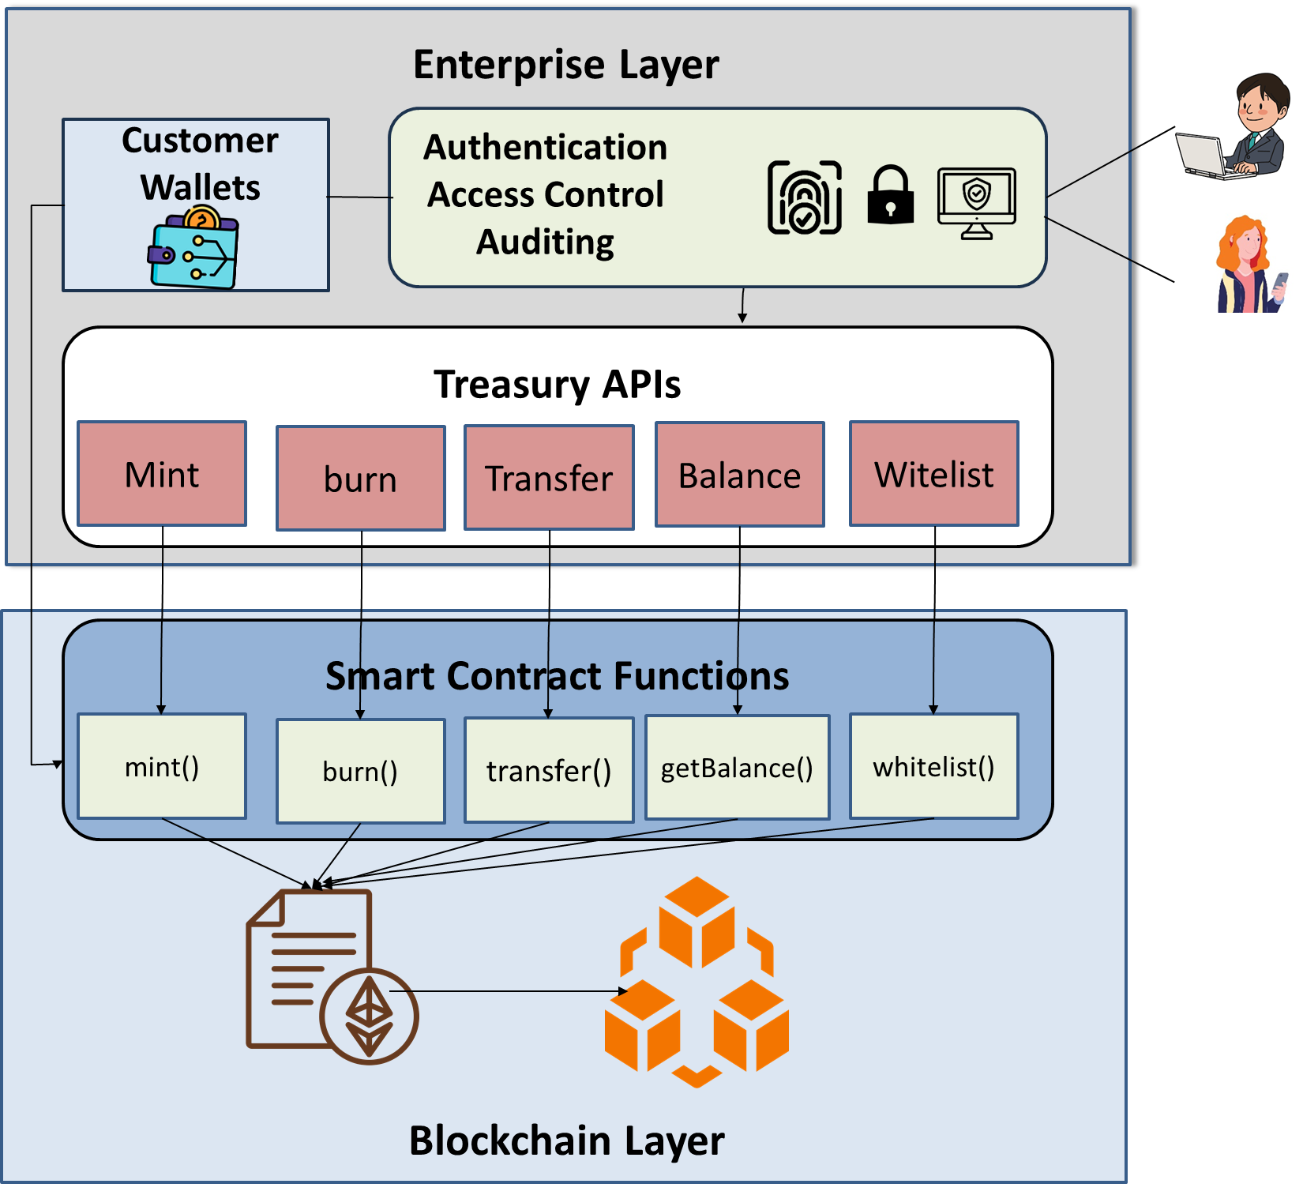
Security Considerations
Security risks and controls
Blockchain layer
Enterprise layer

Slide 6
Security Considerations – Blockchain Layer
Security Risks
Smart Contract Vulnerabilities
Errors in smart contract logic (reentrancy, overflow, underflow)
Reentrancy Vulnerability
Attacker Contract
Vulnerable Contract
Attack() Call Withdraw()
Withdraw()
Send_Ether()
/*transfer ether*/
Update_Balance()
Receive()
Call Withdraw()

Slide 7
Security Considerations – Blockchain Layer
Security Risks
Smart Contract Vulnerabilities
Errors in smart contract logic (reentrancy, overflow, underflow)
Overflow
Underflow
Uint8 balance = 255
balance = balance + 1
Uint8 balance = 0
balance = balance - 1

Slide 8

Security Considerations – Blockchain Layer
Security Risks
Smart Contract Vulnerabilities
Errors in smart contract logic (reentrancy, overflow, underflow)
Exploitation of whitelist/blacklist functionalities
Stablecoin Smart Contract
getBalance()
transfer()
mint()
transfer from()
burn()
approve allowance()

Slide 9

Security Considerations – Blockchain Layer
Security Risks
Sequencing Errors
Incorrect transaction ordering and batching
Manipulation or delays in transaction sequencing
Posted 12:58
Vote A Transaction
Voted at 12:58
DAO Smart Contract
Posted 12:57
Voter A
Voted at 12:57
Vote B Transaction
Voter B
Posted 01:01
Voted at 12:56
Voting Ends at 01:00
Vote C Transaction
Voter C

Slide 10
Security Considerations – Blockchain Layer
Risks
Smart Contract Vulnerabilities
Errors in smart contract logic (reentrancy, overflow, underflow)
Exploitation of whitelist/blacklist functionalities
Sequencing Errors
Incorrect transaction ordering and batching
Manipulation or delays in transaction sequencing
Controls
Formal verification and rigorous smart contract audits
Secure coding practices (e.g., OpenZeppelin standards)

Slide 11


Security Considerations – Blockchain Layer
Private Key Management and Custody - Risks
Loss or theft of private keys results in permanent loss of access
If a private key is lost or stolen, the holder permanently loses control over the associated digital assets — there is no recovery mechanism like in traditional systems
Inadequate backup and recovery mechanisms
Without secure and redundant backups, accidental key deletion, device failure, or natural disasters can result in total asset loss

Slide 12
Security Considerations – Blockchain Layer
Private Key Management and Custody - Risks
Loss or theft of private keys results in permanent loss of access
If a private key is lost or stolen, the holder permanently loses control over the associated digital assets — there is no recovery mechanism like in traditional systems
Inadequate backup and recovery mechanisms
Without secure and redundant backups, accidental key deletion, device failure, or natural disasters can result in total asset loss
Controls
Use Hardware Security Modules (HSMs) for key storage
Implement multi-signature wallets and threshold schemes
Maintain secure key backup with geo-distributed recovery plans

Slide 13
Security Considerations – Blockchain Layer
Interoperability and Cross-chain Security - Risks
Vulnerability in Blockchain bridge smart contract
Example: Wormhole Bridge Exploit (February 2022) - Wormhole Bridge Smart contract served as a messaging and token bridge between Ethereum and Solana
A vulnerability in the Wormhole bridge’s smart contract allowed an attacker to mint wrapped ETH (wETH) on Solana without depositing real ETH on Ethereum, resulting in a loss of around $320 Million in ETH
DepositEthers()
(Deposits Ethers to generate a wrapped Ether on a different chain)
Generate wETH()
(Generates wrapped Ethers equivalent to the amount that was locked)
Ethereum
Solana

Slide 14
Security Considerations – Blockchain Layer
Interoperability and Cross-chain Security - Risks
Vulnerability in Blockchain bridge smart contract
Example: Wormhole Bridge Exploit (February 2022) - Wormhole Bridge Smart contract served as a messaging and token bridge between Ethereum and Solana
A vulnerability in the Wormhole bridge’s smart contract allowed an attacker to mint wrapped ETH (wETH) on Solana without depositing real ETH on Ethereum, resulting in a loss of around $320 Million in ETH
Controls
Use audited bridging protocols
Implement layered verification models
Deploy on-chain monitoring tools to track unusual activity

Slide 15
Lecture 28 Thursday, May 7, 2026

Slide 16
Security Considerations – Blockchain Layer
ERC-20 Limitations: Contracts Cannot Detect Incoming Tokens
ERC-20 transfers do not notify the receiving contract
No callback or hook mechanism
Smart contracts cannot react to deposits automatically
Example Scenario - User attempts to deposit 100 tokens into a staking contract
User Sends Tokens (ERC-20 Transfer) - User directly calls the token contract:
ERC20.transfer(StakingContractAddress, 100)
The 100 tokens move from the user to the staking contract

Slide 17
Security Considerations – Blockchain Layer
ERC-20 Limitations: Contracts Cannot Detect Incoming Tokens
function deposit(uint256 amount) external {
// transfer tokens into contract
stakingToken.transferFrom(msg.sender, address(this), amount);
// update user stake balance
stakedBalance[msg.sender] += amount;
// emit event
emit Deposited(msg.sender, amount);
}
But this function is never called when using ERC-20 transfer()
The 100 tokens sit idle in contract balance
The user is not staked
The contract does not credit reward

Slide 18
Security Considerations – Blockchain Layer
ERC-20 Limitations: Contracts Cannot Detect Incoming Tokens
ERC-777 Solution: tokensReceived Hook
Automatically notifies the receiving contract on every token transfer
Contract can validate, process, or reject incoming tokens
Eliminates silent transfers and prevents stuck deposits
How it works
1. User sends tokens:
send(StakingContract, 100)
2. ERC-777 triggers:
tokensReceived(operator, from, to, amount, ...)
3. Staking contract updates user balance, logs deposit, starts rewards

Slide 19


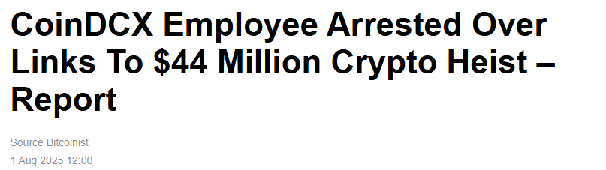

Security Considerations – Enterprise Layer

Slide 20
Security Considerations – Enterprise Layer
API Security - Risks
Unauthorized access via exposed Treasury or service APIs
If APIs are not properly secured, attackers can use them to move funds, extract sensitive data, or manipulate system behavior
Poor authentication and rate limiting
APIs lacking strong user identity checks or traffic throttling are more susceptible to brute-force or scraping attacks

Slide 21
Security Considerations – Enterprise Layer
Customer Wallet Security - Risks
Insider threats or misconfigured permissions
Employees or internal actors with excessive access rights may intentionally or unintentionally compromise customer wallet (private key)

Slide 22
Security Considerations – Enterprise Layer
Controls
Use strong authentication mechanisms (e.g., OAuth 2.0, mTLS)
Implement access control management for both internal and external users
Enforce API rate limiting
Log and audit all API and wallet accesses
Place APIs behind WAFs and API gateways
Ensure end-point protection is enabled on user devices

Slide 23
Concluding Remarks
Security risks span the Blockchain Layer (smart contracts, key custody, cross-chain bridges) and the Enterprise Layer (APIs, insider threats)
Blockchain Layer controls: smart contract audits & formal verification, secure coding standards, HSMs, multi-signature wallets, and monitored cross-chain protocols
Enterprise Layer controls: strong API authentication & rate limiting, access management, audit logging, and endpoint protection
Continuous monitoring & response: real-time threat detection, anomaly tracking, and defined recovery procedures
A layered and holistic security strategy integrating both layers ensures resilience, protects assets, and builds trust in blockchain adoption.

