Slide 1

Introduction to Blockchain CSE-355
Ahmed Akhtar
Department of Computer Science
SMCS, IBA Karachi
Spring 2026

Slide 2
Lecture 19 Tuesday, Apr 7, 2026

Slide 3
Reducing Bitcoin Transaction Fee
Decrease transaction size
Direct reduction in fees
SegWit, Taproot, Schnor signature helped achieve this goal
Increase block size
Block fits more transactions so helps reduce fee indirectly
SegWit increased block size as a soft fork
Introduced discount on witness data, effectively increasing block size from 1 MB to about 4 MB
Batch Processing of transactions
Fee is divided across multiple transactions
Easier for custodial wallets (that hold private keys of multiple users)
Difficult for non-custodial wallets for different users

Slide 4
Transaction Batch Processing
There are two transaction batch processing models
Collaborative batching via joint transaction creation
Non-collaborative batching with independently signed transactions
Collaborative batching:
A joint single transaction is created with multiple inputs and outputs
As single transaction serves many users, transaction fee is shared among all of them
Exchanges & custodial wallets with access to all the private keys can implement this model easily
Wallet level improvement whenever possible and no consensus level changes are required
Non-collaborative batching:
Not possible in Bitcoin
UTXO model prevents combining independently signed transactions
Any attempt to join or merge transactions would invalidate their signatures
Once a transaction enters mempool, it becomes atomic, i.e., it must be included as it is in the block
In contrast, it is possible to build non-collaborative batching solutions in Ethereum, allowing significant fee reduction (these solutions are popularly known as roll ups)
Notes:
Note: It is however, possible to do non-collaborative batch processing in Ethereum

Slide 5
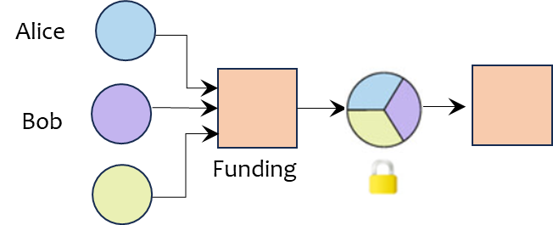
Channel Factory
A payment channel is opened with a 2-of-2 on-chain multisig funding transaction
The fee can be further reduced if multiple users jointly fund a single on-chain transaction and then open several payment channels
Example: Alice, Bob, and Charlie create one funding transaction and then open three payment channels (A–B, A–C, B–C) using the same funding transaction
This setup where multiple parties deposit their funds into a single on-chain funding transaction is known as a channel factory in Bitcoin community

Slide 6
Channel Factory
Channel factory is an appealing idea and seems a natural extension of the payment channels
However, there are several practical challenges
The problem has a combinatorial complexity (N choose 2)
Each participant must track commitment states for every internal channel they are part of
Adding or removing parties or uncooperative peers often requires on-chain reconfiguration or complex protocols
Operational complexity, dispute handling, and watchtower needs raise costs
Channel factories represent the next frontier in Bitcoin scalability, calling for new designs and new research

Slide 7
Satoshi Nakamoto realized his vision of blockchain by launching Bitcoin in 2009
Since then, several alternative blockchains with varying features have been developed

Slide 8
Blockchain Design Considerations
A wide variety of blockchains have been designed
However, there are some important design considerations that require careful attention
Together, these considerations capture the organizational, technical, economic, and architectural dimensions of the blockchain design

Slide 9
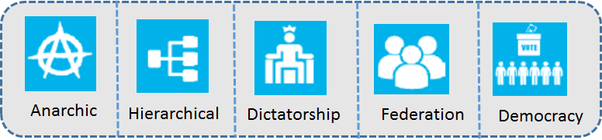
Protocol Governance
Protocol governance refers to the mechanisms and processes by which decisions are made regarding the rules, protocols, and upgrades of a blockchain network
Implications:
Transparency
Efficiency
Perceived legitimacy
Anarchic: Governance norms, processes, and procedures are inherited from free/open-source software community
Hierarchical: There is a recognized leadership e.g., foundation or committee to guide/shape the decision making
Dictatorship: Decisions are taken by a single entity e.g., person, company, mining pool
Federation: A group of agents have the power to vote on alterations
Democratic: Protocol change proposals are voted on, with each vote weighted by the importance of each voter
Bitcoin governance model?
Anarchic

Slide 10



Network Access
Network access determines the right of entry to the system
Open
Semi-Open
Closed
Implications:
Diversity of participants
Consensus mechanism
Trust requirements
Open: Unrestricted network access where anyone can freely join, leave, rejoin
Joining simply requires downloading and running a software client (there are no gatekeepers)
Semi-open: Access is partially restricted where prospective participants need to apply
Decided via on-chain voting/approval of existing network participants
Closed: Access is restricted and decided by a gatekeeper
Bitcoin Network Access Model?
Open Access

Slide 11



Transaction Processing
Transaction processing refers to the degree of centralization in terms of selecting transactions and adding records to the global ledger
Decentralized
Semi-Centralized
Centralized
Implications:
Transaction finality
Participation
Degree of tamper resistance
Decentralized: Any network participant has the right to participate in transaction processing
Semi-Centralized: A select subset of network participants have the authorization to process transactions
Centralized: A single participant has control over transaction processing
Bitcoin Transaction Processing Model?
Decentralized

Slide 12


Incentives
Incentives motivate the nodes to participate in various activities and to validate and process transactions
Implications:
Network type (open/close)
Security
Viability
Monetary
Non-Monetary
Monetary incentives: Block rewards plus transaction fees
These are intrinsic rewards generally paid in the native cryptocurrency of the system
Non-monetary incentives: These incentive are in the form of contractual obligations or reputations
These rewards are extrinsic rewards
Bitcoin Incentives Model?
Monetary

Slide 13




Reference Model
Reference model establishes whether the data produced by participants references internal or external information
Internal Reference
External Reference
Hybrid Reference
Self
Referential
Implications:
Smart Contracts
Internal reference: Tracks information about variables that are native to the system
External reference: Refers to data that tracks information about variables that exist outside of the system
Hybrid reference: Supports both internal and external reference
Self-Referential: Incorporates references to its own components and processes, enabling self-awareness
Useful for smart contract implementation
Bitcoin Reference Model?
Internal Reference

Slide 14
Bitcoin
 |  | Bitcoin
Protocol Governance | Anarchic | ✓
 | Hierarchical
 | Dictatorship
 | Federation
 | Democracy
Network Access | Open | ✓
 | Semi-open
 | Closed
Transaction Processing | Decentralized | ✓
 | Semi-centralized
 | Centralized
Incentives | Intrinsic | ✓
 | Extrinsic
Reference Model | Internal variable/states | ✓
 | External variable/states
 | Hybrid
 | Self-Referential

Slide 15
Lecture 20 Thursday, Apr 9, 2026

Slide 16

Origins of Ethereum
Vitalik Buterin – Born in 1994
Founded Bitcoin magazine in 2012
Argued for a more elaborate scripting language for Bitcoin
Wrote a whitepaper detailing his Ethereum ideas in 2013
Developed his ideas into a working blockchain
First Ethereum block was mined on July 30, 2015
One of the most influential persons in the blockchain community
Frequently writes on various blockchain topics https://vitalik.ca/
Notes:
https://en.wikipedia.org/wiki/Vitalik_Buterin#/media/File:VitalikButerinProfile.jpg

Slide 17
Ethereum
Purpose: General purpose blockchain
Network launch: July 2015 (Ethereum Foundation)
Value proposition: Smart contract functionality on the blockchain to enable the creation of automated and secure agreements and transactions

Slide 18


Ethereum is Turing Complete
Ethereum is designed to write smart contracts capable of executing code with arbitrary and unbounded complexity
In more technical terms, Ethereum is Turing-complete, i.e., it can theoretically compute anything that can be computed
Turing-complete programming languages: C++/Python
Non-Turing complete programming language: Bitcoin scripting language
Ethereum smart contracts are mostly written in Solidity and Vyper
Solidity’s syntax is similar to C++
Vyper’s syntax is similar to Python

Slide 19
Smart Contract
Several steps are involved in creating and deploying a smart contract on Ethereum blockchain
Step 1: Write a smart contract in a high-level programming language
Solidity is the language of choice
Step 2: Compile the smart contract
Solidity compiler comes as a standalone executable or bundled in Integrated Development Environments (IDEs)
Step 3: Deploy the smart contract on blockchain
Smart contract can only be deployed by some user account, also called externally owned account (EOA)
Steps 1 & 2 require programming i.e., writing a code and compiling it to check for any errors or warnings
Step 3 involves some new blockchain concepts

Slide 20

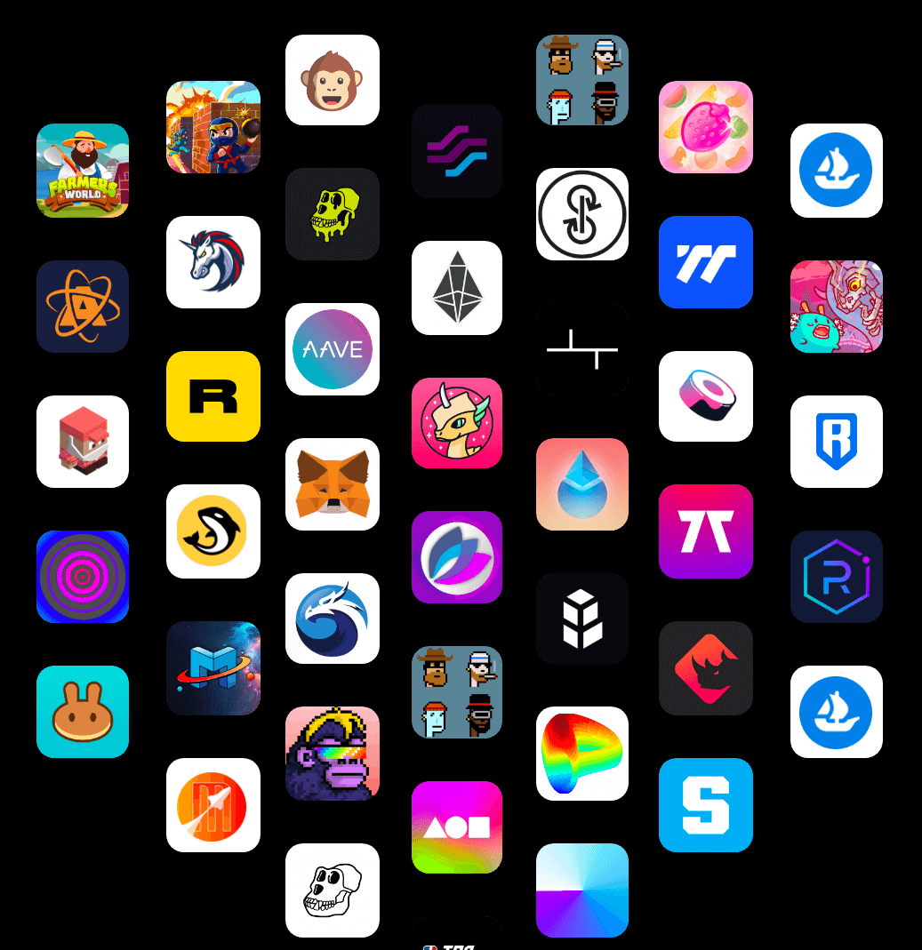
Decentralized Applications
Traditional Application
Apps have a frontend (user interface) and a backend
Frontend
(user interface)
Backend
(hosted on centralized company servers where code is hosted and executed)
Decentralized Application (Dapp)
Mostly, games, NFT swaps, Metaverse, decentralized finance (DeFi), wallets that deploy smart contracts (MetaMask)
Frontend
(user interface) is just like a traditional app)
Backend
smart contract (code) running on blockchain through Web3 Interface)

Slide 21

Web3
Remix IDE
VM environment: Code runs on your computer
Injected Web3
Web3 (APIs, libraries, protocols, tools) is the collective term for the bridge between the frontend and the blockchain, allowing users to interact with smart contracts directly through their wallets, without any centralized server in between
Web3 API
Ethereum Blockchain running on Ethereum nodes: Code of any arbitrary complexity can be executed in the form of smart contracts

Slide 22
Benefits of DApps
Resistance to censorship
No single entity on the network can block users from submitting transactions and deploying DApp
Data integrity
Data on blockchain is immutable and therefore, malicious actors cannot forge transactions or data already publicly available
Trustable computation/verifiable behavior
Smart contracts are guaranteed to execute in predictable ways
Zero downtime
Backend is on blockchain that is always running
Privacy
Real world identity of DApp users remains hidden
https://ethereum.org/en/developers/docs/dapps/

Slide 23
Drawbacks of DApps
Maintenance
DApps can be harder to maintain (updates or bug fixes) because the code and data published to the blockchain cannot be modified
Performance overhead
There is a huge performance overhead because scaling is hard due to decentralization and proof of work
Network congestion
Transaction throughput of public blockchains is very low (Ethereum network can only process 15 to 30 tps) and therefore the pool of unconfirmed transactions can quickly balloon up
Centralization Tendencies
User & developer friendly solutions may store lot of data and sensitive information on server-side, which may eliminate most of the blockchain advantages

Slide 24
Ethereum
 |  | Bitcoin | Ethereum
Protocol Governance | Anarchic | ✓
 | Hierarchical |  | ✓
 | Dictatorship
 | Federation
 | Democracy
Network Access | Open | ✓ | ✓
 | Semi-open
 | Closed
Transaction Processing | Decentralized | ✓ | ✓
 | Semi-centralized
 | Centralized
Incentives | Intrinsic | ✓ | ✓
 | Extrinsic
Reference Model | Internal variable/states | ✓
 | External variable/states
 | Hybrid |  | ✓
 | Self-Referential |  | ✓

