Slide 1

Introduction to Blockchain CSE-355
Ahmed Akhtar
Department of Computer Science
SMCS, IBA Karachi
Spring 2026

Slide 2
Lecture 25 Tuesday, Apr 28, 2026

Slide 3
Stablecoins & Digital Assets: Use Cases and Opportunities

Slide 4
Outline
Definition and properties
Types of stablecoins
ERC-20 Token Standard
Simulation exercise
Smart contract code walkthrough
Issues

Slide 5
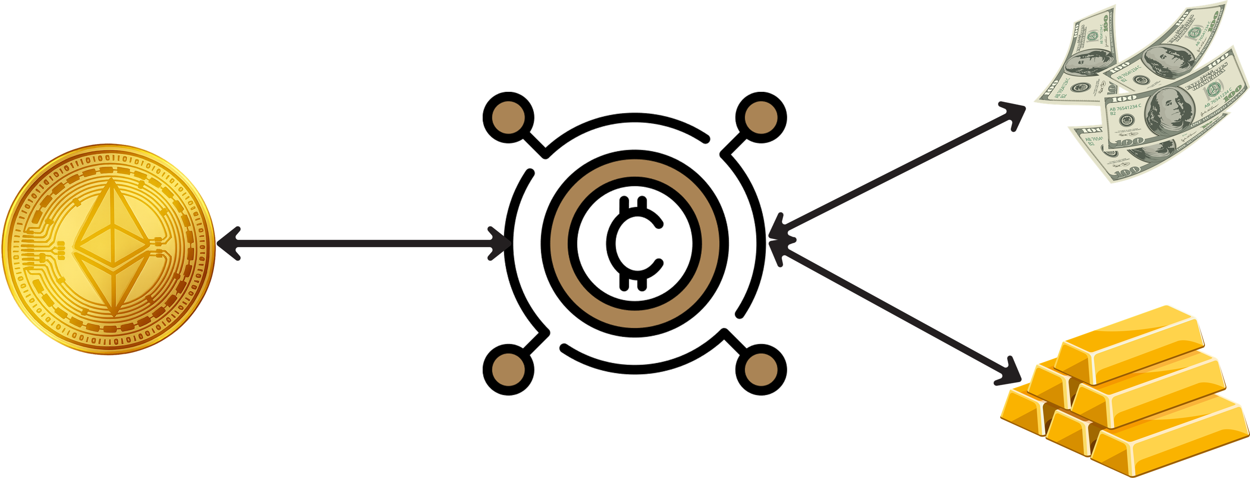
Stablecoin - Definition
“A stablecoin is a cryptocurrency token that is a fungible unit of financial value pegged to a currency, some other asset, or index. It can be traded directly between parties and converted to other currencies or the pegged asset.”¹
¹ Mell, P. and Yaga, D., 2023. Understanding stablecoin technology and related security considerations. US Department of Commerce, National Institute of Standards and Technology.

Slide 6
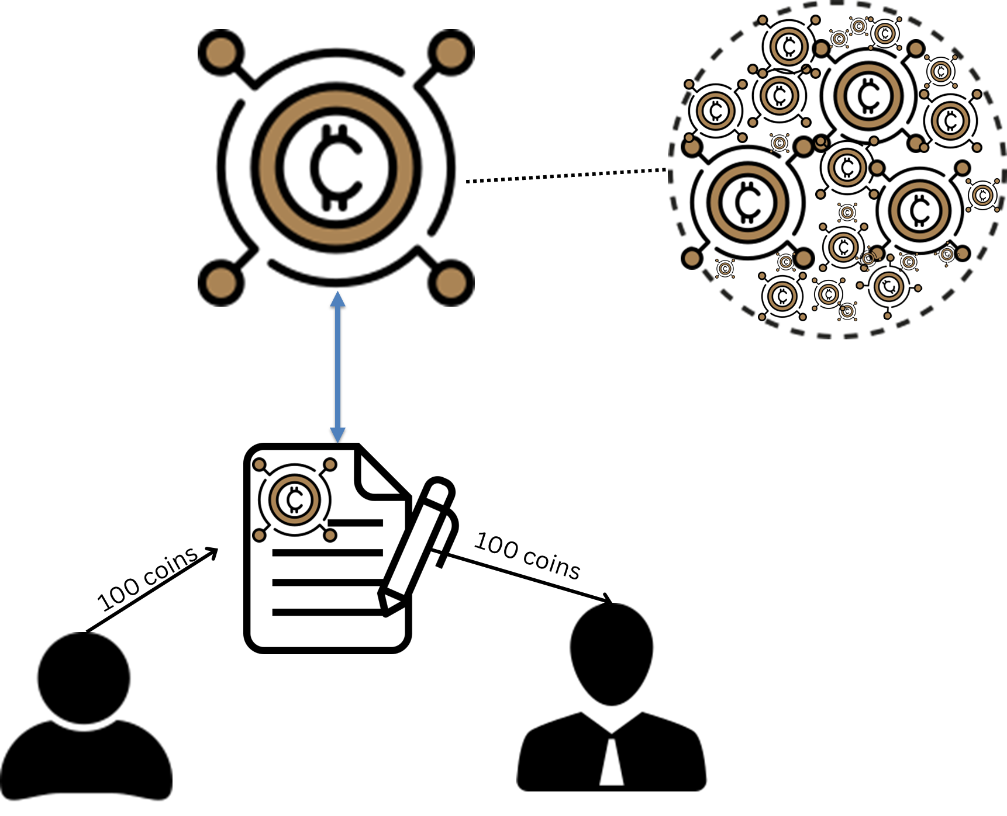
Stablecoin - Properties
Tokenized — Represented as a cryptocurrency token, typically managed by a smart contract
Fungible — Each unit has equal financial value, with minimal price volatility relative to its pegged asset or index
Tradable — Can be exchanged directly between parties without intermediaries
Convertible — Can be redeemed for other currencies or the underlying pegged asset

Slide 7



Stablecoins - Types
Fiat Currency-backed Backed by cash-equivalent reserves of a specific fiat currency (e.g., USD) or a basket of fiat currencies
Noncurrency Asset-backed Backed by reserves of non-currency assets (e.g., commodities, securities) or financial instruments tied to such assets
Cryptocurrency-backed Collateralized by reserves of volatile cryptocurrencies (excluding other stablecoins)

Slide 8

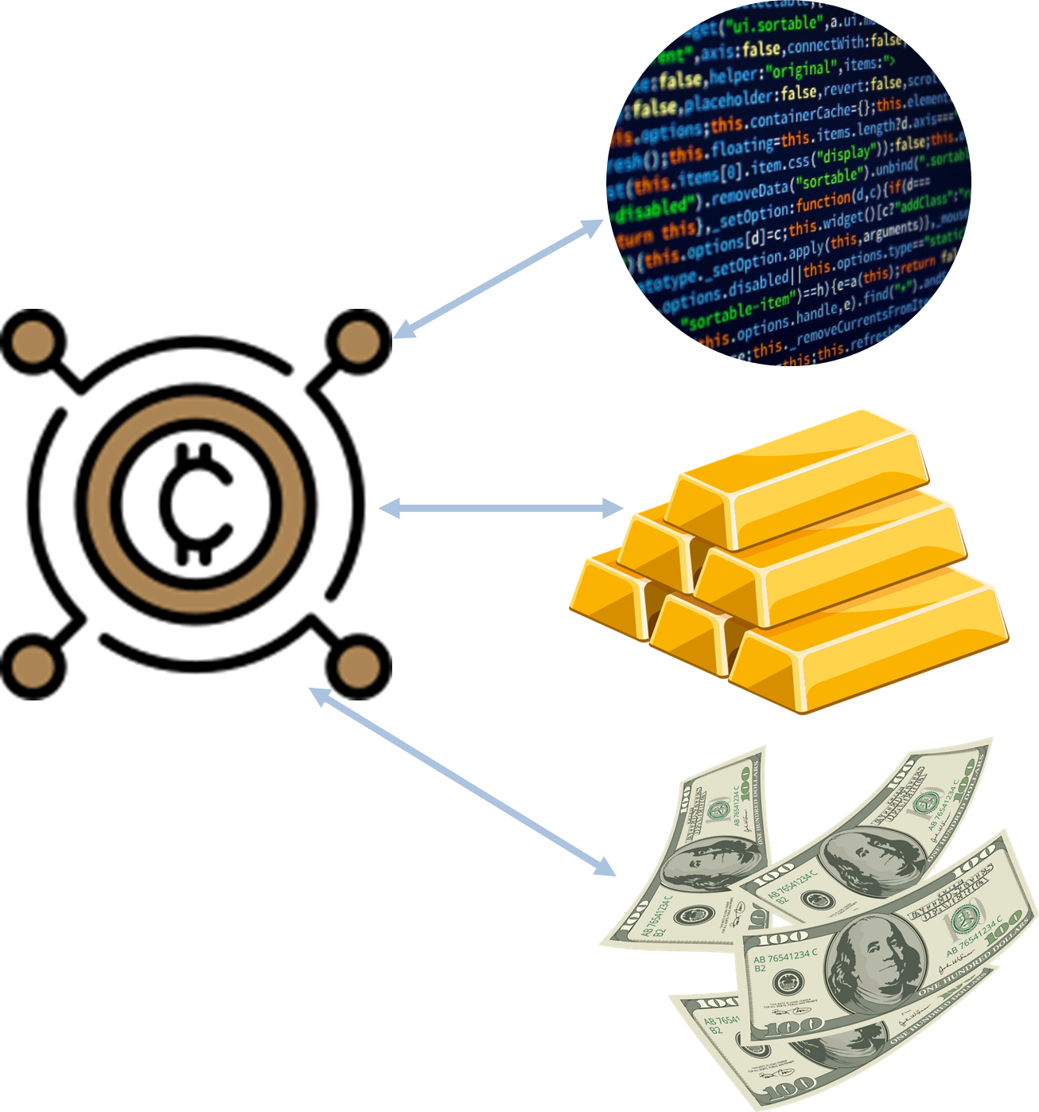

Stablecoin - Types
Algorithmic Non-collateralized Price stabilized through algorithms that automatically expand or contract the coin supply without using collateral
Hybrid Combines multiple stabilization methods, such as partial cryptocurrency collateral with algorithmic supply control
Private Institutional Issued for use within a private blockchain ecosystem, typically for internal transactions among the issuer’s customers

Slide 9
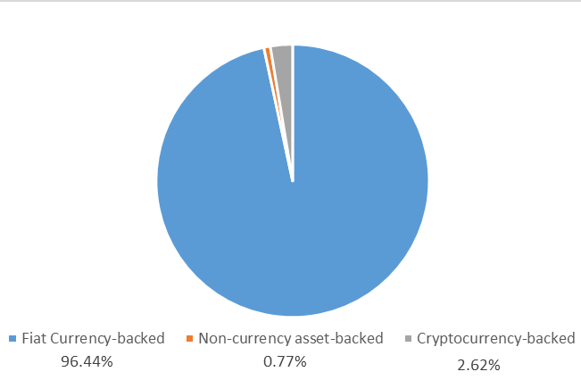
Stablecoin - Types
Stablecoin types on top 20 list by market capitalization
*All caps reflect the latest available figures (July 2025), sourced from CoinMarketCap, CoinGecko, Binance, and CoinCodex

Slide 10




Stablecoin – Fiat Currency-backed
Centralized Finance (CeFi): Managed by an off-chain, centralized entity responsible for holding and managing collateral externally
Collateralization: Typically fully collateralized by cash-equivalent reserves, such as bank deposits, treasury bills, or commercial paper.
Blockchain Transactions: Smart contracts primarily serve as an interface for:
Minting stablecoins upon deposit of equivalent collateral
Burning stablecoins upon redemption
Direct transfers between addresses
Delegated spending on behalf of stablecoin holders

Slide 11
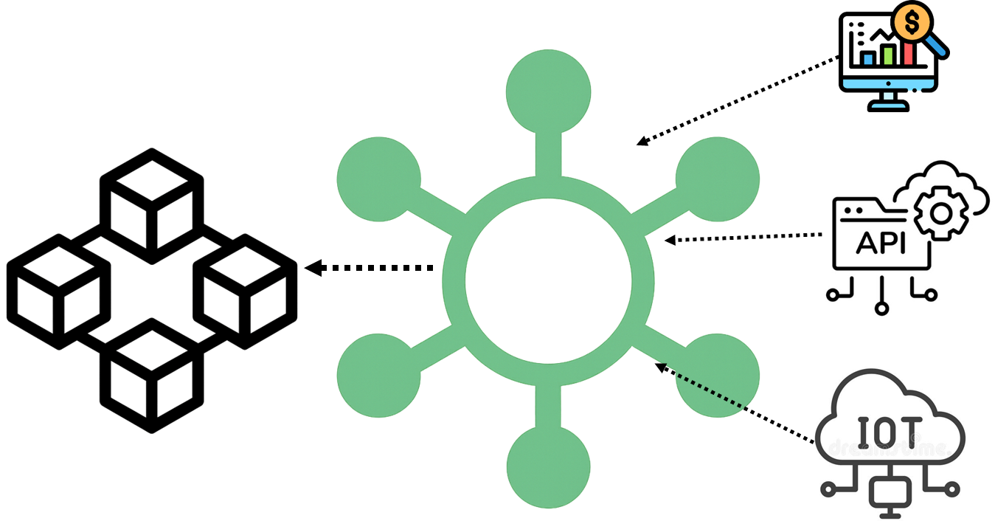
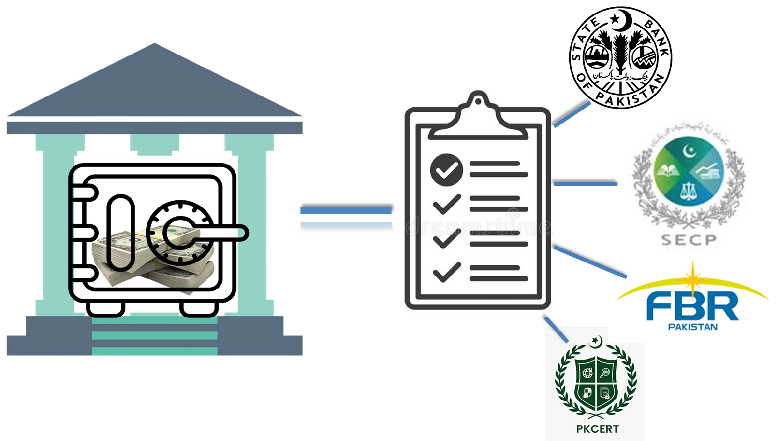
Stablecoin – Fiat Currency-backed
No Oracle Dependence: Does not rely on external entities for price feeds or market data
Regulatory Compliance: Managed by entities typically registered within specific jurisdictions, making them subject to local financial regulations
Stability Mechanism: Price stability is maintained by full collateralization along with a smart contract-based purchase and redemption mechanism
Notes:
Stablecoin Price Stability via Arbitrage: Fiat currency-backed stablecoins maintain their price peg without needing on-chain price feeds (oracles). Instead, they rely on market arbitrage, which means investors profit from price discrepancies:
When the stablecoin price falls below its peg (e.g., below $1): Investors buy the stablecoin cheaply on external markets and immediately redeem it with the issuer at the guaranteed peg value (e.g., $1), earning a profit. This buying activity drives demand, raising the market price back toward the peg.
When the stablecoin price rises above its peg (e.g., above $1): Investors mint new stablecoins at the guaranteed peg value from the issuer and sell them on the market at the higher market price, again profiting from the difference. This selling activity increases supply, bringing the market price back down to the peg.
This self-regulating mechanism eliminates the need for on-chain price oracles because the peg stability is enforced through market incentives rather than externally supplied price data.

Slide 12
Fiat Currency-backed Stablecoins by Market Capitalization
Stablecoin | Issuing/Managing Entity | Underlying Blockchains | Market Cap* (Approx.)
Tether (USDT) | Tether Limited | Ethereum, Tron, Omni, Solana, Algorand, Avalanche, etc. | $161 B
USD Coin (USDC) | Circle (Centre consortium with Coinbase) | Ethereum, Solana, Avalanche, Algorand, Stellar, Tron | $64.6 B
HUSD (HUSD) | Stable Universal Limited | Ethereum, HECO Chain | ~$993 M
TrueUSD (TUSD) | Archblock (formerly TrustToken) | Ethereum, Tron, Avalanche, Binance Smart Chain | $493 M
STASIS EURO (EURS) | STASIS | Ethereum, Algorand, Polygon | $144 M
Pax Dollar (USDP) | Paxos Trust Company | Ethereum | $70 M
Binance USD (BUSD) | Binance (with Paxos Trust Company) | Ethereum, Binance Smart Chain | $55 M
Gemini Dollar (GUSD) | Gemini Trust Company, LLC | Ethereum | $50 M
StraitsX Singapore Dollar (XSGD) | StraitsX (Xfers Pte Ltd, Singapore) | Ethereum, Zilliqa | $11 M
*All caps reflect the latest available figures (July 2025), sourced from CoinMarketCap, CoinGecko, Binance, and CoinCodex

Slide 13
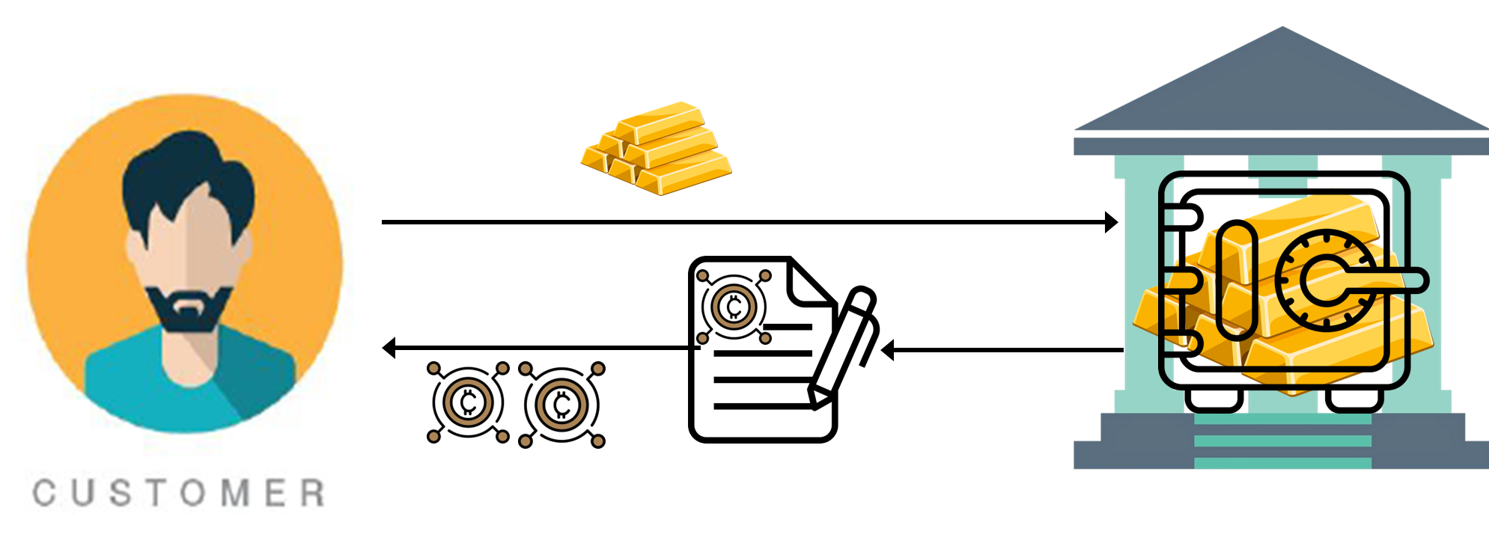
Stablecoin – Non-Currency Asset-Backed
Centralized Finance (CeFi): Managed by an off-chain centralized entity holding reserves of non-currency assets, such as gold, real estate, commodities, or securities
Collateralization: Typically fully collateralized, with reserves matching the total value of issued stablecoins
Blockchain Transactions: Smart contracts serve as a simple interface to the off-chain reserves, enabling minting, burning, and transferring of stablecoins, while actual collateral management remains off-chain

Slide 14
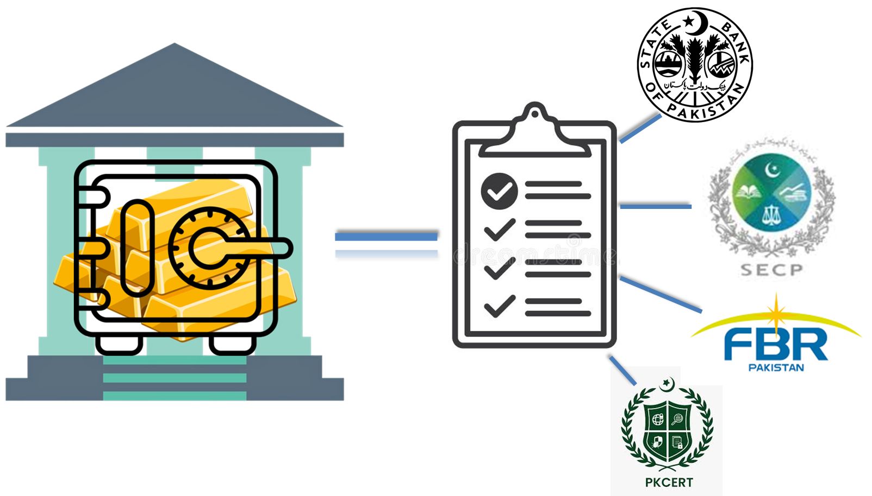
Stablecoin – Non-Currency Asset-Backed
Stability Mechanism: Stability achieved by allowing redemption at pegged value, with arbitrage in open markets correcting deviations
Regulatory Compliance: Typically managed by entities registered in specific jurisdictions, making them subject to local financial regulations

Slide 15
Non-Currency Asset-Backed Stablecoins by Market Capitalization
Stablecoin | Issuer / Manager | Blockchains | Market Cap* (Approx.)
Paxos Gold (PAXG) | Paxos Trust Company | Ethereum | $946 M
Tether Gold (XAUT) | Tether (TG Commodities Ltd.) | Ethereum, TRON | $826 M
Gold Coin (GLC) | GoldCoin Project | Ethereum (ERC‑20) | $10 M
Digix Gold (DGX) | Digix (DigixDAO, Singapore) | Ethereum | $280 K – $2.3 M
*All market cap figures reflect the latest available data (July 2025), sourced from CoinMarketCap, CoinGecko, and related industry trackers
Notes:
Redemption: Upon on-chain redemption, the user receives the equivalent amount of gold (the underlying asset), not fiat currency. For example:
PAXG: Each token represents 1 troy ounce of London Good Delivery gold; upon redemption, the holder can claim allocated gold or sell the token for fiat on exchanges.
XAUT: Each token equals 1 troy ounce of gold held in Swiss vaults; the holder can request physical delivery or transfer ownership.
DGX: Each token equals 1 gram of gold, redeemable for physical gold bars at designated vault locations.
However, if a user sells their stablecoins on an exchange, they will receive fiat currency (e.g., USD) or crypto equivalent at the market rate — but this is a trade, not redemption.

Slide 16
Lecture 26 Thursday, Apr 30, 2026

Slide 17
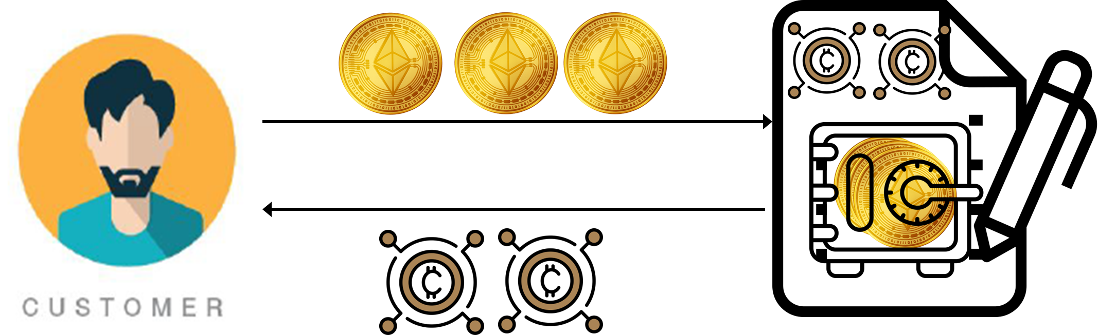
Stablecoin - Cryptocurrency-Backed
Multiple-Coin Ecosystem: Typically involves two or more coins—a stablecoin backed by reserves of volatile cryptocurrencies, and additional volatile companion coin(s)
Decentralized Finance (DeFi): Fully on-chain, with collateral management handled entirely by smart contracts, eliminating the need for centralized custodians
High Level of Automation: Smart contracts automatically manage collateral deposits, stable coin issuance on-chain, transfers, loans, and liquidations

Slide 18
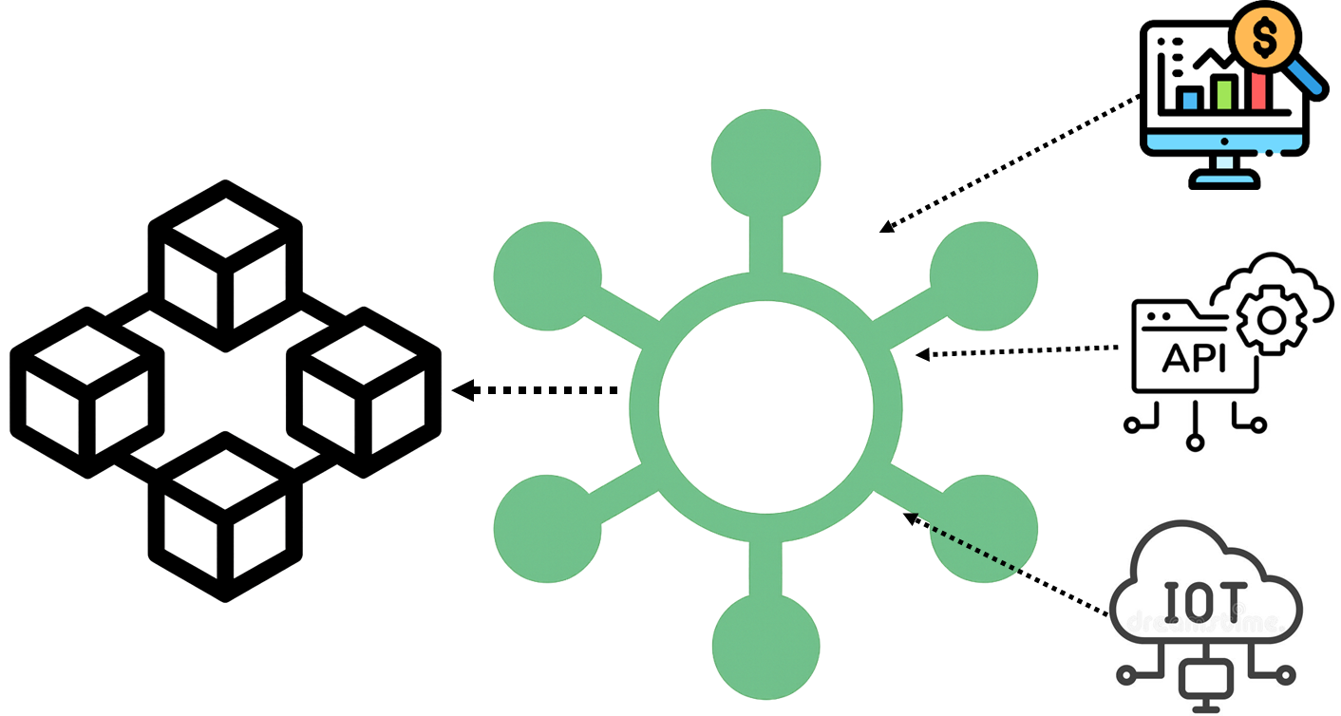
Stablecoin - Cryptocurrency-Backed
Collateralization: Reserves are over-collateralized to mitigate price volatility in the underlying cryptocurrencies
Oracle Dependence: Heavily reliant on blockchain oracles to provide real-time price feeds for accurate collateral valuation and liquidation

Slide 19
Stablecoin - Cryptocurrency-Backed
Stability Mechanism
Stability is maintained through over-collateralization, where collateral is worth more than the issued stablecoin
If the collateral value falls below a required threshold, the system automatically liquidates part of the collateral to repay the debt and protect the peg

Slide 20




Stablecoin - Cryptocurrency-Backed
Example - Automatic liquidation
$20 worth of ETH
$150 worth of ETH
$100 worth of ETH
$100
ETH sold to cover debt
$100
ETH price falls below collateralization threshold of $120

Slide 21
Cryptocurrency-Backed Stablecoin by Market Capitalization
Stablecoin | Issuer / Manager | Blockchain(s) | Market Cap (Approx.) | Typical Collateralization Ratio
Dai (DAI) | MakerDAO | Ethereum | ~$5.37 B | ≥ 150%
Falcon USD (USDF) | Falcon Digital | Ethereum | ~$655 M | ≥ 110%
USDX Stablecoin (USDX) | Kava Labs (Kava) | Kava, others | ~$79.7 M | ≥ 150%
Liquity USD (LUSD) | Liquity Protocol | Ethereum | ~$40.7 M | ≥ 110%
sUSD (SUSD) | Synthetix (SNX-backed) | Ethereum | ~$34 M | ≥ 500% (variable, very high)
*All market capitalization figures for cryptocurrency-backed stablecoins reflect the latest available data (July 2025), compiled from leading market trackers including CoinMarketCap, CoinGecko, and CryptoCompare

Slide 22
Stablecoin - Algorithmic Non-collateralized
Multiple‑Coin Ecosystem: Involves two or more tokens — a stablecoin and at least one companion token, which:
Absorbs volatility and supports the peg mechanism
Is minted when stablecoins are burned
Is burned when stablecoins are minted
Decentralized Finance (DeFi): Fully on‑chain, with stabilization managed entirely by smart contracts
No Collateral: Does not hold reserves; relies on algorithmic control of supply and user incentives to maintain the peg
High Automation: Smart contracts automatically adjust supply by incentivizing users to mint or burn tokens
Oracle Dependence: Requires reliable price oracles to measure the stablecoin’s market price and trigger supply adjustments

Slide 23
Stablecoin - Algorithmic Non-collateralized
Stability Mechanism
When the stablecoin price rises above peg, the protocol increases supply by minting more stablecoins and rewarding companion token holders
When the stablecoin price falls below peg, the protocol contracts supply by offering incentives (e.g., discounted companion tokens) to burn stablecoins

Slide 24
Stability Mechanism: Algorithmic Non-collateralized Stablecoin
Example: TerraUSD (UST) & LUNA
The protocol allows users to always exchange $1 worth of LUNA for 1 UST, and vice versa, regardless of UST’s market price
When UST > $1 (e.g., $1.02)
Users burn $1 worth of LUNA to mint 1 UST via the protocol
They sell 1 UST on the open market for $1.02, earning $0.02 profit
This increases UST supply, pushing the market price back down toward $1
When UST < $1 (e.g., $0.98)
Users buy 1 UST on the market for $0.98
Burn 1 UST via the protocol to mint $1 worth of LUNA
Sell LUNA for $1, earning $0.02 profit
This decreases UST supply, pushing the market price back up toward $1
The LUNA token serves as the volatile companion token, absorbing supply and demand fluctuations to maintain UST’s peg to $1

Slide 25
Algorithmic Non-collateralized Stablecoin by Market Capitalization
Stablecoin | Issuer / Manager | Blockchain(s) | Market Cap* (Approx.) | Companion Token(s)
TerraUSD (UST) | Terraform Labs (community‑run) | Terra (LUNA Classic) | ~$89 M (pre-collapse, 2022) | LUNA
Empty Set Dollar (ESD) | Empty Set community | Ethereum | <$1 M | ESD Shares (ESHARE)
Dynamic Set Dollar (DSD) | Community‑run | Ethereum | <$1 M | DSD Shares
Basis Cash (BAC) | Anonymous devs (Basis clone) | Ethereum | <$1 M | Basis Shares (BAS)
*All market capitalization figures for Algorithmic Non-collateralized Stablecoin reflect the latest available data (July 2025), compiled from leading market trackers including CoinMarketCap, CoinGecko, and Messari

Slide 26
Stablecoin - Hybrid
Combines Multiple Mechanisms: Uses a mix of fiat-backed, crypto-backed, non-currency asset-backed, and/or algorithmic methods for stabilization
Decentralized and Centralized Components: Often combines centralized custodianship of reserves with decentralized smart contracts for automation
Collateralization: May be partially collateralized (e.g., less than 100%) and rely on algorithmic supply adjustments to maintain the peg
Oracle Dependence: Relies on blockchain oracles for price feeds to monitor peg deviations and trigger supply adjustments

Slide 27
Stablecoin - Hybrid
Stability Mechanism
Stability is maintained through:
Partial collateral backing
Algorithmic expansion and contraction of supply
Incentives for arbitrage when price deviates from peg

Slide 28

Stablecoin – Private Institutional
Closed Ecosystem: Issued and used exclusively within a private blockchain network managed by a single institution
Customer Transactions Only: Accessible only to the institution’s customers for internal account transfers and payments
Not Publicly Traded: Cannot be traded on public cryptocurrency markets or between external parties
Management & Control:
Centralized management by the issuing institution
Full control over supply, redemption, and user access

Slide 29
Stablecoin – Private Institutional
Stability Mechanism
Pegged to a fiat currency or other reserve asset
Fully backed by institutional reserves held off-chain
Examples
JPM Coin (issued by JPMorgan Chase)
Wells Fargo Digital Cash (pilot project)
Primary Use Case
Improved settlement efficiency, transparency, and cost savings for institutional clients

Slide 30
Institutional Settlement Example: JPM Coin
Scenario
Company A needs to pay Company B $3M for goods.
Both have accounts with JPMorgan Chase
Traditional Settlement
Uses SWIFT/Fedwire
Takes hours or even a full business day
Involves intermediaries, higher fees, and manual reconciliation
With JPM Coin - Instant settlement on JPMorgan’s private blockchain:
Company A converts $5M into JPM Coin
Transfers JPM Coin to Company B instantly
Company B redeems JPM Coin for USD
Settlement completed in seconds, 24/7

Slide 31


Institutional Settlement Example: JPM Coin
Withdraw $3 Million from A’s Account
Deposit $3 Million from A’s Account
A
B
Company B
Company A

Slide 32
ERC-20 Token Standard
Technical standard for fungible tokens on the Ethereum blockchain
Defines a common set of rules for creating, transferring, and interacting with tokens
Ensures interoperability between:
Wallets (like MetaMask)
Exchanges (like Coinbase, Uniswap, Binance)
Other smart contracts
Enables anyone to create tokens that work seamlessly with the Ethereum ecosystem

Slide 33
Examples of ERC-20 Tokens
USDC (USD Coin)
USDT (USD Tether Coin)
Also deployed on other blockchains using different standards (e.g., TRC-20 standard on Tron Blockchain)
UNI (Uniswap)
LINK (Chainlink)
DAI (MakerDAO)

Slide 34
ERC-20 Token Standard
Key Functions in the Standard
totalSupply()→ Total supply of tokens
balanceOf(address) → Token balance of an account
transfer(address, amount) → Send tokens
approve(address, amount) → Approve another account to spend
transferFrom(address, address, amount) → Transfer on behalf of another
allowance(address, address) → Check approved amount

Slide 35
ERC-20 Token Standard
Events
event Transfer(address indexed from, address indexed to, uint256 value)
event Approval(address indexed owner, address indexed spender, uint256 value)

Slide 36
ERC-20 Token Standard
ERC‑20 Implementation by OpenZeppelin
Provides secure, audited, and reusable smart contract libraries
Complies fully with ERC‑20 standard
Modular and extensible — easy to customize
OpenZeppelin ERC‑20 on GitHub

Slide 37
ERC-20 Token Standard
Deploying your own tokens
// SPDX-License-Identifier: MIT
pragma solidity ^0.8.0;
import "@openzeppelin/contracts/token/ERC20/ERC20.sol";
contract MyToken is ERC20 {
uint8 private constant _DECIMALS = 4;
constructor() ERC20("MyToken", "MTK") {
_mint(msg.sender, 100000 * 10 ** _DECIMALS);
}
function decimals() public pure override returns (uint8) {
return _DECIMALS;
}
}

Slide 38
Concluding Remarks
Stablecoins as a Bridge
Provide stability in the volatile crypto ecosystem by pegging value to fiat, commodities, or cryptocurrency
Ensure trust, liquidity, and usability
Key Opportunities
Faster, cheaper cross-border payments
Improved financial inclusion and access
Institutional settlement efficiency
Challenges
Regulatory compliance and oversight
Dependence on oracles and collateral management

