Slide 1

Introduction to Blockchain CSE-355
Ahmed Akhtar
Department of Computer Science
SMCS, IBA Karachi
Spring 2026

Slide 2
Lecture 11 Tuesday, Feb 24, 2026

Slide 3
Bitcoin Transaction (legacy)
Transaction ID: 7cc90809ea6c90899086ed8607eea8dcc1bbe2ee3fbaa662f3f597888575c4c9
 | OUTPUT Index 0 Value: 0.00025302 BTC scriptPubKey: OP_DUP OP_HASH160 2fa9c4b9585b74fd5fd8c92fd4e32824b531e515 OP_EQUALVERIFY OP_CHECKSIG Index 1 Value: 0.01094000 BTC scriptPubKey: OP_DUP OP_HASH160 9772ba84d827ac93d719a2a40f3f5dcb8963b8ad OP_EQUALVERIFY OP_CHECKSIG
If ScriptPubKey(ScriptSig)
then create output
Lock to Babar’s PubKey Hash
If transaction inputs are valid then
Lock to Alia’s PubKey Hash

Slide 4
Bitcoin Transaction (legacy)
Multiple inputs and outputs
Alia’s output
Babar’s output

Slide 5
Bitcoin Transaction (legacy)
Unspendable Output
INPUT Prev. Trans. ID: Index: 0 ScriptSig | OUTPUT
 | Index 0 Value: 0 BTC scriptPubKey: OP_Return <any thing>
 | Index 1 Value: 0.00025302 BTC scriptPubKey: OP_DUP OP_HASH160 2fa9c4b9585b74fd5fd8c92fd4e32824b531e515 OP_EQUALVERIFY OP_CHECKSIG
Unspendable Output

Slide 6
Bitcoin Transaction (legacy)
INPUT Prev. Trans. ID: 0f07ec1c3738873cd6336f0e2c92094bf08d0ad3bce8aba0efa2eb9d172fd60c Index: 0 ScriptSig 304402208a09e17ddf7f3e7d1d6e18b3b42f9e445c8c6f5f2e93f993b6f6b9c5b1f3a2d702202f7d8b03c2f1763e8c5ff0b8a0b6c80b7d41d6e2a2b9df62d4a056c6bb6f23ef01 (Signature) 026a7cd9a8f65b260bd459d8c1e823110a699391cbaabb6a4304a5e680b2ab2cf8 (Public Key) | OUTPUT Index 0 Value: 0.00025302 BTC scriptPubKey: OP_DUP OP_HASH160 2fa9c4b9585b74fd5fd8c92fd4e32824b531e515 OP_EQUALVERIFY OP_CHECKSIG Index 1 Value: 0.01094000 BTC scriptPubKey: OP_DUP OP_HASH160 9772ba84d827ac93d719 a2a40f3f5dcb8963b8ad OP_EQUALVERIFY OP_CHECKSIG
Transaction ID: 7cc90809ea6c90899086ed8607eea8dcc1bbe2ee3fbaa662f3f597888575c4c9

Slide 7
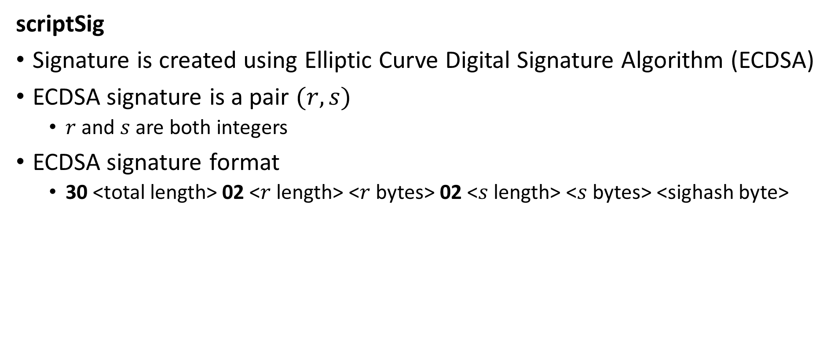
Bitcoin Transaction (legacy)
scriptSig
Signature is created using Elliptic Curve Digital Signature Algorithm (ECDSA)
ECDSA signature is a pair $(r, s)$
$r$ and $s$ are both integers
ECDSA signature format
30 <total length> 02 <$r$ length> <$r$ bytes> 02 <$s$ length> <$s$ bytes> <sighash byte>

Slide 8
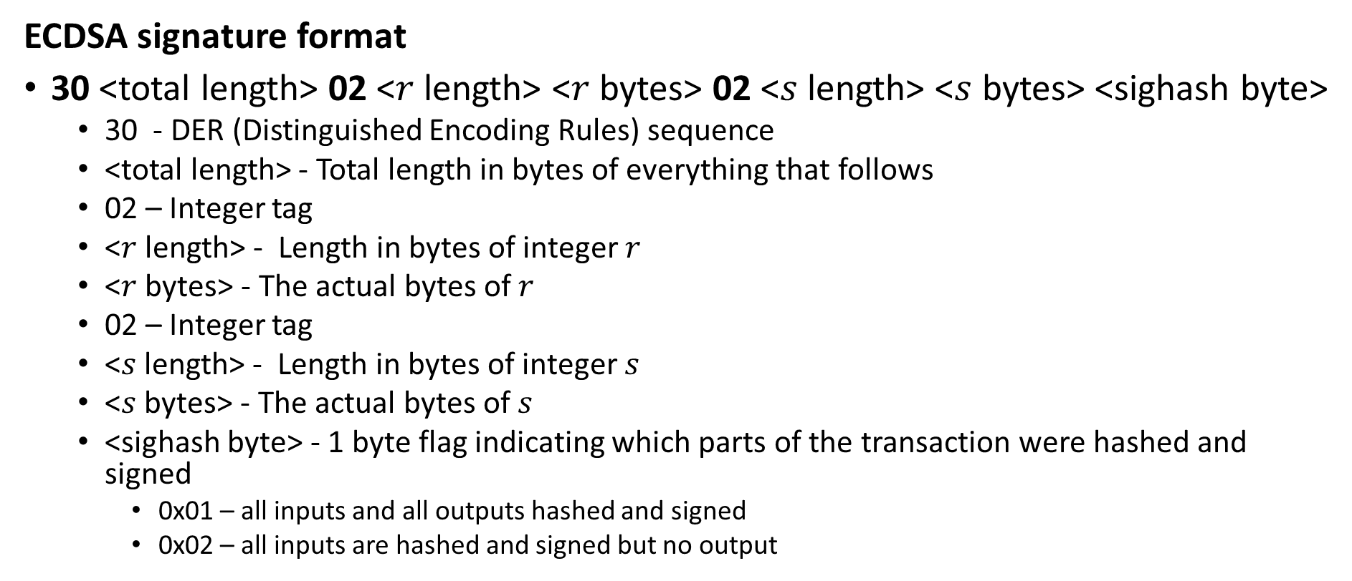
Bitcoin Transaction (legacy)
ECDSA signature format
30 <total length> 02 <$r$ length> <$r$ bytes> 02 <$s$ length> <$s$ bytes> <sighash byte>
30 - DER (Distinguished Encoding Rules) sequence
<total length> - Total length in bytes of everything that follows
02 – Integer tag
<$r$ length> - Length in bytes of integer $r$
<$r$ bytes> - The actual bytes of $r$
02 – Integer tag
<$s$ length> - Length in bytes of integer $s$
<$s$ bytes> - The actual bytes of $s$
<sighash byte> - 1 byte flag indicating which parts of the transaction were hashed and signed
0x01 – all inputs and all outputs hashed and signed
0x02 – all inputs are hashed and signed but no output

Slide 9
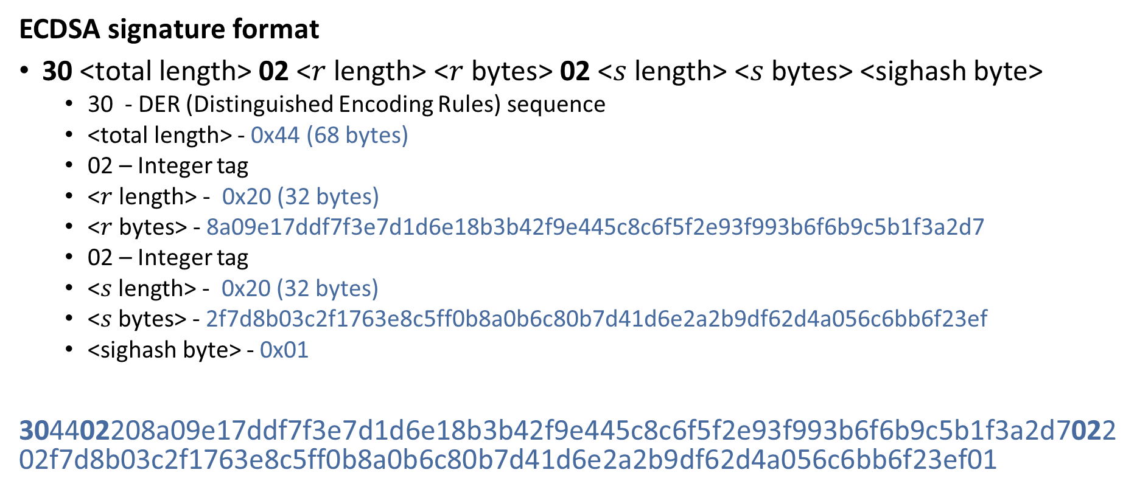
Bitcoin Transaction (legacy)
ECDSA signature format
30 <total length> 02 <$r$ length> <$r$ bytes> 02 <$s$ length> <$s$ bytes> <sighash byte>
30 - DER (Distinguished Encoding Rules) sequence
<total length> - 0x44 (68 bytes)
02 – Integer tag
<$r$ length> - 0x20 (32 bytes)
<$r$ bytes> - 8a09e17ddf7f3e7d1d6e18b3b42f9e445c8c6f5f2e93f993b6f6b9c5b1f3a2d7
02 – Integer tag
<$s$ length> - 0x20 (32 bytes)
<$s$ bytes> - 2f7d8b03c2f1763e8c5ff0b8a0b6c80b7d41d6e2a2b9df62d4a056c6bb6f23ef
<sighash byte> - 0x01
304402208a09e17ddf7f3e7d1d6e18b3b42f9e445c8c6f5f2e93f993b6f6b9c5b1f3a2d702202f7d8b03c2f1763e8c5ff0b8a0b6c80b7d41d6e2a2b9df62d4a056c6bb6f23ef01

Slide 10
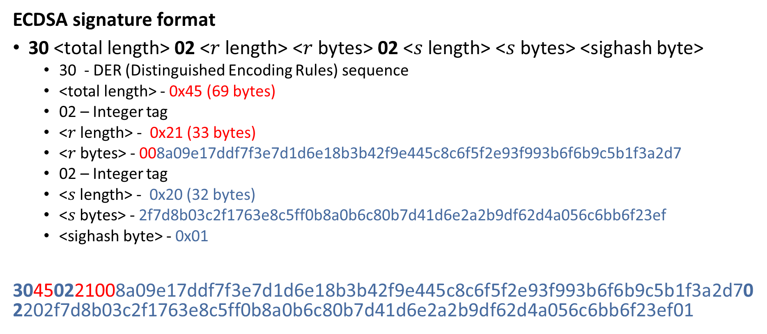
Bitcoin Transaction (legacy)
ECDSA signature format
30 <total length> 02 <$r$ length> <$r$ bytes> 02 <$s$ length> <$s$ bytes> <sighash byte>
30 - DER (Distinguished Encoding Rules) sequence
<total length> - 0x45 (69 bytes)
02 – Integer tag
<$r$ length> - 0x21 (33 bytes)
<$r$ bytes> - 008a09e17ddf7f3e7d1d6e18b3b42f9e445c8c6f5f2e93f993b6f6b9c5b1f3a2d7
02 – Integer tag
<$s$ length> - 0x20 (32 bytes)
<$s$ bytes> - 2f7d8b03c2f1763e8c5ff0b8a0b6c80b7d41d6e2a2b9df62d4a056c6bb6f23ef
<sighash byte> - 0x01
30450221008a09e17ddf7f3e7d1d6e18b3b42f9e445c8c6f5f2e93f993b6f6b9c5b1f3a2d702202f7d8b03c2f1763e8c5ff0b8a0b6c80b7d41d6e2a2b9df62d4a056c6bb6f23ef01

Slide 11
Bitcoin Transaction (legacy)
INPUT Prev. Trans. ID: 0f07ec1c3738873cd6336f0e2c92094bf08d0ad3bce8aba0efa2eb9d172fd60c Index: 0 ScriptSig 304402208a09e17ddf7f3e7d1d6e18b3b42f9e445c8c6f5f2e93f993b6f6b9c5b1f3a2d702202f7d8b03c2f1763e8c5ff0b8a0b6c80b7d41d6e2a2b9df62d4a056c6bb6f23ef01 (Signature) 026a7cd9a8f65b260bd459d8c1e823110a699391cbaabb6a4304a5e680b2ab2cf8 (Public Key) | OUTPUT Index 0 Value: 0.00025302 BTC scriptPubKey: OP_DUP OP_HASH160 2fa9c4b9585b74fd5fd8c92fd4e32824b531e515 OP_EQUALVERIFY OP_CHECKSIG Index 1 Value: 0.01094000 BTC scriptPubKey: OP_DUP OP_HASH160 9772ba84d827ac93d719a2a40f3f5dcb8963b8ad OP_EQUALVERIFY OP_CHECKSIG
Transaction ID: 7cc90809ea6c90899086ed8607eea8dcc1bbe2ee3fbaa662f3f597888575c4c9

Slide 12
Bitcoin Transaction (legacy)
INPUT Prev. Trans. ID: 0f07ec1c3738873cd6336f0e2c92094bf08d0ad3bce8aba0efa2eb9d172fd60c Index: 0 ScriptSig 30450221008a09e17ddf7f3e7d1d6e18b3b42f9e445c8c6f5f2e93f993b6f6b9c5b1f3a2d702202f7d8b03c2f1763e8c5ff0b8a0b6c80b7d41d6e2a2b9df62d4a056c6bb6f23ef01 (Signature) 026a7cd9a8f65b260bd459d8c1e823110a699391cbaabb6a4304a5e680b2ab2cf8 (Public Key) | OUTPUT Index 0 Value: 0.00025302 BTC scriptPubKey: OP_DUP OP_HASH160 2fa9c4b9585b74fd5fd8c92fd4e32824b531e515 OP_EQUALVERIFY OP_CHECKSIG Index 1 Value: 0.01094000 BTC scriptPubKey: OP_DUP OP_HASH160 9772ba84d827ac93d719a2a40f3f5dcb8963b8ad OP_EQUALVERIFY OP_CHECKSIG
Transaction ID: 7cc90809ea6c90899086ed8607eea8dcc1bbe2ee3fbaa662f3f597888575c4c9

Slide 13
Bitcoin Transaction (legacy)
INPUT Prev. Trans. ID: 0f07ec1c3738873cd6336f0e2c92094bf08d0ad3bce8aba0efa2eb9d172fd60c Index: 0 ScriptSig 30450221008a09e17ddf7f3e7d1d6e18b3b42f9e445c8c6f5f2e93f993b6f6b9c5b1f3a2d702202f7d8b03c2f1763e8c5ff0b8a0b6c80b7d41d6e2a2b9df62d4a056c6bb6f23ef01 (Signature) 026a7cd9a8f65b260bd459d8c1e823110a699391cbaabb6a4304a5e680b2ab2cf8 (Public Key) | OUTPUT Index 0 Value: 0.00025302 BTC scriptPubKey: OP_DUP OP_HASH160 2fa9c4b9585b74fd5fd8c92fd4e32824b531e515 OP_EQUALVERIFY OP_CHECKSIG Index 1 Value: 0.01094000 BTC scriptPubKey: OP_DUP OP_HASH160 9772ba84d827ac93d719a2a40f3f5dcb8963b8ad OP_EQUALVERIFY OP_CHECKSIG
Transaction ID: 7cc90809ea6c90899086ed8607eea8dcc1bbe2ee3fbaa662f3f597888575c4c9 7b9ab087c86818551aa77f59bb2c35bd774abed7fcb19c7e840b502b2604271c

Slide 14
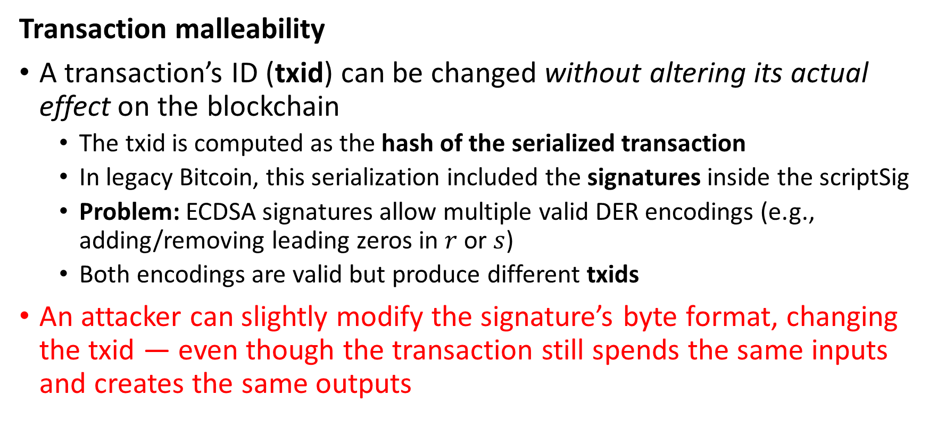
Bitcoin Transaction (legacy)
Transaction malleability
A transaction’s ID (txid) can be changed without altering its actual effect on the blockchain
The txid is computed as the hash of the serialized transaction
In legacy Bitcoin, this serialization included the signatures inside the scriptSig
Problem: ECDSA signatures allow multiple valid DER encodings (e.g., adding/removing leading zeros in $r$ or $s$)
Both encodings are valid but produce different txids
An attacker can slightly modify the signature’s byte format, changing the txid — even though the transaction still spends the same inputs and creates the same outputs

Slide 15
Why Transaction Malleability is an issue?
Unreliable Transaction IDs
Wallets track transactions by txid
If the txid can be changed, wallets may not recognize that a confirmed transaction is the same one they sent
Double-Spend Risks
Attackers can alter a pending transaction’s signature, rebroadcast it, and miners might confirm the modified version instead of the original
Network Confusion
Nodes and users may see multiple versions of the same transaction with different IDs, creating uncertainty until one is mined

Slide 16
Why Transaction Malleability is an issue?
Breaks Layer-2 Protocols
Off-chain protocols (e.g., early payment channels, Lightning prototypes) depend on knowing exact txids
Malleability makes it impossible to pre-build transactions that rely on previous txids

Slide 17
How to prevent transaction malleability?
scriptSig = <ECDSA signature, Public key> acts as a witness proving that:
The payer has authorized this transaction
The payer can unlock the unspent output of previous transaction
To prevent transaction malleability, we need to segregate this witness from the transaction input
Segregated Witness (SegWit) transaction
Txid is not created using scriptSig

Slide 18
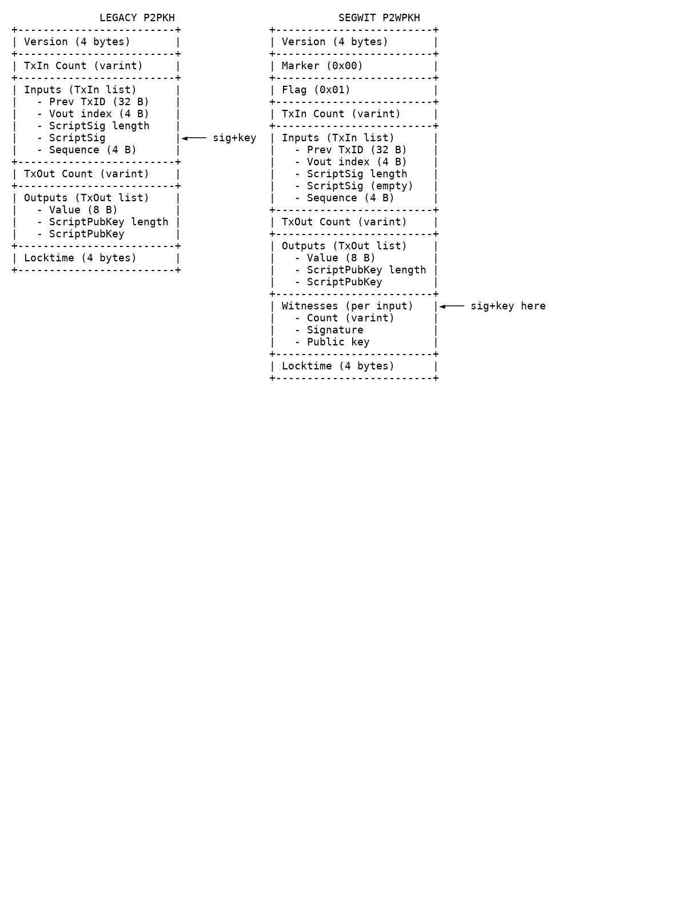
Bitcoin – legacy vs. SegWit Transactions
Legacy – P2PKH
SegWit – P2WPKH

Slide 19
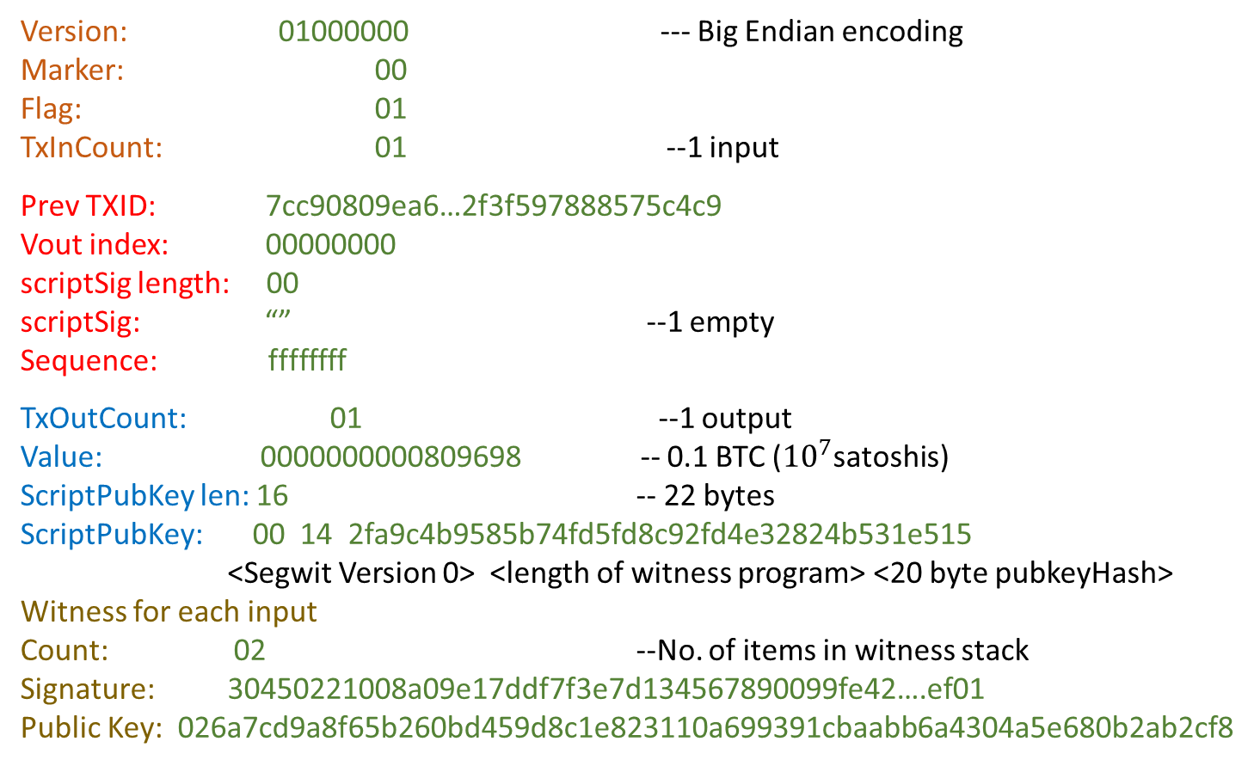
SegWit Transaction
Version: 01000000 --- Big Endian encoding
Marker: 00
Flag: 01
TxInCount: 01 --1 input
Prev TXID: 7cc90809ea6…2f3f597888575c4c9
Vout index: 00000000
scriptSig length: 00
scriptSig: “” --1 empty
Sequence: ffffffff
TxOutCount: 01 --1 output
Value: 0000000000809698 -- 0.1 BTC (${10}^{7}$satoshis)
ScriptPubKey len: 16 -- 22 bytes
ScriptPubKey: 00 14 2fa9c4b9585b74fd5fd8c92fd4e32824b531e515
<Segwit Version 0> <length of witness program> <20 byte pubkeyHash>
Witness for each input
Count: 02 --No. of items in witness stack
Signature: 30450221008a09e17ddf7f3e7d134567890099fe42….ef01
Public Key: 026a7cd9a8f65b260bd459d8c1e823110a699391cbaabb6a4304a5e680b2ab2cf8
Pay to Witness Public Key Hash (P2WPKH)

Slide 20
SegWit Transaction – P2WPKH
INPUT Prev. Trans. ID: 0f07ec1c3738873cd6336f0e2c92094bf08d0ad3bce8aba0efa2eb9d172fd60c Index: 0 ScriptSig “” | OUTPUT Index 0 Value: 0.00025302 BTC scriptPubKey: 00 14 2fa9c4b9585b74fd5fd8c92fd4e32824b531e515 Index 1 Value: 0.01094000 BTC scriptPubKey: 00 14 92fd4e32824b531e5152fa9c4b9585b74fd5fd8c
Witness Signature: 304402208a09e17ddf7f3e7d1d6e18b3b42f9e445c8c6f5f2e93f993b6f6b9c5b1f3a2d702202f7d8b03c2f1763e8c5ff0b8a0b6c80b7d41d6e2a2b9df62d4a056c6bb6f23ef01 Public Key: 026a7cd9a8f65b260bd459d8c1e823110a699391cbaabb6a4304a5e680b2ab2cf8
Babar
Alia
Alia

Slide 21
SegWit Transaction – P2WPKH
INPUT Prev. Trans. ID: 0f07ec1c3738873cd6336f0e2c92094bf08d0ad3bce8aba0efa2eb9d172fd60c Index: 0 ScriptSig “” | OUTPUT Index 0 Value: 0.00025302 BTC scriptPubKey: 00 14 2fa9c4b9585b74fd5fd8c92fd4e32824b531e515 Index 1 Value: 0.01094000 BTC scriptPubKey: 00 14 92fd4e32824b531e5152fa9c4b9585b74fd5fd8c
Witness Signature: 304402208a09e17ddf7f3e7d1d6e18b3b42f9e445c8c6f5f2e93f993b6f6b9c5b1f3a2d702202f7d8b03c2f1763e8c5ff0b8a0b6c80b7d41d6e2a2b9df62d4a056c6bb6f23ef01 Public Key: 026a7cd9a8f65b260bd459d8c1e823110a699391cbaabb6a4304a5e680b2ab2cf8
No OP Codes!
Bitcoin internally expands the scriptPubKey of Prev. Trans. Output into the “virtual” script
OP_DUP OP_HASH160 <pubKeyHash> OP_EQUALVERIFY OP_CHECKSIG

Slide 22
Execution – P2WPKH
ScriptSig: “ ” Witness: 304402205e4a6ac74d35de1ffc1188f717273bada586b3de78f6844a548d548b0d27634c02207b127fa009b9d755b848772dcee21c4a05554501fd5e0d8a60ee8b9f9d13da7d01 Alia’s Signatures 026a7cd9a8f65b260bd459d8c1e823110a699391cbaabb6a4304a5e680b2ab2cf8 Alia’s public key ScriptPubKey: (Prev. Trans.) 00 14 076960c3d0cdf8076ecd0cc220022384475aff76e
Stack
SegWit transaction!
Expand ScriptPubKey to virtual scriptPubkey for P2WPKH

Slide 23
Execution – P2WPKH
ScriptSig: “ ” Witness: 304402205e4a6ac74d35de1ffc1188f717273bada586b3de78f6844a548d548b0d27634c02207b127fa009b9d755b848772dcee21c4a05554501fd5e0d8a60ee8b9f9d13da7d01 Alia’s Signatures 026a7cd9a8f65b260bd459d8c1e823110a699391cbaabb6a4304a5e680b2ab2cf8 Alia’s public key ScriptPubKey: (Prev. Trans.) 00 14 076960c3d0cdf8076ecd0cc220022384475aff76e Virtual ScriptPubKey OP_DUP OP_HASH160 <076960c3d0cdf8076ecd0cc220022384475aff76e> OP_EQUALVERIFY OP_CHECKSIG
Stack
SegWit transaction!
Expand ScriptPubKey to virtual scriptPubkey for P2WPKH

Slide 24
Execution – P2WPKH
ScriptSig: “ ” Witness: 304402205e4a6ac74d35de1ffc1188f717273bada586b3de78f6844a548d548b0d27634c02207b127fa009b9d755b848772dcee21c4a05554501fd5e0d8a60ee8b9f9d13da7d01 Alia’s Signatures 026a7cd9a8f65b260bd459d8c1e823110a699391cbaabb6a4304a5e680b2ab2cf8 Alia’s public key ScriptPubKey: (Prev. Trans.) 00 14 076960c3d0cdf8076ecd0cc220022384475aff76e Virtual ScriptPubKey OP_DUP OP_HASH160 <076960c3d0cdf8076ecd0cc220022384475aff76e> OP_EQUALVERIFY OP_CHECKSIG
Stack
Push witness items to stack

Slide 25
Execution – P2WPKH
ScriptSig: “ ” Witness: 304402205e4a6ac74d35de1ffc1188f717273bada586b3de78f6844a548d548b0d27634c02207b127fa009b9d755b848772dcee21c4a05554501fd5e0d8a60ee8b9f9d13da7d01 Alia’s Signatures 026a7cd9a8f65b260bd459d8c1e823110a699391cbaabb6a4304a5e680b2ab2cf8 Alia’s public key ScriptPubKey: (Prev. Trans.) 00 14 076960c3d0cdf8076ecd0cc220022384475aff76e Virtual ScriptPubKey OP_DUP OP_HASH160 <076960c3d0cdf8076ecd0cc220022384475aff76e> OP_EQUALVERIFY OP_CHECKSIG
Stack
026a7cd9a8f65b260bd459d8c1e823110a699391cbaabb6a4304a5e680b2ab2cf8
304402205e4a6ac74d35de1ffc1188f717273bada586b3de78f6844a548d548b0d27634c02207b127fa009b9d755b848772dcee21c4a05554501fd5e0d8a60ee8b9f9d13da7d01
Push witness items to stack

Slide 26
Execution – P2WPKH
ScriptSig: “ ” Witness: 304402205e4a6ac74d35de1ffc1188f717273bada586b3de78f6844a548d548b0d27634c02207b127fa009b9d755b848772dcee21c4a05554501fd5e0d8a60ee8b9f9d13da7d01 Alia’s Signatures 026a7cd9a8f65b260bd459d8c1e823110a699391cbaabb6a4304a5e680b2ab2cf8 Alia’s public key ScriptPubKey: (Prev. Trans.) 00 14 076960c3d0cdf8076ecd0cc220022384475aff76e Virtual ScriptPubKey OP_DUP OP_HASH160 <076960c3d0cdf8076ecd0cc220022384475aff76e> OP_EQUALVERIFY OP_CHECKSIG
Stack
026a7cd9a8f65b260bd459d8c1e823110a699391cbaabb6a4304a5e680b2ab2cf8
304402205e4a6ac74d35de1ffc1188f717273bada586b3de78f6844a548d548b0d27634c02207b127fa009b9d755b848772dcee21c4a05554501fd5e0d8a60ee8b9f9d13da7d01
Execute OP Codes!

Slide 27
Execution – P2WPKH
ScriptSig: “ ” Witness: 304402205e4a6ac74d35de1ffc1188f717273bada586b3de78f6844a548d548b0d27634c02207b127fa009b9d755b848772dcee21c4a05554501fd5e0d8a60ee8b9f9d13da7d01 Alia’s Signatures 026a7cd9a8f65b260bd459d8c1e823110a699391cbaabb6a4304a5e680b2ab2cf8 Alia’s public key ScriptPubKey: (Prev. Trans.) 00 14 076960c3d0cdf8076ecd0cc220022384475aff76e Virtual ScriptPubKey OP_DUP OP_HASH160 <076960c3d0cdf8076ecd0cc220022384475aff76e> OP_EQUALVERIFY OP_CHECKSIG
Stack
026a7cd9a8f65b260bd459d8c1e823110a699391cbaabb6a4304a5e680b2ab2cf8
026a7cd9a8f65b260bd459d8c1e823110a699391cbaabb6a4304a5e680b2ab2cf8
304402205e4a6ac74d35de1ffc1188f717273bada586b3de78f6844a548d548b0d27634c02207b127fa009b9d755b848772dcee21c4a05554501fd5e0d8a60ee8b9f9d13da7d01

Slide 28
Execution – P2WPKH
ScriptSig: “ ” Witness: 304402205e4a6ac74d35de1ffc1188f717273bada586b3de78f6844a548d548b0d27634c02207b127fa009b9d755b848772dcee21c4a05554501fd5e0d8a60ee8b9f9d13da7d01 Alia’s Signatures 026a7cd9a8f65b260bd459d8c1e823110a699391cbaabb6a4304a5e680b2ab2cf8 Alia’s public key ScriptPubKey: (Prev. Trans.) 00 14 076960c3d0cdf8076ecd0cc220022384475aff76e Virtual ScriptPubKey OP_DUP OP_HASH160 <076960c3d0cdf8076ecd0cc220022384475aff76e> OP_EQUALVERIFY OP_CHECKSIG
Stack
76960c3d0cdf8076ecd0cc220022384475aff76e
026a7cd9a8f65b260bd459d8c1e823110a699391cbaabb6a4304a5e680b2ab2cf8
304402205e4a6ac74d35de1ffc1188f717273bada586b3de78f6844a548d548b0d27634c02207b127fa009b9d755b848772dcee21c4a05554501fd5e0d8a60ee8b9f9d13da7d01

Slide 29
Execution – P2WPKH
ScriptSig: “ ” Witness: 304402205e4a6ac74d35de1ffc1188f717273bada586b3de78f6844a548d548b0d27634c02207b127fa009b9d755b848772dcee21c4a05554501fd5e0d8a60ee8b9f9d13da7d01 Alia’s Signatures 026a7cd9a8f65b260bd459d8c1e823110a699391cbaabb6a4304a5e680b2ab2cf8 Alia’s public key ScriptPubKey: (Prev. Trans.) 00 14 076960c3d0cdf8076ecd0cc220022384475aff76e Virtual ScriptPubKey OP_DUP OP_HASH160 <076960c3d0cdf8076ecd0cc220022384475aff76e> OP_EQUALVERIFY OP_CHECKSIG
Stack
76960c3d0cdf8076ecd0cc220022384475aff76e
76960c3d0cdf8076ecd0cc220022384475aff76e
026a7cd9a8f65b260bd459d8c1e823110a699391cbaabb6a4304a5e680b2ab2cf8
304402205e4a6ac74d35de1ffc1188f717273bada586b3de78f6844a548d548b0d27634c02207b127fa009b9d755b848772dcee21c4a05554501fd5e0d8a60ee8b9f9d13da7d01

Slide 30
Execution – P2WPKH
ScriptSig: “ ” Witness: 304402205e4a6ac74d35de1ffc1188f717273bada586b3de78f6844a548d548b0d27634c02207b127fa009b9d755b848772dcee21c4a05554501fd5e0d8a60ee8b9f9d13da7d01 Alia’s Signatures 026a7cd9a8f65b260bd459d8c1e823110a699391cbaabb6a4304a5e680b2ab2cf8 Alia’s public key ScriptPubKey: (Prev. Trans.) 00 14 076960c3d0cdf8076ecd0cc220022384475aff76e Virtual ScriptPubKey OP_DUP OP_HASH160 <076960c3d0cdf8076ecd0cc220022384475aff76e> OP_EQUALVERIFY OP_CHECKSIG
Stack
026a7cd9a8f65b260bd459d8c1e823110a699391cbaabb6a4304a5e680b2ab2cf8
304402205e4a6ac74d35de1ffc1188f717273bada586b3de78f6844a548d548b0d27634c02207b127fa009b9d755b848772dcee21c4a05554501fd5e0d8a60ee8b9f9d13da7d01

Slide 31
Execution – P2WPKH
ScriptSig: “ ” Witness: 304402205e4a6ac74d35de1ffc1188f717273bada586b3de78f6844a548d548b0d27634c02207b127fa009b9d755b848772dcee21c4a05554501fd5e0d8a60ee8b9f9d13da7d01 Alia’s Signatures 026a7cd9a8f65b260bd459d8c1e823110a699391cbaabb6a4304a5e680b2ab2cf8 Alia’s public key ScriptPubKey: (Prev. Trans.) 00 14 076960c3d0cdf8076ecd0cc220022384475aff76e Virtual ScriptPubKey OP_DUP OP_HASH160 <076960c3d0cdf8076ecd0cc220022384475aff76e> OP_EQUALVERIFY OP_CHECKSIG
Stack
026a7cd9a8f65b260bd459d8c1e823110a699391cbaabb6a4304a5e680b2ab2cf8
304402205e4a6ac74d35de1ffc1188f717273bada586b3de78f6844a548d548b0d27634c02207b127fa009b9d755b848772dcee21c4a05554501fd5e0d8a60ee8b9f9d13da7d01

Slide 32
Execution – P2WPKH
ScriptSig: “ ” Witness: 304402205e4a6ac74d35de1ffc1188f717273bada586b3de78f6844a548d548b0d27634c02207b127fa009b9d755b848772dcee21c4a05554501fd5e0d8a60ee8b9f9d13da7d01 Alia’s Signatures 026a7cd9a8f65b260bd459d8c1e823110a699391cbaabb6a4304a5e680b2ab2cf8 Alia’s public key ScriptPubKey: (Prev. Trans.) 00 14 076960c3d0cdf8076ecd0cc220022384475aff76e Virtual ScriptPubKey OP_DUP OP_HASH160 <076960c3d0cdf8076ecd0cc220022384475aff76e> OP_EQUALVERIFY OP_CHECKSIG
Stack
True

Slide 33
SegWit Transaction – P2WPKH
INPUT Prev. Trans. ID: 0f07ec1c3738873cd6336f0e2c92094bf08d0ad3bce8aba0efa2eb9d172fd60c Index: 0 ScriptSig “” | OUTPUT Index 0 Value: 0.00025302 BTC scriptPubKey: 00 14 2fa9c4b9585b74fd5fd8c92fd4e32824b531e515 Index 1 Value: 0.01094000 BTC scriptPubKey: 00 14 92fd4e32824b531e5152fa9c4b9585b74fd5fd8c
Witness Signature: 304402208a09e17ddf7f3e7d1d6e18b3b42f9e445c8c6f5f2e93f993b6f6b9c5b1f3a2d702202f7d8b03c2f1763e8c5ff0b8a0b6c80b7d41d6e2a2b9df62d4a056c6bb6f23ef01 Public Key: 026a7cd9a8f65b260bd459d8c1e823110a699391cbaabb6a4304a5e680b2ab2cf8
Locked to Babar
Locked to Alia
Alia

Slide 34
Lecture 12 Thursday, Feb 26, 2026

Slide 35
Multisig Transaction
Multisig – Multiple signatures
A Bitcoin transaction that requires M-of-N keys to authorize spending
Example: 2-of-3 multisig → any 2 signatures out of 3 keys are needed
Why?
Security: Protects funds even if one key is lost or stolen
Shared Accounts: Company treasuries or family accounts requiring multiple approvals
Escrow Services: Buyer, Seller, and Arbitrator in 2-of-3 setups
Lightning Network: Payment channels are built on 2-of-2 multisig outputs

Slide 36
Multisig Transaction – How it works?
1. Locking (Output Side)
Bitcoin is sent to a script:
OP_2 <PubKey1> <PubKey2> <PubKey3> OP_3 OP_CHECKMULTISIG
This script is hashed into an address (P2SH or P2WSH)
2. Unlocking (Input Side)
To spend, the spender provides:
M valid signatures (e.g., 2 signatures in a 2-of-3)
The witness script proving the locking conditions
3. Verification
Bitcoin validates: Do the provided signatures match the required keys?

Slide 37
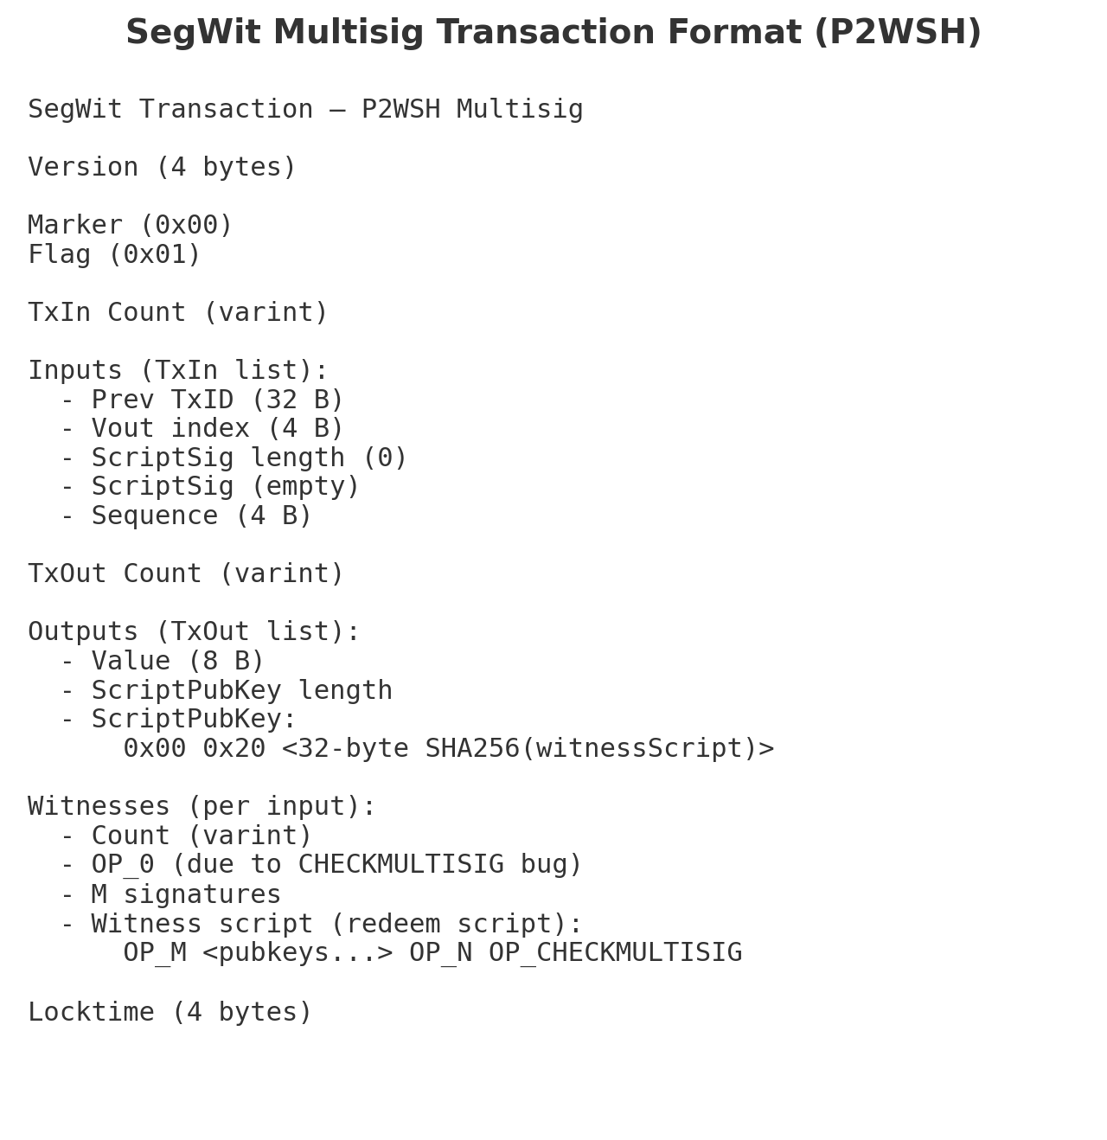
Multisig Transaction - Format

Slide 38
Multisig Transaction – Execution
INPUT Prev. Trans. ID: 0f07ec1c3738873cd6336f0e2c92094bf08d0ad3bce8aba0efa2eb9d172fd60c Index: 0 | OUTPUT Index 0 Value: 0.00025302 BTC scriptPubKey: 00 14 2fa9c4b9585b74fd5fd8c92fd4e32824b531e515
Witness OP_0 <sigA>304402208a09e17ddf7f3e7…. <sigC>d1d6e18b3b42f9e445c8c6f…. <witnessScript> OP_2 <PubKeyA> <PubKeyB> <PubKeyC> OP_3 OP_CHECKMULTISIG
Multisig trans.

Slide 39
Multisig Transaction – Execution
INPUT Prev. Trans. ID: 0f07ec1c3738873cd6336f0e2c92094bf08d0ad3bce8aba0efa2eb9d172fd60c Index: 0 | OUTPUT Index 0 Value: 0.00025302 BTC scriptPubKey: 00 14 2fa9c4b9585b74fd5fd8c92fd4e32824b531e515
Witness OP_0 <sigA>304402208a09e17ddf7f3e7…. <sigC>d1d6e18b3b42f9e445c8c6f…. <witnessScript> OP_2 <PubKeyA> <PubKeyB> <PubKeyC> OP_3 OP_CHECKMULTISIG
Multisig trans.
Tans. ID: 0f07ec1c3738873cd6336f0e2c92094bf08d0ad3bce8aba0efa2eb9d172fd60c
Output:
Index 0
Value: 00026102
ScriptPubKey:
00 20 0123456789abcdef0123456789abcdef0123456789abcdef0123456789abcdef
32-byte hash value follows – P2WSH

Slide 40
Mutisig Execution – P2WSH
Witness: OP_0 <sigA>304402208a09e17ddf7f3e7…. <sigC>d1d6e18b3b42f9e445c8c6f…. <witnessScript> OP_2 <PubKeyA> <PubKeyB> <PubKeyC> OP_3 OP_CHECKMULTISIG
The last witness item must contain the witness script
Stack

Slide 41
Mutisig Execution – P2WSH
Witness: OP_0 <sigA>304402208a09e17ddf7f3e7…. <sigC>d1d6e18b3b42f9e445c8c6f…. <witnessScript> OP_2 <PubKeyA> <PubKeyB> <PubKeyC> OP_3 OP_CHECKMULTISIG
Compute SHA256(<witnessScript>) and check if this is equal to the 32-byte value in the scriptPubkey of the Prev. Trans
If not equal → fail (transaction invalid)
If equal → continue
Tans. ID: 0f07ec1c3738873cd6336f0e2c92094bf08d0ad3bce8aba0efa2eb9d172fd60c
Output:
Index 0
Value: 00026102
ScriptPubKey:
00 20 0123456789abcdef0123456789abcdef0123456789abcdef0123456789abcdef
Stack

Slide 42
Mutisig Execution – P2WSH
Witness: OP_0 <sigA>304402208a09e17ddf7f3e7…. <sigC>d1d6e18b3b42f9e445c8c6f…. <witnessScript> OP_2 <PubKeyA> <PubKeyB> <PubKeyC> OP_3 OP_CHECKMULTISIG
Push all items in the witness on the stack except the last item, which is the witness script
Stack

Slide 43
Mutisig Execution – P2WSH
Witness: OP_0 <sigA>304402208a09e17ddf7f3e7…. <sigC>d1d6e18b3b42f9e445c8c6f…. <witnessScript> OP_2 <PubKeyA> <PubKeyB> <PubKeyC> OP_3 OP_CHECKMULTISIG
Push all items in the witness on the stack except the last item, which is the witness script
Stack
0

Slide 44
Mutisig Execution – P2WSH
Witness: OP_0 <sigA>304402208a09e17ddf7f3e7…. <sigC>d1d6e18b3b42f9e445c8c6f…. <witnessScript> OP_2 <PubKeyA> <PubKeyB> <PubKeyC> OP_3 OP_CHECKMULTISIG
Push all items in the witness on the stack except the last item, which is the witness script
Stack
<sigA>304402208a09e17ddf7f3e7….
0

Slide 45
Mutisig Execution – P2WSH
Witness: OP_0 <sigA>304402208a09e17ddf7f3e7…. <sigC>d1d6e18b3b42f9e445c8c6f…. <witnessScript> OP_2 <PubKeyA> <PubKeyB> <PubKeyC> OP_3 OP_CHECKMULTISIG
Push all items in the witness on the stack except the last item, which is the witness script
Stack
<sigC>d1d6e18b3b42f9e445c8c6f….
<sigA>304402208a09e17ddf7f3e7….
0

Slide 46
Mutisig Execution – P2WSH
Witness: OP_0 <sigA>304402208a09e17ddf7f3e7…. <sigC>d1d6e18b3b42f9e445c8c6f…. <witnessScript> OP_2 <PubKeyA> <PubKeyB> <PubKeyC> OP_3 OP_CHECKMULTISIG
Execute the witness script
Stack
<sigC>d1d6e18b3b42f9e445c8c6f….
<sigA>304402208a09e17ddf7f3e7….
0

Slide 47
Mutisig Execution – P2WSH
Witness: OP_0 <sigA>304402208a09e17ddf7f3e7…. <sigC>d1d6e18b3b42f9e445c8c6f…. <witnessScript> OP_2 <PubKeyA> <PubKeyB> <PubKeyC> OP_3 OP_CHECKMULTISIG
Execute the witness script
Stack
2
<sigC>d1d6e18b3b42f9e445c8c6f….
<sigA>304402208a09e17ddf7f3e7….
0

Slide 48
Mutisig Execution – P2WSH
Witness: OP_0 <sigA>304402208a09e17ddf7f3e7…. <sigC>d1d6e18b3b42f9e445c8c6f…. <witnessScript> OP_2 <PubKeyA> <PubKeyB> <PubKeyC> OP_3 OP_CHECKMULTISIG
Execute the witness script
Stack
<PubKeyA>
2
<sigC>d1d6e18b3b42f9e445c8c6f….
<sigA>304402208a09e17ddf7f3e7….
0

Slide 49
Mutisig Execution – P2WSH
Witness: OP_0 <sigA>304402208a09e17ddf7f3e7…. <sigC>d1d6e18b3b42f9e445c8c6f…. <witnessScript> OP_2 <PubKeyA> <PubKeyB> <PubKeyC> OP_3 OP_CHECKMULTISIG
Execute the witness script
Stack
<PubKeyB>
<PubKeyA>
2
<sigC>d1d6e18b3b42f9e445c8c6f….
<sigA>304402208a09e17ddf7f3e7….
0

Slide 50
Mutisig Execution – P2WSH
Witness: OP_0 <sigA>304402208a09e17ddf7f3e7…. <sigC>d1d6e18b3b42f9e445c8c6f…. <witnessScript> OP_2 <PubKeyA> <PubKeyB> <PubKeyC> OP_3 OP_CHECKMULTISIG
Execute the witness script
Stack
<PubKeyC>
<PubKeyB>
<PubKeyA>
2
<sigC>d1d6e18b3b42f9e445c8c6f….
<sigA>304402208a09e17ddf7f3e7….
0

Slide 51
Mutisig Execution – P2WSH
Witness: OP_0 <sigA>304402208a09e17ddf7f3e7…. <sigC>d1d6e18b3b42f9e445c8c6f…. <witnessScript> OP_2 <PubKeyA> <PubKeyB> <PubKeyC> OP_3 OP_CHECKMULTISIG
Execute the witness script
Stack
3
<PubKeyC>
<PubKeyB>
<PubKeyA>
2
<sigC>d1d6e18b3b42f9e445c8c6f….
<sigA>304402208a09e17ddf7f3e7….
0

Slide 52
Mutisig Execution – P2WSH
Witness: OP_0 <sigA>304402208a09e17ddf7f3e7…. <sigC>d1d6e18b3b42f9e445c8c6f…. <witnessScript> OP_2 <PubKeyA> <PubKeyB> <PubKeyC> OP_3 OP_CHECKMULTISIG
Execute the witness script
Stack
3
<PubKeyC>
<PubKeyB>
<PubKeyA>
2
<sigC>d1d6e18b3b42f9e445c8c6f….
<sigA>304402208a09e17ddf7f3e7….
0

Slide 53
Mutisig Execution – P2WSH
Witness: OP_0 <sigA>304402208a09e17ddf7f3e7…. <sigC>d1d6e18b3b42f9e445c8c6f…. <witnessScript> OP_2 <PubKeyA> <PubKeyB> <PubKeyC> OP_3 OP_CHECKMULTISIG
Pop
n = 3
Stack
<PubKeyC>
<PubKeyB>
<PubKeyA>
2
<sigC>d1d6e18b3b42f9e445c8c6f….
<sigA>304402208a09e17ddf7f3e7….
0

Slide 54
Mutisig Execution – P2WSH
Witness: OP_0 <sigA>304402208a09e17ddf7f3e7…. <sigC>d1d6e18b3b42f9e445c8c6f…. <witnessScript> OP_2 <PubKeyA> <PubKeyB> <PubKeyC> OP_3 OP_CHECKMULTISIG
Pop 3 public keys
n = 3
<PubKeyC>
<PubKeyB>
<PubKeyA>
Stack
2
<sigC>d1d6e18b3b42f9e445c8c6f….
<sigA>304402208a09e17ddf7f3e7….
0

Slide 55
Mutisig Execution – P2WSH
Witness: OP_0 <sigA>304402208a09e17ddf7f3e7…. <sigC>d1d6e18b3b42f9e445c8c6f…. <witnessScript> OP_2 <PubKeyA> <PubKeyB> <PubKeyC> OP_3 OP_CHECKMULTISIG
Pop
n = 3
<PubKeyC>
<PubKeyB>
<PubKeyA>
m=2
Stack
<sigC>d1d6e18b3b42f9e445c8c6f….
<sigA>304402208a09e17ddf7f3e7….
0

Slide 56
Mutisig Execution – P2WSH
Witness: OP_0 <sigA>304402208a09e17ddf7f3e7…. <sigC>d1d6e18b3b42f9e445c8c6f…. <witnessScript> OP_2 <PubKeyA> <PubKeyB> <PubKeyC> OP_3 OP_CHECKMULTISIG
Pop 2 signatures
n = 3
<PubKeyC>
<PubKeyB>
<PubKeyA>
m=2
<sigC>d1d6e18b3b42f9e445c8c6f….
<sigA>304402208a09e17ddf7f3e7….
Stack
0

Slide 57
Mutisig Execution – P2WSH
Witness: OP_0 <sigA>304402208a09e17ddf7f3e7…. <sigC>d1d6e18b3b42f9e445c8c6f…. <witnessScript> OP_2 <PubKeyA> <PubKeyB> <PubKeyC> OP_3 OP_CHECKMULTISIG
n = 3
<PubKeyC>
<PubKeyB>
<PubKeyA>
m=2
<sigC>d1d6e18b3b42f9e445c8c6f….
<sigA>304402208a09e17ddf7f3e7….
verify(sigC, [A,B,C]) → valid (matches C)
Stack
0

Slide 58
Mutisig Execution – P2WSH
Witness: OP_0 <sigA>304402208a09e17ddf7f3e7…. <sigC>d1d6e18b3b42f9e445c8c6f…. <witnessScript> OP_2 <PubKeyA> <PubKeyB> <PubKeyC> OP_3 OP_CHECKMULTISIG
n = 3
<PubKeyC>
<PubKeyB>
<PubKeyA>
m=2
<sigC>d1d6e18b3b42f9e445c8c6f….
<sigA>304402208a09e17ddf7f3e7….
verify(sigC, [A,B,C]) → valid (matches C)
verify(sigA, [A,B,C]) → valid (matches A)
Stack
0

Slide 59
Mutisig Execution – P2WSH
Witness: OP_0 <sigA>304402208a09e17ddf7f3e7…. <sigC>d1d6e18b3b42f9e445c8c6f…. <witnessScript> OP_2 <PubKeyA> <PubKeyB> <PubKeyC> OP_3 OP_CHECKMULTISIG
n = 3
<PubKeyC>
<PubKeyB>
<PubKeyA>
m=2
<sigC>d1d6e18b3b42f9e445c8c6f….
<sigA>304402208a09e17ddf7f3e7….
verify(sigC, [A,B,C]) → valid (matches C)
verify(sigA, [A,B,C]) → valid (matches A)
count(valid) = 2 = m → success
Stack
0

Slide 60
Mutisig Execution – P2WSH
Witness: OP_0 <sigA>304402208a09e17ddf7f3e7…. <sigC>d1d6e18b3b42f9e445c8c6f…. <witnessScript> OP_2 <PubKeyA> <PubKeyB> <PubKeyC> OP_3 OP_CHECKMULTISIG
verify(sigC, [A,B,C]) → valid (matches C)
verify(sigA, [A,B,C]) → valid (matches A)
count(valid) = 2 = m → success
POP 0 (CHECKMULTISIG bug), then PUSH TRUE
Stack
TRUE

Slide 61
Multisig Transaction – Execution
INPUT Prev. Trans. ID: 0f07ec1c3738873cd6336f0e2c92094bf08d0ad3bce8aba0efa2eb9d172fd60c Index: 0 | OUTPUT Index 0 Value: 0.00025302 BTC scriptPubKey: 00 14 2fa9c4b9585b74fd5fd8c92fd4e32824b531e515
Witness OP_0 <sigA>304402208a09e17ddf7f3e7…. <sigC>d1d6e18b3b42f9e445c8c6f…. <witnessScript> OP_2 <PubKeyA> <PubKeyB> <PubKeyC> OP_3 OP_CHECKMULTISIG
Multisig trans.
Transaction validated!!

Slide 62
Bitcoin Transaction
How can you verify the correctness of a transaction, included in some block?
e.g., a vendor would like to verify the following customer transaction before delivering the merchandize
TXID: 7b9ab087c86818551aa77f59bb2c35bd774abed7fcb19c7e840b502b2604271c
Block No. 720,518
Verification Steps
Check Inclusion
Confirm that the transaction with this TXID is part of Block No. 720,518
Validate Block Integrity
Ensure this transaction’s hash contributes to the overall block hash
This guarantees that if the transaction were missing or altered, the block hash would no longer match
3. Confirm Block Validity
Verify that Block No. 720,518 itself is valid and part of the longest chain

Slide 63
Block Hash
Tx 1
Hash(Tx 1)
Prev Block Hash
Tx 2
Hash(Tx 2)
Aggregate Tx Hash
Block Hash
Tx 3
Hash(Tx 3)
Nonce
Tx n
Hash(Tx n)

Slide 64

Block Hash
Verify that some transaction, say Tx 2, is included in some block
Tx 1
Hash(Tx 1)
Prev Block Hash
Tx 2
Hash(Tx 2)
Aggregate Tx Hash
Block Hash
Tx 3
Hash(Tx 3)
Nonce
Tx n
Hash(Tx n)
Aggregate Tx Hash
Transaction verification $− O(n)$ complexity

Slide 65
Block Hash – Merkle tree
Prev. Block Hash
Aggregate Transaction Hash
Nonce
Merkle Root Hash
Hash (…)
Hash(…)
Hash(1,2)
Hash(3,4)
Hash(n-1,n)
Hash(Tx 1)
Hash(Tx 2)
Hash(Tx 3)
Hash(Tx 4)
Hash (Tx n-1)
Hash (Tx n)
Tx 1
Tx 2
Tx 3
Tx 4
Tx n-1
Tx n

Slide 66

Block Hash – Merkle tree
Prev. Block Hash
Aggregate Transaction Hash
Nonce
Verify that some transaction, say Tx 2, is included in some block
$$O(\lg{n) }$$
Merkle Root Hash
Hash (…)
Hash(…)
Hash(1,2)
Hash(3,4)
Hash(n-1,n)
Hash(Tx 1)
Hash(Tx 2)
Hash(Tx 3)
Hash(Tx 4)
Hash (Tx n-1)
Hash (Tx n)
Tx 1
Tx 2
Tx 3
Tx 4
Tx n-1
Tx n
Notes:
https://hackernoon.com/merkle-trees-181cb4bc30b4
Simplified Payment Verification (SPV)
Simplified Payment Verification (SPV) is a method of verifying if particular transactions are included in a block without downloading the entire block. Merkle trees are used extensively by SPV nodes.
SPV nodes do not have data from all transactions in a block. They only download block headers. Merkle trees enable SPV nodes on the blockchain to check if miners have verified the transactions in a block without downloading all the transactions in a block. This method is currently used by some lightweight Bitcoin clients.

Slide 67
Merkle Tree
Summarizes transactions
All transactions in a block are combined into one hash (the Merkle root) stored in the block header.
Enables lightweight verification (SPV)
Clients can verify a transaction is in a block using a Merkle proof (only log₂(N) hashes, not the whole block).
Detects tampering
Changing even one transaction alters the Merkle root → invalidates the block.
Improves scalability
Proof size is small (≈ log₂(N)), even if the block has thousands of transactions.

